Slide 1

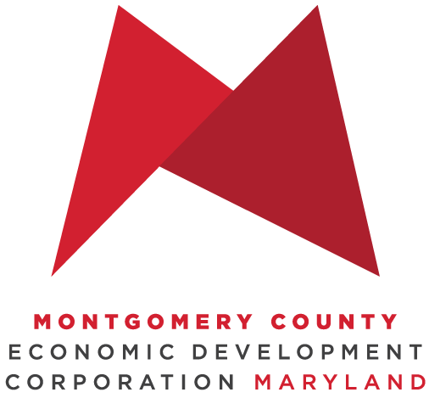
MoCo Office of Procurement
Priming the
County’s
Economic Engine
Presented by Daniel Parra,
Director of Business Diversity and Inclusion
Montgomery County Economic
Development Corporation
March 2022

Slide 2
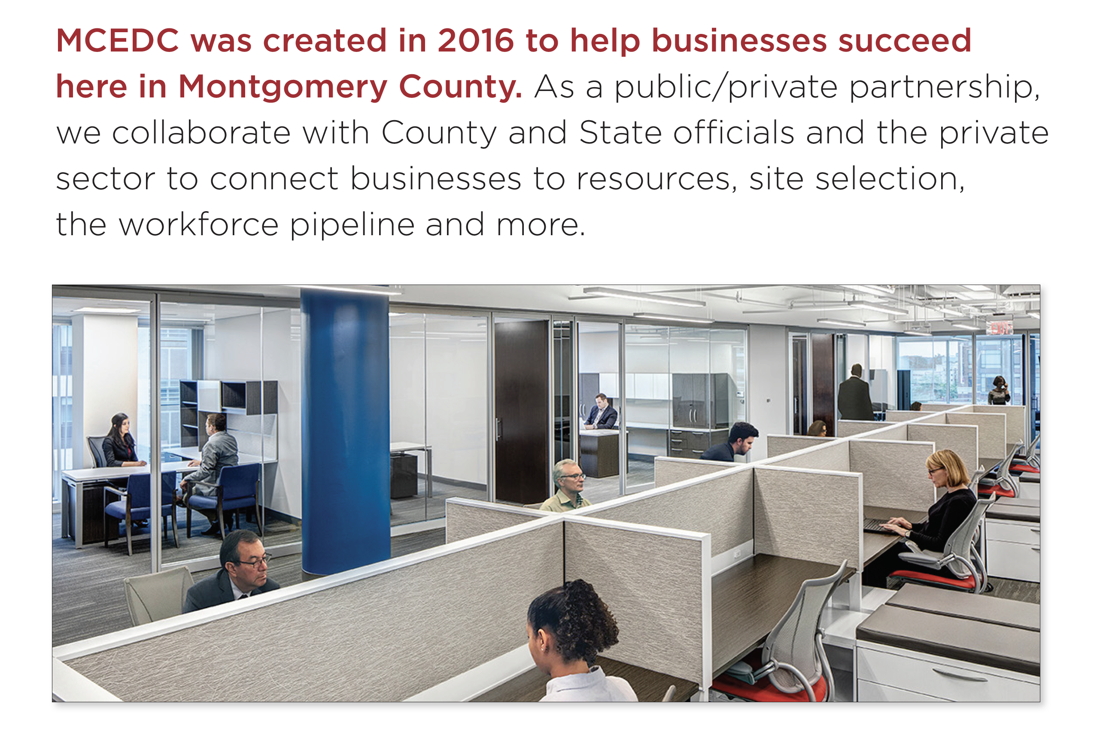
About MCEDC
The official public-private economic development
organization representing Montgomery County, MD
How does MCEDC help?
We help make connections to:
– Gain market intelligence
– Link business owners to aligned
partnerships
– Find the ideal business address
– Explore available incentives
– Attract talent and help with
workforce training
– Help companies relocate here
Led by a board of directors, our mission is to
help businesses start and grow in the county,
or help companies relocate here
M O N T G O M E R Y C O U N T Y E C O N O M I C
D E V E L O P M E N T C O R P O R A T I O N

Slide 3
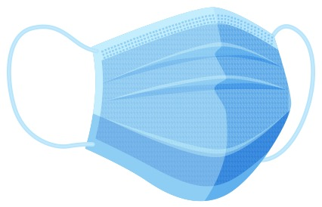
Helping in Pandemic Recovery Efforts
During the pandemic, in addition to ongoing business support, MCEDC has pivoted to help the economic recovery for our businesses. Support grant programs include:
Bio Lab Pilot – $96,000 grant program to six small
life science companies (administered pre-pandemic)
—
Restaurant Relief Fund – 3 rounds of relief for a total of $16.5M dollars distributed to over 900 restaurants
—
Telework Fund – $1M to help businesses purchase telework equipment and software
—
Local Production Fund – $200,000 fund to help businesses
pivot to making Personal Protection Equipment (PPE) to support
local pandemic needs
—
3R Initiative Restaurant & Retail Grants – $1M program to assist restaurants and retailers before the 2020 holiday season and winter
M O N T G O M E R Y C O U N T Y E C O N O M I C
D E V E L O P M E N T C O R P O R A T I O N

Slide 4
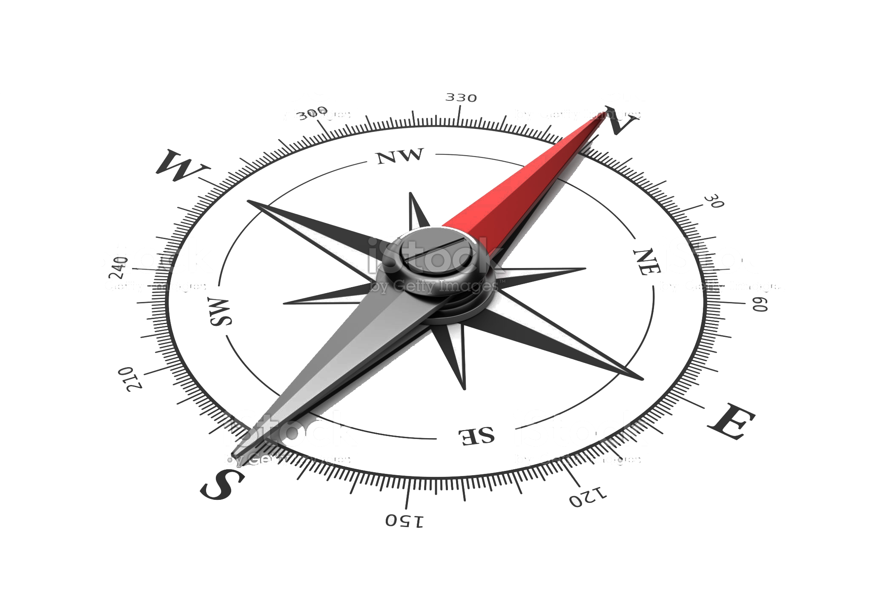
MCEDC can help you navigate and find the resources you need for success including the 3 Ps.
1
Permitting
Recent Speed-to-Market Initiative helps streamline the approval process for development projects by consolidating the processes of planning and land-use approvals.
Faster services in both permitting and planning.
montgomerycountymd.gov/dps/about.html montgomerycountymd.gov
2
Planning
What’s new? Montgomery Planning React Map, where you can
weight in on plans for downtown Silver Spring. mcreactmap.com
The Planning Department is also implementing the Speed-to-Market streamlining process to help businesses.
3
Procurement Opportunities for the County,
Montgomery College and MCPS
Montgomery County montgomerycountymd.gov/PRO/vendor-resources/vip.html
Montgomery College info.montgomerycollege.edu/offices/procurement/index.html
MCPS montgomeryschoolsmd.org/departments/procurement/vendors.aspx
M O N T G O M E R Y C O U N T Y E C O N O M I C
D E V E L O P M E N T C O R P O R A T I O N

Slide 5
Additional County Resources
to Support Business
Business Starter Kits
montgomerycountymd.gov/Biz-Resources/starter-kit.html
Resources for Small Businesses
montgomerycountymd.gov/Biz-Resources/small-biz-resources.html
The Business Solutions Group
Business Advancement Team
montgomerycountymd.gov/Biz-Resources/contact.html
Regional Services Center
Liaison between the County and its residents and businesses
to provide information, identify issues and recommend solutions.
montgomerycountymd.gov/Government/rsc.html
Other resources:
MD Women’s Business Center (MWBC)
Works with entrepreneurs across Maryland's capital region
to help women start, sustain and grow their businesses
Latino Economic Development Center (LEDC) – Drives economic
and social advancement to underserved local Latino communities
MD Small Business Development Center (SBDC)
Offers support to entrepreneurs and small businesses, including training, consulting and research
The Governor's Office of Small, Minority & Women
Business Affairs (GOSBA) – Connects the small business community with greater economic opportunities in both the
public and private sectors.
MD Department of Commerce – Dedicated Montgomery County office to help businesses with retention, relocation and expansion needs and finding opportunities.
Maryland Business Express (MBE) – Plan, start, manage and
grow your business with help from the business express service.
SCORE – Free confidential business advice and mentoring via
a network of 10,000 volunteer business experts through the SBA.
M O N T G O M E R Y C O U N T Y E C O N O M I C
D E V E L O P M E N T C O R P O R A T I O N

Slide 6
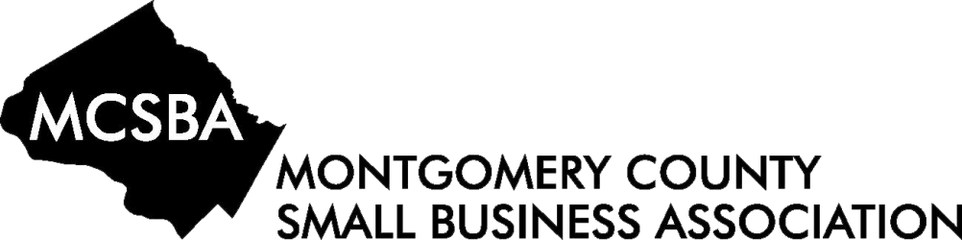

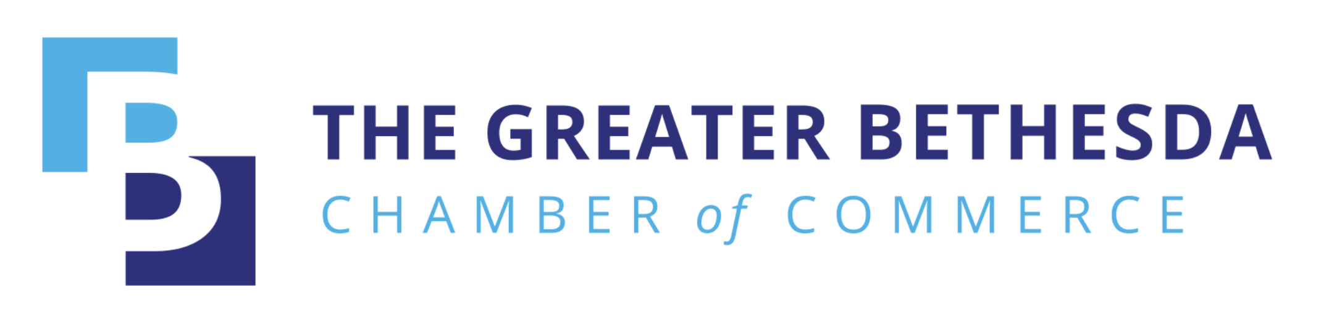




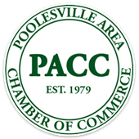
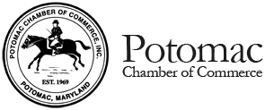

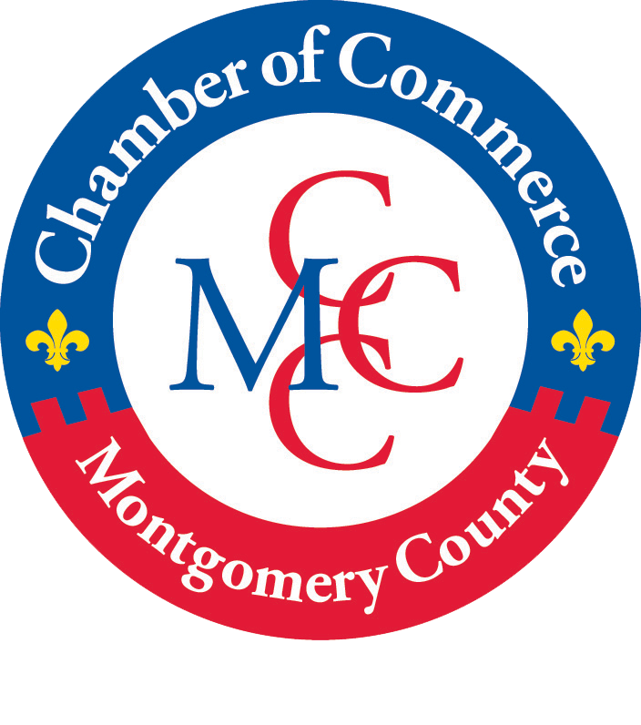
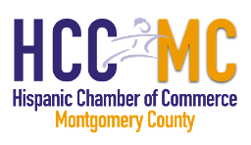


Chambers of Commerce
Montgomery County has dozens of chambers and business membership organizations to support your business. Access this page to learn more: thinkmoco.com/choose/support-resources
M O N T G O M E R Y C O U N T Y E C O N O M I C
D E V E L O P M E N T C O R P O R A T I O N

Slide 7
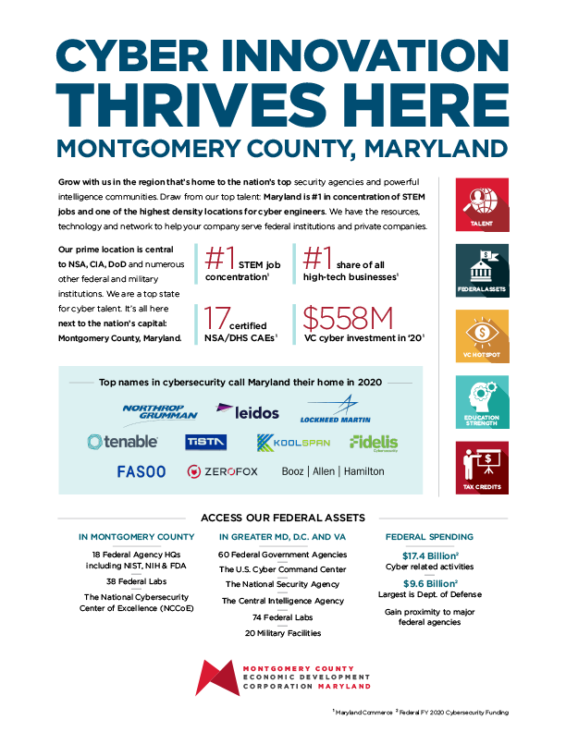
Major Industries
thinkmoco.com/key-industries
Click on images to download
BioHealth and Life Sciences
—
Cybersecurity
—
Tech & Quantum Computing
—
Advanced Manufacturing
—
Hospitality & Tourism
—
Financial Services
—
Agribusiness
—
Nonprofits
M O N T G O M E R Y C O U N T Y E C O N O M I C
D E V E L O P M E N T C O R P O R A T I O N

Slide 8

Tax Credits & Incentives
MOVE Grant – One-time grant available to new businesses that move to the county with a signed commercial lease.
Find other tax credits and incentives information here: thinkmoco.com/incentives
—
Biotech Investment Tax Credits
—
Local matching SBIR grants
We work with new companies to
create incentive packages customized
to specific needs.
M O N T G O M E R Y C O U N T Y E C O N O M I C
D E V E L O P M E N T C O R P O R A T I O N

Slide 9
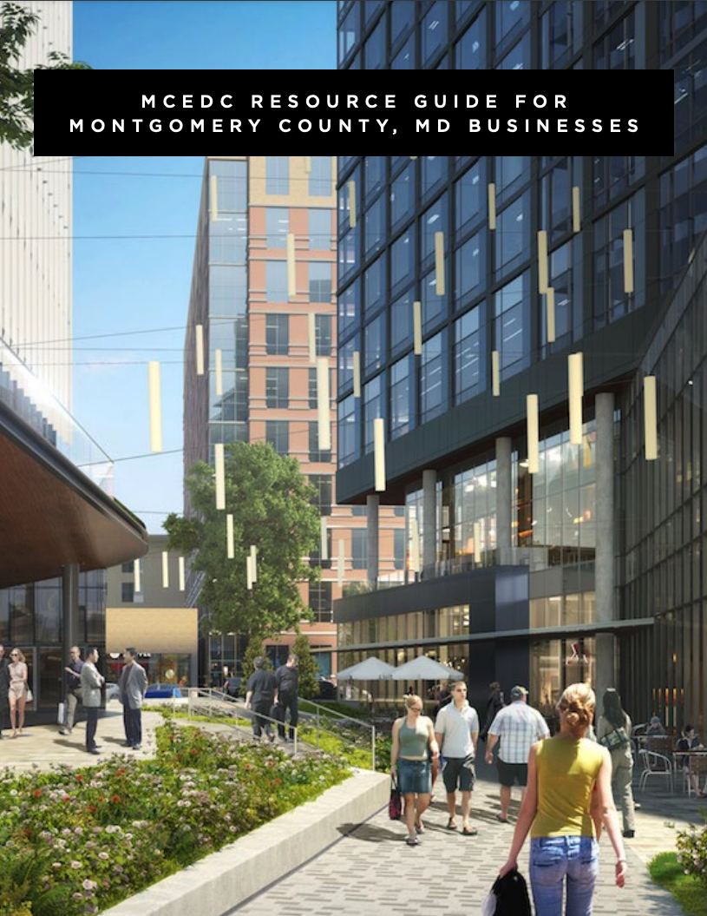
MCEDC Resource Guide
(English and Spanish versions available)
Includes:
Funding and Access to Capital
Training
Diversity, Equity and Inclusion-Oriented
Assistance
Site Selection
Industry-Specific Support
Shared Spaces
Workforce Development
Chambers of Commerce
English version
Spanish version
M O N T G O M E R Y C O U N T Y E C O N O M I C
D E V E L O P M E N T C O R P O R A T I O N

Slide 10
Resources and Support Organizations
The Maryland Business Relief Wizard –
The reliefwizard.net is a business tool to connect businesses
with resources and programming, streamlining the process of finding support.
Maryland Tech Council (MTC) – A collaborative community engaged in building strong tech and life science industries and supporting its membership. For more, visit mdtechcouncil.com
Venture Mentoring of the MTC – Team-based mentoring to help STEM CEOs with development, funding
and beyond. Careful matching to help ventures gain success.
Go to mdtechcouncil.com/vms
TEDCO – Provides Maryland entrepreneur funding,
resources and connections that early-stage technology and life sciences companies need to thrive in the state. tedcomd.com
The MD Entrepreneur Hub – An interactive
portal to find the resources your business needs,
from funding to talent. Over 2,000 resources to build your business in MD. Go to marylandentrepreneurhub.com
BioHealth Innovation (BHI) – Helps with private
and public early-stage capital; active commercialization
talent networks; tech transfer and soft landings for
international companies. Visit biohealthinnovation.org
Opportunity Zones in Maryland –
A national program that provides federal tax
incentives for investment in distressed, local
communities. Find out more at
dhcd.maryland.gov/Pages/OZ/OpportunityZones.aspx
M O N T G O M E R Y C O U N T Y E C O N O M I C
D E V E L O P M E N T C O R P O R A T I O N

Slide 11

Welcome to a diverse
and inclusive community
Four of our communities are ranked among the 10 most diverse in the nation:
Gaithersburg • Silver Spring
Germantown • Rockville
—
One in three residents are foreign born
—
138 languages spoken by county residents
—
Montgomery County public schools support gender identity
—
54% of residents are non-white
—
45% of businesses are minority-owned
M O N T G O M E R Y C O U N T Y E C O N O M I C
D E V E L O P M E N T C O R P O R A T I O N

Slide 12
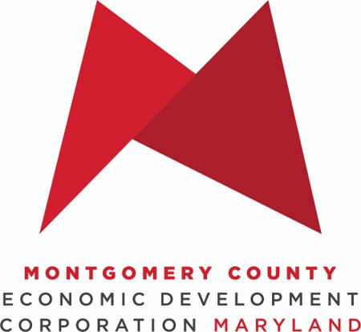
THANK YOU
Visit us at thinkmoco.com
Daniel@thinkmoco.com
Sign up for our newsletter for ongoing business news and support
Send us your updates so we can help promote your business — email us at connect@thinkmoco.com

