Slide 1
Service Planning Work Group Meeting
Presented to
RTS Service Planning Work Group, and
Montgomery County Department of Transportation
Presented by
Dan Goldfarb, P.E.
Transportation Planning Manager Tyson Corner Office
Vanasse Hangen Brustlin, Inc. & FITP
August 21, 2013

Slide 2
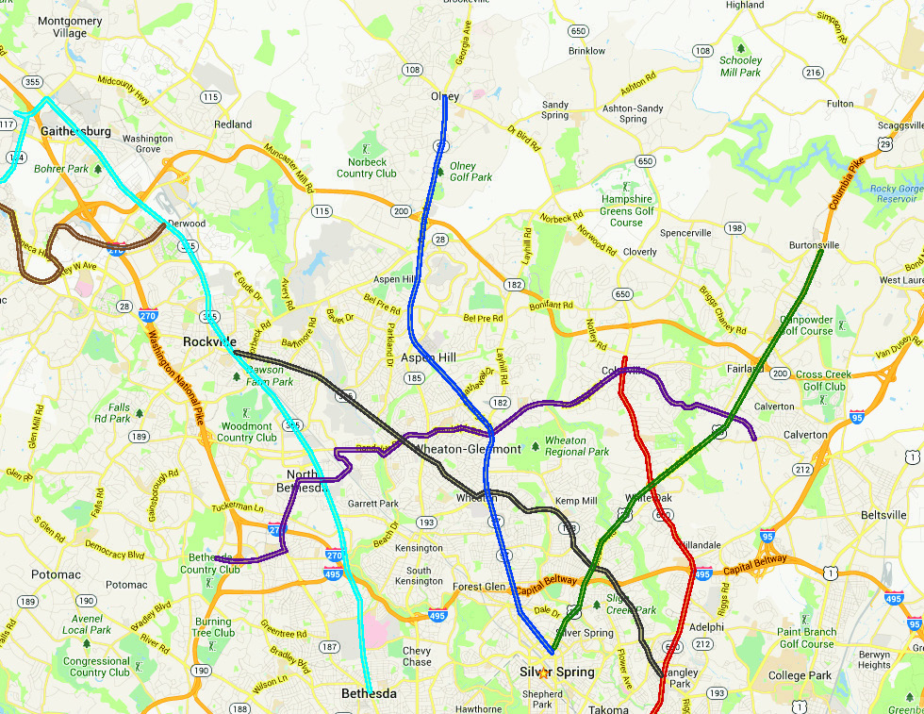
US 29 Corridor
2
Action
  Consistent with Functional Master Plan Draft
Objective
  Continuation of High Transit Mode Share to Silver Spring/DC
  Continuation of the Existing High Level of Service
  Provide Connection between Corridor Activity Centers
    Silver Spring CBD
    White Oak/FDA
Key Stations
  Burtonsville PNR
  White Oak – Transit Center
  FDA Campus
  Four Corners
  Silver Spring Metro

Slide 3
US 29 Corridor
3
Example RTS Service
  Long
    Burtonsville PNR to Silver Spring Metro
  Intermediate
    White Oak to Silver Spring Metro
  Short
    Silver Spring Metro to Four Corners
  Interlining
    Colesville to Silver Spring
    White Oak to Langley Park (Via MD 650 or MD 193)
  Connecting Service from MD 182 & ICC PNR via MD 650

Slide 4
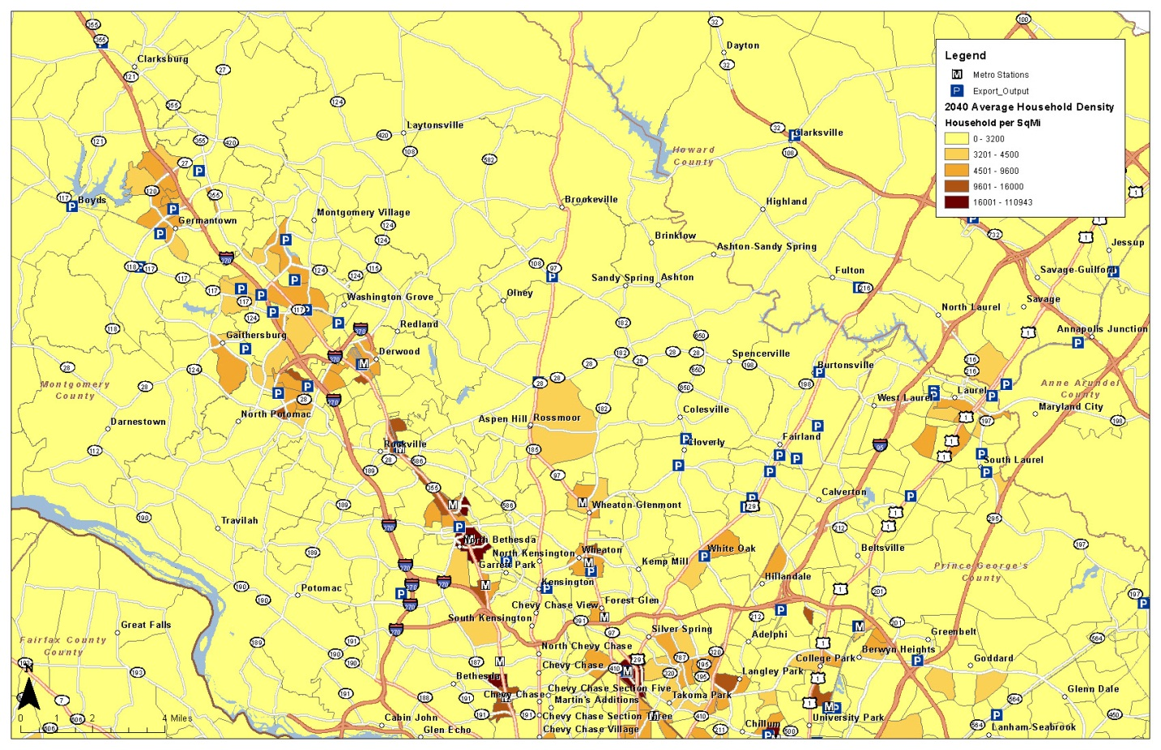
Example Corridor - US 29
4
Population Density
Employment Density
Park-and-Ride Lots
Infrastructure
  Other Modes
  Multimodal Connections
  Highway Facility

Slide 5
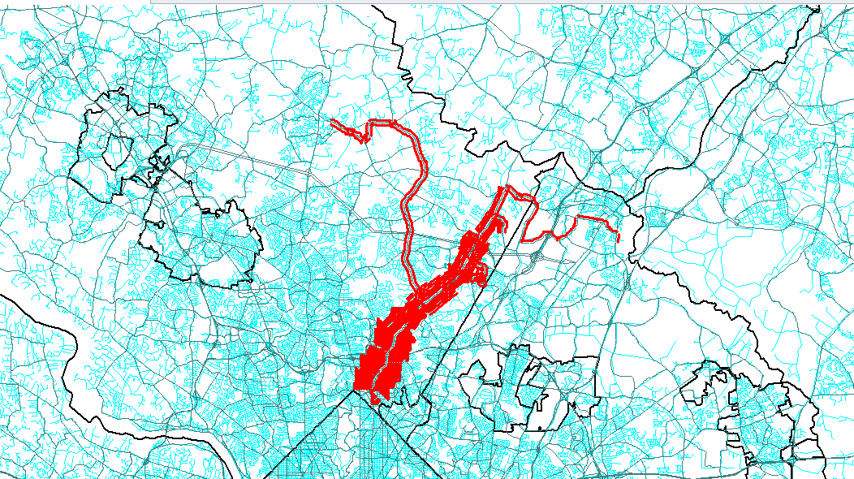
US 29 Corridor Service Supplied
5
WMATA “Z” Services
  Express
  Local
MTA Commuter Bus
Ride-On
Only Bus

Slide 6
US 29 Corridor Service Supplied - Buses in the Peak Hour
6
Segment | Existing | Year 2040
North of ICC | 28 | 38
North of MD 650 (South of ICC) | 53 | 57
South of MD 650 (North of Four Corners) | 57 | 63
Inside Beltway | 87 | 94

Slide 7
US 29 Corridor – Transit & Auto AM Peak Period
7
Segment | Existing Transit | Existing Vehicles | Future Transit Persons | Future Vehicles
North of ICC | 5,900 | 10,400 | 7,200 | 10,400
North of MD 650 (South of ICC) | 7,300 | 8,600 | 8,100 | 9,300
South of MD 650 (North of Four Corners) | 10,800 | 8,000 | 11,000 | 9,100
Inside Beltway | 12,200 | 7,000 | 12,400 | 7,800

Slide 8
US 29 Corridor Service Integration
8
Sustain High Level of Transit Usage
Improve Reliability
Integrating MD 650 Service North of White Oak
Transit Center White Oak Shopping Center
Shoulder Operations North of White Oak
Dedicated Facility South of White Oak

Slide 9
US 29 Corridor White Oak Connections
9
US 29 Connection to MD 650
Randolph Road Service via FDA Campus, MD 650, Randolph Road
High Level of Service Silver Spring to White Oak/FDA Campus
Continued MTA Commuter Bus to/on RTS Facility
  Transfer at White Oak
  Continue to FDA Campus
  Frequent Service White Oak to Silver Spring

