Slide 1
Bringing Women Back to Work

Slide 2
Women need in Workplace Post-Covid
Workplace Flexibility
Training & Development Opportunities
Recognition & Promotion

Slide 3
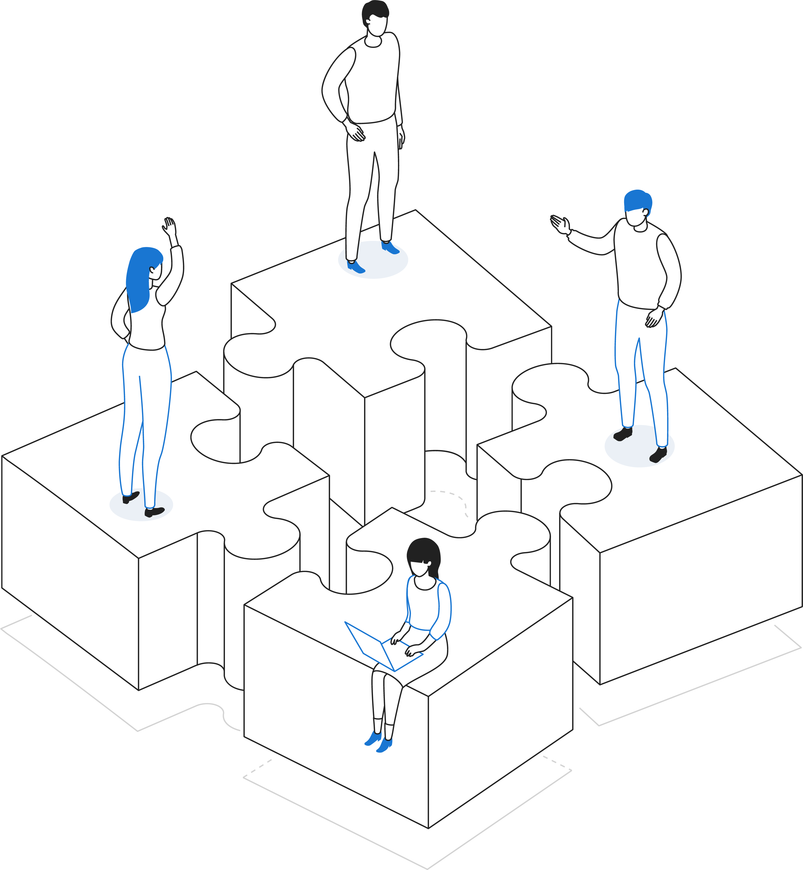
Reopening Plan at REDI/ Maryland Women’s Business Center
Prioritizing
Prioritizing health & safety
Rethinking
Rethinking office space design
Integrating
Integrating more technology
Changing
Changing interaction with clients & the public
Creating
Creating team building times

Slide 4
MWBC Services for Women Entrepreneurs Post-Covid
Accessing and applying for federal resources to access capital and promote business resiliency.
The hazards and prevention of the transmission of COVID-19 and other communicable diseases.
The potential effects of COVID-19 on the supply chains, distribution, and sale of products.
The management and practice of telework to reduce possible transmission of COVID- 19.
The management and practice of remote customer service by electronic or other means.
The risks of and mitigation of cyber threats in remote customer service or telework practices.
The mitigation of the effects of reduced travel or outside activities on small business;
Business practices necessary to mitigate the economic effects of COVID-19 or similar occurrences.

Slide 5
Covid Resources for Small Businesses
https://marylandwbc.org/resources/
https://rockvilleredi.org/small-business-resources/
https://www.rockvillechamber.org/covid-19-resources-for-businesses/
https://www.sba.gov/funding-programs/loans/covid-19-relief-options

