Slide 1
Business Continuity Planning Planning for a rainy Day Are You Prepared? Presented to Montgomery County COVID-19 Economic Revitalization and Recovery Town Hall
Marianne Souders, MSEM, CEM
Montgomery County
Office of Emergency Management and Homeland Security
Notes:
Good Morning, I am Marianne Souders, the Acting Director of the Office of Emergency Management and Homeland Security. Thank you for inviting me to speak on this very important topic.
Business Continuity Planning is key to the survival of any business impacted by a significant emergency or disaster. Planning is just as important for a small Mom and Pop store as it is for a large corporation.

Slide 2
What keeps you up at night?
What do you worry about? What are your What ifs?
Fire
Flooding
Utility Outage
Power
Water
Phone/Internet
IT/Computer Outage/ Cyber Attack
Vendor/Supplier Problems
Notes:
So, what keeps you up at night, what are the what if scenarios?
What do you feel you are ready for and could survive vs. what will sink you?

Slide 3
Disruptions can lead to lost revenue, brand damage and dissatisfied customer and, the longer the recovery time, the greater the adverse business impact. Therefore, a good disaster recovery plan should enable rapid recovery from disruptions, regardless of the source of the disruption.
Notes:
Disruptions leads to lost revenue – bottom line , the longer it takes to get back up and running , the more money lost. Disruptions can also damage your brand and increase customer dissatisfaction

Slide 4
There is much that a business leader can do to prepare his or her organization for the most likely hazards.
When developing an all -hazards preparedness plan,
Threats and Hazards should be identified
vulnerabilities assessed
potential impacts analyzed.
Notes:
There are many this a business owner or manager can do such as: PLAN AHEAD!
Think through these scenarios and develop a plan.
Steps to developing a well though out, actionable plan include:
Identifying threat and hazards
Assess your vulnerabilities, what is most likely to occur ? How likely is? What would the impacts be?
Your BCP will address the likely impacts and the actions that need to be taken.

Slide 5
What is BCP?
A business continuity plan (BCP) is a document that outlines how a business will continue operating during an unplanned disruption in service. It’s more comprehensive than a disaster recovery plan and contains contingencies for business processes, assets, human resources and business partners – every aspect of the business that might be affected.
Notes:
A Business Continuity Plan outlines strategies to minimize the effects of a disaster, so an organization will continue to operate – or quickly resume key operations. The plan provides contingencies for not only business processes and assets but for human resources, customers and supply disruptions.

Slide 6
Where Do I Start?
Identify your critical business processes
What is your company’s mission?
What are the things that you have to do to remain in business?
What do my customers expect of my business?
Notes:
So where do you start?
What is the mission of your business?
What function do you have to do to stay in business? These are your mission critical functions.
What are some examples?
What do my customers expect of me?
The best place to start is by conducting a Business Impact Analysis,

Slide 7
Conduct a Business Impact Analysis (BIA)
process for determining the potential impacts resulting from the interruption of time sensitive or critical business processes.
Risk Analysis: Identify potential hazards and the likelihood that they could occur and the magnitude.
What are your vulnerabilities and weaknesses
What assets are at risk
Notes:
A Business Impact Analysis is the process for determining the potential impacts resulting from the interruption of time sensitive or critical business processes.
There are many “assets” at risk from hazards. First and foremost, injuries to people should be the first consideration of the risk assessment. Assets include people, buildings, technology systems, utilities, supplies, and finished product.
As you conduct the risk assessment, look for vulnerabilities—weaknesses—that would make an asset more susceptible to damage from a hazard.
What are the possible impacts and how can you buy down risk? Do you have adequate insurance? Data Back up processes?
Vulnerabilities include deficiencies in building construction, process systems, security, protection systems and loss prevention programs.

Slide 8
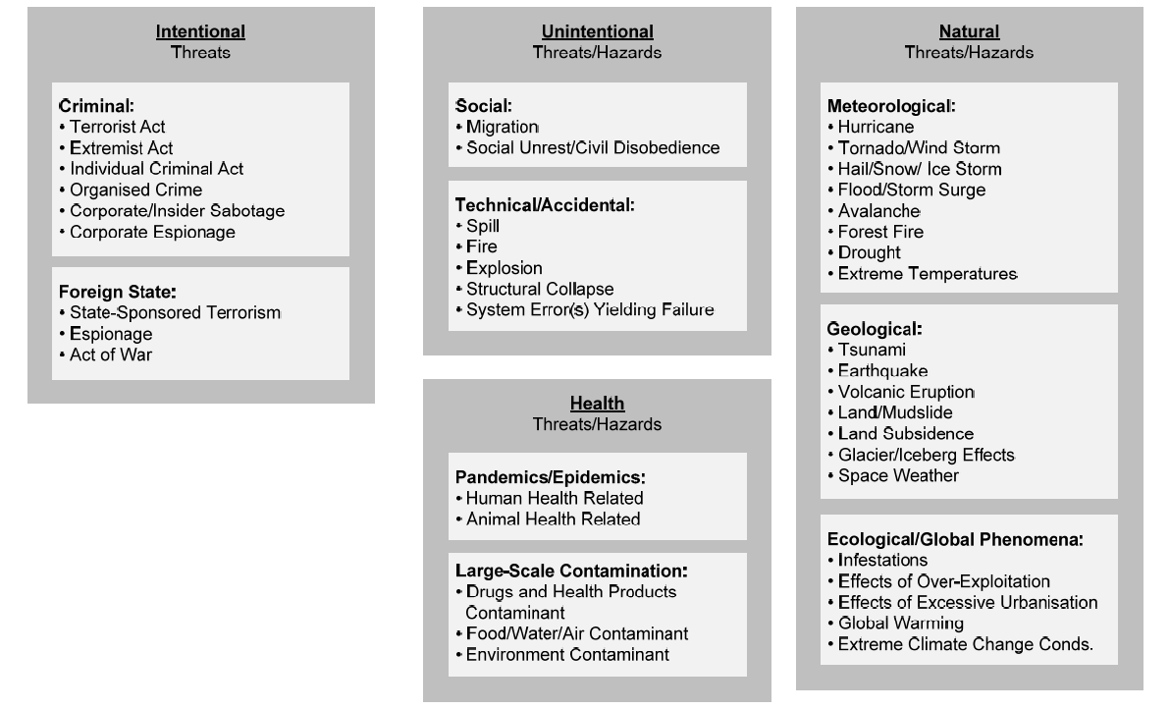

Slide 9
Notes:
This slide provides a good representation of the BIA thought process

Slide 10
What Do I Need?
Who/what do you need to perform your critical business processes?
People/staff
Facilities
Vital records
Vital equipment/ Systems/ contracts
Vendors and Customers

Slide 11
Risk Assessment
Insurance risk management plan, www.smallbusiness.wa.gov.au

Slide 12
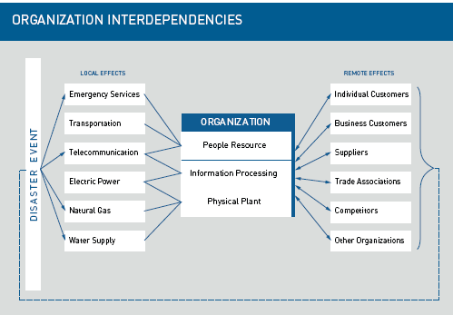
Identify your interdependencies
understanding the critical resources which might impact an organization’s ability to recover in a timely manner
Notes:
Who else do you depend on to run your business? You may not be directly impacted by a disaster but be indirectly impacted because of a disruption of your critical resources.

Slide 13
Develop and Document a Plan
Key elements of a Business Continuity Plan:
Essential Business Processes
Orders of Succession and Delegation of Authority – who will be in charge if you are unavailable
Employee Information – contact information, roles and responsibilities
Alternate Facilities – where you and your staff will operate if your primary facility is unavailable
Vital Records & Vital Equipment – where backups can be found
Vendor and customer information, alternate vendors
Communications plan
Response and recovery steps such as guides and checklists
Notes:
Orders of Succession
* e.g. who has decision making authority over things like to pay/ not to pay the ransomware? Who is the PIC?
Alternate Facility-
* COVID was a great exercise in COOP. What lessons learned can you incorporate to revise your plan? E.g. Telework policies? Do you need an alternate facility, or did your telework policy work if you have a snow day?
* Do you need to operate a physical location? Can you create an MOU with a nearby facility? E.g. Dialysis center? nearby church? Different offices in your org?
Insurance
Do you have insurance, what does it cover? (floods? Physical disruption? Cyber? Etc.) What is required to activate it? Who has authority to activate it.

Slide 14
Emergency Supplies: Create and Store an Emergency Kit
Potable Water
cash
Nonperishable food
Battery powered or crank radio
Flashlight and spare batteries
Cell phone chargers
First aid kit
Dust or filter masks
Sanitizing wipes
Wrench and/or pliers
Can opener (manual)
Plastic sheeting
Duct tape
Garbage bags
Work gloves
Copy of COOP Plan
Notes:
Like we encourage our citizens to build an emergency kit, we also encourage businesses to do the same

Slide 15
Involve Your Staff
Provide each employee with a copy of the plan
Review the plan with them
Get their input for improvements
Conduct drills
Encourage employees to create their own kits – resilient staff makes for a resilient business

Slide 16
Be Prepared!
Primary focus is always the safety of your employees and your customers
By thinking through various hazards and risks, you are less likely to be caught off-guard
Your Business Continuity Plan should be a living, breathing document – review it often and keep it up-to-date, and maintain an off-site copy
Train and Exercise your plan!
Notes:
T&E- TTX, functional, FS--> Find gaps and improve.

Slide 17
Questions?
Notes:
Maybe add Jim's contact info?

