Slide 1
SNOW SUMMIT 2014-2015

Slide 2
Summit Agenda

Slide 3
Introductions

Slide 4
Introductions

Slide 5
Introductions

Slide 6
Welcoming Remarks

Slide 7
Snow Summit Objective

Slide 8
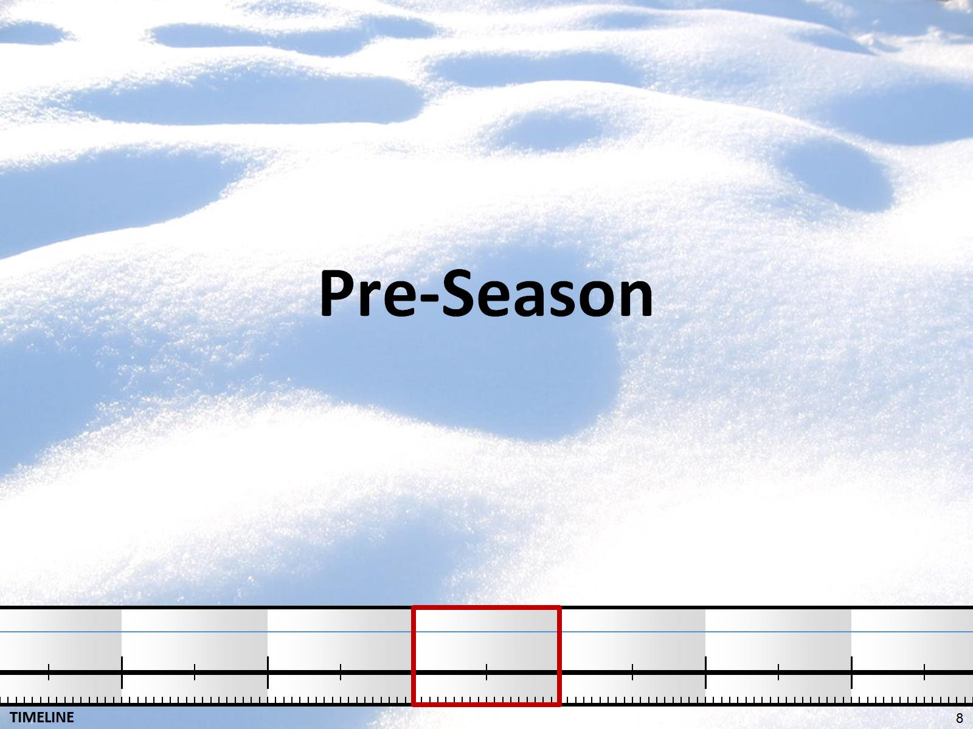
Pre-Season

Slide 9
Storm Readiness

Slide 10
Team Readiness

Slide 11
Practice Makes Perfect

Slide 12
Key Initiatives

Slide 13
Route Planning and Equipment

Slide 14
Forward Planning

Slide 15
Coordinating with Contractors

Slide 16
Salt Management Plan

Slide 17
Montgomery County Statistics

Slide 18
Pre-Storm

Slide 19
Science of Storm and Pavement Forecasting

Slide 20
Storm Analysis, Forecasting and Notification

Slide 21
Storm Analysis, Forecasting, and Notification

Slide 23
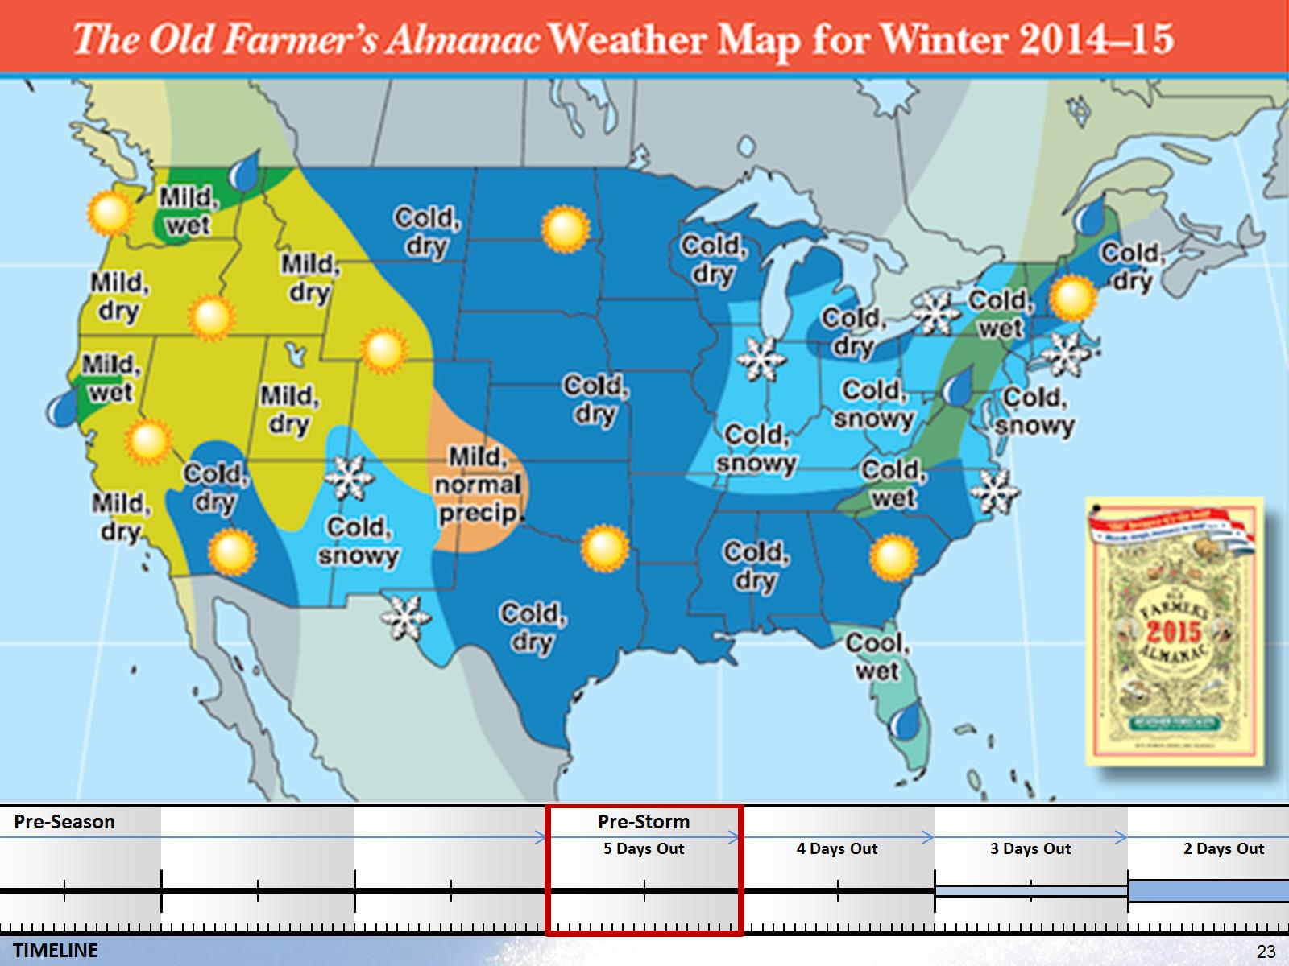

Slide 24
Local Forecasting

Slide 25
Storm Analysis, Forecasting, and Notification

Slide 26
Different Storm Event Scenarios

Slide 27
Storm Analysis, Forecasting, and Notification

Slide 28
Storm Analysis, Forecasting, and Notification

Slide 29
Storm Analysis, Forecasting, and Notification

Slide 30
Storm Analysis, Forecasting, and Notification

Slide 31
Forecast Considerations

Slide 32
Storm Forecast

Slide 33
Pre-Storm Planning

Slide 34
Pretreatment of Major Roadways

Slide 35
Storm Operations Center (SOC)

Slide 36
Storm Operations Center (SOC) Primary Functionality

Slide 37
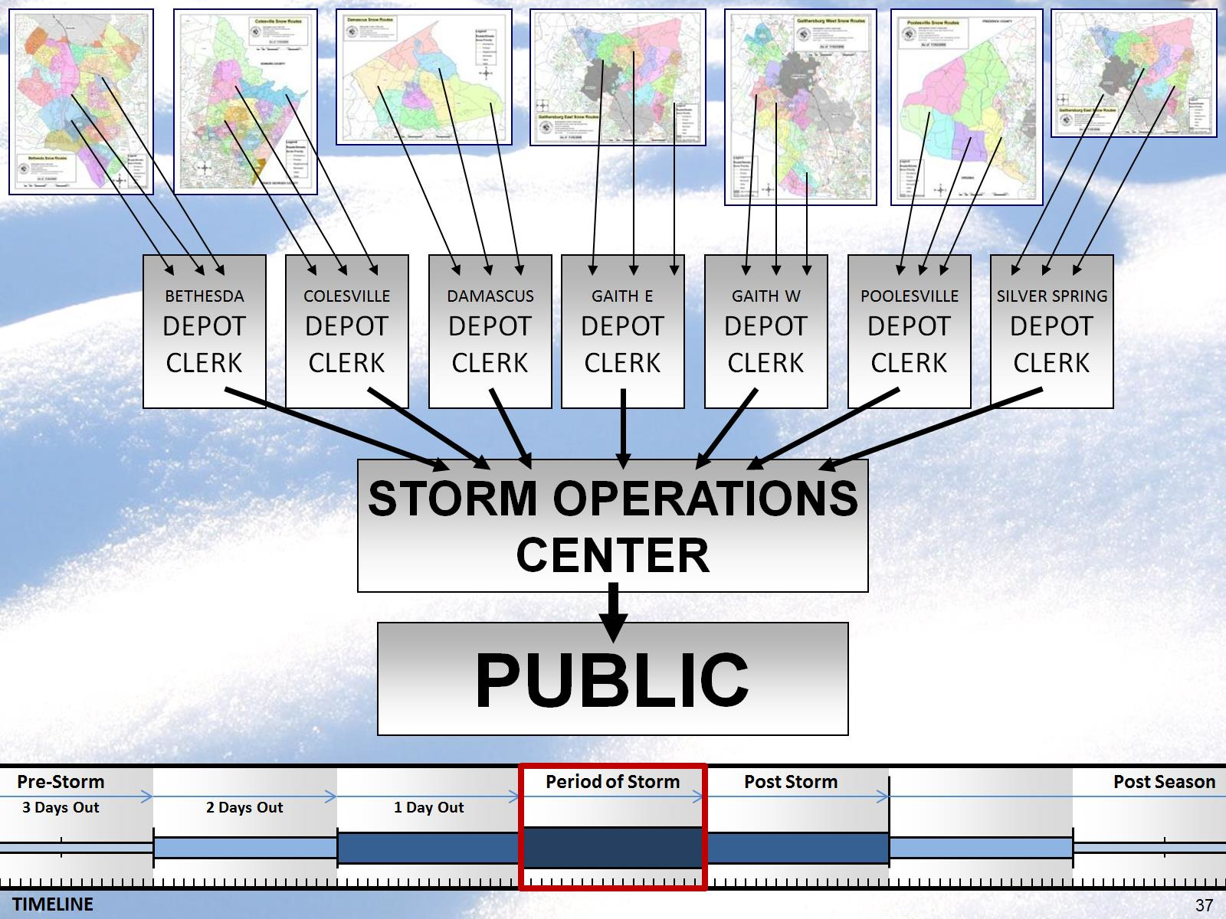

Slide 38
Storm Operations Center (SOC) Support Functions

Slide 39
Storm Operations Center (SOC) Support Functions

Slide 40
Storm Operations Center (SOC) Support Functions

Slide 41
Storm Operations Center (SOC) Support Functions

Slide 42
Snow Tracking Application

Slide 43
Snow Tracking Application

Slide 44
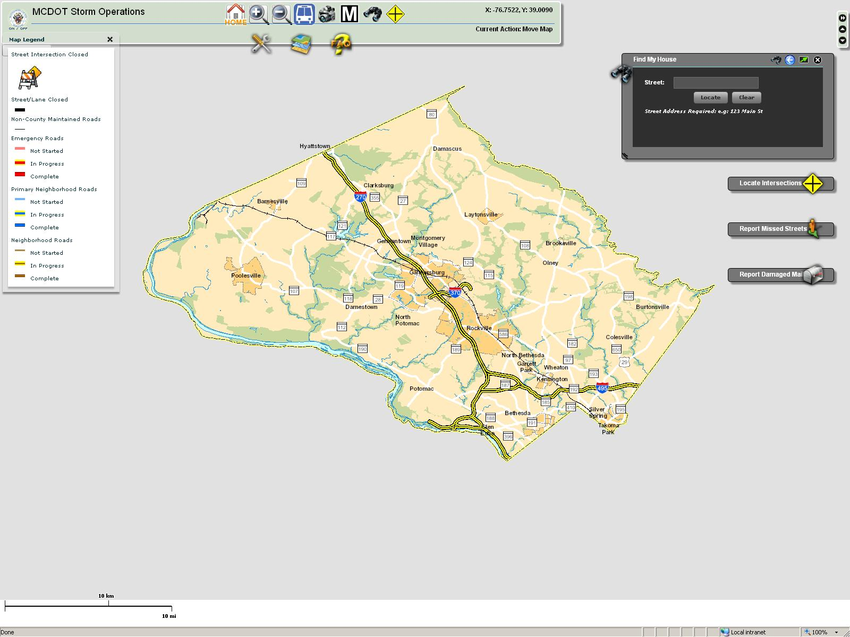

Slide 45
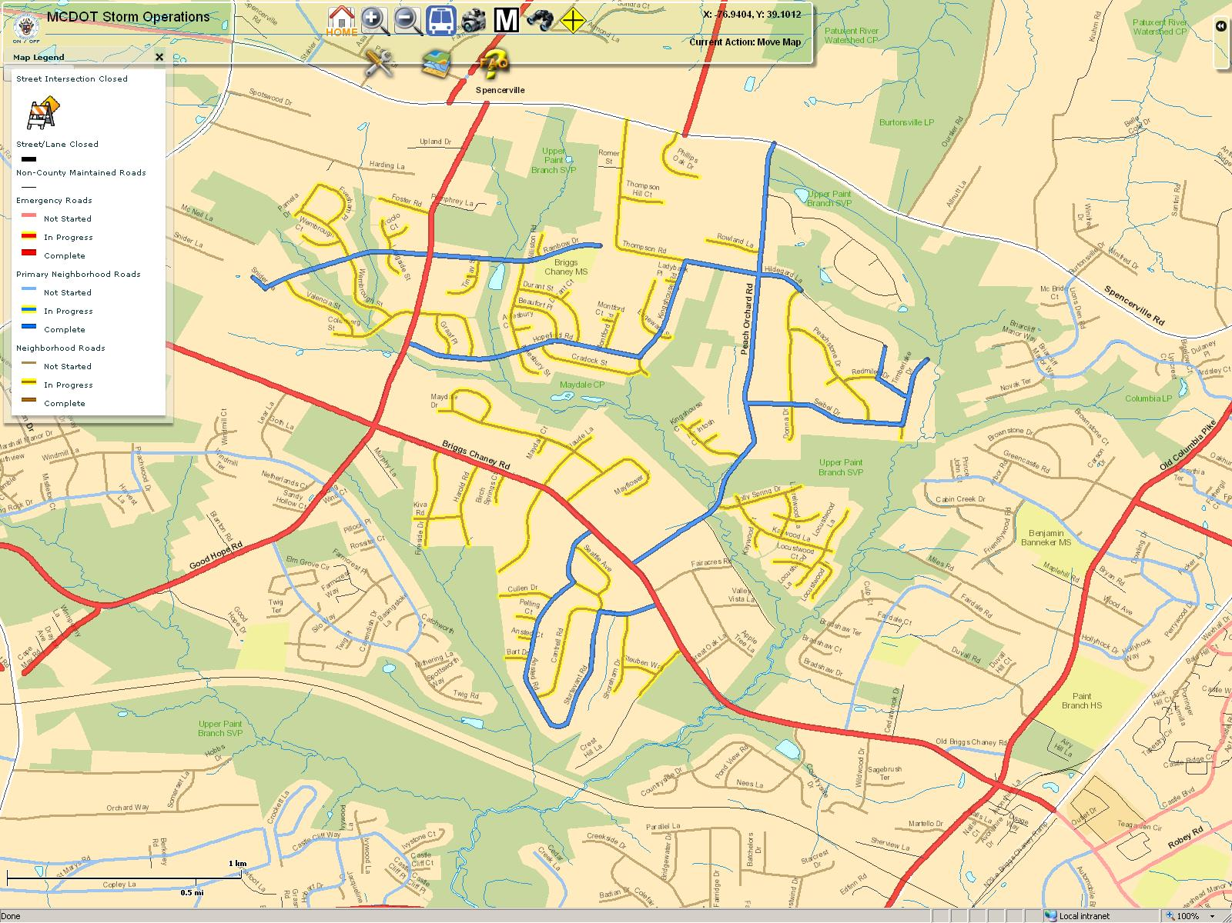

Slide 46
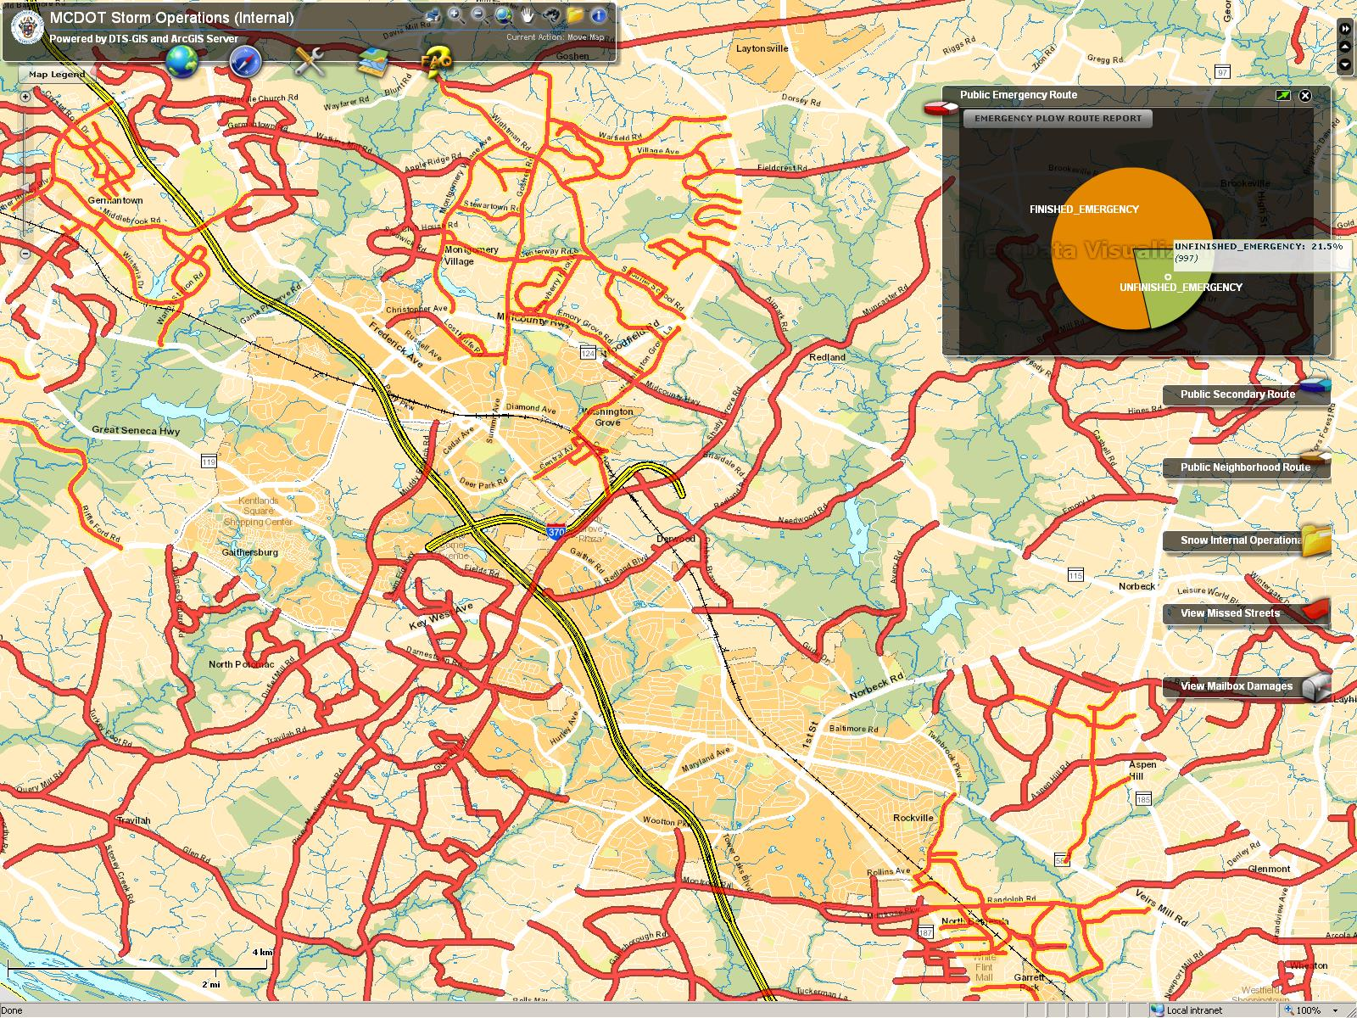

Slide 47
Deployment

Slide 48
Resources and Staffing

Slide 49
Resources

Slide 50
Plow Route Efficiencies

Slide 51
Storm Operations

Slide 52
Key Initiatives (cont’d) Plow Route Efficiencies

Slide 54
Storm Clean Up

Slide 55
Approximate Treatment and Plow Time Frame

Slide 56
Post Storm Activities

Slide 57
Head Count

Slide 58
Demobilization

Slide 59
Tiered Demobilization

Slide 60
Post Storm Debriefing

Slide 61
Debriefing

Slide 62
Debriefing

Slide 63
Post Season

Slide 64
Why the Fuss?

Slide 65
Economic Impacts

Slide 66
Winter Facts

Slide 67
Storm Forward Planning

Slide 68
Debrief Last Season

Slide 69
Wrap-up

Slide 70
Wrap-up

Slide 71
Thanks to all Attendees:

Slide 72
Questions & Answers

