Slide 1
NORTH POTOMAC NANCY H. DACEK COMMUNITY
RECREATION CENTER

Slide 2
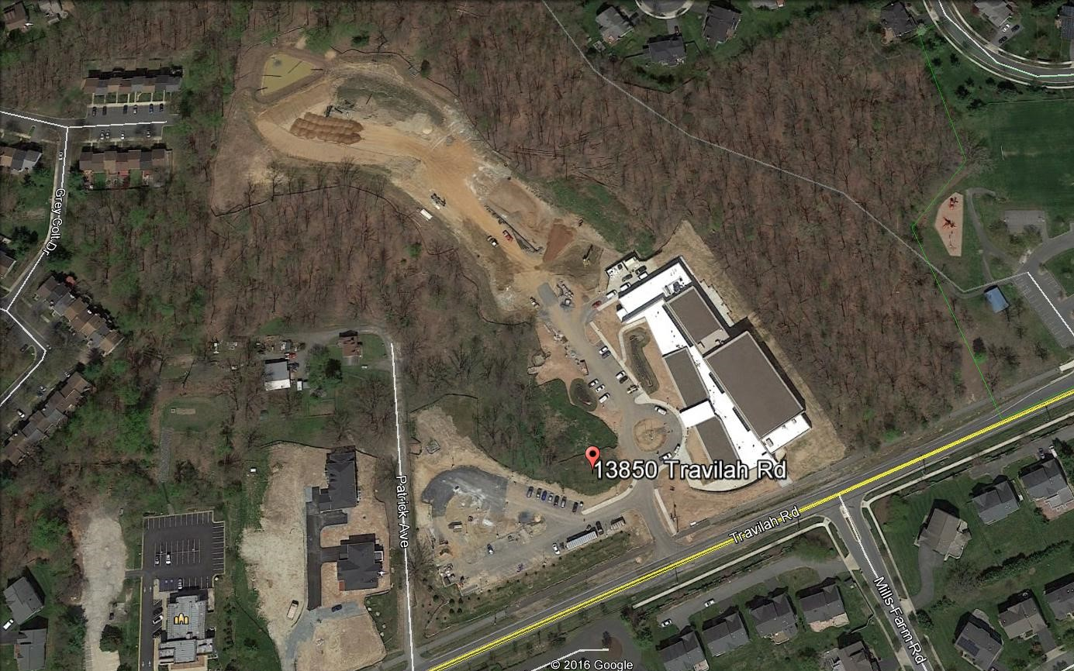
NORTH POTOMAC NANCY H. DACEK COMMUNITY RECREATION CENTER
Entrance

Slide 3
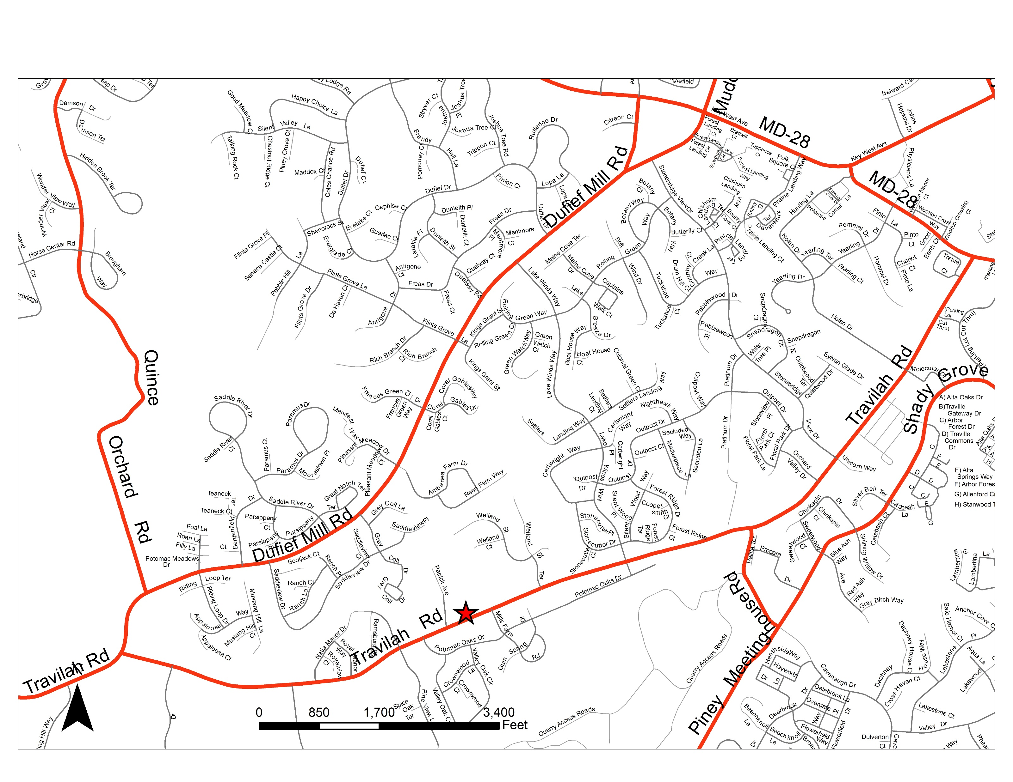
NORTH POTOMAC NANCY H. DACEK COMMUNITY RECREATION CENTER
13850 Travilah Rd., Rockville, MD 20850

Slide 4
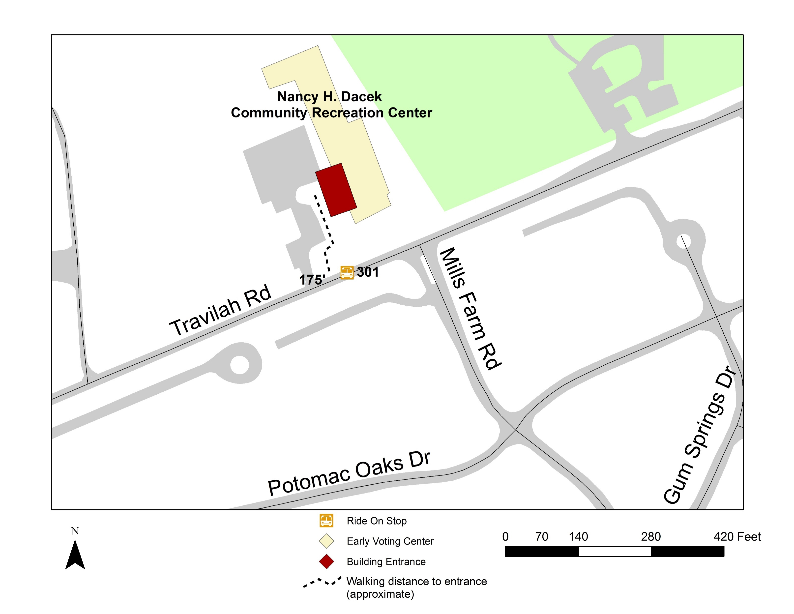
NORTH POTOMAC NANCY H. DACEK COMMUNITY REC CTR - PUBLIC TRANSIT

Slide 5
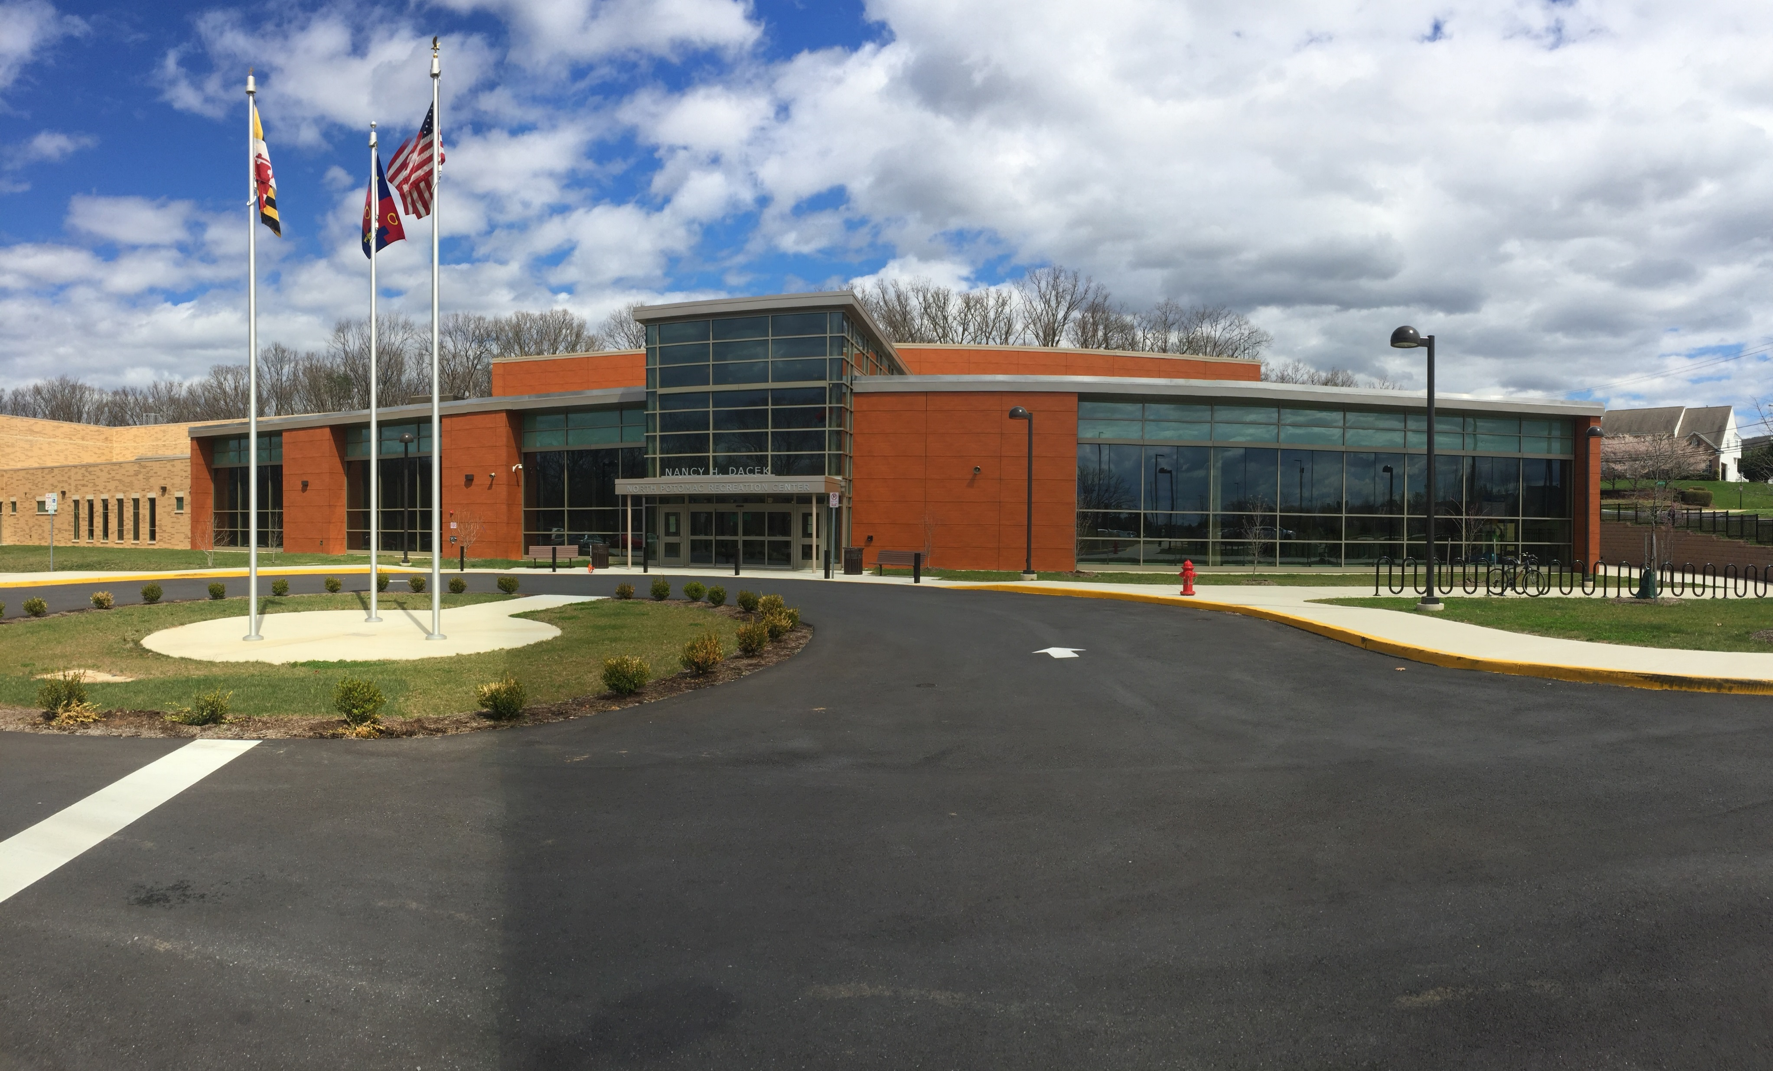
NORTH POTOMAC NANCY H. DACEK COMMUNITY RECREATION CENTER
Entrance

Slide 6
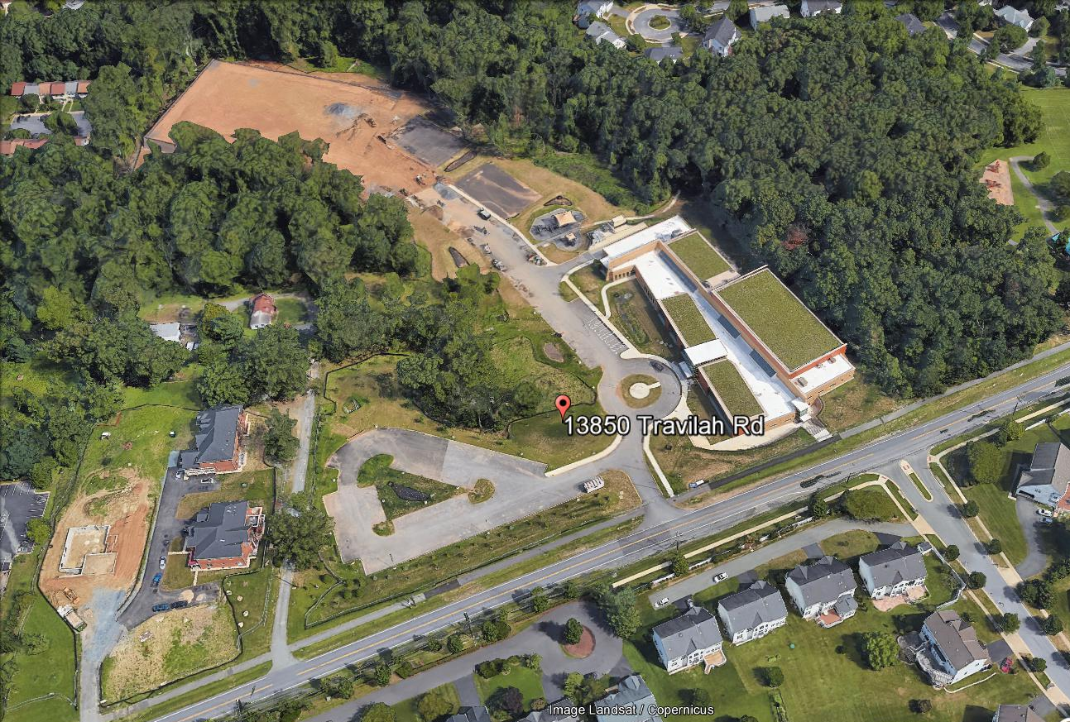
NORTH POTOMAC NANCY H. DACEK COMMUNITY REC CENTER - PARKING
Entrance
100 SPACES

Slide 7
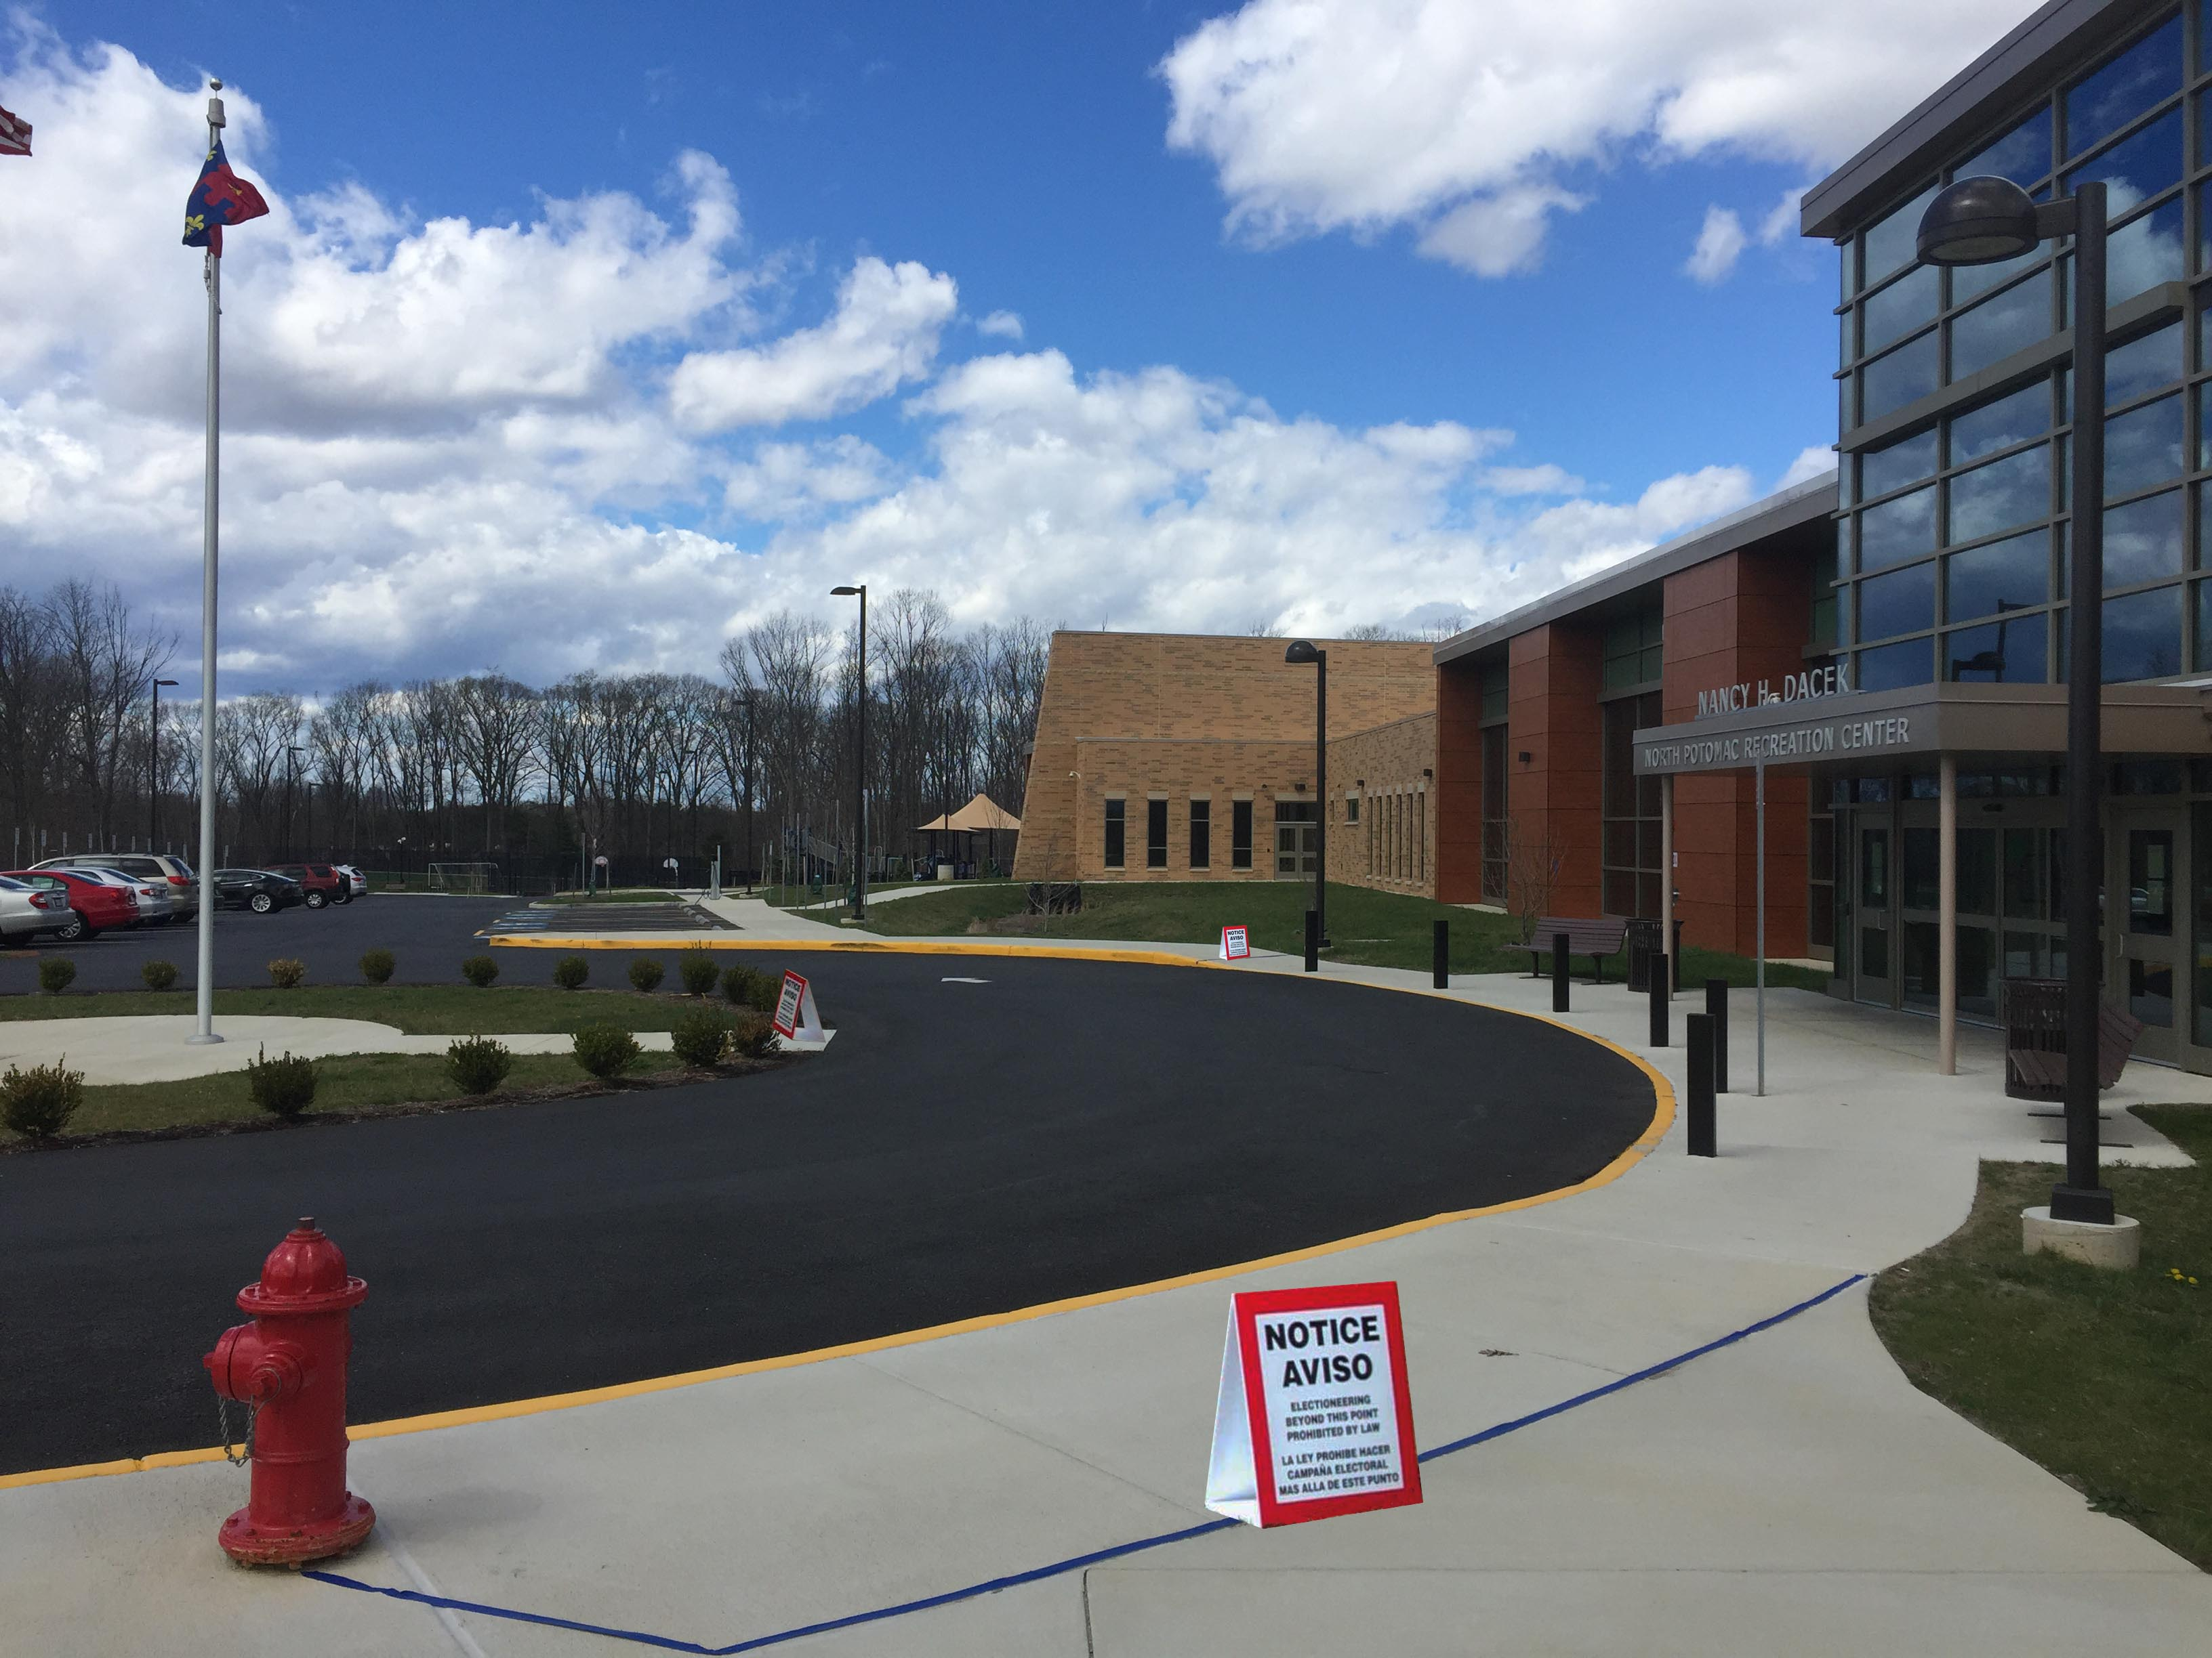
N. POTOMAC DACEK COMMUNITY REC CENTER - NO ELECTIONEERING ZONE

Slide 8
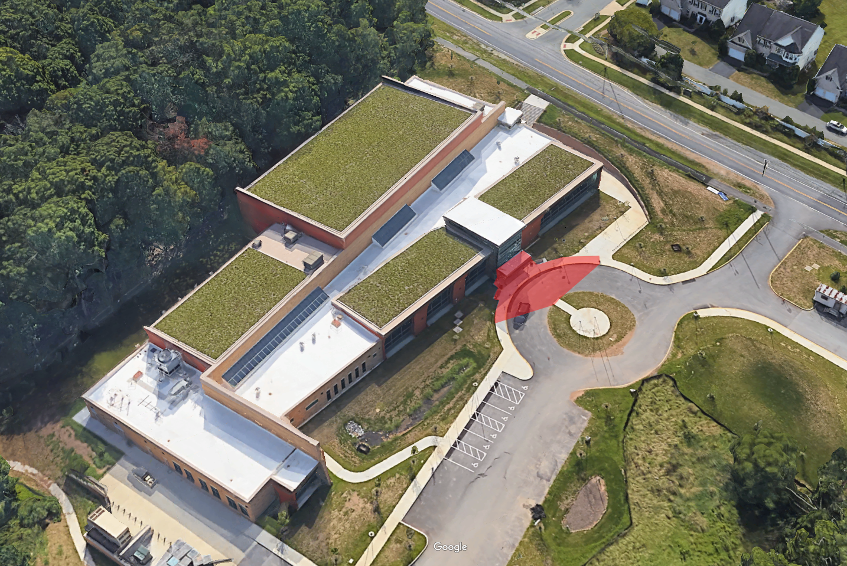
N. POTOMAC DACEK COMMUNITY REC CENTER - NO ELECTIONEERING ZONE
No Electioneering Zone

Slide 9
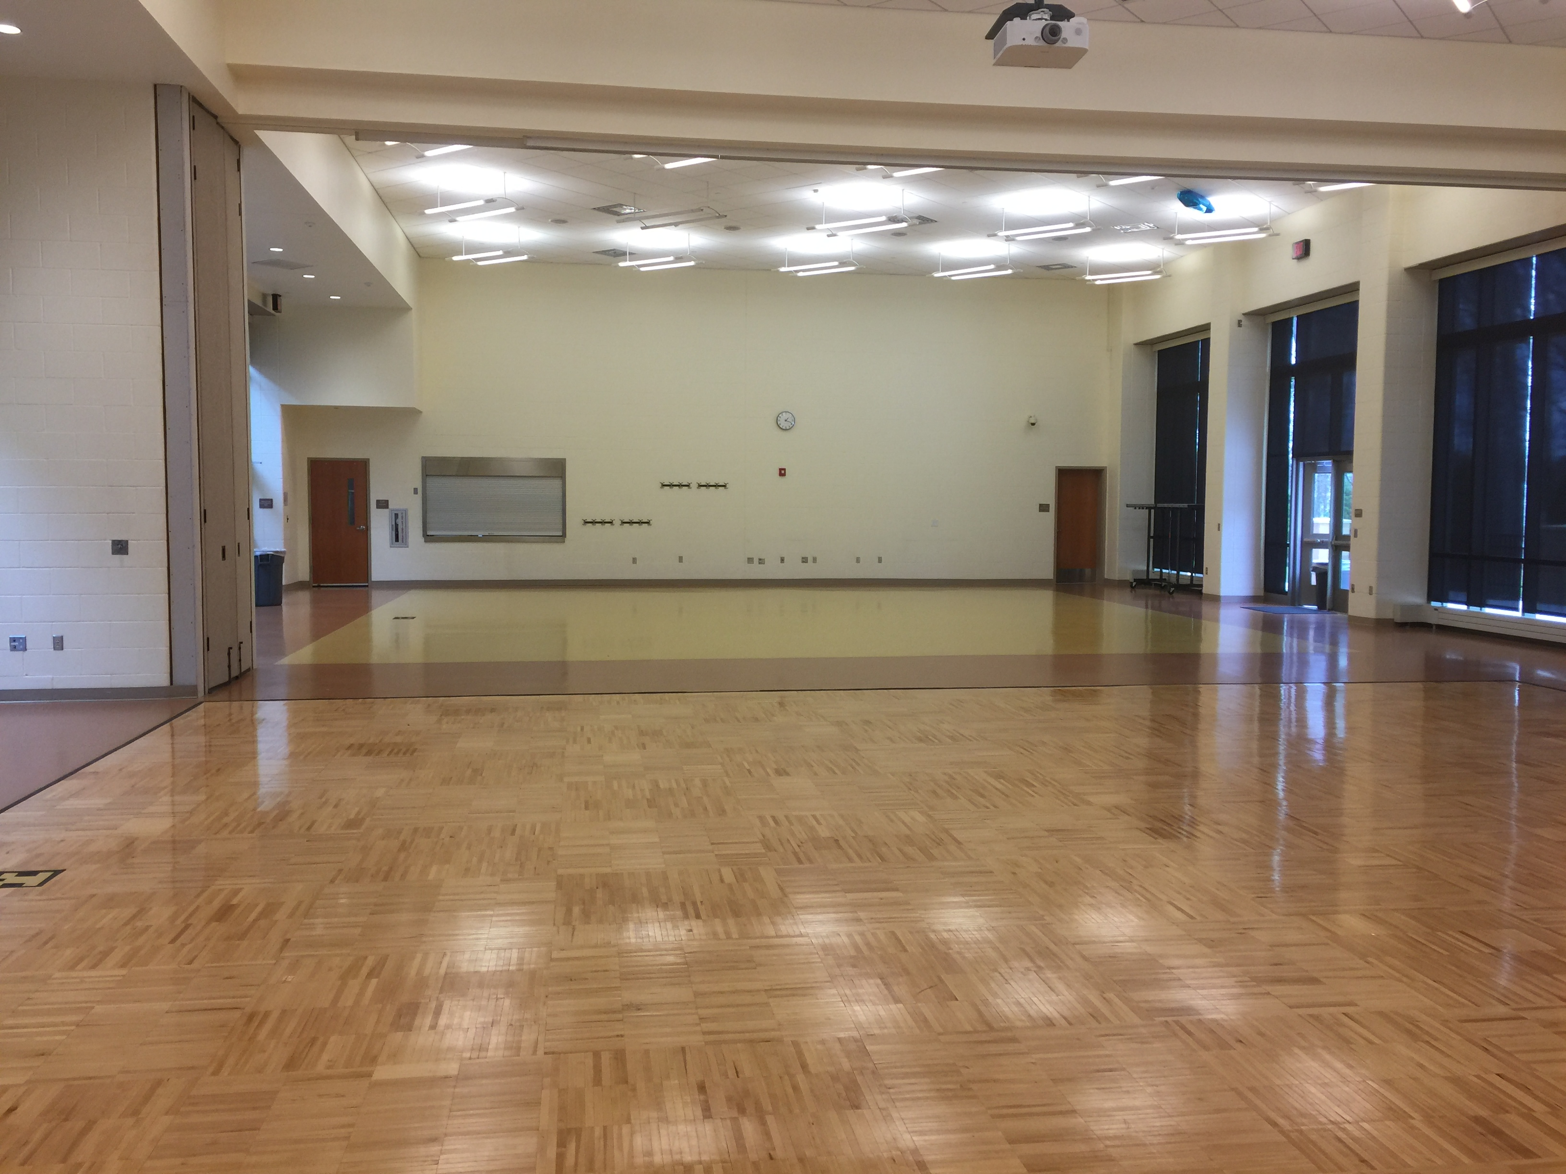
NORTH POTOMAC NANCY H. DACEK COMMUNITY REC CENTER (Social Hall)
4,157 SQ. FT.

