Slide 1
FY20 Compensation Changes
Changes effective July 7, 2019:
MLS and PLS
FY19 Performance-based Pay Increases
FOP
Deferred Service Increment (FY12 or FY13)
Additional Longevity Step
Lump Sum
MCGEO
Lump Sum
Sheriff and Correctional Officers Longevity
Minimum Wage and Seasonal Salary Schedule Increases
IAFF Pay Differential
Compensation Resource Links

Slide 2
MLS and PLS – Performance-Based Pay
Currently active MLS and PLS employees as of July 7, 2019 who met the following FY19 Performance Rating criteria (in an MLS or PLS assignment) are eligible for the following CAO approved performance-based pay increases:
FY19 Performance Rating | Performance-based Pay Award
Exceptional | $3,500
Highly Successful | $2,500
Successful | $2,000
Note: The total increase may be allocated as an increase to base salary, or a lump sum or a combination of base salary
and lump sum.

Slide 3
FOP – Deferred Service Increment
Currently active uniform police officers (non-PLS) as of July 7, 2019 who meet the following criteria:
Increment Categories | Hire Date before July 4, 2010 | Hire Date before July 3, 2011 | Hire Date before July 1, 2012
# Postponed increments eligible: | (3) FY11, FY12, FY13 | (2) FY12, FY13 | (1) FY13
Postponed increments paid in FY14/15 | 1 | 1 | 1
# Postponed increments eligible for FY20 | 1 | 1 | 0

Slide 4
FOP – Additional Longevity
Currently active uniform police officers (non-PLS) as of July 7, 2019 who meet the following criteria:
Years of Service Completed | Increase
16 Years (New) | 3.5% of base salary
16 Years > 20 Years (New) | 3.5% of base salary
20 Years | 3.5% of base salary
20+ years (New) | Additional 3.5% of base salary (element changes from 3.5% to 7.0%)

Slide 5
FOP - $1,000 Lump Sum
Currently active full time or part-time regular uniform police officers (non-PLS) at the top of the grade as of July 7, 2019 who will not receive any of the following increases July 7, 2019 through July 5, 2020:
New or Additional Longevity Steps | 16 years
 | 16 years > 20 years
 | 20 years
 | 20+ years
Deferred Compensation | FY20 postponed service increment

Slide 6
MCGEO – $1,000 Lump Sum
Currently active full-time regular employees at the top of the grade as of July 7, 2019 who will not receive any of the following increases July 7, 2019 through July 5, 2020:
A service increment
The 1.0% postponed service increment
Any new longevity steps anytime during FY20
Notes:
Part-time regular employees’ payment will be prorated based on their standard working hours as defined in Oracle however, employees will not be paid out until end of FY20.
LWOP employees returning to work before July 5, 2020 will receive payment upon their return.

Slide 7
MCGEO – Longevity
Currently active Sheriffs and Correctional Officers at top of the grade as of July 7, 2019 who meet the following criteria:
Years of Service Completed | Increase
20 Years | 3.5% of base salary
24 Years | Additional 2.5% of base salary

Slide 8
Minimum Wage/Seasonal Salary Schedule
Minimum wage increased to $13.00 effective June 23, 2019
Employees not effected by the minimum wage increase will receive $.25 per hour effective July 7, 2019

Slide 9
IAFF – Pay Differential
Pay Differential for the fire bargaining unit employees will change effective July 7, 2019 from a specific dollar amount for the salary grade step to a percentage of the salary grade step

Slide 10
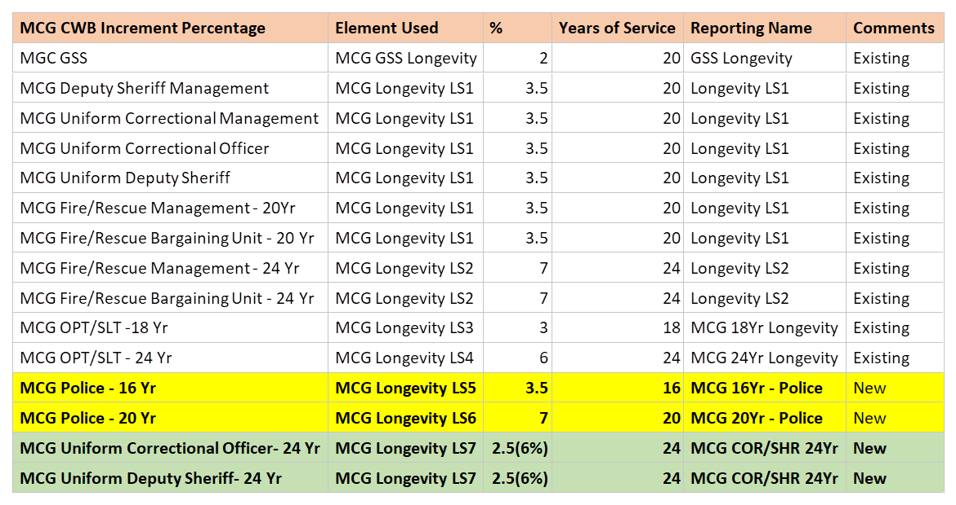
Longevity Guide

Slide 11
FY20 Compensation Resource Links
FY20 Compensation Changes Memo: FY20 Compensation Changes
FY20 Salary Schedules:
FY20 General Salary Schedule
FY20 Correctional Management Salary Schedule
FY20 Correctional Officers Salary Schedule
FY20 Deputy Sheriff Management Salary Schedule
FY20 Deputy Sheriff Uniform Salary Schedule
FY20 Police Management Salary Schedule
FY20 FOP Salary Schedule
FY20 Fire/Rescue Services Management Salary Schedule
FY20 IAFF Salary Schedule
FY20 Medical Doctors Salary Schedule
FY20 Minimum Wage/Seasonal Salary Schedule
FY20 MLS Salary Schedule
FY20 OPT/SLT Salary Schedule

