Slide 1
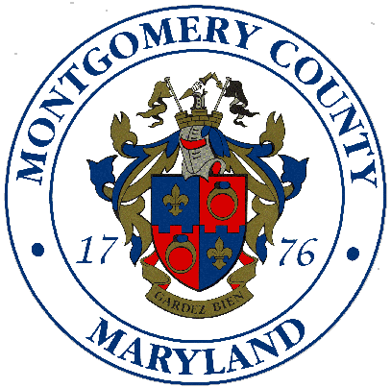
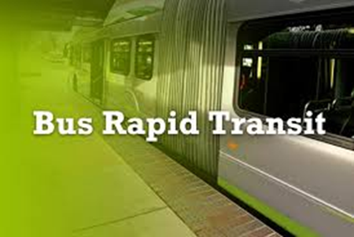
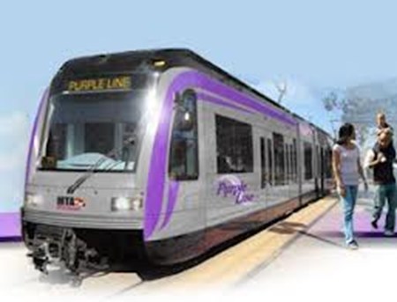
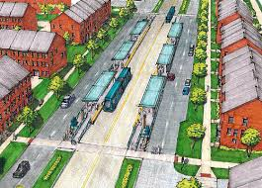
MONTGOMERY COUNTY
TRANSIT PROJECT BRIEFING
8/22/13
Prepared by Charles Lattuca
Montgomery County Department of Transportation

Slide 2
Bus Rapid Transit (BRT) in Montgomery County
Not a New Idea
Activity | Date
Georgia Avenue Busway Study | 1999
I-270/US 15 Multi-Modal Corridor Study Draft Environmental Impact Statement | 2002
Veirs Mill Road BRT Study Final Report | 2003
Phase 1 Veirs Mill Road Bus Rapid Transit Facility Planning Report | 2005
Countywide BRT Study | 2011
MDOT preliminary engineering for BRT projects on Veirs Mill Road and Georgia Avenue | 2012
County Executive Transit Task Force Report | 2012
Countywide Transit Corridors Functional Master Plan | 2013

Slide 3
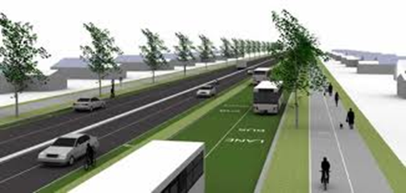
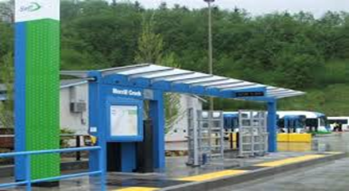
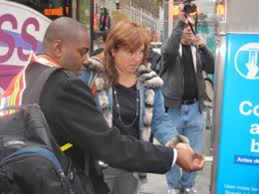
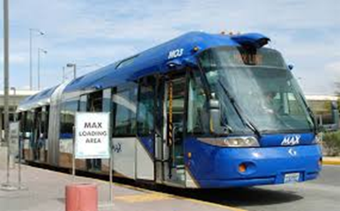

Elements of a BRT System
Dedicated Lanes or Busways
Off Board Fare Collection
Specialized Vehicles
Greater Distance Between Stops
Integration With Other Public Transport
Platform Boarding
Transit Signal Priority
Real Time Traveler Information Systems
Branding and Marketing
Bicycle Sharing Integration

Slide 4
Countywide Transit Corridors Functional Master Plan for Bus Rapid Transit
Recommends changes and additions to the transportation network.
Supports economic development and mobility goals.
Identifies 10 BRT corridors throughout the County.
The BRT network is 80.6 miles in size and includes a variety of BRT treatments.
Does not change current planned land use or zoning.
Notes:
This Plan is anticipated to be reviewed by the County Council at the same time as the White Oak Science Gateway Master Plan. Land use decisions made as part of the approval of WOSG may require an upgrade in treatment on portions of the following corridors: US29, New Hampshire Avenue, and Randolph Road.

Slide 5
Determining BRT Treatments
Plan Thresholds for BRT Lanes
Treatment Level | Person Per Peak Hour in the Peak Direction | Buses Per Hour 100 passengers per bus (60’ Bus 57 Seated/63 Standing) | Headway (Minutes)
Dedicated Lane | *1,200 -------------------------- Draft Plan 1,000 | 12 -------------------------------- 10 | 5 -------------- 6
Median Busway | *2,400 -------------------------- Draft Plan 1,600 | 24 -------------------------------- 16 | 2.5 -------------- 3.75
*Transportation Research Board, Transit Capacity and Quality of Service Manual, 2nd Edition

Slide 6
Lane Repurposing
Lane Repurposing Test -- Lane Repurposing Test – When forecast BRT ridership on a roadway is greater than the capacity of a general traffic lane.
Example: MD 355 South Corridor
MD 355 from I-495 to Friendship Heights Metro has a lane capacity of 800-1550 cars per hour.
The 2040 BRT forecast states that taking lanes BRT treatments will provide a person throughput capacity of 1,775-2000 persons per hour.

Slide 7
Other Recommendations in the Planning Board Draft
The transit network may evolve over time to meet future transit needs.
Success must be measured by person throughput not vehicle throughput.
The Service Planning and Integration Study will determine station locations, size and links to other transit services.
Improvement of existing bicycle and pedestrian facilities near all BRT stations.
Enhanced MARC commuter train services.

Slide 8
Recommended Corridors
Corridor | Corridor Size (directional miles) | # of Stations
Georgia Ave North | 9.5 | 13
Georgia Ave. South | 3.7 | 8
MD 355 North | 14.1 | 20
MD 355 South | 9.3 | 14
New Hampshire Avenue | 8.5 | 12
North Bethesda Transitway | 2.7 | 7
Randolph Road | 10.1 | 11
University Boulevard | 5.5 | 9
US 29 | 11.0 | 11
Veirs Mill Road | 6.2 | 11
Total | 80.6 | 115

Slide 9
Recommended Transit Corridor Map & Transit Treatments

Slide 10
Treatments by Category
Treatment | Directional Miles | % of BRT Network
Two Lane Median | 28.1 | 34.8
Two Lane Side Running Busway | 0.9 | 1.1
Reversible One Lane Median | 16.6 | 20.6
Bidirectional One Lane Median | 6.2 | 7.7
Curb Lanes | 4.0 | 5.0
Managed Lanes | 0.9 | 1.1
Mixed Traffic | 23.9 | 29.7
Total | 80.6 | 100

Slide 11
Planning Board Draft Versus TTF Report Slide I
Corridor | PB Draft (miles) | TTF Phase 1 (miles) | TTF Phase 2 (miles) | TTF Phase 3 (miles)
Georgia Ave. North | 9.5 | 9.8 | 0 | 0
Georgia Ave. South | 3.7 | 0 | 0 | 3.9
MD 355 North | 14.1 | 0 | 0 | 14.9
MD 355 South | 9.3 | 12.1 | 0 | 0
New Hampshire Ave. | 8.5 | 0 | 10.1 | 0
North Bethesda Transitway | 2.7 | 0 | 5.1 | 0
Randolph Road | 10.1 | 12.5 | 0 | 0
University Boulevard | 5.5 | 0 | 6.4 | 0
US 29 | 11 | 10.7 | 0 | 0
Veirs Mill Road | 6.2 | 6.7 | 0 | 0
Total Directional Miles | 80.6 | 51.8 | 21.6 | 18.8

Slide 12
Planning Board Draft Versus TTF Report Slide 2
Corridor | Transit Task Force Start & End Points | Planning Board Draft Start & End Points | Difference (miles)
Georgia Ave. North | Olney Sandy Hill Rd to Veirs Mills Road | Prince Phillip Dr. (Medstar) to Veirs Mill Rd | -0.3
Georgia Ave. South | Veirs Mill Rd to Silver Spring Transit Center | Veirs Mill Rd to DC Line/Montgomery College | -0.2
MD 355 North | Montgomery Village Ave, Clarksburg to Montgomery College, Germantown | Redgrave Place, Clarksburg to Rockville Metro | -0.8
MD 355 South | Montgomery Village Ave, Gaithersburg to Bethesda Metro Station | Rockville Metro to Friendship Heights Metro | -2.8
New Hampshire Ave. | Intercounty Connector, Colesville to Fort Totten, D.C. | Colesville Park & Ride to D.C. Line | -1.6
North Bethesda Transitway | Grosvenor Metro to Montgomery Mall | White Flint Metro to Montgomery Mall | -2.4
Randolph Road | White Flint Metro to FDA Blvd. | White Flint Metro to US 29 | -2.4
University Boulevard | Wheaton Metro to New Hampshire Ave. | Wheaton Metro to Takoma /Langley Park Transit Center | -0.9 (identical route)
US 29 | Burtonsville/MD 198 to Silver Spring Metro | Burtonsville Park & Ride to Silver Spring Transit Center | +0.3 (identical route)
Veirs Mill Road | Rockville County Office Bldg./Metro to Wheaton Metro | Rockville Metro to Wheaton Metro | -0.5 (identical route)

Slide 13
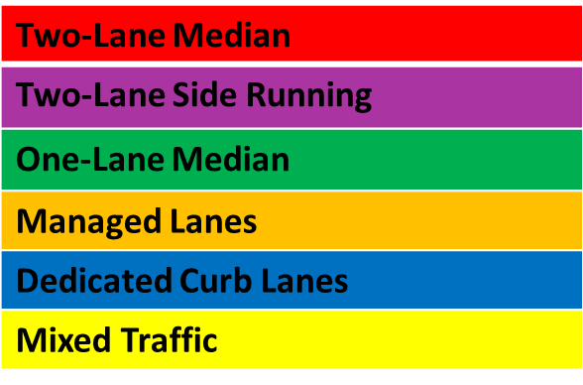
Georgia Ave North & South
Corridor 1: Georgia Avenue North, Prince Phillip Dr. (Medstar) to Veirs Mill Rd
Length: 9.5 Miles -- 8.6 One Lane Median Busway & 0.9 Mixed Traffic
Stations: 13 Stations -- avg. every 0.73 miles
Corridor 2: Georgia Avenue South, Veirs Mill Rd to DC Line/Montgomery College
Length: 3.7 Miles – 2.0 Mixed Traffic & 1.7 Dedicated Curb Lanes
Stations: 8 Stations – avg. every 0.46 miles

Slide 14

MD 355 North and South
*Corridor 3: MD 355 North, Redgrave Place, Clarksburg to Rockville Metro
Length: 14.1 miles – 12.5 Two Lane Median Busway & 1.6 Mixed Traffic
Stations: 20 Stations -- avg. every 0.7 miles
*Corridor 4: MD 355 South, Rockville Metro to Friendship Heights Metro
Length: 9.3 Miles – 8.2 Two Lane Median Busway & 1.2 Dedicated Curb Lanes
Stations: 14 – avg. every 0.66 miles
*Assuming Rockville & Gaithersburg agree to
endorse the Planning Board Draft.

Slide 15
New Hampshire Avenue & North Bethesda Transitway
Corridor 5: New Hampshire Avenue, Colesville Park & Ride to D.C. Line
Length: 8.5 Miles – 3.8 One Lane Reversible Median, 2.8 Mixed Traffic & 1.8 Two Lane Median
Stations: 12 – avg. every 0.71 miles
Corridor 6: North Bethesda Transitway, White Flint Metro to Montgomery Mall
Length: 2.7 miles – 1.5 Two Lane Median, 0.9 Two-Lane Side Running & 0.3 Mixed Traffic
Stations: 7 – avg. every 0.38 miles

Slide 16
Randolph Road & University Boulevard
Corridor 7: Randolph Road, White Flint Metro to US 29
Length: 10.1 miles Mixed Traffic
Stations: 10 – avg. every 1.0 miles
Corridor 8: University Boulevard, Wheaton Metro to Takoma /Langley Park Transit Center
Length: 5.5 miles – 2.8 Mixed Traffic & 2.7 One Lane Median
Stations: 9 Stations – avg. every 0.6 miles

Slide 17
US 29 & Veirs Mill Road
Corridor 9: US 29 Corridor, Burtonsville Park & Ride to Silver Spring Transit Center
Length: 11 miles – 5.6 Two Lane Median, 3.4 Mixed Traffic, 1.1 Curb Lanes & 0.9 Managed Lanes
Stations: 11 – avg. every 1.0 miles
Corridor 10: Veirs Mill Road, MD 355 to Wheaton Metro
Length: 6.2 miles One Lane Median
Stations: 11 – avg. every 0.56 miles
Bi-Directional

Slide 18
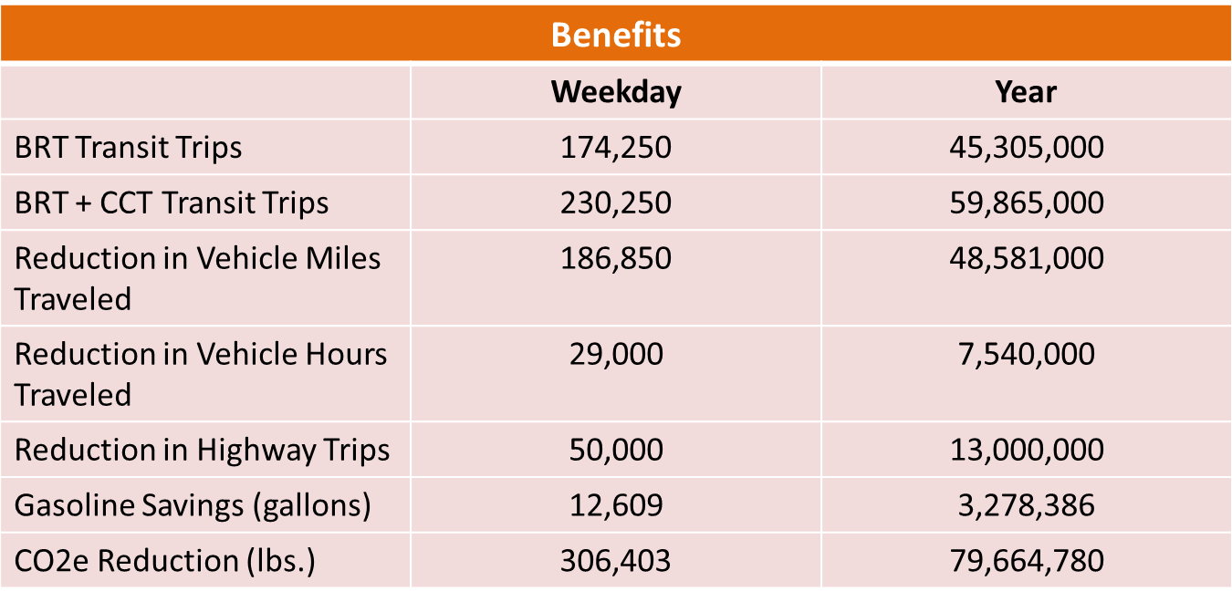
Transit, Traffic & Environmental Impacts by 2040

Slide 19
MARC Brunswick Line Expansion
The Brunswick Line serves 7,000 daily passengers at 11 stations in Montgomery County.
Calls for a 3rd track be constructed between Frederick County line and the Metropolitan Grove station (12 miles).
Consistent with MTA’s 2007 Growth & Investment Plan.
The additional capacity, coupled with expanded service, would accommodate a tripling of ridership.

Slide 20
MARC Brunswick Line Expansion

Slide 21
Bikeways
The Plan recognizes good bike/pedestrian access is needed to all BRT stations.
All master plan bikeways within the recommended ROW are accommodated.
Recommends designating new Bicycle-Pedestrian Priority Areas in the State’s Bicycle-Pedestrian Master Plan around major transit and BRT stations.

Slide 22
RTS Funding Update
To date, MCDOT has dedicated $11 million for BRT corridor studies on Veirs Mill & Georgia Ave.
MDOT is expected to offer another $10M to advance BRT corridor planning.
MCDOT would program the State’s $10M for concept planning related to the MD 355 South, US 29 and Randolph Road Corridors

Slide 23
Process
Action | Timing
Planning Board Draft Sent to Council | 7/25
Fiscal Impact Analysis | Mid September
Departmental Comments to DGS | 9/6
Draft to County Executive | Mid September
Council Public Hearings | 9/24 & 26
Council T&E Committee Work Sessions | October
Council Resolution Approving the Planning Board Draft as Amended | Winter 2014
Maryland-National Capital Park and Planning Commission Adoption | Spring 2014

Slide 24

How Do We Compare to Other BRT Initiatives in the US
Bus Rapid Transit Around the Country
System | Start Date | Length (miles) | Avg. Daily Ridership | Stations | Cost millions
Los Angles County Metro Orange line | 2005 | 18 | 21,800 | 18 | 349
Los Angles County Metro Silver Line | 2009 | 26 | 13,765 | 9 | 210
Everett, WA Swift BRT | 2009 | 16.7 | 2,660 | 12 | 29
Eugene, OR Emerald Express Green Line | 2007 | 4 | 4,700 | 10 | 31
Hartford, CT Fastrack | 2014 | 9.4 | 16,000 | 11 | 275
Salt Lake City MAX | 2008 | 10 | 4,100 | 13 | 7
Cleveland, Healthline BRT | 2008 | 9.4 | 14,300 | 42 | 197
Corridor Cities Transitway Phase I | 2020 | 9.5 | 35,000 | 12 | 545
Countywide Transit Corridors FMP | TBD | 80.6 | 174,250 | 115 | TBD

Slide 25
Plan Versus Project
BRT corridors identified in the Planning Board Draft do not automatically become County projects.
A functional master plan addresses systems or policies but does not make land use or zoning recommendations.
BRT projects that are developed may vary from those outlined in the Plan.

