Slide 1
Steering Committee Meeting
Presented to
Montgomery County Department of Transportation
Presented by
Dan Goldfarb, P.E.
Transportation Planning Manager Tyson Corner Office
Vanasse Hangen Brustlin, Inc. & FITP
August 27, 2013

Slide 2
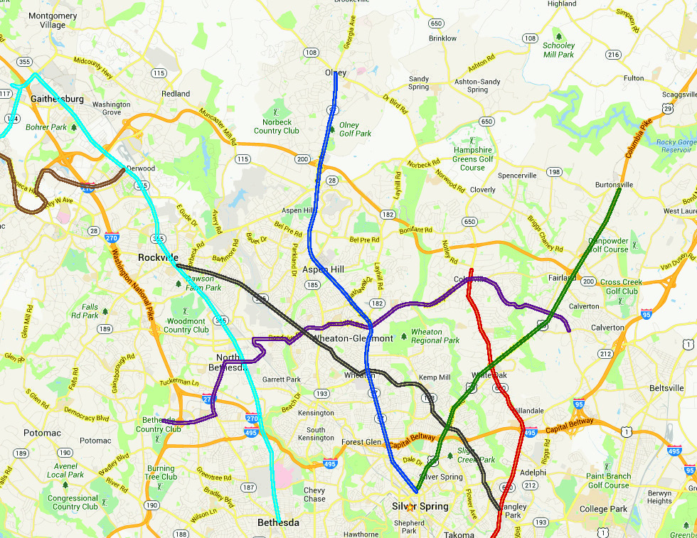
US 29 Corridor
2
Action
  Consistent with Functional Master Plan Draft
Objective
  Continuation of High Transit Mode Share to Silver Spring/Washington, DC
  Continuation of the Existing High Level of Service
  Provide Connection between Corridor Activity Centers
    Silver Spring CBD
    White Oak/FDA
Key Nodes
  Burtonsville PNR
  White Oak – Transit Center
  FDA Campus
  Four Corners
  Silver Spring Metro

Slide 3
US 29 Corridor
3
Example RTS Service
  Long
    Burtonsville PNR to Silver Spring Metro
  Intermediate
    White Oak to Silver Spring Metro
  Short
    Silver Spring Metro to Four Corners
  Interlining
    Colesville to Silver Spring
    White Oak to Langley Park (Via MD 650 or MD 193)

Slide 4
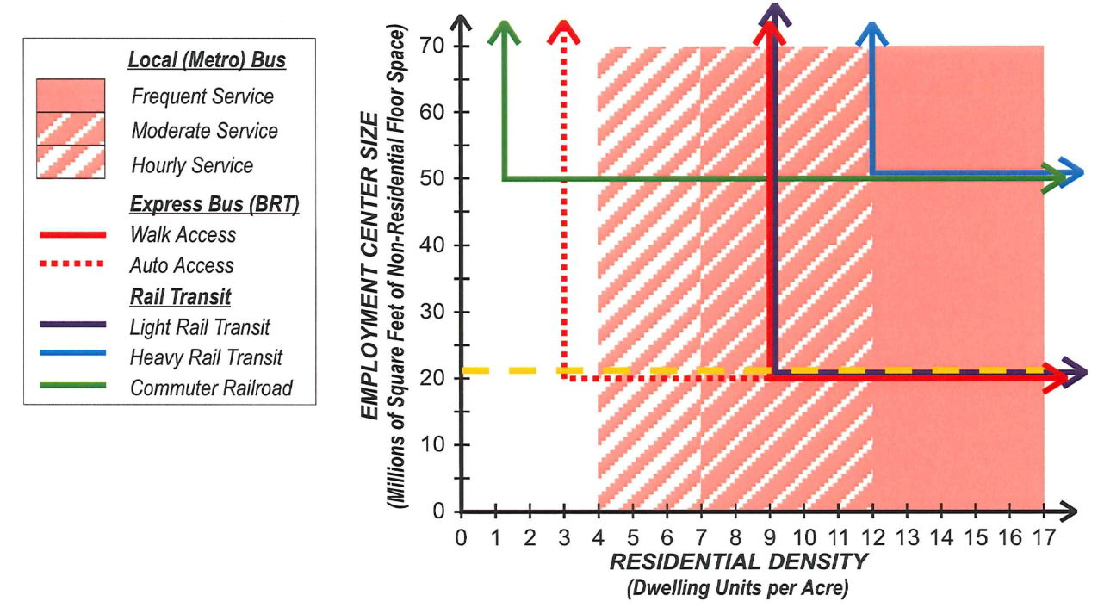
Route Planning Process
Focus Corridor Level
Identifying Connectivity
  Activity Centers
    Office/Retail/Households
    Office/Retail
    Central Business District (CBD)
  Multimodal Transfer Points
    RTS ← → RTS
    RTS ← → Metro
    RTS ← → Bus

Slide 5
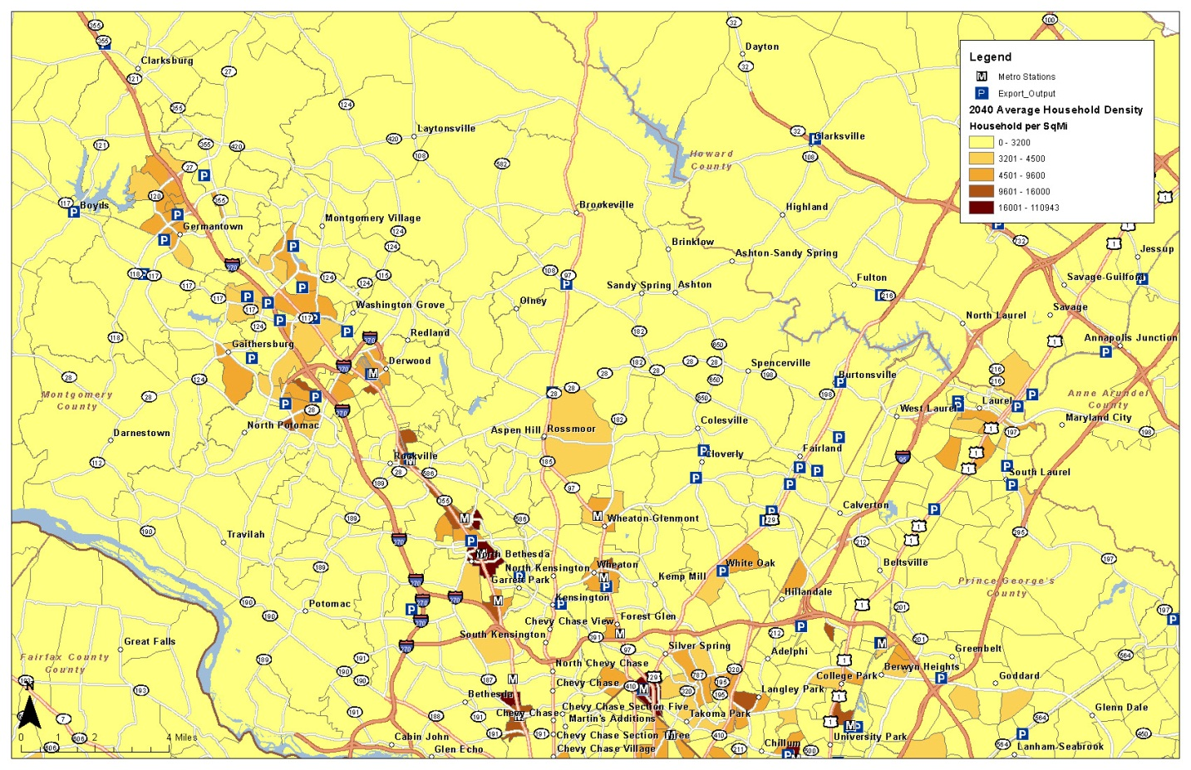
Example Corridor - US 29
5
Population Density
Employment Density
Park-and-Ride Lots
Infrastructure
  Other Modes
  Multimodal Connections
  Highway Facility

Slide 6
US 29 Corridor Characteristics - Households
6
Modest household growth in the corridor, except for downtown Silver Spring

Slide 7
US 29 Corridor Characteristics - Jobs
7
High job growth for Activity Centers in White Oak and downtown Silver Spring

Slide 8
US 29 Corridor Characteristics – Households to Jobs
8
The balance of households to jobs will increase, and there will be continued travel into the corridor.

Slide 9
Transit Mode Share
9
Transit Planning Focus on Commuter Trips (HBW)
  Longer Trips
  Higher Transit Mode Share
Jurisdiction | Transit Mode Share Commuting | Transit Mode Share Non-Commuting
Montgomery County | 16% | 3%
DC Core | 56% | 38%

Slide 10
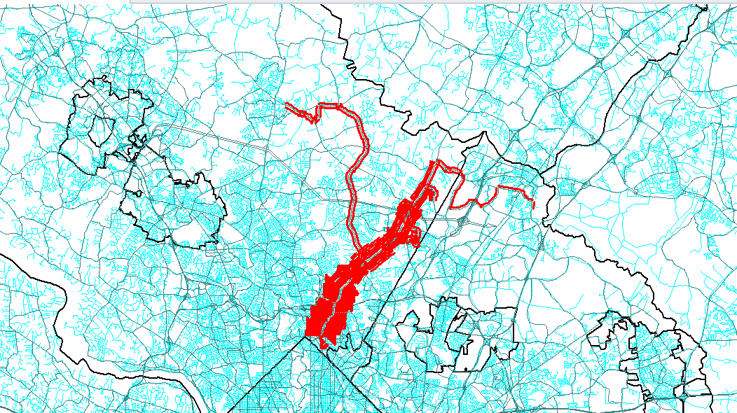
US 29 Corridor Service Supplied
10
WMATA “Z” Services
  Express
  Local
MTA Commuter Bus
Ride-On
Only Bus

Slide 11
US 29 Corridor Service Supplied - Buses in the Peak Hour
11
Segment | Existing | Year 2040
North of ICC | 28 | 38
North of MD 650 (South of ICC) | 53 | 57
South of MD 650 (North of Four Corners) | 57 | 63
Inside Beltway | 87 | 94

Slide 12
US 29 Corridor – Mode Share
12

Slide 13
US 29 Corridor – Mode Share Summary
13
Corridor to Silver Spring CBD
  High Transit Destination
  Existing 40% Commuter Trips Transit
  Future 48% Commuter Trips Transit
Corridor Trips to DC
  Existing 48% Commuter Trips Transit
  Future 50% Commuter Trips Transit
White Oak
  Existing Commuter Trips Transit Mode Share to White Oak 7%
  Future Commuter Trips to Transit Mode Share to White Oak 8%
  From Silver Spring CBD & DC Commuter Mode Share 25%

Slide 14
US 29 Corridor – Transit & Auto AM Peak Period
14
Segment | Existing Transit | Existing Vehicles | Future Transit Persons | Future Vehicles
North of ICC | 5,900 | 10,400 | 7,200 | 10,400
North of MD 650 (South of ICC) | 7,300 | 8,600 | 8,100 | 9,300
South of MD 650 (North of Four Corners) | 10,800 | 8,000 | 11,000 | 9,100
Inside Beltway | 12,200 | 7,000 | 12,400 | 7,800
Auto Occupancy for Commuting Trips in Montgomery County is 1.06 persons/vehicle (2007/2008 MWCOG Household Travel Survey)

Slide 15
US 29 Corridor Service Integration
15
Sustain High Level of Transit Usage
Improve Reliability
Integrating MD 650 Service North of White Oak
Transit Center White Oak Shopping Center
Connections Life Science Center and FDA Campus
Connections Between White Oak and Silver Spring

Slide 16
US 29 Corridor White Oak Connections
16
US 29 Connection to MD 650
Randolph Road Service via FDA Campus, MD 650, Randolph Road
High Level of Service Silver Spring to White Oak/FDA Campus
MTA Commuter Bus
  Continued Services to Silver Spring/Washington, D.C.
  Transfers at White Oak
  Connections to FDA Campus

Slide 17
Questions/Comments/Discussion

