Slide 1
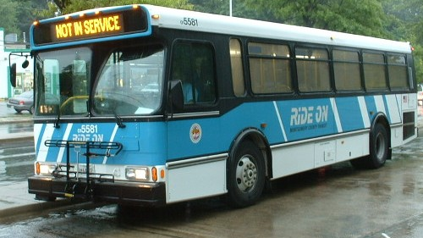



Transit Signal Prioritization (TSP) and RTS
RTS Transit Signal Priority Work Group
A Path to Successful Implementation
July 16, 2013

Slide 2
Outline
  What is Transit Signal Priority
  Potential Benefits of TSP
  Implementing TSP within Montgomery Co.
    Countywide Transit Signal Priority
      Current Operations/ No special Transit ROW treatments
      Countywide TSP Study
      Montgomery County TSP Technology Pilot Test
    Transit Signal Priority within RTS
      Future operations / RTS ROW Guideway & Service
      RTS TSP Study

Slide 3
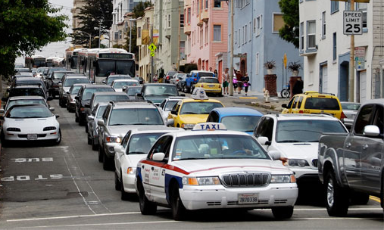
What is Transit Signal Priority (TSP)
TSP is a traffic signal operational strategy that facilitates the movement of transit vehicles, either buses or streetcars, through traffic signal controlled intersections.
Passive TSP adjusts signal timing/coordination for transit operations
Active TSP is used selectively and conditionally to provide passage for transit vehicles at signalized intersections when requested.
Source: TSP Handbook
Active TSP is conditional priority, not to be confused with Emergency Vehicle Preemption which is unconditional priority

Slide 4

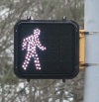



Traffic Signals 101
1 Cycle
A Cycle consists of multiple Phases
Phases allocate time to movements competing for shared right-of-way
Phase Length is a function of geometry, and vehicle and pedestrian volumes (demand)
Phase
Phase
Phase
Cycle length is sensitive to many factors including coordination with adjacent signals; time of day; volume demand, and vehicle detection (e.g. loops)

Slide 5
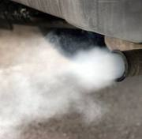
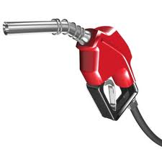
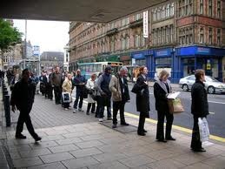
Benefits of TSP
Improve travel time reliability and schedule, reduce delay and reduce emissions, may increase ridership
Waiting at Traffic Signals represents an average of 15% of a bus’s trip time¹.
Cause of signal delay include:
  Pedestrians Crossing
  Volume-related delay
  Accommodating side-street traffic
  Special phases (e.g. left-turns only).
Conditional Priority reduces severe delay and improves reliability
1. (“Overview of Transit Signal Priority.” ITS America, 2004)

Slide 6
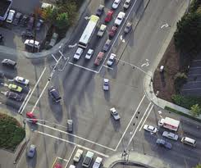
What TSP does not address
Delay or travel time variability related to:
  Lane merging
  Crashes
  Construction
  Weather
  Closely-spaced Bus Stops
  Idling/Dwell Time

Slide 7
What else is usually Implemented with TSP to Increase its effectiveness?
Geometric Improvements at intersections
  Queue jumps
  Exclusive Bus Lanes
Signal Timing Optimization (Passive Priority)
Transit Operational Improvements
  Consolidation/ Relocation of bus stops
  Schedule optimization
Combination of above

Slide 8
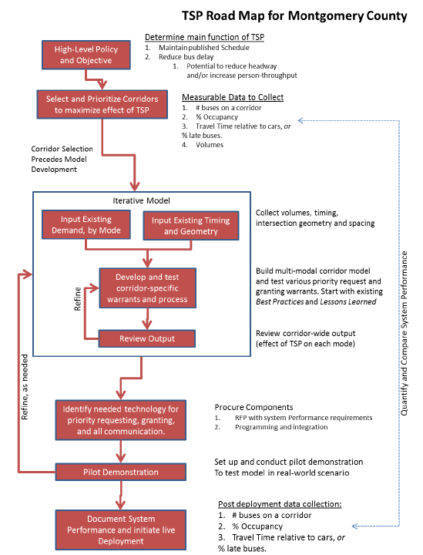
Implementing TSP in Montgomery County
Follow earlier successful implementations and lessons learned

Slide 9
Transit Signal Priority Considerations
Countywide versus RTS
Countywide – Current Ops
Within RTS – Ops
Current service in mixed flow (no other special treatment)
All transit in corridor treated equally
Corridors selected on most potential transit benefit with least potential traffic harm
First come first served transit priority request granted
Person throughput auto and transit equal
Traffic signals coordinated for all traffic
Traffic coordination allowed to recover between requests
TSP options:
  Green extension (through)
  Truncated red (through or cross)
Future service in tandem with RTS ROW and other priority treatments
How should RTS, Express, Local & peak in or out be given priority?
Corridors from County Transit Functional Master Plan
What service gets priority when there are multiple requests?
Should RTS service get additional priority?
Should signals be coordinated for RTS vehicle flow?
How often should priority be granted?
New Signal treatment Options:
  Passive priority
  Transit only phase

Slide 10
Countywide Transit Signal Priority
Transit vehicles in mixed flow without other priority measures
No differentiation between types of transit service
Transit riders and travelers in personal vehicles given equal weight (throughput)
Signal coordination and traffic flow allowed to “recover” between instances of signal priority

Slide 11
Countywide TSP Study
Phase I
  State of the Practice/ Lessons Learned
  Infrastructure and Communications System Readiness
Phase II
  Needs Assessment
    Concept of Operations Development
    Technology Assessment and Selection
      Data Requirement
      Procurement and Deployment
      Pilot Study Demonstration and Evaluation
Phase III
  Identify, Screen and Select Routes and Performance Metrics
  Develop TSP Policy: Warrants and Conditional Measures (In Draft)
  Coordinate with agency Stakeholders (July 2013)
  Finalize Deployment Plan – costs and timeline (August 2013)

Slide 12
Countywide TSP Objectives
Transit:
  Reduce Signal Delay
  Reduce variation in time through intersection or segment
  (i.e. Improve schedule adherence)
  Limit severe (maximum) delay at intersections
General Traffic:
  Limit negative impact on general traffic (through and cross)
Overall:
  Increase person throughput
  Reduce person delay
  Reduce variation in person travel time (through intersection and along corridor)

Slide 13
Countywide TSP
Signal Priority Options
In conjunction with no other transit priority treatments
  Extend Green Phase
  Truncate Red Phase
Build upon Traffic Signal System Modernization (TSSM) project and ATMS transit CAD/AVL upgrades & Technology Assessment
  Econolite ASC/3 traffic signal controller with TSP
  Distributed TSP Architecture
  GTT Opticom GPS system for TSP

Slide 14



Signal Operations without TSP
N
Min. Green=
Walk +
Min. Green Met
FDW
Main Line
Phase
Side Street
Phase
Min. Green Met
Left Turn Phase

Slide 15
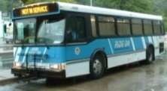
TSP Request when Green is on N-S Street Movements
  If bus is approaching toward the end of the Phase…
Min. Green=
Walk +
Min. Green Met
Min. Green Met
Min. Green=
Walk +
Min. Green Met
Min. Green=
Walk +
FDW
FDW
FDW
  Extend Green.
Phase
Phase
Phase
Phase
Phase
Phase
Min. Green Met
Min. Green Met
Min. Green Met
Phase
Phase
Extended Green
(Extra Time for Bus)
Extended Green
(Extra Time for Bus)
Phase

Slide 16
TSP Request When Green is on N-S Street, Left Turn
  Do Nothing; TSP is not Granted
  Skip Left-Turn Or Shorten Left-Turn Phase if No Demand
Min. Green=
Walk +
Min. Green Met
Min. Green=
Walk +
Min.
Green Met
FDW
FDW
Phase
Phase
  Start Early Green on the Next Phase for E-W street, then start N-S Green with Bus
Phase
Phase
Min. Green Met
Min. Green Met
Phase
Phase

Slide 17
TSP Request When Green is on E-W Street
Min. Green Met
Min. Green=
Walk +
  Truncate Green on E-W if minimum green (WK+FDW) is met, and start Green on N-S street with bus.
Min. Green=
Walk +
FDW
Min.
Green Met
FDW
Phase
Phase
Phase
Min. Green Met
Phase
Min. Green Met
Phase
Phase

Slide 18
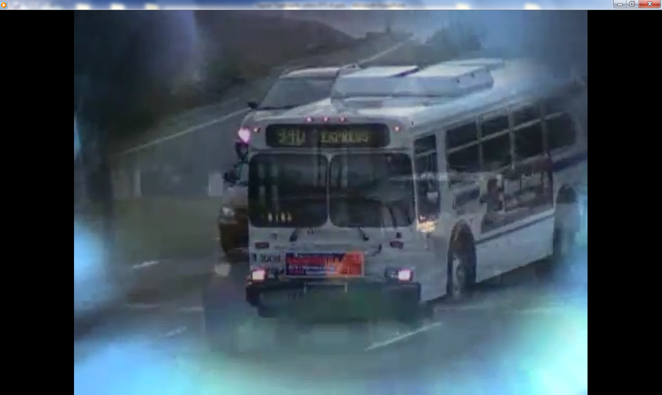
How TSP Works within the
Opticom GPS System TSP System
Click to start video

Slide 19
Countywide TSP
Three Level Screening
Corridor / Segment
  Which bus routes and vehicles should be TSP enabled?
Intersection
  Which intersections should provide for TSP?
Trip (Conditional TSP)
  TSP provided when conditions are met:
    Time of Day
    Vehicle running late
    Does not cause undo impact on traffic system operations

Slide 20

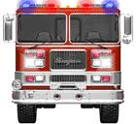
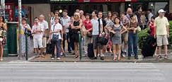

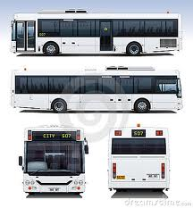
What Happens to TSP with Competing Demands at the Intersection ?
Can everyone stop for me for a few minutes?
High Vehicular demand
High Transit Demand
High Pedestrian Demand
Emergency Vehicle Pre-Emption
Can I have more time to cross the street?
I am behind schedule can I have some extra green?
Will I have enough green time to clear the intersection?
I need a longer green arrow for this left-turn
I am behind schedule can I have some extra green?

Slide 21

Establishing Performance Metrics
Benefits and impacts can be estimated based on quantifiable data. May include:
  Bus travel time
    Total bus wait time at signalized intersections.
  On-time performance
  Overall person throughput/ delay
  Pedestrian wait time
  Vehicle delay
  Number of calls/ frequency of calls

Slide 22
Route Screening and Selection
Assess opportunities and constraints for each corridor and for various times of the day (AM peak, midday, PM peak and night) and service types (local, limited, express):
  Transit: Bus volumes, bus delay, bus ridership
  Traffic: Vehicle volume, pedestrian volume, number of signals, number of failing intersections/ level of service, signal timing (phasing and splits), cross-streets functional classification
  Land use: Density, type, intermodal connections

Slide 23
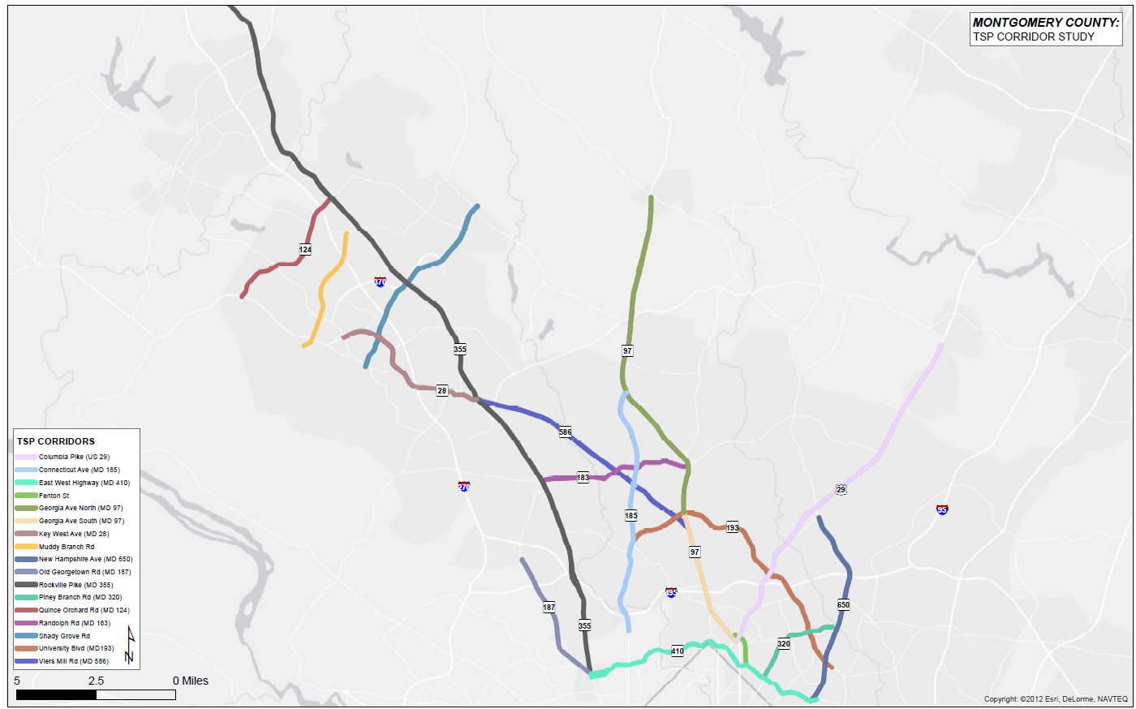
Countywide TSP Corridors
18 corridors initially identified
Over 800 traffic signals maintained by the County
Over 350 signals in the selected 18 corridors

Slide 24
Establishing Policy and Warrants
Under what traffic and transit conditions will TSP be granted?
  Based upon underlying data and desired performance metrics.
  Will the conditions for priority vary by time of day?
Is the reduction in bus-passenger delay (trip hours) weighed heavier than the increase in passenger car delay?
  What about delay to pedestrians? Cross-street Buses?

Slide 25
Measures:
Transit Characteristics
Stop location
  Near
  Far
Other Priority Treatments (existing, potential)
  Dedicated lane
  Queue jump
  Bus bulbs
Signal Delay per vehicle (by approach; AM, PM, Midday; Local, limited, express; etc.)
  % with delay
  Average delay
  Distribution (will be skewed)
  % GT X
Transit Service
  Vehicles per hour (by approach; AM, PM, Midday; Local, limited, express; etc.)
  Vehicles per hour routing, straight, left, right (by approach; AM, PM, Midday; Local, limited, express; etc.)
  Passengers per vehicle (by approach; AM, PM, Midday; Local, limited, express; etc.)
  % Vehicle trips on time (by approach; AM, PM, Midday; Local, limited, express; etc.)
  Impact on transit progression (do we want to tie priority together for groups of signals, e.g. Us29 at University).

Slide 26
Measures:
Traffic Characteristics
Performance
  Volume (by approach; AM, PM, Midday)
  Intersection LOS (by approach; AM, PM, Midday)
  Queue length, average, max (by approach; AM, PM, Midday)
  Delay, average, max (by approach; AM, PM, Midday)
  Volume-to-Capacity Ratio (by approach; AM, PM, Midday)
  Available green (by approach; AM, PM, Midday)
  Corridor/mid block LOS (is the intersection impacted by other near by intersections, is upstream congestion significant)
  Pedestrians and bicycles per hour
Signal
  Controller type and capabilities
  Coordinated ? Boundaries ?
  Timing (phases, actuated, AM, PM, Midday)
  cycle length
Physical
  Number of lanes by type and approach
  Pedestrian and bicycle features (actuated request, bike lanes, pedestrian island, accessibility)

Slide 27
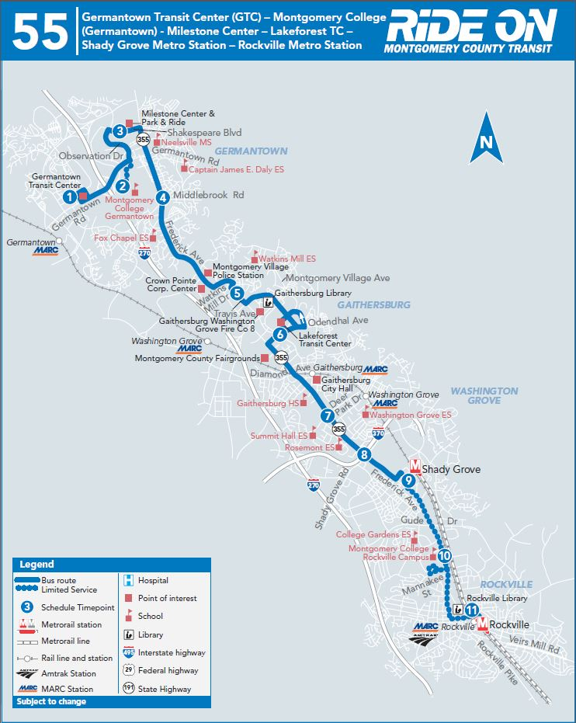

TSP Technology Pilot Test Status
  TSP Technology test fully operation January 2013
  Five buses equipped with emitters
  Three traffic signals equipped with roadside receivers
  Data collection underway for:
    late buses detected by roadside equipment
    late buses reported by ORBCAD
  Ride On evaluation underway to identify any change in bus on time performance

Slide 28
      Transit Signal Priority Within RTS
      RTS Transit Signal Priority Study
Goal:
  Define the appropriate metrics for the implementation of TSP systems on each RTS corridor (Build on Countywide TSP Study)
Purpose:
  Define:
    Current state of traffic signal control & TSP systems used in Montgomery County.
    Key measures of effectiveness and range of functional attributes for TSP within RTS Corridors
    Qualitative impacts associated with TSP system operations within RTS Corridors
    Systems Engineering Approach to TSP planning, design, and implementation within RTS Corridors
  Recommend:
    Approach to coordinate implementation of planned countywide and RTS TSP (WMATA?)
  Establish:
    Guidelines for TSP systems on RTS study corridors and the degree/need for consistency with TSP systems used on other county and state highways in Montgomery County.
    Proposed guidelines for agency coordination regarding implementation of TSP on RTS corridors.
Components
  Existing Conditions Evaluation
  TSP System Development Guidelines
  Operational Parameters & Criteria
  RTS Corridor Evaluation

Slide 29
      RTS Transit Signal Priority Study
      Deliverables
Tech Memo 1: Needs Assessment & Goals/Objectives of TSP (August, 2013)
  TSP system purpose and capabilities
  Potential role of TSP in the RTS program
  Stakeholders involved in TSP implementation, operation, and maintenance
Tech Memo 2: Existing conditions, Signal Systems & Operations on Corridors (Early – Mid September 2013)
  Overall Transportation System Operations
    Montgomery County and SHA signal characteristics (controller, signal head, TSP capabilities, etc.)
    Transit Operational technologies & systems (MTA , WMATA, RIDEON, etc.)
  Within each corridor:
    Characteristics (length, number of signals, HCM LOS, volumes, signal coordination, etc. )
    Existing and proposed ROW and other priority treatments
    Existing and proposed transit service
    Potential for TSP

Slide 30
      RTS Transit Signal Priority Study
      Deliverables
Tech Memo 3: RTS Transit Signal Priority Planning Technical Memorandum (Mid – Late September 2013)
Document Findings and Recommendations on:
  Existing conditions and assumptions
  TSP Policy and Corridors
    Recommended Montgomery County RTS-related TSP policies and procedures
    Preferred minimum criteria and Measures of Effectiveness (MOE) for selection and evaluation of TSP locations
    Preliminary operational review of RTS study corridors
  TSP and Traffic Operations
    Preferred active priority strategies
    Preferred detection system parameters
    Preferred traffic control system parameters, including coordination and recovery process
  Concept of Operations and System Control
    Integration of TSP with other transit ITS, traffic engineering, and EMS pre-emption systems
    High-level Concept of Operations for TSP integration with the RTS system
    Recommended system control architecture

Slide 31
Transit Signal Priority Within RTS
Signal Operations
How should potential signal operations change when combined with other priority treatments options (queue jumps, exclusive guideway, etc.)?
What types of transit service will be eligible for signal priority (RTS, Express, Local) and in which directions (peak, off-peak, cross)?
How often should priority be granted when requested?
What weights should be given to transit ridership versus general traffic?
Should the TOC be integrated or separate?
How should we plan to evolve with Advances in Technology (e.g. Connected Vehicles)

Slide 32
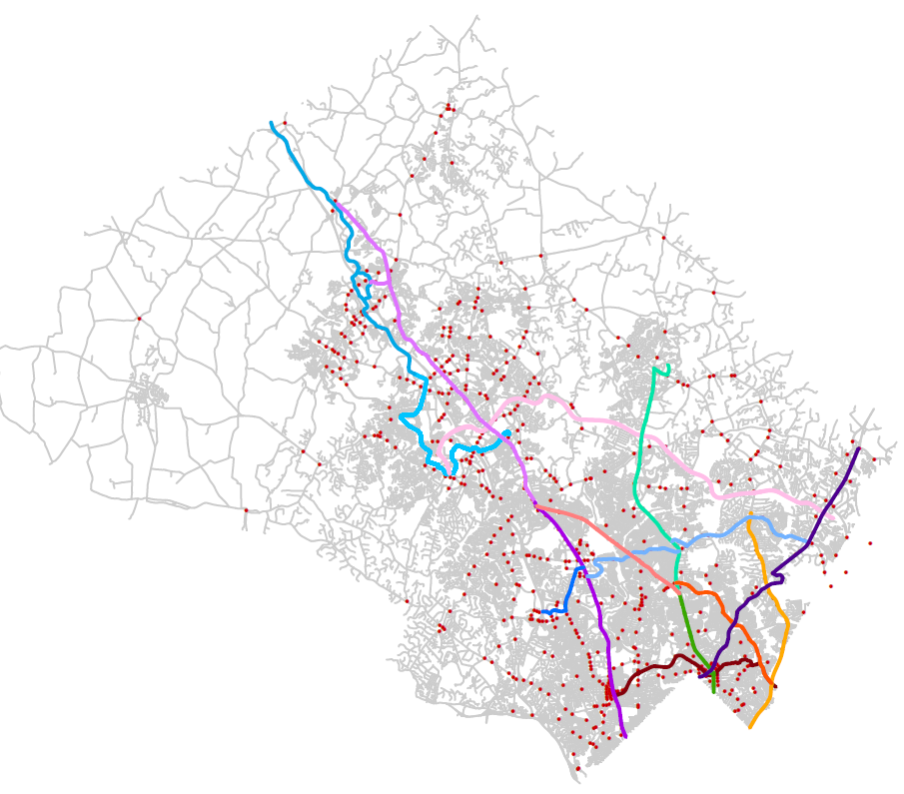
Transit Signal Priority With RTS
Priority Corridors

Slide 33
Transit Signal Priority within RTS
Signal Priority Options
Within Mixed Flow Operations (as before)
  Extend Green Phase
  Truncate Red Phase
With RTS Right of Way treatments or queue jump lanes (new options)
  Passive – Adjusts signal coordination to support unimpeded flow of transit vehicles within corridor
  Exclusive Transit Phase – Provide a transit only phase for transit vehicles at intersections

Slide 34
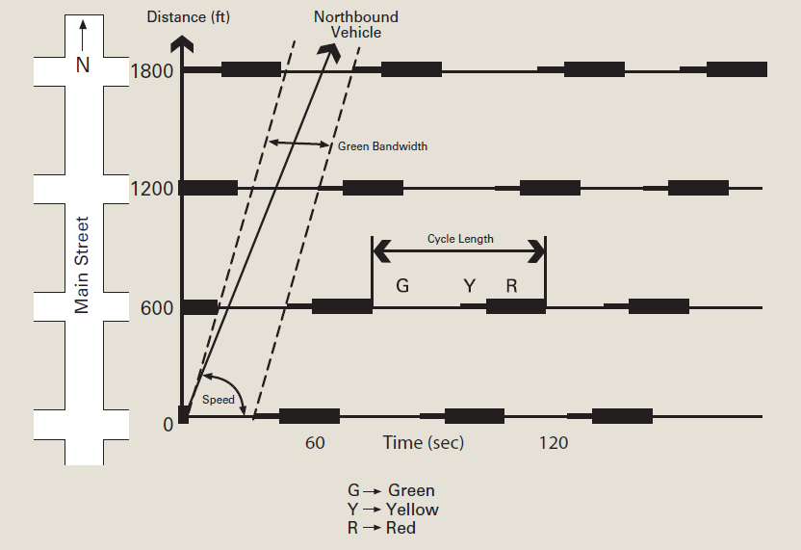
Passive Priority
Coordinate Signals with RTS Service
Transit
Auto
Source: TSP Handbook (FTA, 2005)

Slide 35

With Transit Only Phase
N
Exclusive Lane
‘Slack Time’
Min. Green=
Walk +
Min. Green Met
Don’t Walk
Main Street
Phase
Side Street
Phase
Min. Green Met
Transit Only
Phase
Crossing ROW
Queue Jumps
Left-Turn Phase

Slide 36
Transit Priority Treatment versus Signal Operations

Slide 37
Other Characteristics
Impacting TSP and Signal Operations

Slide 38
RTS Corridors
Proposed ROW Treatments & Signals
See Handout
Potential Corridors by # signals, RTS ROW type, stations, General traffic LOS, Major cross streets, etc.

Slide 39
How will the System Evolve?
The US DOT Connected Vehicle Program
  DSRC real time short range communications between vehicles and/or roadside
  Transit vehicles can be “aware” of each other, and downstream or cross-street conditions
  Smart vehicles with real time information
  Developing applications and conducting pilots now
New System Components
  Priority Request Generators and Servers to address multiple simultaneous requests
  Automatic Passenger Counters
  Predictive and coordinated priority progression (along a corridor)

Slide 40
Questions/Issues
Does the intersection cause significant signal delay to transit vehicles?
Is there significant variability in the delay that transit vehicles experience that is greater than expected due to signal timing?
Are transit vehicles caught in upstream queues and other congestion?
Can transit vehicles avoid upstream queues and other congestion?
Are there potential conflicts with other transit service when priority is granted (other main, or cross)?
Are there physical constraints?
Will there be significant impacts to the signal phasing (is there available green, etc.)?
Will the person time savings and throughput increase (on main lines, on cross streets)?
Same questions as Countywide TSP
Will the answers vary by RTS, Express, or Local service? By direction?

