Slide 1
MAY 2022
TFCG SLIDE DECK

Slide 2
Crown Castle/T-Mobile @
Pepco 788426-970820
(2021051448)

Slide 3
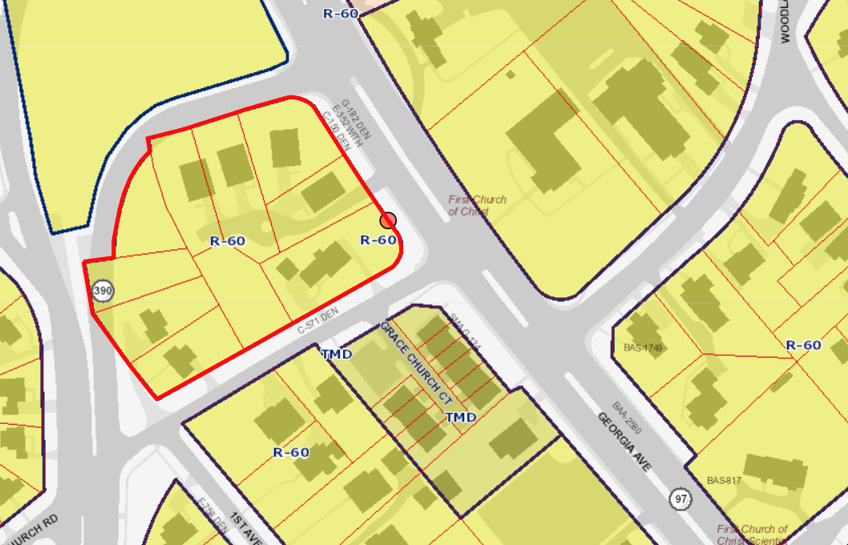
1448 - PEPCO 788426-970820

Slide 4
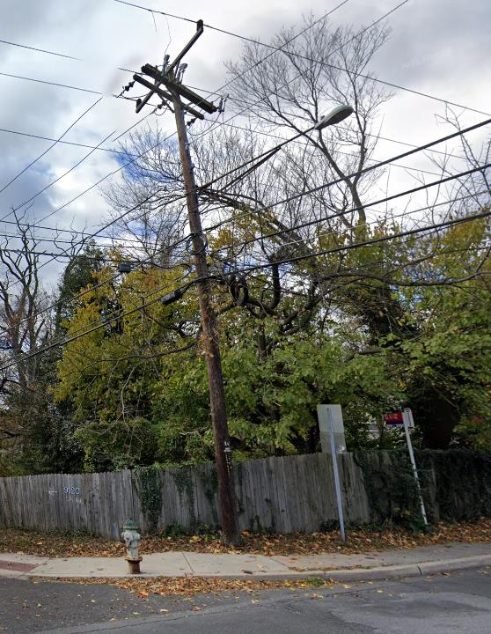
1448 - PEPCO 788426-970820

Slide 5
AT&T @ PEPCO 773452-4449
(2021111613)
Notes:
Sitelink has filed on behalf of New Cingular Wireless/AT&T for installation of a small cell antenna on a PEPCO replaced wooden utility pole located in the Montgomery county right of way. (1) antenna will be installed at the top of the pole with (2) RRH's installed in a cabinet located mid pole.

Slide 6
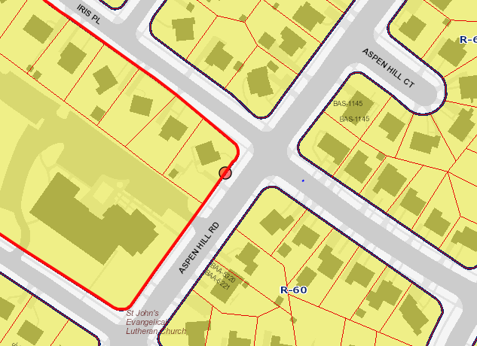
1613 - PEPCO 773452-4449
Notes:
The site is zoned R-90. The pole is located approximately 80 feet from a single-family home.

Slide 7
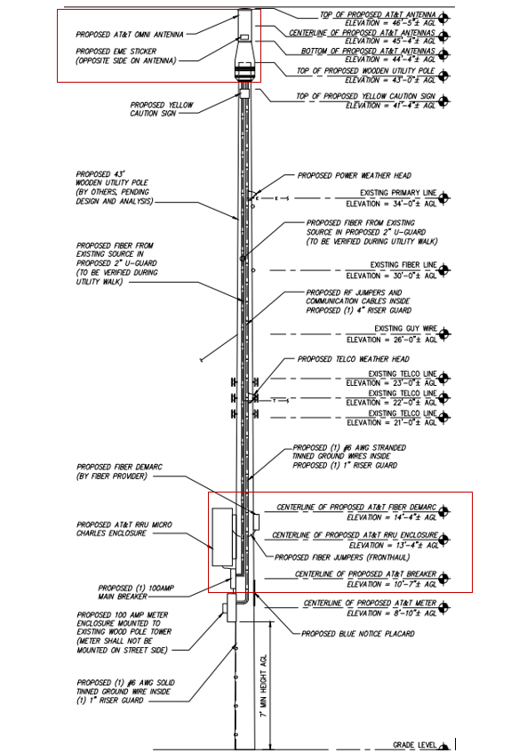
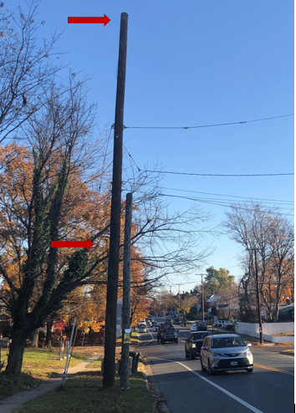
1613 - PEPCO 773452-449
Notes:
The existing pole is 43’ tall and replaced a pole of the same height. A 2’1" tall antenna/shroud will be attached atop the pole. Two remote radio heads will be placed in a 4’ equipment cabinet mounted at 13’4".

Slide 8
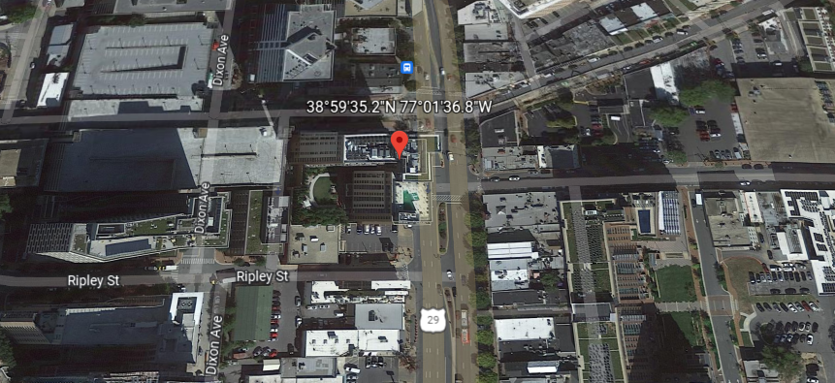
Starry Internet @ 8250 Georgia Avenue
2022011658
Notes:
8250 Georgia Avenue, Silver Spring. West side of Georgia Avenue between Ripley and Bonifant Streets. The site is an apartment building.
Starry Internet has applied on its own behalf to install (9) masts across three sectors with (6) Titan antennas, (1) Siklu Dish antenna, (1) SIAE Dish antenna, (6) Airmax antennas with (6) Ubiquiti Rocket Prism RRUs, (2) IGN ML2.5-60 antennas. (2) 2"conduits will be installed from the cabinet to each sector with data cabling and dc power wiring. An equipment cabinet with a battery chamber and (1) add on battery chamber will be installed on the parapet. Electrical and telco to be pulled from onsite source

Slide 9
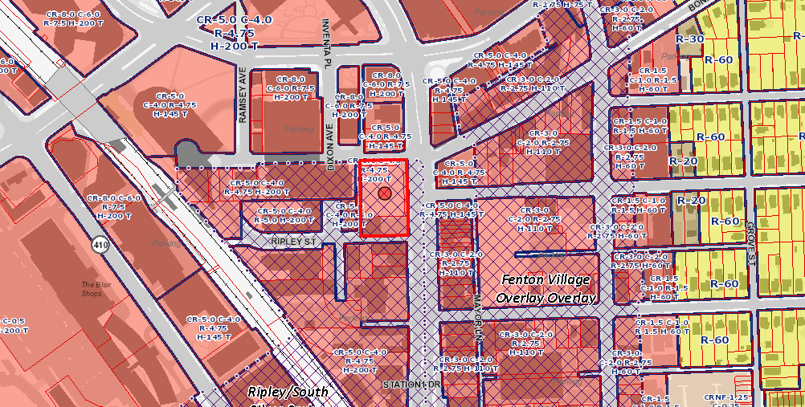
8250 Georgia Ave, Silver Spring
Notes:
The site is zoned CR-5.0, C-4.0, R-4.75, H-200 T .

Slide 10
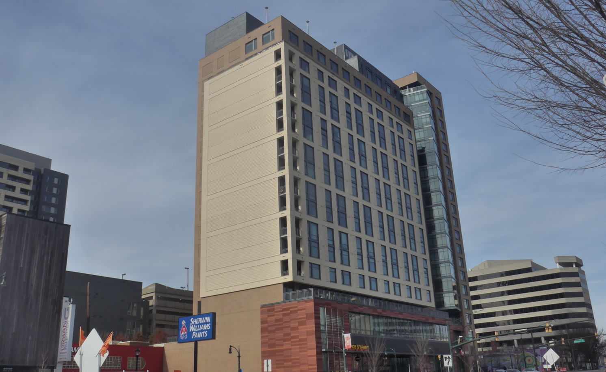
8250 Georgia Ave, Silver Spring
Notes:
It is an apartment building, aka The Solaire.

Slide 11
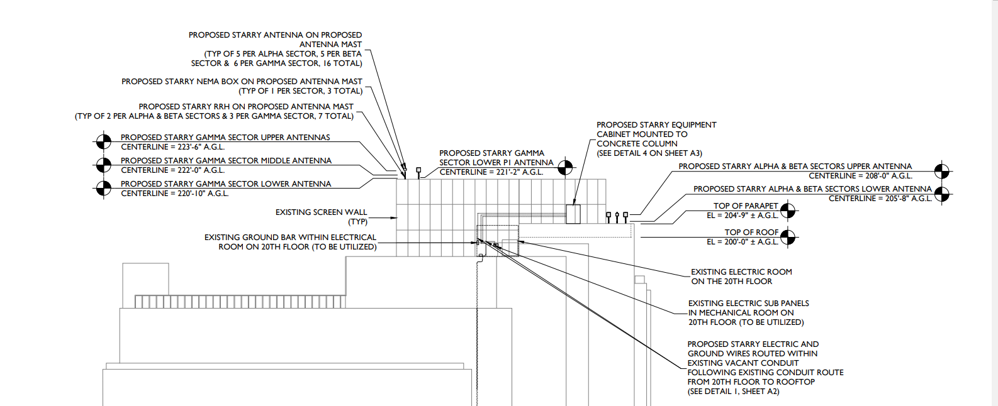
8250 Georgia Ave, Silver Spring
Notes:
There are no other carriers on the building.
Sixteen antennas are proposed and will be mounted on antenna masts. Four of the proposed antennas will be mounted at the RAD Center of 205'8" and five antennas will be mounted at the RAD Center of 208' on the existing building parapet. Two antennas will be mounted at the RAD Center of 223'6". The remaining five antennas will be mounted at RAD Centers of 208'5", 220'10", 221'2", 222', and 223'6". An equipment cabinet will be placed on the parapet level.

Slide 12
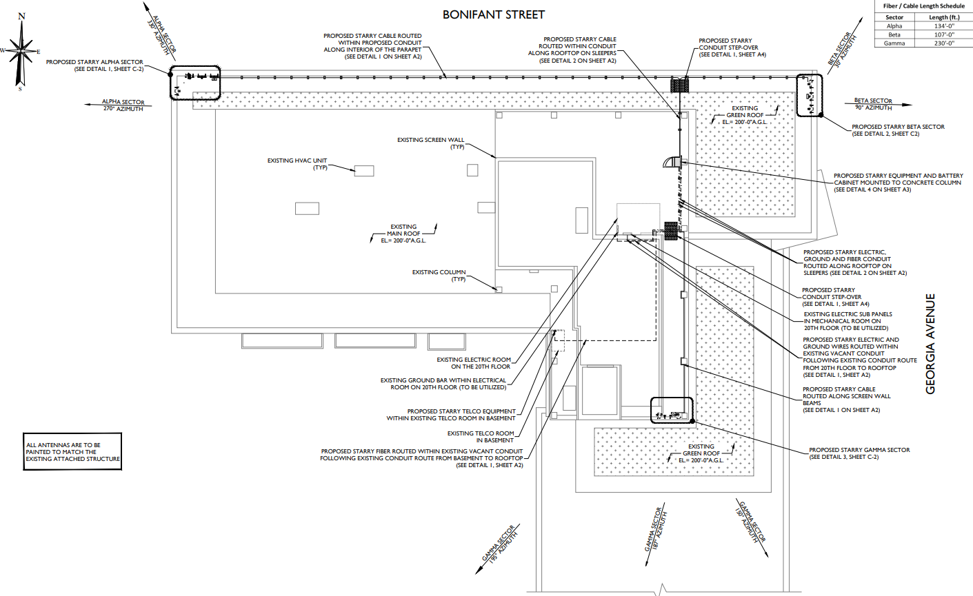
8250 Georgia Ave, Silver Spring
Notes:
The equipment cabinet with battery chamber and an additional battery chamber will be placed on the parapet. The installation will use the on-site electricity.
Antennas will be painted to match the building.

Slide 13
Crown Castle/T-Mobile @
PEPCO 787431-4559
(2022011659)

Slide 14
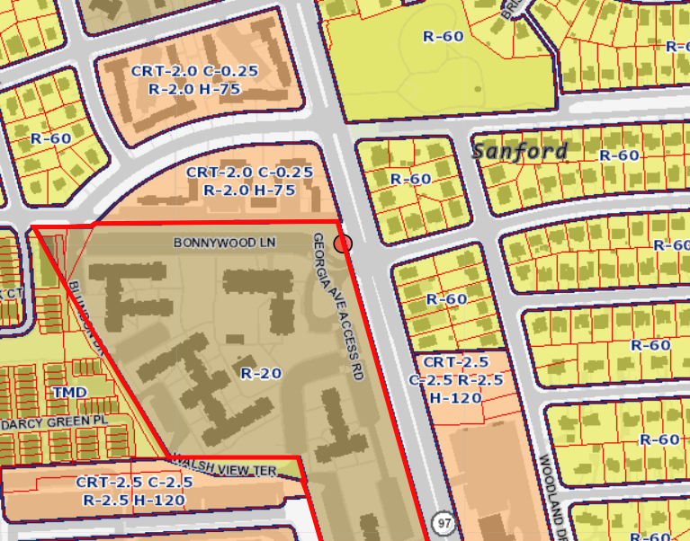
1659 - PEPCO 787431-4559

Slide 15
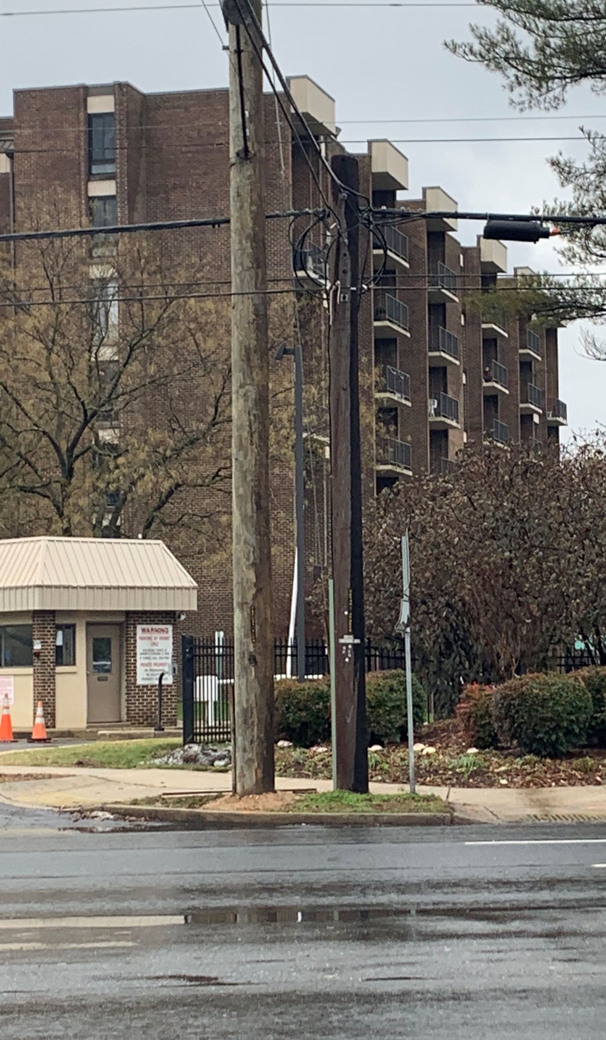
1659 - PEPCO 787431-4559

Slide 16
Crown Castle/T-Mobile @
Pepco 793424-9936
(2022031708)

Slide 17
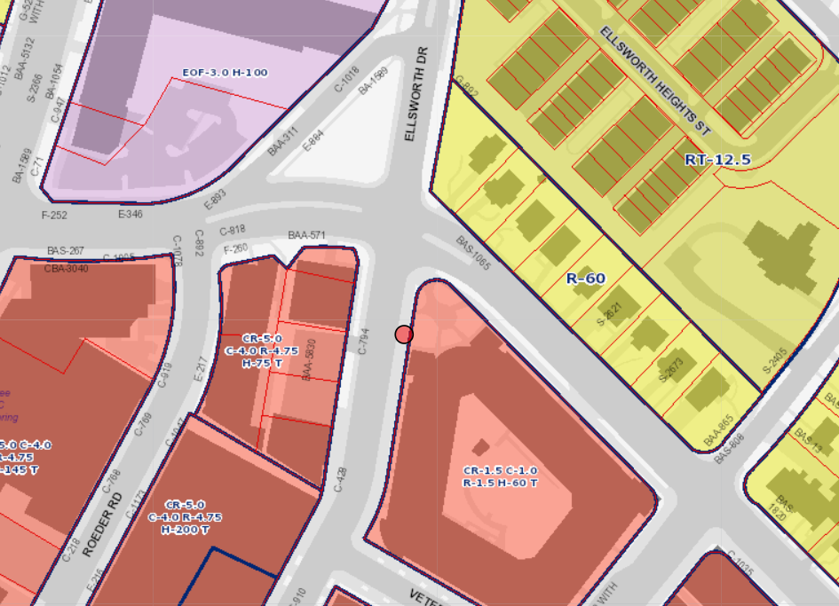
1708 – PEPCO 793424-9936

Slide 18
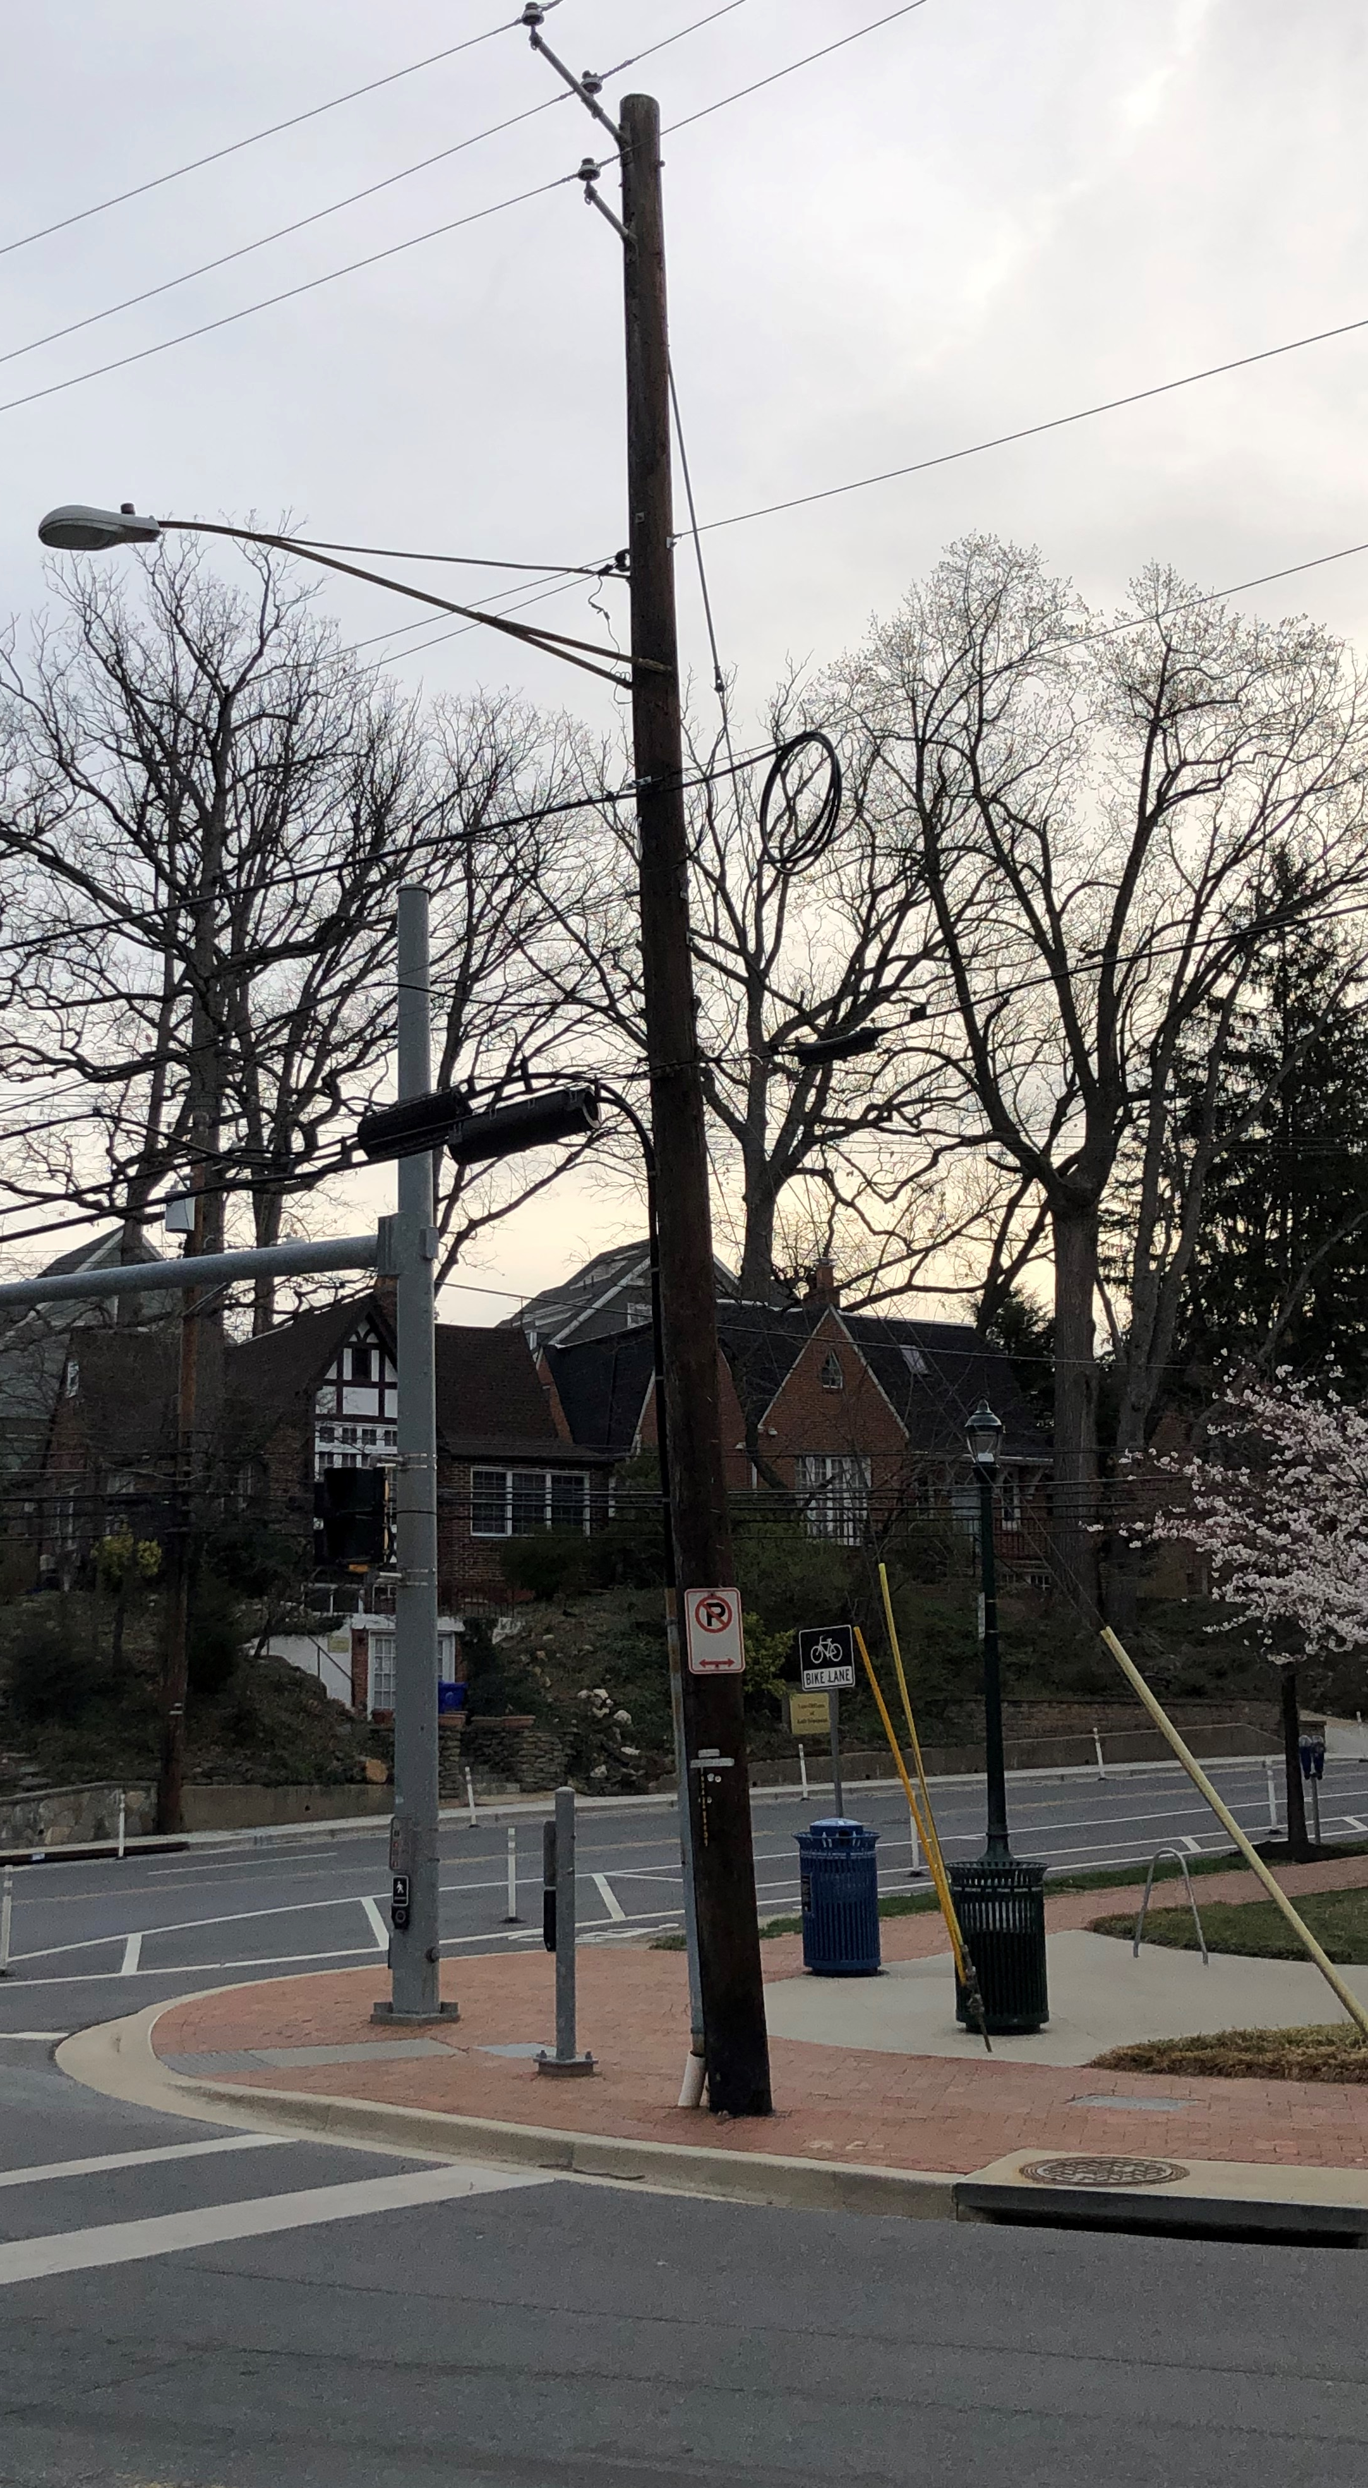
1708 - PEPCO 793424-9936

