Slide 1
June 2022 TFCG SLIDE DECK

Slide 2
Crown Castle/T-Mobile @
Pepco 802417-3164
(2022031709)

Slide 3
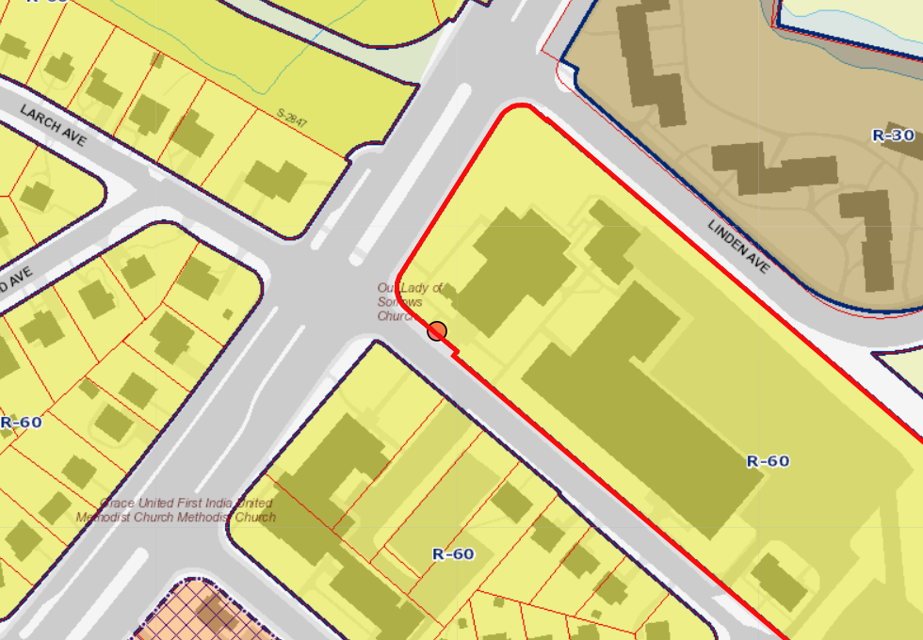
1709 - PEPCO 802417-3164

Slide 4
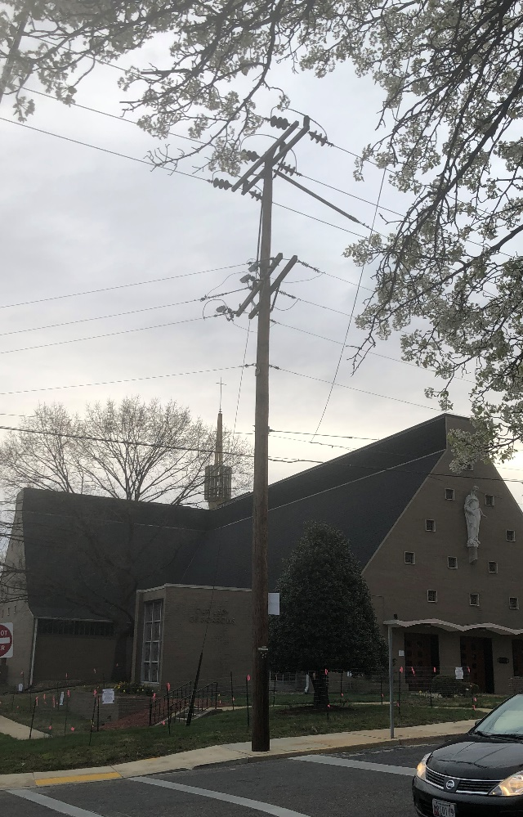
1709 - PEPCO 802417-3164

