Slide 1
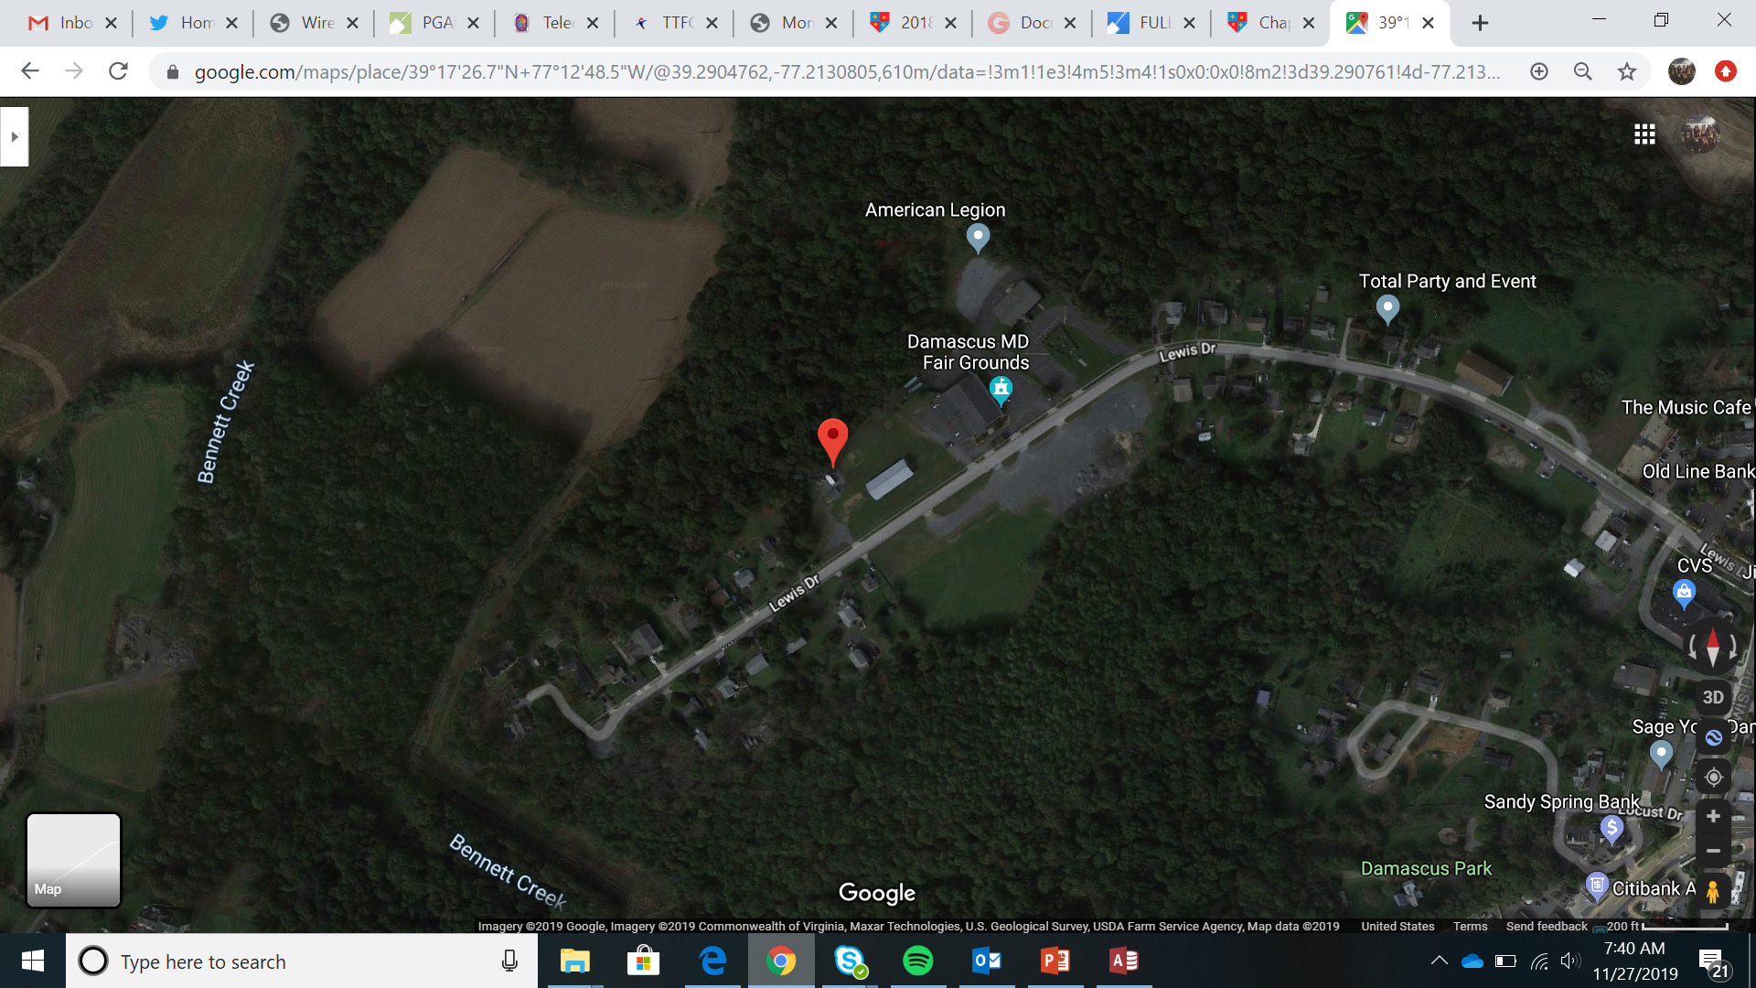
Damascus VFD 13 Activity Ctr

Slide 2
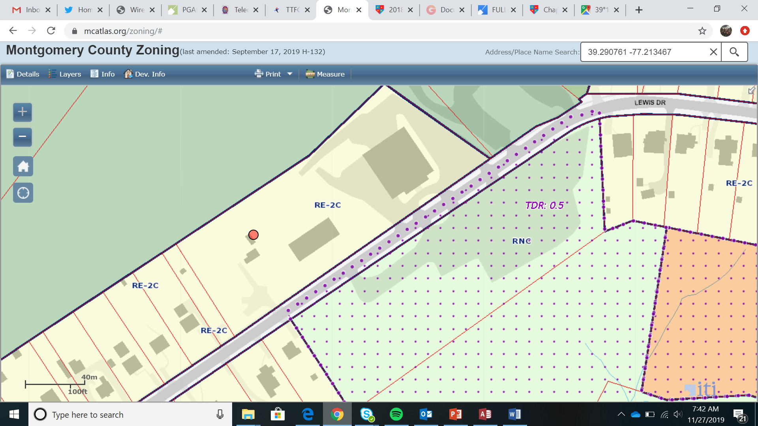
Damascus VFD 13 Activity Ctr

Slide 3
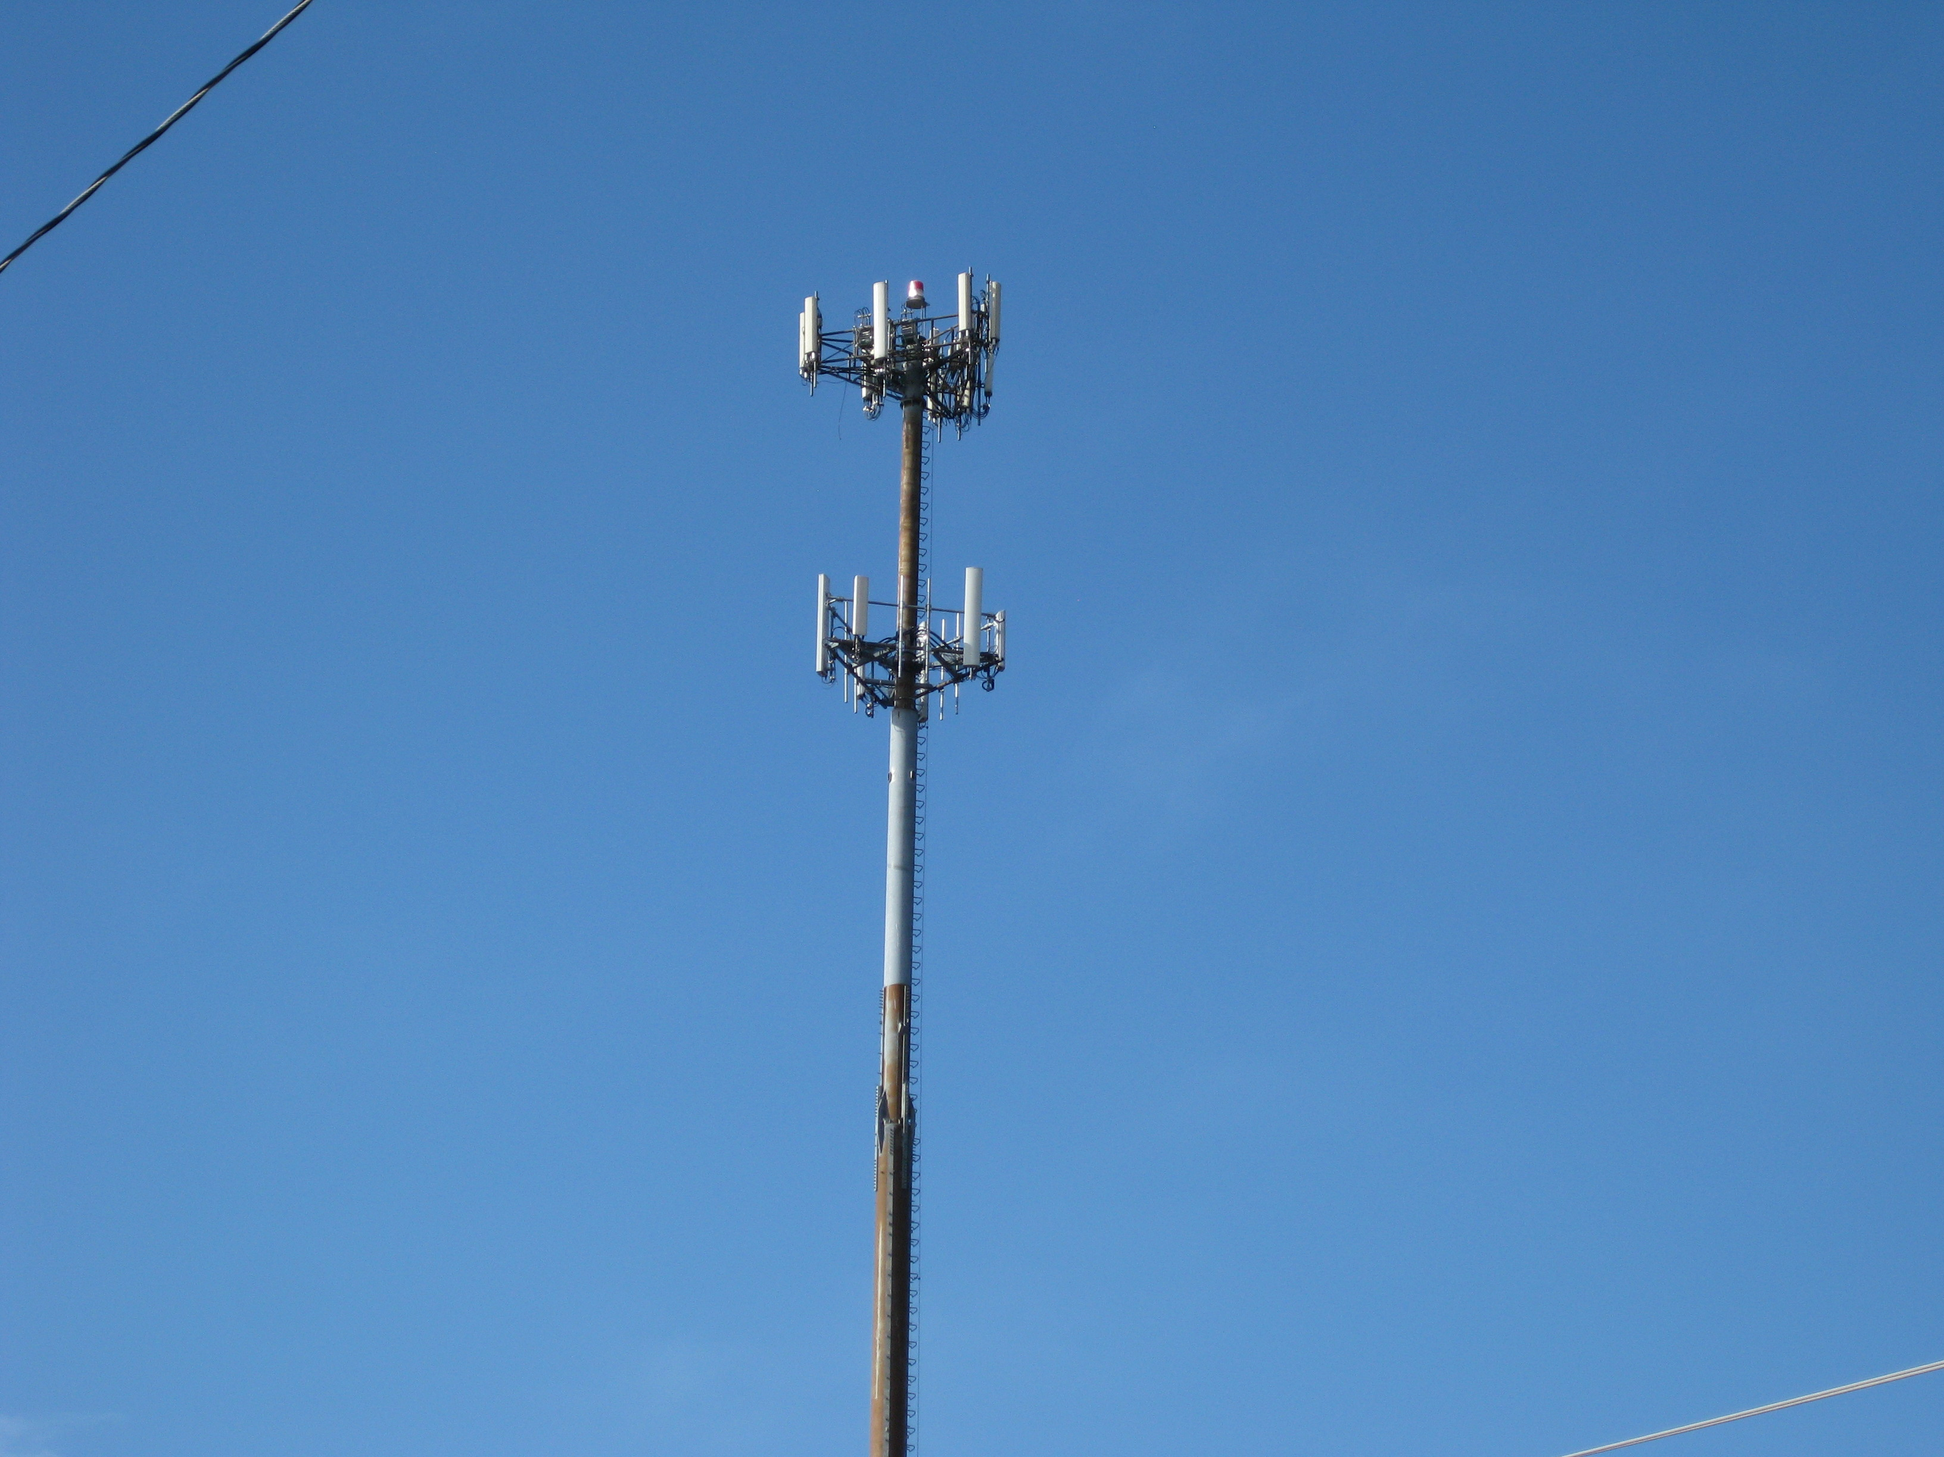
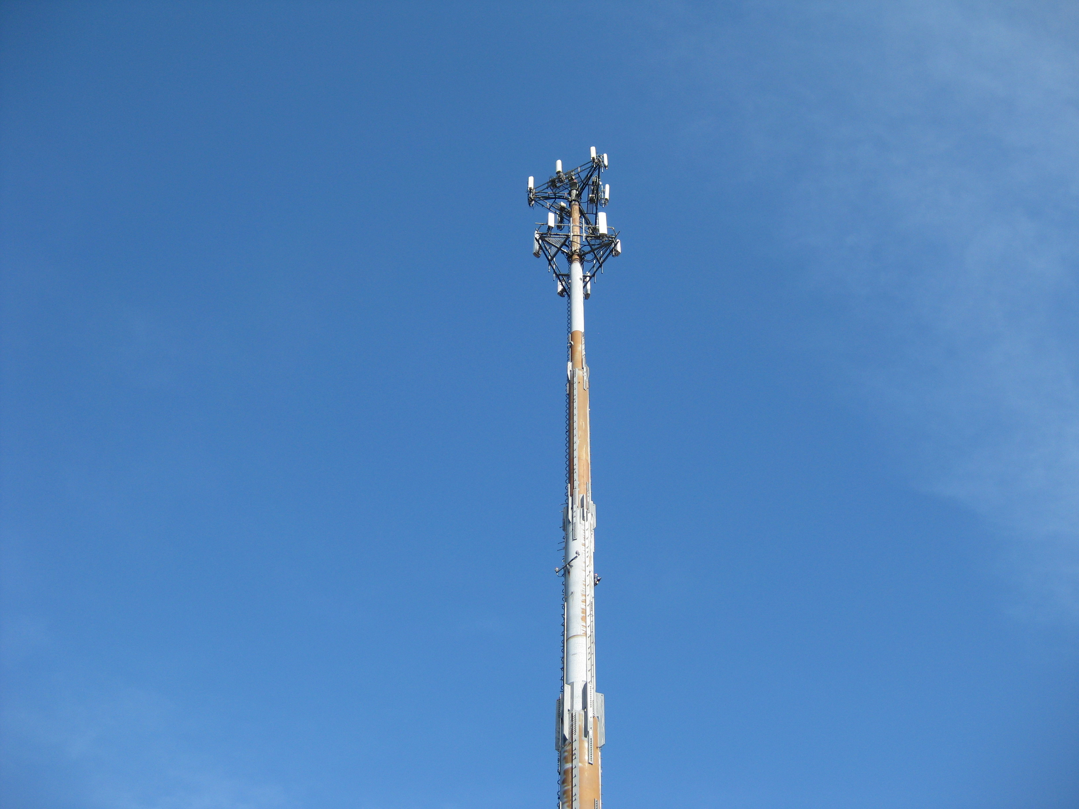
Damascus VFD 13 Activity Ctr

Slide 4
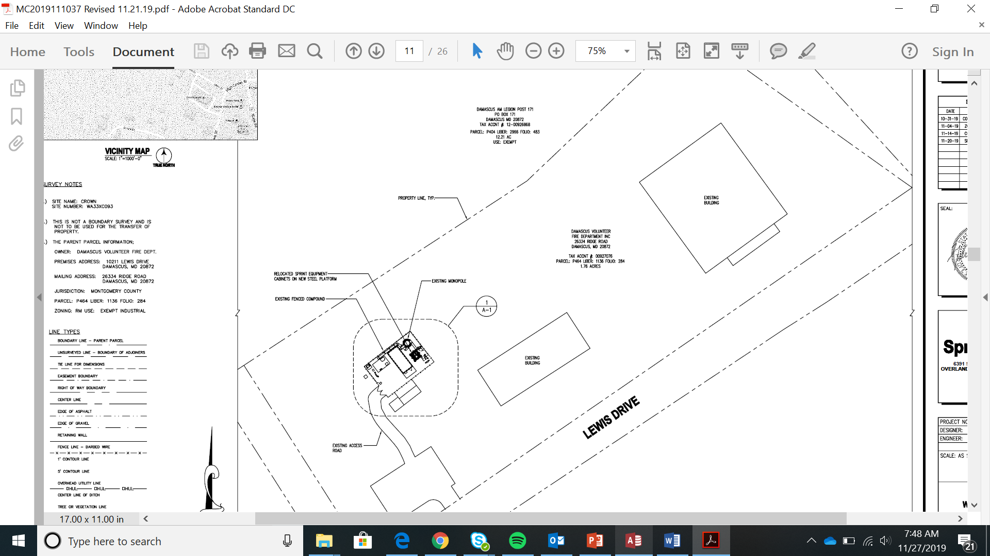
Damascus VFD 13 Activity Ctr

Slide 5
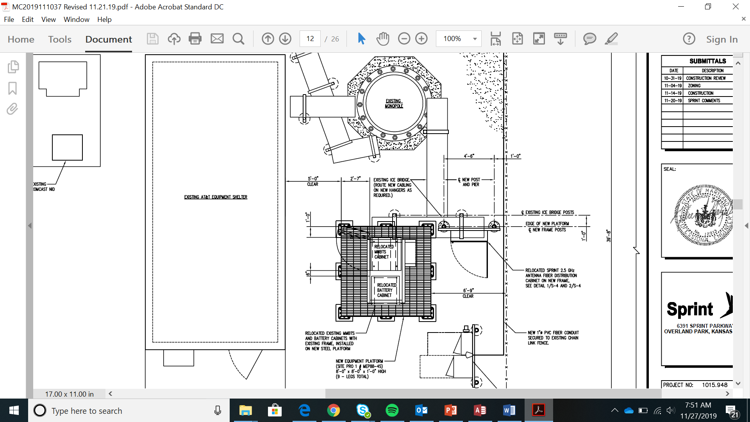
Damascus VFD 13 Activity Ctr

Slide 6
Damascus VFD 13 Activity Ctr

Slide 7
Damascus VFD 13 Activity Ctr

