Slide 1
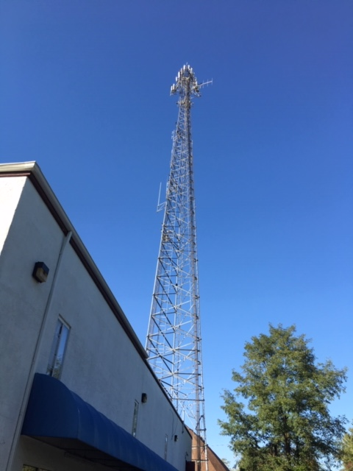
Lewis Drive COW

Slide 2
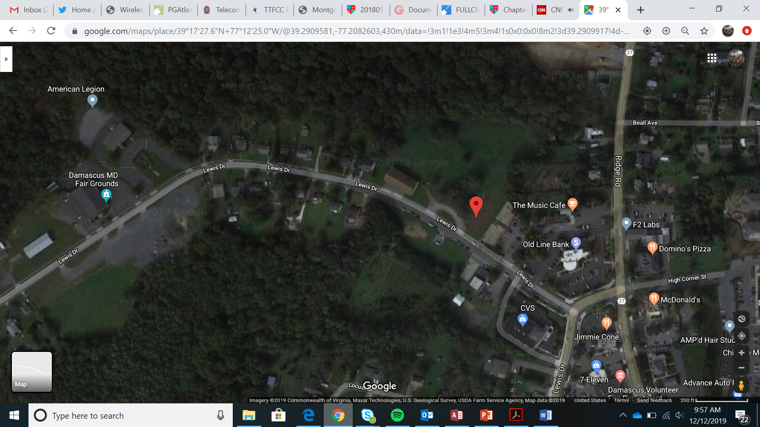
Lewis Drive COW

Slide 3
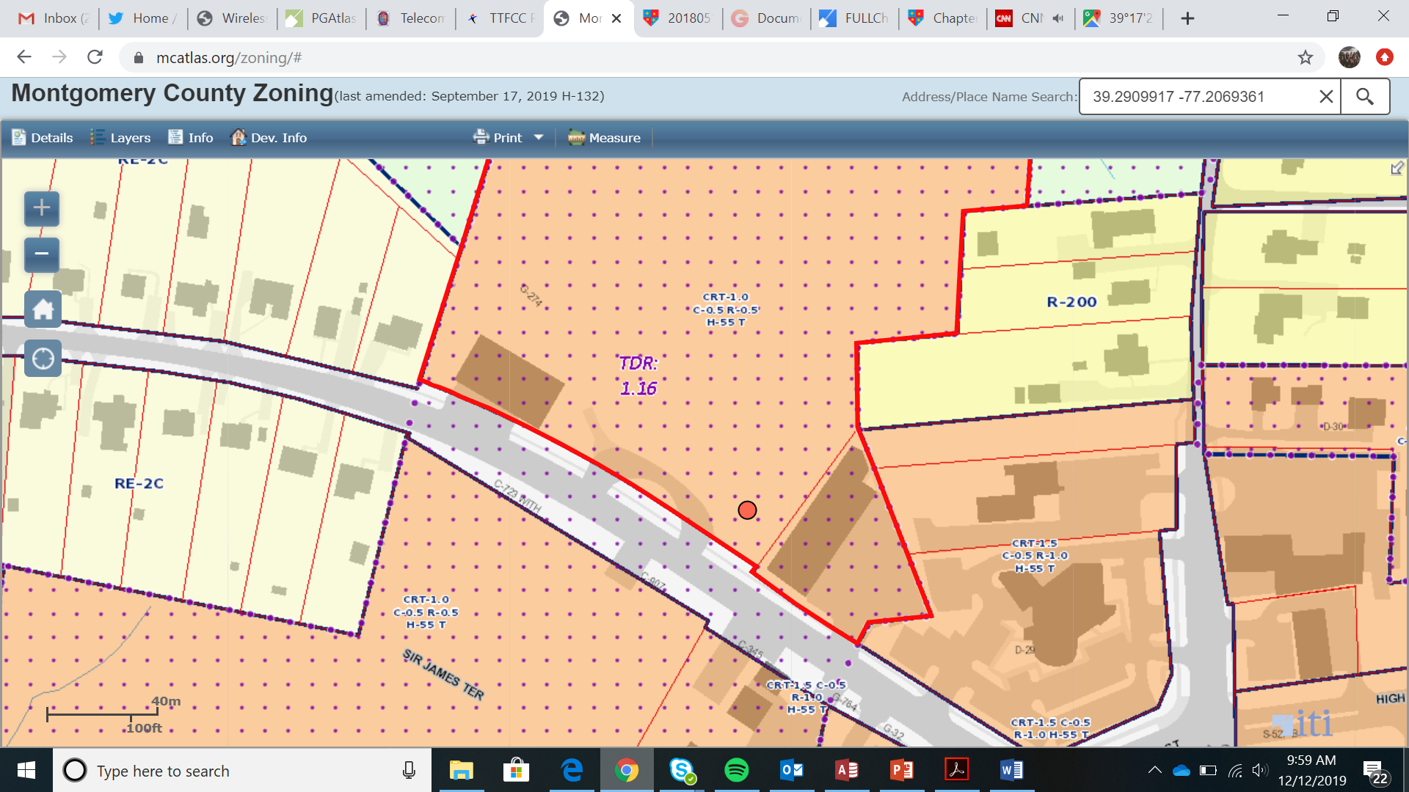
Lewis Drive COW

Slide 4
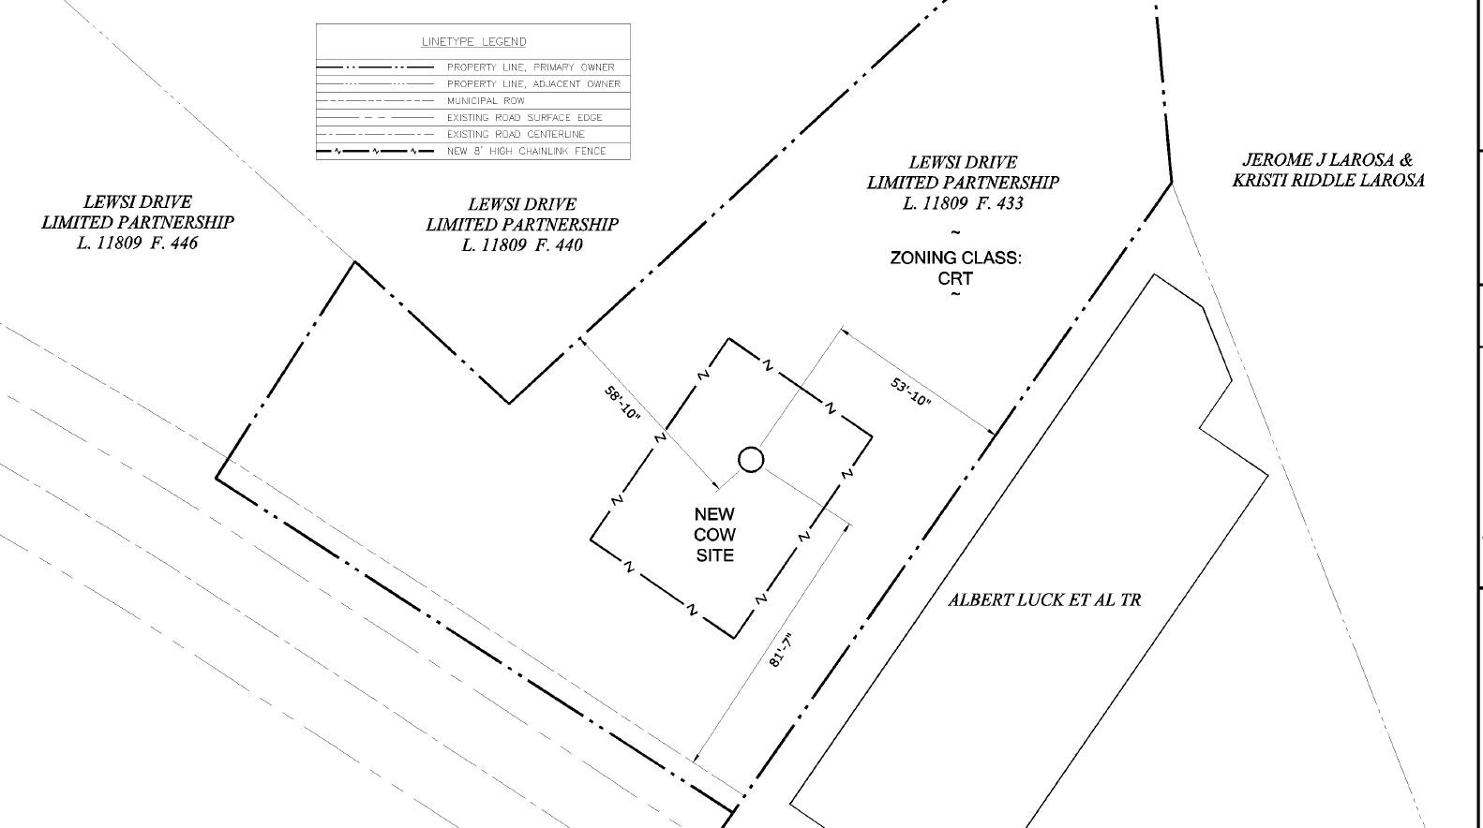
Lewis Drive COW

Slide 5
Lewis Drive COW

Slide 6
Lewis Drive COW

