Slide 1
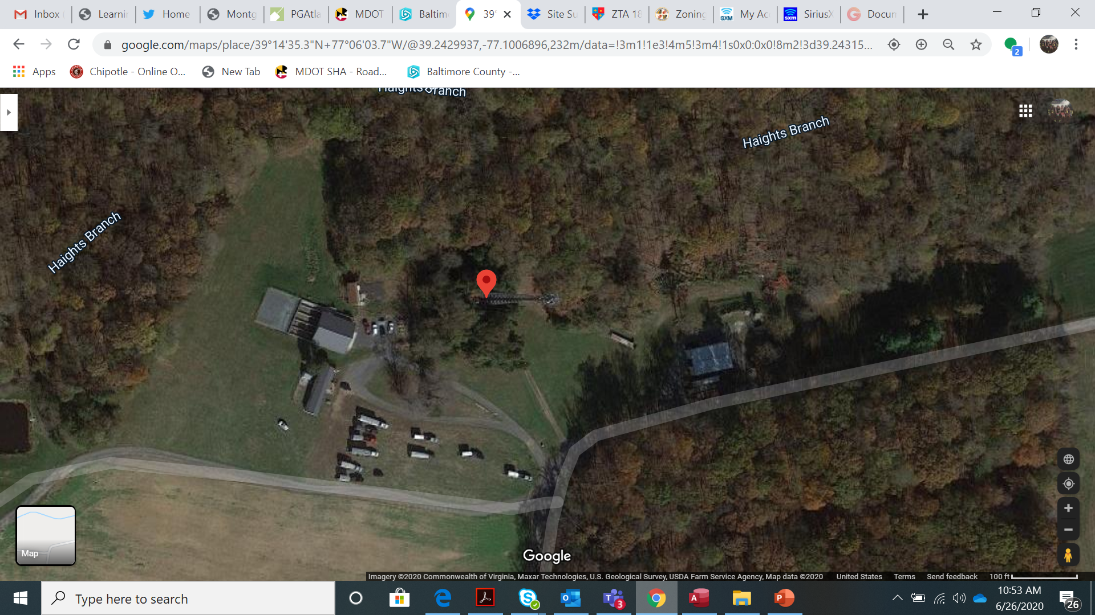
Haights Branch Tower

Slide 2
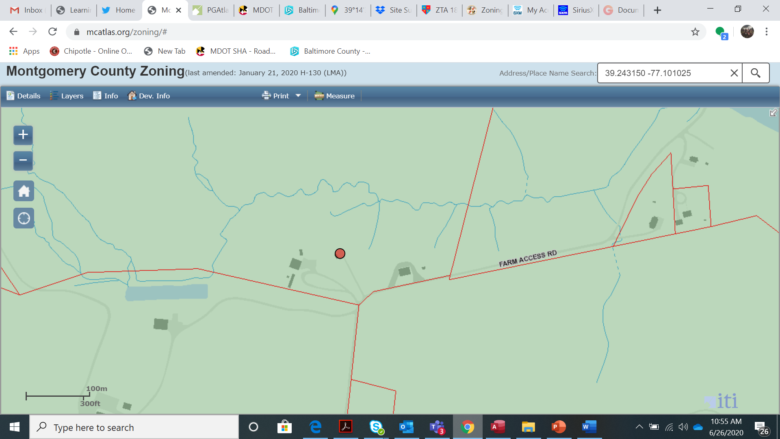
Haights Branch Tower

Slide 3
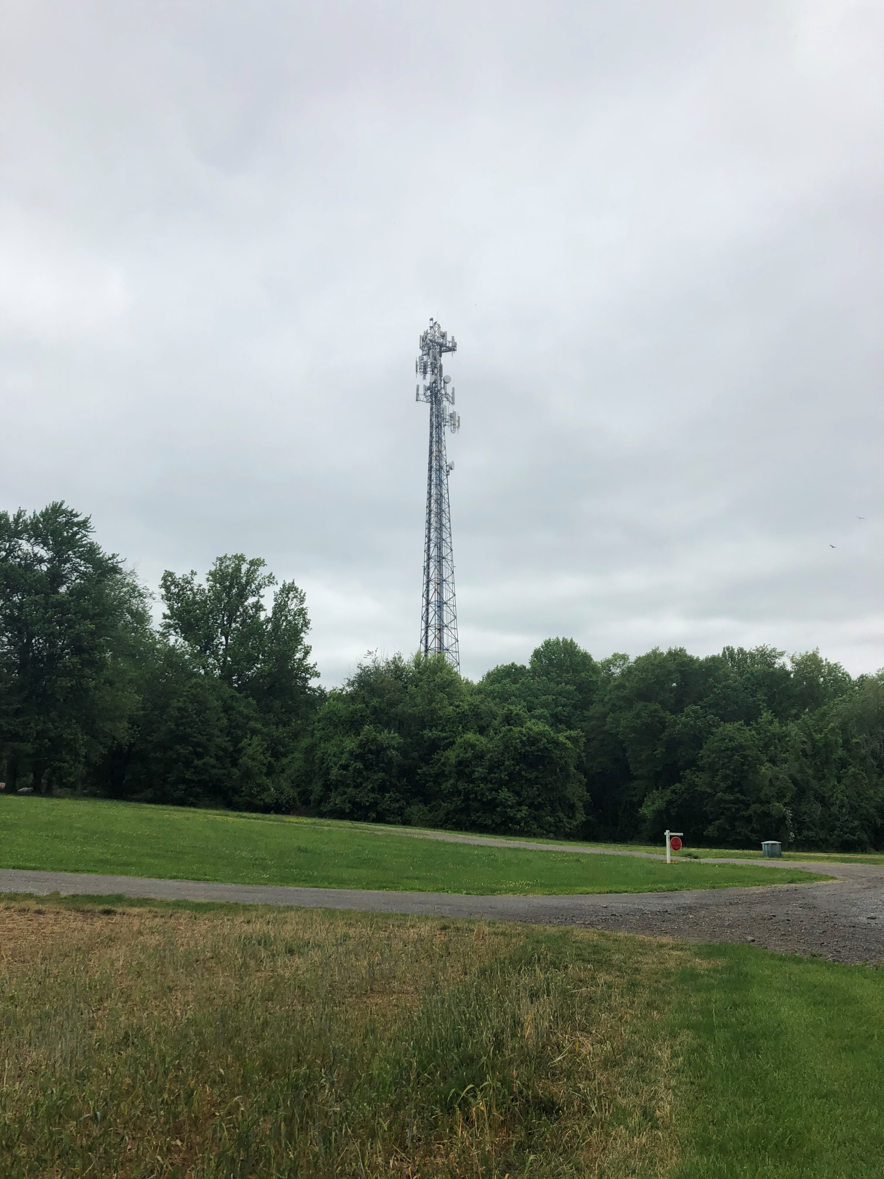
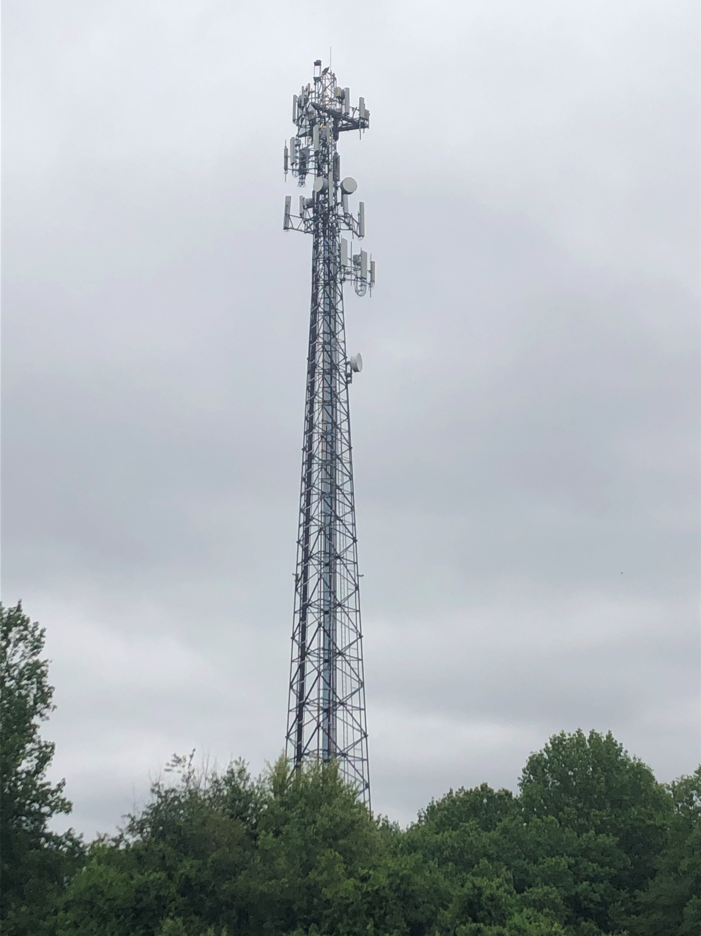

Slide 4
Haights Branch Tower

Slide 5
Haights Branch Tower

Slide 6
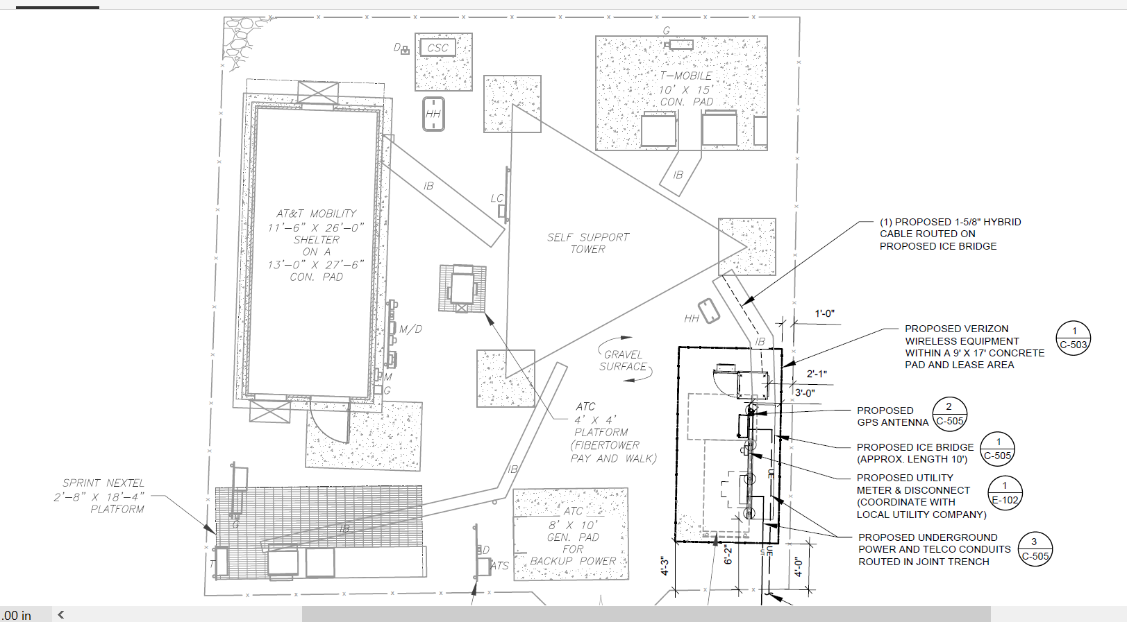
Haights Branch Tower

