Slide 1
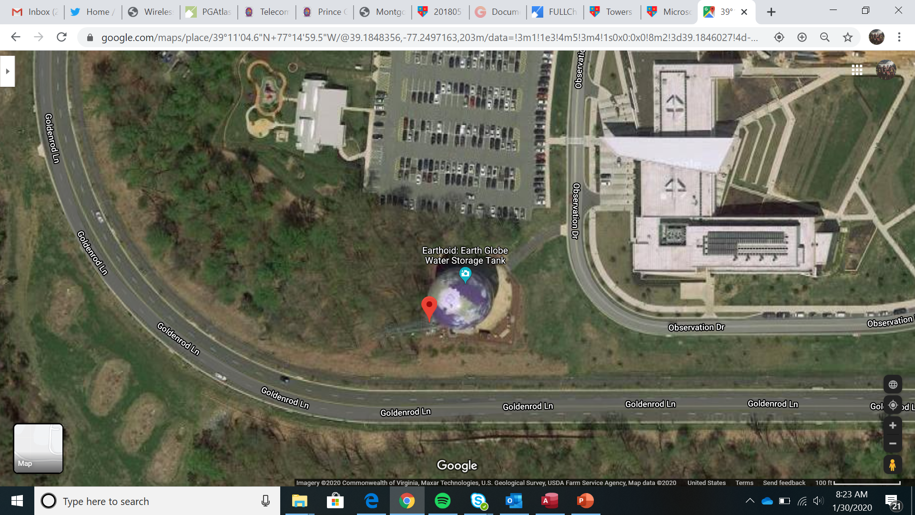
Montgomery College Germantown

Slide 2
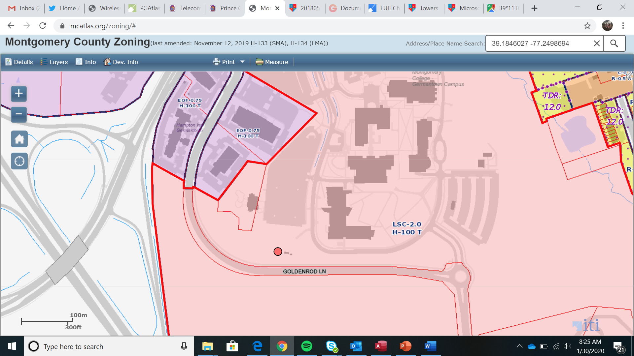
Montgomery College Germantown

Slide 3
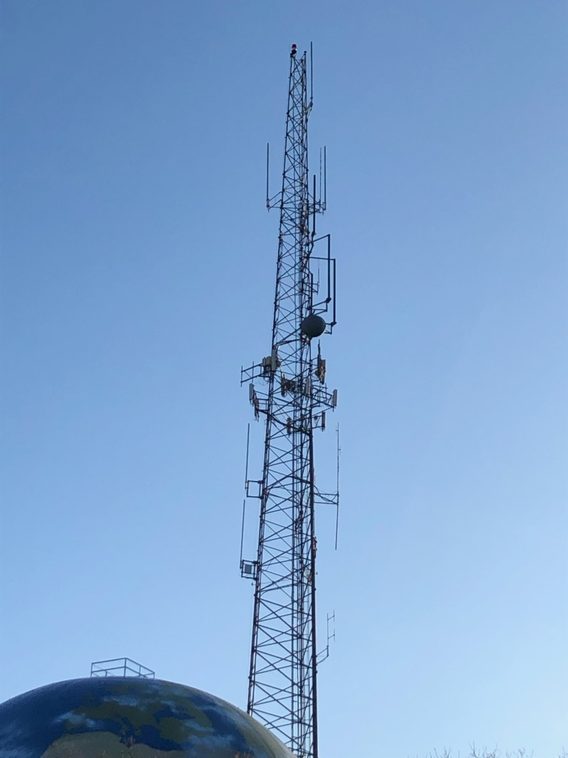
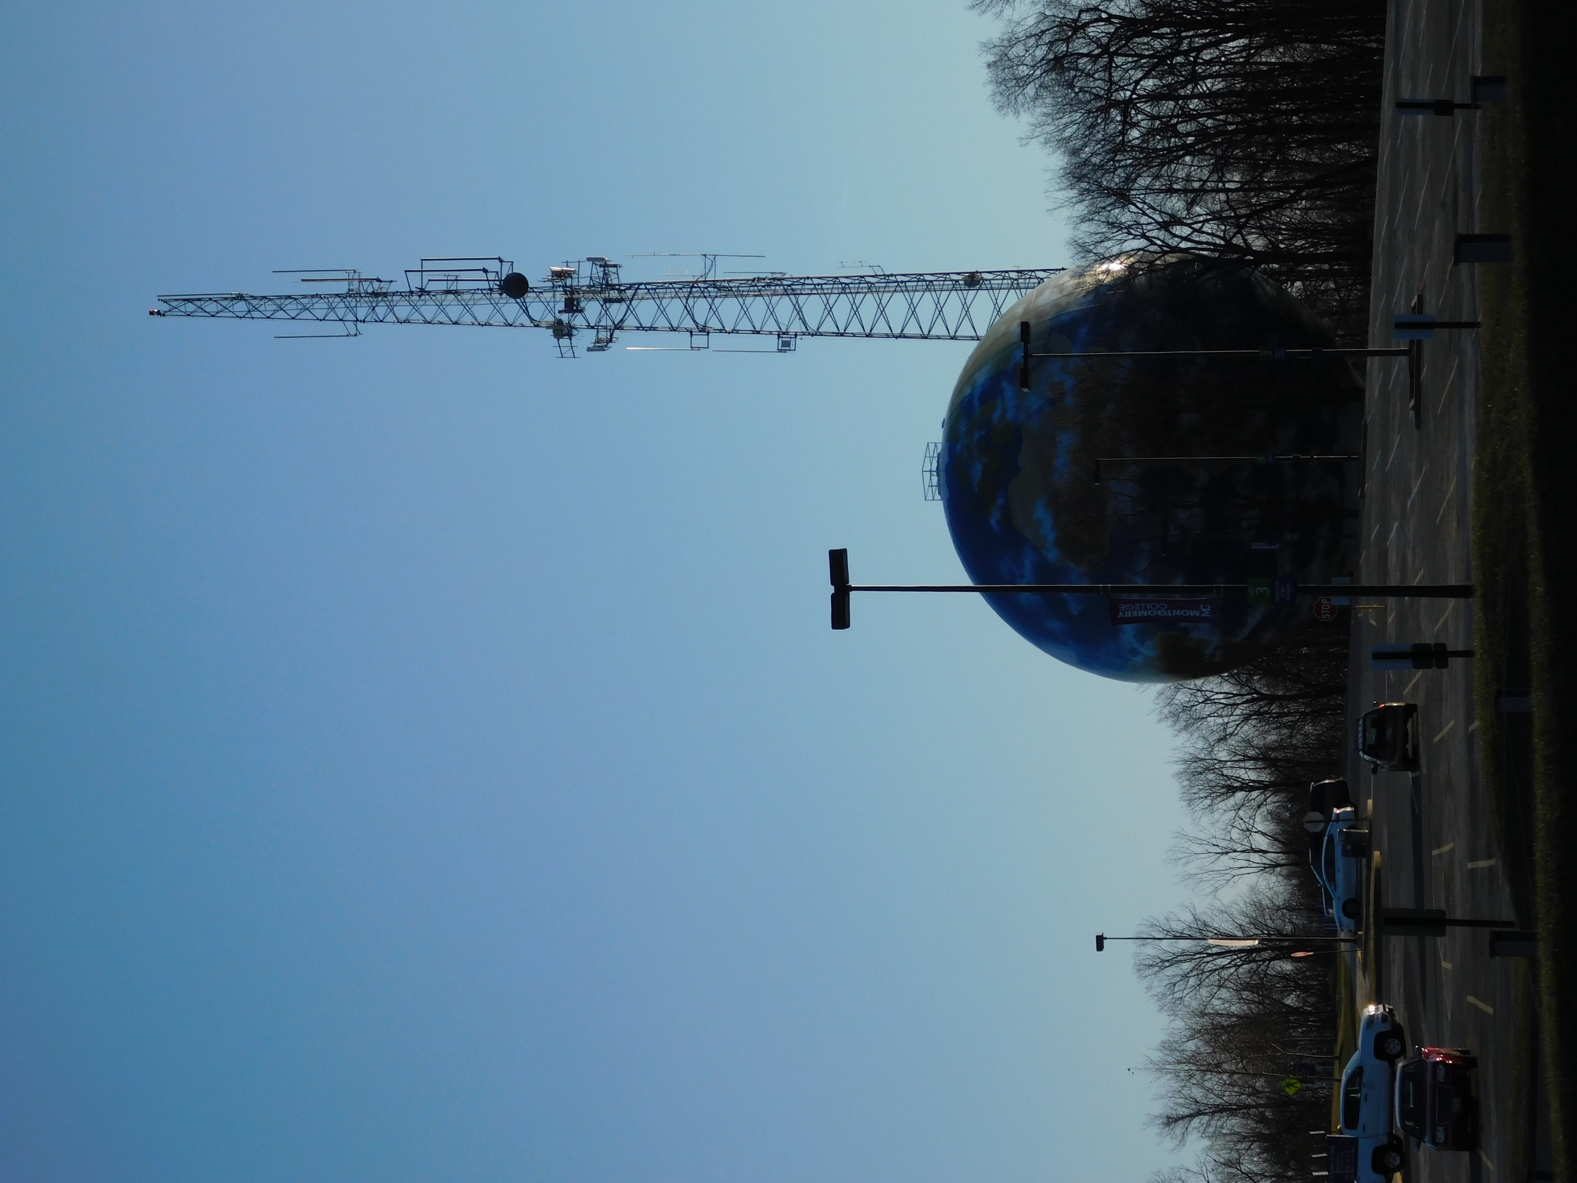
Montgomery College Germantown

Slide 4
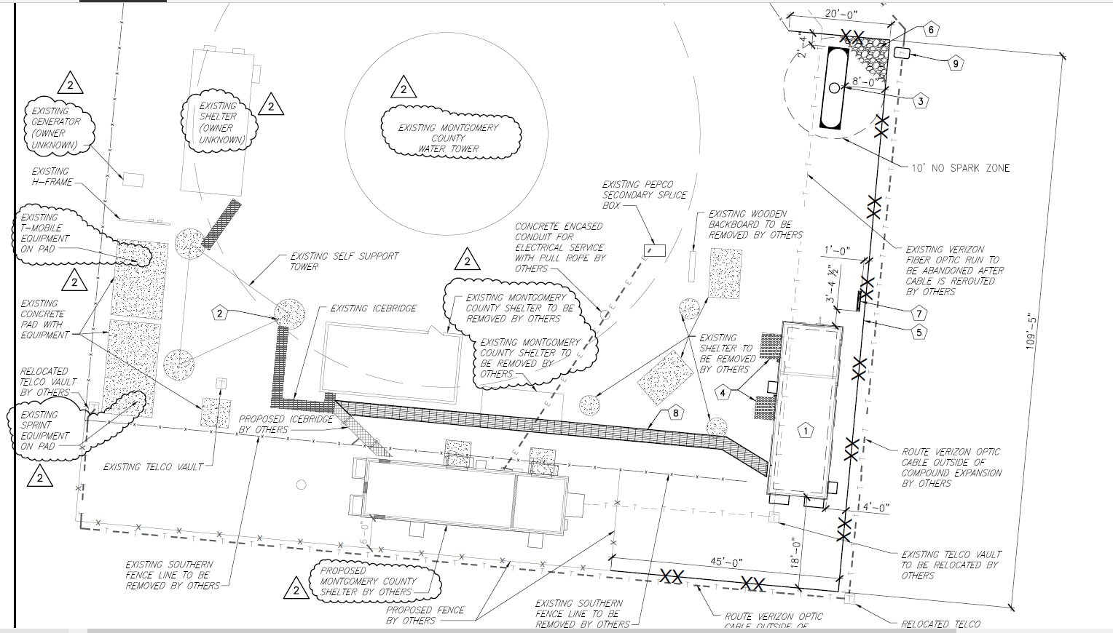
Montgomery College Germantown

Slide 5
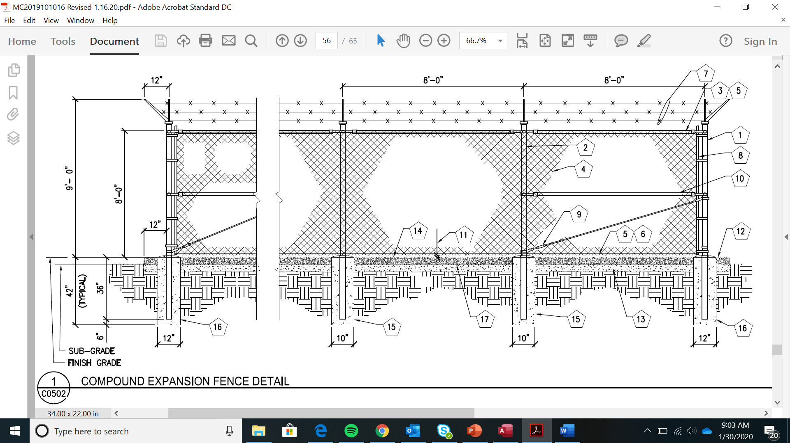
Montgomery College Germantown

Slide 6
Montgomery College Germantown

Slide 7
Montgomery College Germantown

