Slide 1
Washington Grove Connector
&
Crabbs Branch Way Extension
Public Meeting #1
February 13, 2020

Slide 2
Outline
Study Overview
Washington Grove Connector
Crabbs Branch Way Extension
Q&A
Contact Information

Slide 3
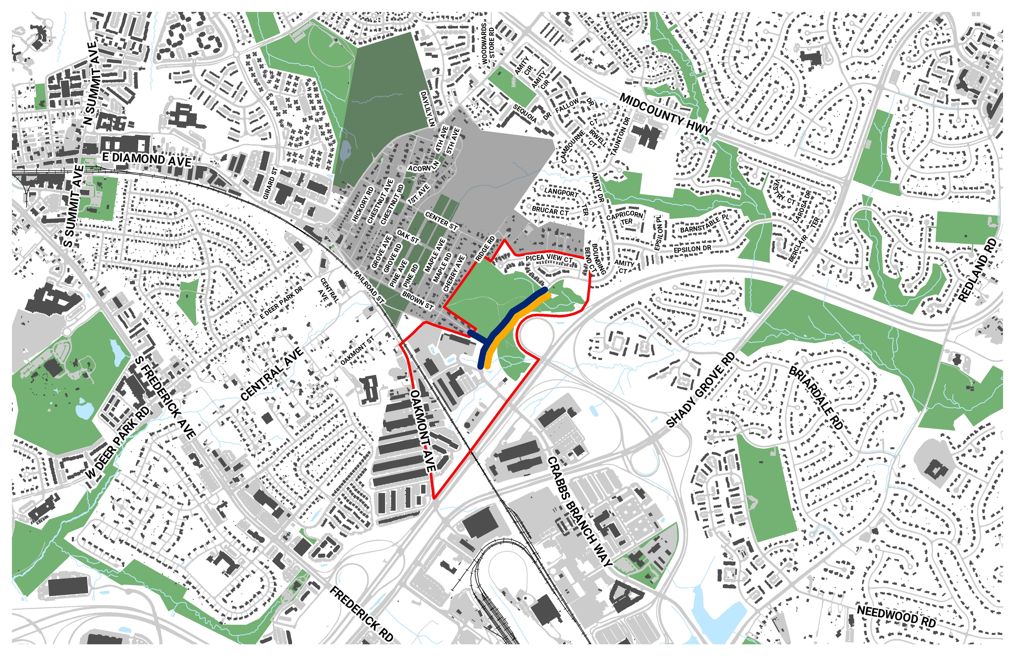
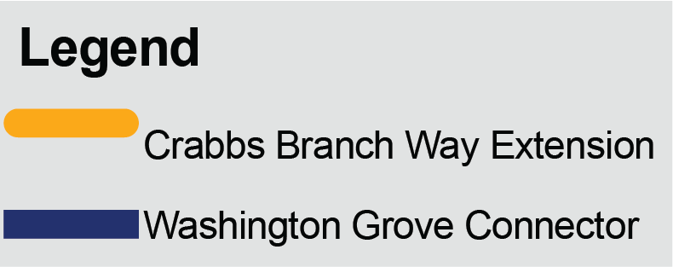
Project Overview
Washington Grove Connector Path
Bikeway Program minor (P507596)
Funded for Planning, Design & Construction
FY20 - FY24
Crabbs Branch Way to Amity Dr Extension
Facility Planning Transportation (P509337)
Funded for Planning only
Not funded for Design or Construction
FY20 – FY21

Slide 4
Project Schedule
Nov 2019
Feb 2020
Summer 2020
Fall 2020
Project Kick-Off
Public Workshop #1
Select Preferred Alignment
Public Meeting #2
Information Gathering
We Are Here
Further Analysis
Winter 2020
Concept Development
Fall 2020
Advance Concepts
Spring 2020 2019

Slide 5
Process
Information Gathering
Review existing traffic, historical, cultural, environmental data, etc
Conceptual Plan Development
Conceptual layout
Alternatives Analysis
Select Preferred Alternatives
Project site investigation and master plan review
Traffic data collection
Utility Information
Landscape and environmental information
Cost Estimates
Property Impacts

Slide 6
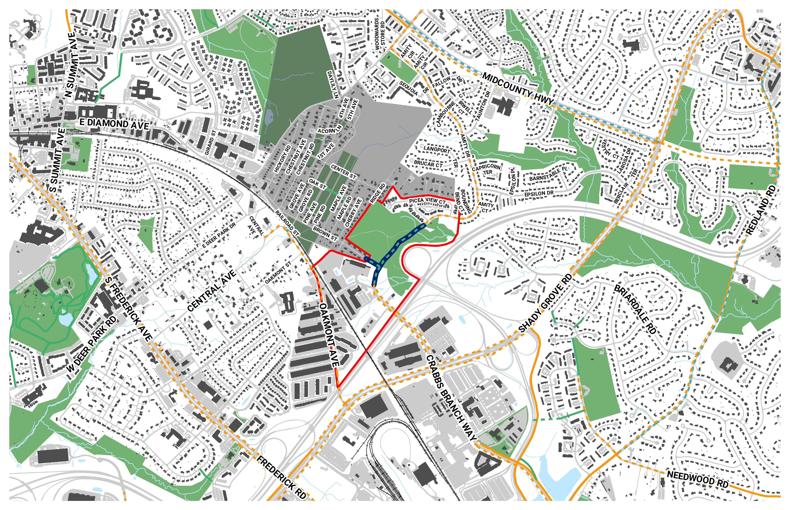
Washington Grove Connector Path
Bikeway Program minor (P507596)
Funded for Planning, Design & Construction
FY20 - FY24

Slide 7
Feedback
Desired Path Connections
Brown St
Railroad St
Amity Dr
Other
Desired Path Type
Asphalt / Concrete
Permeable Asphalt / Concrete
Crushed Stone
Natural Surface
Raised Wooden Boardwalk

Slide 8
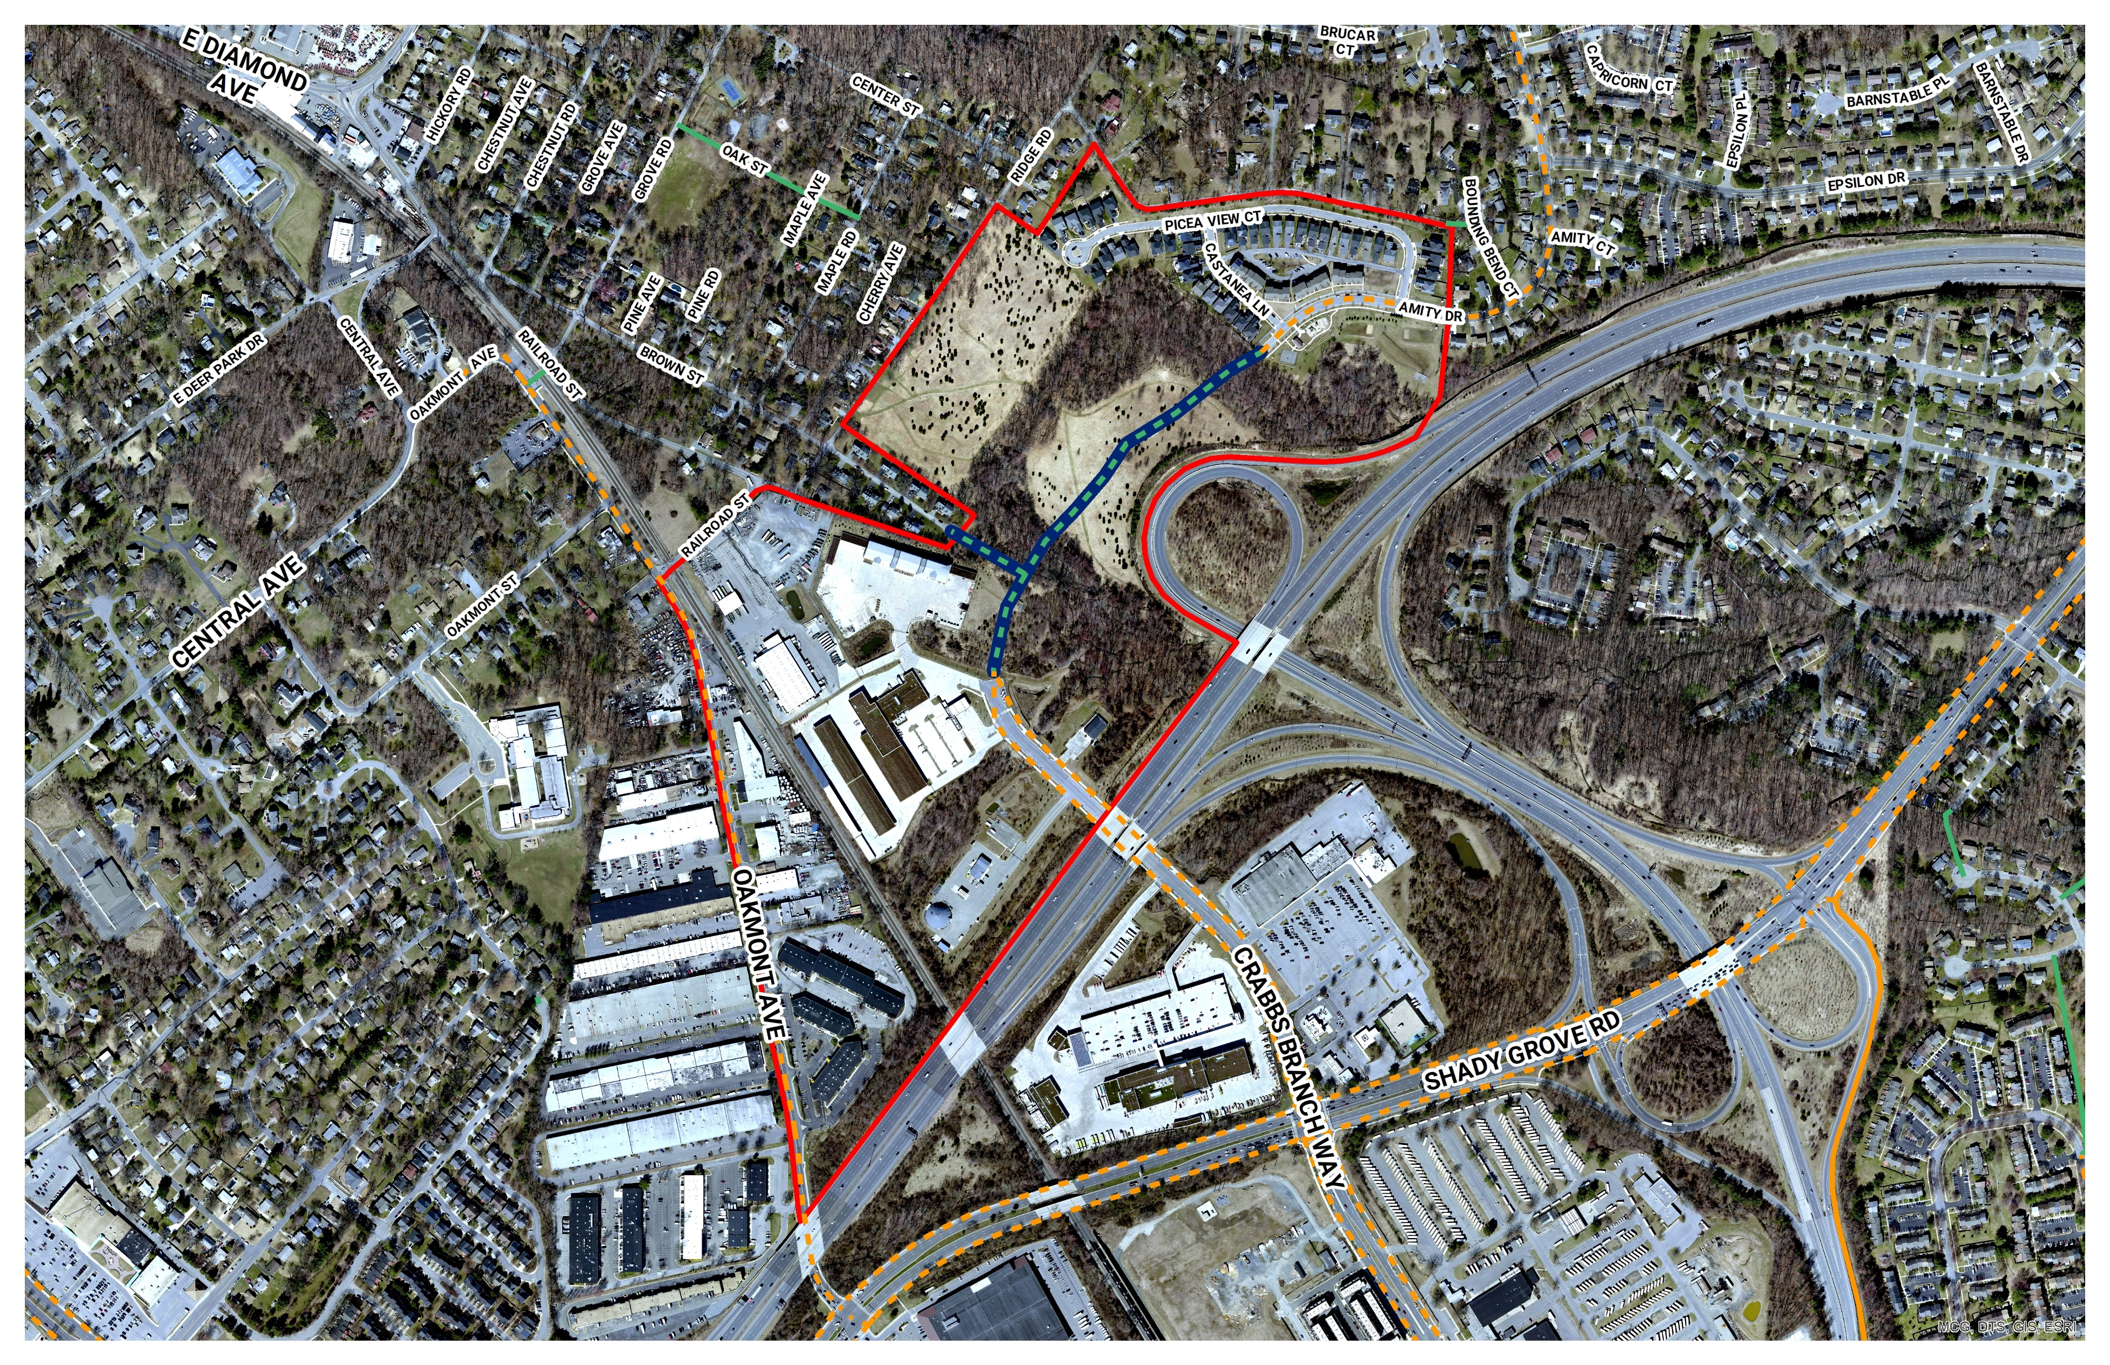

Slide 9
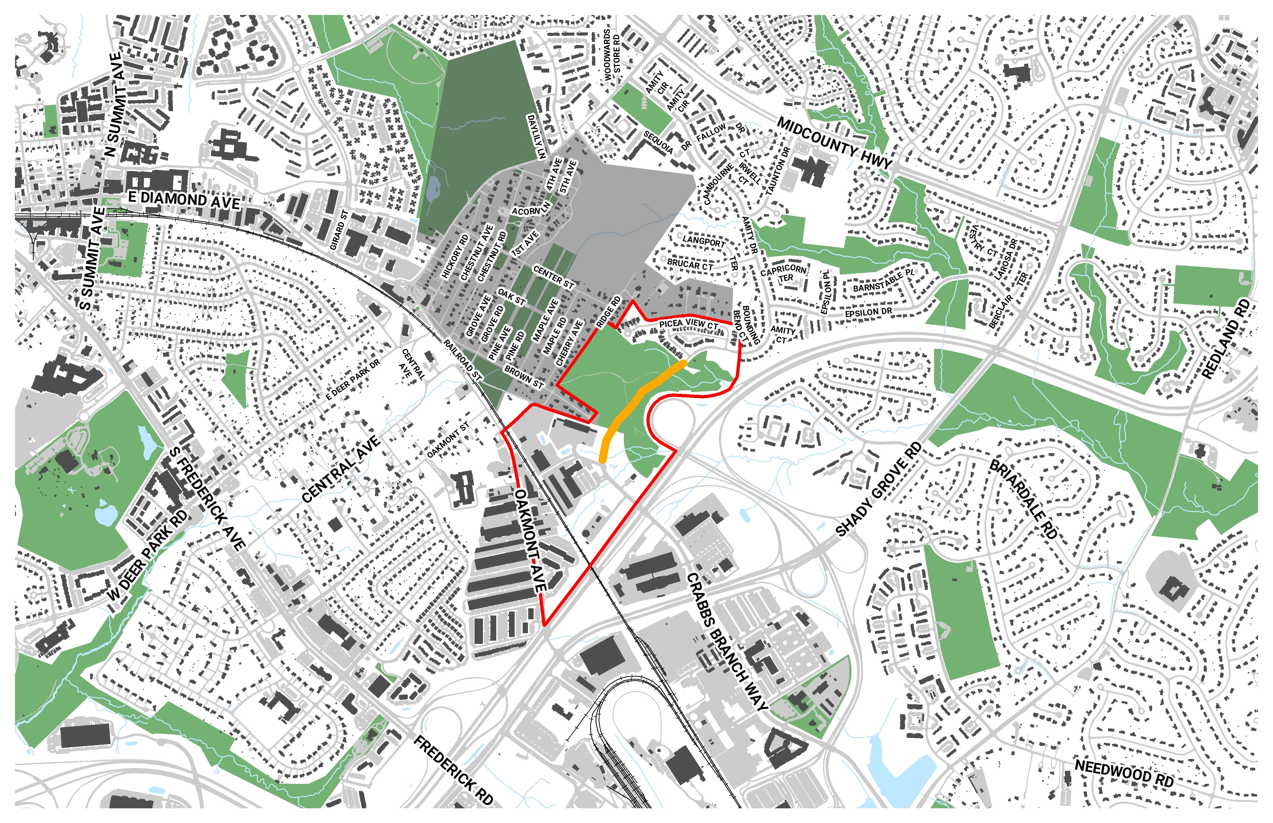
Project Overview
Crabbs Branch Way to Amity Dr Extension
Facility Planning Transportation (P509337)
Funded for Planning only
Not funded for Design or Construction
FY20 – FY21

Slide 10
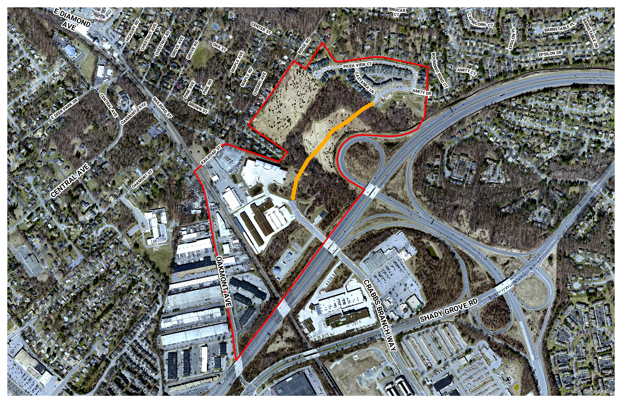
Project Overview

Slide 11
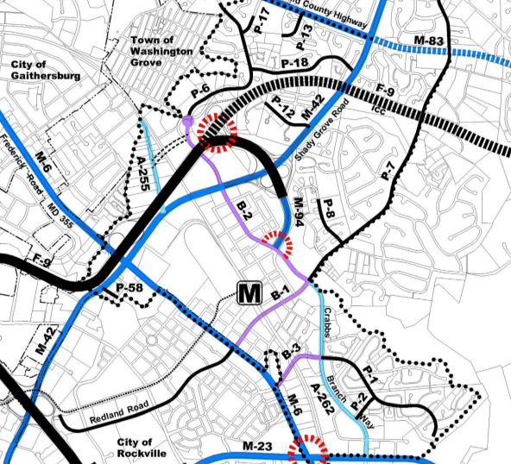
Shady Grove Master Plan
Road P-6
Extending Crabbs Branch Way with an 80-foot right-of-way, under I-370 to Amity Drive, to improve local connections. To discourage cut-through traffic, a traffic circle should be considered at the intersection of Crabbs Branch Way and Amity Drive. Additional traffic calming measures along Amity Drive should also be considered.

Slide 12
80’

Slide 13
Facility Planning Phase I
Collecting background data such as traffic and environmental inventory;
Reviewing the Master Plan;
Providing public outreach through public meetings, newsletters and obtaining their input;
Developing concept plans;
Selecting a preferred alignment and establishing design parameters based on planning level analysis (no build could be option);
Ongoing town input;
Briefing the Maryland-National Capital Park and Planning Commission (MNCPPC) Planning Board;
Obtaining concurrence from the Montgomery County Council's Transportation, Infrastructure, Energy & Environment Committee (T&E)
Approval from the Montgomery County Department of Transportation (MCDOT);
Project advances to Facility Planning Phase II

Slide 14
Facility Planning Phase II
On Going Public Input
Preliminary Engineering
Horizontal & Vertical Alignments
Physical Investigation
Soils, Storm Drains, Hydraulic, Structural, & Sediment Control
Right of Way (if needed for entry agreement or purchase)
Intersection Geometrics
Final Concepts
Noise
Environmental
Construction Sequence
Develop Detailed Scope, Schedule, & Cost Estimate
Project advances to design and construction (if funded)

Slide 15
Feedback
For/against road connection?
Design considerations?
Which side of road for bike path?

Slide 16
Next Steps
Review Public Comments
Select Alternatives for Study
Develop Concepts
Develop Cost Estimates
Advance Preferred Alternatives

Slide 17
Contact
Kyle Lukacs, AICP – Project Manager
240-777-7207
Kyle.Lukacs@montgomerycountymd.gov
https://www.montgomerycountymd.gov/dot-dte/projects/washgroveconnector/index.html

Slide 18
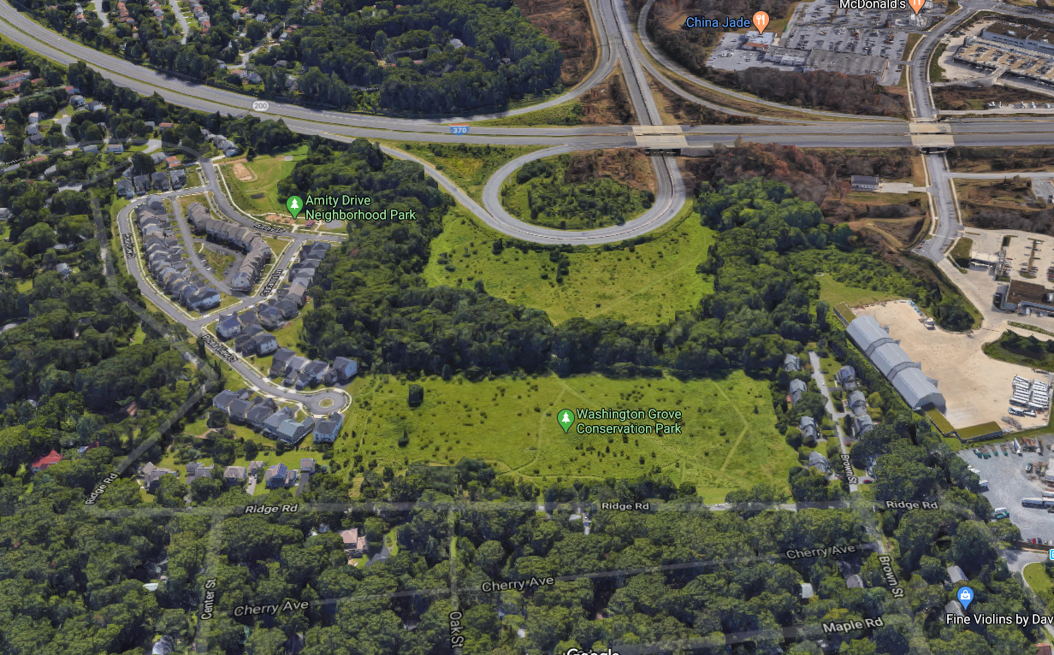

Slide 19
