Slide 1
Rapid Transit System
Steering Committee Meeting
December 4, 2012

Slide 2
Agenda for RTS Steering Committee
Introductions and Purpose of Meeting
Steering Committee Mission and Schedule
Overview of Studies and Reports on RTS in Montgomery County
  Montgomery County Initiatives
    Councilman Elrich’s Initiative
    MCDOT BRT Feasibility Study
  County Executive’s Rapid Transit Task Force Report
  Institute for Transportation and Development Policy (ITDP) Study
  Countywide Transit Corridors Functional Master Plan – Preliminary Recommendations
  Veirs Mill and Georgia Avenue BRT New Start Studies underway
  Corridor Cities Transitway Status
  Purple Line
FY 13 CIP Amendment Supplemental
Next Steps

Slide 3
Rapid Transit Steering Committee
Mission: The Rapid Transit Steering Committee is to support and provide advice to the Chief Administrative Officer (CAO) and County Executive in the implementation of a Rapid Transit System in the County, within the framework of adopted and soon to be adopted Master Plans in the County, and within the fiscal constraints and overall policy direction of the County Executive.

Slide 4
Rapid Transit Steering Committee
Responsibilities:
  Background
  Organizational structure
  Funding the system
  System standards
  Communications
  Schedules
  Other Responsibilities
Schedule: Meet on a quarterly basis or more frequently, as needed

Slide 5
Overview of Studies and Reports
  Montgomery County Initiatives
    Councilman Elrich’s Initiative
    MCDOT BRT Feasibility Study
  County Executive’s Rapid Transit Task Force Report
  Institute for Transportation and Development Policy (ITDP) Study
  Countywide Transit Corridors Functional Master Plan – Preliminary Recommendations
  Veirs Mill and Georgia Avenue BRT New Start Studies underway
  Corridor Cities Transitway Status
  Purple Line

Slide 6
    Councilman Elrich’s Initiative

Slide 7
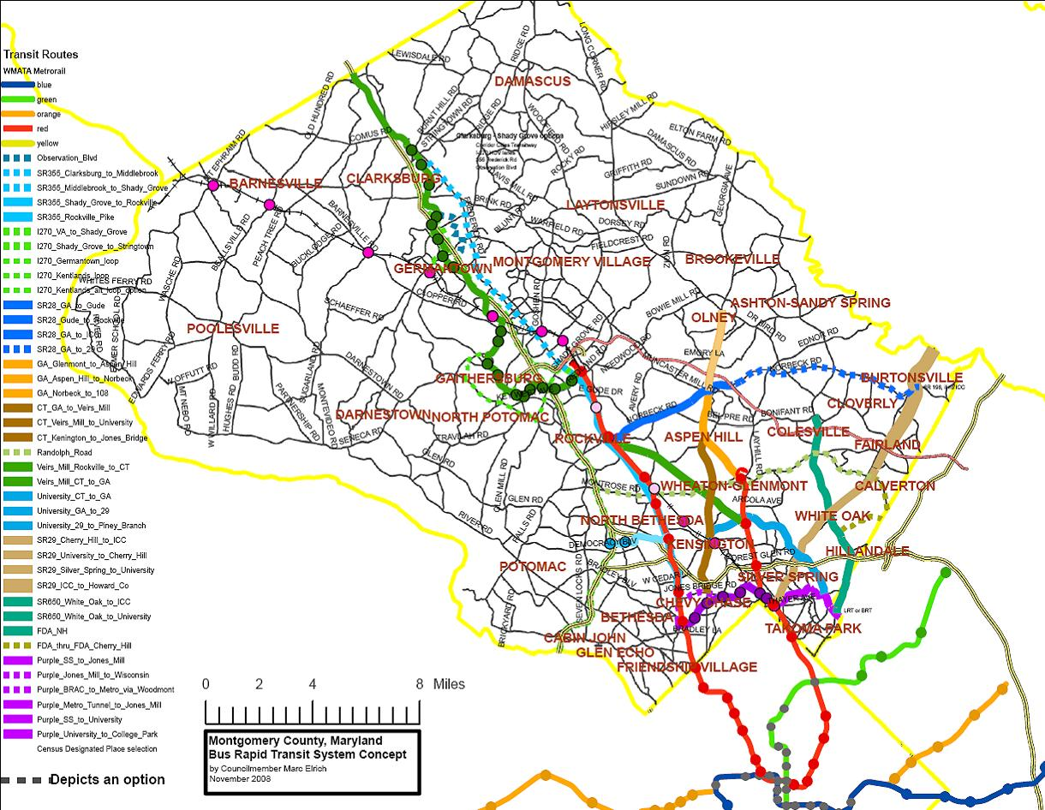
Councilman Marc Elrich’s
Concept Map

Slide 9
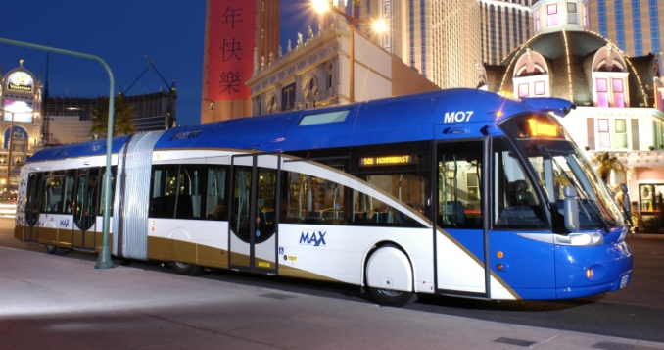
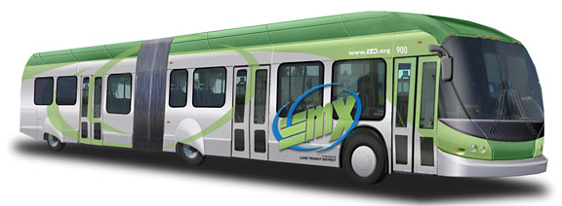
Purpose of the Study
    Test the feasibility of a network system of BRT routes providing access to county activity centers within the existing right of way
Las Vegas MAX (RTC of Southern NV)
Eugene EmX (LTD, Oregon)

Slide 10
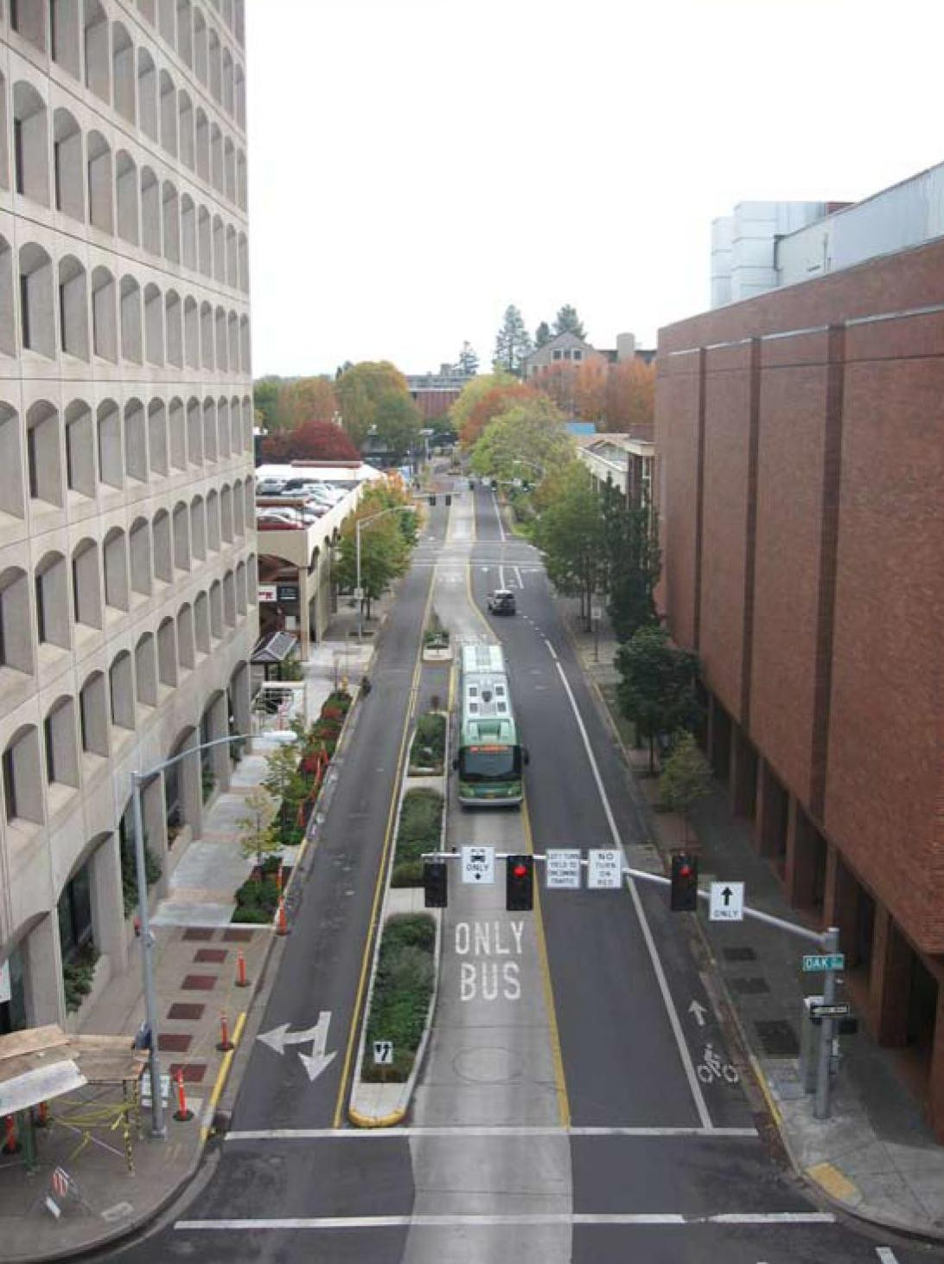
Project Scope Summary
Screen all County roadways for potential BRT corridors
Conduct planning-level corridor analyses to determine potential BRT treatments
Determine travel demand and identify routes for network
Determine generalized capital and O&M costs for BRT network
Reversible median busway (Eugene, OR)

Slide 11
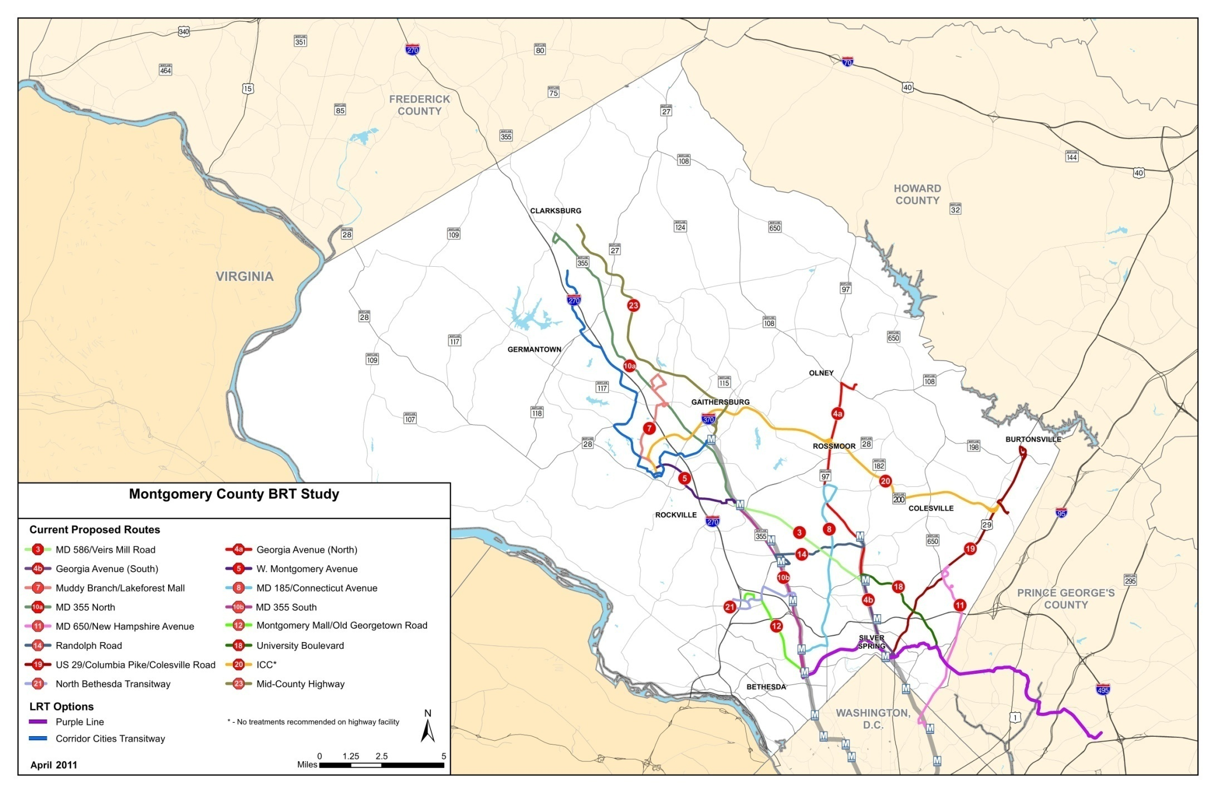
The Proposed Network
16 Corridors, 150 Miles

Slide 12
Summary of Preliminary Findings
All results compared to 2040 No-build
50,000 new daily transit trips
150,000 to 190,000 daily BRT boardings
Majority of corridors with over 1,000 daily boardings per mile
O&M costs for Ride On and Metrobus decrease
BRT network reduces Ride On and Metrobus boardings, permitting redeployment of resources

Slide 13
Other Findings – Preliminary
BRT system requires additional bus maintenance facilities and the modification of existing facilities to service articulated vehicles
Requires approximately 300 buses to accommodate passenger demand
Will require redeployment of Ride On and Metrobus fleets

Slide 14
  County Executive’s Rapid Transit Task Force Report

Slide 15



Slide 16
  Countywide Transit Corridors Functional Master Plan – Preliminary Recommendations

Slide 17
Veirs Mill and Georgia Avenue BRT New Start Studies

Slide 18
Corridor Cities Transitway

Slide 19
Purple Line

Slide 20
Proposed FY 13 CIP Supplemental
$1 million supplemental appropriation to the FY 13 CIP to fund initial steps and detailed studies to advance Transit Task Force Phase 1
  Service planning and integration study
  Pedestrian and bicycle access to station study
  Transit signal priority
  Park and ride facilities to serve corridors and stations
  Organizational study to effectively design, build, operate and maintain RTS system and integrate with Ride On and Metrobus
  Framework and policies associated with use of MDOT rights of way and operational agreements

Slide 21
Next Steps
End of January 2013 - Council action on Supplemental Appropriation
February 2013 - Prepare and review draft scopes of work for studies
March 2013 - Kick off studies
June 2013 - Status report on projects and studies

