Slide 1
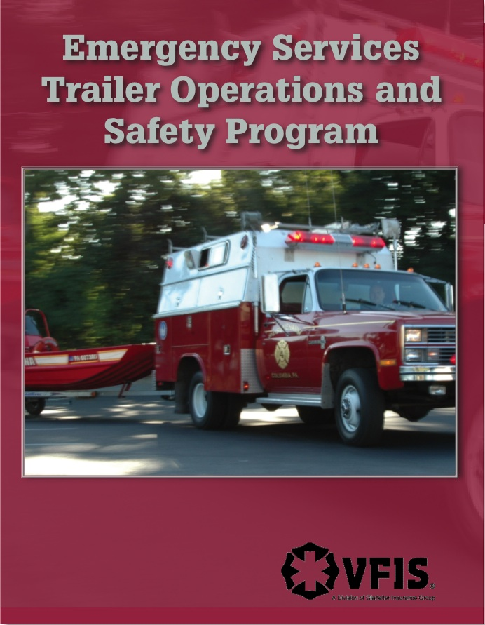
Instructed by:

Slide 2
Program Overview
Pre-Quiz
Course Objectives
Introduction
  Need for Trailers
  Use of Trailers
  Trailer Security
Risk Management Overview
Why a Trailer Operations and Safety Training Program?
Subject Content
  Chapters One through Eight
Review

Slide 3
Measurement of Learning
Pre-Quiz
  Answers
    D
    A
    3) C
    4) D
    5) A

Slide 4
Course Goal
Provide classroom and field experience so
participants have a better understanding of
trailer operations and are able to apply
gained knowledge in an emergent situations.

Slide 5
Course Objectives
Identify and understand the current challenges of driving a trailer in the private setting and the emergency service environment.
Identify and understand how operating a trailer correctly is a good risk management tool.
Identify five characteristics that influences vehicle performance while towing trailers.

Slide 6
Course Objectives
Understand the importance of pre-towing inspection and demonstrate an acceptable inspection procedure.
Be capable of explaining or demonstrating the procedure for proper pre-response hook-up.
Successfully complete the practical driving exercise.

Slide 7
Course Content
Chapters
    1. Trailers
    2. The Tow Vehicle
    3. Brake Requirements
    4. Tow Hitch, Ball and Coupler Assembly
    5. Inspecting the Vehicles
    6. Loading the Trailer
    7. Driving with a Trailer
    8. The Course

Slide 8
Introduction
Evolution of Emergency Services
CULTURAL changes MUST occur to insure that EVERYONE GOES HOME
New and safer methods of responding to emergencies
Re-thinking scene set-up and safety
Legislation

Slide 9
Introduction (Cont’d)
Public service Emergency Service Organizations (ESOs) are being asked to do more
The introduction of new concepts in design of vehicles
Equipment that was never considered is now being moved with increasing frequency
Availability of funding for equipment
Increased potential for terrorism

Slide 10
Introduction (Cont’d)
Question – How does an ESO get needed
equipment to the scene?
  Standard vehicles
    Engines, ambulances, lighting vehicles
  Specialty vehicles
    Haz Mat, collapse team, bio-terrorism, mass casualty, rehab,
  Trailers
    Boats, lighting, direction boards, equipment

Slide 11
Why Trailer Training?
We train on the standard vehicles.
  EVDT, Intersection, Rollover, etc.
We train on specialty vehicles.
Why training on trailer operations and safety is essential?

Slide 12
Comprehensive Trailer Driving Training Program
Classroom Instruction
    4 hours (3 contact hours)
Testing
Skills Course Completion
    Specific Vehicle
    Task Evaluation
Street and Highway Driving
    10 hours
Annual Refresher Training

Slide 13
Risk Management
Process of pro-active decision making that minimizes the adverse affects of accidental losses, such as death to personnel or the public. Risk management also works toward decreasing potential damage to public and private property.

Slide 14
Risk Management
What is the outcome of identifying and analyzing exposures to accidental and business losses that might interfere with the organization’s basic objectives?
Decision Making

Slide 15
Risk Control
Definition – Any conscious effort or action (or decision not to act) that reduces the frequency, severity, or unpredictability of accidental losses.

Slide 16
Examples Of Risk Control
Developing SOGs for driving with a trailer
Requiring all of those who drive tow vehicles to complete initial and ongoing trailer driving program
Conducting routine inspections of trailer

Slide 17
Adoption Of New Philosophy
Trailers in service for many years
Increased use in emergency services
“New” operation or maybe “New technology”
If you have the opportunity to do it,
then “do it right.”

Slide 18
Remember
It is not your emergency!
You can only mitigate what has already occurred.

Slide 19
Towing Troubles
There are no studies or reliable information
available on collisions involving ESO trailers.
SO: We will review what we know.

Slide 20
Towing Troubles
Based on a five year data history, more than 68,000 incidents involving passenger vehicles towing trailers occurred on the nation’s highways.
Source: National Highway Traffic Safety Administration

Slide 21
Towing Troubles
This data also shows:
Accidents involving trailers resulted in the deaths of 440 people, 24,000 injuries and 43,000+ reported cases of property damage
US total deaths (Motor Vehicle) – Approximately 38,000
So, more than 1% of all deaths occurred in accidents involving a trailer (total US highway deaths)
Source: National Highway Traffic Safety Administration

Slide 22
Master Lock Study
Master Lock concluded that trailer owners lack
the basic knowledge of trailer safety and proper
towing procedures and few had any training on
their trailers. It was also determined that the
majority of owners thought they knew what they
were doing.
(For more info, visit www.towingtroubles.com.)
Source: Master Lock

Slide 23
Findings From Study
57% did not know or were uncertain of their trailers GVW, which is crucial to selecting the proper towing systems.
54% did not know or were uncertain of their class of trailer hitch.
71% admitted to being only “somewhat” to “not knowledgeable” about proper towing practices and safety.
Source: Master Lock

Slide 24
Findings From Study
75% admitted that a main source of information was based on past experience.
24% used the owner’s manual and about 45% sought other’s help.
13% received towing information from the dealer.
9% of boat owners received their information from magazines.
Source: Master Lock

Slide 25
Risk Pyramid
440 Deaths
24,000+ Injuries
General Public
43,000+ Property Damage
68,000+ Reported Incidents

Slide 26
Emergency Service Statistics
Approximately 100 Firefighters die each year
On an average 25% die in a vehicle accident
Increased use of trailers may result in additional deaths
Who will it be?

Slide 27
Troubling Attitude
Although one third of trailer owners felt they were
very knowledgeable, nearly 63% felt they did not
need help or further information. This disconnect
reveals a significant lack of understanding of the
risks of towing a trailer.
Source: Master Lock

Slide 28
What Does This Mean?
Is it any surprise that those that tow trailers using a POV become the “experts” in an Emergency Service Organization?
Emergency drivers take their past non-educated experience of driving in a controlled, non-emergent situation and apply it to an uncontrolled emergency driving situation.

Slide 29
Training
Less than 40% of those who purchased trailers
were educated in the key safety practices essential
to safe operations of trailers.
Proper use of safety chains 57%
Fastening the trailer to the hitch 55%
Trailer/brake lights 49%
Weight distribution 49%
Securing cargo 47%
Tire safety 46%
Source: Master Lock

Slide 30
Training (Cont’d)
20% of all trailer owners received any instruction on proper towing and safety procedures.
21% of owners have experienced a safety incident that included swaying, tire blowout or disconnect of trailer from the tow vehicle or loss of cargo.
56% of the situations resulted in vehicle/trailer damage.
11% resulted in injuries.
Source: Master Lock

Slide 31
Ultimately
Will a crash occur?

Slide 32
Trailer Security
How secure are trailers in general?
What is the cost of the equipment in a trailer?
What could someone steal from the trailer that could be of great value to them and a great loss to the organization?

Slide 33
Introduction Summary
Emergency service leaders must become more aware of the risks involved in developing and utilizing a trailer response program.
Leaders must insist on educating drivers and have them practice the techniques in proper operations and safety.
Leaders must continue to monitor the way drivers handle these units.
Notes:
Change to slide

Slide 34
Chapter One – Trailers
Why a trailer?
Trailer uses
Rules for loading a trailer
The loading process
Hooking-up the trailer

Slide 35
The Trailer
While emergency services have used vehicles that pull another vehicle for decades (the tiller), the surge in smaller specialty trailers is a relatively new concept.
NFPA 1901 Standard for Automotive Fire Apparatus – emergency service organizations will also have to consider the three classifications outlined in this document.

Slide 36
Types Of Trailers Used By ESO’s
Foam delivery
Canteen services
Breathing Air tanks and compression equipment
Heavy construction
Command centers
Mass casualty support
Fire wagons
Fire investigation
Smoke houses
Boats
All-terrain vehicles (ATVs)
Hazardous materials response equipment
High angle rescue
Collapse equipment and trench rescue
Traffic signage

Slide 37
NFPAs 1901 Standard for Automotive Fire Apparatus
Three classifications
  Type I → Trailers designed to remain connected to their tow vehicle and are dependent on the tow vehicle to provide power.
  Type II → Trailers designed to allow separation from the tow vehicle and are not dependent on the tow vehicle for power
  Type III → Open trailer designed to transport vehicles, equipment or containers that will be removed from the trailer after arrival that will not block the right-of-way during the incident.

Slide 38
Trailer information
Rules For Loading
Driver awareness items for The Trailer
The Process
Trailer Hook-Up

Slide 39
Rules For Loading
The rules for loading MUST never be broken.

Slide 40
Rules For Loading
Front to back (horizontally)
  60% in front; 40% behind axle
  Tongue weight is 10-15% gross trailer weight
Vertically
  Heaviest equipment near floor over axle
Left to right
  Trailer should sit level

Slide 41
Driver awareness items for
The Trailer
Use of spotter is essential
Driver should perform the hook-up
Second set of hands and eyes can double check the hook-up and spot for backing
Each trailer will have nuances to consider

Slide 42
The Process
Generally:
  place wheel chocks
  align the ball under the raised coupler
  lower the coupler onto the hitch and ball assembly
  engage the locking mechanism around the ball
  attach brake release cable around the ball or
  onto a fixed point on the tow vehicle
    Brake release cable must be shorter than safety chain

Slide 43
The Process (Cont’d)
  hook the safety chains in a criss-crossed fashion under the ball assembly
  connect electrical systems
  lock the trailer to the hitch/ball assembly
  ensure trailer jack is retracted and secured
  remove wheel chocks, and
  complete walkaround

Slide 44
The Process (Cont’d)
connect electrical harness to vehicle outlet
    Adapters may be necessary
double check all connections
start vehicle engine and check all lights for proper operation
pull forward 10-20 feet and final check all connections

Slide 45
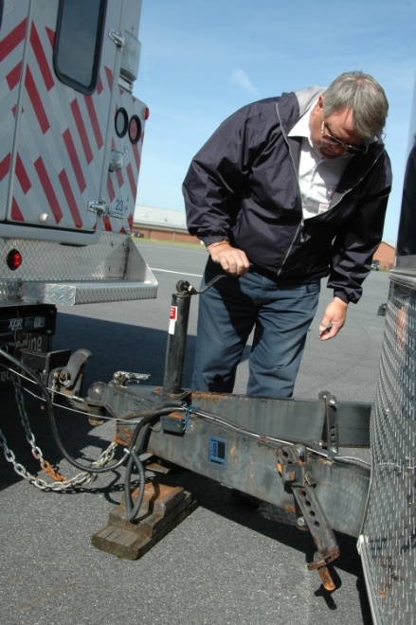
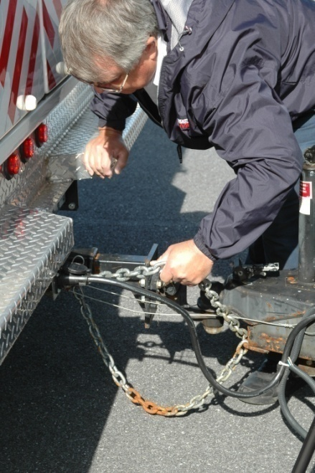
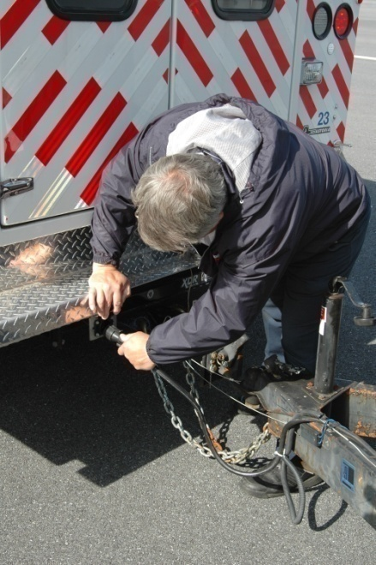
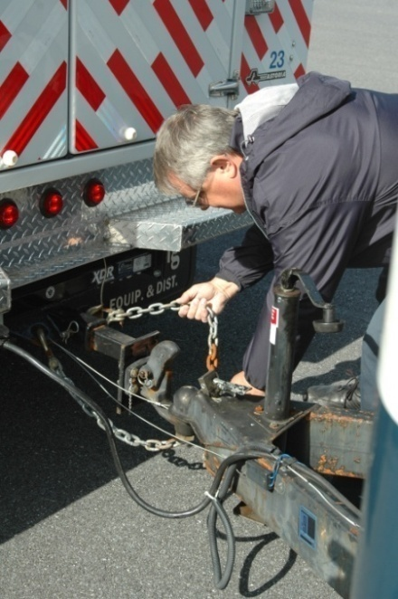
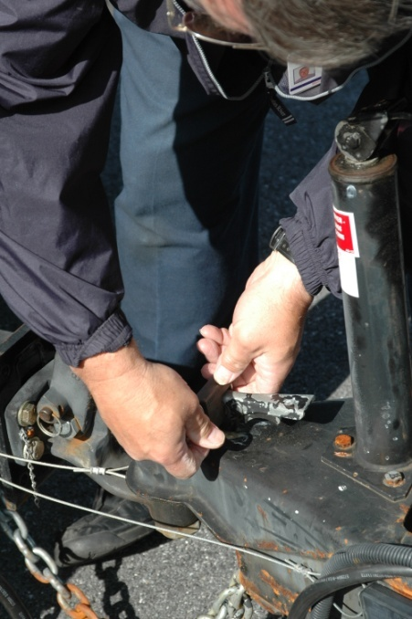
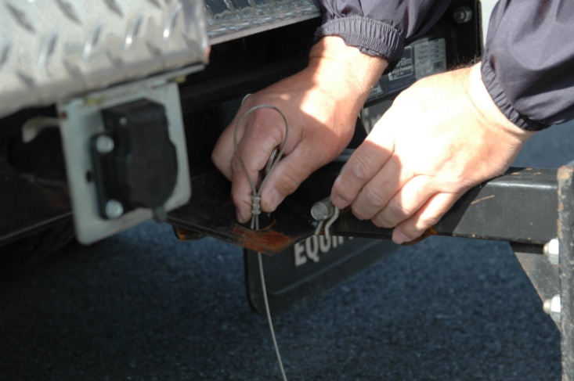
Visual

Slide 46

Click
On
Video
To
Play
Clip

Slide 47
Chapter 1 – Summary
Planning requires knowledge of the type of vehicle towing the trailer, the size of the trailer, equipment and materials that are going to be loaded into the trailer, and the personnel who could potentially ride in the tow vehicle. With this information, the ESO can determine the best set-up for their needs.

Slide 48
Chapter 2 – The Tow Vehicle
Planning is essential when determining what vehicle will tow the trailer. Equipping vehicles with towing packages does not mean the vehicle is capable of moving a trailer safely. Selecting the right vehicle is critical in designating or purchasing the vehicle should be well thought out.

Slide 49
The Tow Vehicle
Using Current Vehicle vs. Purchasing New
  Current vehicle – Questions to ask may include:
      Is the vehicle big enough to move the trailer safely?
      What adaptations do we have to make to
      re-enforce the tow vehicle?

Slide 50
The Tow Vehicle
Consider
  Vehicle in Current Fleet vs. New Vehicle
    Is the current vehicle big enough to perform the task?
    What adaptations need to be made?
    What is the towing capacity of the vehicle?
The GVWR of the vehicle is neither a guideline nor estimate. They are LIMITS. There is not a safety margin or “fudge factor” built into these ratings.

Slide 51
The Tow Vehicle
Adding a trailer to a tow vehicle, the braking requirements suddenly change:
  Stopping distances lengthen
  Brakes will undergo more wear
  Driver may not adequately change their driving habits to accommodate the added weight

Slide 52
Important Information To Know
The tow vehicle and the hitch must be capable of handling at least 15% of the Gross Weight of the trailer (weight of trailer plus contents).
Terms – GCWR, GVWR, GTWR, GAWR
Determine the towing potential and loading at least 12% of your best estimate of the total weight on the hitch will provide a margin of safety.

Slide 53
Definitions
GCWR, or gross combination weight rating
  The total allowable weight of the towing vehicle,
  plus the trailer, cargo in each, fluids and
  occupants.
GVWR, or gross vehicle weight rating
  The total allowable weight for the towing
  vehicle, including fluids, options, occupants,
  hitch, cargo and any trailer hitch weight.

Slide 54
Definitions
GTWR, or gross trailer weight rating
  The total allowable weight of the trailer, fluids,
  options and cargo.
GAWR, or gross axle weight rating
  The total allowable weight on any given
  individual axle. This includes the weight of the
  tires and brakes and the axle itself.

Slide 55
Important Information To Know (Cont’d)
Information labeling
Fluid pressures
Braking systems
Suspension and tires
Hitches and capacity
Electrical systems
Weight distribution

Slide 56
Exercise One
Manual – GCWR 23,000 lbs
Manual – Tow Rating 17,000 lbs
Manual – GVWR 9,900 lbs
Manual – GAWR (f) 5,000 lbs
Manual – GAWR (r) 6,824 lbs
Formula → GCWR – GVWR =
True Towing Capacity

Slide 57
Answer
True Towing capacity of vehicle is
23,000 – 9,900 = 13,100 lbs
The manual states the towing rating is
17,000

Slide 58
Exercise Two
Manual – GCWR 23,000 lbs
Manual – Tow Rating 17,000 lbs
Manual – GVWR 9,900 lbs
Weight of People, Vehicle
Supplies, Fluids, etc. 7,500 lbs
Formula → GCWR – Actual Weight =
True Towing Capacity Allowed

Slide 59
Answer
True Towing Capacity Allowed
23,000 – 7,500 = 15,500 lbs
Remember the manual stated the tow rating was 17,000 lbs

Slide 60
Exercise Three
Manual
GVWR -14,350
Front GAWR – 4,900
Rear GAWR – 9,450
Manual GCWR – 23,000
Actual
Actual weight = ?
Front axle weight = 4,840
Rear axle weight = 6,240
Trailer weight = 5,480

Slide 61
Answer
1) tow vehicle weight + trailer weight = CW (combined weight)
11,080 + 5,480 = 16,560
GCWR – GVWR = towing capacity (manufacturer)
23,000 – 14,350 = 8,650
Allowable weight on hitch = GVWR-GVW = 3,270
Optimal weight on hitch = 15% of trailer weight = 822 lbs

Slide 62
Can we safely tow this vehicle?
YES

Slide 63
Considerations
Compare Vehicle’s manual recommendations with actual weights
Weigh vehicles annually and when equipment is changed
Weigh vehicle with maximum number of people and equipment carried
  Allows for safety cushion

Slide 64
Chapter 2 – Summary
Organizations and operators must understand how the tow vehicle MUST be capable to tow the trailer safely. Evaluating the tow vehicle’s capacity is the first step in determining this capability.
Also important is not relying on the manufacturer’s manual for the acceptable weights when determining capability to pull a trailer.

Slide 65
Chapter 3 – Brake Requirements
Adding a trailer to a tow vehicle means the braking requirements suddenly change. Stopping distances lengthen, brakes undergo more wear, and the driver may need to change his or her driving habits to accommodate the added weight.

Slide 66
Brake Requirements
Electronically controlled electric brakes - provide automatic and manual control of electric trailer brakes.
Hydraulically controlled electric brakes – allow for evenly applied braking, which is proportional to brake pedal pressure.
Surge brakes – independent system activated by a master cylinder at the junction of the hitch and trailer tongue.

Slide 67
Braking Systems
Braking system, on the tow vehicle, should be capable of handling the braking duties of the tow vehicle and the trailer, and when parked safely holds the trailer stationary.
According to NFPA 1901, a trailer with a GVWR of 3,000 lbs. or more shall be equipped with a braking system that functions on all wheels.
Electric or air brakes are required on all trailers over 8,000 lbs.

Slide 68
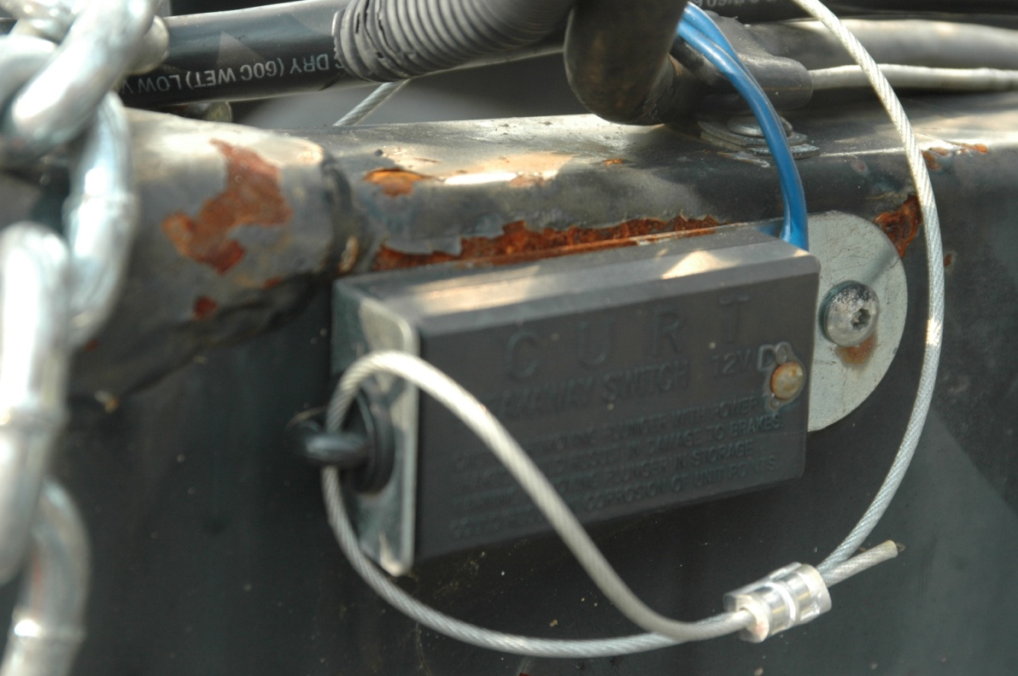
Electric Breakaway System
Activated only if the trailer comes loose from the hitch and the breakaway pin is pulled.

Slide 69
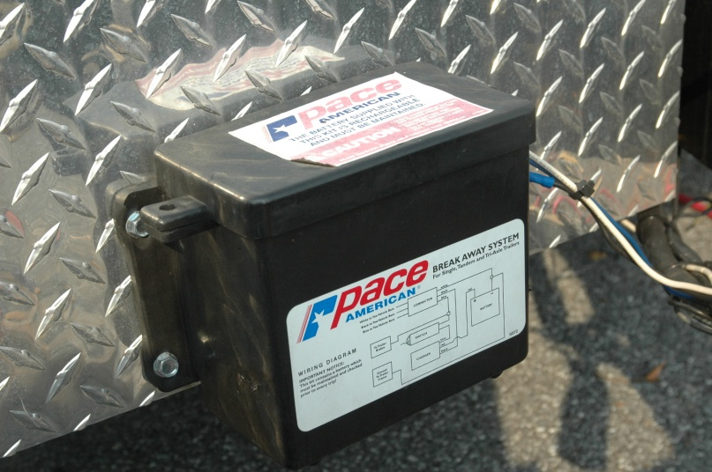
Battery and Inspection
Inspect brakes on a regular basis
Safety features are essential – pull cables, pull pins, switch

Slide 70
Braking System
The system is only as good as the BATTERY

Slide 71
Chapter 3 – Summary
Having a good braking system on the tow vehicle and the trailer is essential for safe operation. The benefits for investing in a good system include saving on wear and tear on both vehicles and adding a higher level of safety to the operation of trailers in emergency situations.

Slide 72
Chapter 4 – Tow Hitch, Ball Coupler Assembly
Another very important aspect is the connection between the tow vehicle and trailer… the tow hitch, ball and coupler assembly.

Slide 73
Tow Hitch, Ball and Coupler Assembly
Tow hitch – supports the weight of the trailer tongue and pulls the trailer.
  Hitch is attached to the tow vehicle, it must have a capacity equal to or greater than the load rating of the trailer.
  Tow hitch capacity must also be matched to the tow vehicle capacity.
  A hitch is rated by not only its towing capacity, but also its tongue weight.

Slide 74
Common Hitch Types
Weight-carrying Hitch
  designed to carry all of the trailer’s tongue weight
Weight Distributing or Load Equalizer Hitch
  used with a receiver hitch and special parts that distribute the tongue weight among all tow vehicle and trailer axles
Fifth Wheel or Gooseneck
– not discussed

Slide 75
Relationship Of Ratings
Consider how the hitch weight compares to the GVW.
  If the hitch weight is 10% of the GVW, load supplies as far forward as possible.

Slide 76
Establishing Correct Height of Weight Carrying Ball Hitch
Trailer is fully loaded. Measure distance at coupler and ground AND back of trailer and ground at predetermined points.
Hitch trailer to tow vehicle.
Trailer should be level after connected.

Slide 77
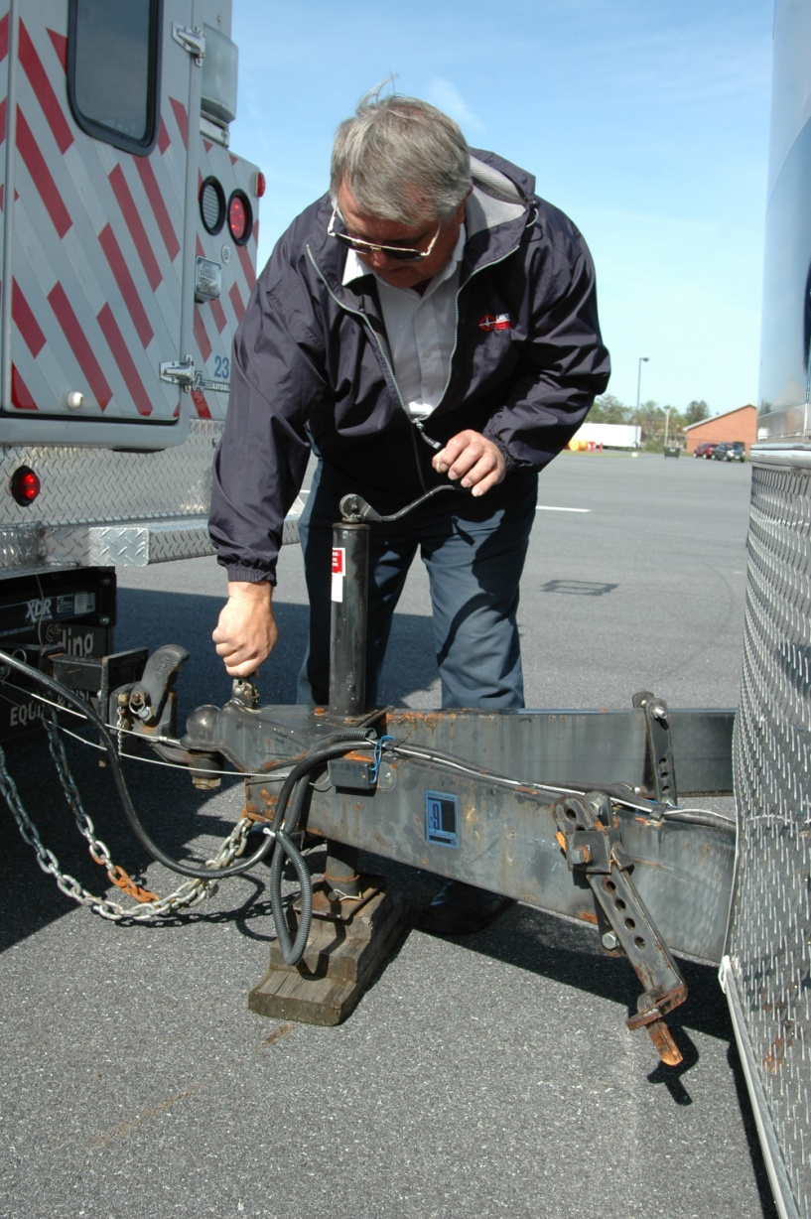
Couplers
Coupler attaches to the hitch.
Coupler handle lever must rotate freely and automatically snap into the latch position.
Operators should oil pivot points, sliding surfaces and spring ends using manufacturer recommendations.

Slide 78
Ball Assembly
Ball is the device the coupler sits on to connect the trailer and the tow vehicle.
Ball will have a range of diameters.
Ball location should allow the trailer to sit level when connected to the tow vehicle.
Ball should be slightly greased with a thin layer of automotive bearing grease.

Slide 79
Chains
Safety backup if the coupler comes loose.
Cross underneath the coupler.
Loop around the frame member of the tow vehicle or to holes provided on the hitch system.
Have enough slack to permit tight turns, but not be close to the road surface to drag or not support the trailer if it uncouples.
Safety chains are required by most states.

Slide 80
Minimizing Sway
If sway does occur, the operator should check for load shift, suspension problems and tire/wheel security and inflation.
Sway device allows the tow vehicle and trailer to operate as “one vehicle.” There are two basic types:
  friction bar
  dual cam sway control

Slide 81
Chapter 4 – Summary
The equipment that connects the trailer to
the tow vehicle is essential to the safe
operations of the entire system. Without
correct hook-up, proper care and
maintenance of the ball, coupler, chains and
tow hitch assembly the trailer could
disconnect while driving.

