Slide 1
Chapter 7 – Driving with a Trailer
Driving with a trailer requires specific skills and
awareness. These skills must be learned and
practiced. Over time, with continued driving time
experience is gained.

Slide 2
Driving With A Trailer
Drivers must not believe they can go as fast
as they would go in an emergency response
with a single vehicle, regardless of how
critical the incident

Slide 3
Posted Speed vs. Relative Speed
While the posted speed limit may be appropriate for a single vehicle, adding a trailer may require the driver to slow down below the posted speed limit for a safer response.

Slide 4
Posted Speed vs. Relative Speed
Relative speed – The speed measured at any mph relative to the operating environment, road conditions, or vehicle condition.

Slide 5
Driving With A Trailer
Response
The driver should be familiar with the area he/she is responding to.
If unfamiliar ask for “best approach”
Since trailers are often specialty vehicles with specialized equipment responding into areas to assist other organizations is possible, the driver should always determine the “best approach directions” to reduce response time and minimize potential damage to the trailer.

Slide 6
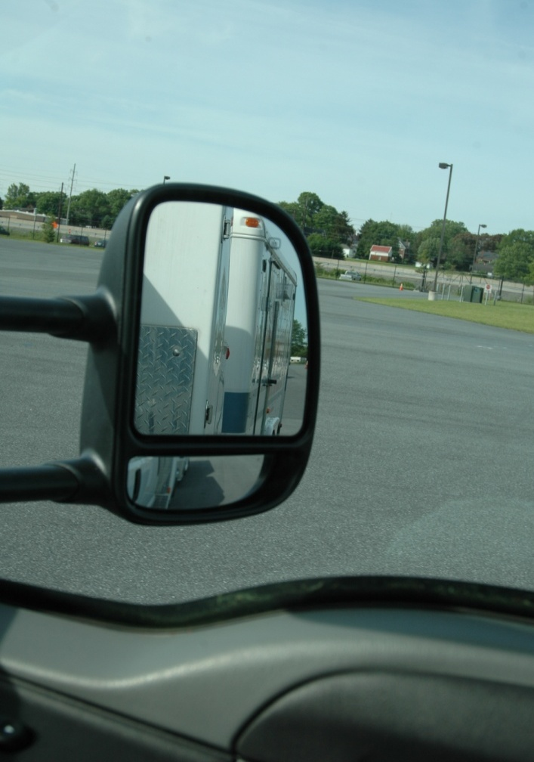
Driving With A Trailer
Vehicle is now a lot longer and heavier.
Vehicle will experience reduced acceleration.
Requires longer stopping distances.
Mirrors will have larger blind spots.
Mirrors, on the vehicle, MUST provide a clear view of the entire sides of the trailer.
Much wider turning circle.

Slide 7
Driving With A Trailer
Seeing ahead – look at least 12 to 15 seconds ahead, depending on speed (at least one block to a quarter of a mile).
Trailer does not follow the same turning arc as the tow vehicle.
Remember the blind spot behind trailer.
There are three pivot points.

Slide 8
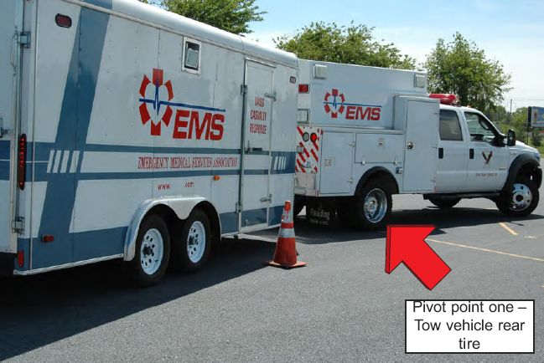
Pivot Points

Slide 9
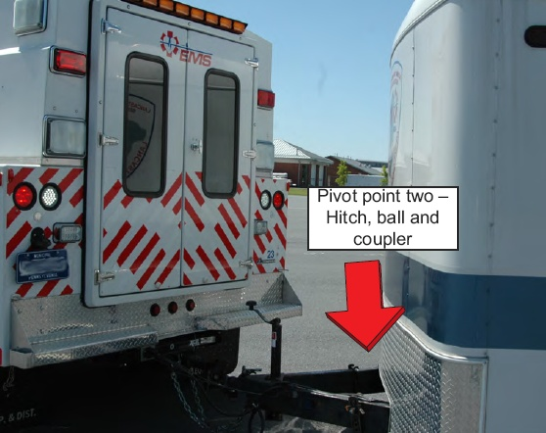
Pivot Points

Slide 10
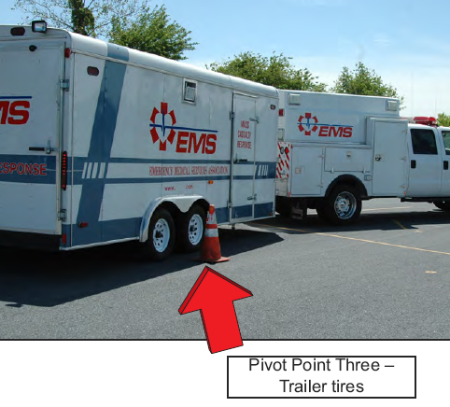
Pivot Points

Slide 11
Driving With A Trailer
Backing
Easiest method to steer in reverse is to place one hand on the bottom of the steering wheel (six o’clock), and move your hand in the direction you want the trailer to go.
Trailer will go the opposite direction of the towing vehicle.
If moving in the wrong direction, stop, pull forward and try again.
More time is lost when a driver attempts to correct while backing up.

Slide 12
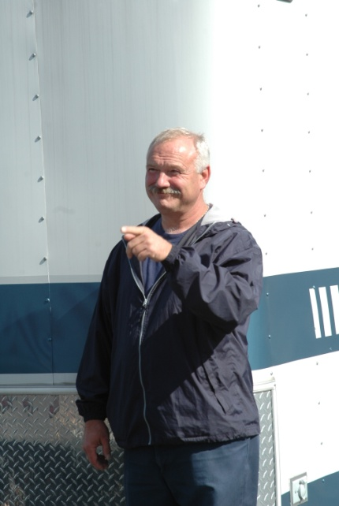
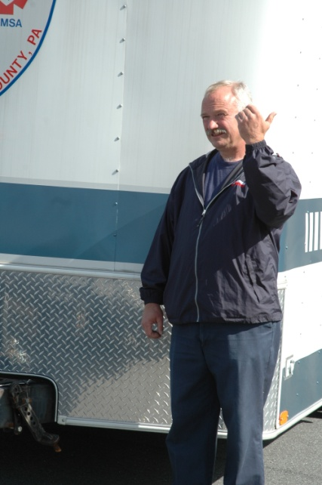
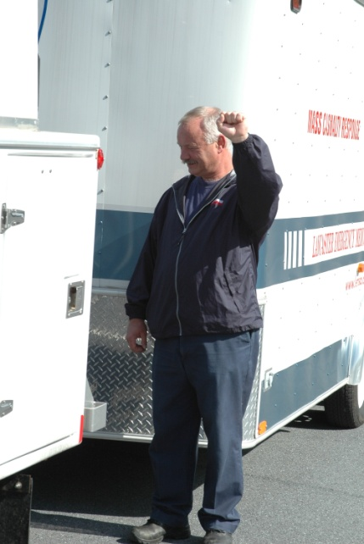
Driving With A Trailer
Backing (Cont’d):
Blow the horn of the tow vehicle prior to backing.
Spotter and driver should become familiar with hand signals and use them.

Slide 13
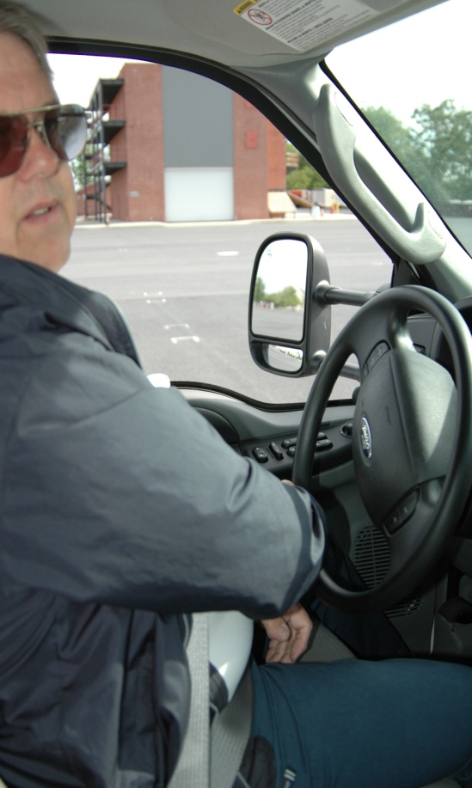
Driving With A Trailer
Turning
Look at the rear of the vehicle to ensure it will not hit anything while turning.
Left turn: make sure you reach the center of the intersection before starting the turn.
Right turn: avoid swinging into the on-coming lane of travel to make turn.

Slide 15
Driving With A Trailer
Wind
Causes significant movement between tow vehicle and trailer (push of trailer).
When passing or being passed by a large vehicles, pressure changes develop between the front and rear of the vehicle.
Truck’s “bow wave” will move the trailer first.

Slide 16
Driving With A Trailer
Acceleration and passing
Added weight of a trailer will dramatically decrease the ability to accelerate and pass other vehicles.
Allow the appropriate amount of space between the back of the trailer and the slower vehicle before pulling back into the lane.

Slide 17
Driving With A Trailer
Downgrades and Upgrades
Downshifting assists in deceleration.
Downshifting provides added power for climbing hills.
On flat roadways operate in overdrive or, if equipped, the tow/haul mode.

Slide 18
Driving With A Trailer
Parking
Whenever possible, avoid parking on a grade
Set emergency brake
Place a wheel chock

Slide 19
Driving With A Trailer
Intersections
Civilian operators will anticipate one vehicle passing through an intersection.
Will wait the obligatory amount of time for the “one vehicle” and then proceed as normal
Emergency vehicle responding with a trailer is an added “abnormal” situation that the public does not anticipate.

Slide 21
Driving With A Trailer
Braking
Speed and stopping distance are directly related
Perception distance
Reaction distance
Braking distance
Doubling the traveling speed means that it takes four times as much distance to stop the vehicle and it will have 4x the destructive energy if a crash occurs.

Slide 22
Driving With A Trailer
Skid Control
5 ways a vehicle driver will lose control
Over braking – Braking too hard and locking up the wheels.
Over steering – Turning the wheels more sharply than the vehicle can turn.
Over acceleration – Providing too much power to the tow vehicle.
Driving too fast – SLOW DOWN!
Lack of Situational Awareness

Slide 23
Driving With A Trailer
Controlling the skid
Tow vehicle could slide either right or left.
Trailer will go the opposite direction which can push the tow vehicle into a jack knife position.
Correcting this situation requires steering the tow vehicle in the intended direction.

Slide 24
Driving With A Trailer
Driving into curves
Driving into a curve too fast with a trailer can pull the tow vehicle toward the outer part of the curve. Trailers with higher center of gravity can roll over even when the driver is adhering to posted speed limits, as the limits are determined for the normal vehicle – not a vehicle towing a trailer.

Slide 25
Chapter 7 – Summary
Driving a vehicle with a trailer attached is
very different than driving a single vehicle.
The operator has many other factors to
consider. The driver’s ability to control the
forces that act on the tow vehicle and trailer
will enhance safe travel to the scene.

