Slide 1
Chapter 8 – The Course
Practicing needed skills can take many
forms. One form is having all drivers
practice on a controlled course. The
practical course allows all drivers the
opportunity to learn how the tow vehicle and
trailer handle in non-emergent situations
and gain an appreciation for both vehicles.

Slide 2
Purpose of Controlled Driving
Assist in the training of candidate driver
Qualify the candidate driver for the street and highway portion
Verify the competency of an existing driver
Examine the proficiency of an existing driver

Slide 3
Station Practice
Measure a driver’s skill, knowledge and judgment
Identifies limitations of the trailer and vehicle
Is only one part of a comprehensive driver training program. Street and highway practice, ongoing assessment and continued education is essential to ensure competency

Slide 4
Emphasis on Safety
Safety Officer Assigned
Driver and support personnel briefing
Safety vests for spotter, safety officer and support personnel
Eating, drinking and smoking are not permitted by any vehicle occupant
All personnel in the vehicle shall be belted and seated
6. Pre-trip safety inspection completed

Slide 5
Emphasis on Safety
7. Low speed thru each station
Towing vehicle should operate with headlights on
A second person should accompany the driver in the cab
A spotter shall be used when backing
No vehicle shall maneuver thru any station until given the signal by the safety officer

Slide 6
Skill Stations
Station One – Straight Line
Station Two – Right (Passenger Side) and Left (Driver Side) Alley Dock
Station Three – Serpentine
Station Four – Off Set Alley

Slide 7
Skill Stations
Operators need to resolve to learn and practice the proper safety procedures for operating a trailer in emergency situations. In addition, leaders must insist on educating drivers and having them practice these techniques as well as continue to monitor the way drivers handle these units.

Slide 8
Skill Station Recommendations
Each station is set up one at a time and
each driver practices the application until
proficient.
The student should complete the straight line, serpentine and off set alley exercises before moving to the right/left side alley dock exercise.

Slide 9
Station One – Straight Line
Purpose – To familiarize the driver with operating the vehicle and trailer within close quarters both in forward and reverse directions at a steady speed.
Set-up:
  Approximately 15 to 20 (24″) cones
  Width is10 feet and is measured at the edge of the cone. Length is the total length of the tow vehicle and trailer plus 20 feet.
  A spotter is required

Slide 10
Station One Skills
This station tests the driver’s ability to negotiate a narrow alley
Tests driver’s ability to rely on mirrors
Tests driver’s ability to see how minor steering adjustments affect trailer direction
Tests driver’s ability to focus on backing

Slide 11
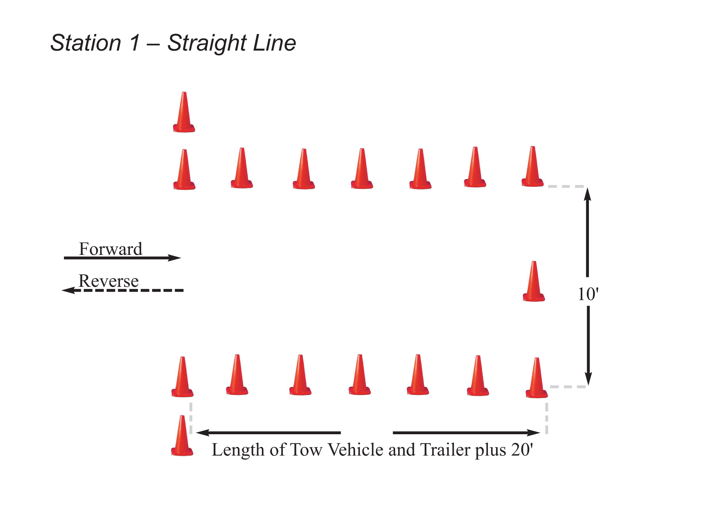
Station 1 – Straight Line
Length of Tow Vehicle and Trailer plus 20'

Slide 12
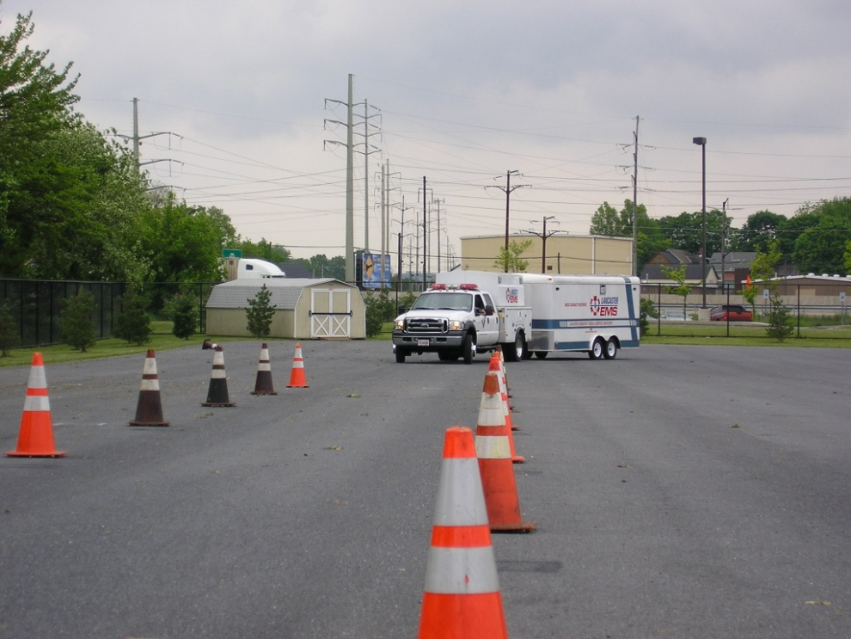
Station One – Skill
The driver will move the unit into the straight-a-way and proceed forward to the end of the station.
The driver will back the unit through the station.

Slide 13
Station Two – Alley Dock
Purpose – To familiarize the driver with positioning the vehicle and trailer in a restricted space and to judge depth perception and distance using the mirrors on both sides of the vehicle.
Set-up:
  Approximately 25 to 30 (24″) cones
  Width is12 feet measured at edge of cone
  Depth is length of the tow vehicle plus trailer
  A spotter is required

Slide 14
Station Two – Skill
Station tests the driver’s ability to use mirrors on both sides of the vehicle.
Driver must be aware of the pivot points.
Push the ball as a means of negotiating this skill.

Slide 15
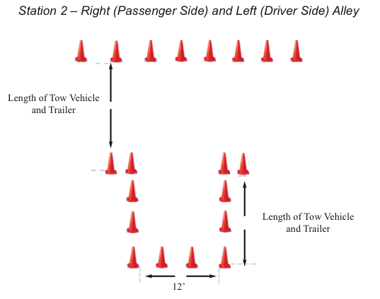

Slide 16
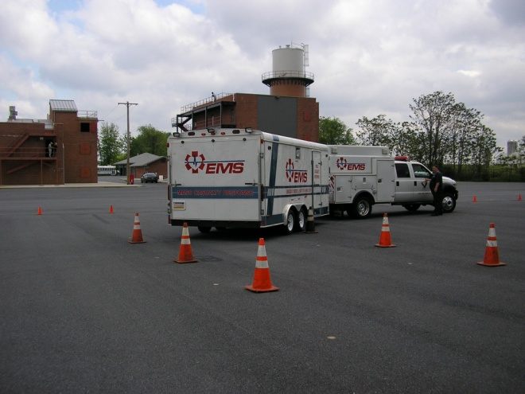
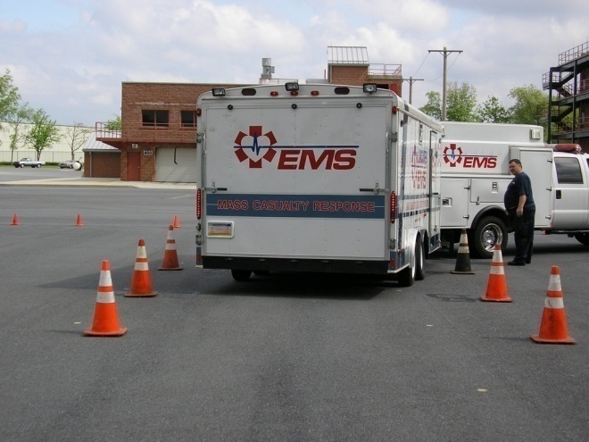
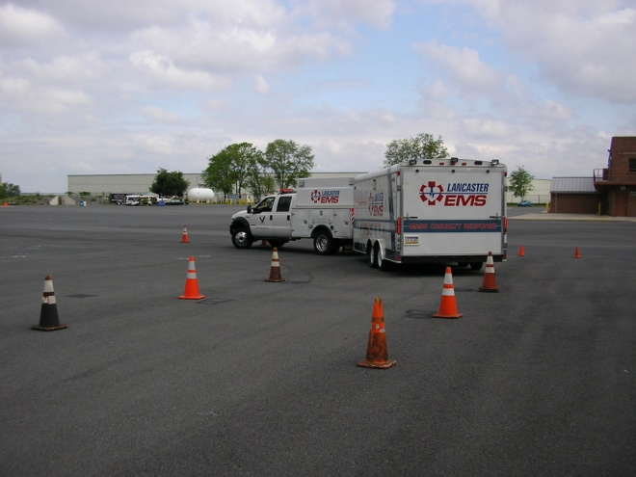
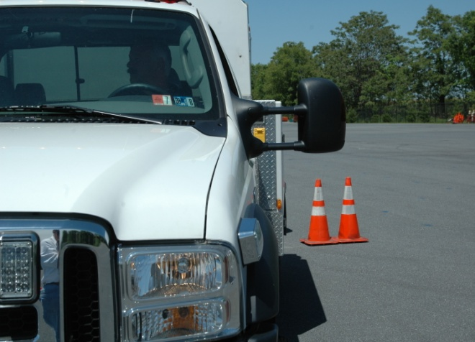
Station Two – Skill
Right side backing
Left side backing

Slide 17
Station Three – Serpentine
Purpose – To familiarize the driver with the locations of the corners, turning radius and pivot points of the towing vehicle and the trailer.
Set-up:
  Approximately 15 to 20 (24″) cones
  Width is 10 feet
  Distance between cones is length of tow vehicle and trailer combined measured at the edge of each cone.

Slide 18
Station Three – Skill
Station tests the driver’s ability to use mirrors on both sides of the vehicle.
Driver must be aware of the pivot points.
Tests driver’s ability to move through rapidly changing direction and close objects while maintaining control of both tow vehicle and trailer.

Slide 19
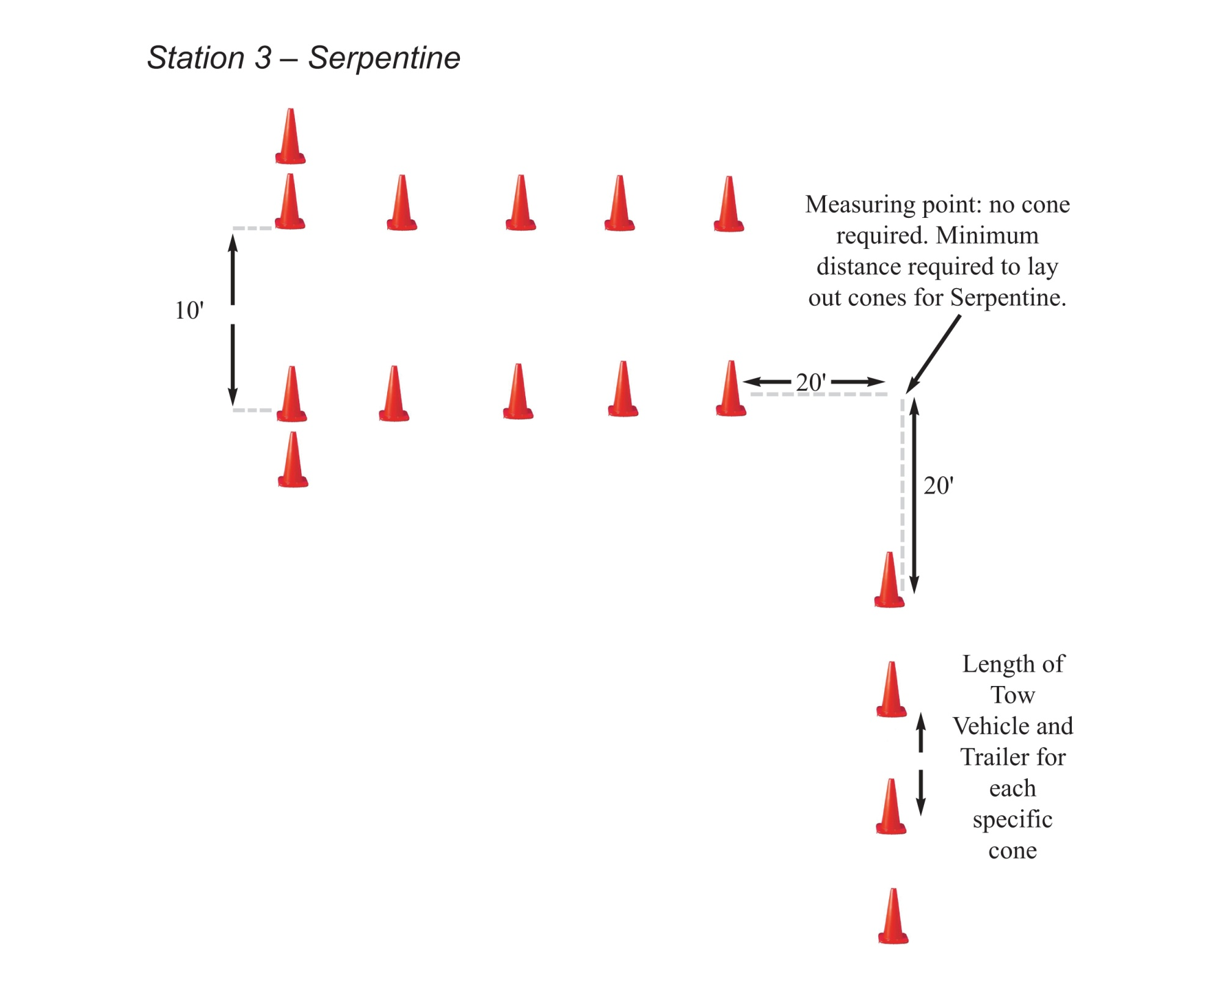

Slide 20
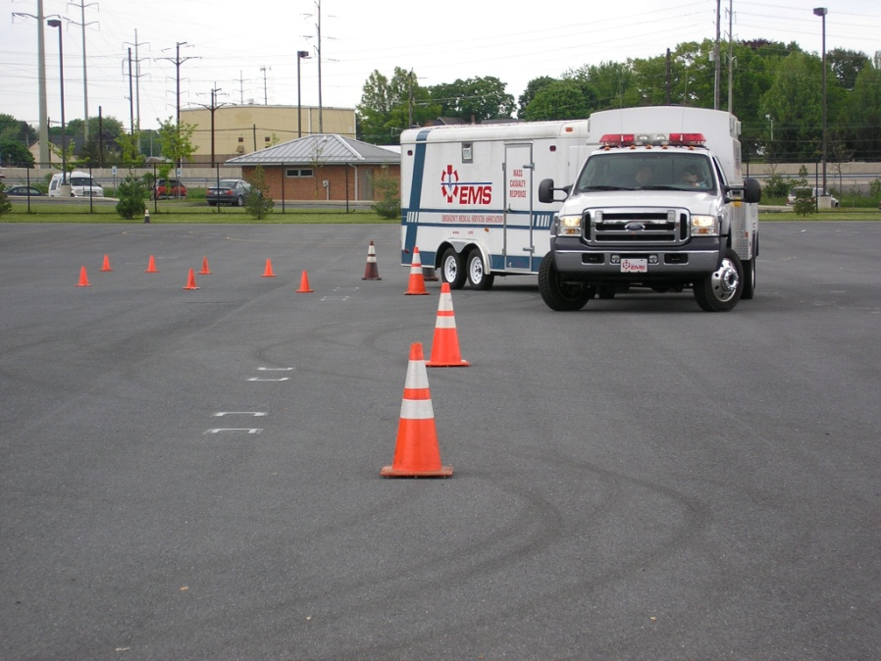
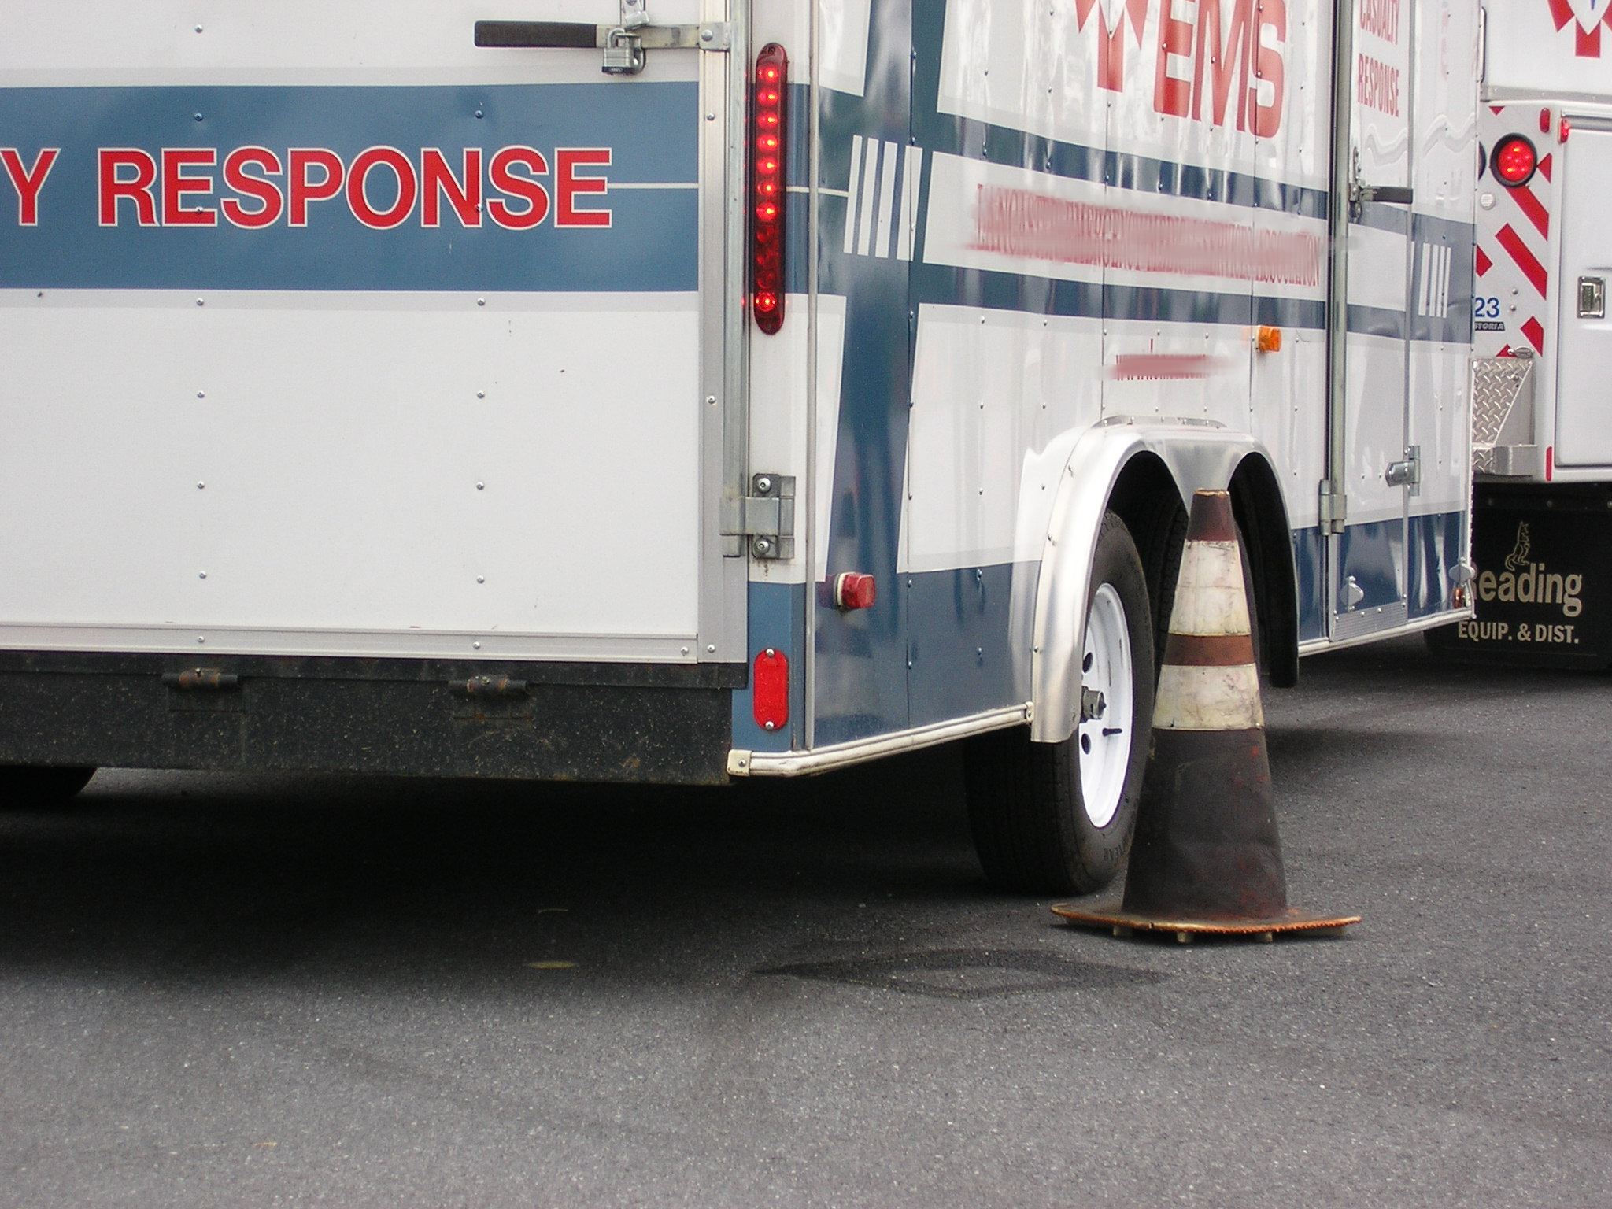
Station Three – Skill
Test the basic skills the driver needs to maneuver the trailer.

Slide 21
Station Four – Off Set Alley
Purpose – To familiarize the driver with the front and rear track of the towing vehicle and trailer as well as the pivot points of each.
Set-up:
  Approximately 20 to 25 (24″) cones
  Width is 10 feet
  Length of alley – length of tow vehicle and trailer combined
  Distance between alleys is the tow vehicle and trailer plus 10 feet measured at the edge of the cones

Slide 22
Station Four – Skills
This station tests the driver’s ability to maneuver through lanes at a controlled speed
Tests driver’s ability to judge distance and use pivot points to negotiate lane changes
Tests driver’s to straighten tow vehicle and trailer before hitting cones.

Slide 23
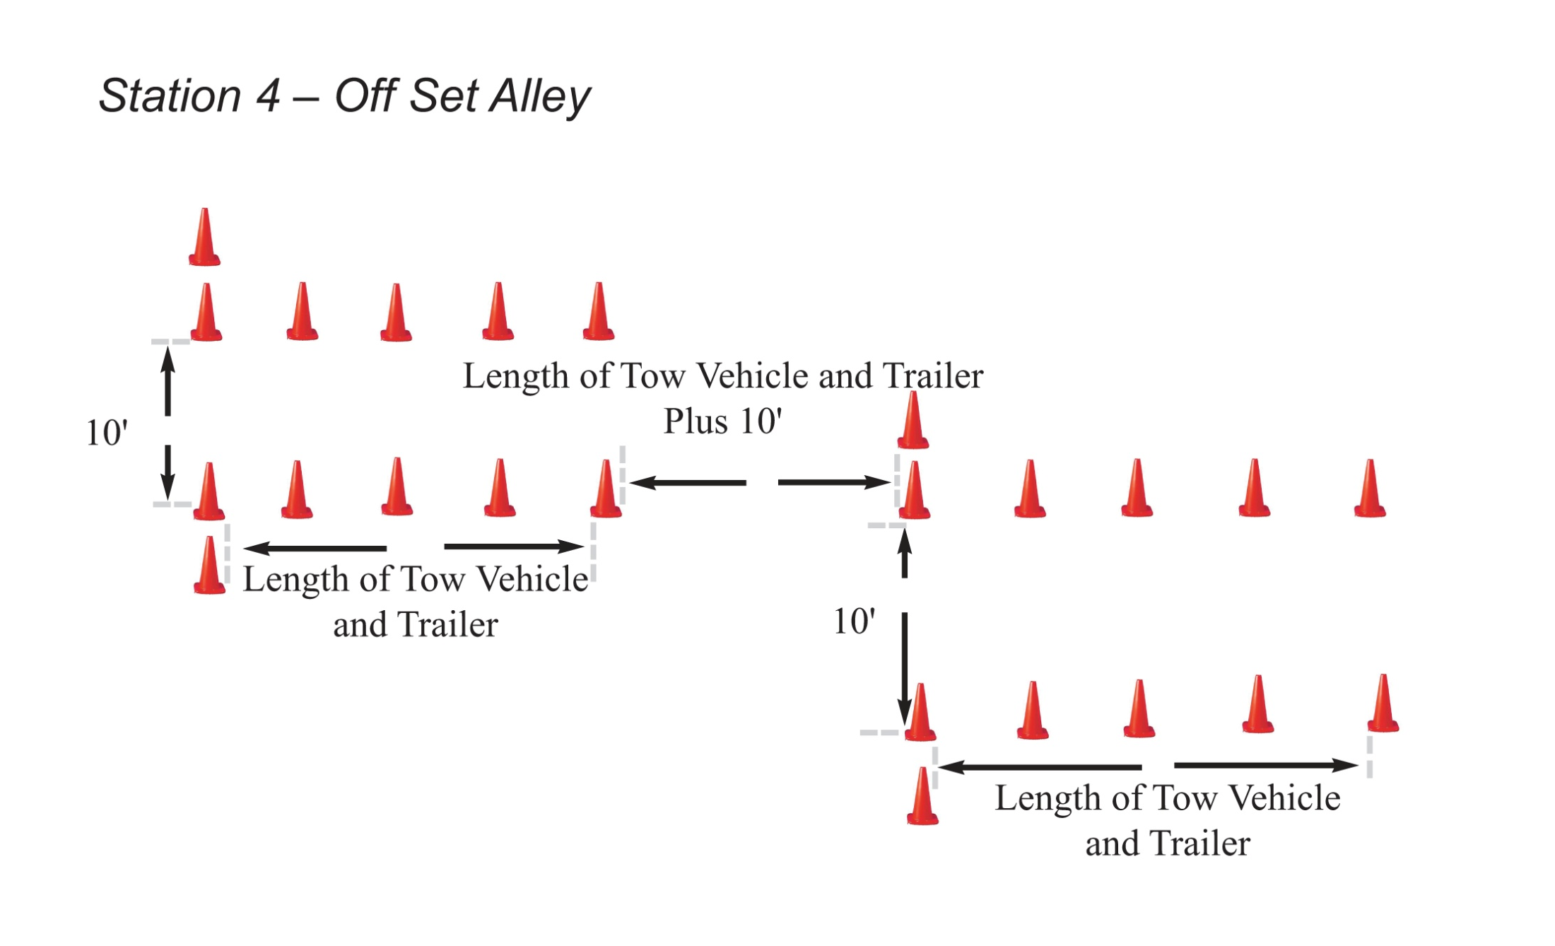

Slide 24
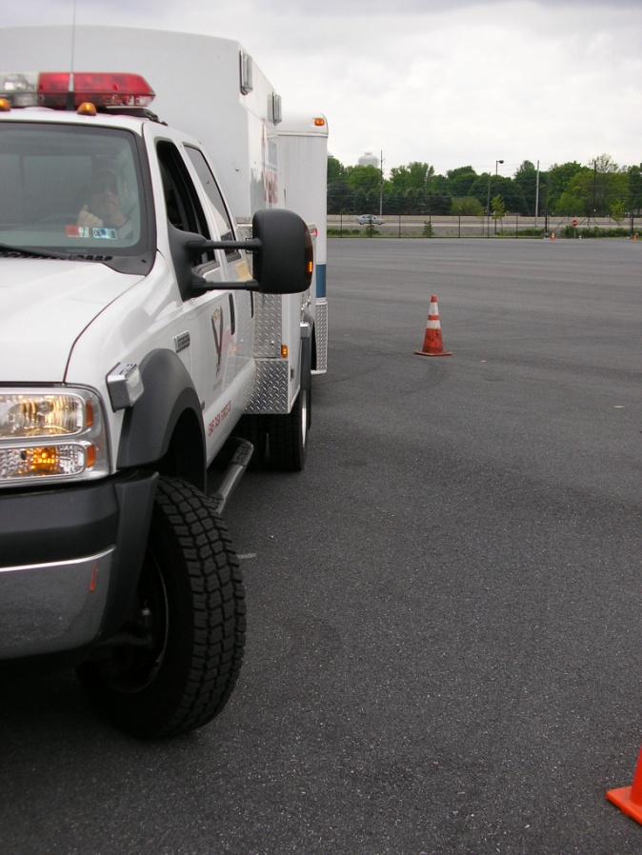
Station Four – Skill
To test the driver’s skill in negotiating a lane change

Slide 25
Case Study
Driver was responding to assist a neighboring department on a dwelling fire
Weather was clear and the road surface was dry
Posted speed limit was 45 MPH
Driver was in the proper lane of travel and rounding a curve

Slide 26
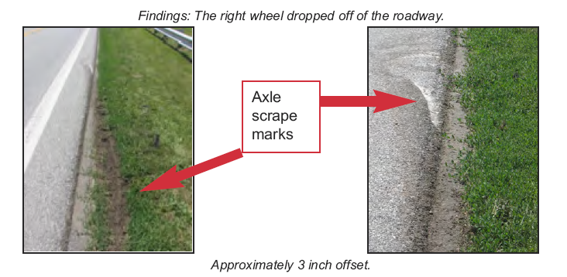
Case Study - Findings

Slide 27
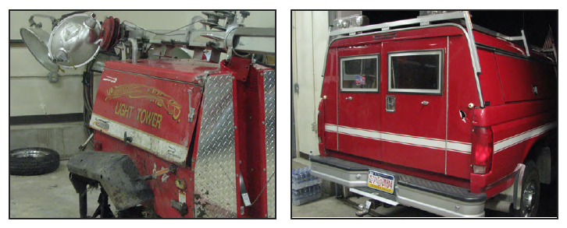
Case Study- Damage

Slide 28
Case Study – Insight
The tow vehicle was bigger than the trailer
Two different insurance carriers
Driver speed relative to call, road conditions and equipment
Training
Trailer tips
Light tower bounced
Company SOPs were followed

Slide 29
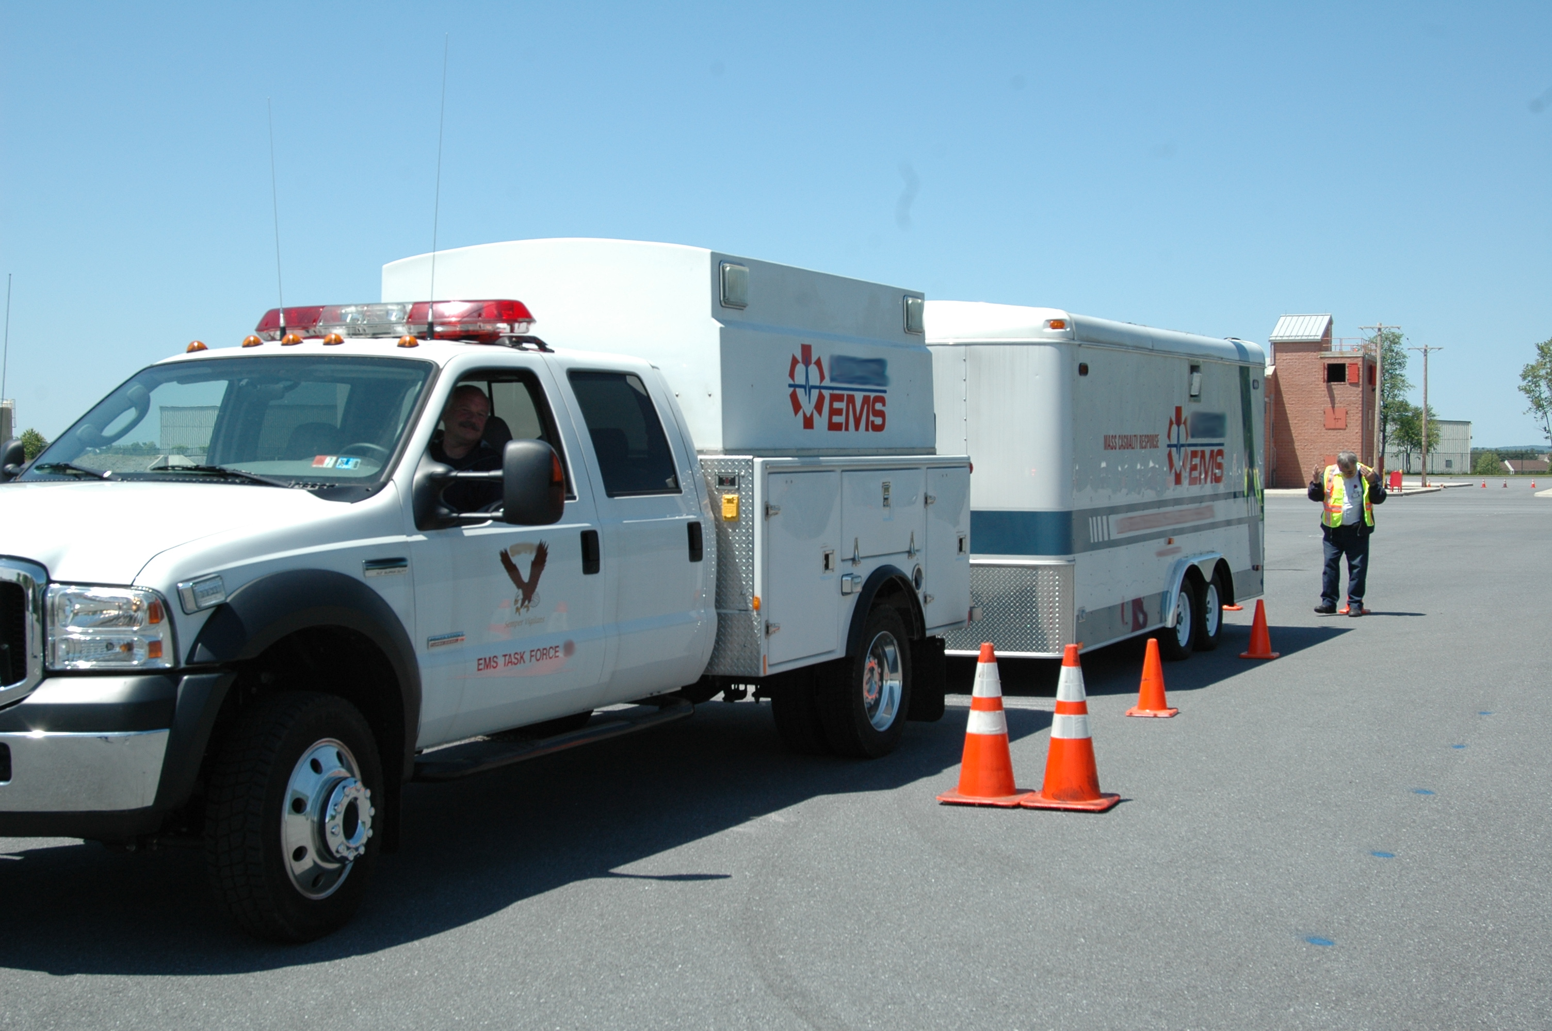
Thank You
VFIS @ 1-800-233-1957
www.vfis.com

