Slide 2
Online Open House: January 18, 2023
LSBRP and MFD Presentation

Slide 3
Welcome
This meeting is being recorded for future use on our website and social media accounts
Please hold your questions until the end, or type them in the chat box
Please mute yourselves and turn off your camera during the presentation
The recording and PPT slides will be available on our website very soon

Slide 4
Montgomery County: Local Business Programs
1st Step for ALL vendors:
Register in our database: www.mcipcc.net
Enter your commodity codes

Slide 5
Montgomery County: Local Business Programs
Local Small Business Reserve Program (LSBRP)
Local Business Preference Program (LBPP)
Local Business Subcontracting Program (LBSP)

Slide 6
Local Small Business Reserve Program
The Local Small Business Reserve Program (LSBRP) ensures that County departments award 25 percent (with specified exceptions) of their procurements for goods, services and construction to registered and certified local, small businesses.
https://www.montgomerycountymd.gov/PRO/DBRC/lsbrp.html

Slide 7
LSBRP: Do I Qualify?
Eligibility for the LSBRP is determined by ownership type, location, number of employees and gross sales.
Ownership
Independently-owned businesses only; brokers and subsidiary businesses are not eligible. A federal tax number or W-9 in the name of the business is required.

Slide 8
Local Small Business Reserve Program
Location
The business must have its principal place of business in Montgomery County defined as follows:
The business has its physical business location(s) only in Montgomery County; or
The business has physical business locations both in and outside of the County, but the County-based location(s) accounts for over 50% of the business's total number of employees, or over 50% of the business's gross sales.

Slide 9
Local Business Preference Program
The Local Business Preference Program (LBPP) is a local preference points program, so Montgomery County-based businesses will receive an extra 10% preference points on proposals.
https://www.montgomerycountymd.gov/PRO/DBRC/local-business-preference.html

Slide 10
Local Small Business Subcontracting Program
Local Business subcontracting goals:
At least 10% of the contract dollars awarded for each High Dollar Value Contract should be awarded to a Local Business; and
At least 10% of the total dollar value of all High Dollar Value Contracts in the aggregate should be awarded to Local Businesses.
https://www.montgomerycountymd.gov/PRO/DBRC/local-business-subcontracting.html

Slide 11
LSBRP Annual Report FY22
https://montgomerycountymd.gov/PRO/report/index.html
In $ Values | FY19 | FY20 | FY21 | FY22
Total Encumbrance to LSBRP | $101,604,034 27.4% | $120,318,366 27.8% | $129,860,381 27.2% | $141,569,096 26.2%

Slide 12
LSBRP Major Awards FY22
​ DEPT​ | Vendor​ | MFD?​ | Description​ | Amount​
DGS​ | Mallick Plumbing & Heating, Inc.​ | ​ | Time and Material Plumbing Services​ | $1,221,000.00​
DOT​ | SFMS, LLC​ | Y​ | Snow Removal Services at County Parking Facilities - Groups 2 and 6​ | $720,000.00​
DOT​ | The Media Network, Inc., dba TMNCORP​ | Y​ | Marketing Services​ | $714,285.00​
DOT​ | The Hatcher Group Inc.​ | Y​ | Marketing Services​ | $714,285.00​
DOT​ | Van Eperen Public Relations, LLC T/A FOVNDRY​ | Y​ | Marketing Services​ | $714,285.00​
DOT​ | Clark Concepts, LLC​ | Y​ | Marketing Services​ | $714,285.00​
DOT​ | McAndrew Co Inc​ | Y​ | Marketing Services​ | $714,285.00​
DOT​ | Montage Marketing Group LLC​ | Y​ | Marketing Services​ | ​
DOT​ | Sharp & Company, Inc​ | Y​ | Marketing Services​ | $714,285.00​
DGS​ | Professional Hispanic Contractors, Inc.​ | Y​ | Snow Removal at County Facilities- Areas 6 and 7​ | $611,560.00​
DGS​ | CT Stanley & Son Inc​ | Y​ | Snow Removal at County Facilities- Area 8​ | $ 608,620.00​
DGS​ | Earn Contractors, Inc.​ | Y​ | Snow Removal at County Facilities- Areas 4 and 5​ | $588,000.00​
DGS​ | MAS Natural Restoration, Inc.​ | ​ | Snow Removal Services at County Parking Facilities - Groups 5 and 7​ | $584,000.00​
DGS​ | Kiara's Landscaping Inc.​ | ​ | Snow Removal at County Facilities- Areas 1 and 2​ | $523,280.00​

Slide 13
LSBRP Major Awards FY22 (continued)
DGS​​ | Clover Carpet Co.​​ | ​​ | Carpet, Carpet Tile and Other Floor Coverings, Installation and Repair Services​​ | $500,000.00​​
DOT​​ | EARN Contractors, Inc.​​ | Y​​ | Snow Removal Services at County Parking Facilities - Groups 3 and 4​​ | $492,000.00​​
DOT​​ | K.E.S. Contracting LLC​​ | ​​ | Snow Removal at County Facilities- Area 3​​ | $ 491,528.00​​
DGS​​ | Burgos Contractors LLC​​ | ​​ | Time & Material Carpentry and Painting Services 2nd rotation​​ | $356,995.00​​
DGS​​ | Earn Contractors, Inc.​​ | Y​​ | Time & Material Carpentry and Painting Services First on a rotating basis​​ | $315,200.00​​
DOT​​ | Kiara's Landscaping, Inc.​​ | ​​ | Snow Removal Services at County Parking Facilities - Groups 1 and 8​​ | $220,000.00​​
REC​​ | Amato Industries, Inc./Amchlor​​ | ​​ | Dry Chemicals for Swimming Pools​​ | $180,000.00​​
REC​​ | Personalized Classics​​ | ​​ | Screen Printed Apparel​​ | $140,000.00​​
DGS​​ | American Reprographics Inc.​​ | ​​ | Reproduction and Copying of Engineering Drawings​​ | $125,000.00​​
REC​​ | Investscure LC​​ | ​​ | Appliance Purchase and Repair​​ | $100,000.00​​

Slide 14
Minority, Female, Disabled-Owned Business Program (MFD)
Montgomery County’s MFD Program assists certified minority firms in gaining access to prime contractor and subcontractor opportunities with County government agencies.
The MFD Program is a subcontracting program administered through the Office of Procurement.
https://www.montgomerycountymd.gov/PRO/DBRC/mfd.html

Slide 15
Minority, Female, Disabled-Owned Business Program (MFD)
MFD Current Goals
​ | ​Construction​ | Professional Services​ | Non-Professional Services​ | Goods​
CY 2023​ | 21%​ | 19%​ | 22%​ | 10%​
Based on 2014 Disparity Study
Minority primes are required to have MFD subs as well
Goals are posted on the MFD page www.montgomerycountymd.gov/MFD

Slide 16
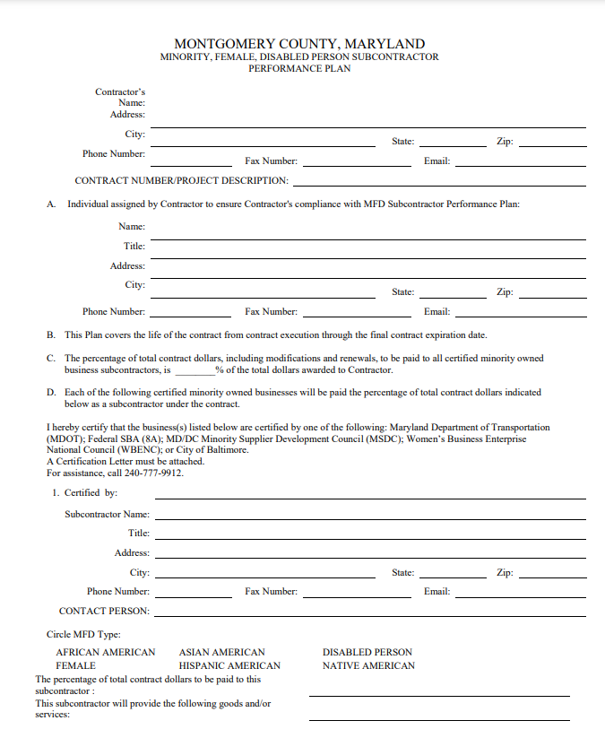
Minority, Female, Disabled-Owned Business Program (MFD)
MFD Subcontractor Performance Form

Slide 17
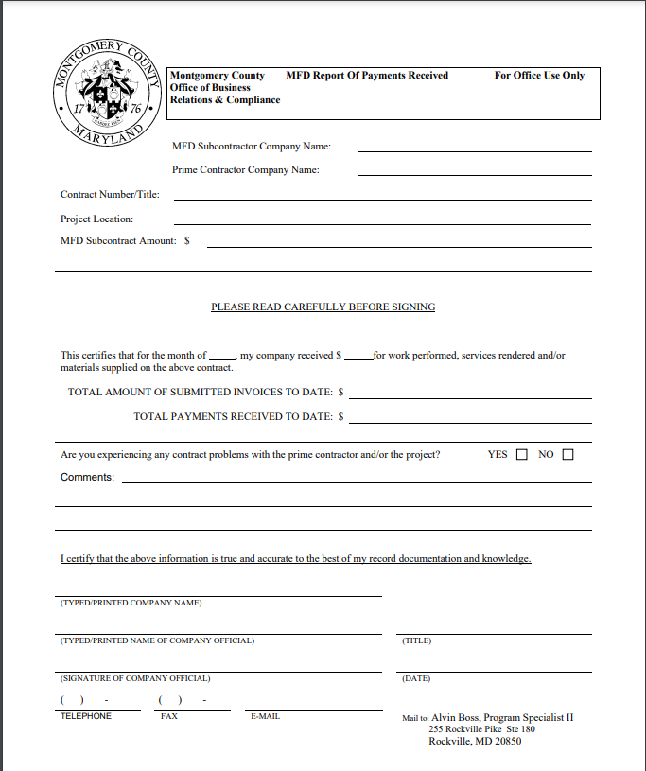
Minority, Female, Disabled-Owned Business Program (MFD)
MFD Payment Form

Slide 18
Minority, Female, Disabled-Owned Business Program (MFD)
MFD Certifications Accepted by Montgomery County
Agency​ | Program​ | Description​ | Contact​
NEW! U.S. Department of Veterans Affairs (VA)​ | Service-Disabled Veteran Owned Small Business​ | Service-Disabled Veteran Owned Small Business​ | 1-866-584-2344​ website link​
Maryland Department of Transportation​ | Minority Business Enterprise​ | MDOT Directory of Certified MBE and/or DBE firms (MDOT-MBE)​ | 1-800-544-6056​ website link​
Federal Small Business Administration​ | 8(a) Program​ | Directory of Certified 8a firms (SBA)-8a​ | 1-202-272-0345​ website link​
Women's Business Enterprise National Council​ | Women's Business Enterprise​ | Women's Business Enterprise (WBENC)​ | 1-202-595-2632​ website link​
Capital Region Minority Supplier Development Council​ | Minority Business Enterprise​ | Minority Business Enterprise (MSDC)​ | 1-301-593-5860​ website link​
City of Baltimore​ | Minority and Women's Business Opportunity Office​ | Minority and Women's Business Opportunity Office (MWBOO)​ | 1-410-396-4355​ website link​

Slide 19
Minority, Female, Disabled-Owned Business Program (MFD)
MFD Annual Report
https://montgomerycountymd.gov/PRO/report/index.html
Fiscal Year | Total $Subject to MFD | Total $ Encumbered to MFD | % of Total $ Encumbered to MFD
FY 22 | $816,175,595 | $212,449,525 | 26.03%
FY 21 | $746,510,083 | $200,457,253 | 26.86%
FY 20 | $797,850,214 | $182,655,316 | 22.89%
FY 19 | $784,305,871 | $195,995,706 | 24.41%

Slide 20
Helpful Links
Procurement website www.montgomerycountymd.gov/PRO
Vendor Registration System www.mcipcc.net
Vendor Resources https://www.montgomerycountymd.gov/PRO/vendor-resources/index.html
PROjection (Forecasting tool)
https://www.montgomerycountymd.gov/PRO/solicitations/projections.html
Subscribe to weekly newsletter
https://content.govdelivery.com/accounts/MDMONTGOMERY/bulletins/2fb9c49
Monthly Virtual Open House (Third Wed 10AM-11AM)
Check the event calendar on www.montgomerycountymd.gov/pro)

Slide 21
Questions?

Slide 22
Contact Information
Michael Brown, Program Manager Montgomery County Local Business Programs Phone: 240-777-9913 Email: Michael.brown@montgomerycountymd.gov
Alvin Boss, Program Manager Minority, Female and Disabled-Owned Business Program Phone: 240-777-9912 Email: alvin.boss@montgomerycountymd.gov
Grace Denno Chief | Division of Business Relations and Compliance Phone: 240-777-9959 Email: Grace.Denno@montgomerycountymd.gov

