Slide 1

Addressing the Reduction of Women in the U.S. Workforce
Post-COVID
Lynne Stein Benzion, Director of Economic Development
Brandon Bedford, Research & Policy Manager
Montgomery County Economic Development Corporation
  June 11, 2021

Slide 2
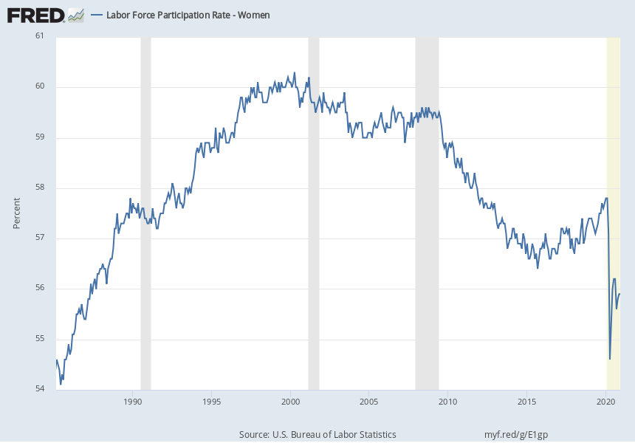
Labor Force Participation Rate Nationally for Women since 1985
Labor force participation rate for women now lowest since 1988
Spring 2020: dropped below 55% for the first time since 1986
Participation peaked in 2000; first big decline was after recession, next was pandemic
2.9 million women left workforce from Q1 to Q2 in 2020
1.9 million fewer women in workforce in Q1 2021 than Q1 2020

Slide 3
National Labor Force Participation by Race and Sex
All race/gender combinations saw significant declines in labor force participation;
black and Hispanic women labor force participation continues to decline
while other groups have shown some recovery

Slide 4
Wages by Gender and Race
Most long-term job losses nationwide are in low wage occupations (retail, hotels, restaurants, childcare)
Black and Hispanic women are disproportionately in low wage occupations
Low wage occupations less likely to have remote work ability than higher wage work
Long-term school closures led to workforce exits, as daycare services cost more than total earnings for low wage workers
Caring for sick loved ones led to workforce exits: COVID-19 disproportionately infected black and Hispanic communities
Sex | Race | Median Hourly Wage (All Occupations) (USA) (2019)
Men | Asian | $17.22
Men | White | $17.10
Women | Asian | $15.29
Men | Hispanic | $15.25
Men | Black | $14.98
Women | White | $14.93
Women | Hispanic | $14.68
Women | Black | $14.00

Slide 5
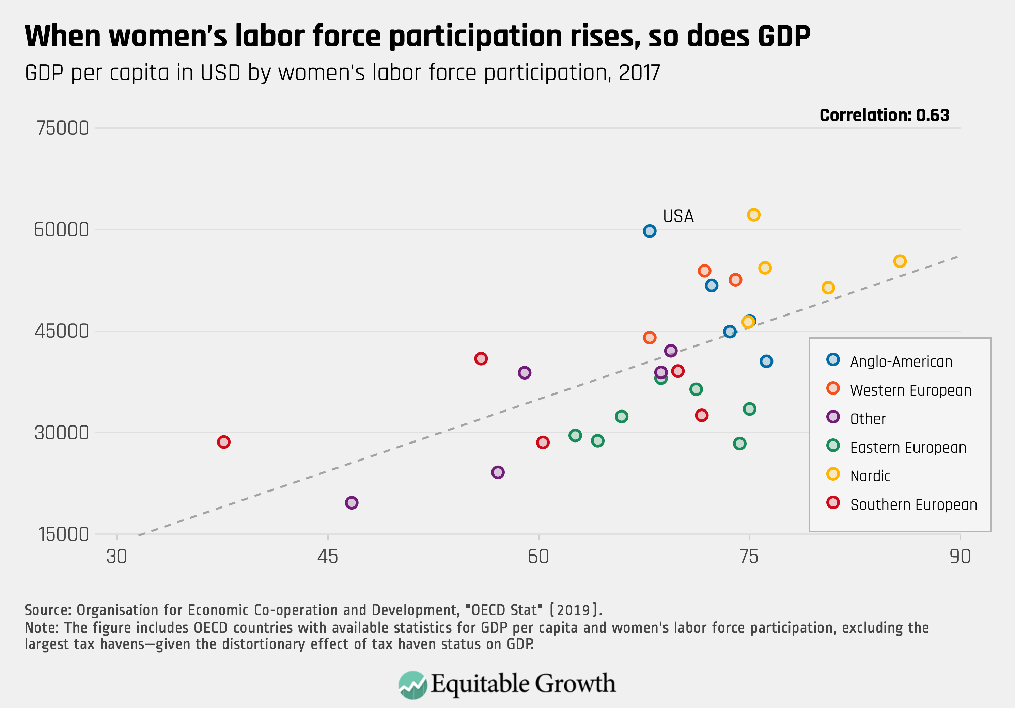
Women in Labor Force Benefits Everyone
Countries with higher labor force participation have higher GDP
In the US, 10% increase in women working in a metro area is correlated with a 5% increase in overall average wages (Harvard Business Review)

Slide 6
Addressing the Reduction of Women in the U.S. Workforce
Post-COVID
Lynne Stein Benzion, Director of Economic Development
Montgomery County Economic Development Corporation
  Lynne@ThinkMoCo.com
www.ThinkMoCo.com

