Slide 1

Diversion Center Project Update
4.29.2024
Earl Stoddard, PhD, MPH, CEM
Assistant Chief Administrative Officer
Office of the County Executive

Slide 2
 | Restoration Center | Diversion Center
Hours of Operation | 24 hours per day, 7 days per week, 365 days per year | 24 hours per day, 7 days per week, 365 days per year
Purpose | Provide integrated care for adults and children with mental health conditions and/or addiction. | Decompression & diversion via short-term crisis stabilization services, then referral to community-based resources
Target Population(s) | County residents experiencing a mental health and/or substance use crisis | County residents ages 18+ experiencing mental health and/or substance use crisis who have been: Transferred after release from Montgomery County Detention Center (MCDC) Transported by public safety responders Transferred and transported from a hospital via ambulance
Accessibility | Open to the general public, “no wrong door” policy | Open to county residents transported by MCPD, MCFRS, DOCR, DHHS, or hospitals

Slide 3
 | Restoration Center | Diversion Center
Exclusion Criteria | None | Walk-ins Referrals from community-based behavioral health organizations Non-county residents Children/adolescents
Location | Geographic areas with greatest unmet need; highest number of crisis events (e.g., “hot spots”) | Centralized in the County with proximity to the MCDC/Central Processing Unit (CPU) to effectively divert prior to entry into the criminal justice system
Services | Short-term behavioral health crisis stabilization May include supported housing, residential and employment programs for walk-in clients Discharge planning and referrals to community-based resources | Short-term behavioral health crisis stabilization for eligible clients Discharge planning, referrals, & transportation to community-based resources

Slide 4
Diversion Center Project Update
Held first stakeholder workgroup on 9/28/2023 and meetings have continued monthly since.
Stakeholder group did a site visit over to the Seven Locks property in October 2023.
Program of Requirements remains updated to reflect current scope.
County project website remains updated to reflect current scope.
County has onboarded an architect to begin design work based on the decisions and feedback provided by the both the external stakeholder group and an internal operator workgroup (DHHS, consultants)

Slide 5
Stakeholder Engagement Team
Current Composition:
  3 members of neighboring community (Seven Locks Alliance)
  2 members of the recovery community (NAMI & STEER)
  1 member from the Department of Health & Human Services
  1 member from the Department of General Services
  1 member from the Department of Corrections & Rehabilitation
  ACAO Stoddard
Ad hoc participants have included Montgomery County Police Department, Fire Rescue Service, & Office of the State’s Attorney.

Slide 6
Stakeholder Engagement Team Issues
Facility Placement on Site
Fencing, Sidewalks, Lighting, Traffic, Buffers, Landscaping, Sound attenuation
Signage at the facility
Post-Release Transport options for both diversion center and central processing
What happens when there isn’t a referral and a client is approaching 72hrs
Legal processes if a client fails to complete diversion programming
What happens if there is a walk-in
Referrals from the Crisis Center or Mobile Crisis Outreach Teams (MCOTs)
Client flow through the site from arrival based on different points of origination (pre-arrest, arrest, ED, etc)

Slide 7
Stakeholder Engagement Team Issues
Facility Placement on Site
Fencing, Sidewalks, Lighting, Traffic, Buffers, Landscaping, Sound attenuation
Signage at the facility
Post-Release Transport options for both diversion center and central processing
What happens when there isn’t a referral and a client is approaching 72hrs
Legal processes if a client fails to complete diversion programming
What happens if there is a walk-in
Referrals from the Crisis Center or Mobile Crisis Outreach Teams (MCOTs)
Client flow through the site from arrival based on different points of origination (pre-arrest, arrest, ED, etc)

Slide 8
Stakeholder Engagement Team Issues
Facility Placement on Site – Discussed 1/11, 2/8
Fencing, Sidewalks, Lighting, Traffic, Buffers, Landscaping, Sound attenuation – Discussed 10/28, 1/11, & 2/8
Signage at the facility - Discussed 10/28, 1/11, & 2/8
Post-Release Transport options for both diversion center and central processing – Discussed 10/28
What happens when there isn’t a referral and a client is approaching 72hrs – Discussed 3/14
Legal processes if a client fails to complete diversion programming – Discussed 12/12
What happens if there is a walk-in – Discussed 11/9
Referrals from the Crisis Center or Mobile Crisis Outreach Teams (MCOTs) – Discussed 11/9
Client flow through the site from arrival based on different points of origination (pre-arrest, arrest, ED, etc) – Discussed 2/8
Visitor Policy – Discussed 3/14

Slide 9
Stakeholder Engagement Team Issues
Post-Release Transport options for both diversion center and central processing – Discussed 10/28
    Reviewed bus needs, shuttle from court to MCDC post bond release (Mondays particularly).
    Need for HHS to expand Uber, Lyft, and taxi contracts.
What happens when there isn’t a referral and a client is approaching 72hrs – Discussed 3/14
    Discharge planning will begin at intake.
    Metrics will be tracked for average length of stay.
    The County will not release someone actively in crisis back into the community just because an arbitrary time period has been met.

Slide 10
Stakeholder Engagement Team Issues
Legal processes if a client fails to complete diversion programming – Discussed 12/12
    State’s Attorney McCarthy provided a list of crimes for which he would not support on 4/10. Subject to review and follow-up with the stakeholders.
    If a client fails to complete the initial treatment course (as medically indicated; up to 72hours), police will return to complete to transport to central processing and charging.
    Will need state legislative action to allow Emergency Evaluation Petition at the Diversion Center (instead of just a hospital ED).
    Need more work for developmental disability allowance at facility.
    Further conversations requested with Public Defender’s Office for pre-arrest vs. post-arrest diversion.
What happens if there is a walk-in – Discussed 11/9
    Walk-ins will be discouraged by messaging.
    Walk-ins will be diverted for assessment to the Crisis Center and only transported back (by official transport by government agency) if deemed appropriate after triage.

Slide 11
Stakeholder Engagement Team Issues
Referrals from the Crisis Center or Mobile Crisis Outreach Teams (MCOTs) – Discussed 11/9
    Permissible. HHS will need to develop a direct transport capability to effectuate.
Client flow through the site from arrival based on different points of origination (pre-arrest, arrest, ED, etc) – Discussed 2/8
    Proposed internal layout of facility discussed on 3/14, but an internal operator workgroup with consultation from experts that operate facilities in other states is ongoing.
Visitor Policy – Discussed 3/14
    Original position was no visitors. However, after discussions with stakeholders, an alternate strategy was devised.
    Consensus around allowing visitors ONLY under the following criteria:
      Client and clinician agreement around the specific visitors.
      Visitor hours will be limited (for example, 8am to 8pm).
      Visiting both in-person, but also remote visitation capability.
      Visitors may support discharge planning efforts.

Slide 12
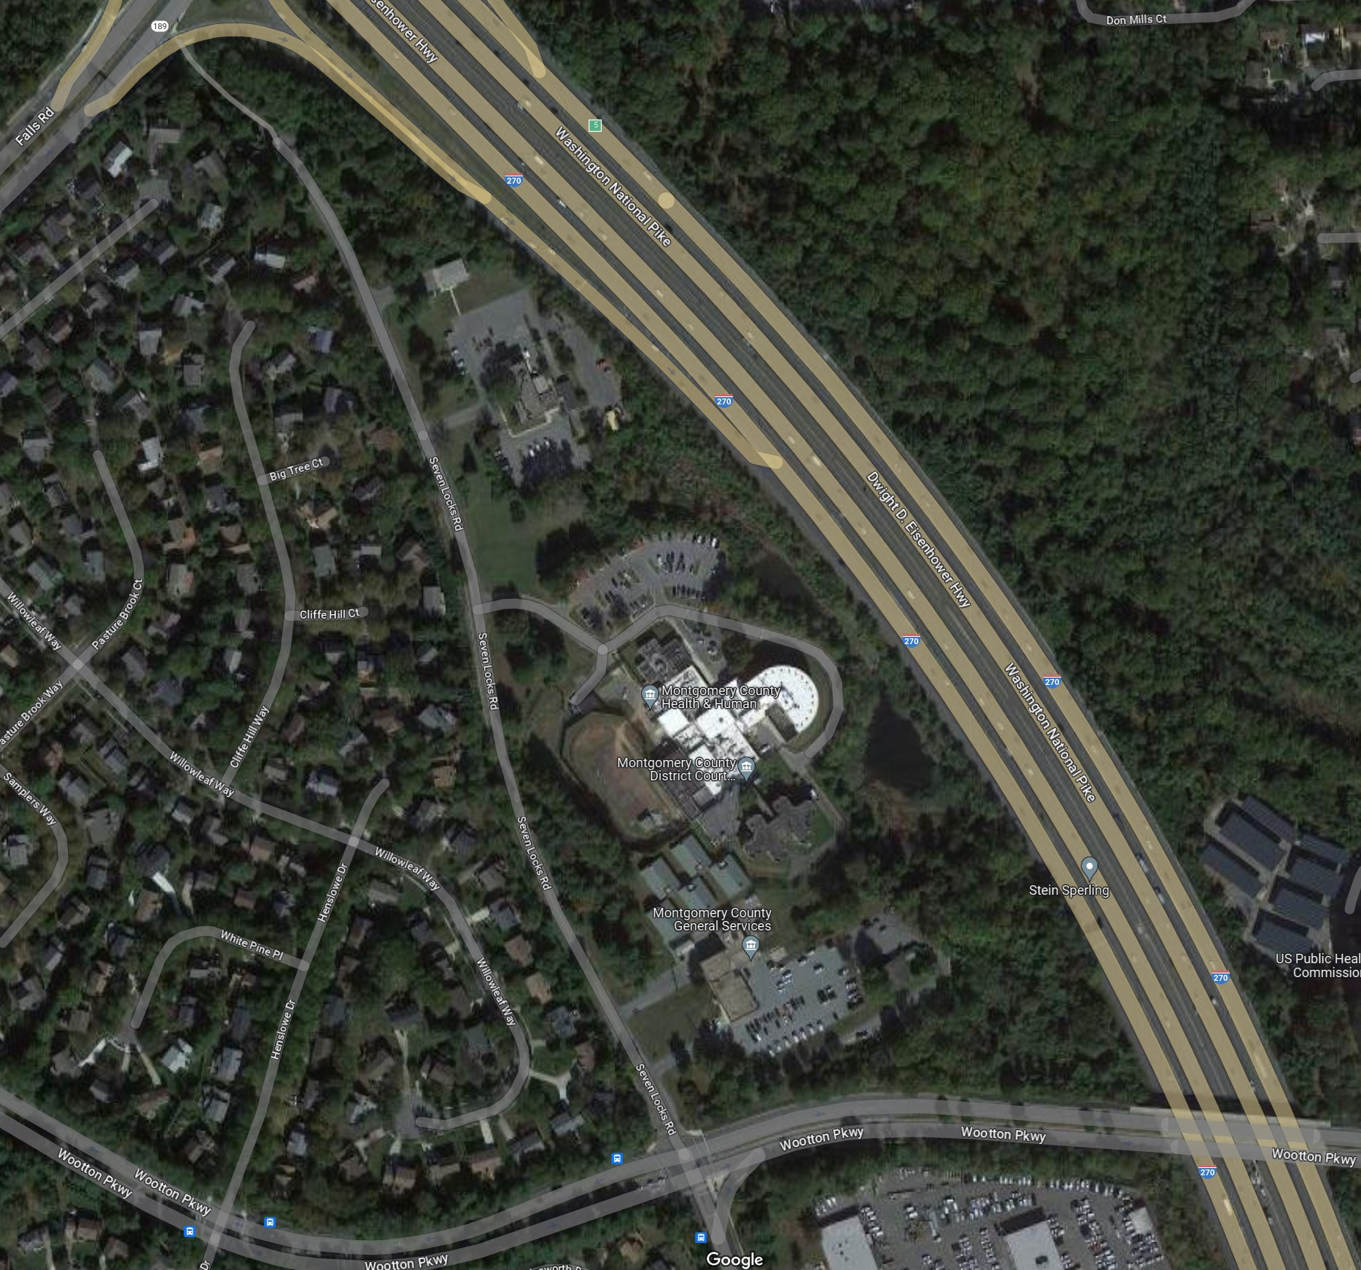
Location of the building on the site.
Factors for the decision:
1- Larger area
2- Avoid traffic into 7 Locks
3- Better access to bus stop
4- Better visual barrier from the community
5- Storm Water Management constraints on the north side.
JC
DC
JC
DC

Slide 13
New Location Elements
1- Building the new Diversion Center at the location of the existing DGCS Facility.
2- Maintain 2 existing entrance driveways
3- Locate future Judicial Center in the back/East
4- Provide a visual barrier between DC and JC
5- provide more residential façade for the new Diversion Center.
4
3
2
5
1
2

Slide 14
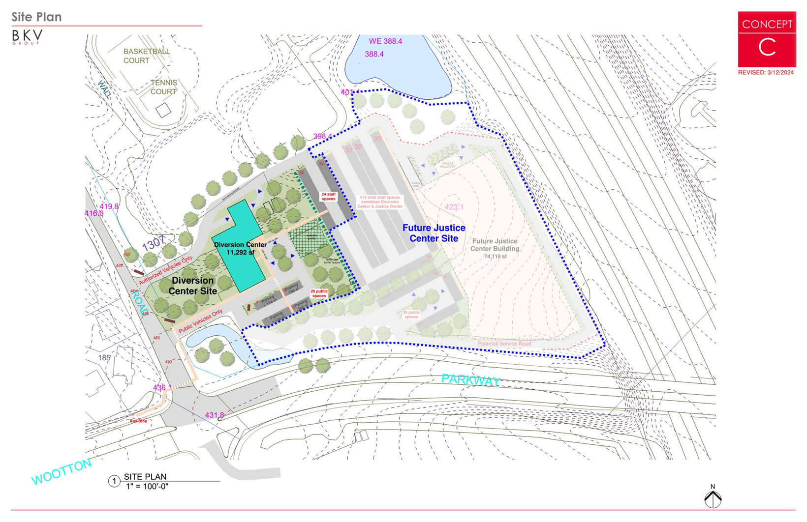

Slide 15
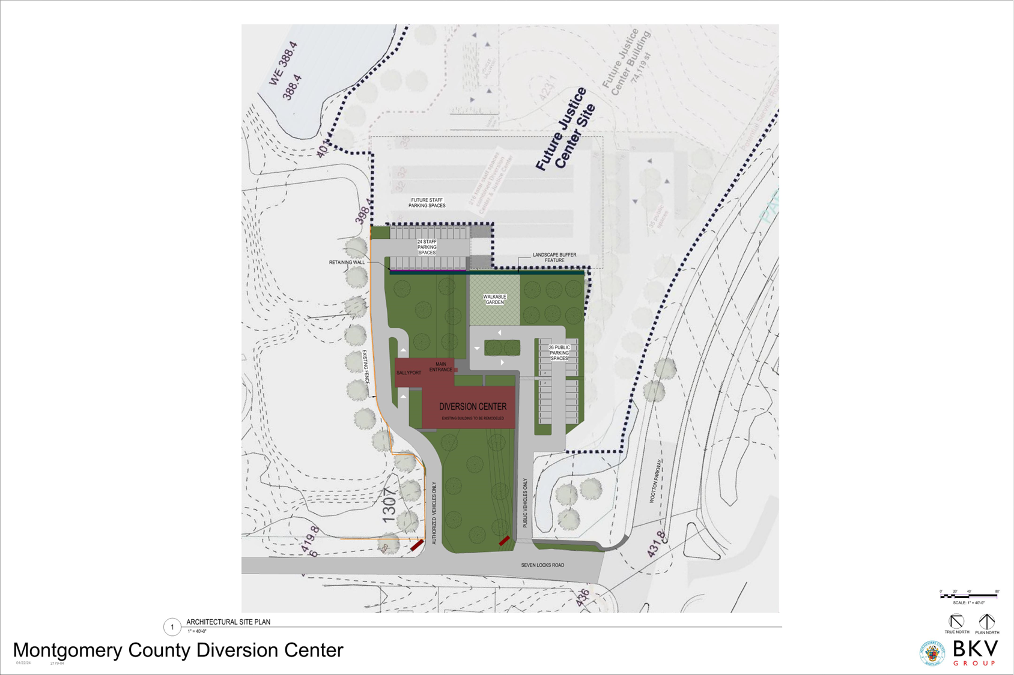
Enlarged Proposed Concept Plan for the Diversion Center Site

Slide 16
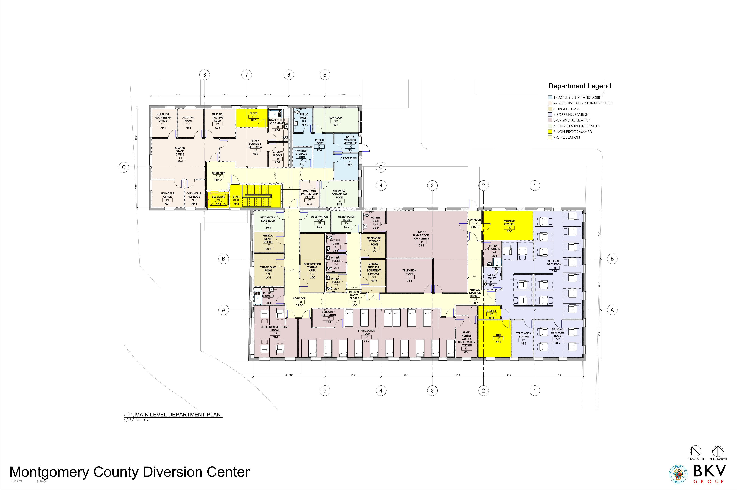
Visitors Entrance
Main Level Floor Plan

Slide 17
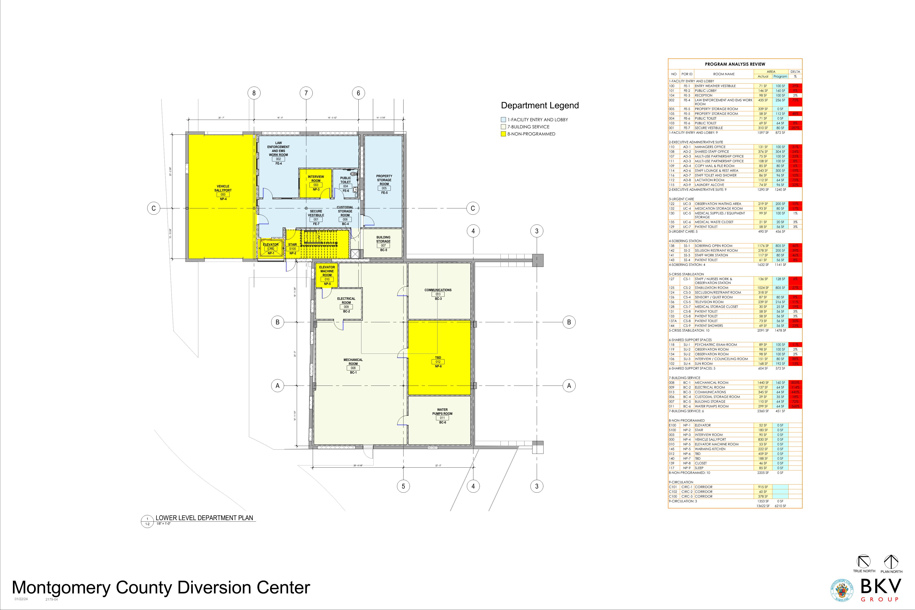
Patients arrive in public safety vehicles inside the sallyport.

Slide 18
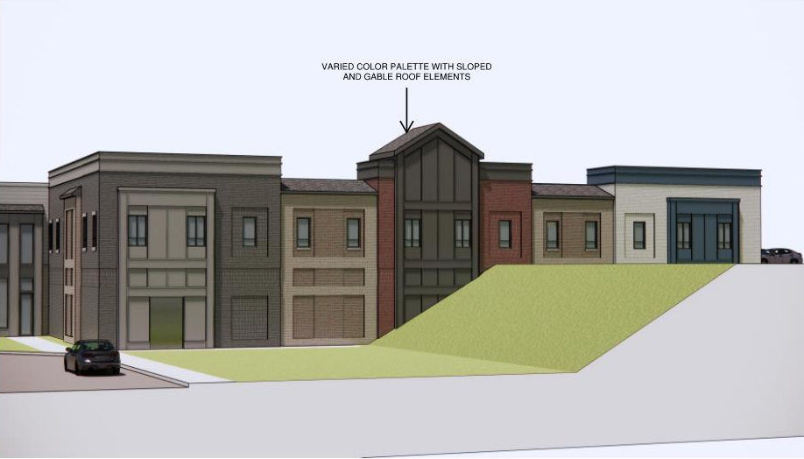
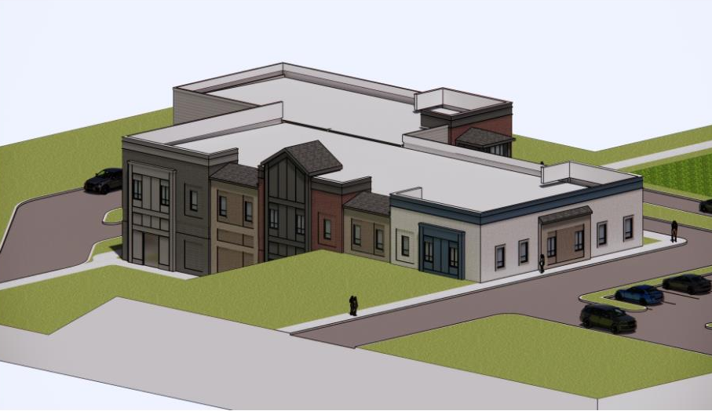
Concept Façade Design

Slide 19
Project Schedule
Start Design …………………………..2/2024
File for Permit ……………………….12/2024
Bid ……………………………………….2/2025
Start Construction ……………………5/2025
Construction Completed ……………7/2026
Facility Open …………………………..9/2026
Note: Dates are tentative

