Slide 1

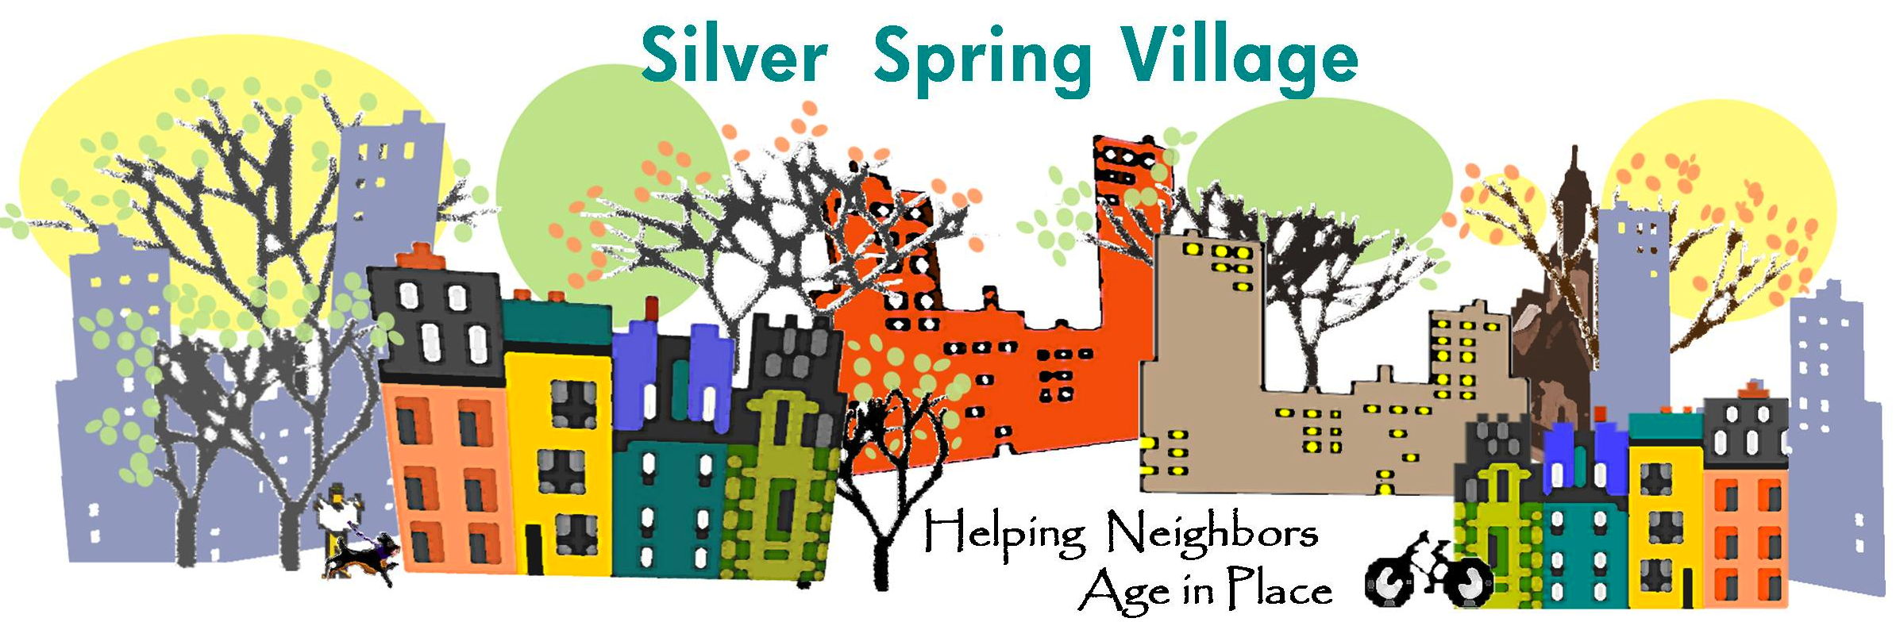
Hands-On Strategies to Enhance Diversity Outreach in Your Community
Wolfgang Mergner, Village of Takoma Park
Marcy Frosh, Silver Spring Village
Pazit Aviv, Montgomery County Area Agency on Aging
National Village to Village Gathering
11/7/2017

Slide 2
Panel Objectives
Gain
insight into why diversity outreach is challenging
Learn
about strategies for outreach and inclusion
Discuss
your environment and develop a diversity outreach plan

Slide 3
Five Ideas to Start our Thinking on Enhancing Diversity
Define your village
Research your community
Utilize community knowledge
Acknowledge challenges
Identify the benefits

Slide 4
Define
Community term to describe mission: SSV embraces the term “Cultural Dexterity” or an “enhanced capacity for being among people of a different race or ethnicity.” Sheryll Cashin, Washington Post – August 25, 2017

Slide 5
Acknowledge Challenges (examples):
Culture: Representative cultures view aging differently and reject outside involvement -- building trust is key
Economics: Village dues may be prohibitive for low-income folks
Language: Prospective members are not English language speakers

Slide 6
What’s Diverse for You?
Shifting demographic trend that includes an aging population and significant foreign immigration, along with other differences -- such as education and income.
Both Villages are a “Work in Progress!”
Villages with more homogeneous racial/income/other demographics may seek to focus outreach on other demographics

Slide 7
Research: Data and Neighborhood Knowledge
Silver Spring Village and Village of Takoma Park serve a similarly diverse community
For example, for Silver Spring:
Age 55 or older = 23%
Female > age 65 = 57 %; Male > age 65 = 43%
Race (> 65) White = 51%; Black = 37%; Hispanic = 9%; Asian = 7%

Slide 8
Historical Context
Effects of “redlining” going back to WWII era as a federal policy to restrict mortgage guarantees to African Americans (1932-1962)
Silver Spring community members examine the implications of this history.

Slide 9
Organizational Barriers – Some Obvious, Some Not
Barriers may include:
Absence of agreement about a melting-pot ideal for the Village
Planning done without meaningful feedback
Lack of agreement on time and resource allocation (some want the status quo)
Information gap about cultural norms regarding care and support of older people

Slide 10
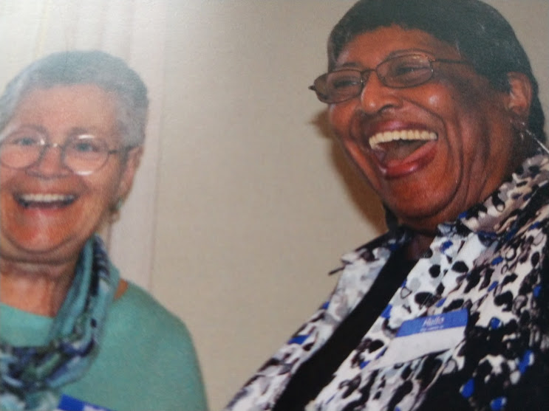
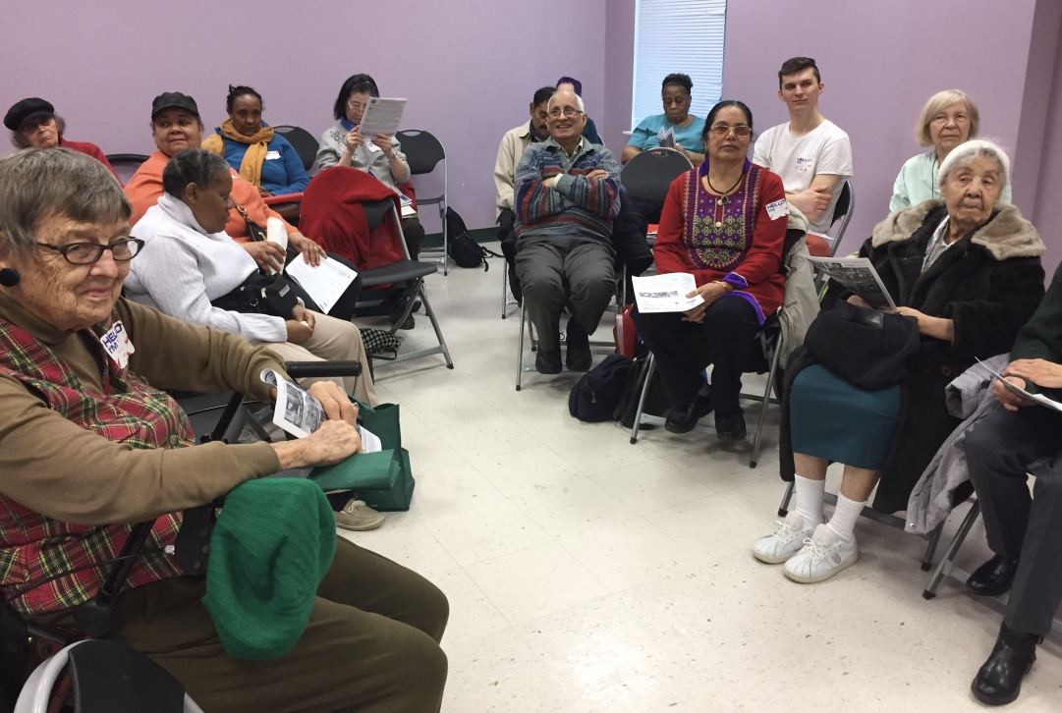
New Ideas, New Hope
Villages in Silver Spring and Takoma Park have similar populations, but different challenges

Slide 11
Focus on Why Diversity Adds Value
Silver Spring Village notes the potential to “sharpen” the Village “brand” when “strengthened and invigorated by the diversity of life experiences . . . .” Lakey, B.M. Board Source for Friends Services for the Aging (2012)
We become indispensable community builders both within the Village and beyond
Personal stories

Slide 12
Successful Strategies
Diversity embedded in all village operations (not a silo committee)
Focus on diverse community’s assets (rather than needs)
Take a long breath: results take time (rather than expecting short term outcomes
Recruit a diverse board
Recruit volunteers who speak other languages
Notes:
Pazit’s diagram for ABCD

Slide 13
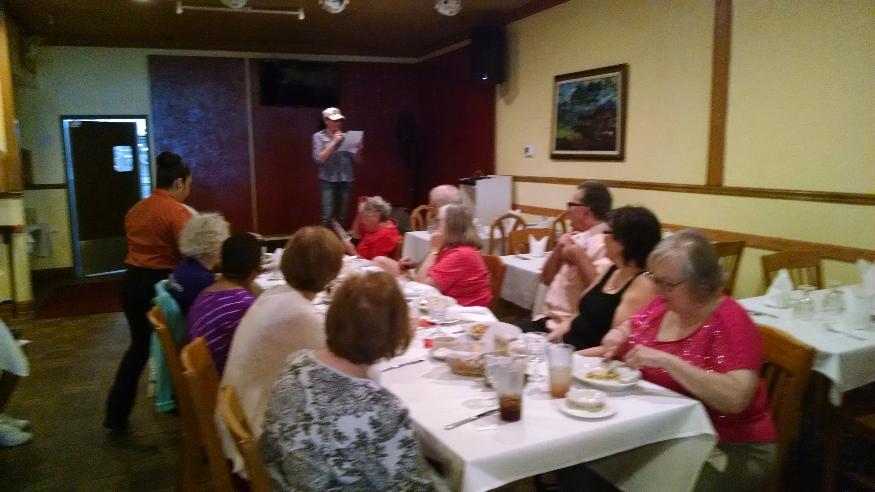
Meet People Where They Are Silver Spring Village
initial gatherings with extensive publicity in diverse neighborhoods -- followed by smaller events
“Dining + Storytelling” program at local ethnic restaurants
Literature in places easily available to diverse communities
“Discussion Guide” on diversity for the board

Slide 14
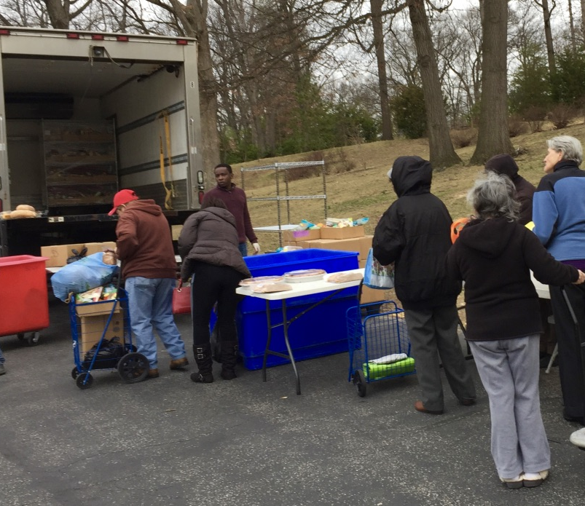
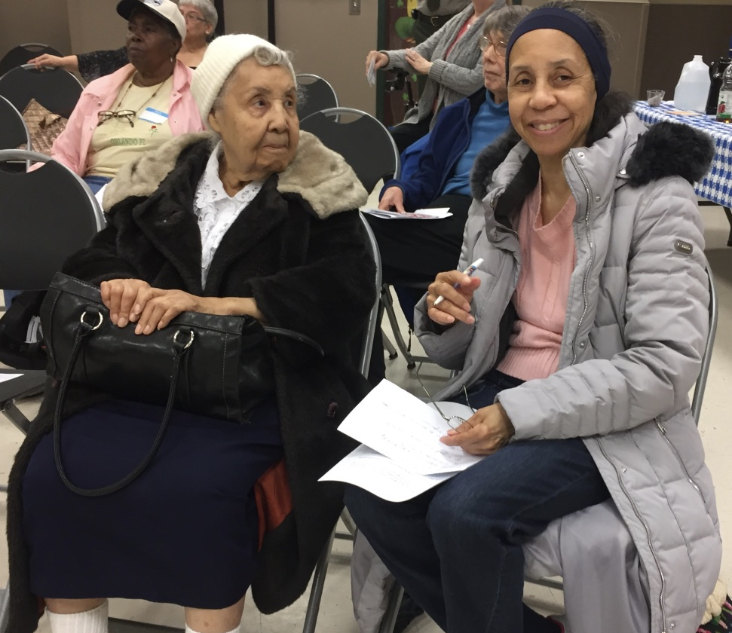
Meet People Where They Are - TVP
Build relationships with individuals
Visit low income senior housing frequently
Hold events at the senior housing communities
Respond the requests for support: Food shortage, information on benefits
Become the link between people and providers

Slide 15
Listen and respond to specific concerns
At our first meeting 69 people came. And everybody spoke and we recorded it.
We reviewed this record frequently to guide us.
We asked if services actually work.
We sought ideas from key leaders in the community.

Slide 16
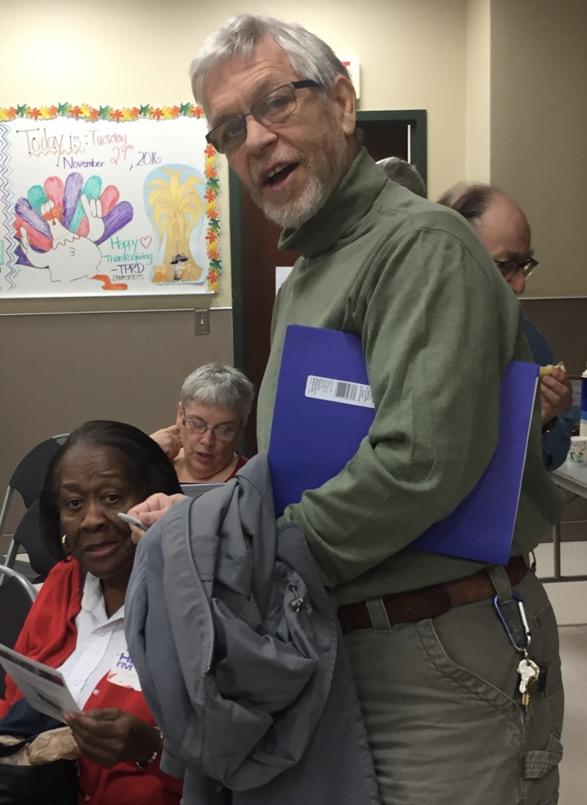
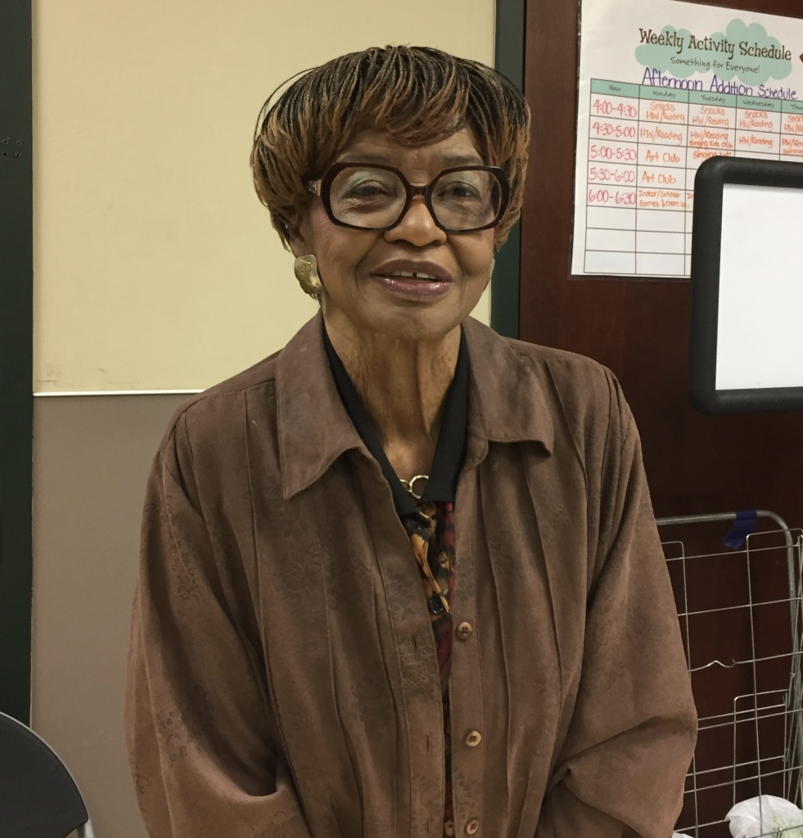
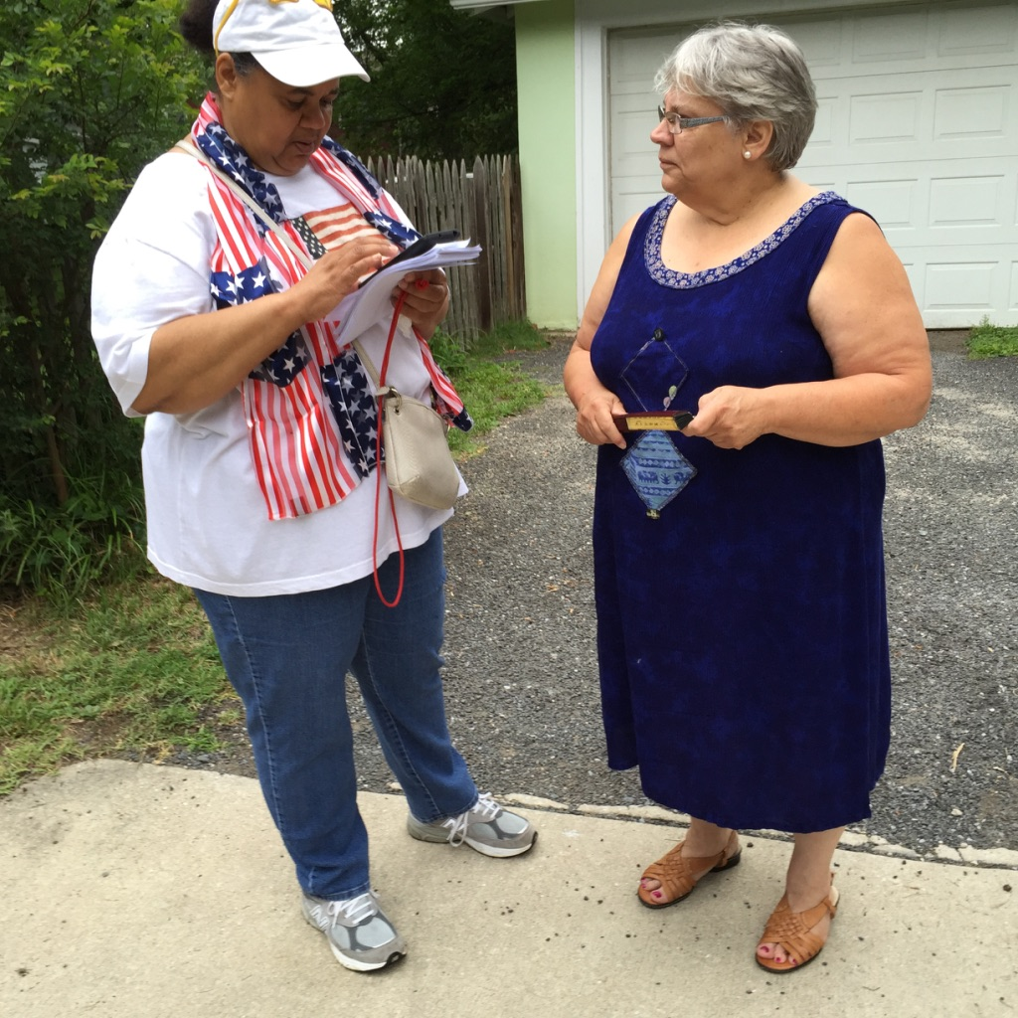
FIND THE LEADERS
Not necessarily older ones

Slide 17
Find the leaders
Silver Spring Village strategies have included:
seeking out the advice, support, and participation from leaders such as those in a remarkable historic African-American community – itself a Village over the last century
broadening programs to include the voices of younger leaders of color, such as a talk by a young Caribbean-American local news reporter
leveraging efforts of local government on diversity

Slide 18
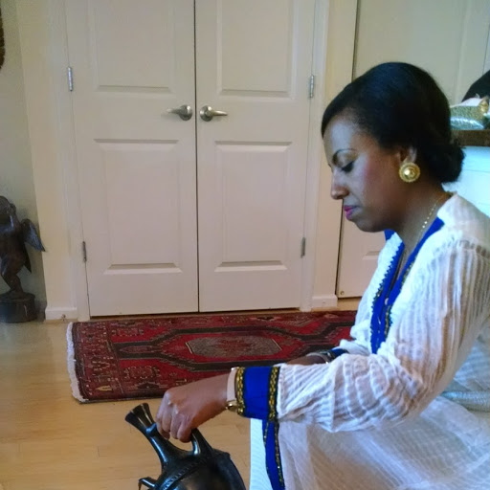
Respect Need for Affinity with Identity Group
Village’s potential to “add to, but
never replace
Showing up – at festivals and other events that are important to the groups
Learning history/ cultural norms – such as an Ethiopian Coffee Ceremony led by Ethiopian members
Recognizing language limitations by supporting groups that are fluent
(e.g., Amharic)

Slide 19
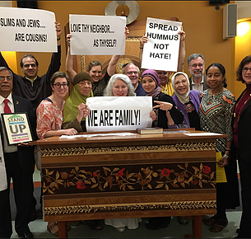
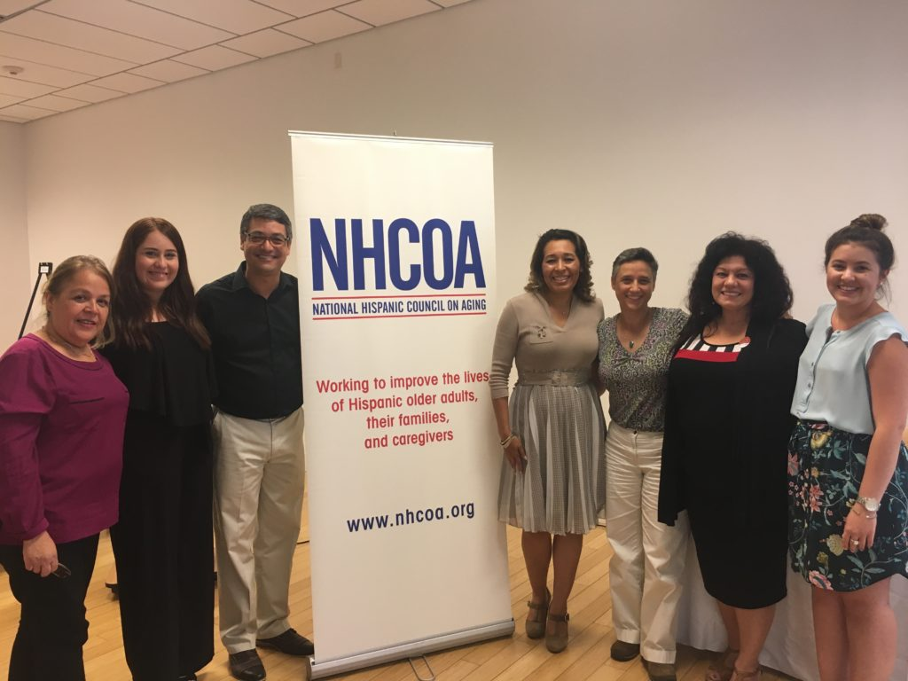
Respect Affinity with Identity Group
Latino leadership capacity building With National Hispanic Council On Aging
Ethiopian DREAM Center
Connect with faith communities including Muslims

Slide 20
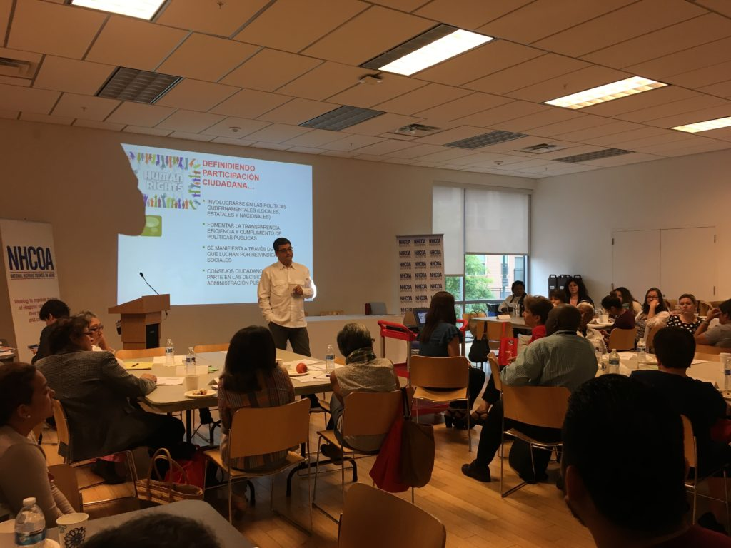
Leadership Capacity
Partner with organizations with similar vision
Use multiple channels for outreach
Food brings people together
Create dialogue on key issues that communities care about

Slide 21
No Financial Barriers
Village of Silver Spring
For qualifying individuals, fees are ~ 80% less than the regular $150 or $350 annual membership fee
Village of Takoma Park
Annual Membership fee - $10.
Rarely waived

Slide 22
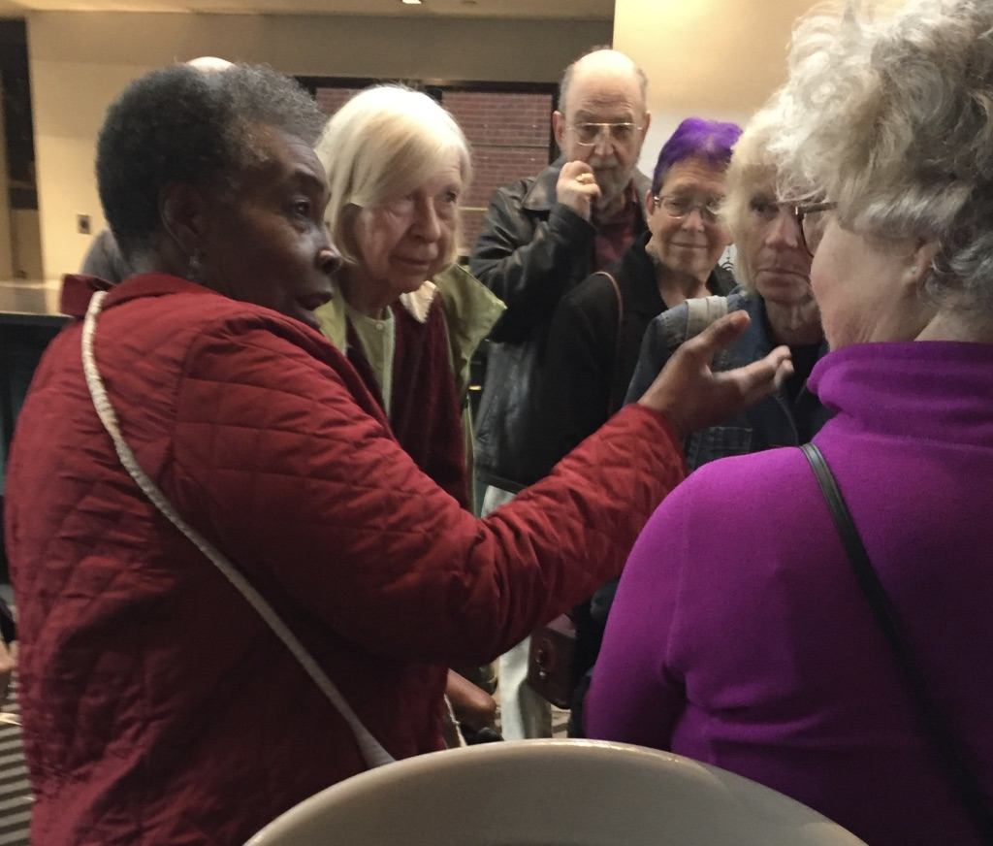
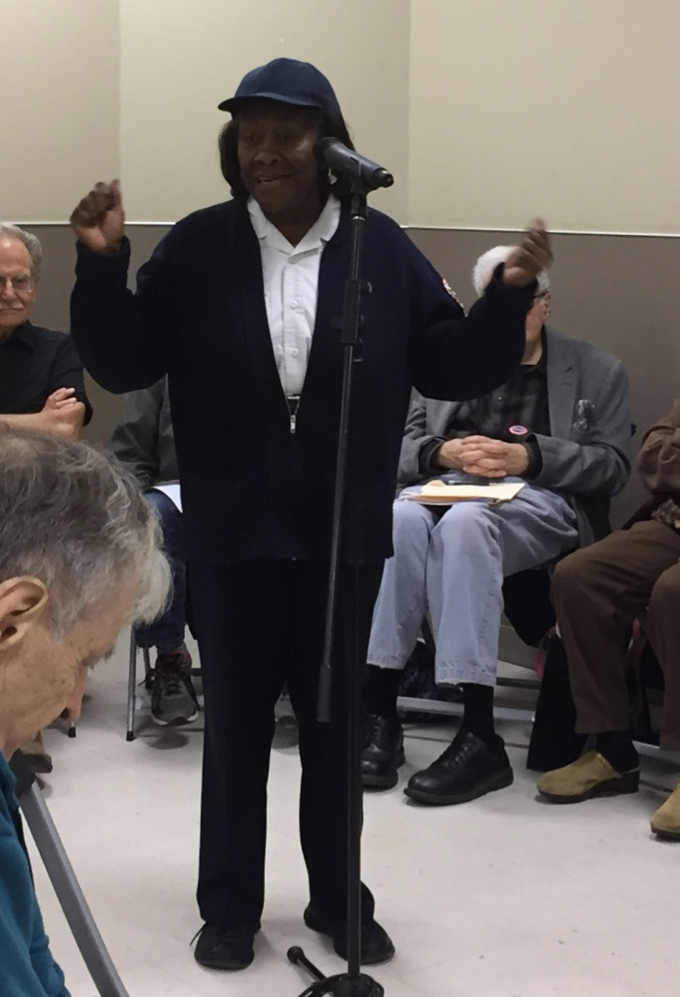
Invest time and energy in relationships and trust

Slide 23
Seek Out Diverse Groups Even if Their Focus is Not on Aging
Networking to ensure that diverse groups know about the Village – whether business (Chamber of Commerce or Rotary), housing (senior and mixed-income properties) or local nonprofits
Knocking on doors of faith groups, businesses, and others with diverse members or clients
Engaging in activities, such as an Easter Seals intergenerational reading program for individuals (younger & older) with disabilities

Slide 24
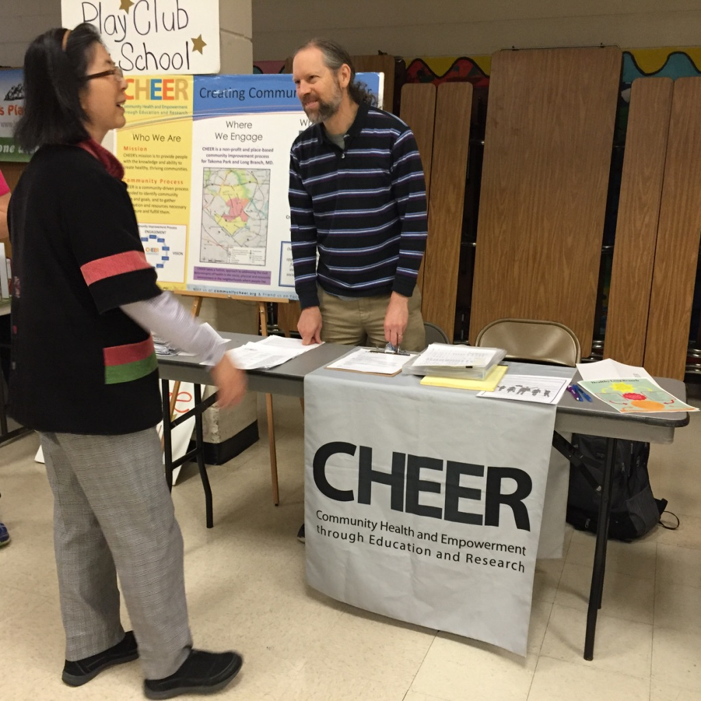
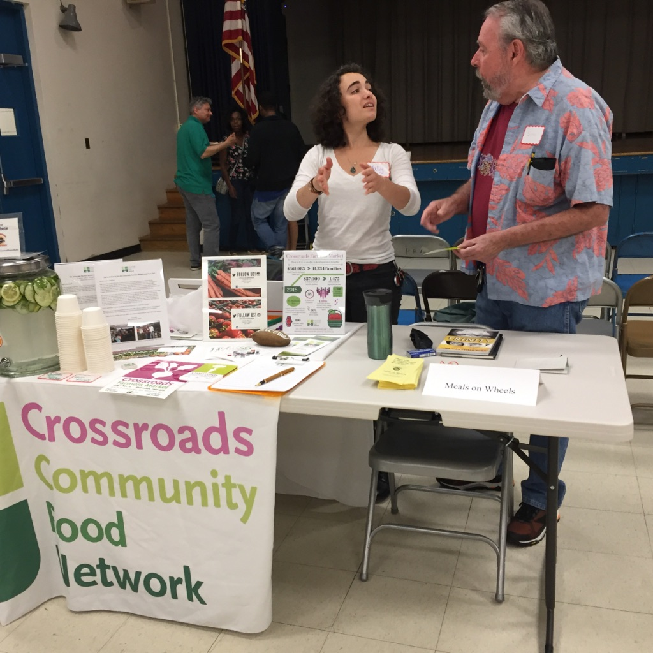
SEEK COMMUNITY ORGANIZATIONS Even if they do not have a focus on aging

Slide 25
IMPACT
More diverse senior group in monthly seminars
More diverse leadership
More diverse seniors call for services
Participates with County and Community Organizations

Slide 26
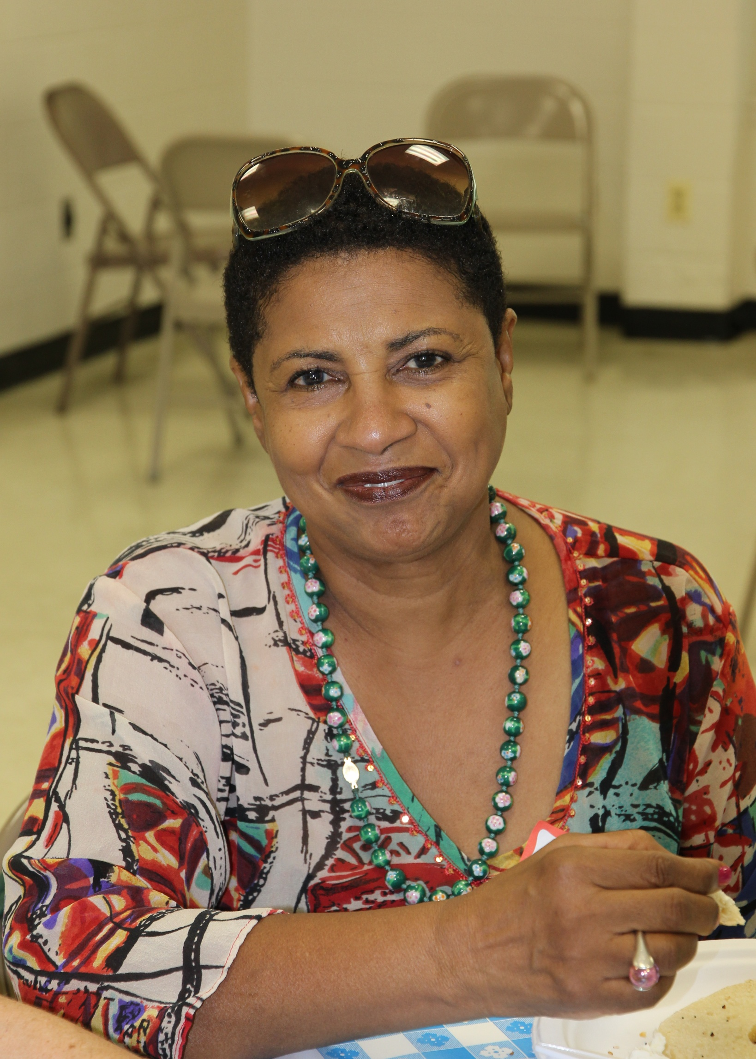
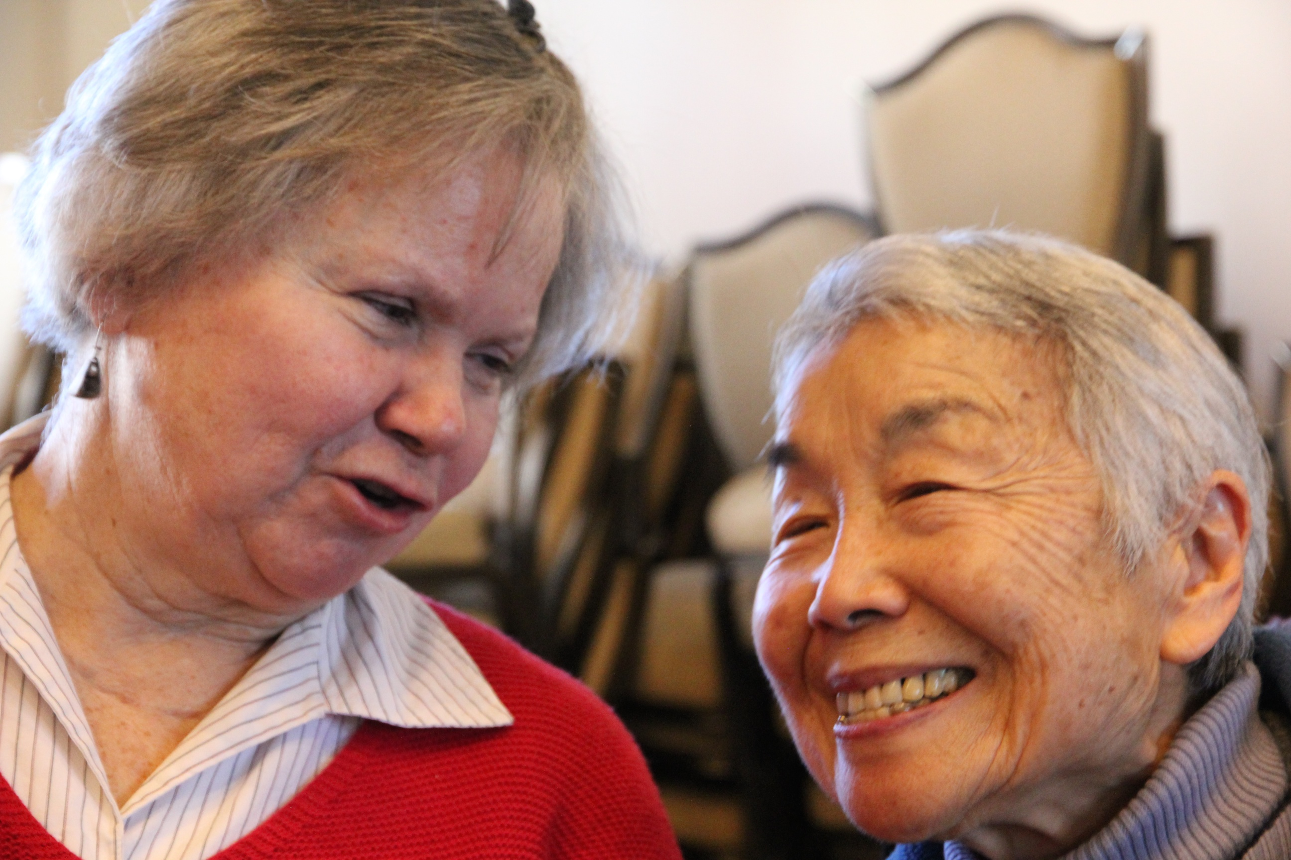
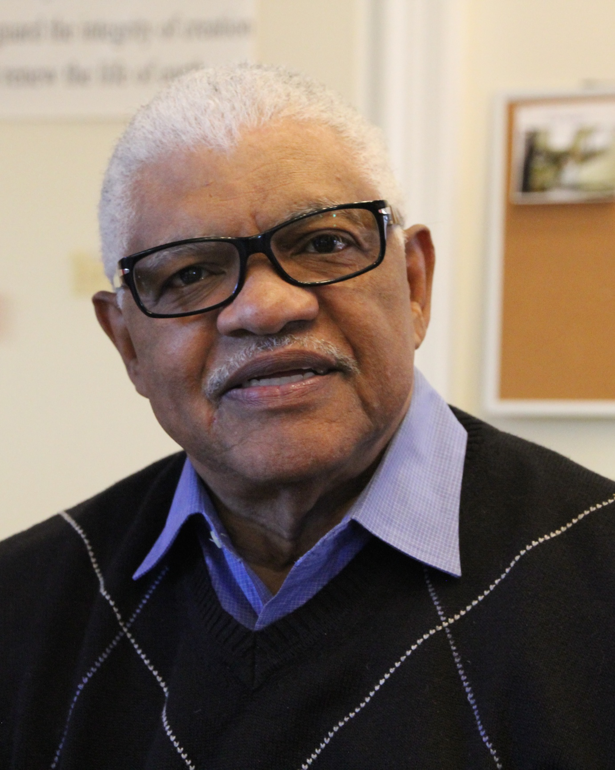
IMPACT
More diverse leadership and participation
New & innovative programming to appeal to broader diverse community
Collaboration with businesses, county government, and nonprofits

Slide 27
Conclusion
Diversity Outreach is a “Work in Progress” and will continue to be!
Each village needs to consider its unique strengths
Respect, listen and build relationships

Slide 28
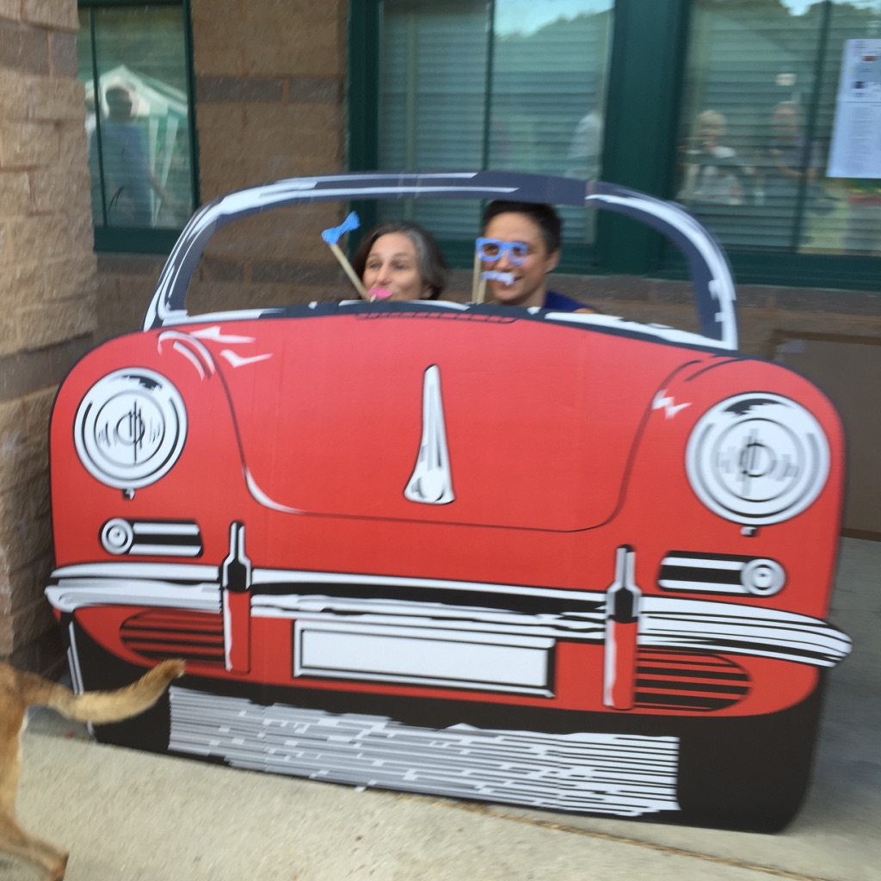
BON
Voyage

