Slide 1


VillageRides is a program of Jewish Council for the Aging®, funded by the Transportation Planning Board of the Metropolitan Washington Council of Governments. The program serves people of all faiths, ethnicities and walks of life. For more information about JCA programs, visit www.AccessJCA.org
301-255-4212 - Sara Fought - sara.fought@accessjca.org - 301-255-4247 (direct)
Notes:
Hello, and thank you Fran for that warm welcome. First of all, VillageRides is a project of JCA, Jewish Council for the Aging. Please take one or two… or a hundred JCA brochures. Every Senior in Greater Washington should have these, as far as I’m concerned.
Second, I want to introduce Sara Fought, the Coordinator for VillageRides. Sara comes to JCA after years working for Susan G. Koman, Race for the Cure. I am willing to bet that there is not a person in this room who has never heard of that charity. Theirs is one of the most successful marketing and outreach campaigns in this country, and Sara brings deep and broad experience to JCA. If one of the services you offer to your members is transportation, Sara is your contact for support for that aspect of your Village’s work.

Slide 2


The Direct Approach
People
Publicity
Planning
Persistence
Notes:
THE DIRECT APPROACH
Publicity: You’re putting your time, talent, and energy into this… big time! The question is WHY? I urge you to write a short story about what convinced you that this matters more than other volunteer work you could be doing. What touched your heart such that there was no looking back? Before you can spread your Message, you need to be clear about “What’s in it for you” and then clearly convey it.
People: Open your own home for a neighborhood potluck. Do something personal. The first step is to reach a few people who will dive in as deeply as you. They’re rare, and they will always be rare. Appreciate them, love on them, thank them… and put them to work!
Planning: Now, how can you reach MORE PEOPLE? If you already have a Board, one requirement for being on the Board should be that each person promotes your Village. Establish goals and time-tables for obtaining, names, addresses, email addresses, and phone numbers, as if you are the ACME Village Company and everyone is on commish.
Persistence: Take advantage of every opportunity to spread your message. Sometimes you may create a splash. But, mostly you need to drip, drip, drip your message on people. It’s kind of like living in Seattle, without the craft beer. Whatever you do, keep it up and follow through!

Slide 3



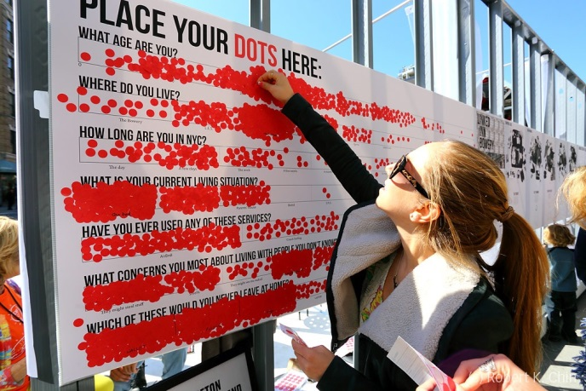

Community Outreach
Notes:
COMMUNITY OUTREACH
Get your foot in the door of Churches, Synagogues, Mosques, and Temples. This is where core values are preached and PRACTICED. Can you become an identified recipient of volunteer services from within your local houses of faith? Can you at least place brochures in the office? Get your foot in the door!
Speak to the constituents of your local civic groups, Kiwanis, Elks, Moose, Lions… Otters, you get the picture.
Ask for a local restaurant to do a night of giving. It’s a win-win. Always remember that any business has boosting it’s own image in mind when supporting your cause. Promote them hard as a thank you, and they will continue to be a supportive partner.
Partner up with your city or town. Are there small grants you can apply for? Are there community events you can bring an outreach table to? How can your town advertise FOR YOU?
At festivals do something fun to get you noticed. Have a game for festival attendees to play with, a photo op, a raffle, or a survey. Stand out, don’t just stand there!

Slide 4





Marketing Materials
Brochures
Posters & Flyers
Logo Design
Driver ID Badges
Fridge Magnets
24” x 12” Magnetic Car Signs (not pictured)
Notes:
MARKETING MATERIALS
I’m going out on a limb here, but I’m guessing your Village has very limited funds. Just guessing.
Make every dollar count. At some point, you’ve got to use precious funds for marketing materials. I recommend prioritizing just two. A brochure is a tried and true, familiar format for telling the story of who you are, what you do, and how to connect with you. And fridge magnets last FOREVER. Here’s what you MUST have in order for any marketing materials to work for you.

Slide 5
The Whole Package
Logo
Images
K.I.S.S.
Lasting
Attractive
Notes:
THE WHOLE PACKAGE
Keep it Simple, Stupid. Like the rule of “What’s in it for me?” tell your reader what’s in it for them.
Portray friendly faces, close up, of REAL PEOPLE, crisp, clear, and bright, free of shadows, and in high resolution.
Layout should be attractive to the eye. Some basics for Seniors with eyesight limitations include:
Use large, clean fonts, no smaller than 12 point.
Use no more than 2 fonts on any one document
Use white background with black type, no matter how tempting it is to go for mauve and grey.
Leave white space. Don’t make it too crowded.
Edit your text, then eliminate some more.
Contact information should be in large type and in multiple places.
Print a lasting message. For example, don’t put this year’s events on a brochure that will make it outdated next year. Use role-based email addresses, like volunteers@myvillage.org, rather than names. Those fridge magnets will get put up for a rainy day that might not come for many years.

Slide 6
Social and Digital Media
Your Website
Facebook
Emails
Twitter
Texts
Calendar
Notes:
SOCIAL AND DIGITAL MEDIA
Tying many digital opportunities together can solidify the loyalty of your audience… or turn them off. You’re a nice organization doing nice things for nice people. So, be nice!
Send email newsletters with engaging subject lines and a calendar of upcoming events once a month.
Send helpful text alerts about weather-hazards, power-outages, and changing garbage days due to holidays.
Turn your website into a source of helpful information and update it at least quarterly.
Post timely and relevant news, sports, health, and entertainment stories on Facebook and Twitter weekly, if not daily! It’s actually not called stealing anymore. It’s called re-tweeting!

Slide 7

Free Media
Get Political. Get Coverage.
Tell Stories.
Press Releases
Seniors Today with Austin Heyman
Senior Beacon Editor Barbara Ruben
WAMU Metro Connection, wants to hear from you!
WAMU’s the Kojo Nnamdi Show
Montgomery Magazine Editor, Jeff Thoreson
WPFW Social Justice Calendar
Notes:
And, finally, FREE MEDIA
Be interesting and pro-active by sending press releases monthly.
Be “political.” After last night, this is probably the last thing you want to be. But, this just means taking action about an injustice or unfairness that exists. Be loud and proud about the political action you take by fighting the injustices our Elders face every day.
Maya Angelou once said, “People will forget what you said. They will forget what you did. But they will never forget how you made them feel.” Tell heartfelt stories.

Slide 8

Overview
Community Outreach
Social and Digital Media
Free Media
Marketing Materials
The Direct Approach
The Whole Package
Notes:
Thank you. I hope these tips help you to carry your message forward, so that you can help create a better story for your neighbors, the cherished Elders in your community, and create the world you want to age into.

