Slide 1

Procurement Fair
November 16, 2023

Slide 2
AGENDA
8:30 a.m. – 9:00 a.m.: Registration and Networking
9:00 a.m. – 9:30 a.m.: Welcome Remarks
County Executive Marc Elrich
Grace Denno, Office of Procurement
9:30 a.m. – 10:30 a.m.: MFD Certifying Agencies Panel
10:30 a.m. – 10:45 a.m.: Networking Break
10:45 a.m.: Remarks
Council President Evan Glass
10:50 a.m. – 11:45 a.m.: Upcoming Procurement
Opportunities from Around the County
11:45 a.m. – 12:30 p.m.: Strategic Networking
12:30 p.m: Adjourn

Slide 3
Welcome Remarks
County Executive Marc Elrich

Slide 4
MFD Certifying Agencies Panel
9:30 a.m. – 10:30 a.m.

Slide 5
Maryland Dept. of Transportation
Eun Young Hong

Slide 6

Office of Small and Minority Business Policy
MBE/DBE/ACDBE/SBE Overview
Montgomery County Procurement Fair
Eun Young Hong
November 16, 2023
Wes Moore Aruna Miller Paul J. Wiedefeld
Governor Lt. Governor Secretary

Slide 7
OFFICE OF SMALL & MINORITY BUSINESS POLICY
We are responsible for the oversight and implementation of outreach activities related to the MBE/DBE/ACDBE/SBE programs including:
Monthly workshops
Internal and external events
Communication strategies for program updates
Development of training and outreach materials
Management of MBE website

Slide 8
MINORITY BUSINESS ENTERPRISE PROGRAM
The Maryland Department of Transportation (MDOT) is the official certification agency for the State
Established in 1978, Maryland’s Minority Business Enterprise (MBE) Program is known to be the oldest in the country
Largest MBE program in the country
One of the most aggressive in the nation with a 29% MBE participation goal and contract sub goals
Notes:
Largest MBE program: over 9,000 companies in directory

Slide 9
TYPES OF CERTIFICATION
There are four types of certifications:
Minority Business Enterprise (MBE)
  State-funded contracts
Disadvantaged Business Enterprise (DBE)
  USDOT contracts administered by:
    Maryland State Highway Administration (SHA)
    Maryland Aviation Administration (MAA)
    Maryland Transit Administration (MTA)
    Metropolitan Planning Organizations (MPOs)
Airport Concessions Disadvantaged Business Enterprise (ACDBE)
  Airport concessions contracts administered by MAA
Small Business Enterprise (SBE)
  USDOT contracts administered by SHA, MAA, and MTA
  Race and gender neutral

Slide 10
BENEFITS OF CERTIFICATION:
Access and Opportunities
Greater exposure to government and private sector contracting opportunities
Only MBE/DBE certified firms can fulfill the minority participation goals
Certified firms appear on the Directory of Certified Firms which is used by prime contractors, consultants, government agencies and private sector companies seeking minority business participation

Slide 11
BENEFITS OF CERTIFICATION:
Monitoring and Advocacy
Enforcement of MBE compliance policies and procedures
MBE Liaison Officers

Slide 12

FREE! FREE! FREE!
There is NO cost to apply for or maintain certification with MDOT’s Office of Minority Business Enterprise

Slide 13






CERTIFICATION ELIGIBILITY

Slide 14
ELIGIBILITY STANDARDS
There are five eligibility standards each applicant must meet:
Ownership
Minority Status
Control
Personal Net Worth
Size

Slide 15
ELIGIBILITY STANDARDS: OWNERSHIP
An MBE/DBE/ACDBE is a small business that is at least 51% independently owned and controlled by one or more socially and economically disadvantaged individuals
Ownership must be real and substantial
Owner must be a U.S. citizen or permanent resident
Firms headquartered in Maryland must be in good standing with the Maryland Department of Assessments and Taxation

Slide 16
ELIGIBILITY STANDARDS: MINORITY STATUS
Certain groups are presumed to be socially disadvantaged:
Women
African Americans
Hispanic Americans
Native Americans
Asian Pacific Americans
Subcontinent Asian Americans
Disabled Persons (MBE Program Only)
Firms owned by ethnic women are dually certified

Slide 17
ELIGIBILITY STANDARDS: CONTROL
Minority owner(s) must have an overall understanding of, and managerial and technical competence and experience directly related to, the type of business in which the firm is seeking certification
Firms are certified in specific areas of work as defined by the North American Industry Classification System (NAICS Codes)
To learn more about NAICS Codes visit
https://www.census.gov/naics/

Slide 18
ELIGIBILITY STANDARDS: PERSONAL NET WORTH
In order to evaluate economic disadvantage, each minority
owner must submit a Personal Financial Statement (a.k.a.
Personal Net Worth (PNW) Statement)
PNW is the net value of the assets held by an individual or
includes the minority applicant’s portion of assets
held jointly or as community property
MBE Cap:
  $1,995,008(adjusted annually)
DBE Cap:
  $1,320,000
ACDBE Cap:
  $1,320,000
PNW Calculations DO NOT Include:
Applicant’s personal residence
Value of the applicant business

Slide 19
ELIGIBILITY STANDARDS: SIZE
All applicant firms must be “small”
Size standards are set by the U.S. Small Business Administration (SBA) under Regulation 13 CFR Part 121
Size standards are determined by industry based on NAICS Codes
Firms seeking DBE Certification must not exceed the current DBE statutory cap of $30.40 (million)
For more information regarding size standards visit SBA’s website at:
https://www.sba.gov/size
Notes:
Manufacturing: based on employee size
Other industries: based on gross receipts

Slide 20
The Certification Process

Slide 21
THE PROCESS
APPLICATION – Applicants must submit an application along with all applicable supporting documentation; online and hard copy versions available
INVESTIGATION – An MBE Officer reviews the entire application package then conducts an on-site interview with the applicant(s) and performs a job-site visit (if applicable); all findings are documented in a written report
EVALUATION – MBE Advisory Committee (MBEAC) reviews the investigative report to evaluate whether the applicant firm meets all program requirements; the owner(s) may be asked to appear before the MBEAC as part of the evaluation process
DETERMINATION – The MBEAC Chairperson issues a written determination
Out of state firms must be certified in their home state before applying in Maryland

Slide 22
The Application

Slide 23
COMPLETING THE ONLINE APPLICATION
Create a profile and complete the application using the Certification Management System (https://marylandmdbe.mdbecert.com/)
You will not be able to submit your application until all required fields are completed. All required fields are marked with an asterisk.
Out of state firms must be certified in their home state before applying in Maryland

Slide 24
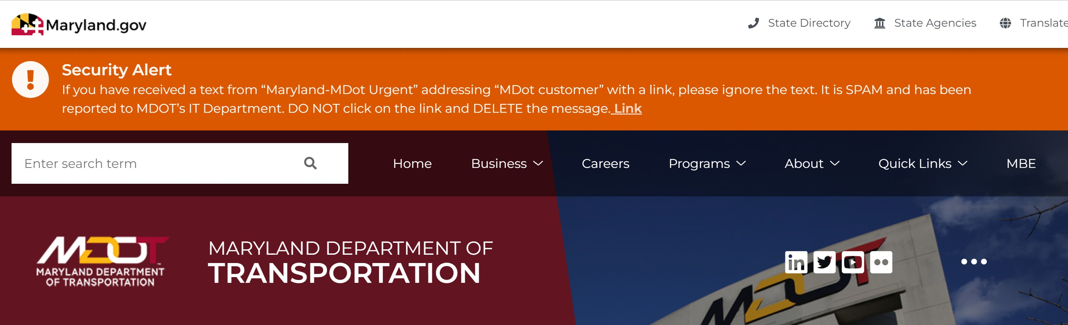
COMPLETING THE ONLINE APPLICATION
www.mdot.maryland.gov – Select MBE in Toolbar

Slide 25
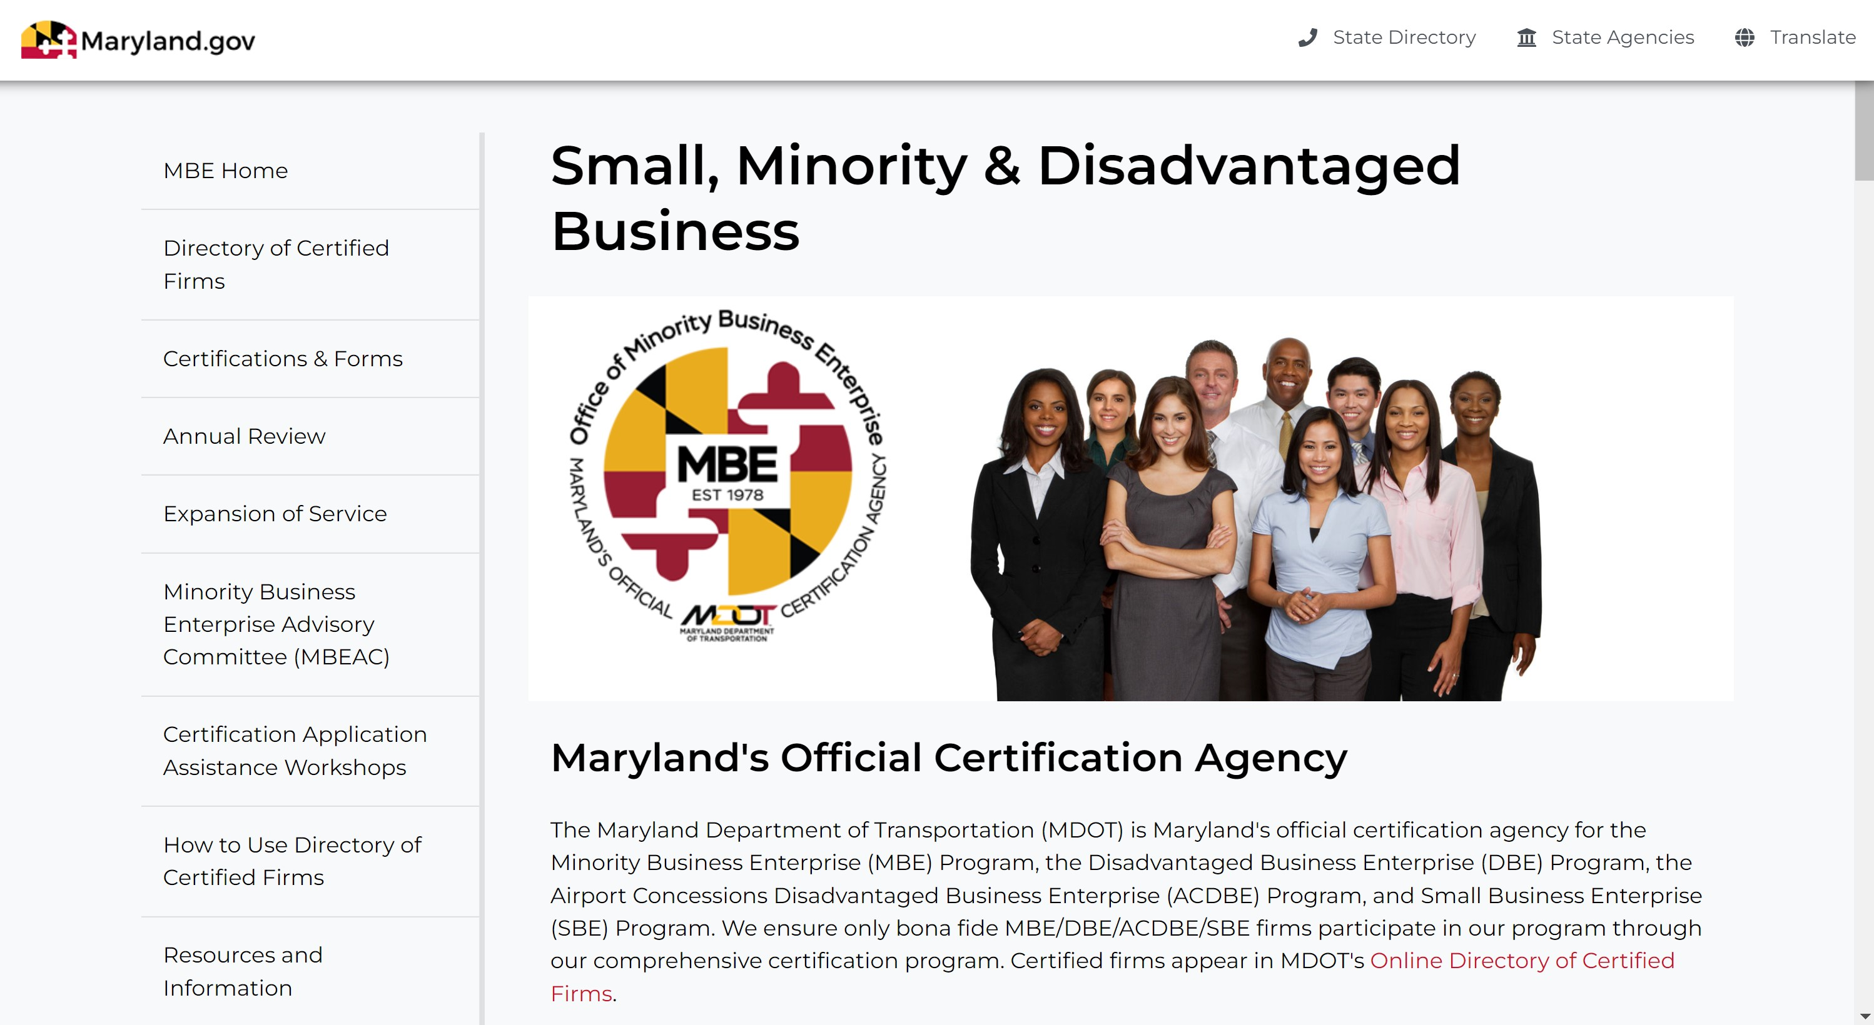
COMPLETING THE ONLINE APPLICATION

Slide 26
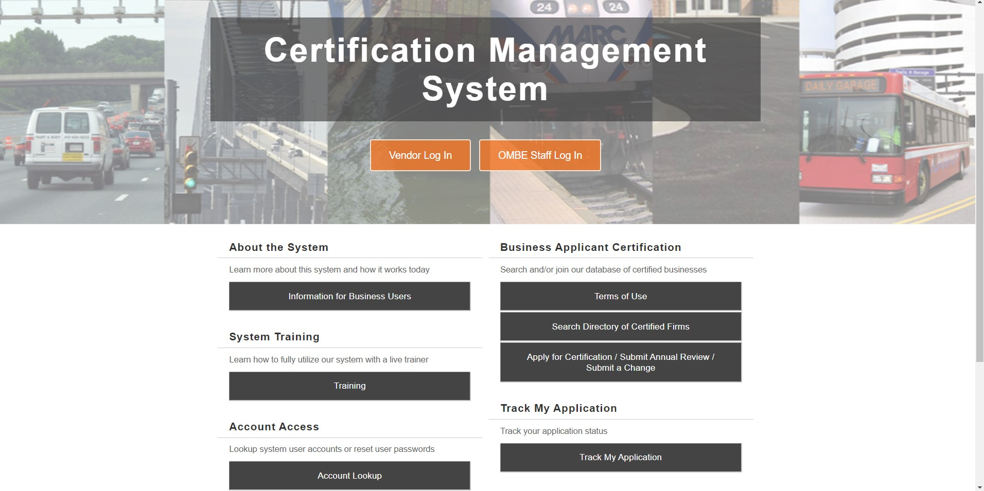
COMPLETING THE ONLINE APPLICATION

Slide 27
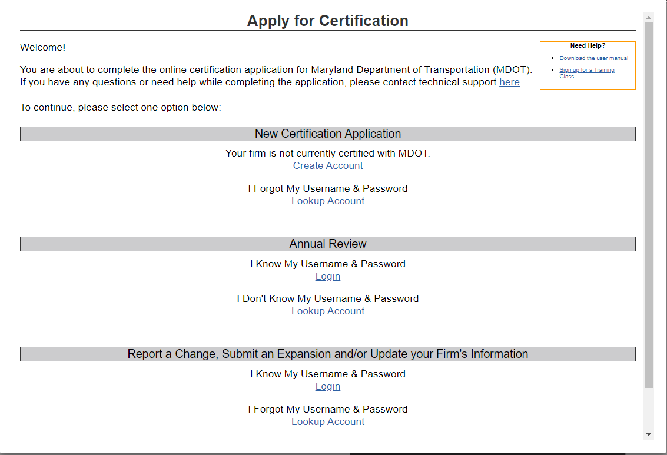
COMPLETING THE ONLINE APPLICATION

Slide 28
CERTIFICATION TIME
Once a complete application package has been received,
it takes an average of
90 days to complete
the certification
process
If you do need assistance, please call the OMBE office at 410-865-1269.

Slide 29

As you go through the certification process… talk with the experts!
410.865.1269
mbe@mdot.maryland.gov
www.mdot.maryland.gov
For individual guidance on your application, please contact the Office of Minority Business Enterprise using the contact information above.

Slide 30
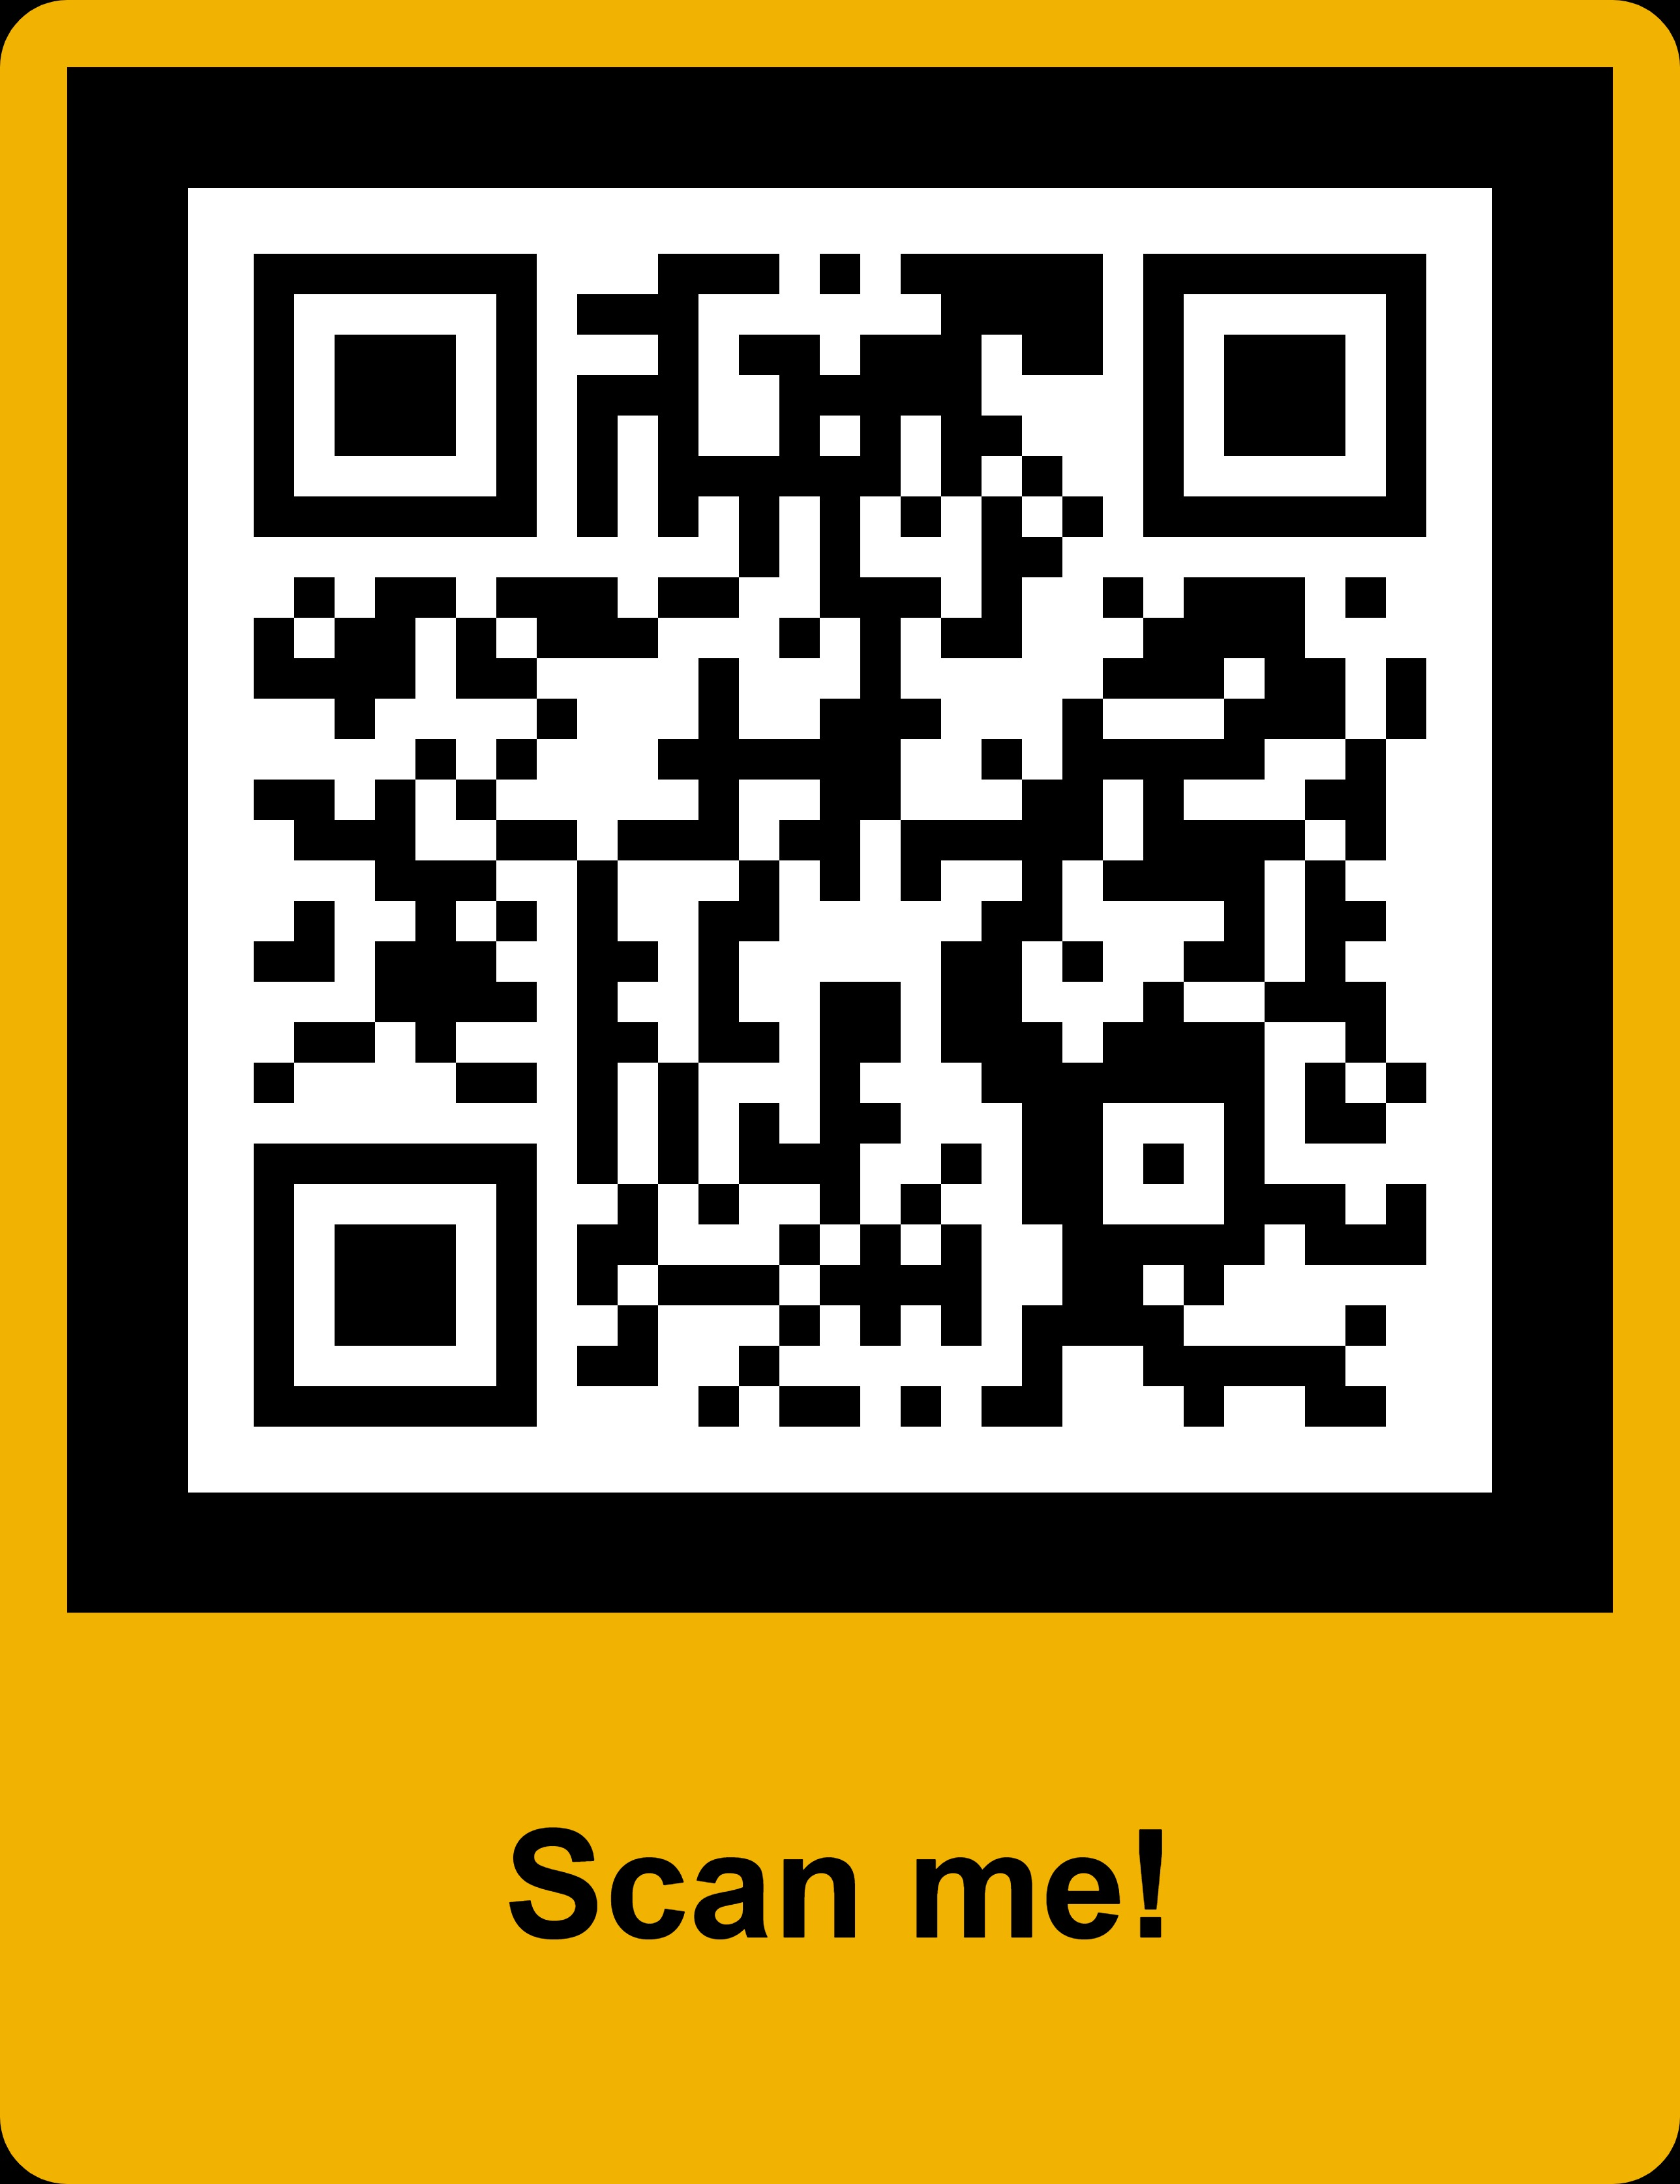
Office of Small & Minority Business Policy
December 5, 2023, 10:00 AM & 5:30 PM
Registration is now open online!
Contact:
Eun Young Hong: ehong@mdot.maryland.gov
Office of Small & Minority Business Policy
www.mdot.maryland.gov

Slide 31
Disparity Study
Vendor Survey is Now Open
To learn more about this study, please visit: https://stateofmddisparitystudy.com

Slide 32
Women’s Business Enterprise National Council
Vanessa Foster

Slide 33

Why to Get
WBENC Certified
WBEC Greater DMV

Slide 34
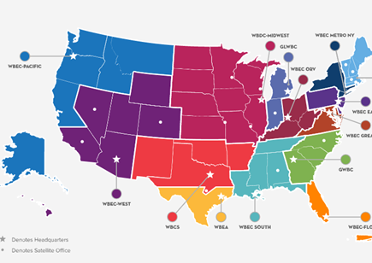
What is WBENC?
The Women’s Business Enterprise National Council (WBENC) is the nation’s leading third-party certifier of business owned and operated by women
Founded in 1997
14 Regional Partner Organizations (RPO) who deliver the WBENC Certification
The leading advocate of WBEs & WOSBs as suppliers to Corporate America and Government Agencies
Corporate Membership Organization

Slide 35









SUPPORTING
Southern Connecticut
New York
Northern New Jersey
District of Columbia
Maryland
Virginia

Slide 36
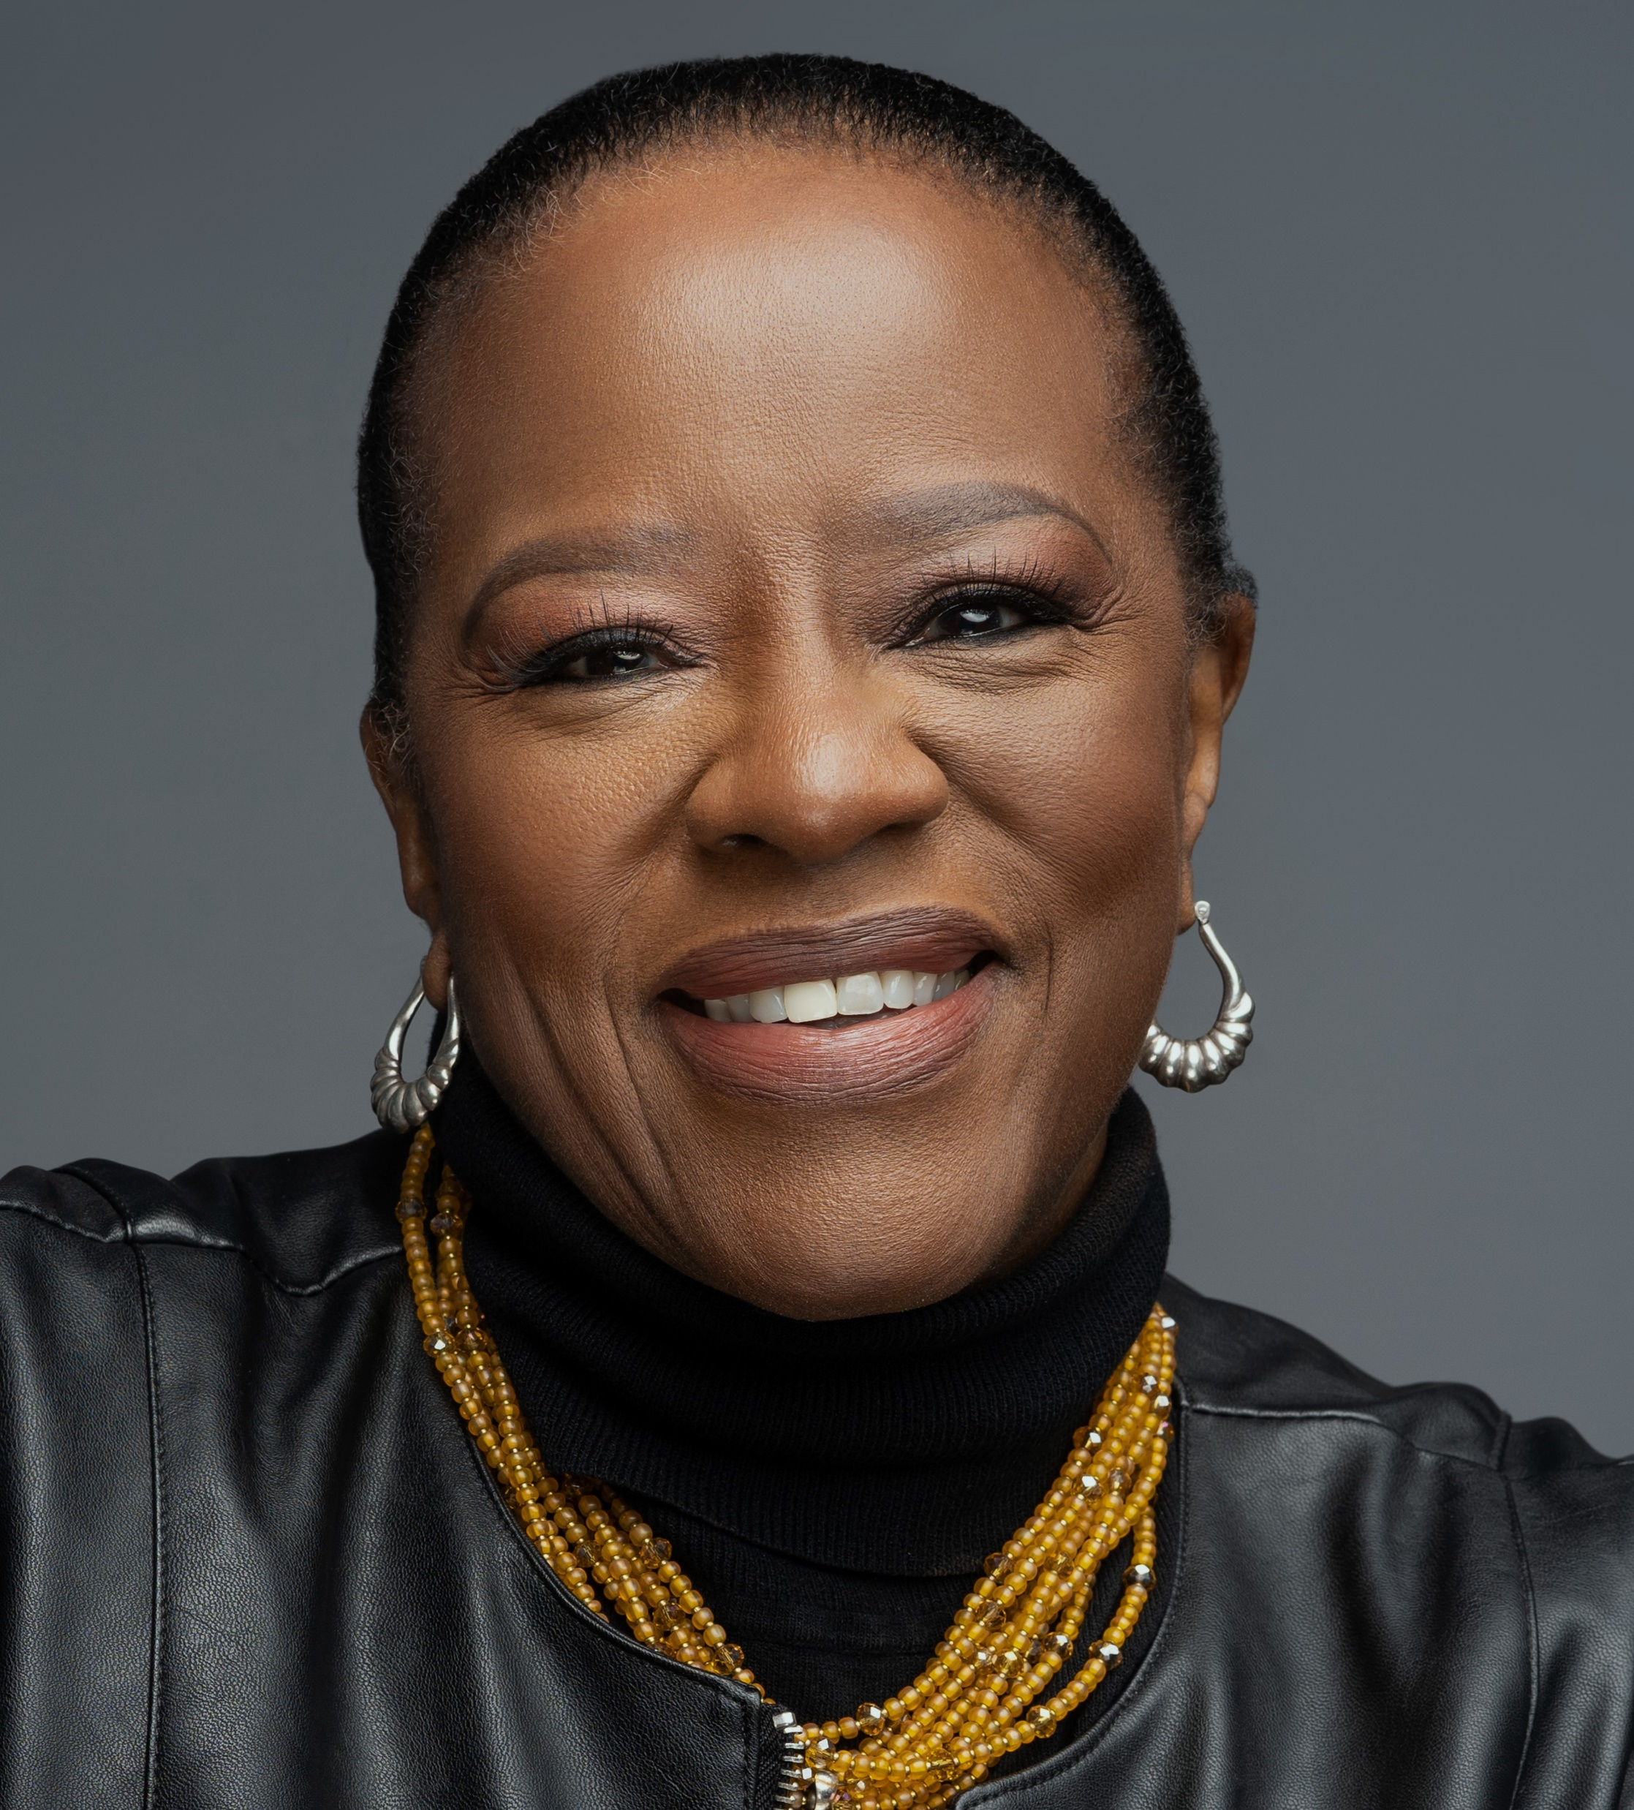

Who We Are
WBEC Metro NY and Greater DMV Inc DBA WBEC Metro NY and WBEC Greater DMV are two of the 14 Regional Partner Organizations of the Women’s Business Enterprise National Council (WBENC). Metro NY and Greater DMV provides WBENC certification—the gold standard in diversity certification—at the regional level and serve as an advocate for certified women-owned businesses in Southern Connecticut, New York, Southern New Jersey, District of Columbia, Maryland and Virginia, offering professionally executed educational programs, high-level networking opportunities, recognition, and an entrée to corporate supplier diversity programs.
Metro NY and Greater DMV’s corporate membership provides access to the vast WBENC data base of certified Women Business Entrepreneurs (WBEs), custom curated procurement lists, match maker events, corporate networking opportunities, custom programming, signature events, award recognition and additional opportunities for engagement.
Sandra Eberhard
President & CEO
Notes:
Images Source:-
https://pixabay.com/en/business-woman-professional-suit-2697954/

Slide 37
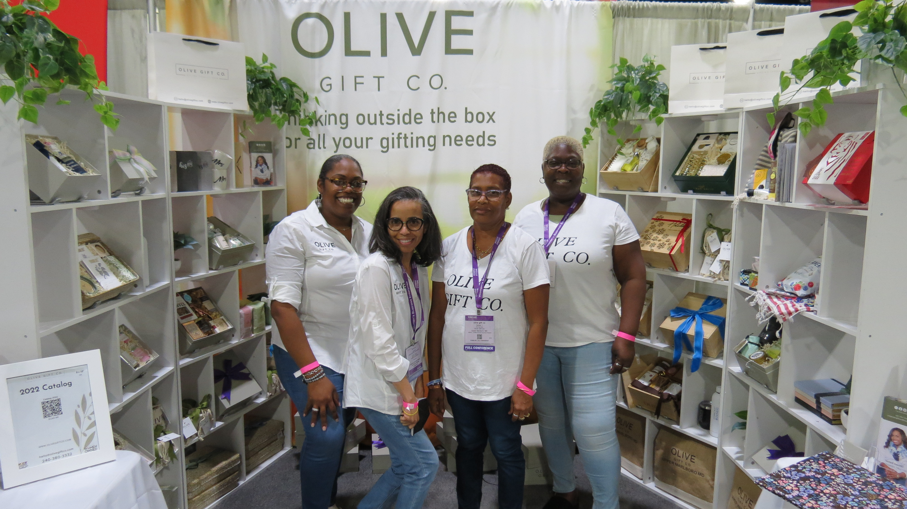

960+ WBEs
163 New WBEs added in 2023
$7 Billion in Aggregate Revenue
Employing 54,000+ People
Averaging 15 Years in Business
57% are WOSB Certified
46% Minority
Top Industries Represented
Professional, Scientific, and Technical Services
Administrative Support, Waste Management and Remediation Services
Construction
Wholesale Trade
Educational Services
Notes:
https://unsplash.com/photos/IYRq_5Lv-Yc

Slide 38



Our Certifications
WBE Certification
Ownership
At least 51% owned by a woman/women
U.S. citizen or legal resident status
Control
Governance
Operations & Management
Independence
Headquarters
USA Domestic
WBENC is also an approved third-party certifier for the SBA’s Women-Owned Small Business (WOSB) Federal Contracting Program
WOSB Certification
Ownership
At least 51% owned by a women/women
U.S. citizen
Size Standard
Revenue Threshold
Number of Employee Threshold
Control
Governance
Operations & Management
Independence

Slide 39


Benefits of Certification
Access to supplier diversity and procurement executives at hundreds of major U.S. corporations and federal, state, and local government entities that accept WBENC Certification
Formal and informal opportunities to pursue business with Corporate and Government Members, as well as other WBENC-Certified WBEs
Access to networking events and programs, procurement opportunities, mentoring, executive education, capacity development programs, and other business tools and resources
Eligibility for regional and national awards and recognition
Use of Women Owned Logo and Women’s Business Enterprise Seal as a marketing tool to promote your business and expand your company’s visibility
Community of support from other female business owners and like-minded professionals all dedicated to the growth and success of women-owned businesses

Slide 40

Application Fees
The non-refundable processing fee for new applications and recertification is based on annual gross revenue as reported on Federal Taxes and is divided into five (5) tiers. Please identify which range your company’s revenues fall within to identify the required fee.
Revenue Range Category
Under $1 million: $350
$1M < $5M: $500
$5M < $10M: $750
$10M < $50M: $1,000
$50M+: $1,250

Slide 41












The Process
Determine if you are eligible
Compile Required Documentation
Complete Online Application
You’re In!
Review & Site Visit
Certification Determination
WBENC Certification validates that a business is at least 51 percent owned, controlled, operated, and managed by a woman or women. This means one or more women must have unrestricted control of the business, a demonstrated management of day-to-day operations, and a proportionate investment of capital or expertise.
Before applying for certification online, we recommend gathering all of the required documents in advance.
You will be providing general business information, owner eligibility, financial structure, personnel & management information, and governance information.
Once you have ensured you meet the certification criteria and gathered your documentation, the next step is to register and complete an online application on WBENCLink2.0.
Review your application carefully before submitting. Be prepared to pay a certification application fee.
The WBENC process includes a thorough review of the documentation presented and a site visit interview with the female owner(s). The Regional Partner Organization near you will process your application, which includes ensuring all documentation is complete, reviewing your application with a Certification Committee, and arranging a site visit with the owner.
The review process takes approximately 90 days from the date your file is deemed complete. WOSB certification takes approximately 30 additional days.
The Certification Committee at your Regional Partner Organization will complete a thorough review of your application, ensuring your business meets our certification criteria. Certification Committees are trained and confidential groups of volunteers from Certified WBEs, corporations, government or community organizations.
Your Regional Partner Organization will notify you via email and letter when a determination has been made.
As a WBENC-Certified WBE, you will have access to a wide range of benefits. Once you are certified, use our checklist to get acquainted with the network, download logos, and best leverage your certification. And don’t forget to set a calendar reminder for recertification!

Slide 42
Documentation requirements
General:
History of Business
(Explain the start and history of your business, including when, where, why, with whom, and how the business was started/acquired)
Professional and business license(s) (if applicable)
Resumes of all owners, board of directors, and key management team
OWNER ELIGIBILITY
Evidence of gender for female owner(s):
Copy of current U.S. Passport, U.S. Birth Certificate, or Driver’s License
Evidence of U.S. citizenship or Permanent Legal Resident Alien status for female owner(s):
FINANCIAL STRUCTURE FOR THE BUISNESS
Three years’ Federal Income Tax returns
Profit and loss statement and Balance sheet that aligns with the most recent tax return submitted.
Copies of any loan documents that are currently active (listed under the Liabilities section of the company’s Balance Sheet)
Copy of bank signature authorization card {mandatory}
Proof of capital and/or equity investment by female owner(s): cancelled checks, opening bank statement, proof of stock purchase, written statement by owner, list of contributed equipment/expertise, etc.)

Slide 43
Documentation requirements
PERSONNEL & MANAGEMENT
List of all full- and part-time employees by name, position, and length of service or date of hire, including all owners {mandatory}
Employee payroll for the month prior to submitting the application {mandatory}
W-2s and/or 1099 forms from every officer, director, or owner receiving compensation from the company for the most recent year {mandatory}
Only if this applies to you:
Trust agreement(s) that involve the majority female owner(s)
Employee Stock Ownership Plan Agreements (ESOPs)
Submit copies of the following documents that are currently active:
Management/consulting agreements
Service agreements
Affiliate/subsidiary agreements
Franchise Agreements (if applicable)
Union Agreement (if applicable)
GOVERNANCE
NOTE: REQUIREMENTS DIFFER BY BUSINESS STRUCTURE. Ex. Operating Agreement/bylaws, Articles of Organization, Minutes from shareholders’ first organizational meeting , Minutes from first meeting of board of directors
WOSB
All businesses seeking WOSB Certification in addition to WBENC WBE certification must also submit: Printout of the first page of System Award Management (SAM) Registration showing an “Active” status.
Partnerships, Corporations, and LLCs must submit additional documents

Slide 44
Leadership Development Programs
We offer Leadership Development programs to support the reclamation and future growth of the women owned businesses in the WBEC Metro NY and Greater DMV network.
Some curriculums have the capacity to be delivered as a single program, but most are offered and designed to support business owners through multiple classes.
(Program content is delivered virtually.) These extended curriculums also include online tools, peer-to-peer engagement, and coaching/mentorship support opportunities throughout the program and possibly beyond.

Slide 45





SAGE Advice
January – June
Strategies to Advance and Grow Enterprises
The SAGE program takes participants on a transformative journey
Six-Month Program Roadmap
The Corporate Connection
Your Financial Picture
Marketing for Success
Building Your “A Team”
Maximizing the WBENC certification
Navigating Corporate Procurement Process
Negotiating the Deal
Relationship Management
Supplier Management
Introduction to the One Page Business Plan
Finding and managing the money needed to run a successful business
Financial & Cash Flow Statement
Access to Capital – Panel Discussion
Individual Banker Session
Budgeting
Marketing and Selling to maximize your profits
Brand Analysis & Positioning
Developing a Marketing Plan
Social Media Strategy
Selling Panel
Scaling Your Business
Making the case for who, when and how to get help for your company
You Must Have Advisors
Building Your Advisory Board
HR and the Current Workforce
Hiring Well and Managing with Ease

Slide 46



Amplify Mastermind
DURATION: 6 months
DELIVERY:
One 90-minute session each month. WBEs paired with each other WBEs
in a mastermind group and a dedicated corporate business resource partner (BRP).

Slide 47
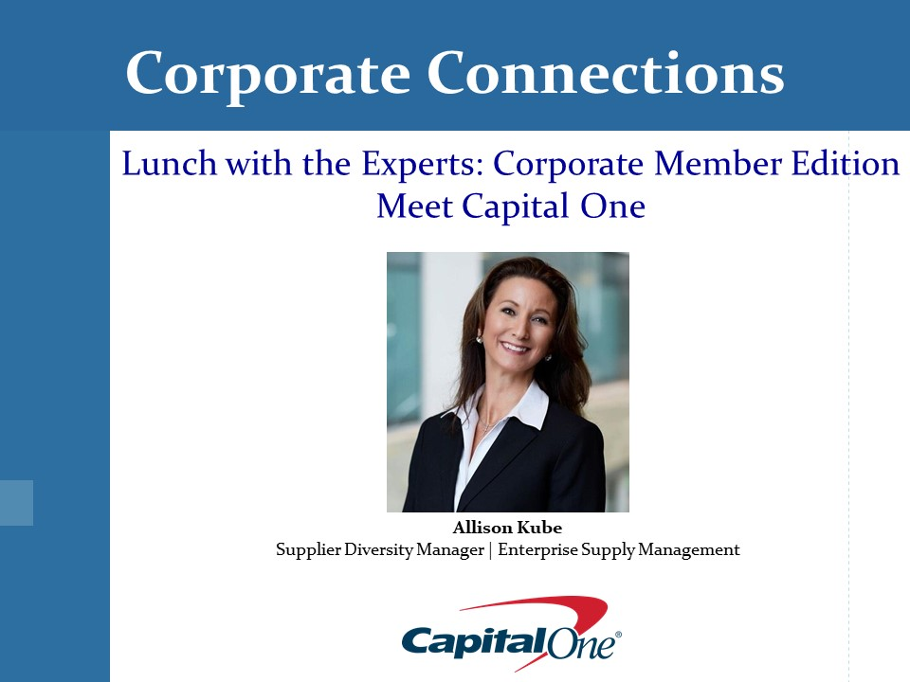

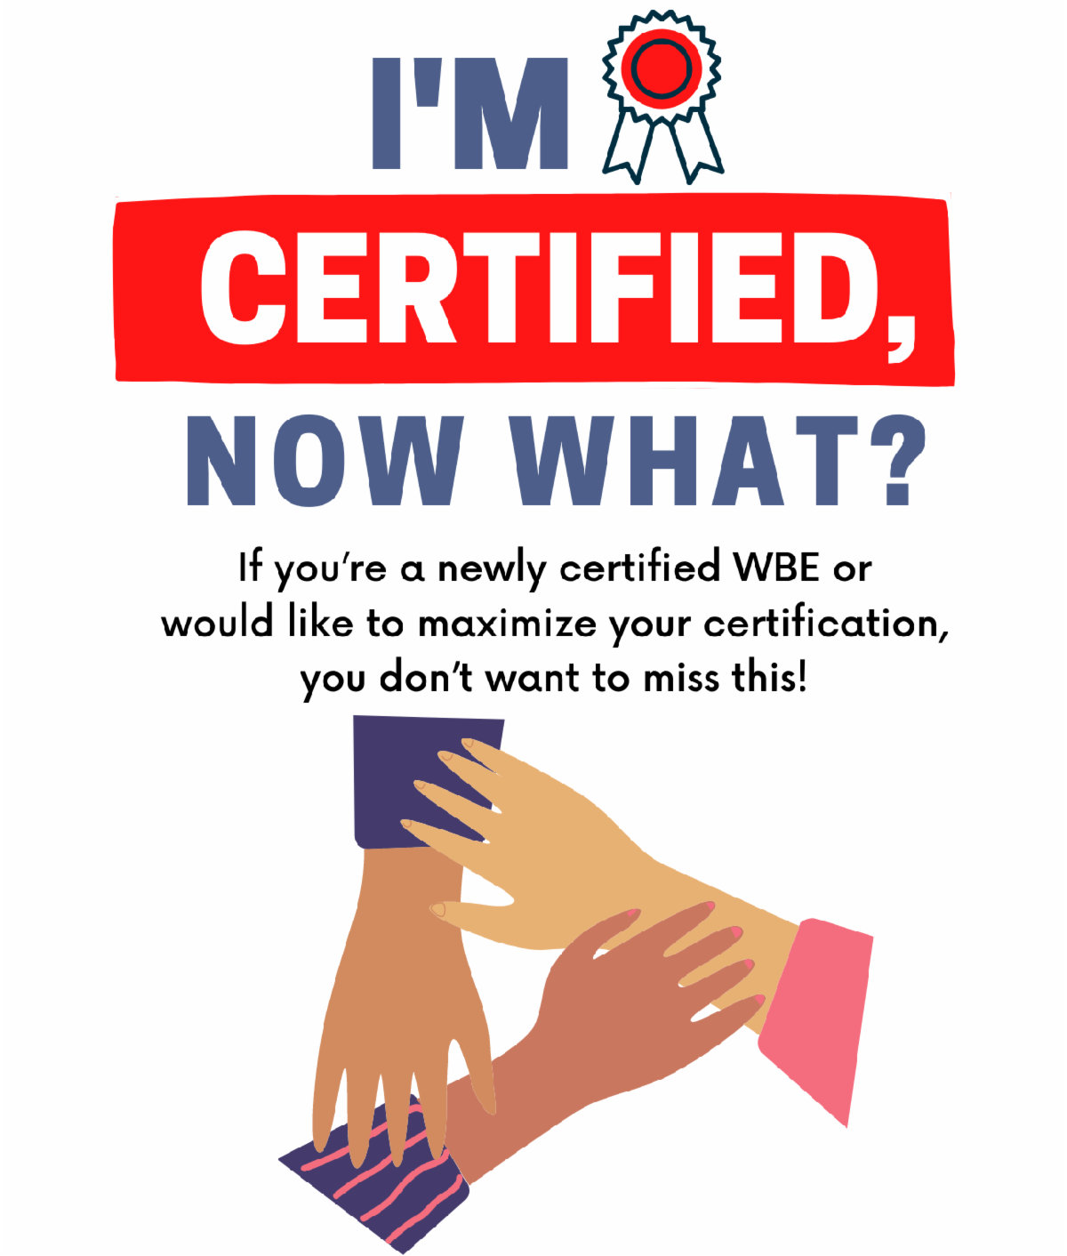

Content & Connections
Lunch with the Experts
Invites Corporate Members to give an interactive presentation at an online program for WBEs. Delivered over lunchtime, allows WBEs to step away from regular business to gain insight about corporate involvement without intruding on their workday and learn about Corporate Members’ supplier diversity programs and how to navigate their sourcing/procurement processes.
Webinars
Provide more detailed information to WBEs about WBEC Greater DMV and WBENC, and how to maximize WBENC Certification and local RPO support.

Slide 48
Recertification
Re-certify every year
Notified 120 days prior to expiration date
Provide current year supporting documentation
Site Visit conducted every 3 years (or annually if substantive changes have occurred in the company)
WOSB certification
  WBENC certified WOSB will use their annual WBENC certification certificate as proof of attestation

Slide 49
Our Corporate Members
Arts, Entertainment, Recreation
A+E Networks
AMC Networks
Major League Baseball
MGM Empire City
Monumental Sports & Entertainment
NBC Universal
Paramount
The Metropolitan Museum of Art
US Tennis Association (USTA)
Warner Media
Biotech & Pharmaceutical
AstraZeneca
Bayer US LLC
Bristol Myers Squibb
Johnson & Johnson
Merck & Company
Novartis Pharmaceuticals Corp
Novo Nordisk
Organon
Pfizer Inc.
Sanofi
Teva Pharmaceuticals
Consumer Products
Altria Client Services
Colgate-Palmolive
Education
New York University
Engineering
Leidos
Raytheon Technologies
Financial Services
Bank of America
BNY Mellon
Capital One
Citigroup
Federal Home Loan Bank of New York
Federal Reserve Bank of New York
Federal Reserve Bank of Richmond
FIS Global
Freddie Mac
Guggenheim Partners
HSBC Bank
JP Morgan Chase & Co.
KPMG
Moody's Corporation
Morgan Stanley
T. Rowe Price
Webster Bank
Wells Fargo
Financial Services & Insurance
AIG
NEA Member Benefits
Prudential
Food & Beverage
Mars Inc.
McCormick & Co.
PepsiCo
Food & Facilities Management
Sodexo
HealthCare
Northwell Health
MassMutual
MetLife
New York Life
Manufacturing
Micron Technology
Non-Profit
AARP
Professional Services
Accenture
Ampcus Inc.
EY
Fairfax County EDA
Marsh & McLennan
PricewaterhouseCoopers (PwC)
Real Estate & Management
Tishman Speyer
Veris Residential
Retail
Peapod Digital Labs
Technology & Connectivity
Amazon
AT&T
IBM
Transportation & Logistics
MWAA
Travel & Hospitality
Marriott International
Wyndham Hotels & Resorts
Utilities
Con Edison
Constellation
DC Water
Dominion Energy
National Grid
New York Power Authority
Pepco, an Exelon Company
PSEG
SMECO
Vistra Corp.
Washington Gas
WSSC Water
Metro NY Member
Greater DMV Member
Dual Member
New Member 2023

Slide 50
Is Certification Right For You?
You should consider going through the certification process if:
You would like your company to have access to more business opportunities and services
You want to validate to corporations, government entities and other buying entities that you are, in fact, a woman-owned, controlled and managed company
You would like access to programs that will provide you with knowledge and skills to develop your business
You enjoy building relationships
When WBENC Certification may not be right for you:
You do not meet WBENC’s Certification Standards
You think certification will guarantee contracts
You think certification will grant you or your company preferential treatment

Slide 51
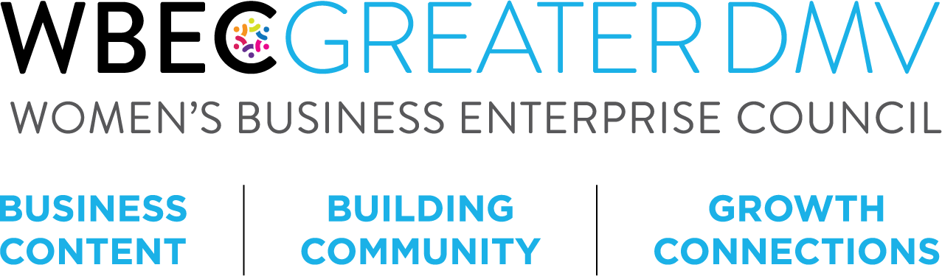

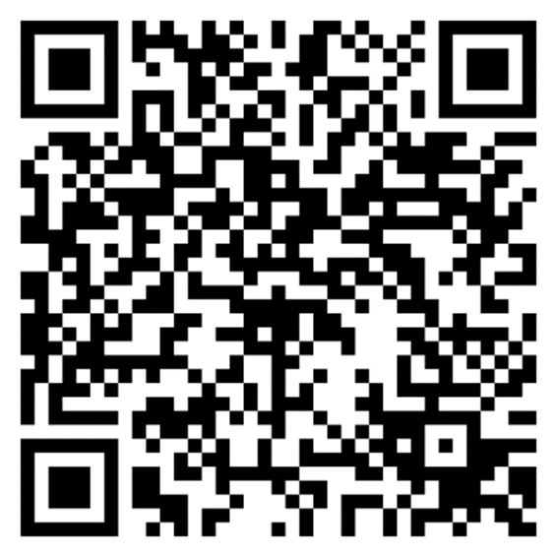
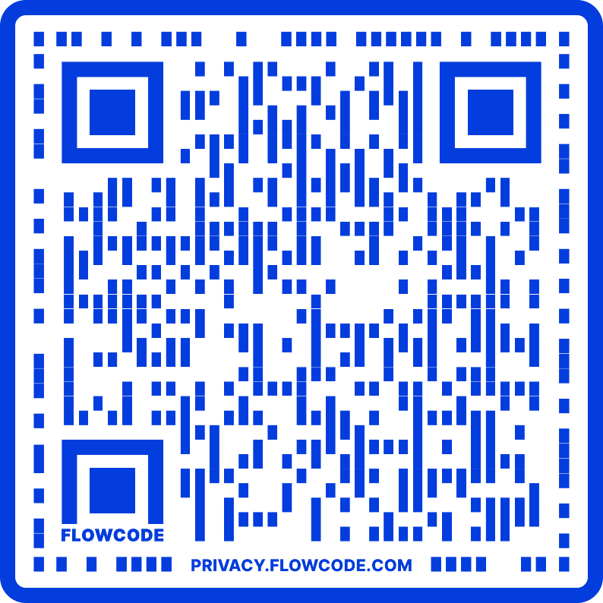
Interested in WBENC certification or
WBEC Greater DMV programming?
Scan the QR Code, submit your information and someone from our team will reach out to you.
Scan the QR Code to visit our event calendar.

Slide 52
Visit Our Website: https://www.wbecnydmv.org/
For more information please contact: Vanessa Foster, Growth and Retention Specialist vfoster@wbecgreaterdmv.org

Slide 53
City of Baltimore
Christopher Lundy

Slide 54
City code article 5, subtitle 28
SMBA&D oversees compliance with Subtitle 28 the Minority & Women’s Business Program (MWB Program) and Small Local Business Enterprises.
This subtitle applies to all contracts awarded by the City. Article 5, § 28-4.
This civil rights program works to remedy past discrimination in the City’s contracting process by prime contractors against minority and women’s business enterprises.
This has resulted in the significant underutilization of minority and women’s business enterprises in contracts awarded by the City in the major contracting markets: construction, commodities, architectural, engineering, and professional services.
Notes:
MWBOO is grounded in ensuring equity in the procurement process

Slide 55
MBE/WBE Contract Participation
MBE/WBE participation is a top priority of the City. It is mandated by the City Code and is incorporated into every City contract.
Certification allows you to participate on City contracts and have your work count towards the MBE/WBE goals on the contract.
The City does not want to renew or extend contracts where there has not been compliance with the MBE/WBE contract participation goals.

Slide 56
What are MBE’s / WBE’s ?
Minority Business Enterprise is defined as a business enterprise owned and controlled by an African-American, Hispanic-American, Asian-American, or Native-American.
A Women’s Business Enterprise is defined as a business enterprise owned and controlled by a woman (WBE), which includes non-minority females as well as a woman who is part of any of the above-mentioned minority groups (M/WBE).
Non-profits are ineligible for certification. The Code defines business enterprise as a legal entity operated for profit.
However, the participation of a MBE/WBE is limited to being designated as counting towards a single contract goal.

Slide 57
MBE/WBE Certification Application Criteria
The minority and/or women must own at least 51% of the company and have operational and managerial control
Be an independent, operating, small business
Have been in operation for at least 12 months before applying for certification
Have been minority or women-owned for at least 12 months before applying for certification
Have an operating office in the Baltimore City Market Area
You can now complete the entire application and submit it via the website.
If you have a pending renewal application you remain certified until a final determination has been made. Please contact SMBA&D if you require an extension of your certification date.
Notes:
Certified Services per NAICS Codes North American Industry Classification System
Size Limitations Small Business Administration (SBA) size standards for the service code
MWBOO certification does not rate or reflect the skills of the business, only that they meet baseline requirements to operate the business

Slide 58
Baltimore Market Area Defined
Baltimore Market Area includes the following areas:
Baltimore City
Baltimore County
Anne Arundel County
Carroll County
Harford County
Howard County
Queen Anne’s County

Slide 59
M/WBE Application Timeframe
The application is now in a fillable form on the website: https://baltimorecity.diversitycompliance.com/
Training & Events are also listed on the site.
Please allow between 60 days for processing of your application. Any missing documentation will delay this process!
Once approved, certifications are valid for two years.
Remember when being used to achieve the goals, you MUST be certified to provide the services being performed on the contract!
Lastly but certainly not least, CERTIFICATION IS NOT A GUARANTEE OF BUSINESS! YOU MUST MARKET YOUR OWN COMPANY!

Slide 60
Annual Participation Goals
These goals are not universally applicable.
Annual participation goals are aspirational goals that aid the City in its annual evaluation of the effectiveness of the Minority and Women’s Business Enterprise Program.
Goals or waivers remain applicable and typically are not changed during the contract term. To change or impose goals upon a contract it must be resolicited.
Goals can be negotiated on a contract with an existing waiver via the contractor/vendor voluntarily entering into a Commitment to Comply with contract participation goals.
MBE 27%
WBE 10%

Slide 61
Stay Current
Once certified it is critical that you keep all of your contact information current with SMBA&D

Slide 62
Statement of Intent
Do not sign any incomplete documents
Ensure that your business is correctly listed, as it is in the active certification directory
Be sure to list your certification number
If M/WBE, ensure you select which designation you are working under for the contract
Ensure the dollar amount & percentage are correct
List the certified services you will be providing
Post award: All changes must be approved by SMBA&D

Slide 63
Supplier Diversity Management system
Contract Compliance Reporting training via webinar on November 14th & 16th
This will be a component of compliance when working on City contracts
If you have previously reported in the B2G now platform this will be a familiar process
The project manager and staff at the end user agency will be available to assist you in understanding the requirements
There are on demand trainings on Baltimore Diversity Compliance website that is identical to the live training

Slide 64

Develop & grow your business

Slide 65
Speaker Series
    December Session: Estimating
      Date: Tuesday, December 5, 2023
      Time: 10:00 a.m. – 12:00 noon
      Speakers:
      Andy Scherer
      Vice President
      The Whiting-Turner Contracting Company

Slide 66

Business Guidance & Resources
Startup
Growth
Funding
Business Guides
Info regarding licenses & permits
Sizeup Baltimore
Notes:
Certified Services per NAICS Codes North American Industry Classification System
Size Limitations Small Business Administration (SBA) size standards for the service code
MWBOO certification does not rate or reflect the skills of the business, only that they meet baseline requirements to operate the business

Slide 67

Current Main Street Districts:
Belair-Edison
Fell’s Point
Hamilton-Lauraville
Highlandtown
Historic Federal Hill
Pennsylvania Avenue
Pigtown
Waverly
Please keep these areas in mind to locate your brick & mortar business
Notes:
Certified Services per NAICS Codes North American Industry Classification System
Size Limitations Small Business Administration (SBA) size standards for the service code
MWBOO certification does not rate or reflect the skills of the business, only that they meet baseline requirements to operate the business

Slide 68
Thank you for participating!
Baltimore City Mayor’s Office of Small & Minority Business Advocacy & Development
3000 Druid Park Drive, Suite 3000B, Baltimore, MD 21215
(410) 396-3818
https://smba-d.baltimorecity.gov/
https://smba-d.baltimorecity.gov/mwboo/faq

Slide 69
U.S. Small Business Administration
David Hincapie

Slide 70
Questions?
Please line up by the microphone

Slide 71
Networking Break
10:30 a.m. – 10:45 a.m.

Slide 72
Remarks
County Council President Evan Glass

Slide 73
Upcoming Procurement Opportunities from Around the County
10:50 a.m. – 11:45 a.m.

Slide 74
Montgomery County Office of Procurement
Bob Norris

Slide 75
Montgomery County Office of Procurement
Formal Solicitations (>$100K)
  IFBs – Invitations for Bids
  RFPs - Request for Proposals
  REOIs – Request for Expressions of Interest
Informal Solicitations (> $10K, < $100K)
  All reserved under the LSBRP
  >$50K all subject to MFD requirements
  >$50K services contracts subject to Wage Requirements Law
Direct Purchase (departments buy directly) (< $10K)

Slide 76
Montgomery County Office of Procurement
Visit our website for current solicitations:
www.montgomerycountymd.gov/PRO/solicitations
Visit our PROjections page to find projected upcoming solicitations:
www.montgomerycountymd.gov/PRO/solicitations

Slide 77
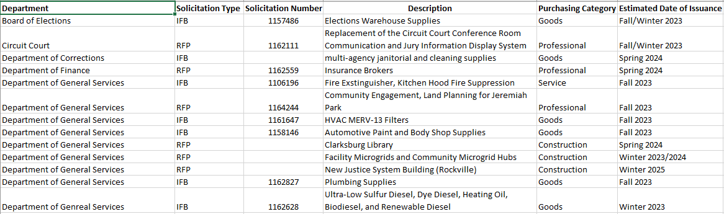
Montgomery County: Potential Upcoming Solicitations

Slide 78
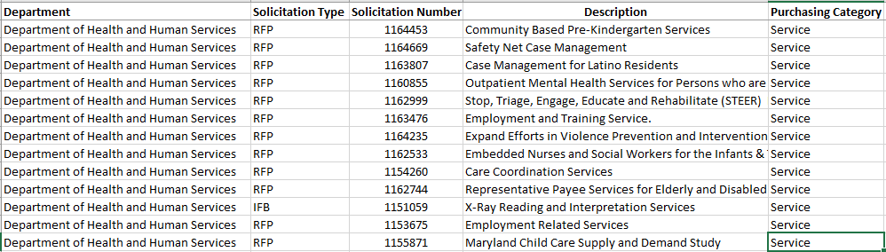
Montgomery County: Potential Upcoming Solicitations

Slide 79
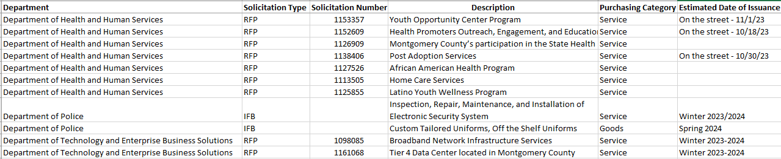
Montgomery County: Potential Upcoming Solicitations

Slide 80
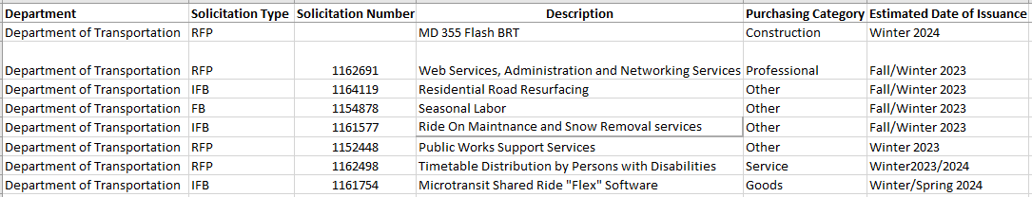
Montgomery County: Potential Upcoming Solicitations

Slide 81
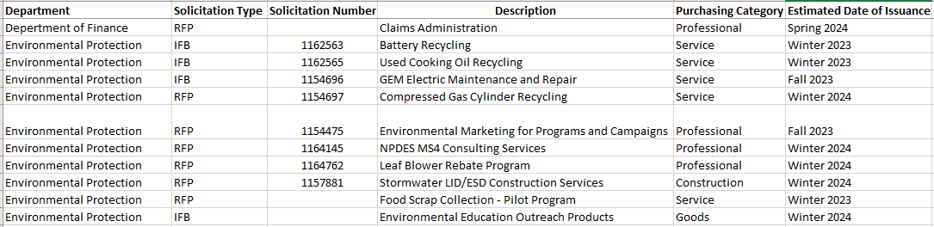
Montgomery County: Potential Upcoming Solicitations

Slide 82
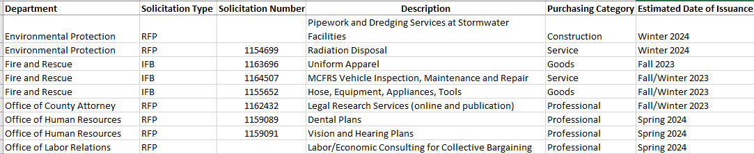
Montgomery County: Potential Upcoming Solicitations

Slide 83
Montgomery College
Patrick Johnson

Slide 84

Office of Procurement
Patrick Johnson, Director of Procurement
Patrick.johnson@montgomerycollege.edu

Slide 85
Procurement-related Resources
Procurement website:
https://info.montgomerycollege.edu/offices/procurement/index.html
The following information is available at website:
Upcoming bid opportunities
Existing contract listing
Purchasing agent contact information
Procurement Process guide

Slide 86
Upcoming Bid Opportunities
Description | Issue Date:
Athletics Transportation | Jan – Feb 2024
Geese Management Services | August 2024
T&M On-call Paving Services | Jan – Feb 2024
T&M On-call Electrical Services | Jan – Feb 2024
Pay-for-print Management Services | Feb – March 2024
NetApp Products and Services | Aug – Sept 2024
Supplementary Snow Removal | Feb – March 2024

Slide 87
Upcoming Bid Opportunities - continued
Description | Issue Date
Motorola Two-way Radio Equipment & Svcs. | Jan – Feb 2024
Group & Individualized Case Management & Job Training Counseling Services | Jun - July 2024
Collegewide Elevator Maintenance | Jan 2024

Slide 88
City of Rockville
Jessica Lewis

Slide 89


Doing Business with the City of Rockville
Presented by:
Jessica Lewis, CPPO, CPPB, MBA
Director of Procurement

Slide 90


Overview
Page 2
The mission of the Procurement Division is to provide support to the City by performing the procurement function and materials management operation in a customer-focused, strategic, ethical and transparent manner while ensuring opportunities to our diverse business community and complying with applicable governing laws and policies.
The ideal capabilities of our vendors include fair and reasonable price, quality of product/service, strong customer service and ethics/integrity. Likewise, the City pledges integrity and open and fair competition with our vendors. The City’s complete Vendor Guide can be found at: https://www.rockvillemd.gov/2317/Vendor-Guide
The City buys all types of products and services: from commodities to construction to various professional services (IT related, consulting in multiple areas: planning, public information, recreation & parks, public works).

Slide 91
City of Rockville: Upcoming Solicitations
Page 3
Contract Title | Solicitation Method | Estimated Solicitation Date
Architectural and Engineering Services (Multiple Award) | Request for Proposals/Formal | 12/2023
Residential Rehabilitation/Repairs to Single Family Homes | Request for Quotes /Informal | On-Going
Occupational Medical and Urgent Care Services | Request for Proposals/Informal | 12/2023
State Lobbying Services | Request for Proposals/Formal | 12/2023
Taft Court Phase 1B renovations | Invitation for Bids/Formal | 3/2024
Compensation and Classification Study | Request for Proposals/Formal | 12/2023
King Farm Farmstead Electrical Improvements | Invitation for Bids/Formal | 1/2024
Tents and Equipment Rentals | Invitation for Bids/Formal | 2/2024
The above list is a sampling of upcoming solicitations. A complete listing can be found at: https://www.rockvillemd.gov/231/Procurement and includes Procurement contact information. Note: The estimated solicitation dates may be subject to change

Slide 92
Resources
Page 4
The City’s Upcoming solicitations/forecast can be found on our website at:
https://www.rockvillemd.gov/231/Procurement
The City has a new Collaboration portal where all bids/proposals are submitted electronically. Instructions and information can be found on our website at:
https://www.rockvillemd.gov/bids.aspx
The City also posts its solicitations on eMaryland Marketplace (eMMA):
https://emma.maryland.gov/page.aspx/en/usr/login?ReturnUrl=%2fpage.aspx%2fen%2fbuy%2fhomepage

Slide 93
Contact Information
Page 5
Provided is the link to Procurement on the City’s website: https://www.rockvillemd.gov/231/Procurement
Please contact us, we look forward to talking with you:
        Jessica Lewis, CPPO, CPPB, MBA, Director of Procurement
        240-314-8432
        jjlewis@rockvillemd.gov
        Jonathan Pierson, CPM, Assistant Director of Procurement
        240-314-8433
        jpierson@rockvillemd.gov
        Pat Ryan, CPPB, MBA, Principal Buyer – email/call for technical one on one assistance
        240-314-8434
        pryan@rockvillemd.gov
        Thomas Ellison, CPPB, Principal Buyer
        240-314-8436
        tellison@rockvillemd.gov
        Regina Washington, Senior Buyer
        240-314-8431
        rwashington@rockvillemd.gov
        Christos Bazekis, Buyer
        240-314-8446
        cbazekis@rockvillemd.gov

Slide 94
WSSC Water
Caprecia Poole-Williams

Slide 95

Procurement at WSSC
Caprecia Poole-Williams, Chief Procurement Officer
November 16, 2023

Slide 96
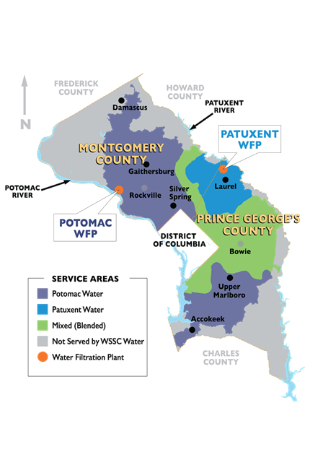
Tap Into Business With WSSC Water!
104-years old: NEVER had a drinking water quality violation. . . EVER
1,000 square mile service area in Prince George’s & Montgomery Counties
475,000 accounts with 1.9M residents
Largest water utility in Maryland

Slide 97

What Do We Buy?
The following list provides an example of the goods and services we purchase. The list is not exhaustive.
GOODS | SERVICES
Chemicals | Construction Services
Office Supplies | Cleaning and Restoration
Pipes, Valves, and Fittings | CCTV Inspection
IT Equipment | IT Consulting Services
Vehicles | Maintenance, Repair, and Operations

Slide 98

How We Buy
The dollar values below represent thresholds at which goods or services are procured via P-Cards, small purchases and solicitations.
“Micro Purchases”/Purchase Card: ≤ $5K
Small Purchases: $5,001 - $100K
Solicitations: > $100K
  Invitation for Bid (e.g., lowest price)
  Multi-Step Invitation for Bid (e.g., pre-qualified & lowest price)
  Request For Proposal (e.g., most advantageous)

Slide 99
WSSC Water’s Bidding Process
Visit wsscwater.com for solicitation information
Register in the Supplier Portal to view full solicitations
Find a solicitation you want to submit a bid/proposal for
Read the solicitation thoroughly, including all attached documents
The following is an overview of the process to submit bids/proposals for solicitations.
Understand WSSC Water’s bidding process
Provide requested information in a readable style
Structure proposals so they’re persuasive, compelling, and tell a story
For RFPs, be ready to potentially negotiate!

Slide 100


Tips for Business Success
Understand
Read
Compete
Keep Trying
WSSC Water Regulations
WSSC Water bidding process and requirements
Carefully read full solicitation
Ask questions
Submit responses in timely manner
Be patient – Success takes time
Learn from previous attempts
Keep submitting responses
Add value through innovation and savings
Give your very best response based on the information

Slide 101

Actions to Avoid
Making Assumptions
Assuming things about the solicitation
Leading with politics over substance
Not Following Guidelines
Being late with submissions
Quitting
Thinking you’ll win because you know someone at WSSC Water
Submitting incomplete/out of order responses

Slide 102
Upcoming Solicitations
Solicitation Description | Department | Estimated Contract Range
Conversion RGH Building and Pkwy Water Resource Recovery Facility (WRRF) | Architectural & Engineering | $500,000 - $1 Million
Bill Presentment Services Consolidation | Customer Service | $5 - $10 Million
Foreign Language Interpretation and Translation Services | Customer Services | $500,000 - $1 Million
Anacostia II Wastewater Pumping Station Electrical Upgrade | Engineering & Construction | $15 - $20 Million
Paint Branch Roads Sewer Rehab | Engineering & Construction | $15M - $20M
Sligo Creek 24" CIPP Lining | Engineering & Construction | $5 - $6 Million
Queen Elizabeth Water Main Replacement | Engineering & Construction | $5 - $10 Million
Rosaryville Rd Water Main Replacement | Engineering & Construction | $2 - $3 Million
Solicitation Description | Department | Estimated Contract Range
Janitorial Services at Remote Sites | General Services | $250,000 - $500,000
Window Cleaning | General Services | $100,000 - $250,000
Security Operations Center Video Wall | Homeland Security | $100,000 - $250,000
DocuSign Enterprise Pro with FEDRAMP | Information Technology | $500,000 - $1 Million
Isilon Refresh | Information Technology | $1 - $2 Million
General Construction Services | Production | $5 - $10 Million
Pump Maintenance Repair & Installation Services | Production | $500,000 - $1 Million
Lateral Inspection Services | Utility Services | $500,000 - $1 Million
Metallic MainTool Inspection Services | Utility Services | $3 - $5 Million
Notes:
Current solicitation forecast.

Slide 103
Montgomery County Public Schools
Stephanie Dorah

Slide 104
Division of Procurement
Montgomery County Public Schools

Slide 105
Division of Procurement
MCPS Procurement is dedicated to ensuring that—
  high-quality goods and services are purchased in a timely manner, at a reasonable cost;
  all purchasing actions are enacted in a fair and impartial manner, with no appearance of impropriety;
  all qualified vendors have access to MCPS business;
  offerors are not excluded arbitrarily or capriciously;
  specifications reflect the procurement needs of the purchasing body rather than a particular vendor; and
  the maximum feasible degree of competition is achieved

Slide 106
Solicitations - working with mcps
MCPS Procurement websites
  https://procurement.montgomeryschoolsmd.org/home/Bids
  https://ww2.montgomeryschoolsmd.org/calendar/mcpsbids.aspx
  https://www2.montgomeryschoolsmd.org/departments/procurement/supplier-portal/
eMMA - eMaryland Marketplace Advantage
  All of our solicitations are posted to eMMA
  Vendor registration is encouraged for notification

Slide 107
Vendor Responses
Ways to work with MCPS:
Register with eMMA
Register with MCPS Supplier Portal
RFP and Bid responses are required to be hard copy submissions
We are working toward electronic submissions, supplier portal registration is the first step

Slide 108
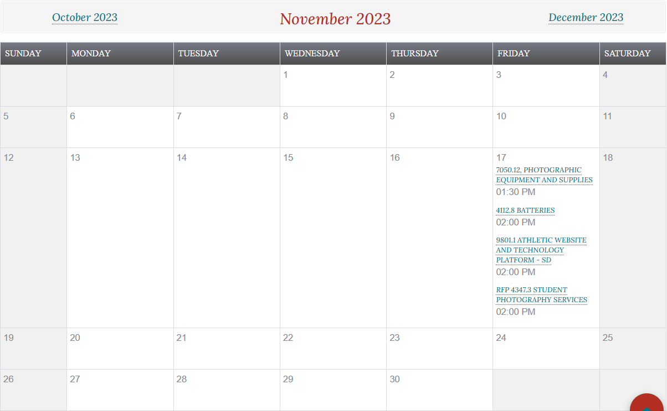
Vendor Calendar
Registering for eMMA so you, as a vendor, can receive the notifications and checking the MCPS Procurement website is the best way to keep up with our open solicitations.
The vendor calendar also shows what is currently open for the month.

Slide 109
Upcoming Solicitations
Bid/RFP# | Title
1083.7 | Professional Services and Temporary Personnel for Information Technology Consulting/Contractual Services
4079.13 | Health Room Supplies
4081.11 | Art Equipment
4087.13 | Office and School Supplies
4088.13 | Media Center Supplies
4121.21 | Office Paper - Virgin and Recycled
4940.1 | Spanish Literacy Textbooks
7133.12 | Cafeteria Disposable Supplies
9116.9 | Detergents and Cleaners for Laundry and Kitchen Use
9620.6 | Replacement of Acoustical Suspended Ceiling Systems and Related Lighting at Various Locations

Slide 110
Questions?
Please line up by the microphone

Slide 111
Strategic Networking Session
11:45 a.m. – 12:30 p.m.

Slide 112
Strategic Networking
This is a networking session designed to help you meet new people today.
On your name badge, there is a color sticker.
Please move to the “red, green, yellow or blue” section of the room.
If you don’t have a sticker, pick a section for yourself.

Slide 113
Strategic Networking Session
Small group suggested discussion topics:
Exchange business cards (digital or printed).
Briefly tell us your name, business name and industry.
Are you looking to subcontract on any projects? OR – are you looking for a subcontractor on any projects?
What brings you to this event today?
What’s a recent challenge you have overcome in your business, and what insights can you share about how you overcame it?

Slide 114
Thank you for attending!
A survey will be emailed to all attendees.

