Slide 1

Montgomery County’s Prevailing Wage Requirements
Presented by
Contractor Compliance and Monitoring Inc.
Deborah Wilder
443-906-2187
dwilder@ccmilcp.com
© Deborah Wilder 2021

Slide 2
Montgomery County’s Prevailing Wage Overview
Adopted September 9, 2008
Effective July 1, 2009
Requires the payment of prevailing wages on county funded construction
  In excess of $250,000
  County adopted many of Maryland’s Prevailing Wage Law provisions.

Slide 3
What is Construction Work
Work of Improvement- Construction
  Onsite
  Adjacent or nearly adjacent
Excluded work
  Performed in Permanent Shop
  Supplier Deliveries
  Professional Services
  Inspection work

Slide 4
Workers Covered
Who is covered?
Employees on the project
  Exceptions for Exempt (FLSA 541) Supervisory/Management Personnel
  No 1099 employees

Slide 5
Prevailing Wages
The Total Amount of Wages and Benefits must be paid to the employee or for his/ her benefit.
Wages must be paid to the employee on their paycheck
+
Benefits can be paid to any ERISA approved benefit plan
Medical Plan Dental Plan Pension Plan Life Insurance Disability Plan Vision Plan
OR
Added to the employees wages on the paycheck

Slide 6
Wages Paid Based on Type of Work Performed
Workers paid based on the type of tools used (not on job titles or job skills)
Omitted or missing classification, contact:
  CCMI or
  Steve Noguera, Program Manager 240-777-9918
Unskilled Laborer is NOT the default classification if a contractor cannot identify the proper classification

Slide 7
Maryland/Montgomery Co Overtime
Overtime is paid for:
  More than 10 hours worked in one day
  More than 40 hours worked in one week
  All Sunday work
  All Holiday work:
    New Year’s Day, Memorial Day, July 4th, Labor Day, Thanksgiving and Christmas
    Check footnotes on determination in case additional holidays apply to specific trades.

Slide 8
Overtime Calculations
1.5 times the base wage rate and only 1 time on Fringes
Base Wage Fringes
$25.00 $10.00
$25.00(base wage rate) x 1.5 + $10 (fringe) = $47.50
Exception: When the employee’s normal base wage rate is more than the prevailing wage rate, then 1.5 times applied to the employee’s regular wage rate.
$30 (base wage rate) X 1.5 + $10 (fringe) = $55.00

Slide 9
Fringe Benefits
Fringe Benefits
  For the benefit of the employee
  Employee must “qualify” for the benefit
  Benefit must be definite and certain
  Contribution must be irrevocably made
  Paid not less than quarterly
  Some benefits must be amortized

Slide 10
Fringe Benefits
Pension
  Must meet DOL/ERISA guidelines
  Special DB Pension plans allow for differing pension amounts to be contributed for different wage rates/packages
  Profit Sharing Plans do not apply

Slide 11
Fringe Benefits
Amortization of H&W benefits
Monthly premium X 12 months ÷ 2080 =
Per hour rate for PW purposes
Amortization of Vac/Hol benefits
Total Number of Hours accrued per year
X RRP(regular rate of pay) ÷ 2080=
Per hour rate for PW purposes

Slide 12
Maryland/Montgomery Co. Apprenticeship Rules
Only those individuals actively enrolled in an approved apprenticeship program may be paid apprenticeship rates.
  Maryland, Virginia or Washington DC Apprenticeship Training Council or

Slide 13
Maryland/Montgomery Co. Apprenticeship Rules
Apprentices must be properly supervised
Apprentices must be employed in proper ratio. Based on ratio of approved program, but no more than 1:1
No pre-apprentices
ALL contractors shall employ only competent workers and apprentices and may NOT employ anyone classified as a HELPER or TRAINEE.

Slide 14
Training Contributions
State of Maryland adopted a separate obligation to contribute a portion of the prevailing wage amount to training committees.
Montgomery County did NOT adopt this requirement for any of its County projects

Slide 15
Onsite Interviews
On site visits typically conducted once a month
Verification that prevailing wage rates are posted on the jobsite
Posting of prevailing wage rates at each jobsite is required by County law

Slide 16
Onsite Interviews
Randomly interview workers on the project for proper work classification and pay rate.
Employees should carry a recent paycheck stub with them.
This information is cross referenced against the certified payrolls submitted.

Slide 17
Forms and Certified Payroll
Certified Payrolls are required to be submitted on all Montgomery County projects under this ordinance.
Certified payrolls must be submitted through LCPtracker (Web-based electronic submission of certified payrolls).
Payrolls MUST be submitted within 14 days after the end of each payroll period.

Slide 18
Forms and Certified Payrolls
All weeks must be accounted for from the start of the contractor’s work to completion.
File a Statement of Non Performance when work is not being performed in a specific week

Slide 19
Documentation and Contractor Liability
Each contractor has the obligation to maintain complete and accurate payroll records. (time cards, cancelled checks, wage statements)
A contractor shall be liable for the underpayment of prevailing wages by all subtier subcontractors.
  Liquidated Damages applicable to any subcontractor and will be withheld by the County from the funds to be paid to the prime contractor.

Slide 20
Liquidated Damages
$10 per calendar day for late payroll submission- more than 14 days after close of payroll period.
$20 per worker per day for a wage underpayment (including an overtime underpayment or worker misclassification)
  LDs assessed even if payroll is corrected and restitution paid.
$50 per day for not posting prevailing wage rates on the jobsite.

Slide 21
LD Comparison
Maryland
  Delinquent payrolls
    $10 per day
  Underpayment wages/ misclassification
    $20 per day/worker
  Failure to Post Wages
    $50 per day
    California
  Delinquent payrolls
    $100 per day/worker
  Underpayment wages/ misclassification
    $200 per day/worker
  Apprenticeship Violations
    $100 per day

Slide 22
Links and Resources
Montgomery County website:
http://www.montgomerycountymd.gov/pro/DBRC/PrevailingWage.html
Frequently Asked Questions
http://www.montgomerycountymd.gov/PRO/DBRC/PrevailingWageFAQ.html

Slide 23
When Does
Davis-Bacon Apply?
Federal funding of $2,000 or more triggers federal Prevailing Wage (Davis-Bacon) requirements.
Federal DB requirements will preempt Maryland/Montgomery County PW requirements.

Slide 24
Davis-Bacon
Wage Determination published in the specifications
Required Davis-Bacon Language
Locked in at Time of Bid
  Exceptions for delayed projects
    Project not awarded within 90 days
    For housing projects- if construction does not start within 90 days of closing.

Slide 25
Davis-Bacon
Wages paid based on classification of work performed.
  Not on job titles
  Not necessarily based on union agreement
  DB rates and classifications are NOT identical with Maryland/Montgomery County rates
  DBA no longer covers Surveyor work on an active construction. AAM 235 reverses AAM 212

Slide 26
Omitted Classifications
Federal
  To obtain a wage classification and rate not contained in the published wage determination, Agency or contractor must request a “conformance”, using form SF1444.
  Should be done as soon as possible (even before job start, if possible).
  Note: Can be requested at any point during the course of the project, but the earlier, the better.

Slide 27
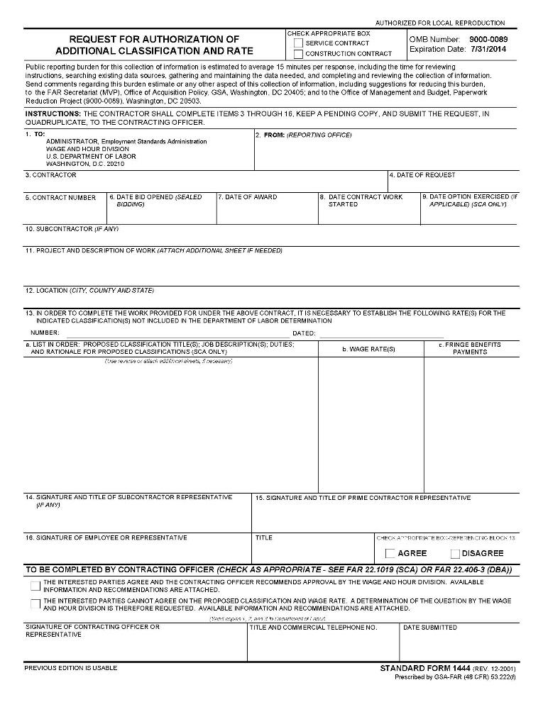
SF-1444 Form

Slide 28
Davis-Bacon
Wages MUST be paid weekly.
CWHSSA (Contract Work Hours Safety Standard Act)- Overtime at 1.5 times is required for more than 40 hours worked in a week in the execution of a federally funded project.
Holidays- see specific DBWD language.

Slide 29
Davis-Bacon Overtime
Melded Rate: When working in more than one wage classification a week
  22 hours as a Laborer at $25.00
  25 hours as a Carpenter at $35.00
  22 X $25 =$550 + 25 x $35 = $875
  $1425 ÷ 47 hours = $30.32 (melded rate)
  OT = 7 hours X $30.32 X .5 =$106.12
  Total pay = $1531.12
  $550 + $875 + $106.12

Slide 30
Davis Bacon Overtime
Melded Rate Overtime Exception:
    When there is a policy communicated to the employees BEFORE they begin work;
    The employee AGREES to the policy; AND,
    The employer has sufficient documentation to support a different overtime formula based on actual tasks performed. (detailed time records)

Slide 31
Davis-Bacon- Apprentices
Apprenticeship
  Individual actively enrolled in State approved apprenticeship program (MD, D.C. and VA)
  Must be employed in proper ratio 1:1 or ratio of approved program if less than 1:1
  Must be properly supervised
  No pre-apprentices

Slide 32
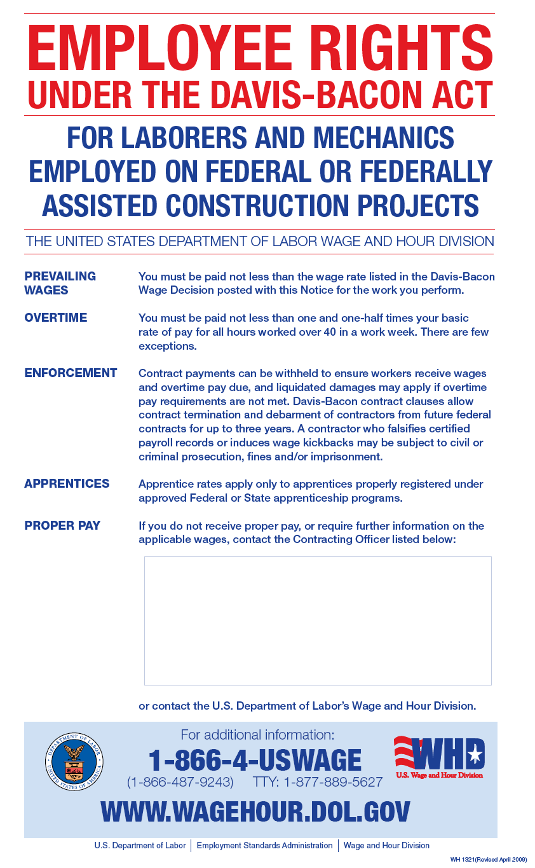

Slide 33
Davis-Bacon
I-9 compliance
  New forms as of 10/21/2019
  DOL or other federal agency may request these during audit, although not routinely.
  http://www.uscis.gov/files/form/i-9.pdf
  E-Verify for federal contractors

Slide 34
Davis-Bacon Contacts and links
Davis-Bacon Wage Determinations:
http://www.wdol.gov
Davis-Bacon compliance overview:
http://www.dol.gov/compliance/laws/comp-dbra.htm
Field Operations Handbook:
http://www.dol.gov/whd/FOH/FOH_Ch15.pdf
Davis-Bacon Certified Payroll WH-347:
http://www.dol.gov/whd/forms/wh347.pdf

Slide 35
Davis Bacon
Liquidated Damages
Federal
  Reprimand for first time offenders with good faith errors.
  Debarment from public works for repeat offenders or gross violations on first offense.
  Overtime (over 40 hours per week) $27 per day. (adjusted annually)

Slide 36
Questions?
Contractor Compliance and Monitoring, Inc.
PO Box 1279
Severna Park, MD 21146
Deborah Wilder: dwilder@ccmilcp.com
© Deborah Wilder 2021

