Slide 1

Procurement Fair
October 11, 2022

Slide 2
AGENDA
9:00am – 9:30am: Networking
9:30am – 10:00am: Welcome Remarks
10:00am – 10:45am: MFD Certifying Agencies Panel
10:45am – 11:00am: Networking
11:00am – 11:45am: Upcoming Procurement Opportunities
11:45am – 12:00pm: Networking
12:00pm – 12:45pm: Business Resources Panel
1:00pm: Adjourn

Slide 3
Welcome Remarks
9:30am – 10:00am

Slide 4
Ash Shetty
Director and Chief Procurement Officer, Procurement

Slide 5
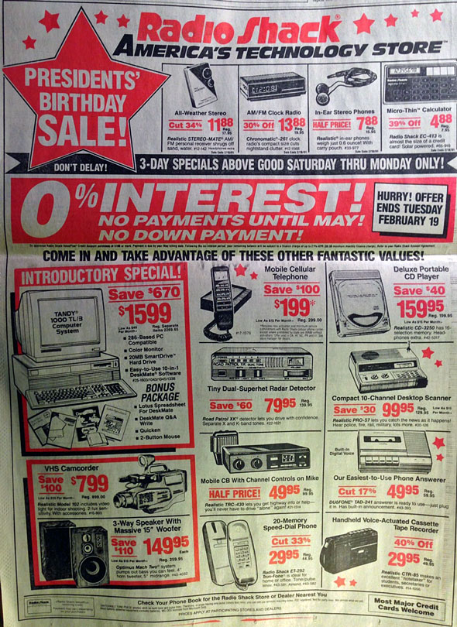

Slide 7
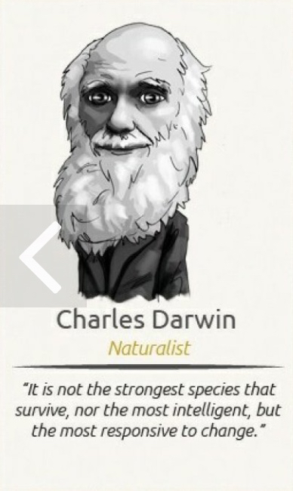

Slide 8
County Executive Marc Elrich

Slide 9
Local, Small and Minority Business Certifications
10:00am -10:45am

Slide 10

Office of Small and Minority Business Policy
MBE/DBE/ACDBE/SBE
Application Assistance Workshop
Larry Hogan Boyd K. Rutherford
Governor Lt. Governor

Slide 11
TYPES OF CERTIFICATION
There are four types of certifications:
Minority Business Enterprise (MBE)
  State-funded contracts
Disadvantaged Business Enterprise (DBE)
  USDOT contracts administered by:
    MDOT State Highway Administration (MDOT SHA)
    MDOT Maryland Aviation Administration (MDOT MAA)
    MDOT Maryland Transit Administration (MDOT MTA)
    Metropolitan Planning Organizations (MPOs)
Airport Concessions Disadvantaged Business Enterprise (ACDBE)
  Airport concessions contracts administered by MDOT MAA
Small Business Enterprise (SBE)
  USDOT contracts administered by MDOT SHA, MDOT MAA,
  and MDOT MTA
  Race and gender neutral

Slide 12
BENEFITS OF CERTIFICATION:
Access and Opportunities
Greater exposure to government and private sector contracting opportunities
Only MBE/DBE certified firms can fulfill the minority participation goals
Certified firms appear on the Directory of Certified Firms which is used by prime contractors, consultants, government agencies and private sector companies seeking minority business participation

Slide 13
BENEFITS OF CERTIFICATION:
Monitoring and Advocacy
Enforcement of MBE compliance policies and procedures
MBE Liaison Officers

Slide 14






The Certification Process

Slide 15

FREE! FREE! FREE!
There is NO cost to apply for or maintain certification with MDOT’s Office of Minority Business Enterprise

Slide 16
ELIGIBILITY STANDARDS
There are five eligibility standards each applicant must meet:
Ownership
Minority Status
Control
Personal Net Worth
Size

Slide 17
THE PROCESS
APPLICATION – Applicants must submit an application along with all applicable supporting documentation; online and hard copy versions available
INVESTIGATION – An MBE Officer reviews the entire application package then conducts an on-site interview with the applicant(s) and performs a job-site visit (if applicable); all findings are documented in a written report
EVALUATION – MBE Advisory Committee (MBEAC) reviews the investigative report to evaluate whether the applicant firm meets all program requirements; the owner(s) may be asked to appear before the MBEAC as part of the evaluation process
DETERMINATION – The MBEAC Chairperson issues a written determination
Out of state firms must be certified in their home state before applying in Maryland
Notes:
If you meet before the MBEAC, you will not receive your determination on the day you appear before MBEAC, they are sent by mail.

Slide 18
CERTIFICATION TIME
Once a complete application package has been received,
it takes an average of
3 months to complete
the certification
process
Due to COVID-19 all in-person application reviews have been suspended. If you do need assistance, please call the OMBE office at 410-865-1269.

Slide 19
Upcoming Application Assistance Webinars
November 1, 2022, 10:00 AM
December 6, 2022, 10:00 AM
December 6, 2022, 5:30 PM
Registration is now open online!
www.mdot.maryland.gov

Slide 20
Office of Small and Minority Business Policy
Chantal Kai-Lewis, Director
ckailewis@mdot.state.md.us
410-865-1269
Vashti Pyatt, Outreach Coordinator
vpyatt@mdot.maryland.gov
410-865-1394
The OSMBP is responsible for the oversight of all outreach activities related to MDOT's implementation of the MBE, DBE, ACDBE, SBE, and SBR programs. This includes the execution of the application assistance workshops; participation in internal and external events; the development of communication strategies for program updates and new initiatives; the development of training and outreach materials, including pamphlets and surveys; and management of the OMBE webpage.

Slide 21

As you go through the certification process… talk with the experts!
410.865.1269
mbe@mdot.maryland.gov
www.mdot.maryland.gov

Slide 22
Women’s Business Enterprise National Council
Sandra Eberhard

Slide 23
How and Why to get WBENC Certified
October 11, 2022
WBEC Greater DMV

Slide 24

01
Meet WBEC Greater DMV
Certification Benefits
Topics
03
Certification Process
04
Upcoming Training

Slide 25



Supporting
Maryland
Virginia
District of Columbia

Slide 26
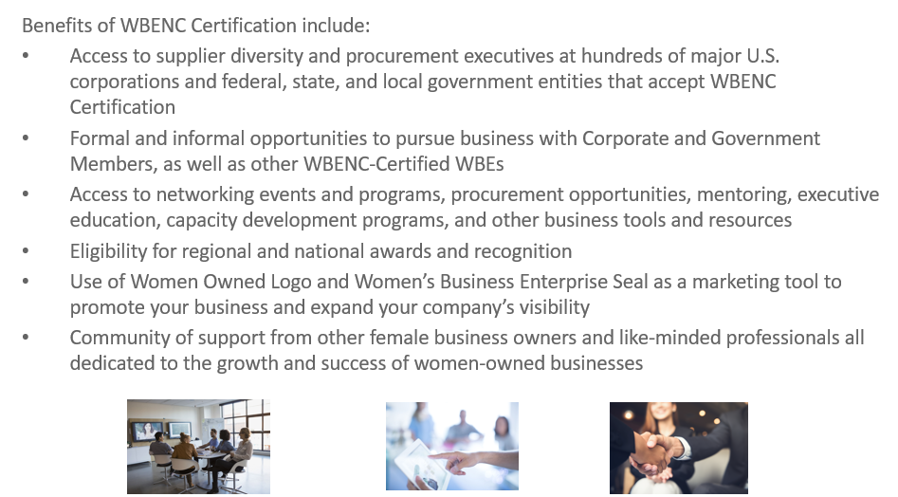
Certification Benefits

Slide 27
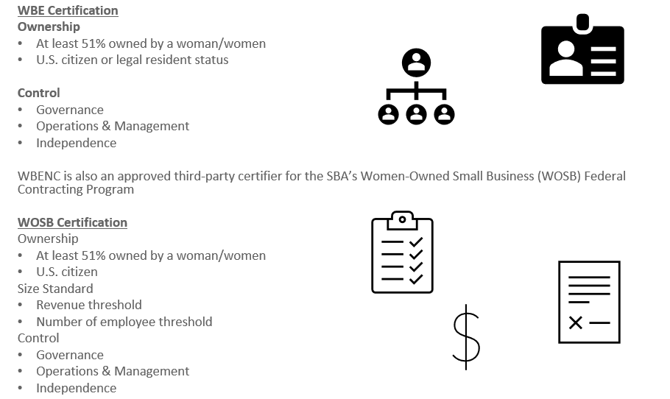
Certification Process

Slide 28
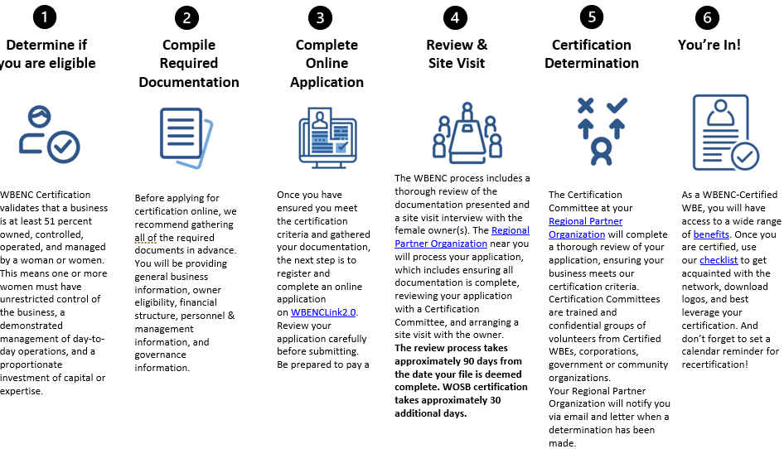
Certification Process

Slide 29
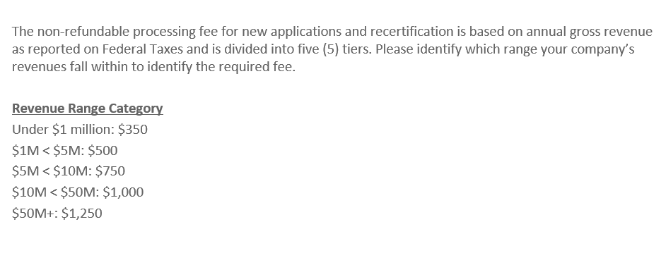
Certification Process

Slide 30
Please find monthly Certification Training on the WBEC Greater DMV website:
www.wbecnydmv.org
Thank you

Slide 31
City of Baltimore
Christopher Lundy

Slide 32

The Baltimore City Minority and Women’s Business Opportunity Office (MWBOO) CERTIFICATION
Overview

Slide 33
City code article 5, subtitle 28
MWBOO oversees compliance with Subtitle 28 governing Minority Business Enterprises (MBE), Women’s Business Enterprises (WBE), and Small Local Business Enterprises (SLBE). This subtitle is applicable to all City contracts or agreements providing fiscal assistance pursuant to Article 5, § 28-4.
The program works to remedy past discrimination in the City’s contracting process by prime contractors against minority and women’s business enterprises.
This has resulted in the significant underutilization of minority and women’s business enterprises in contracts awarded by the City in the major contracting markets: construction, commodities, architectural, engineering, and professional services.
Notes:
MWBOO is grounded in ensuring equity in the procurement process

Slide 34
MBE/WBE Contract Participation
MBE/WBE participation is a top priority of the City. It is mandated by the City Code and is incorporated into every City contract.
Certification allows you to participate on City contracts and have your work count towards the MBE/WBE goals on the contract.
The City does not want to renew or extend contracts where there has not been compliance with the MBE/WBE contract participation goals.

Slide 35
Annual Participation Goals
These goals are not universally applicable.
Annual participation goals are aspirational goals that aid the City in its annual evaluation of the effectiveness of the Minority and Women’s Business Enterprise Program.
Goals or waivers remain applicable and typically are not changed during the contract term. To change or impose goals upon a contract it must be resolicited.
Goals can be negotiated on a contract with an existing waiver via the contractor/vendor voluntarily entering into a Commitment to Comply with contract participation goals.
MBE 27%
WBE 10%

Slide 36
M/WBE Certification Classifications
A company can be certified as MBE, WBE, or both (M/WBE). You do not need to submit multiple applications if you qualify as M/WBE.
However the participation of a MBE/WBE is limited to being designated as counting towards a single contract goal.
When being used to achieve the participation goals on a contract, the MBE/WBE is not allowed to subcontract more than 10% of the dollar amount of services to be performed under the contract to another company.
Please Note: City MWBOO certification is separate from State MDOT certification.
Notes:
To ensure subcontractor receives the contracted work

Slide 37
MBE/WBE Certification Application Criteria
The minority and/or women must own at least 51% of the company and have operational and managerial control
Be an independent, operating, small business
Have been in operation for at least 12 months before applying for certification
Have been minority or women-owned for at least 12 months before applying for certification
Have an operating office in the Baltimore City Market Area
You can now complete the entire application and submit it via the website.
If you have a pending renewal application you remain certified until a final determination has been made. Please contact MWBOO if you require an extension of your certification date.
Notes:
Certified Services per NAICS Codes North American Industry Classification System
Size Limitations Small Business Administration (SBA) size standards for the service code
MWBOO certification does not rate or reflect the skills of the business, only that they meet baseline requirements to operate the business

Slide 38
Baltimore Market Area Defined
The Baltimore Market Area includes the following areas:
Baltimore City
Baltimore County
Anne Arundel County
Carroll County
Harford County
Howard County
Queen Anne’s County

Slide 39
Common application mistakes
Seeking certification prior to the business being in operation for one year.
Failing to review your operating documents prior to submitting your application. Does it actually reflect your day to day operations and ownership of the business?
Not maintaining an active operating office in the market area.
Not providing all requested documents: notarized affidavit; prior two years of filed tax returns; all state & local licenses for the business; proof of minority &/or female status of each owner, director, and officer; proof of maintaining an active operating office in the market area; employee roster; & business organization agreements: articles of incorporation, partnership agreements, etc.
Exceeding the SBA size standards.
Notes:
MWBOO is grounded in ensuring equity in the procurement process

Slide 40
M/WBE Application Timeframe
The application is now in a fillable form on the website: https://baltimorecity.diversitycompliance.com/
Training & Events are also listed on the site.
Please allow between 90-120 days for processing of your application. Any missing documentation will delay this process!
Once approved, certifications are valid for two years.
Remember when being used to achieve the goals, you MUST be certified to provide the services being performed on the contract!
Lastly but certainly not least, CERTIFICATION IS NOT A GUARANTEE OF BUSINESS! YOU MUST MARKET YOUR OWN COMPANY!

Slide 41
Post Certification
Seek out work on City contracts. Be sure to get pre-qualified by the Office of Boards & Commissions (OBC).
1
Read the MBE/WBE & Prime Contractor’s Statement of Intent document closely.
2
All substitutions, additions, & changes in utilization must be submitted & approved by MWBOO.
3
Contact MWBOO if you need guidance.
4

Slide 42
CONTACT INFORMATION
Baltimore City Minority and Women’s Business Opportunity Office
100 N. Holliday Street, Room 101, City Hall
MWBOO Website (Please click the “Contact MWBOO” link to submit questions) & FAQs:
https://law.baltimorecity.gov/mwboo
https://law.baltimorecity.gov/mwboo-faq

Slide 43
Montgomery County Office of Procurement
Michael Brown

Slide 44
Montgomery County:
Local Business Programs
  1st Step for ALL vendors:
  Register in our database: www.mcipcc.net
  Enter your commodity codes

Slide 45
Montgomery County:
Local Business Programs
  Local Small Business Reserve Program (LSBRP)
  Local Business Preference Program (LBPP)
  Local Business Subcontracting Program (LBSP)

Slide 46
Montgomery County:
Local Small Business Reserve Program
  The Local Small Business Reserve Program (LSBRP) ensures that County departments award 25 percent (with specified exceptions) of their procurements for goods, services and construction to registered and certified local, small businesses.
  https://www.montgomerycountymd.gov/PRO/DBRC/lsbrp.html

Slide 47
Montgomery County:
Local Small Business Preference Program
  The Local Business Preference Program (LBPP) is a local preference points program, so Montgomery County-based businesses will receive an extra 10% preference points on proposals.
  https://www.montgomerycountymd.gov/PRO/DBRC/local-business-preference.html

Slide 48
Montgomery County:
Local Small Business Subcontracting Program
Local Business subcontracting goals:
At least 10% of the contract dollars awarded for each High Dollar Value Contract should be awarded to a Local Business; and
At least 10% of the total dollar value of all High Dollar Value Contracts in the aggregate should be awarded to Local Businesses.
https://www.montgomerycountymd.gov/PRO/DBRC/local-business-subcontracting.html

Slide 49
Montgomery County Office of Procurement:
Helpful Links
Procurement website www.montgomerycountymd.gov/PRO
Vendor Registration System www.mcipcc.net
Vendor Resources https://www.montgomerycountymd.gov/PRO/vendor-resources/index.html
PROjection (Forecasting tool)
  https://www.montgomerycountymd.gov/PRO/solicitations/projections.html
Subscribe to weekly newsletter
  https://content.govdelivery.com/accounts/MDMONTGOMERY/bulletins/2fb9c49
Monthly Virtual Open House (Third Wed 10AM-11AM)
  Check the event calendar on www.montgomerycountymd.gov/pro)

Slide 50
Q&A Session

Slide 51
NETWORKING BREAK
10:45am – 11:00am

Slide 52
Upcoming Procurement Opportunities
11:00am -11:45am

Slide 53
Montgomery College
Patrick Johnson

Slide 54
Montgomery College
The Office of Procurement supports the educational mission of Montgomery College through the acquisition of goods and services with considerations of price, time, and source, while adhering to all applicable laws, regulations and College policy.
We are looking to engage vendors that are qualified in the areas of need, and possess the experience and capacity to fulfill commodity or service requirements.
The College purchases copy paper to construction services, and everything in between.
College bid opportunities can be found at the website link below.
https://info.montgomerycollege.edu/offices/procurement/bid-opportunities.html
When submitting proposals in response to College bid opportunities, email to vendor.proposals@montgomerycollege.edu

Slide 55
Montgomery College
Refer to our “active contracts listing” for existing and expiring “requirements” contract information. See link below
https://info.montgomerycollege.edu/offices/procurement/active-contracts.html

Slide 56
Montgomery College
Website: https://info.montgomerycollege.edu/offices/procurement/
Contact: Patrick Johnson, Director of Procurement
Patrick.johnson@montgomerycollege.edu
240 567-5288
Note: The following additional information can be found at the above website:
1. Procurement Staff & contact information
2. Commodity assignment information
3. Past bid results
4. How to do business with the College

Slide 57
Montgomery College
(Upcoming Bid Opportunities)
Philips Ultrasound Equipment (Nursing) | Task Order Structural Design, Engineering and Related Services (Construction)
Biotech Equipment (Biology) | Printing & Delivery of Business Cards & Stationary
Onsite Document Shredding Services | Purchasing & Corporate Card Program
Generator Maintenance (Facilities) | IT Contracting Services
Building Renovation – Writing and Reading Center (Construction) | Sign Language Interpreting Services
Suite Renovation and Expansion – PT Faculty (Construction) | IT Infrastructure Cabling Materials & Services
Nursing Lab (Construction)

Slide 58
City of Rockville
Jessica Lewis

Slide 59
City of Rockville
The mission of the Procurement Division is to provide support to the City by performing the procurement function and materials management operation in a customer-focused, strategic, ethical and transparent manner while ensuring opportunities to our diverse business community and complying with applicable governing laws and policies.
The ideal capabilities of our vendors include fair and reasonable price, quality of product/service, strong customer service and ethics/integrity. Likewise, the City pledges integrity and open and fair competition with our vendors. The City’s complete Vendor Guide can be found at: https://www.rockvillemd.gov/2317/Vendor-Guide
The City buys all types of products and services: from commodities to construction to various professional services (IT related, consulting in multiple areas: planning, public information, recreation & parks, public works).

Slide 60
City of Rockville
The City’s Upcoming solicitations/Forecast can be found on our website at:
https://www.rockvillemd.gov/231/Procurement
The City has a new Collaboration portal where all bids/proposals are submitted electronically. Instructions and information can be found on our website at:
https://www.rockvillemd.gov/bids.aspx
The City also posts its solicitations on eMaryland Marketplace (eMMA):
https://emma.maryland.gov/page.aspx/en/usr/login?ReturnUrl=%2fpage.aspx%2fen%2fbuy%2fhomepage

Slide 61
City of Rockville: Upcoming Solicitations
Contract Title | Solicitation Method | Estimated Solicitation Date
Human Services Needs Assessment Survey | Request for Proposals/Formal | 2/2023
Residential Rehabilitation/Repairs to Single Family Homes | Request for Quotes /Informal | On-Going
Sound and Lighting Services | Request for Quotes/Informal | 3/2023
Flowering Annuals | Request for Quotes /Informal | 2/2023
Printing and Mailing Services for Utility Billing | Invitation for Bids/Formal | 1/2023
City Hall Window Film | Invitation for Bids/Formal | 12/2022
Compensation and Classification Study | Request for Proposals/Formal | 5/2023
Comprehensive Zoning Ordinance Rewrite | Request for Proposals/Formal | 11/2022
Outdoor Recreation Pool Renovation-Construction | Request for Bids/Formal | 05/2023
Janitorial Services | Invitation for Bids/Formal | 12/2022
Furnish and Plant Trees and Shrubs | Invitation for Bids/Formal | 12/2022
Asphalt and Concrete Improvements | Invitation for Bids/Formal | 3/2023
The above list is a sampling of upcoming solicitations. A complete listing can be found at: https://www.rockvillemd.gov/231/Procurement and includes Procurement contact information.

Slide 62
City of Rockville
City of Rockville Procurement website:
https://www.rockvillemd.gov/231/Procurement
Please contact us, we look forward to talking with you:
    Jessica Lewis, CPPO, CPPB, MBA, Director of Procurement
    240-314-8432
    jjlewis@rockvillemd.gov
    Jonathan Pierson, CPM, Assistant Director of Procurement
    240-314-8433
    jpierson@rockvillemd.gov
    Pat Ryan, CPPB, MBA, Principal Buyer – email/call for technical one on one assistance
    240-314-8434
    pryan@rockvillemd.gov
    Thomas Ellison, CPPB, Principal Buyer
    240-314-8436
    tellison@rockvillemd.gov
    Regina Washington, Senior Buyer
    240-314-8431
    rwashington@rockvillemd.gov

Slide 63
WSSC Water
Caprecia Poole-Williams

Slide 64
Upcoming Procurement Opportunities @ WSSC Water
By: Caprecia Poole-Williams,
Chief Procurement Officer
Date: October 11, 2022

Slide 65
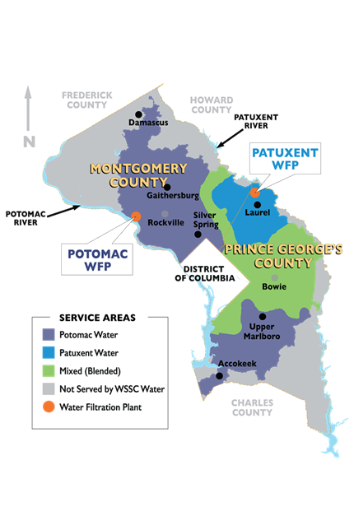
WSSC Water: Who We Are
104-years old: NEVER had a drinking water quality violation. . . EVER
1,000 square mile service area in Prince George’s & Montgomery Counties
475,000 accounts with 1.9M residents
Largest water utility in Maryland
Please visit https://www.wsscwater.com/contracts for more information about contracting opportunities.

Slide 66
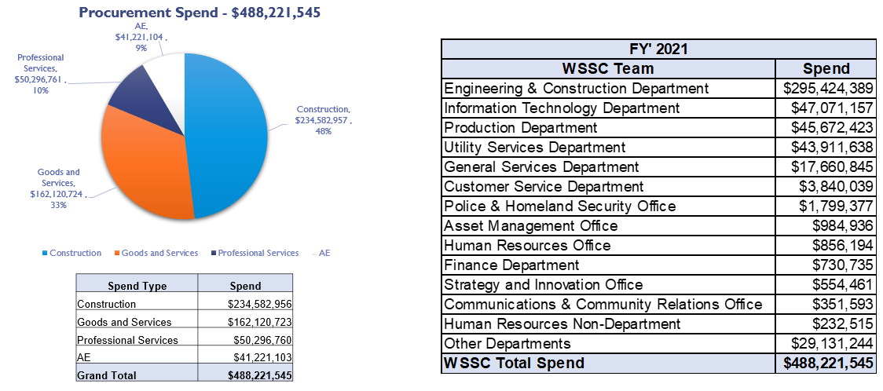
FY 2021 WSSC Water Spend
Please visit https://www.wsscwater.com/contracts for more information about contracting opportunities.

Slide 67

What Do We Buy?
The following list provides an example of goods and services we purchase. The list is not exhaustive.
GOODS | SERVICES
Chemicals | Construction Services
Office Supplies | Cleaning and Restoration
Pipes, Valves, and Fittings | CCTV Inspection
IT Equipment | IT Consulting Services
Vehicles | Maintenance, Repair, and Operations
Please visit https://www.wsscwater.com/contracts for more information about contracting opportunities.

Slide 68
How Do We Buy?
The dollar values below represent thresholds at which goods or services are procured via P-Cards, small purchases and solicitations.
“Micro purchases”/Purchase Card: ≤ $5K
Small purchases: $5001 - $100K
Solicitations: > $100K
  Invitation for Bid (e.g., lowest price)
  Multi-Step Invitation for Bid (e.g., pre-qualified & lowest price)
  Request For Proposal (e.g., most advantageous)
Please visit https://www.wsscwater.com/contracts for more information about contracting opportunities.

Slide 69

Overview - Where Do I Start?
1- Visit www.wsscwater.com > Contracting > Bid Solicitation Opportunities
2) Read the solicitation thoroughly, including Appendix A and the
Good Faith Efforts Guide and follow the Instructions.
3) Register in the WSSC Supplier Portal to submit bids or proposals.
3) Provide the requested information in a READABLE style.
4) Know that competitive bidding is likely and be ready to negotiate your
best and final offer on RFPs, if applicable.
5) Understand WSSC’s bidding and proposal processes.
6) Be prepared to be SUCCESSFUL.
7) Unsuccessful? Get a debriefing!
8) Structure proposals so they’re persuasive, compelling, and tell a story.
Please visit https://www.wsscwater.com/contracts for more information about contracting opportunities.

Slide 70
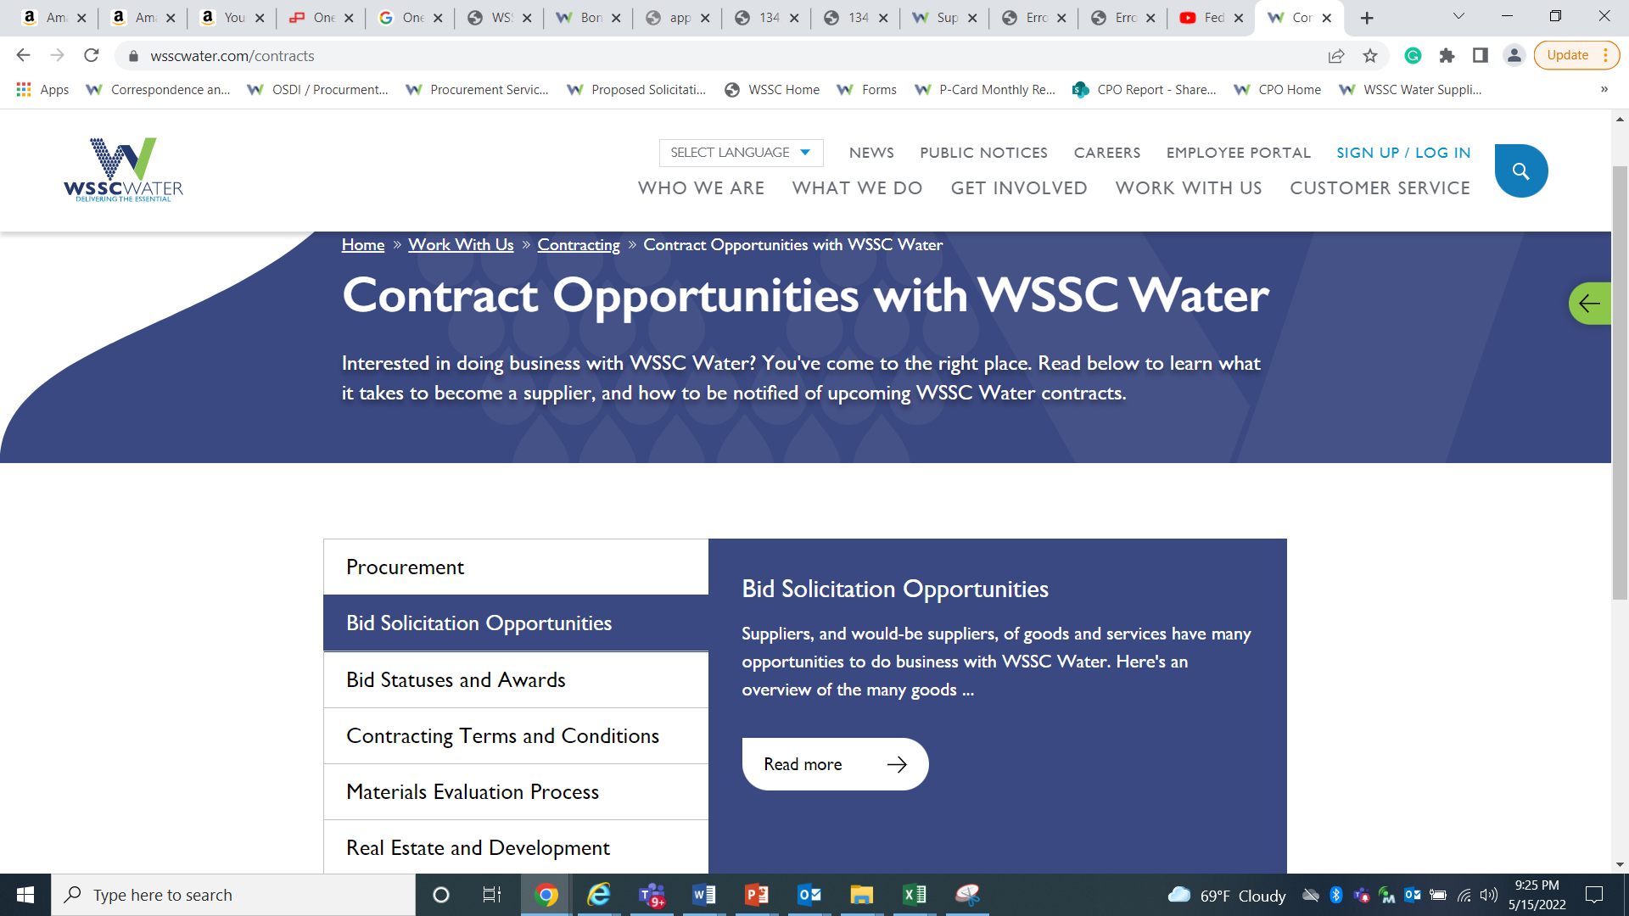
View Solicitations And Bid Statuses
Solicitation opportunities, bid statuses, and awards may be viewed by visiting the following webpage: https://www.wsscwater.com/contracts.

Slide 71
Tips To Successfully Win A Contract
DO
DON’T
  Seek to understand WSSC’s Regulations
  Register in the Supplier Portal to bid
  Keep Supplier Portal information updated
  Read solicitations carefully and provide all requested information
  Submit your responses timely
  Ask questions during the open discussion
  Be patient – Success takes time
  Add value through innovation and savings
  Compete and give your very best response
  Be late with submissions
  Make any assumptions regarding the solicitation
  Attempt to get a contract because you know someone at WSSC
  Lead with politics over substance
  Rely on a one-size-fits-all approach
  Submit incomplete/out of order responses
  Quit trying
Please visit https://www.wsscwater.com/contracts for more information about contracting opportunities.

Slide 72
Upcoming Solicitations
The following list is for informational purposes only and may be revised at any time without notice. It represents upcoming solicitations expected in FY23, Q2 (October - December 2022). Additional upcoming solicitations may be viewed on our website via the following link: Solicitations Opportunities.
Please visit https://www.wsscwater.com/contracts for more information about contracting opportunities.

Slide 73
Upcoming Solicitations Continued
The following list is for informational purposes only and may be revised at any time without notice. It represents upcoming solicitations expected in FY23, Q2 (October - December 2022). Additional upcoming solicitations may be viewed on our website via the following link: Solicitations Opportunities.
Please visit https://www.wsscwater.com/contracts for more information about contracting opportunities.

Slide 74
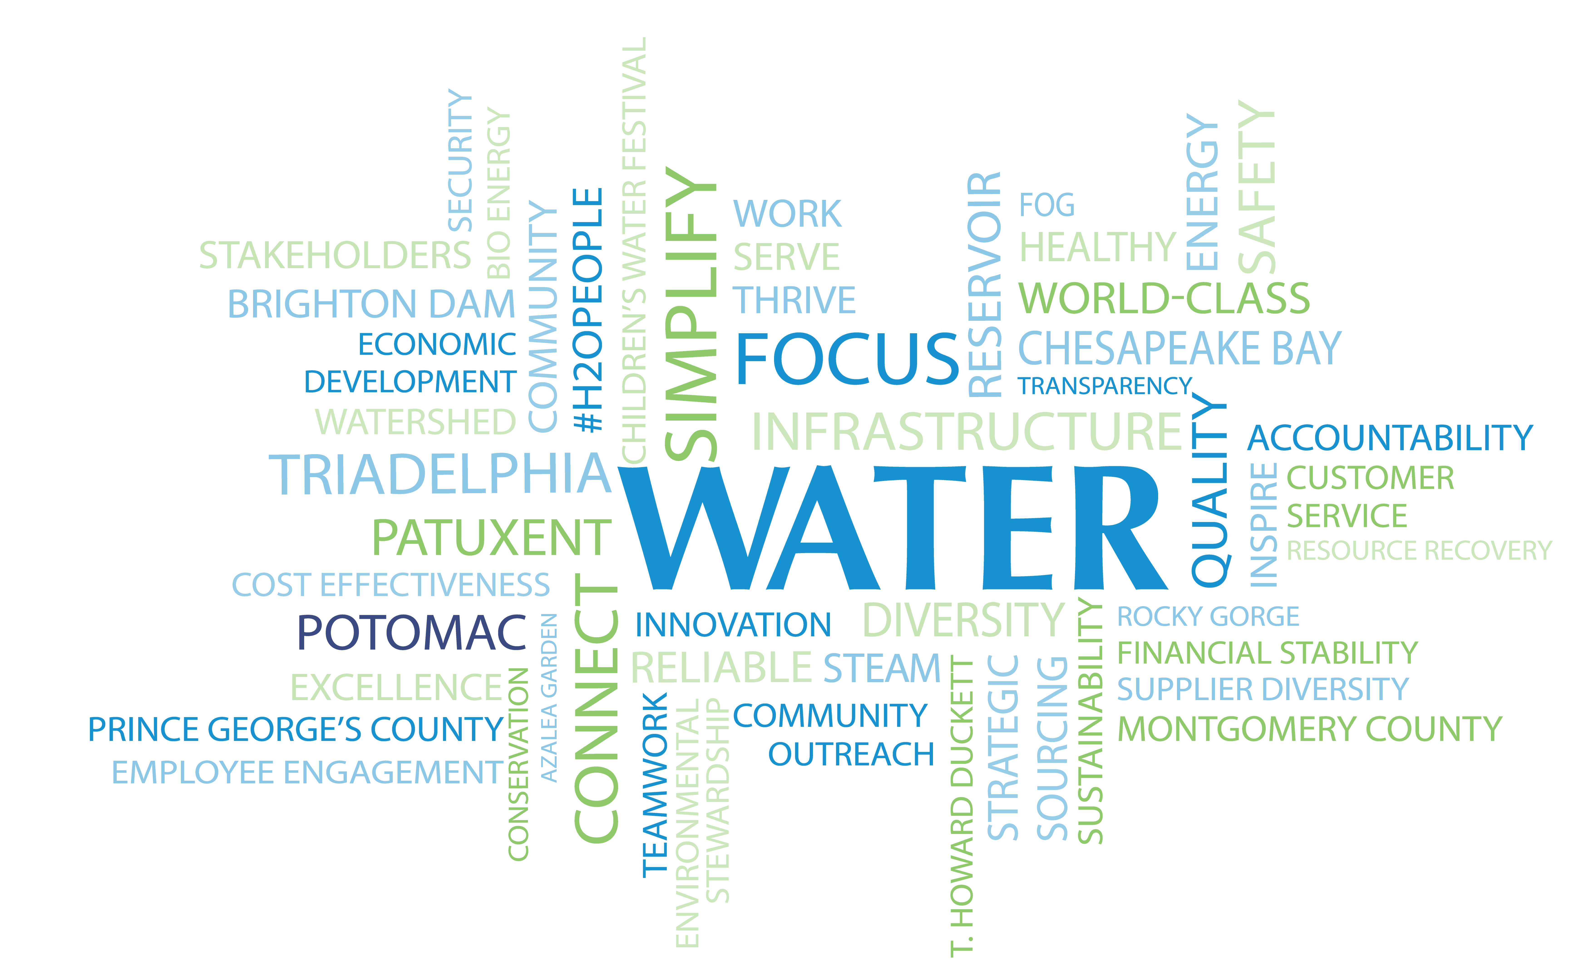
Questions?

Slide 75
Montgomery County Office of Procurement
Melissa Garner

Slide 76
Montgomery County:
Upcoming Procurement Opportunties
Formal Solicitations (>$100K)
  IFBs – Invitations for Bids
  RFPs - Request for Proposals
  REOIs – Request for Expressions of Interest
Informal Solicitations (> $10K, < $100K)
  All reserved under the LSBRP
  >$50K all subject to MFD requirements
  >$50K services contracts subject to Wage Requirements Law
Direct Purchase (departments buy directly) (< $10K)

Slide 77
Montgomery County:
Upcoming Procurement Opportunties
Visit our website for current solicitations:
www.montgomerycountymd.gov/PRO/solicitations
Visit our PROjections page to find projected upcoming solicitations:
www.montgomerycountymd.gov/PRO/solicitations

Slide 78
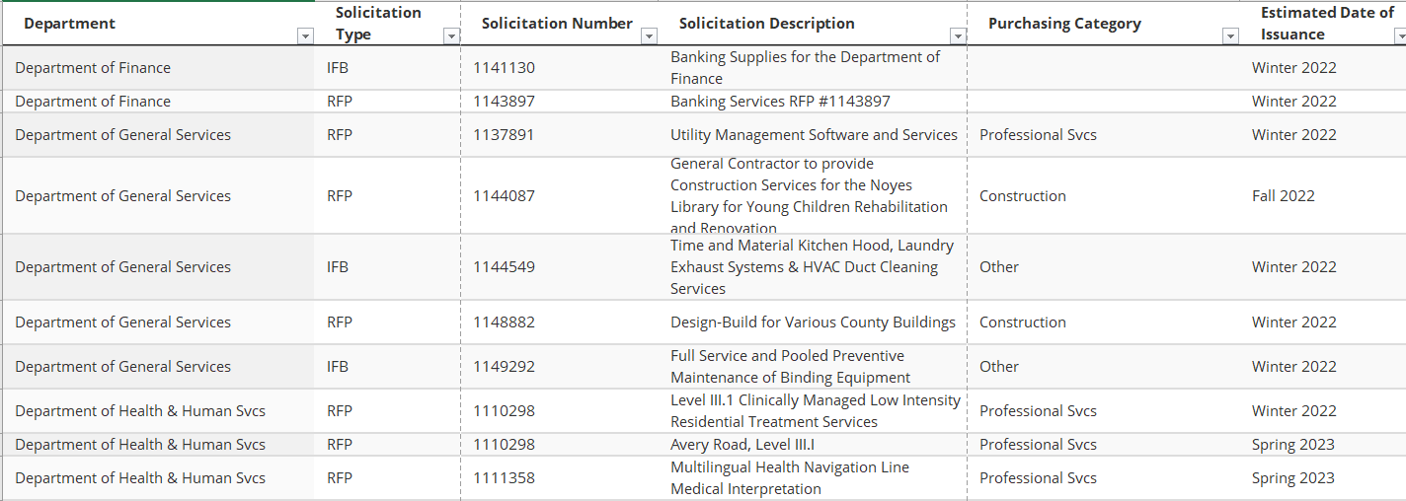
Montgomery County:
Upcoming Procurement Opportunties

Slide 79
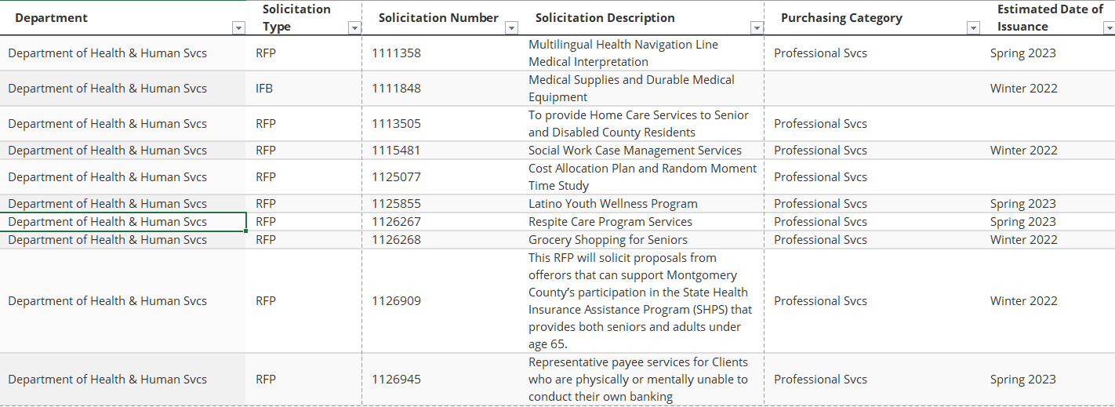
Montgomery County:
Upcoming Procurement Opportunties

Slide 80
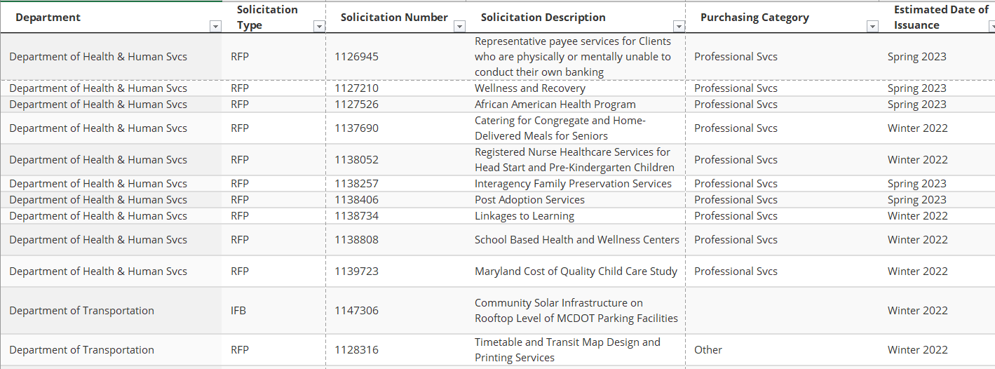
Montgomery County:
Upcoming Procurement Opportunties

Slide 81
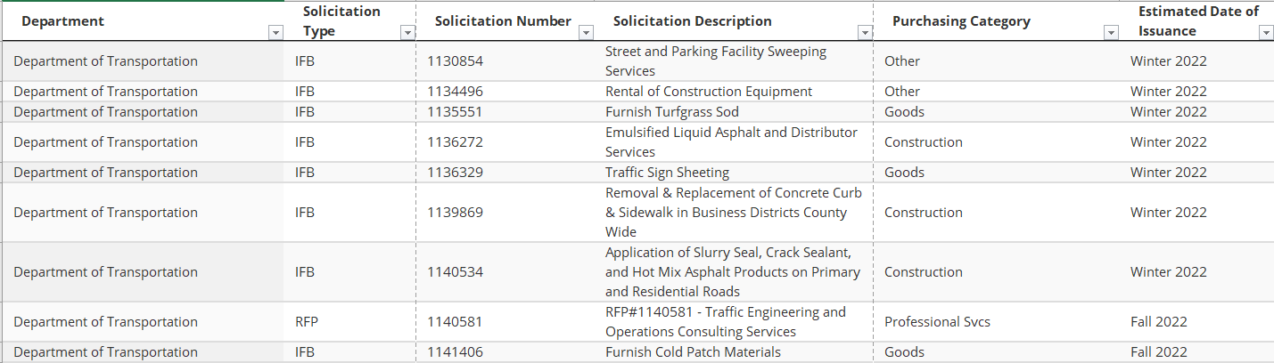
Montgomery County:
Upcoming Procurement Opportunties

Slide 82
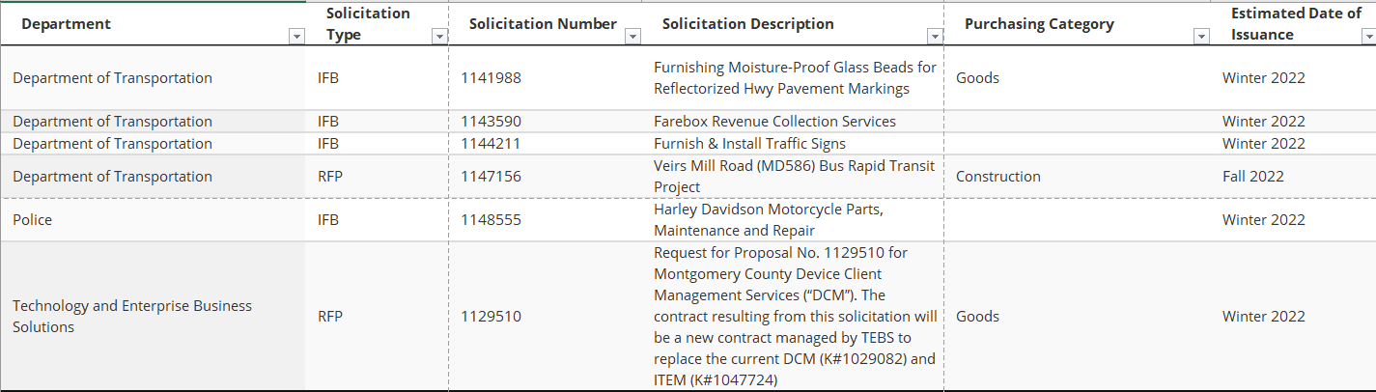
Montgomery County:
Upcoming Procurement Opportunties

Slide 83
Q&A Session

Slide 84
NETWORKING BREAK
11:45am – 12:00pm

Slide 85
Business Resources Panel
12:00pm – 12:45pm

Slide 86
Montgomery County Small Business Navigator
Naddia Clute

Slide 87
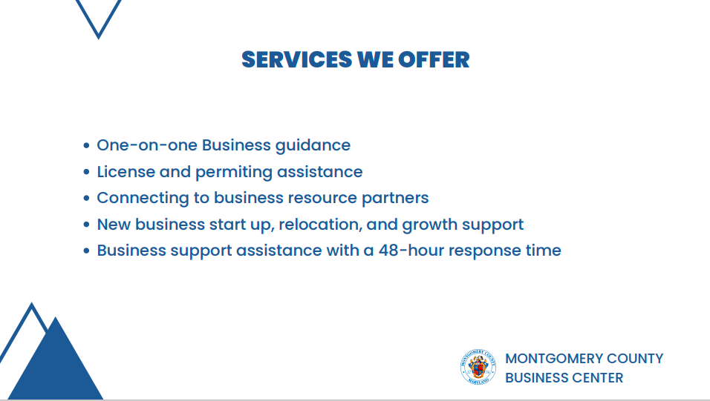

Slide 88
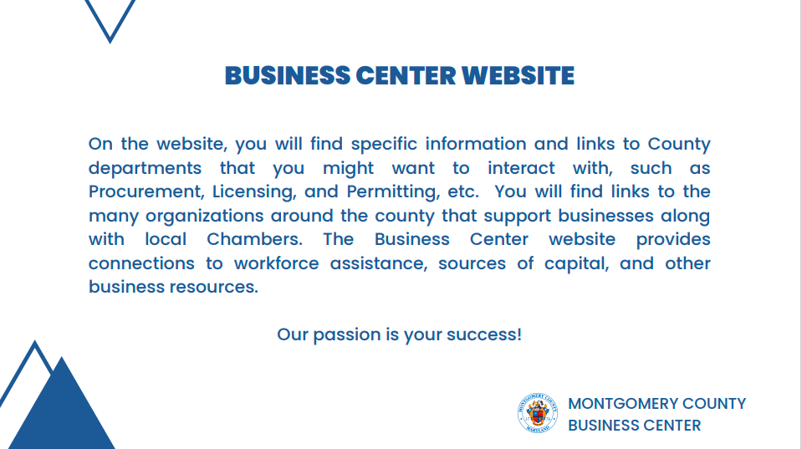

Slide 89
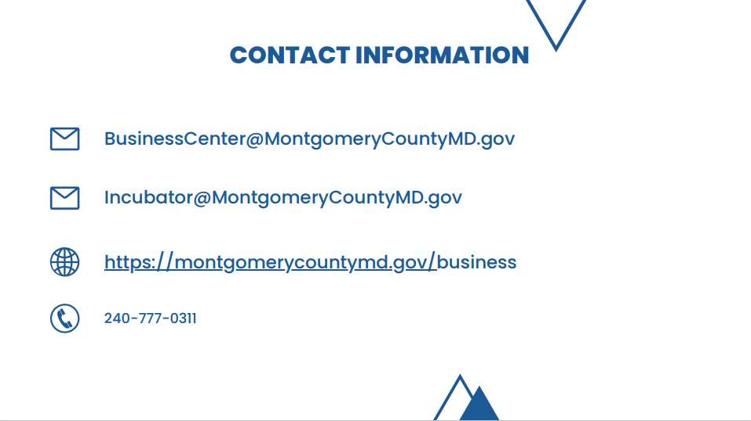

Slide 90


Slide 91
Maryland Small Business Development Center
Kyle Bayliss

Slide 92

Maryland Small Business Development Center
Kyle Bayliss
Managing Director, Corridor Region
University of Maryland College Park, SBDC
www.mdsbdc.org

Slide 93


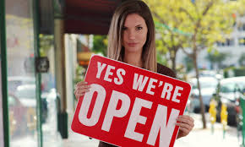
SBDC – About Us
Since 1988 the seasoned staff of the Maryland Small Business Development Center (SBDC) Network has provided sound advice consulting, and support to entrepreneurs and small businesses across the state. We are part of a national SBDC network—founded in 1979—that helps over 500000 U.S. businesses annually.
One-on-One Consulting World-Class, SME, Training Case Management
State-wide Support
www.mdsbdc.org

Slide 94




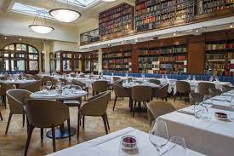
How We Serve the Entrepreneur & Business Communities
Start-up Business Lifecycles Sell/Session
Specialized Consulting Services
Loan Packaging
Bi-lingual Consulting
Executive Training (Cohorts)
Technology Commercialization
Restaurant & Retail
Help Making Business Ownership Dreams Come True!
www.mdsbdc.org

Slide 95
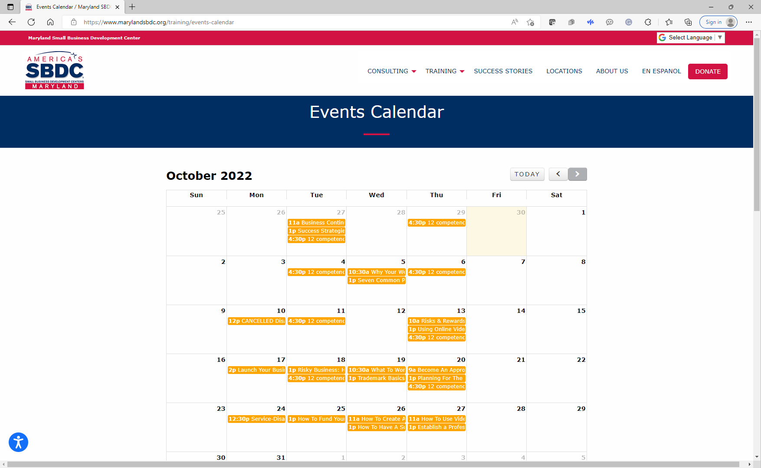
Training and Events
No-Cost & Low-Cost Training, Special Events, & Programs
State-wide Online Training
Regional Training, In-person
Conferences, Women, Latino, Bankers
Forums – Hear from You What you need
Technology Programs

Slide 96
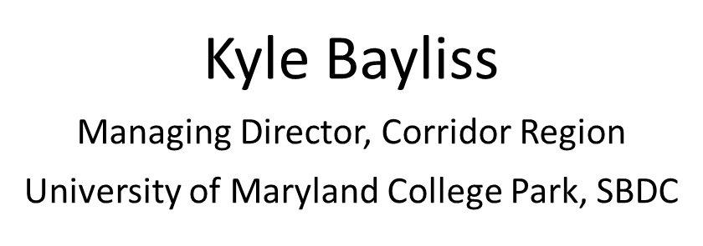


“What’s Really Important is What you Learn After Thinking you Know it All.”

Slide 97
Maryland Washington Minority Companies Association
Wayne Frazier

Slide 98

MD. Washington Minority Companies Association

Slide 99
Website:
www.mwmca.org
Weekly E-newsletter

Slide 100
Mission Statement:
Connecting Large and Small Businesses to Work Together

Slide 101
Services we provide:
Get Listed in our online business directory so primes can locate your business.
Expert assembly of MDOT and Baltimore City Minority Business Enterprise Certification Application packages.
Customized marketing packages.
Payment and project dispute mediation and resolution.
Prime business or contractor connecting.
Advertise one's product, service or event on our best in class website and e-newsletter.

Slide 102
Upcoming Events:
The Baltimore County Public Schools
Meet The Primes 14th Annual Meet & Greet
Wednesday, October 12, 2022
8am - 12pm
Maryland Department of Transportation
7th Annual Business Opportunities & Entrepreneurial Training Summit
Monday, October 31, 2022
8am - 5pm
Live! Casino & Hotel
Minority Outreach Fair
Wednesday, December 14, 2022
8am – 12pm

Slide 103

Contact:
Wayne R. Frazier, Sr.
President
P.O. Box 29602
Baltimore, MD 21216
Phone: (443) 759-8580
Fax: (888) 609-8318
Email: wrf@mwmca.org
Website: www.mwmca.org
Facebook: www.facebook.com/wrfrazier YouTube: www.youtube.com/mwmca2010
LinkedIn: www.linkedin.com/in/wfrazier

Slide 104
Montgomery County Economic Development Corporation
Laurie Boyer-Babb

Slide 105


Montgomery County Office
of Procurement
Small Business Support
Presented by Laurie Boyer Babb, CEcD
Director of Economic Development
Montgomery County Economic
Development Corporation
October 2022

Slide 106
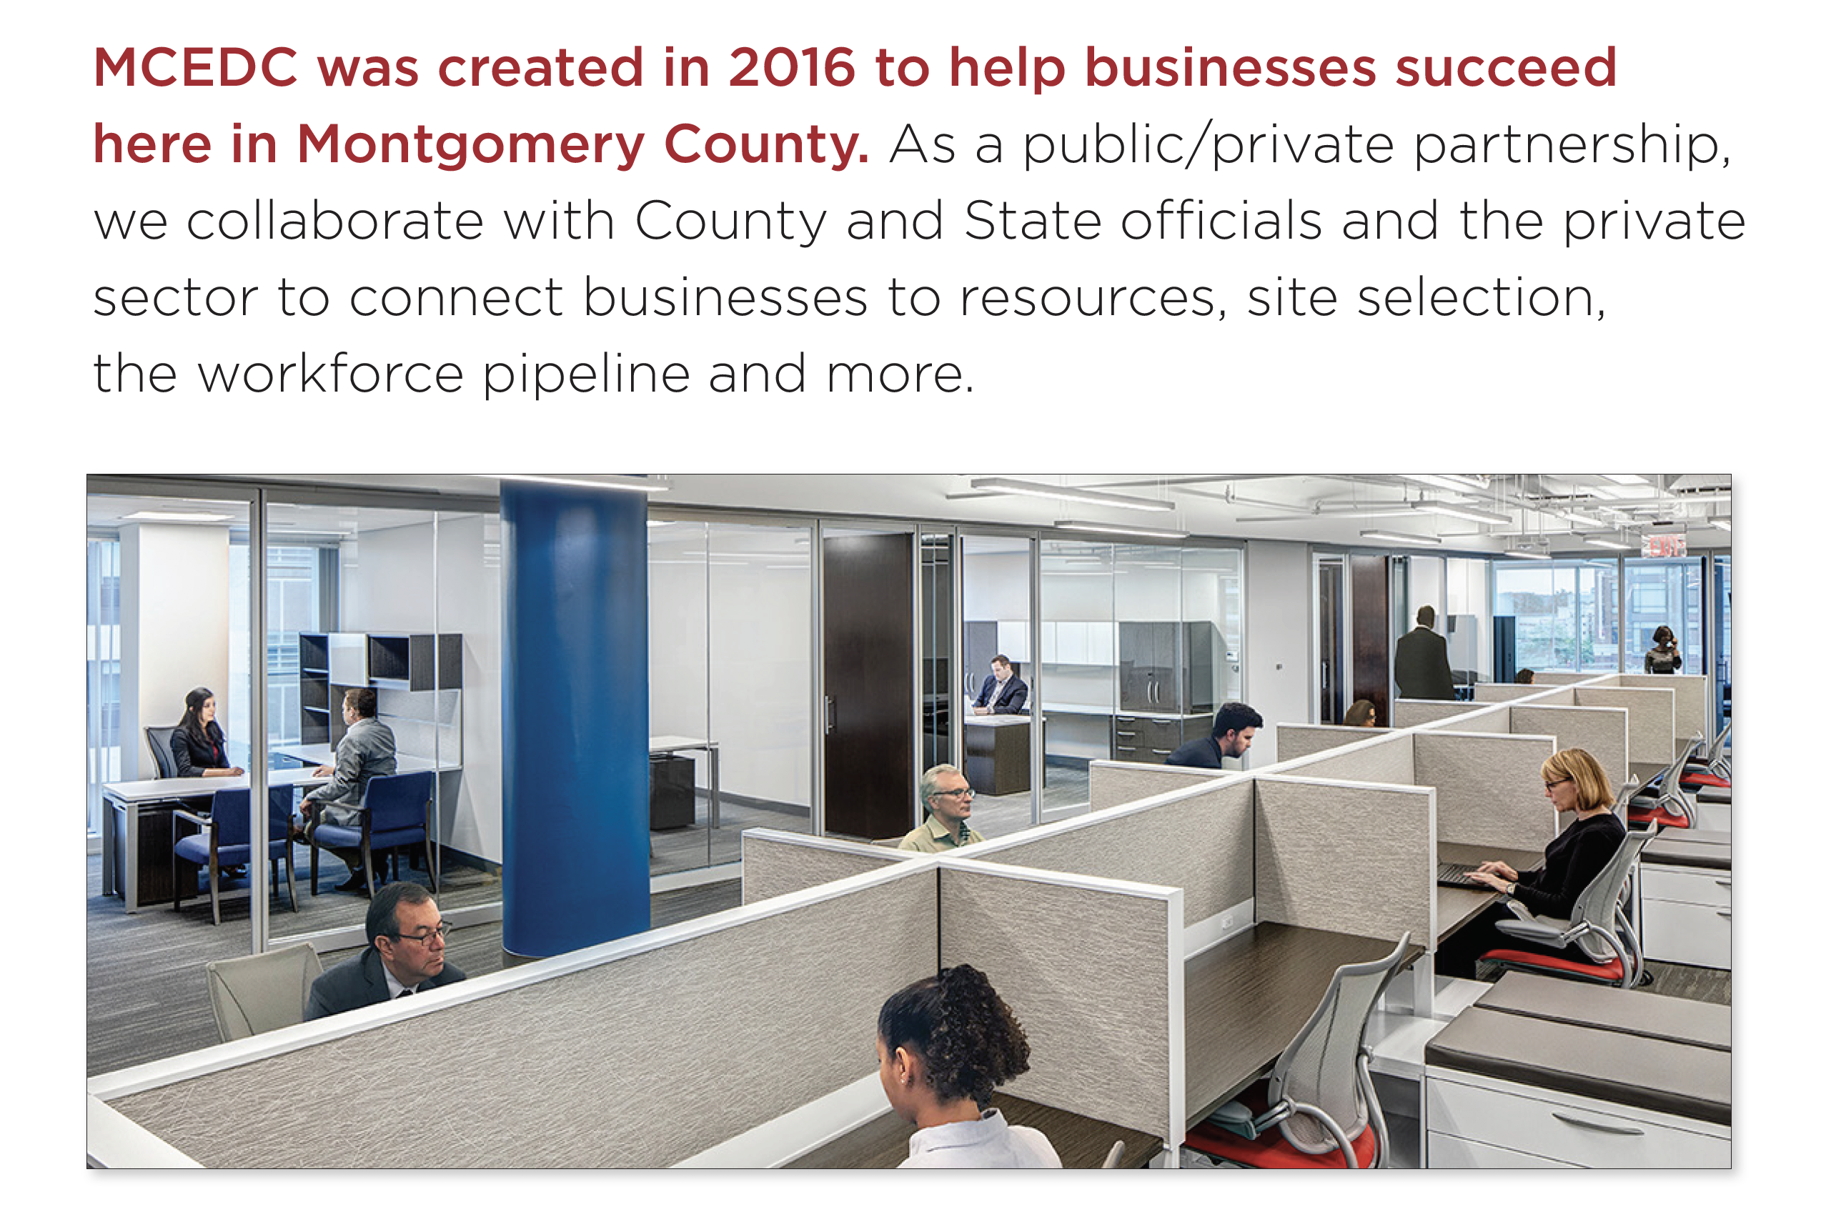
Who is Montgomery County Economic Development Corporation (MCEDC)
The official public-private economic development
organization for Montgomery County, MD
Led by a board of directors, our mission is to
help new businesses start and grow in the county, help existing businesses grow and thrive and attract companies to relocate here

Slide 107
How MCEDC Can Help
Location/Site Selection Assistance
Data / database resources
Demographics / industry information: market intelligence
Marketing the County and its Companies
Referrals/introductions to potential partners
Explore incentive opportunities
Workforce recruitment assistance/referrals

Slide 108
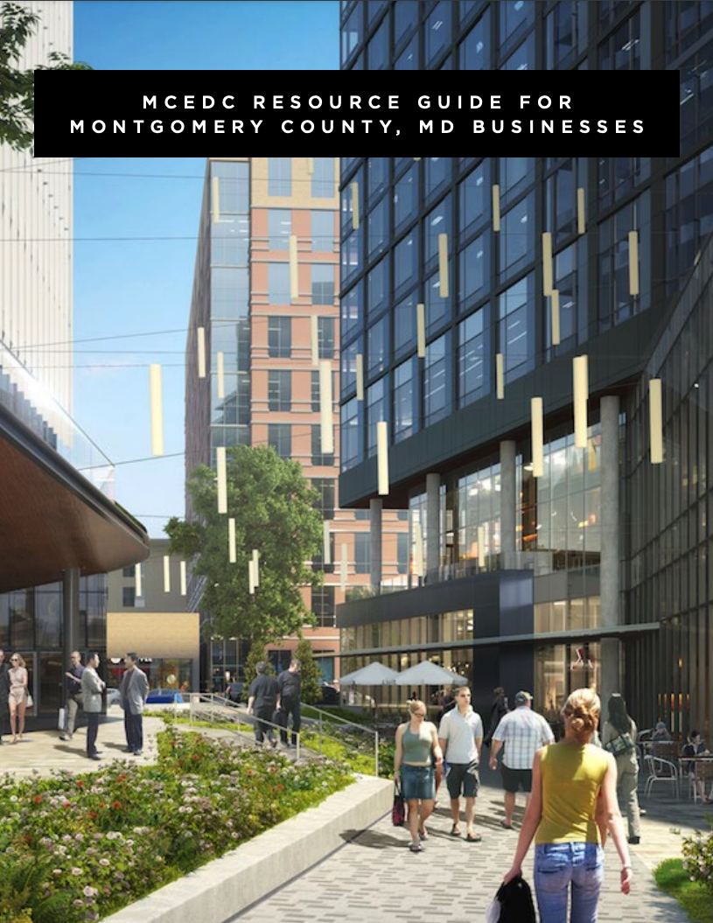
MCEDC Resource Guide
(English and Spanish versions available)
Includes:
Federal, State & Local Resources
Funding and Access to Capital
Training
Diversity, Equity and Inclusion-Oriented
Assistance
Industry-Specific Support
Shared Spaces / Incubators
Workforce Development
Chambers of Commerce
Many other additional resources

Slide 109


Montgomery County Economic Development Corporation (MCEDC) was awarded an initial allocation of $1.5 million from the State’s Video Lottery Terminal (VLT) Fund program to serve as a loan fund manager. The program uses proceeds from video lottery terminals (slots) to assist small, minority, and women owned businesses.​
We are partnering with the Latino Economic Development Center (LEDC) as our loan underwriter and servicing agency. LEDC plans to contribute $500,000 to the loan fund and may participate with funding up to 50% of some of the loan application requests.​

Slide 110
ELIGIBILITY:
  Small minority- and woman-owned businesses
    At least 50 percent of our allocation is designated for businesses in targeted areas surrounding Maryland’s six casinos
    The other 50 percent will be targeted to small minority- and woman-owned businesses in Montgomery County
  No minimum credit score is required​
  No minimum business revenue is required​
  No minimum number of years in business is required​
  Loan Size: from $2,500 - $250,000​
  Rates/Term: 4.5% - 12% based on credit risk analysis; 6 months –
  10-year terms

Slide 111
USE of FUNDS:
  General business purposes, such as:
      Startup costs​
      Working capital​
      Business acquisitions
      Equipment loans
      Commercial real estate acquisitions​
Expansion​
Franchise financing
Construction
Inventory financing
Etc.
Visit ledcmetro.org/ace_loan_program to apply!

Slide 112
Additional Resources to Support Montgomery County Businesses
Montgomery County Business Center/Business Advancement Team
County government staff to help your business navigate County government, licensing, permitting, procurement, and other processes.
MD Women’s Business Center (MWBC)
Works with entrepreneurs across Maryland's capital region to help women start, sustain and grow their businesses
Latino Economic Development Center (LEDC) – Drives economic and social advancement to underserved local Latino communities
MD Small Business Development Center (SBDC)
Offers support to entrepreneurs and small businesses, including training, consulting and research
The Governor's Office of Small, Minority & Women
Business Affairs (GOSBA) – Connects the small business community with greater economic opportunities in both the public and private sectors.
Montgomery County Regional Services Centers​
Liaison between the County and its residents and businesses ​to provide information, identify issues and recommend solutions.​
The MD Entrepreneur Hub – An interactive
portal to find the resources your business needs,
from funding to talent. Over 2,000 resources to build your business in MD.
MD Department of Commerce – Dedicated Montgomery County office to help businesses with retention, relocation and expansion needs and finding opportunities.
Maryland Business Express (MBE) – Plan, start, manage and grow your business with help from the business express service.
SCORE – Free confidential business advice and mentoring via a network of 10,000 volunteer business experts through the SBA.

Slide 113














Chambers of Commerce
Montgomery County has dozens of chambers and business membership organizations to support your business.

Slide 114

Montgomery County: A Diverse and Inclusive Community
Four of our communities are ranked among the 10 most diverse in the nation:
Gaithersburg • Silver Spring
Germantown • Rockville
—
One in three residents are foreign born
—
152 languages spoken by county residents
—
Montgomery County public schools support gender identity
—
54% of residents are non-white
—
45% of businesses are minority-owned

Slide 115

THANK YOU
Visit us at thinkmoco.com
Laurie@thinkmoco.com
Sign up for our newsletter for ongoing business news and support
Send us your updates so we can help promote your business — email us at connect@thinkmoco.com

Slide 116
Q&A Session

Slide 117
Thank you for attending

