Slide 1


Slide 2
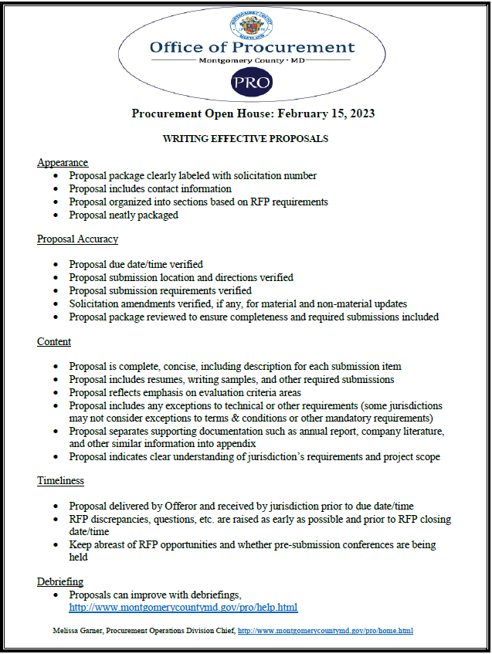

Slide 3
Appearance:
- Proposal package clearly labeled with solicitation number
- Proposal includes contact information
- Proposal organized into sections based on RFP requirements
- Proposal neatly packaged
Proposal Accuracy:
- Proposal due date/time verified
- Proposal submission location and directions verified
- Proposal submission requirements verified
- Solicitation amendments verified, if any, for material and non-material updates
- Proposal package reviewed to ensure completeness and required submissions included
Content:
- Proposal is complete, concise, including description for each submission item
- Proposal includes resumes, writing samples, and other required submissions
- Proposal reflects emphasis on evaluation criteria areas
- Proposal includes any exceptions to technical or other requirements (some jurisdictions may not consider exceptions to terms & conditions or other mandatory requirements)
- Proposal separates supporting documentation such as annual report, company literature, and other similar information into appendix
- Proposal indicates clear understanding of jurisdiction’s requirements and project scope

Slide 4
Timeliness:
- Proposal delivered by Offeror and received by jurisdiction prior to due date/time
- RFP discrepancies, questions, etc. are raised as early as possible and prior to RFP closing date/time
- Keep abreast of RFP opportunities and whether pre-submission conferences are being held
Debriefing:
- Proposals can improve with debriefings,
http://www.montgomerycountymd.gov/pro/help.html
Melissa Garner, Procurement Operations Division Chief, http://www.montgomerycountymd.gov/pro/home.html

