Slide 1
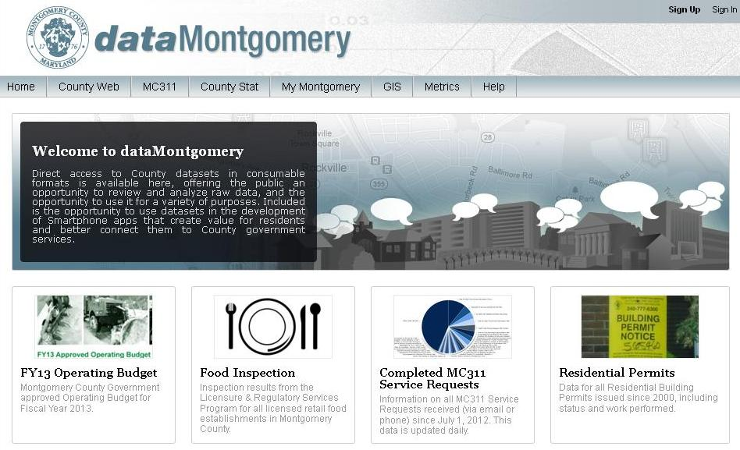
dataMontgomery Department Point of Contacts Kickoff – September 30, 2013

Slide 2
Topic Highlights
Department Point of Contact Introductions
Project Overview
Bill 23-12
Site highlights, benefits and examples
Countywide Dataset Inventory Process and Timeline
Department Point of Contact Information
Responsibilities
What are these meetings for?
Dataset Analysis Recommendations
Dataset candidate Qualities
Key information
Next Steps

Slide 3
Project Overview
The basic objective of the project is to provide a centralized site to make County government data available to the public.
Key public users can be defined as Residents, Advocates, Developers, Researchers, County Employees, County Agencies, Other Jurisdictions
This project is in compliance with Bill 23-12, passed by County Council in December 2012
3

Slide 4
Bill 23-12
(1) Require the County to make certain public data sets available on a single web portal on the internet
(2) Require the County to develop a technical standards manual for publishing public data sets
(3) Requires creation of an implementation plan as a regulation that must be approved by the Council, to ensure there is no gap between the policy goal and actual implementation
(4) Require the County to include on the single web portal, a website that includes certain information on requests submitted to the County under the Maryland Public Information Act and the County's response to that request
4

Slide 5
Site Highlights
Ability to load both public and private datasets
Search, sort and filter data
Ability to extract data in multiple formats
Create charts, graphs
Embed dynamically updated datasets and visualizations into a web page
Ability to layer datasets together
APIs for developers to use data for apps or other sites
GIS:
Generate maps on data using Socrata mapping function (point, heat, boundary)
Can load shape files
Ability to use ESRI Integration Module using map services
Ability to layer maps
5

Slide 6
Open Data Benefits
Provides an easy and inexpensive way for agencies to share their data with the public
Provides ability to embed datasets or visualizations in Department websites if applicable
Publishing a dataset can reduce resource hours supporting the development of canned reports (internal and external use) and MPIA requests
Drives engagement with all constituents; including citizens, media organizations, analysts, scientists, researchers and mobile application developers
Improves and standardizes the ways in which visitors to the County’s website find, download, analyze, visualize and share public datasets
By publishing consumable data, independent developers are free to create creative mobile applications using County data

Slide 7
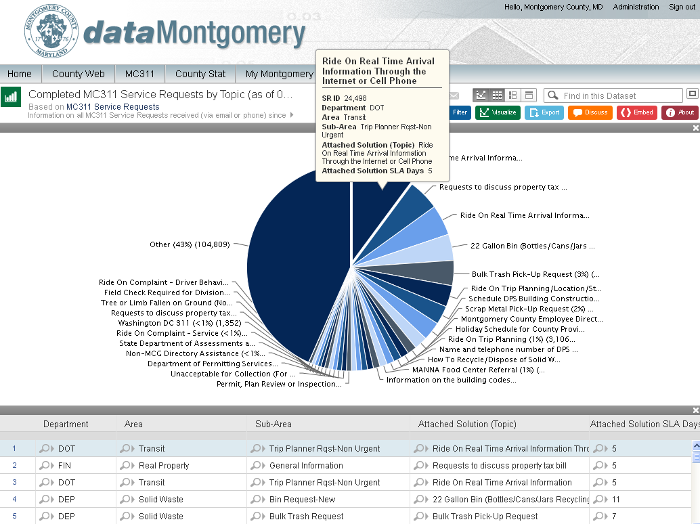
MC311 Service Requests Dataset

Slide 8
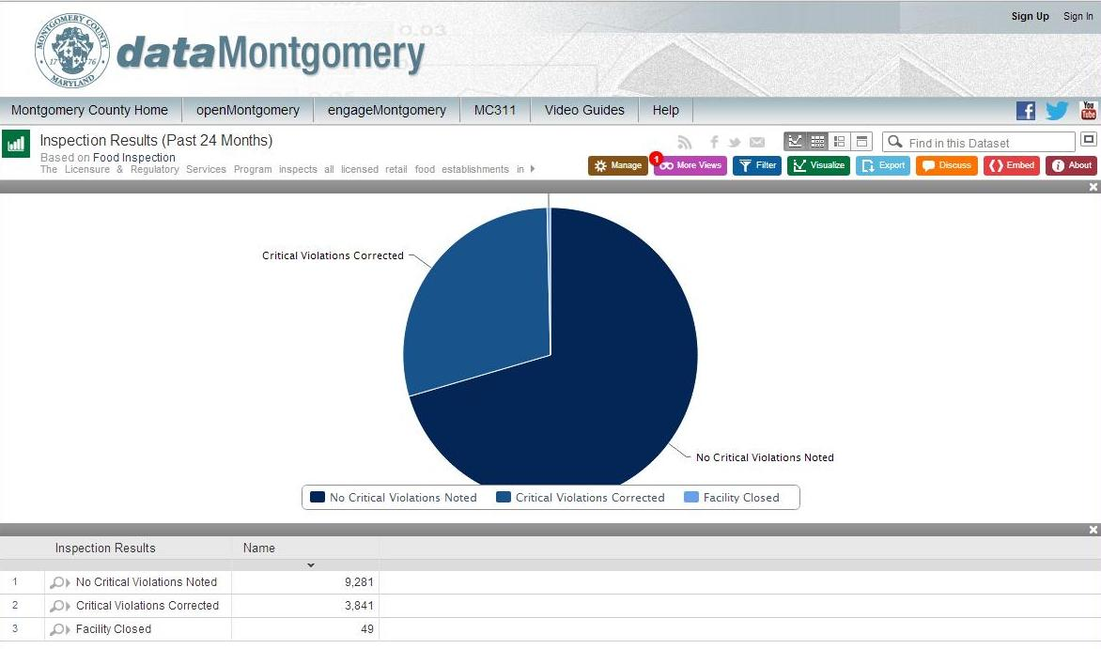
Food Inspection Dataset
8

Slide 9
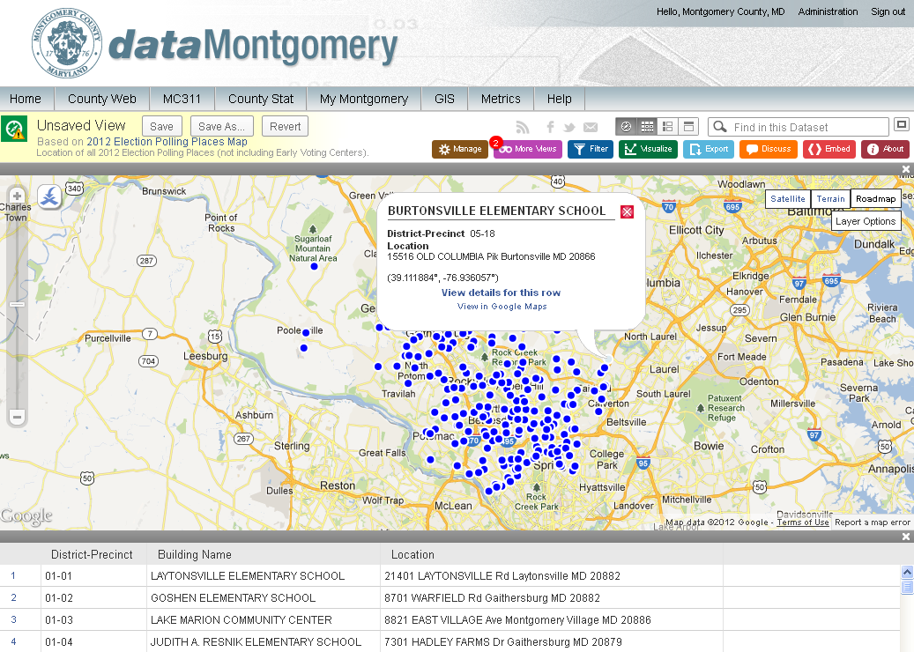
Election Polling Places Dataset
9

Slide 10
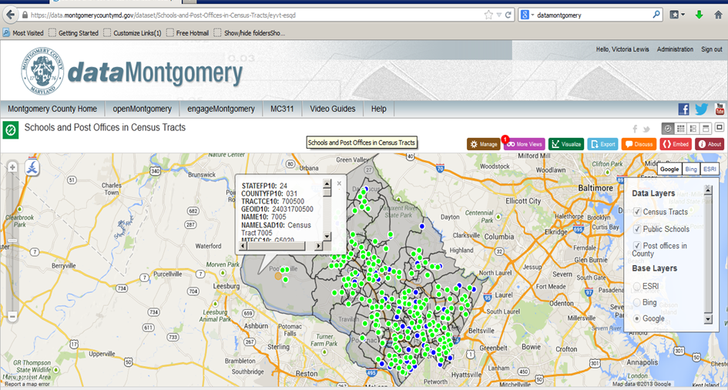
Example of Layering Datasets on Shape Files

Slide 11
Current Status– Published Datasets
8 Departments Represented
Organization Abbreviation | Organization Name | Names of Datasets Published
DGS | Department of General Services | Contracts
DPS | Department of Permitting Services | Residential Permits Commercial Permits Mechanical Permits Demolition Permits Electrical Business Licenses Public Right of Way Permits Electrical Building Permits
DTS | Department of Technology Services | Public Schools (GIS) Election Polling Places (GIS) HHS Facilities (GIS) Post Offices (GIS) Hospitals (GIS) Fire Stations (GIS) Libraries (GIS) Cable Complaints Transmission Facilities Application Status Cable Inspections
FIN | Department of Finance | Real Property Tax Rates Spending Disclosure (multiple years)
HHS | Department of Health & Human Services | Food Inspection
OHR | Office of Human Resources | Employee Salaries Tuition Assistance
OMB | Office of Management & Budget | FY13 and FY14 Budgets FY13 and FY14 Budget – Internal Service Funds
PIO | Public Information Office | MC311 Service Requests
11

Slide 12
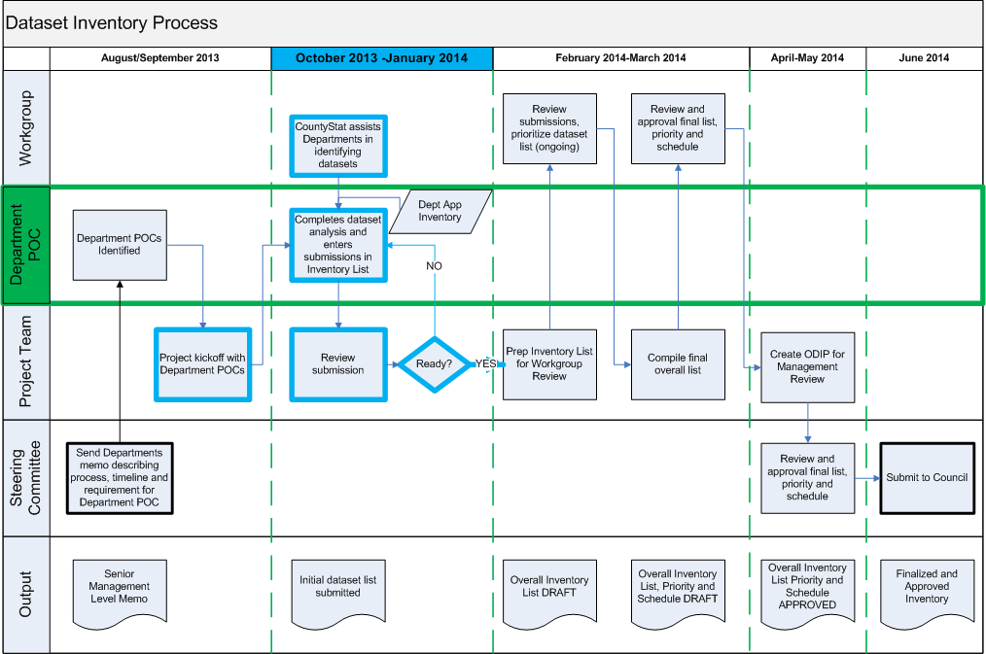
Project Governance Document Review Inventory Process and Timeline
12

Slide 13
Department Point of Contacts
1 POC identified per Department
Central Department point of contact for the dataMontgomery project
Responsibilities:
Analyzing available Department data
Identifying potential datasets to publish
Legal review of datasets prior to approval
Managing Department activities according to dataMontgomery Implementation Plan requirements and timeline
Point of escalation for operational dataset issues (in case the dataset owners are non-responsive, etc)
13

Slide 14
Dept Point of Contact (POC) Meetings
Provide Point of Contacts with agenda topics to assist during the inventory process, such as
Socrata tool capabilities
GIS Mapping
OCA discussion around sensitive data
Point of Contact-requested topics
Encourage data collaboration between Departments
Data needs/analysis from other Departments
Multi-Department data analysis
Provide a venue to discuss common data standards to show the public (licensing, permitting, maps, inspections, etc)
14

Slide 15
Dataset Inventory Recommendations
Inputs:
Application Inventory List
dataMontgomery Technical Standards Document
Best practices observed from similar datasets seen on other open data sites
Who should you involve in creating this list?
Department IT key contacts
Department function resources who can characterize “Department mission driven data”
CountyStat resources will assist in identifying high value datasets
dataMontgomery team to assist with reviewing initial lists, questions, best practices, etc
15

Slide 16
Dataset Candidate Qualities
Guiding Principle
Complete | All public data is made available. Public data is data that is not subject to valid privacy, security, or privilege limitations.
Timely | Data is made available as quickly as necessary to preserve the value of the data.
Non-discriminatory | Data is available to anyone, with no requirement of registration
License-free | Data is not subject to any copyright, patent, trademark, or trade secret regulation. Reasonable privacy, security, and privilege restrictions may be allowed.
Primary | Data is as collected at the source, with the highest possible level of granularity, not in aggregate or modified forms
Accessible | Data is presented in a meaningful way
Machine Processable | Data can be processed
Non-proprietary | Data is available in a format over which no entity has exclusive control.
16

Slide 17
Socrata’s “Most Compelling Datasets”
Geospatial data. (People love maps!)
Public safety data of all kinds:
Traffic fatalities, moving violations, etc.
Crime
Attorney General’s complaint database
Parking violations
Salary data. (Every year the most popular issue of the Sunday newspaper insert “Parade” is the salary issue. People are fascinated to learn how much people earn)
Health data. Most state health departments have a wealth of interesting and useful health measure data. Restaurant inspection results are always compelling.
Expenditure data. Citizens want to see where the government spends money. Many progressive governments are working towards automating the publication of expenditure data (checkbook level transactions) in real-time or nightly.
Education data.
311 data.
Census data.
Election data.
Budget breakdowns.
Employment figures.
Parcel/property data
New business listings, incorporations, etc.
Locations of government services including parks & public spaces
Government Accountability performance metrics for services provided
17

Slide 18
Socrata Customers
City of New Orleans
MetroChicagoData.com
City of Baltimore
City of Austin
SAMHSA
City of San Francisco
U.N.D.P.
New York City
State of Illinois
King County
City of De Leon
State of Washington
NYC Comptroller
City of Wellington, Florida
CFPB
Alameda County
HSMP
City of Somerville
Cook County
City of Edmonton
State of Maryland
World Bank
State of Oregon
State of Oklahoma
City of Chicago
City of Seattle
State of Colorado
State of Missouri
Ethics.gov
Data.gov
Medicare

Slide 19
Key Information
Portal page with key information, tips and tools for the project is coming soon and will be sent to the Point of Contacts for reference.
Questions?
#DTS.dataMontgomery@montgomerycountymd.gov
19

Slide 20
Next Steps
Department Point of Contacts need to set up IDs on the dataMontgomery website using their County email addresses as user IDs
dataMontgomery team will grant access to Dataset Inventory repository
Next Department POC Meeting: October 29th, 1PM
20

