Slide 1
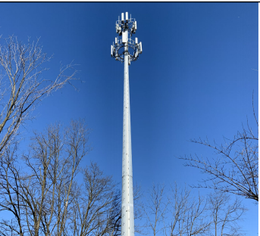
Dish Wireless @ Derwood Monopole
Notes:
15948 Derwood Road, Derwood

Slide 2
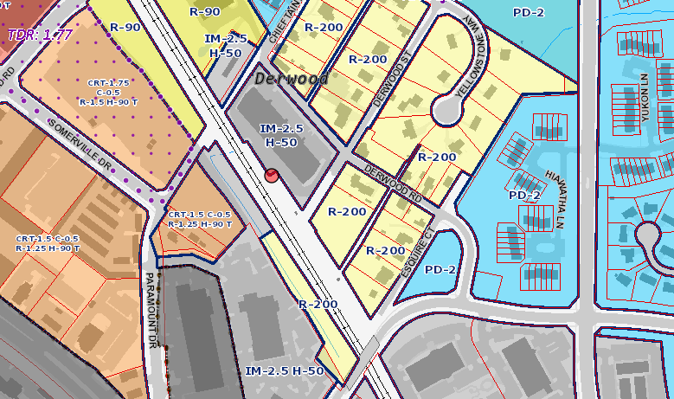
Derwood Monopole
Notes:
The 145’ monopole is owned by CSX Transportation and managed by City Switch, as subsidiary of CSX. The monopole was constructed in 2019 . Verizon and T-Mobile are already present. The monopole is located approximately .3 miles south of the Shady Grove Metro Station.

Slide 3
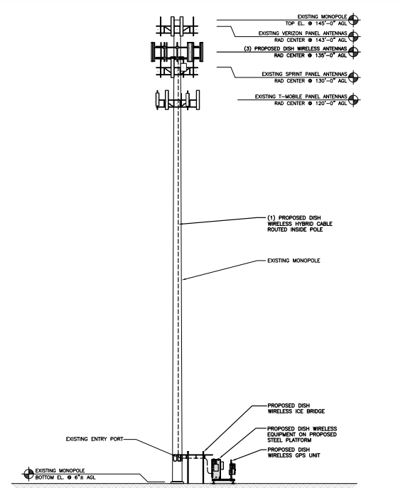
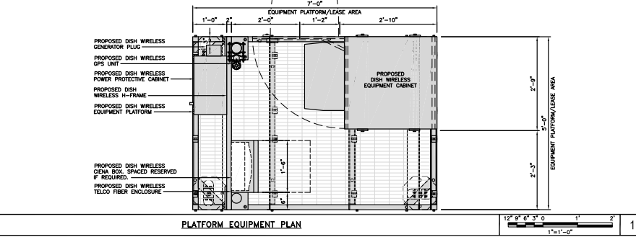
Derwood Monopole
Notes:
This drawing of the monopole elevation shows the proposed Dish Wireless attachments of (3) JMA-MX08FRO665-20 antennas at a centerline of 135’. At ground level, Dish Wireless to install an ice bridge, a steel platform, an equipment cabinet and an electrical cabinet all within the existing compound.

