Slide 1
Strand Mounted Applications August 2021 TFCG Meeting

Slide 2
T-Mobile @
PEPCO 788430-060600 (2021041428)

Slide 3
1428- PEPCO 788430-060600

Slide 4
1428- PEPCO 788430-060600

Slide 5
T-Mobile @
PEPCO 806428-0869 (2021051447)

Slide 6
1447 - PEPCO 806428-0869

Slide 7
1447- PEPCO 806428-0869

Slide 8
T-Mobile @
PEPCO 787430-990520(2021051449)

Slide 9
1449 – PEPCO 787430-990520

Slide 10
1449 - PEPCO 787430-990520

Slide 11
T-Mobile @
PEPCO 803418-060250 (2021061489)

Slide 12
1489 – PEPCO 803418-060250

Slide 13
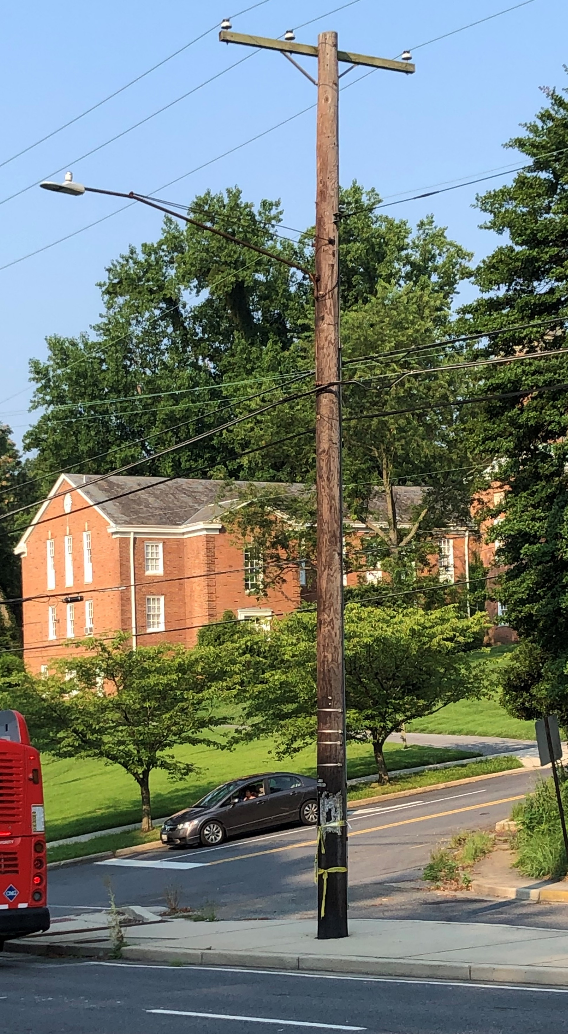
1489 – PEPCO 803418-060250

