Slide 1
Telecommunications Facilities Coordinating Group
(TFCG) Slide Deck
MAY 2023

Slide 2
Crown Castle/T-Mobile @
PEPCO 806432-5346
(2023032135)

Slide 3
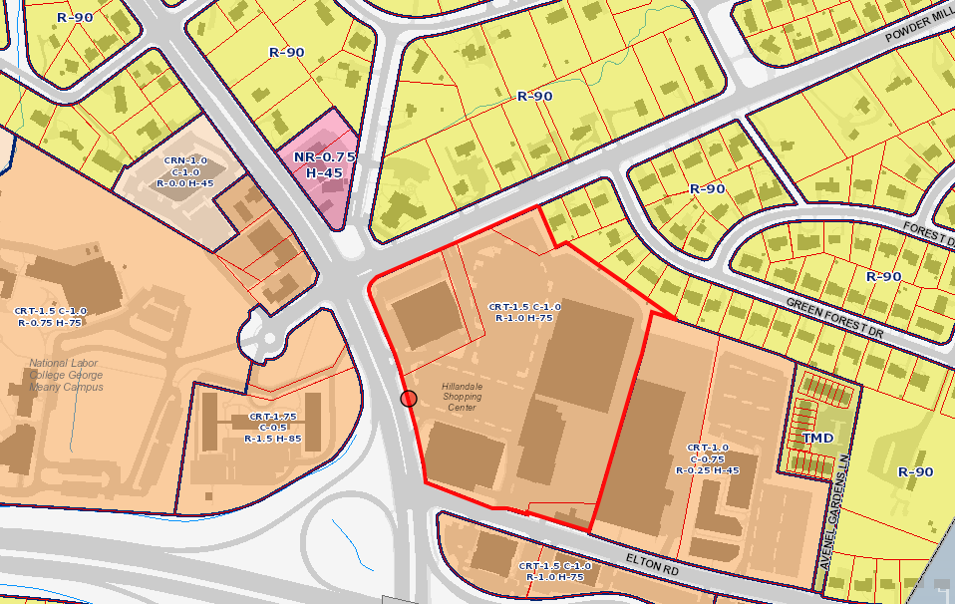
PEPCO 806432-5346

Slide 4
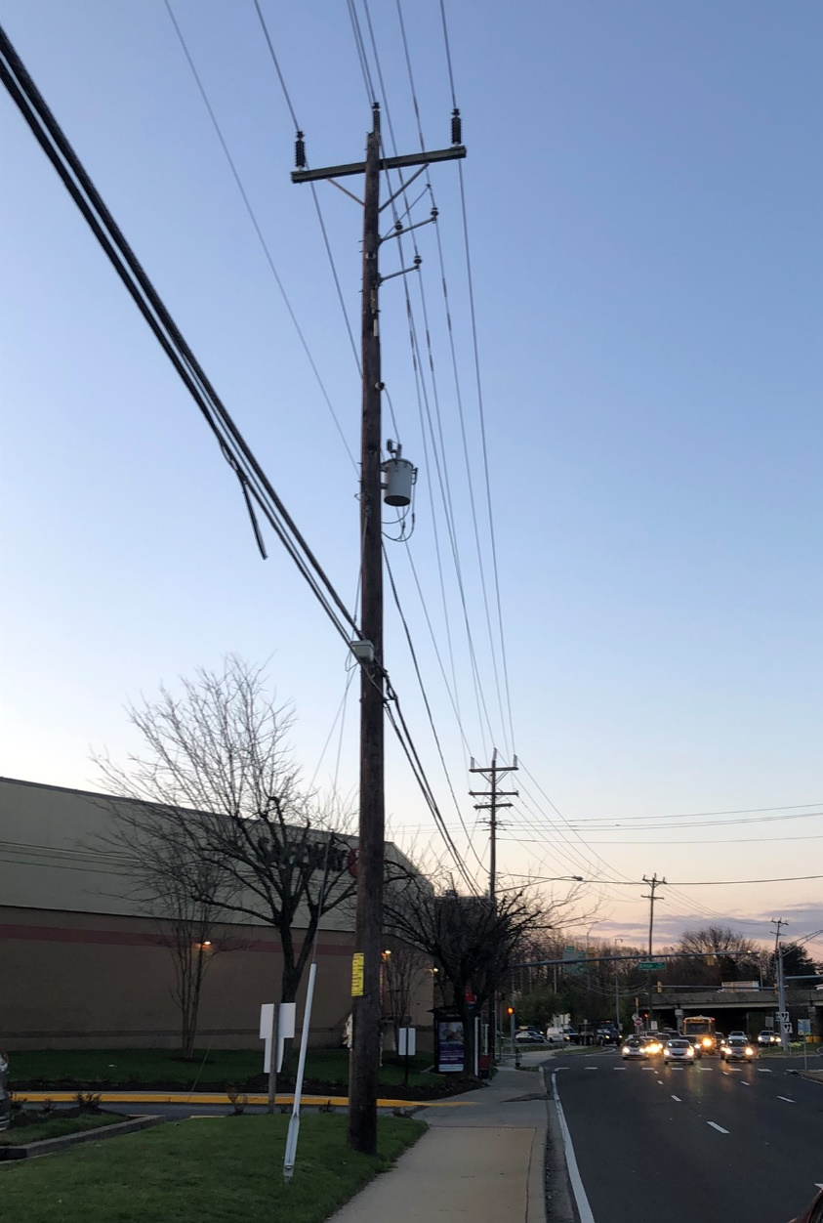
PEPCO 806432-5346

Slide 5
Crown Castle/T-Mobile @
PEPCO 803430-770360
(2023042143)

Slide 6
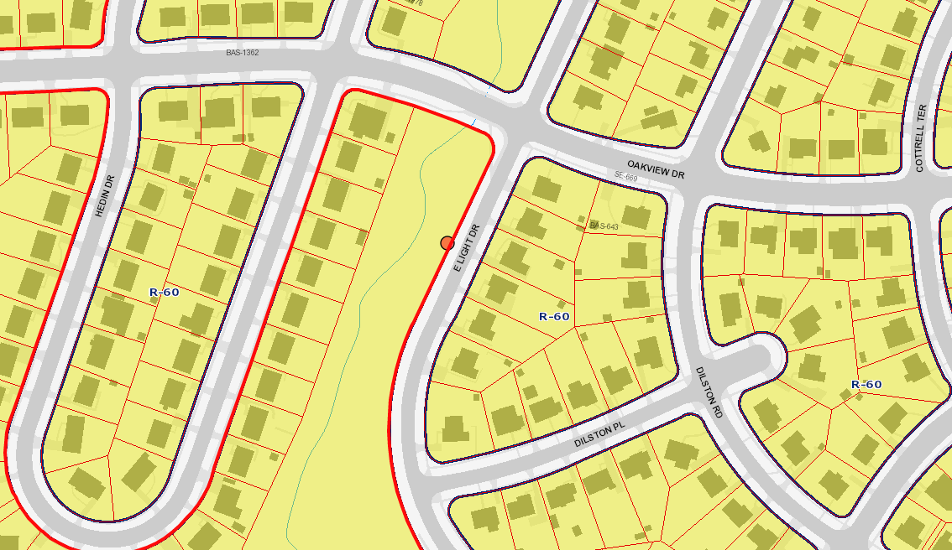
PEPCO 803430-770360

Slide 7
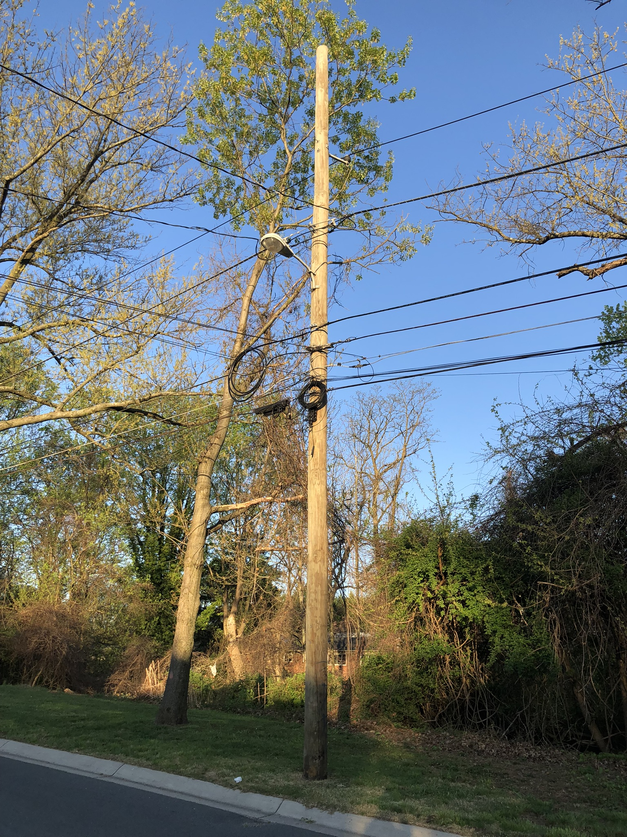
PEPCO 803430-770360

Slide 8
Crown Castle/T-Mobile @
PEPCO 799422-243180
(2023042144)

Slide 9
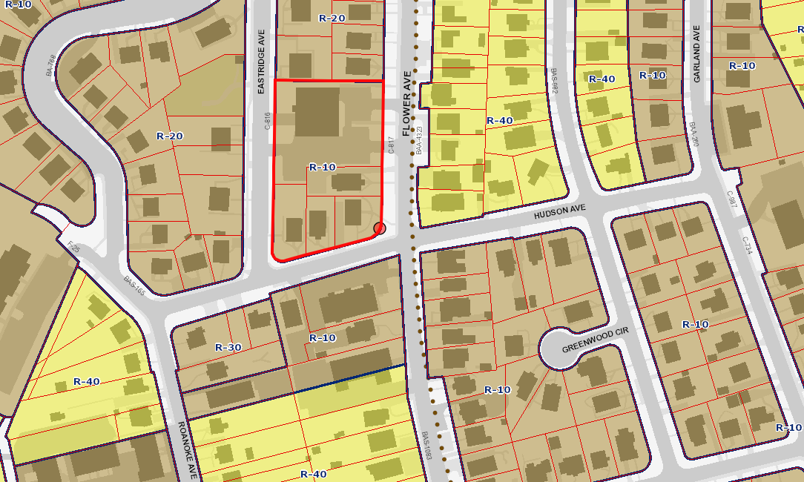
PEPCO 799422-243180

Slide 10
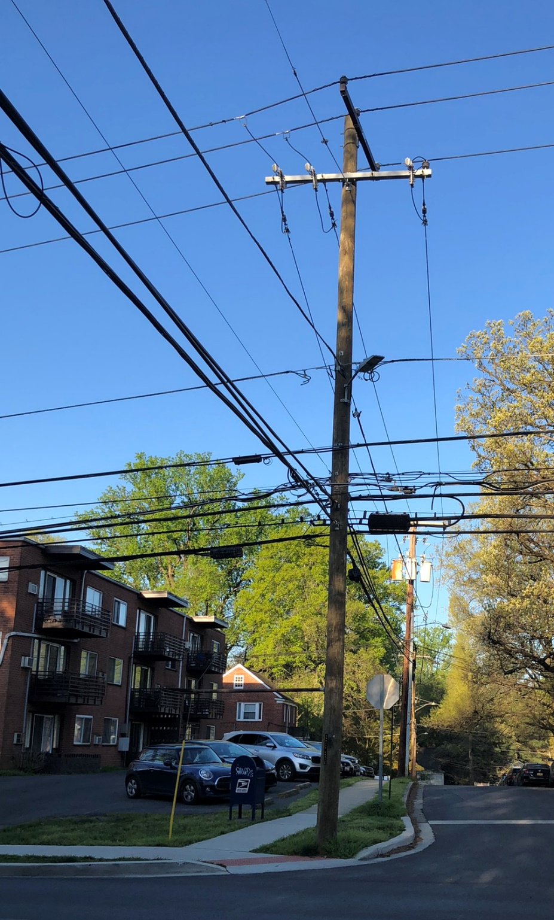
PEPCO 799422-243180

