Slide 1
Telecommunications Facilities Coordinating Group (TFCG) Slide Deck
December 2023

Slide 2
Crown Castle/T-Mobile @
PEPCO 802423-370300 (2023052155)

Slide 3
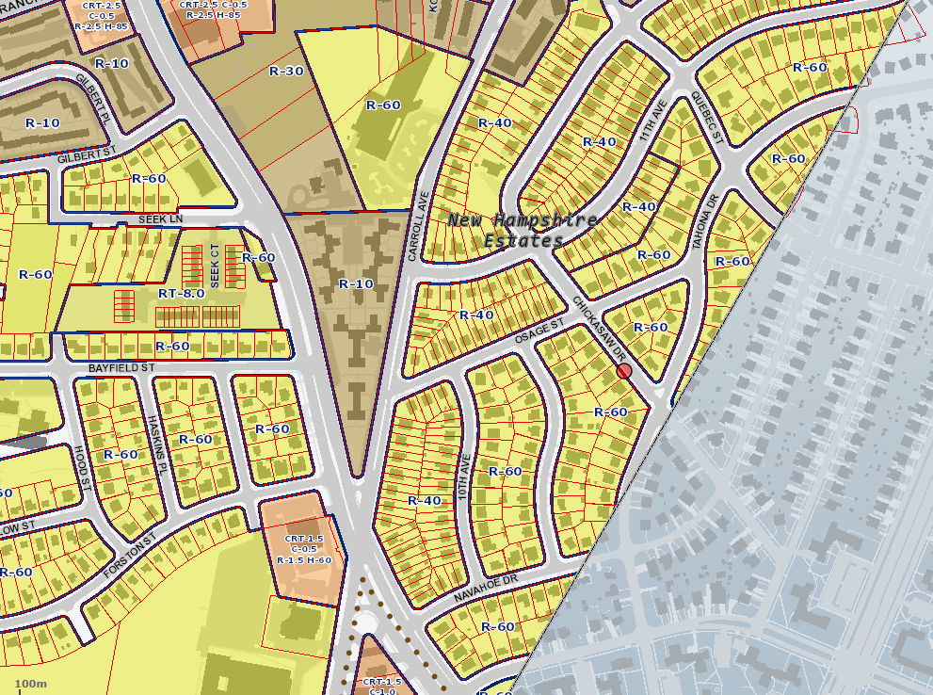
PEPCO 802423-370300

Slide 4
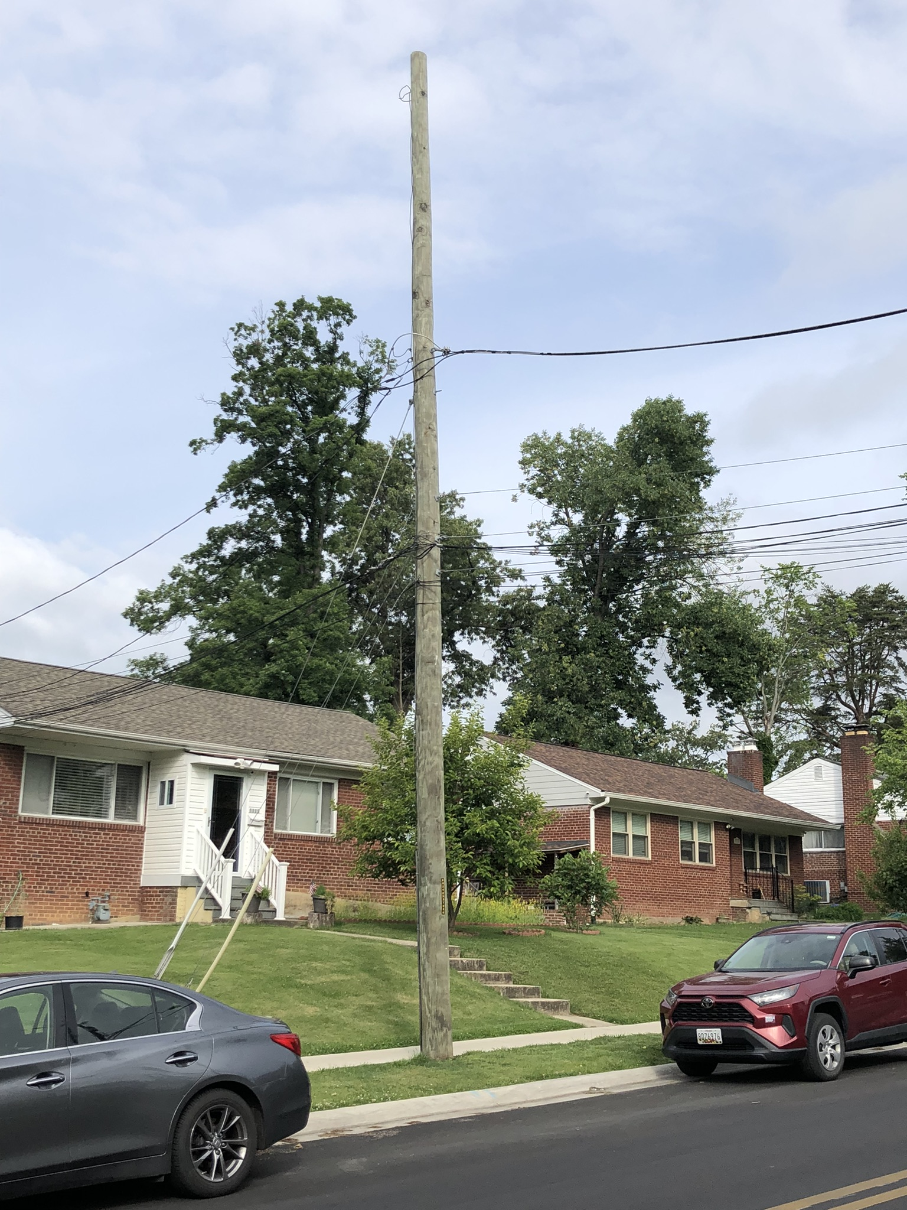
PEPCO 802423-370300

