Slide 1
Telecommunications Facilities Coordinating Group (TFCG) Slide Deck
January 2024

Slide 2
Crown Castle/T-Mobile @
PEPCO 803425-860050 (2023102210)

Slide 3
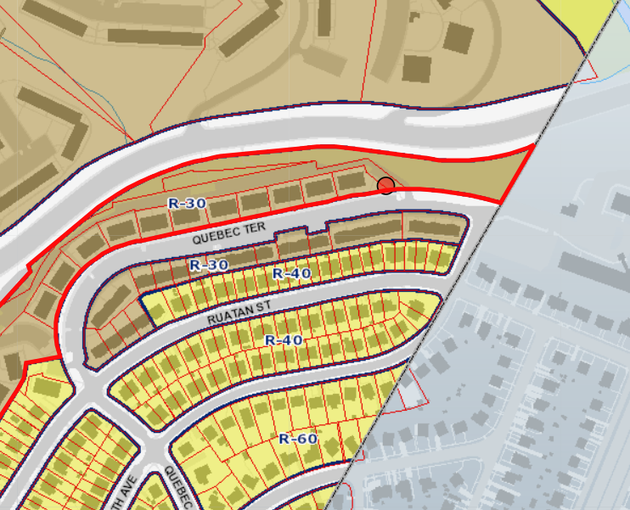
PEPCO 803425-860050

Slide 4
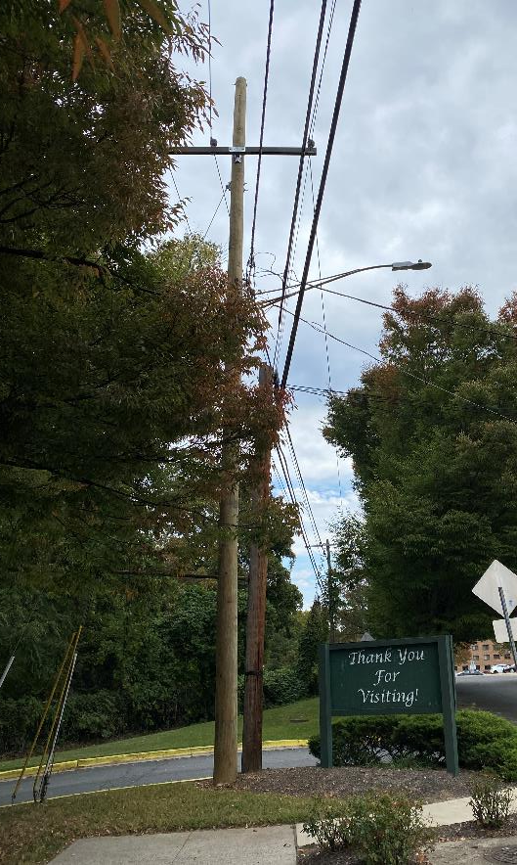
PEPCO 803425-860050

Slide 5
Crown Castle/T-Mobile @
PEPCO 805428-710390 (2023102211)

Slide 6
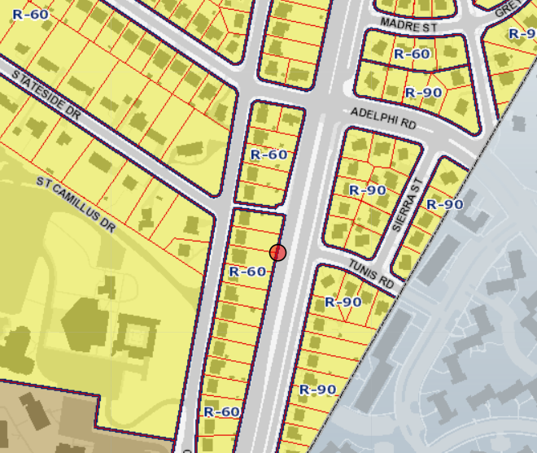
PEPCO 805428-710390

Slide 7
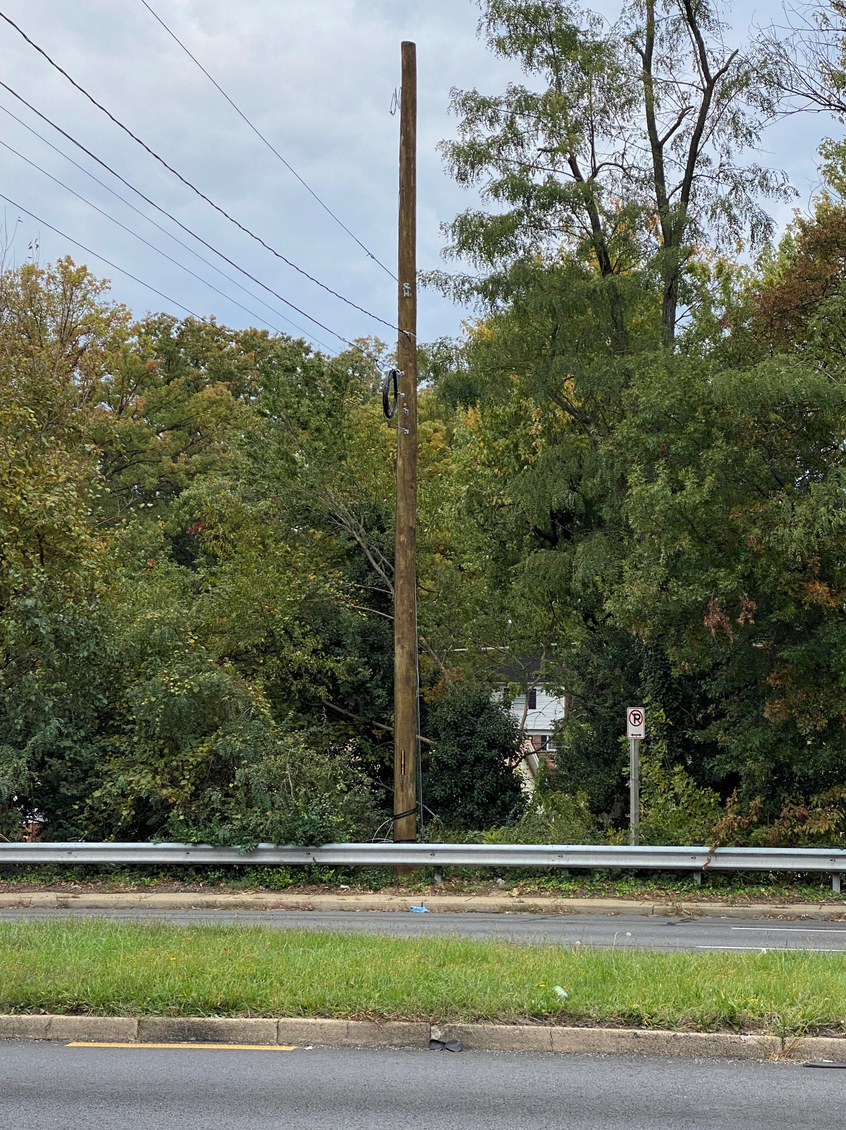
PEPCO 805428-710390

Slide 8
Crown Castle/T-Mobile @
PEPCO 803424-160310 (2023102212)

Slide 9
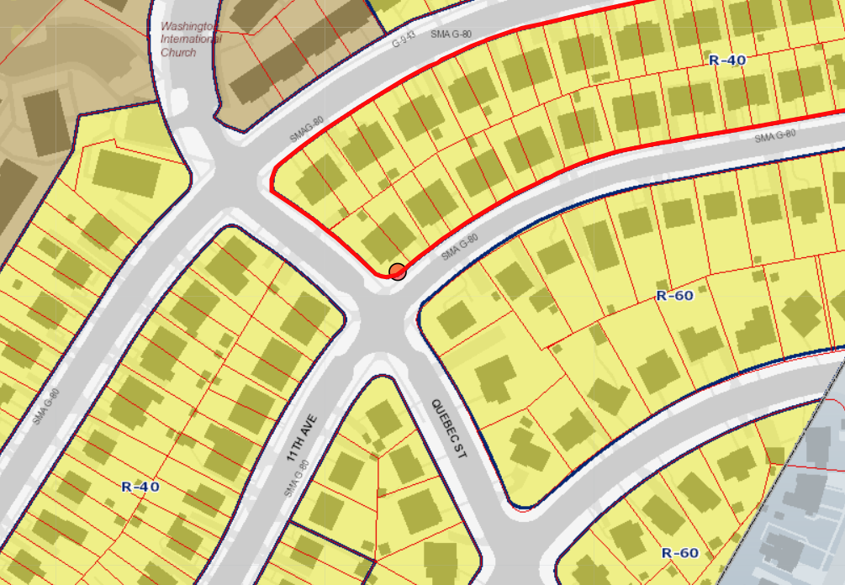
PEPCO 803424-160310

Slide 10
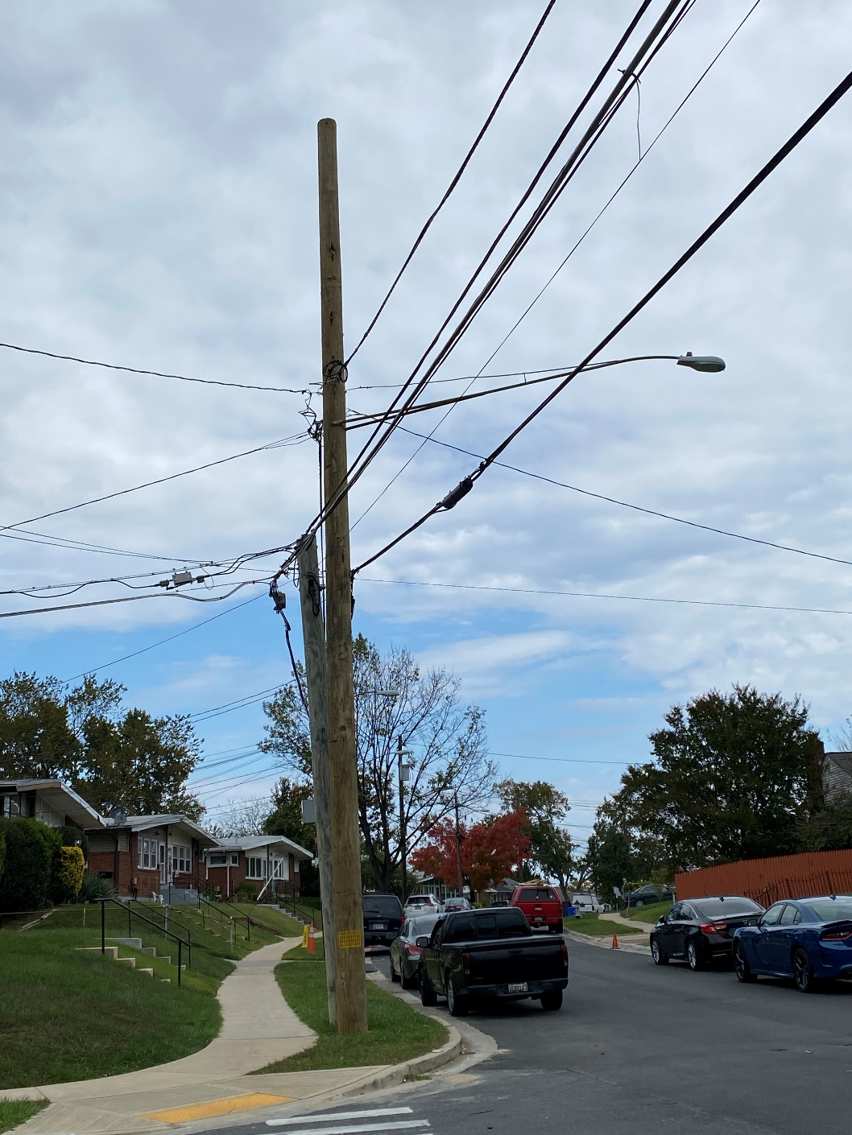
PEPCO 803424-160310

Slide 11
Crown Castle/T-Mobile @
PEPCO 794425-910000 (2023102213)

Slide 12
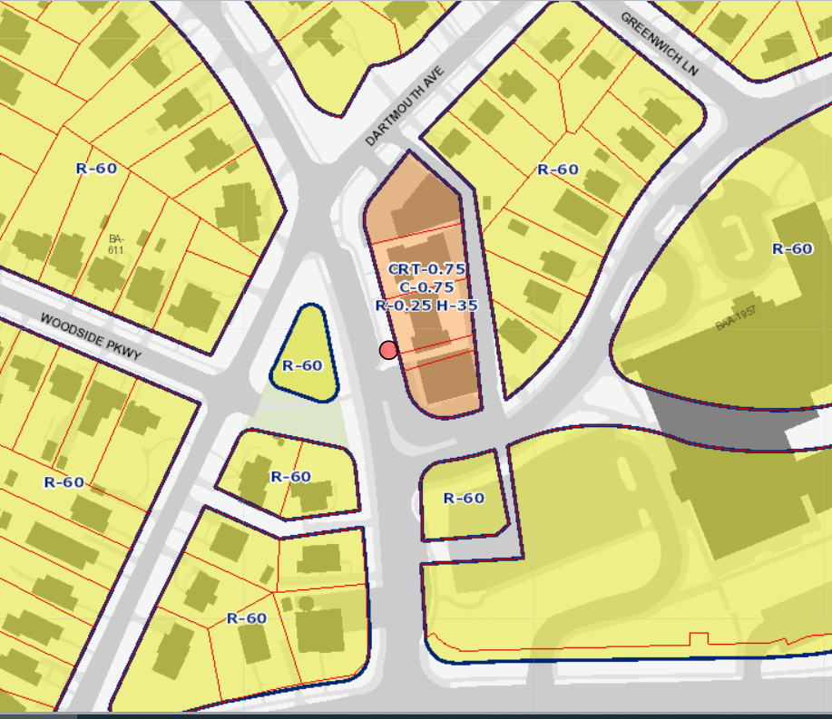
PEPCO 794425-910000

Slide 13
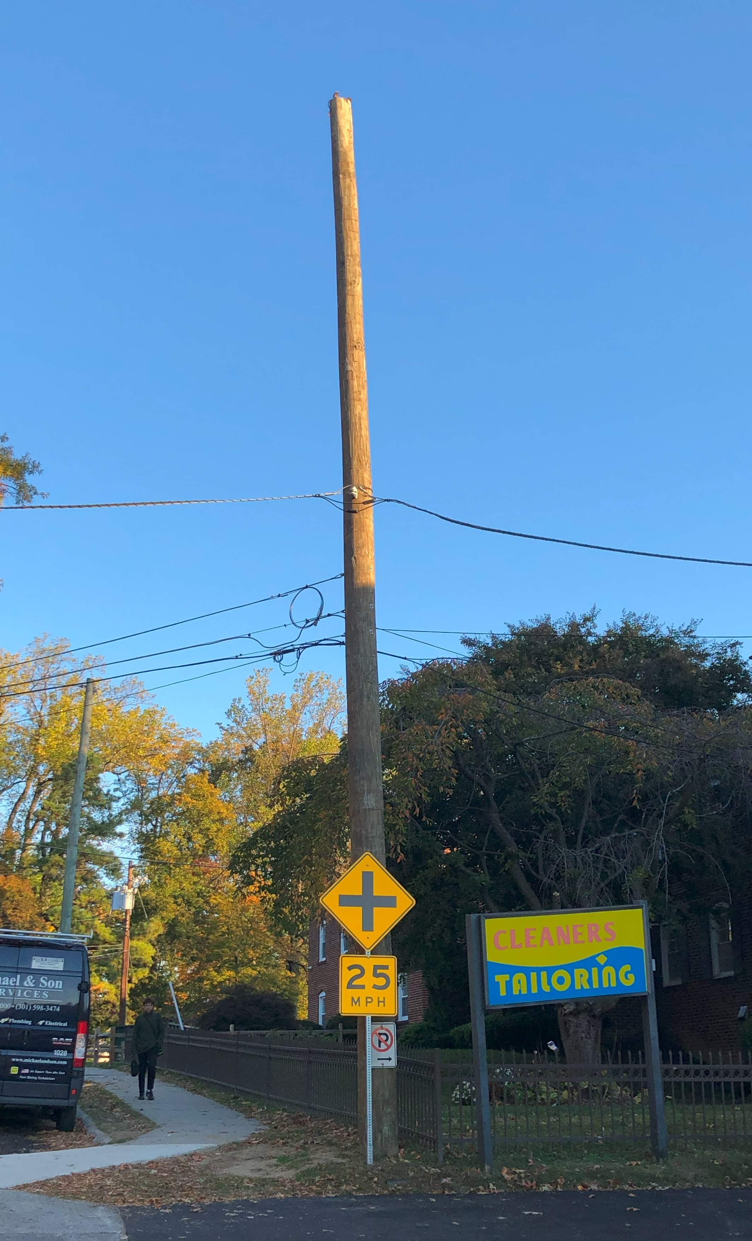
PEPCO 794425-910000

