Slide 1
Telecommunications Facilities Coordinating Group (TFCG) Slide Deck
June 2024

Slide 2
T-Mobile @ Washington Adventist University
(2024042252)

Slide 3
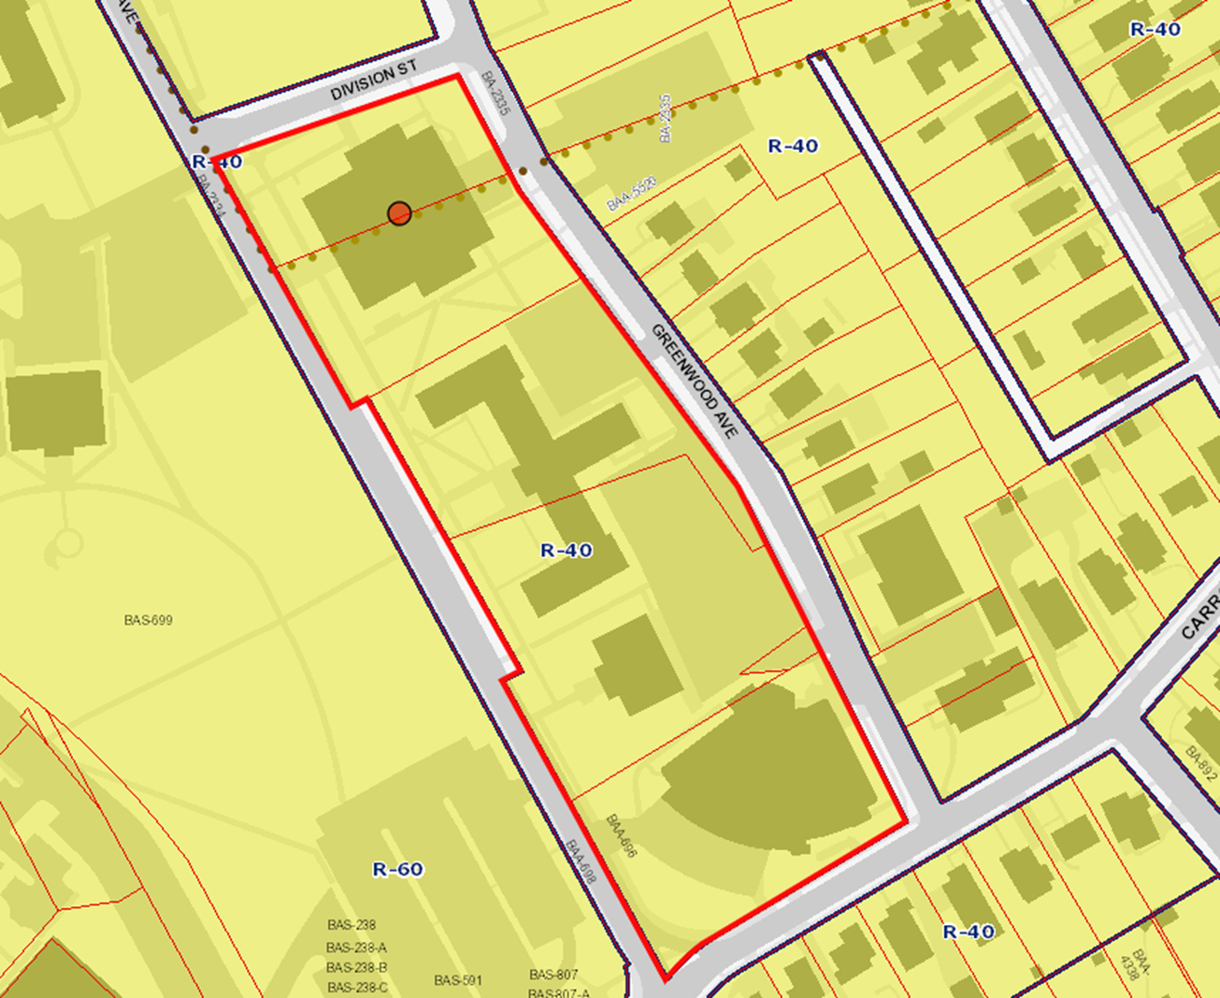
2024042252

Slide 4
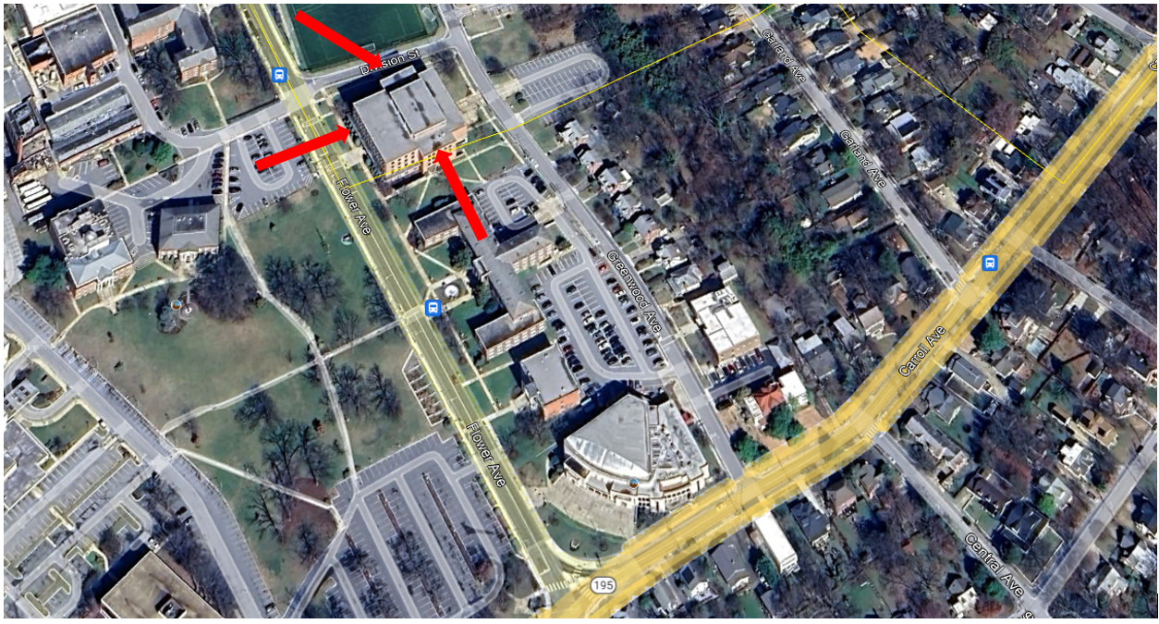
2024042252

Slide 5
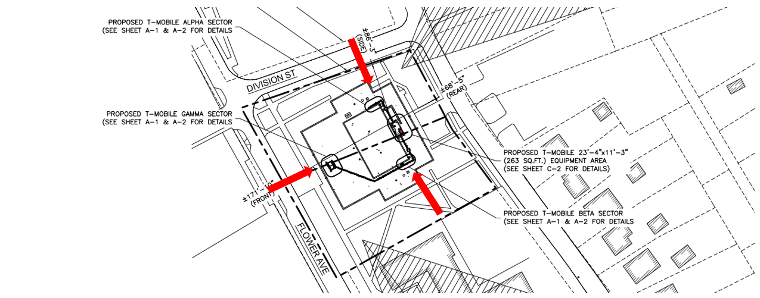
202402252

