Slide 1
Transmission Facilities Coordination Group
(TFCG) Meeting
November 2025

Slide 2
Smartlink/AT&T Wireless @
Shady Grove Tower 2
Permit Number: COMBUILD-1126848
(2025082557)

Slide 3
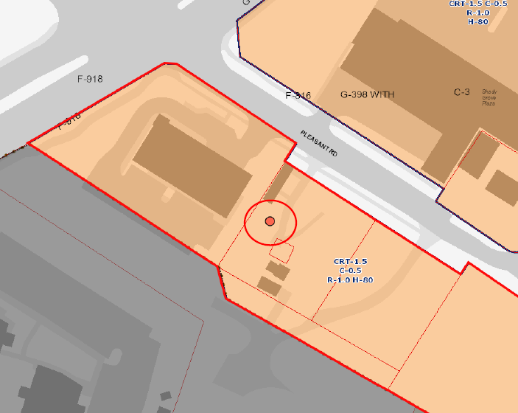
860 Pleasant Road

Slide 4
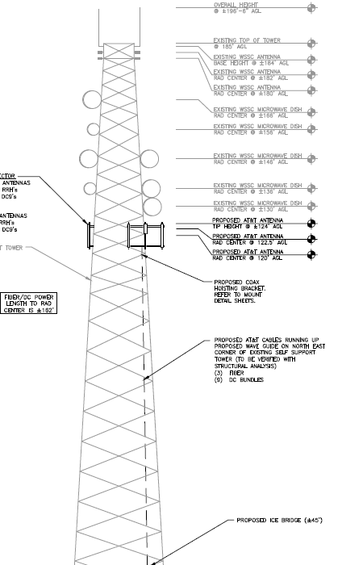
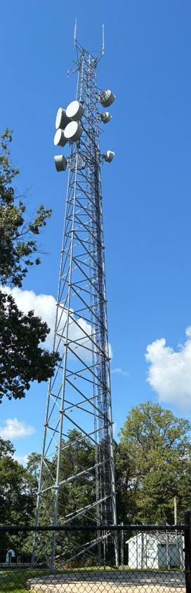
860 Pleasant Road

Slide 5
Crown Castle/T-Mobile @
VZ13911
Permit Number: COMBUILD-1126566
(2025092574)

Slide 6
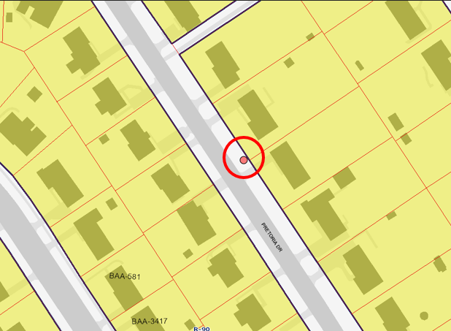
12405 Pretoria Drive

Slide 7
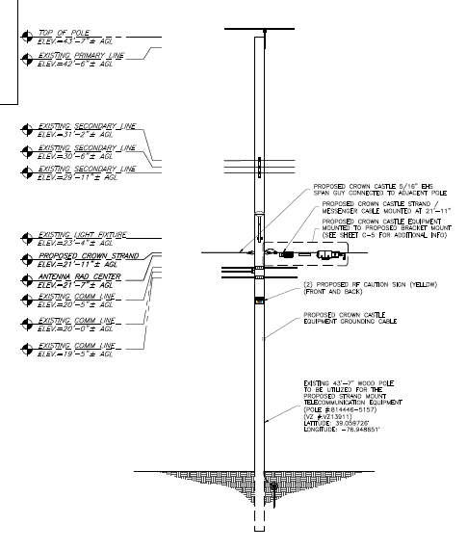
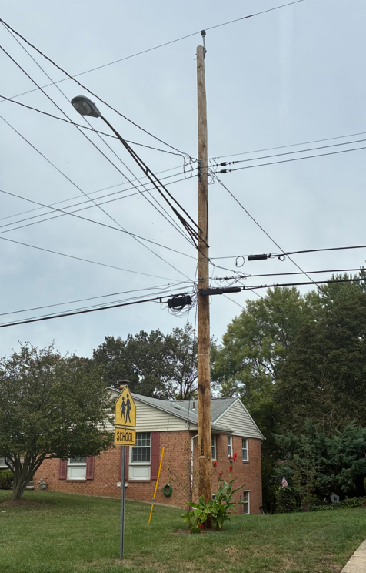
12405 Pretoria Drive

Slide 8
Crown Castle/T-Mobile @
VZ13689
Permit Number: COMBUILD-1126536
(2025092573)

Slide 9
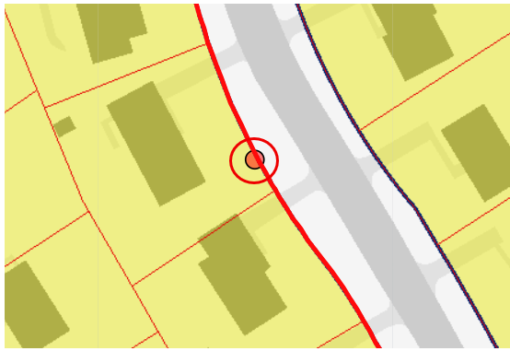
12412 La Plata Street

Slide 10
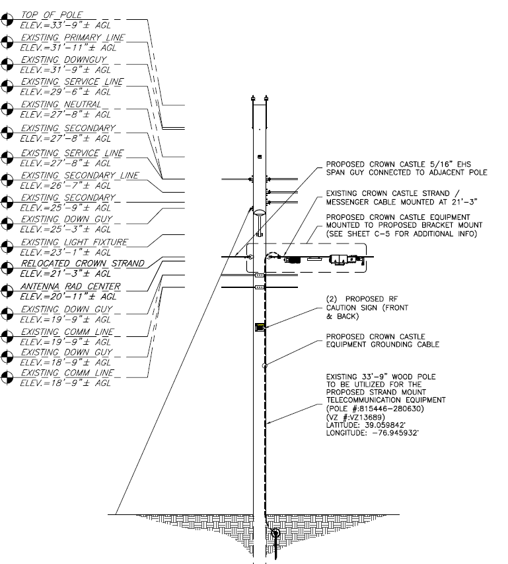
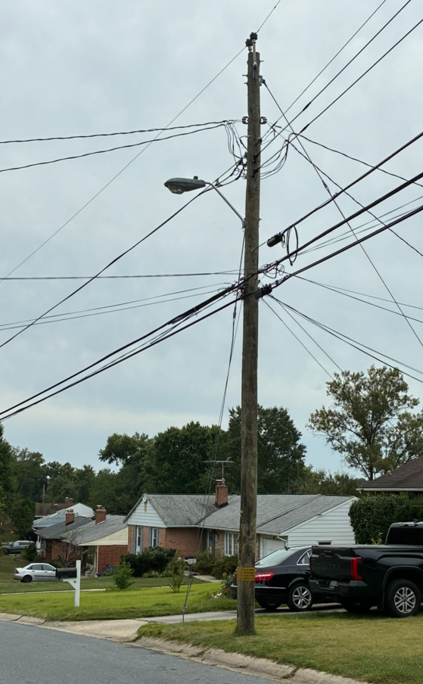
12412 La Plata Street

