Slide 1
Telecommunications Facilities Coordinating Group
(TFCG) Slide Deck
October 2023

Slide 2
AT&T/Verizon/T-Mobile
New (temporary) Monopole and Colocation
Yeshiva School Temp Monopole site
Application 2023072184 – AT&T New pole
Application 2023072183 – Verizon colocation
Application 2023072180 – T-Mobile Monopole colocation

Slide 3
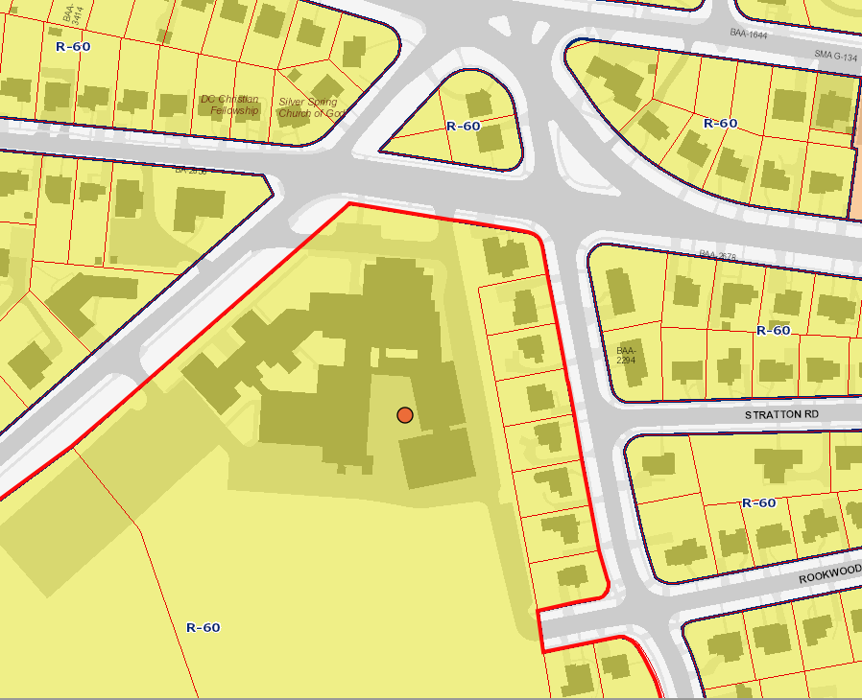

Slide 4
Yeshiva Monopole
AT&T
T-Mobile
Verizon

Slide 5
T-Mobile
AT&T
Verizon

Slide 6
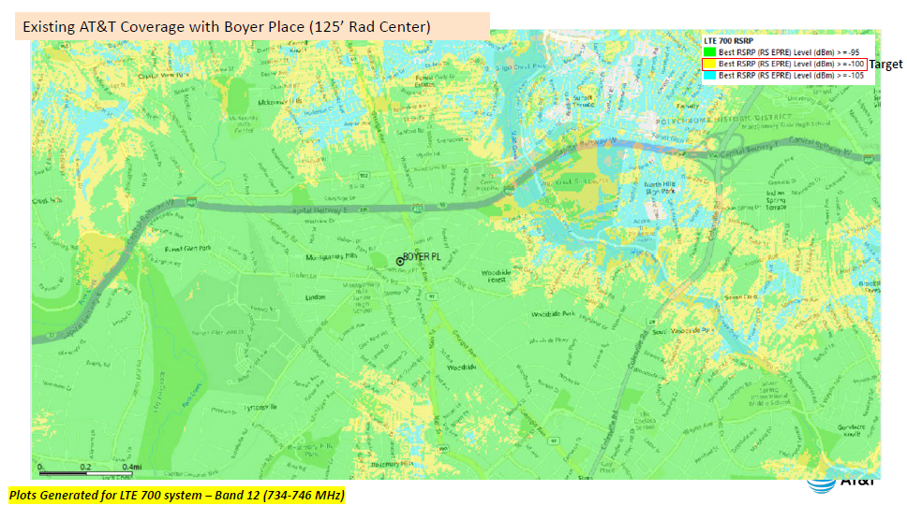
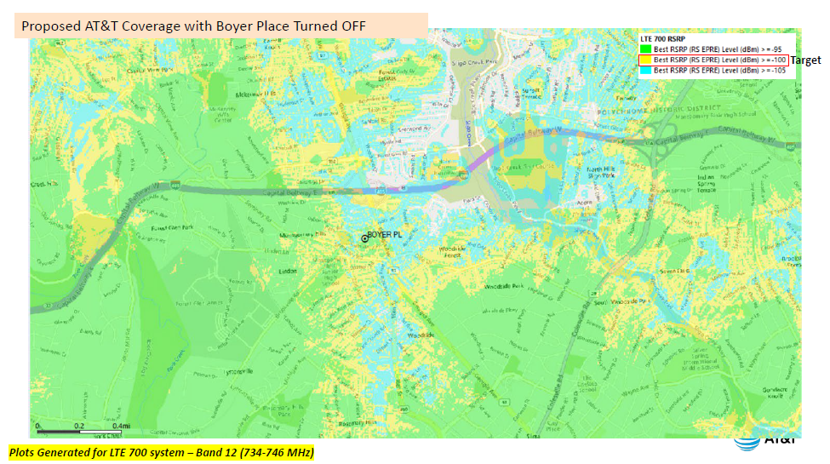
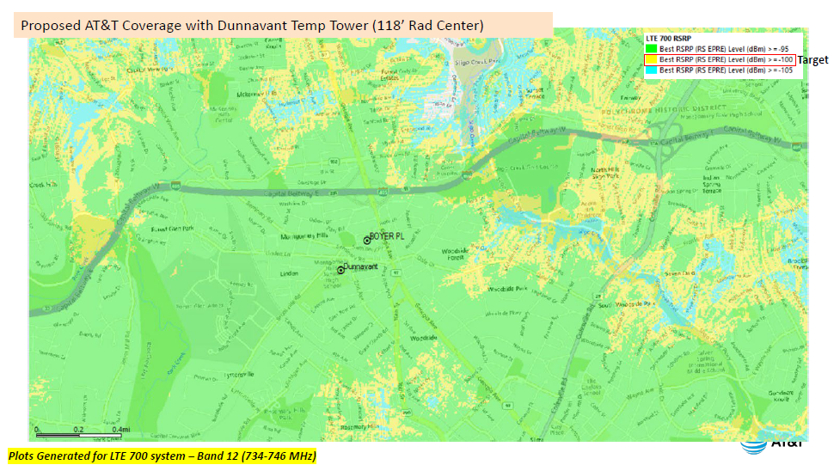

Slide 7
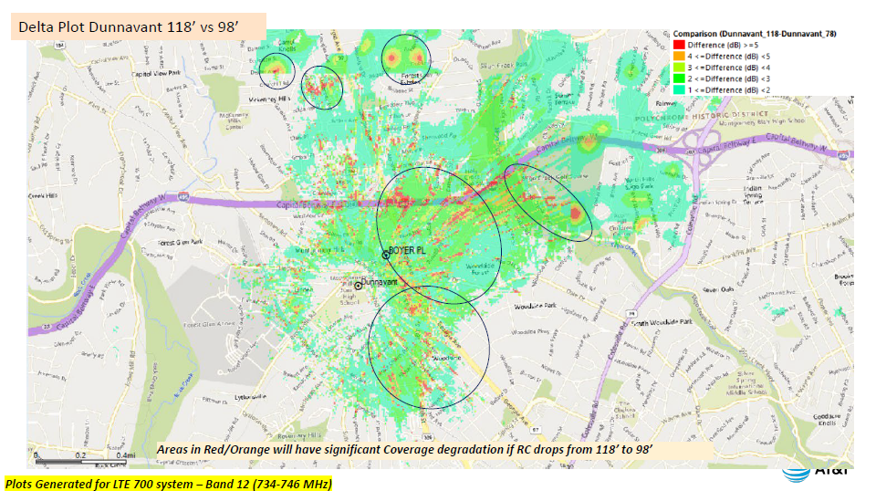
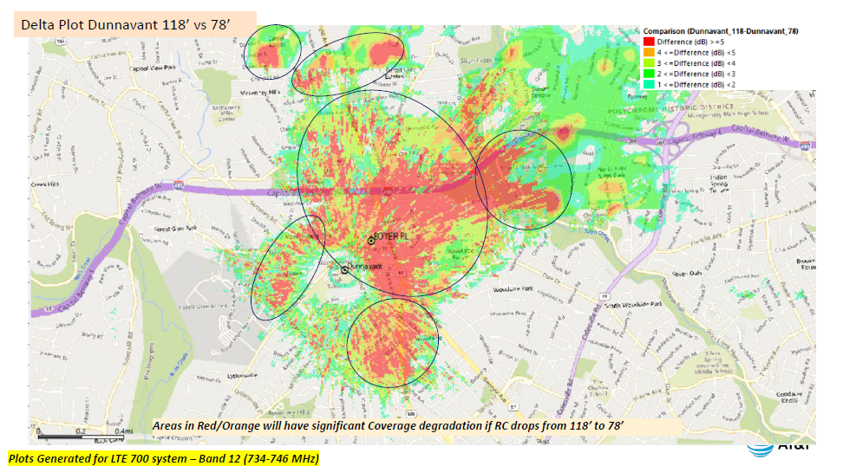

Slide 8
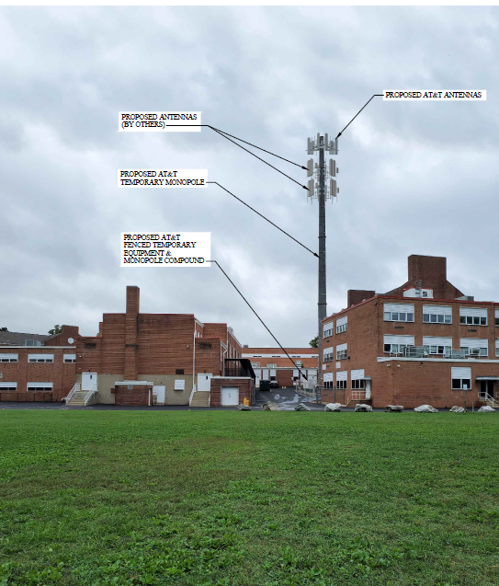
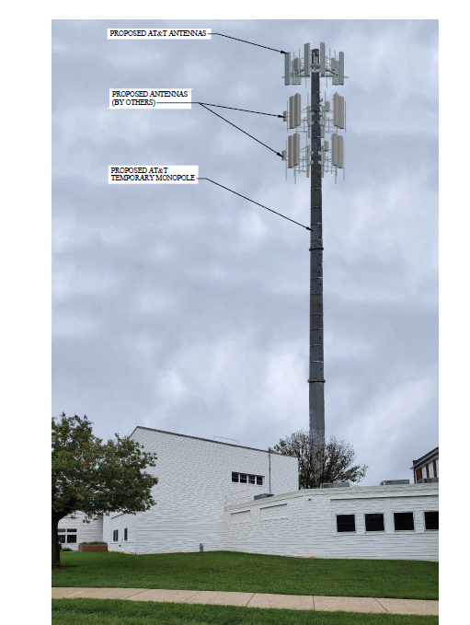
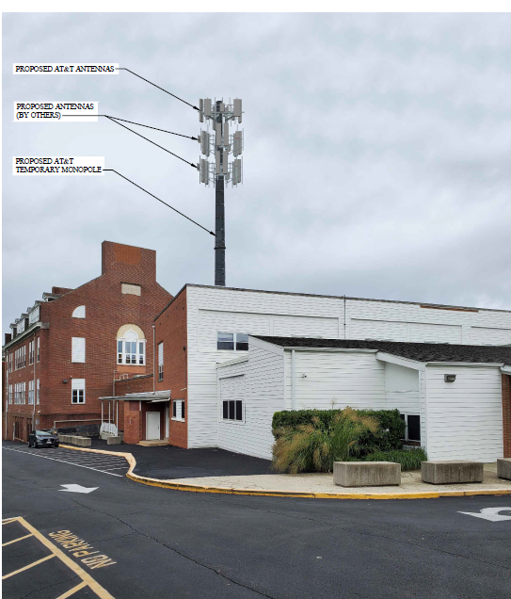

Slide 9
T-Mobile
Colocation on Yeshiva School Rooftop Site
Application 2023072186

Slide 10
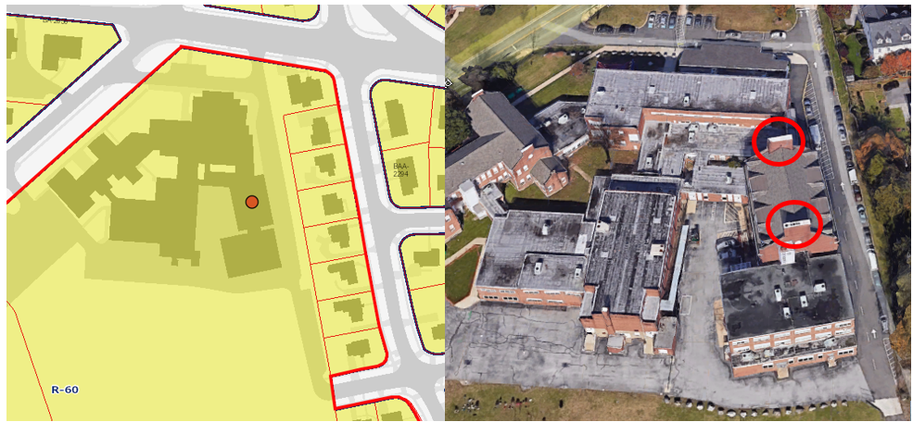

Slide 11
