Slide 1
Telecommunications Facilities Coordinating Group (TFCG) Slide Deck
September 2023

Slide 2
Crown Castle/T-Mobile @
PEPCO 799423-050560 (2023052154)

Slide 3
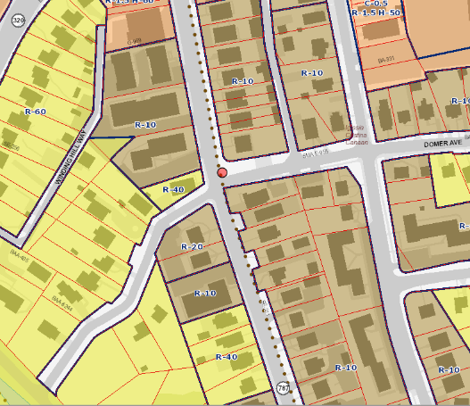
PEPCO 799423-050560

Slide 4
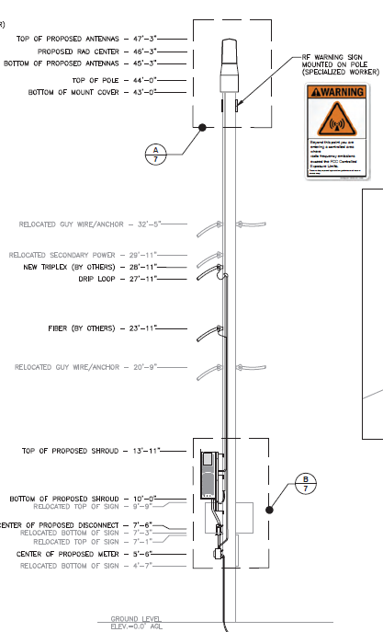
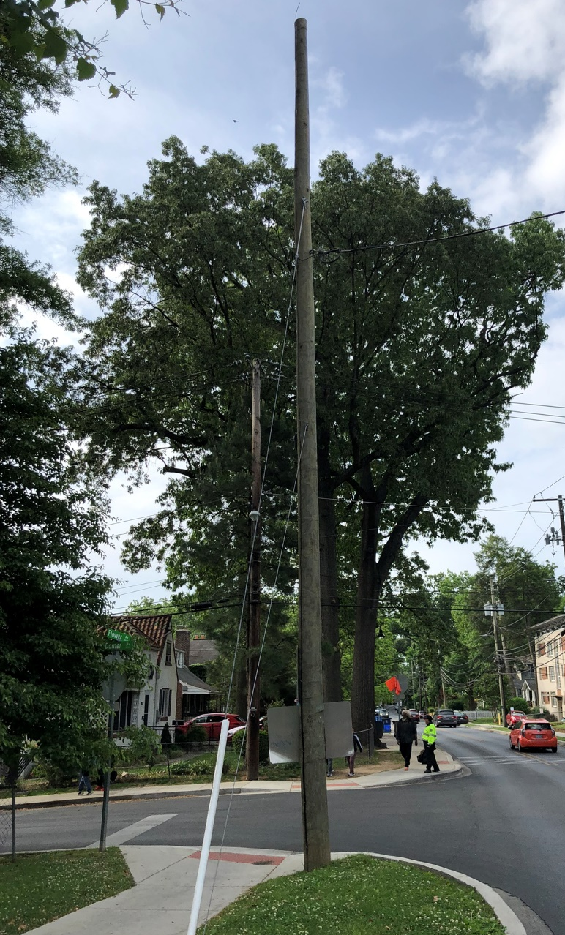
PEPCO 799423-050560

Slide 5
Crown Castle/T-Mobile @
PEPCO 789421-700970 (2023052158)

Slide 6
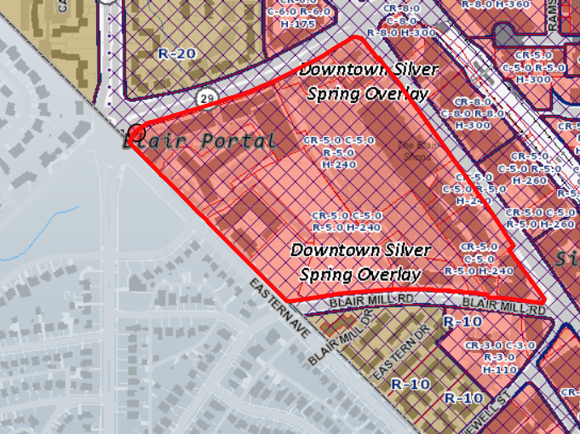
PEPCO 789421-700970

Slide 7
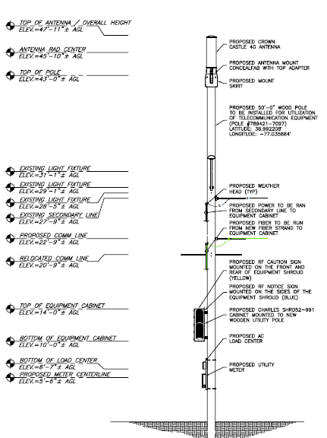
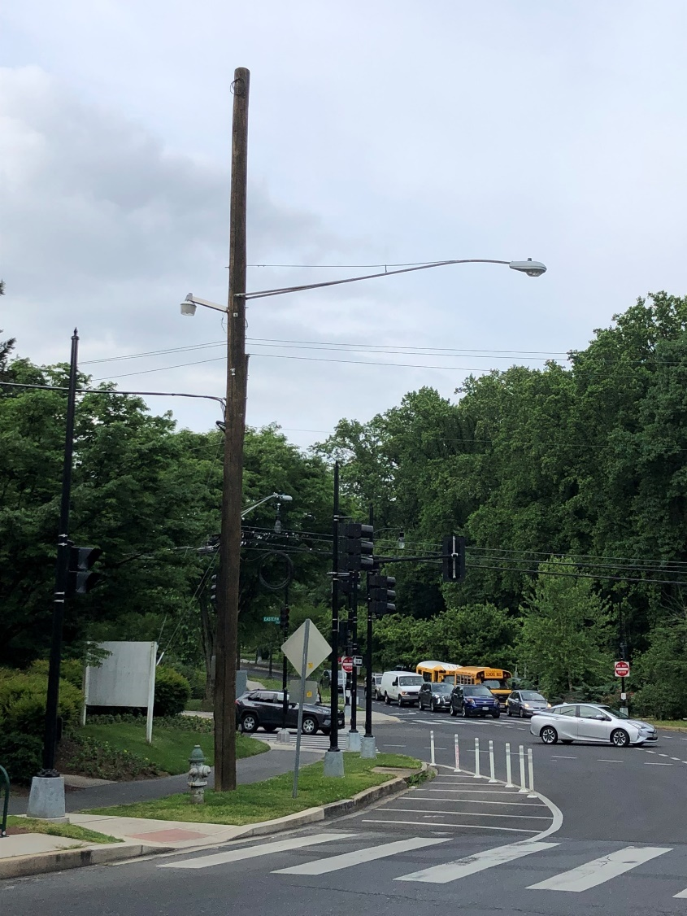
PEPCO 789421-700970

Slide 8
Crown Castle/T-Mobile @
PEPCO 798421-9250
(2023052168)

Slide 9
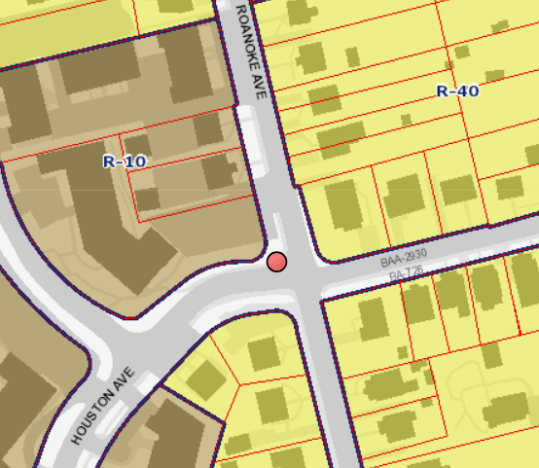
PEPCO 798421-9250

Slide 10
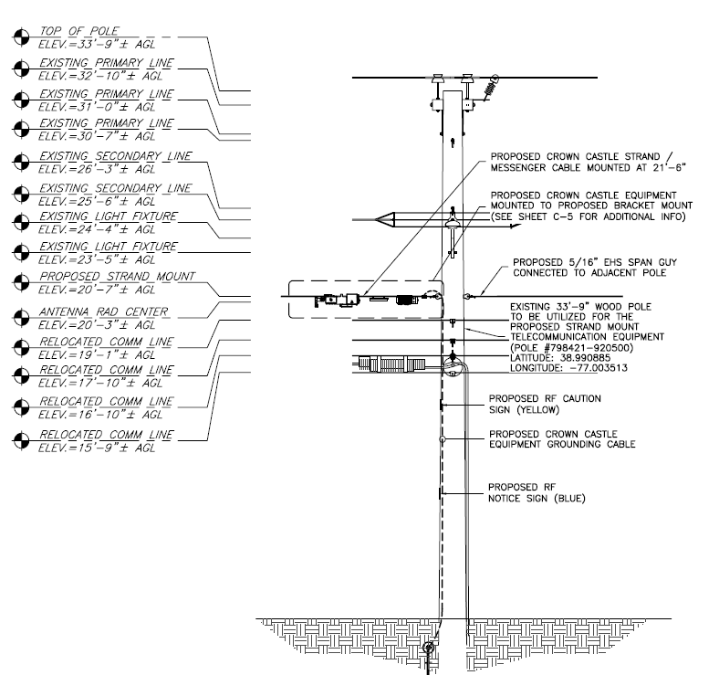
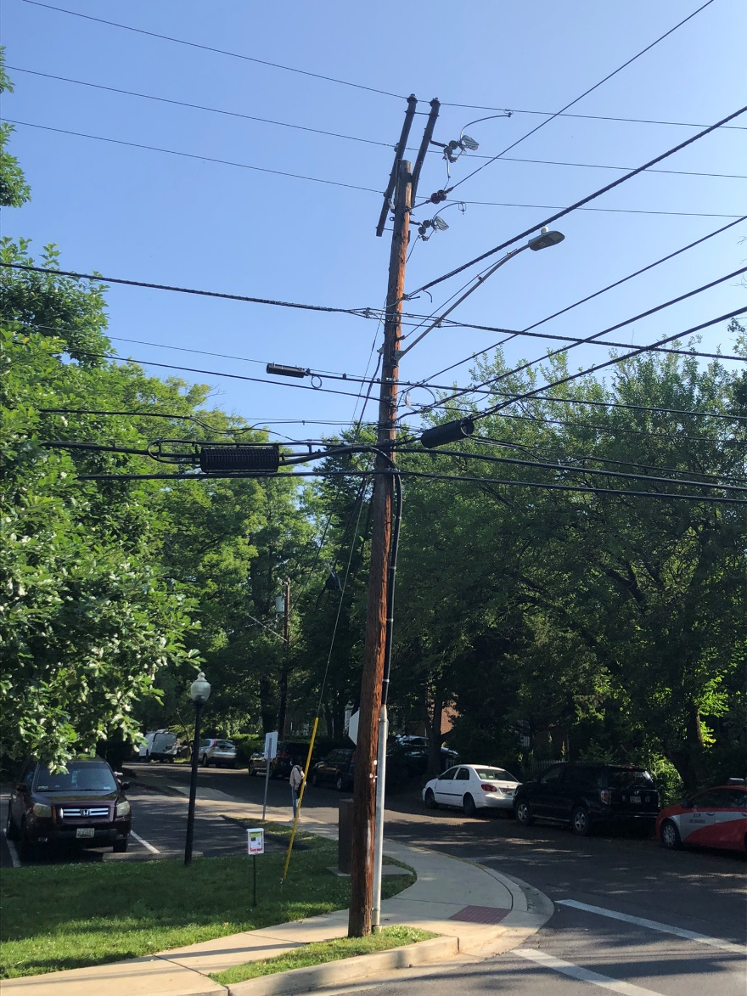
PEPCO 798421-9250

Slide 11
T-Mobile @
Holy Cross Hospital South Building (2023072178)

Slide 12
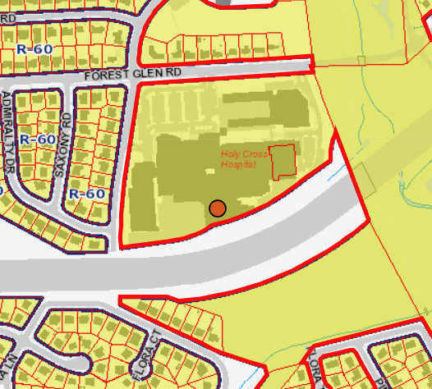
2023072178

Slide 13
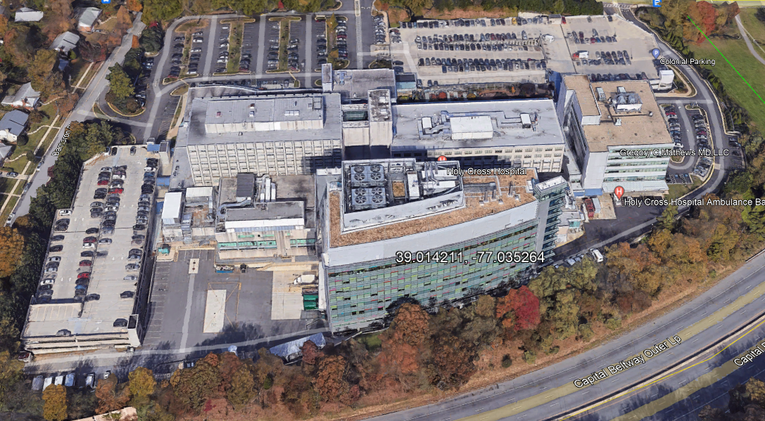
2023072178

Slide 14
2023072178

