Slide 1
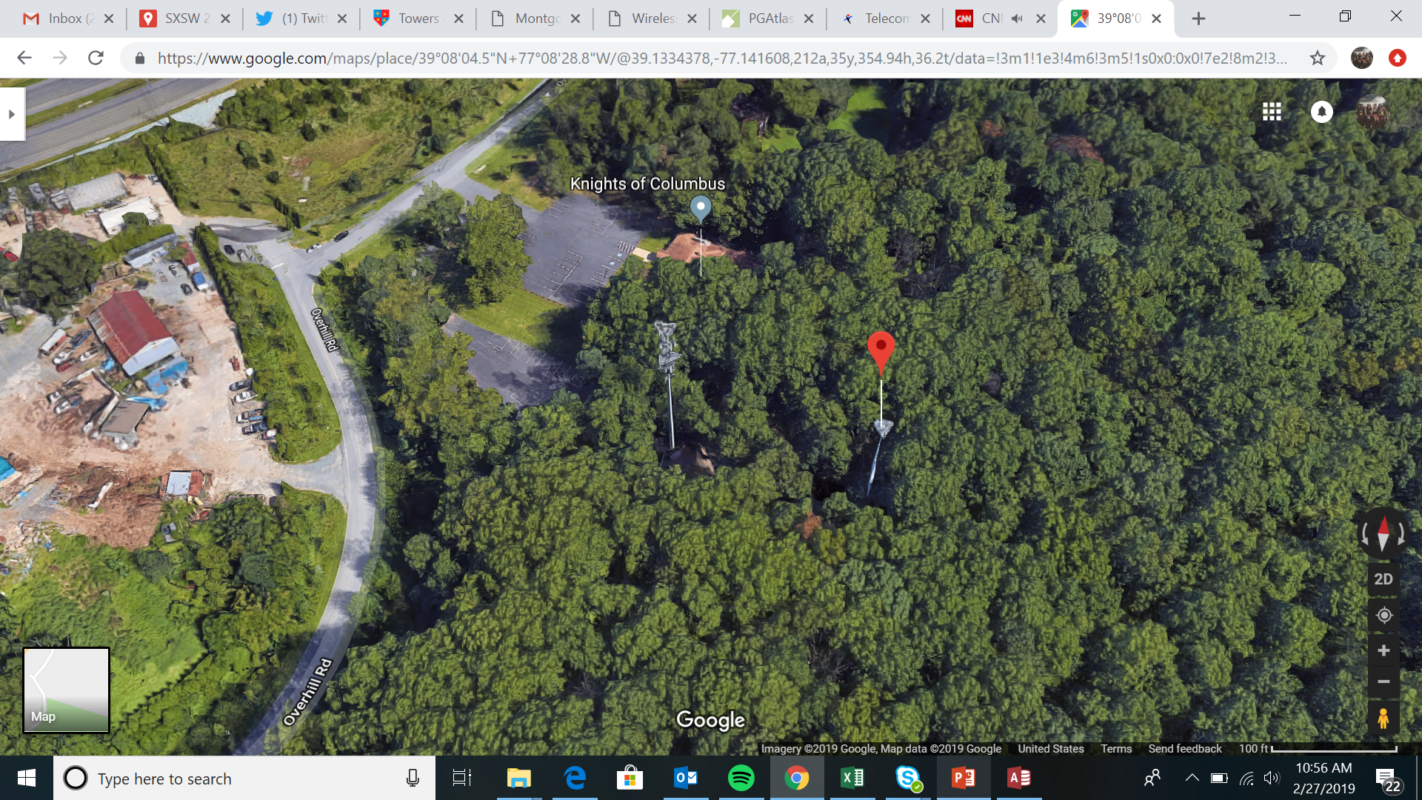
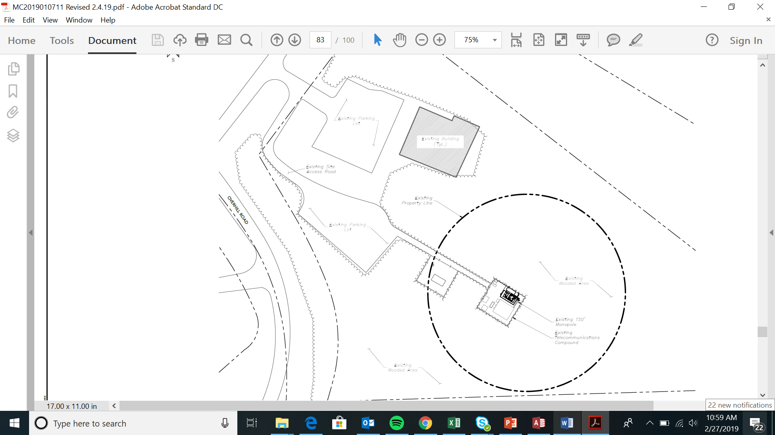
Knights of Columbus 2

Slide 2
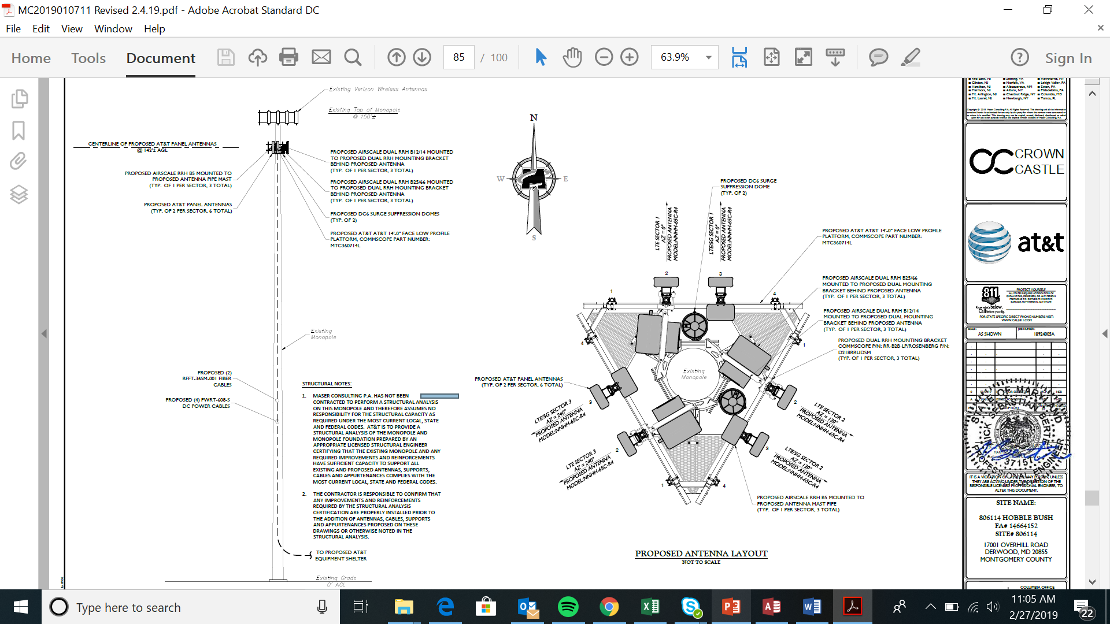
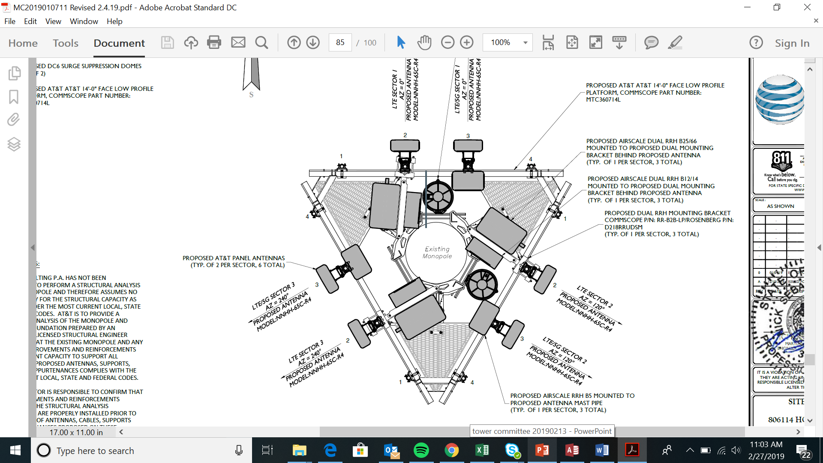
Knights of Columbus 2

Slide 3
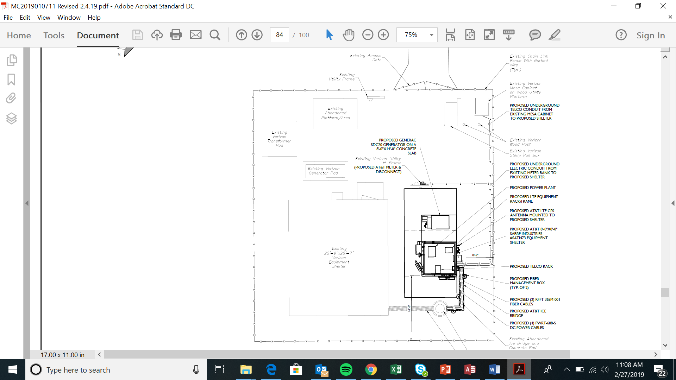
Knights of Columbus 2

Slide 4
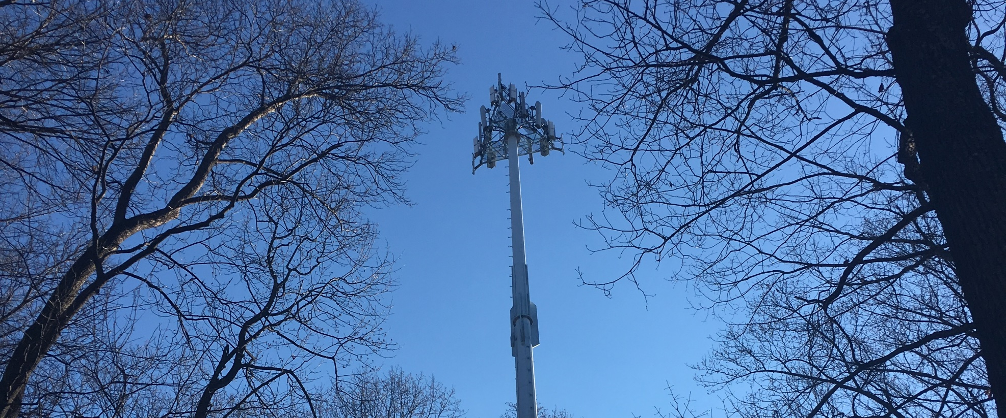
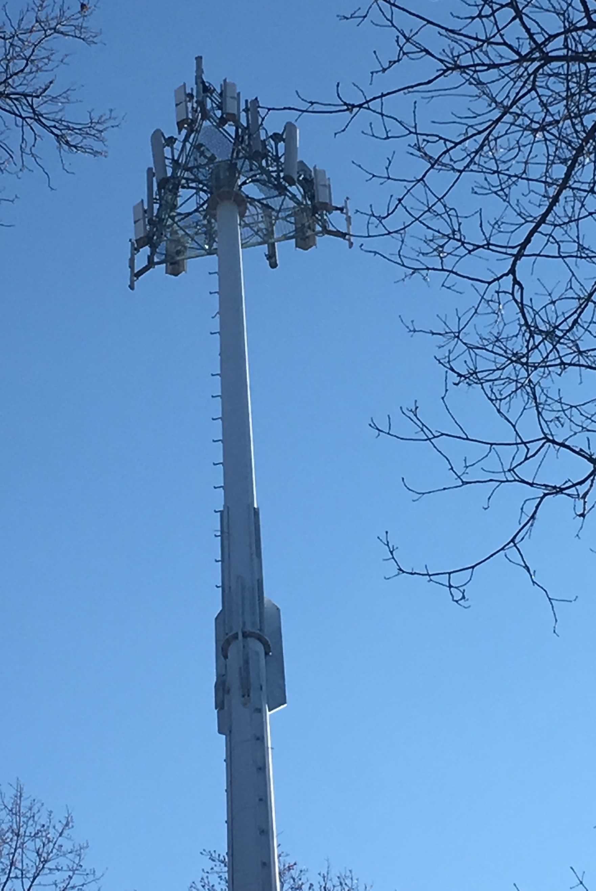
Knights of Columbus 2

Slide 5
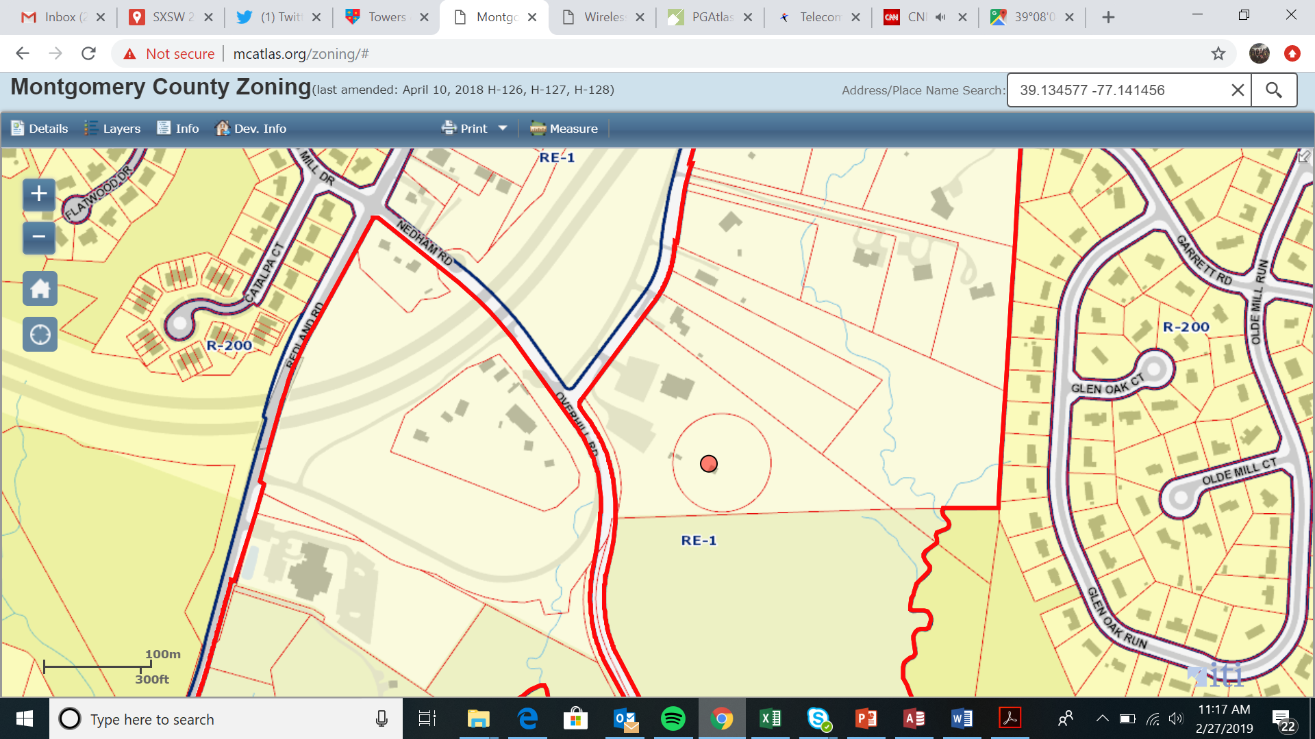
Knights of Columbus 2
https://goo.gl/maps/QdJCJm7GnhS2

Slide 6
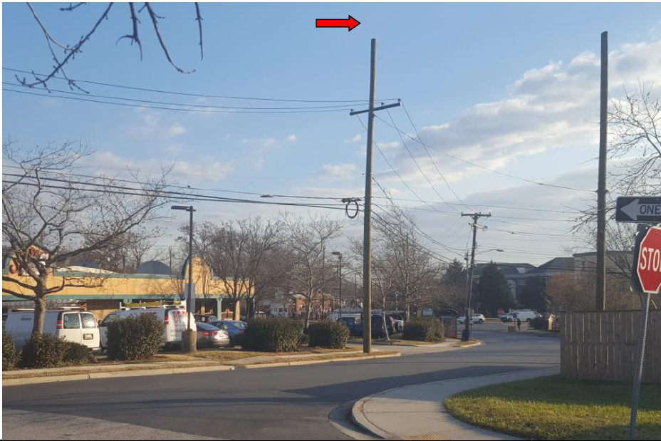
Pepco 802422-090050 / 902 Merrimac Drive

Slide 7
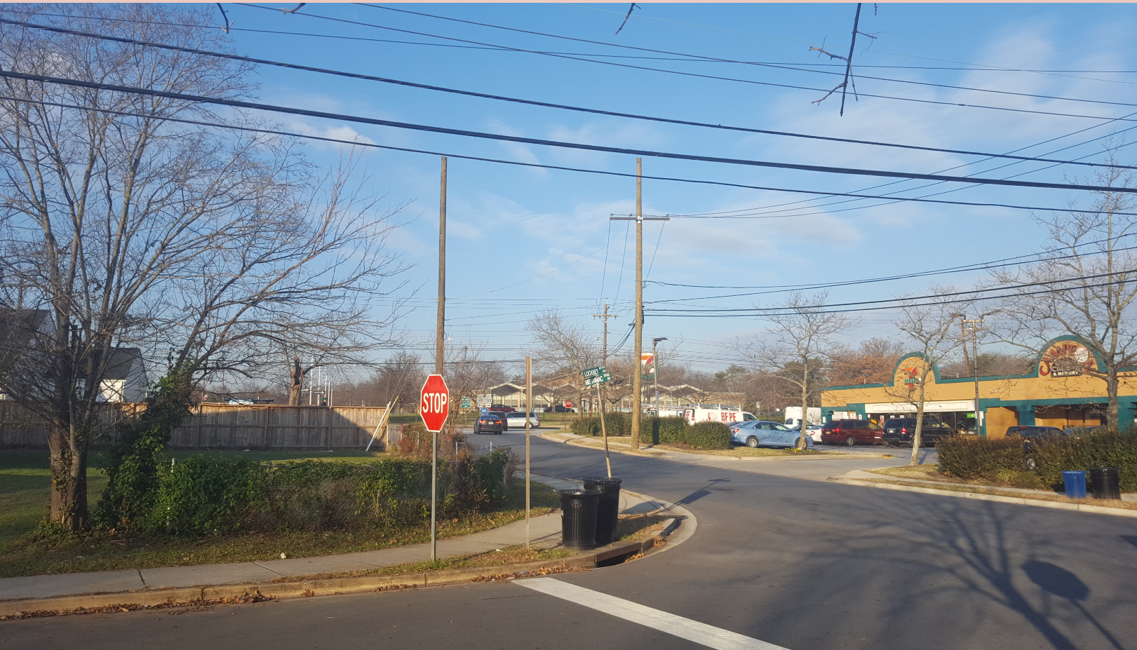
Pepco 802422-090050 / 902 Merrimac Drive

Slide 8
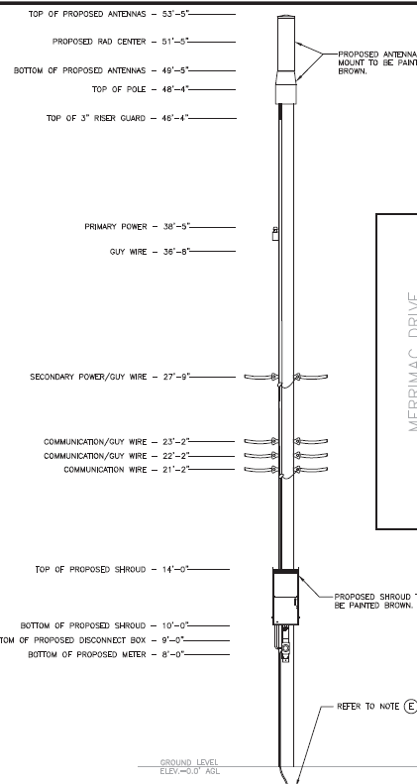
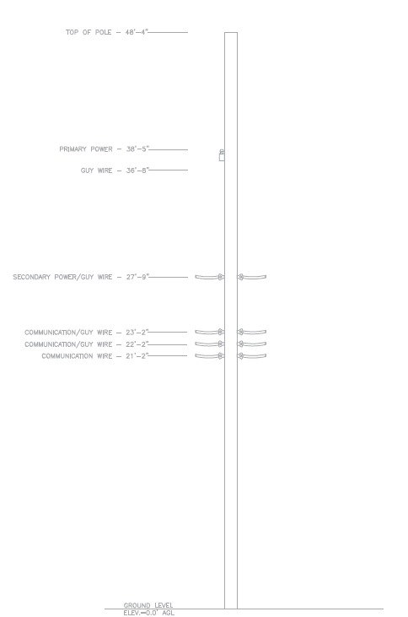
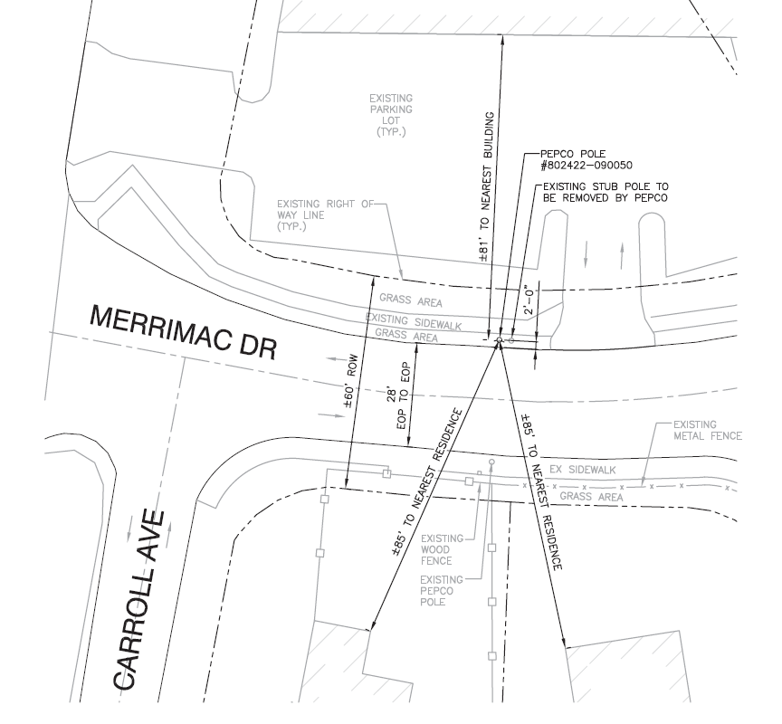
Pepco 802422-090050 / 902 Merrimac Drive

Slide 9
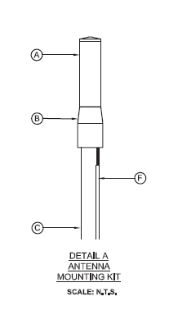
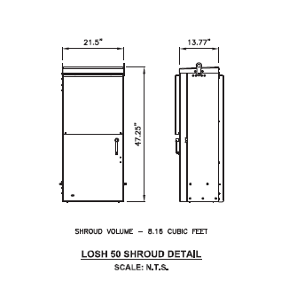
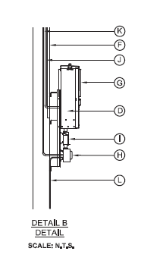
Pepco 802422-090050 / 902 Merrimac Drive

Slide 10
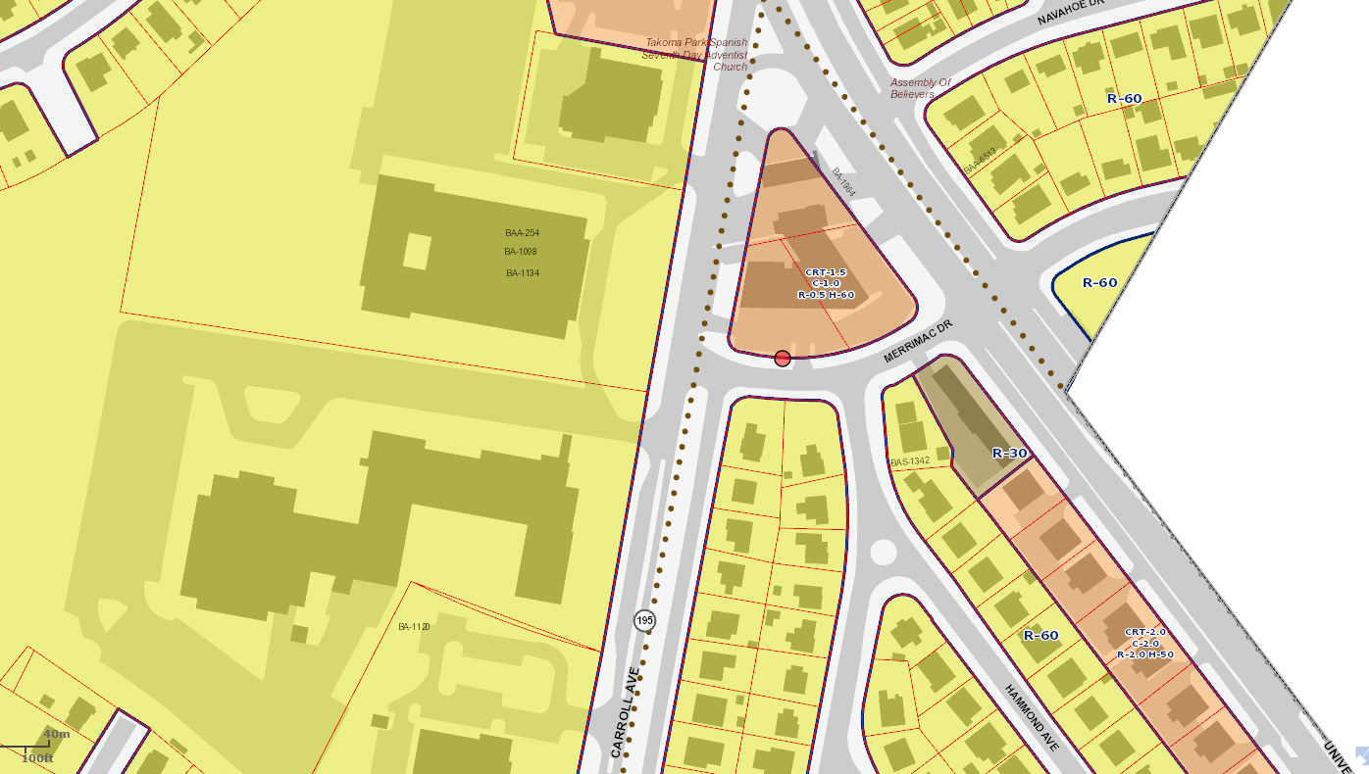
Pepco 802422-090050 / 902 Merrimac Drive
https://goo.gl/maps/ENKhkfwGkMn

