Slide 1
Shumaker Property

Slide 2
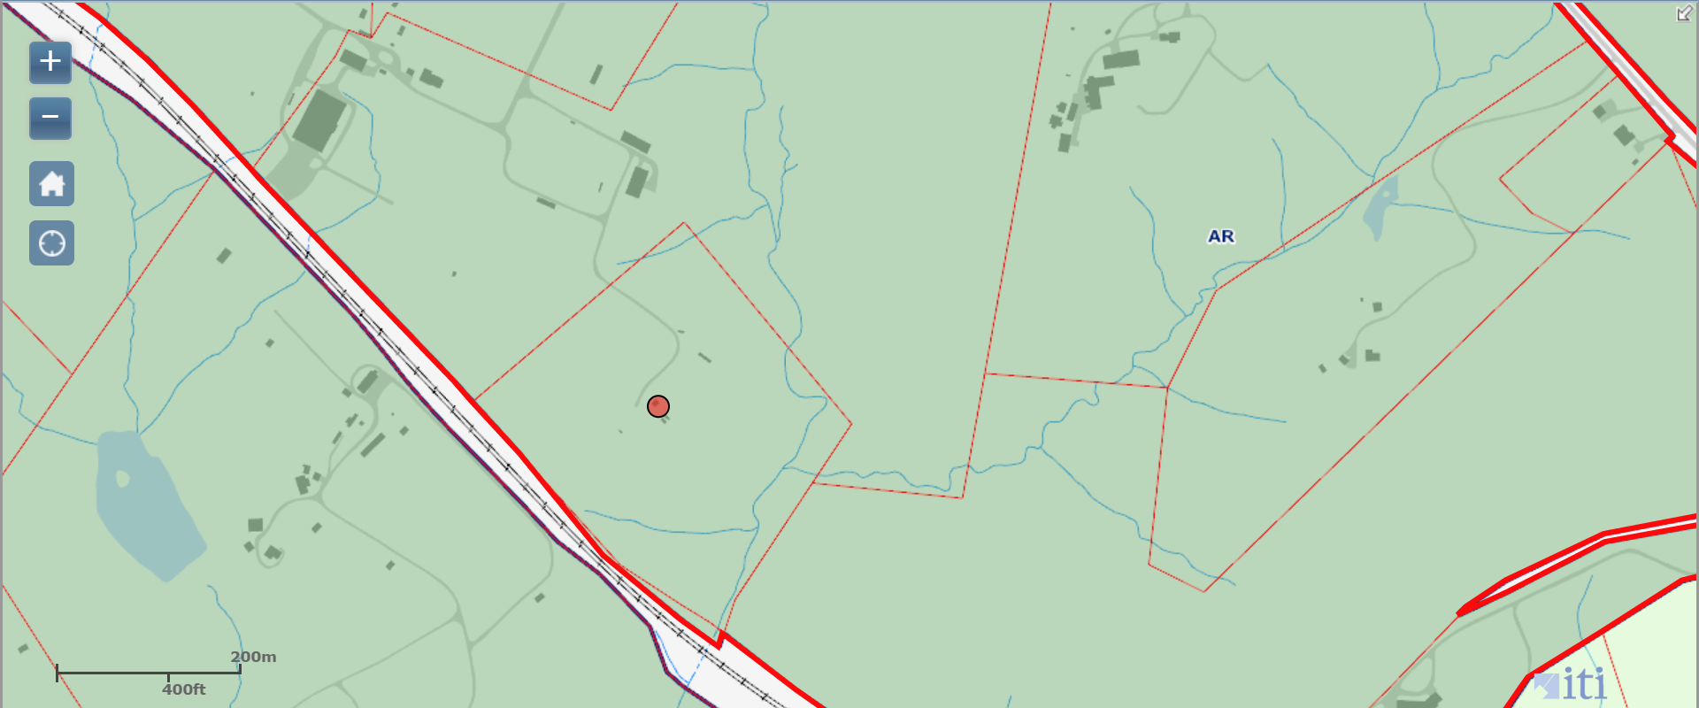
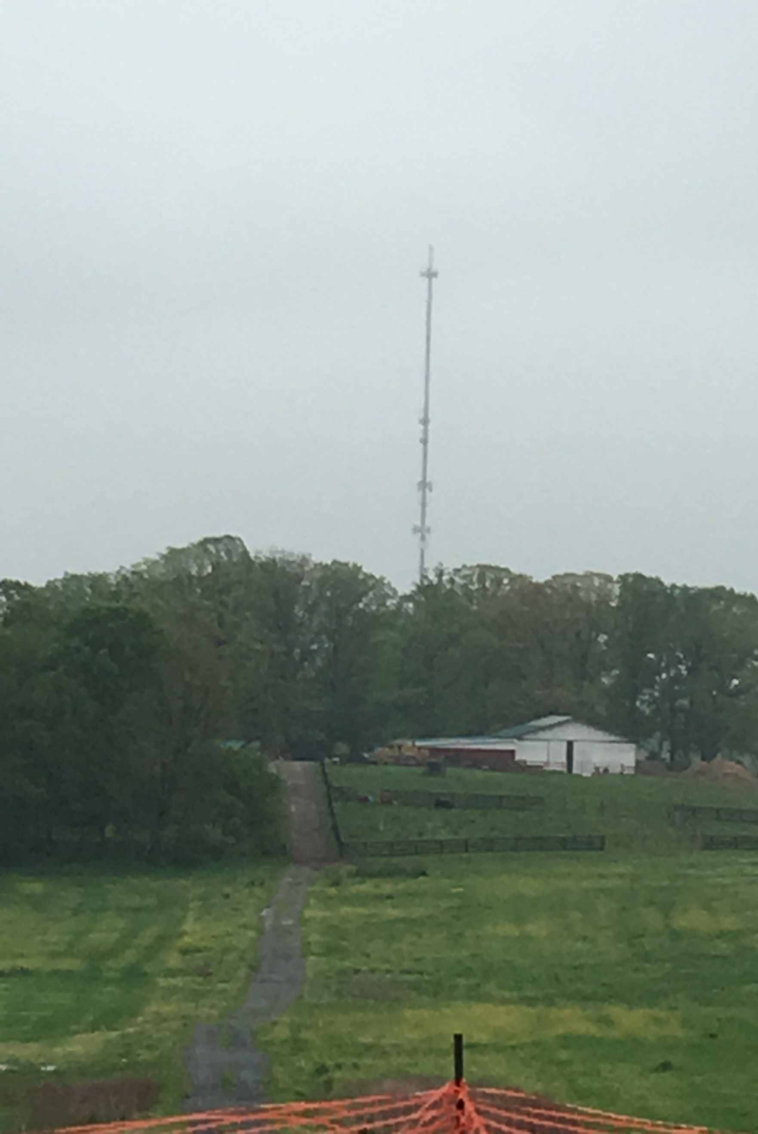
Shumaker Property

Slide 3
Shumaker Property

Slide 4
Shumaker Property

Slide 5
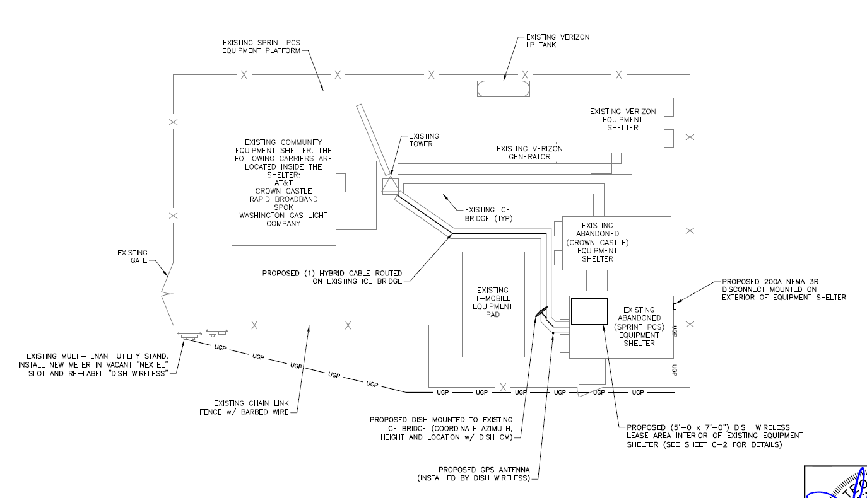
Shumaker Property

Slide 6
Shumaker Property

Slide 7
Pinnacle Towers

Slide 8
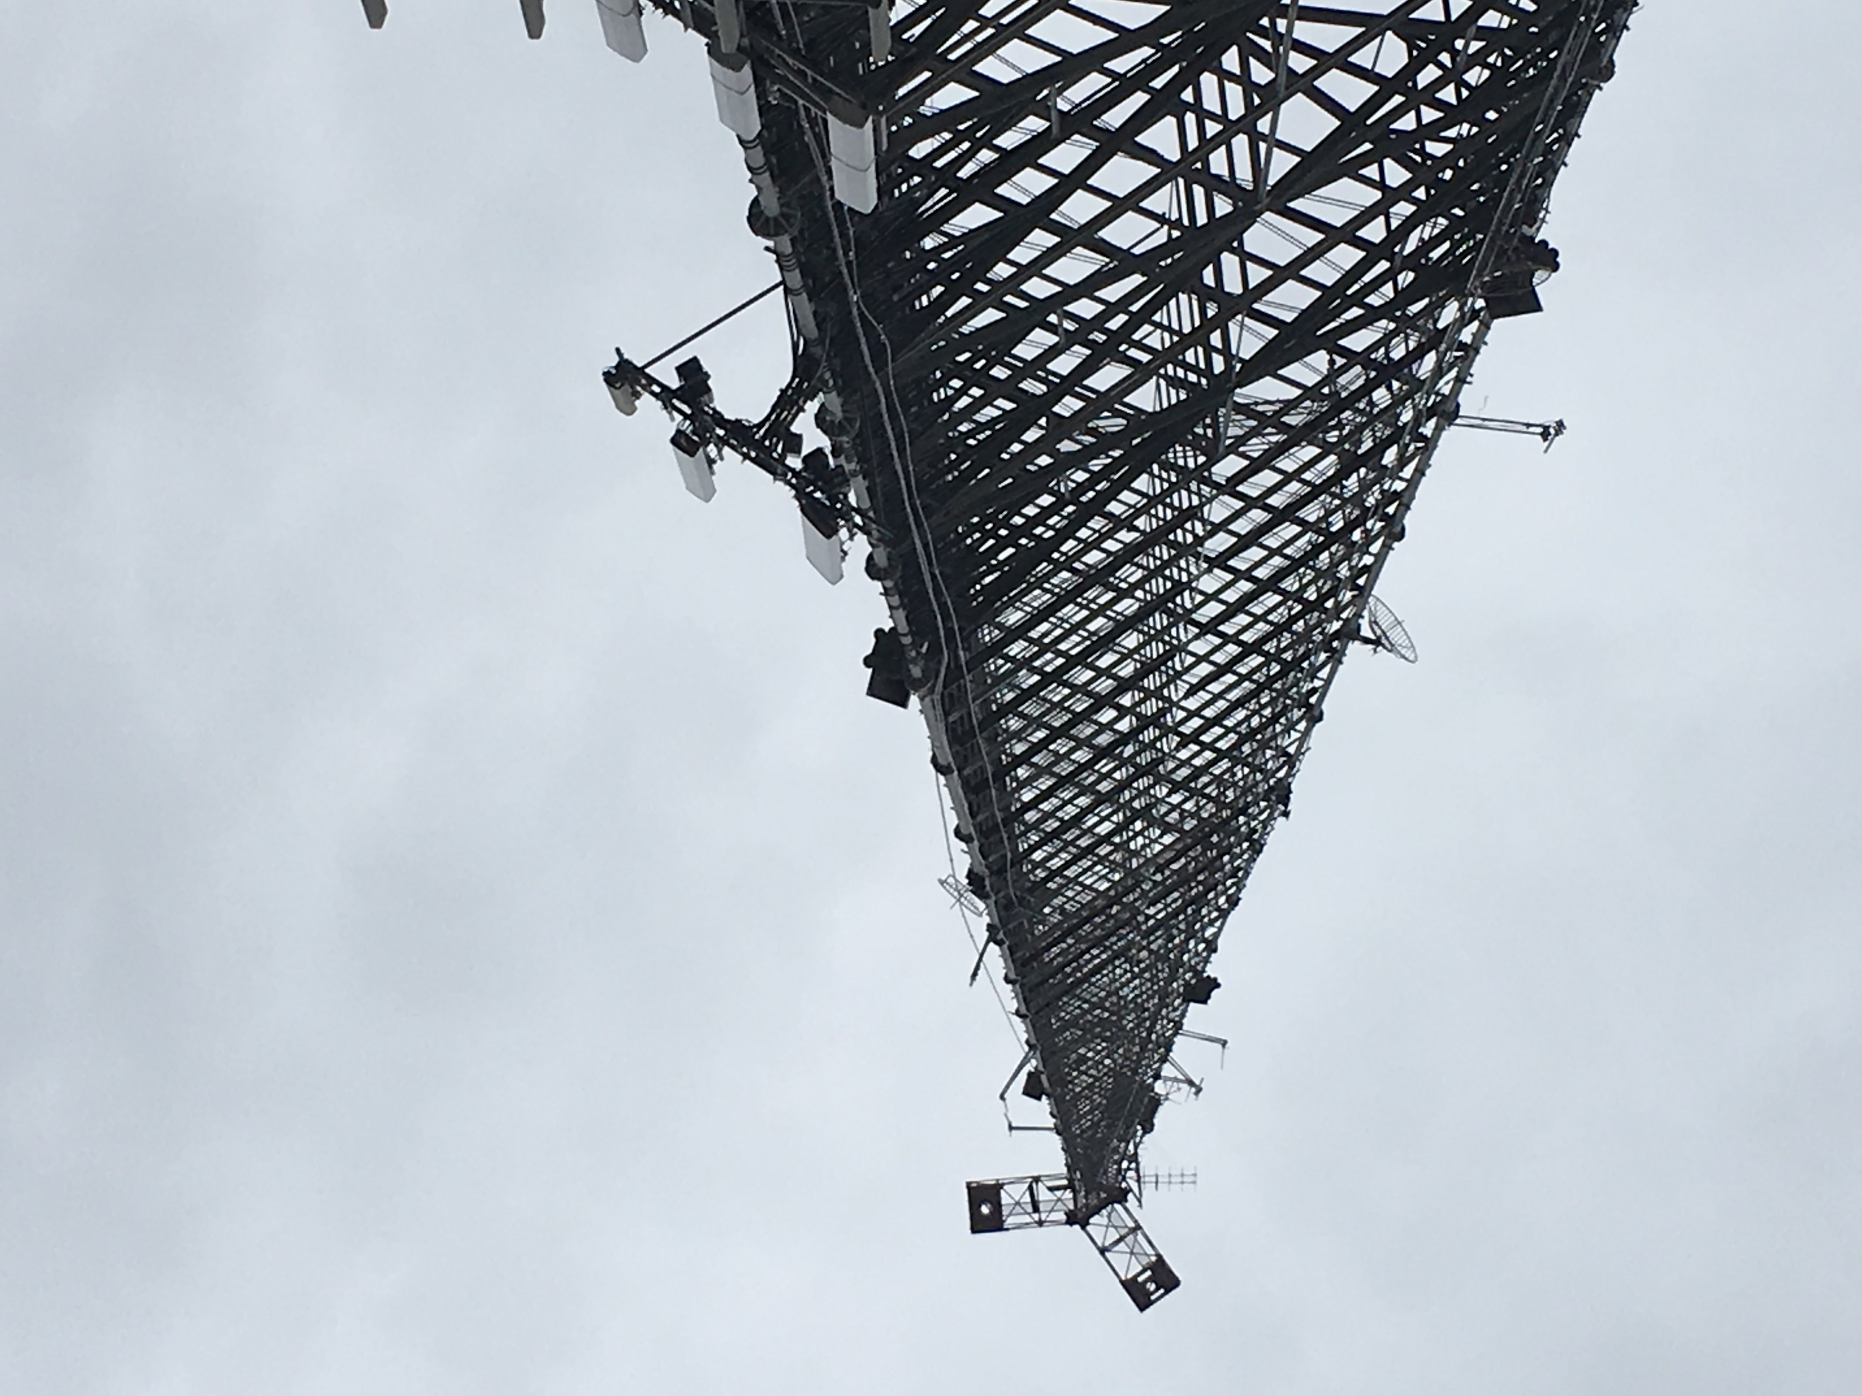
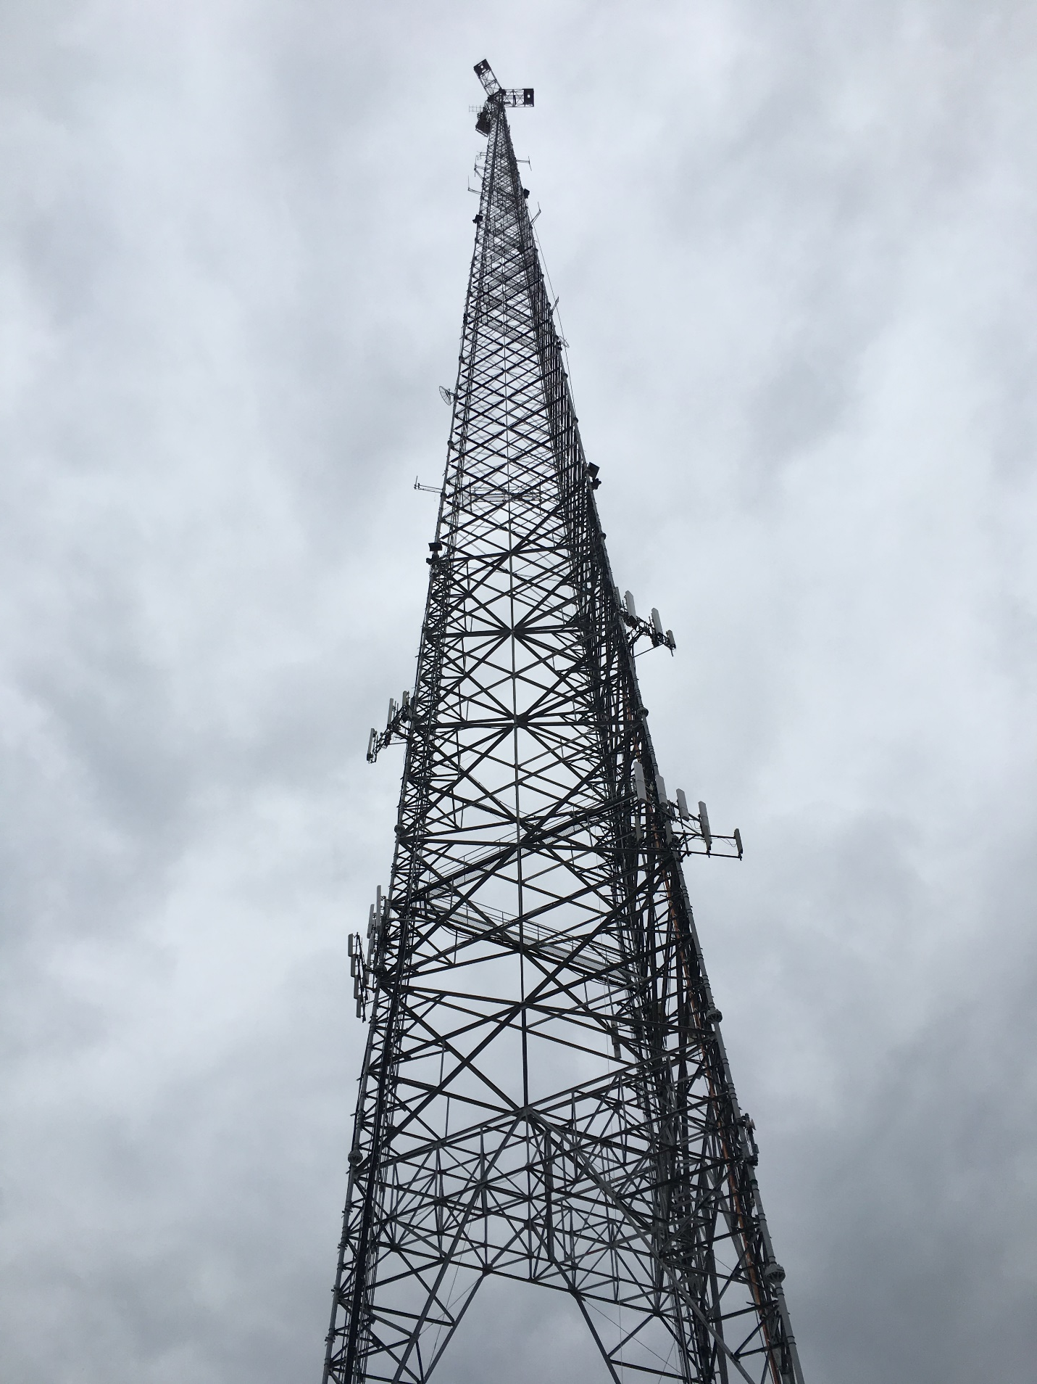
Pinnacle Towers

Slide 9
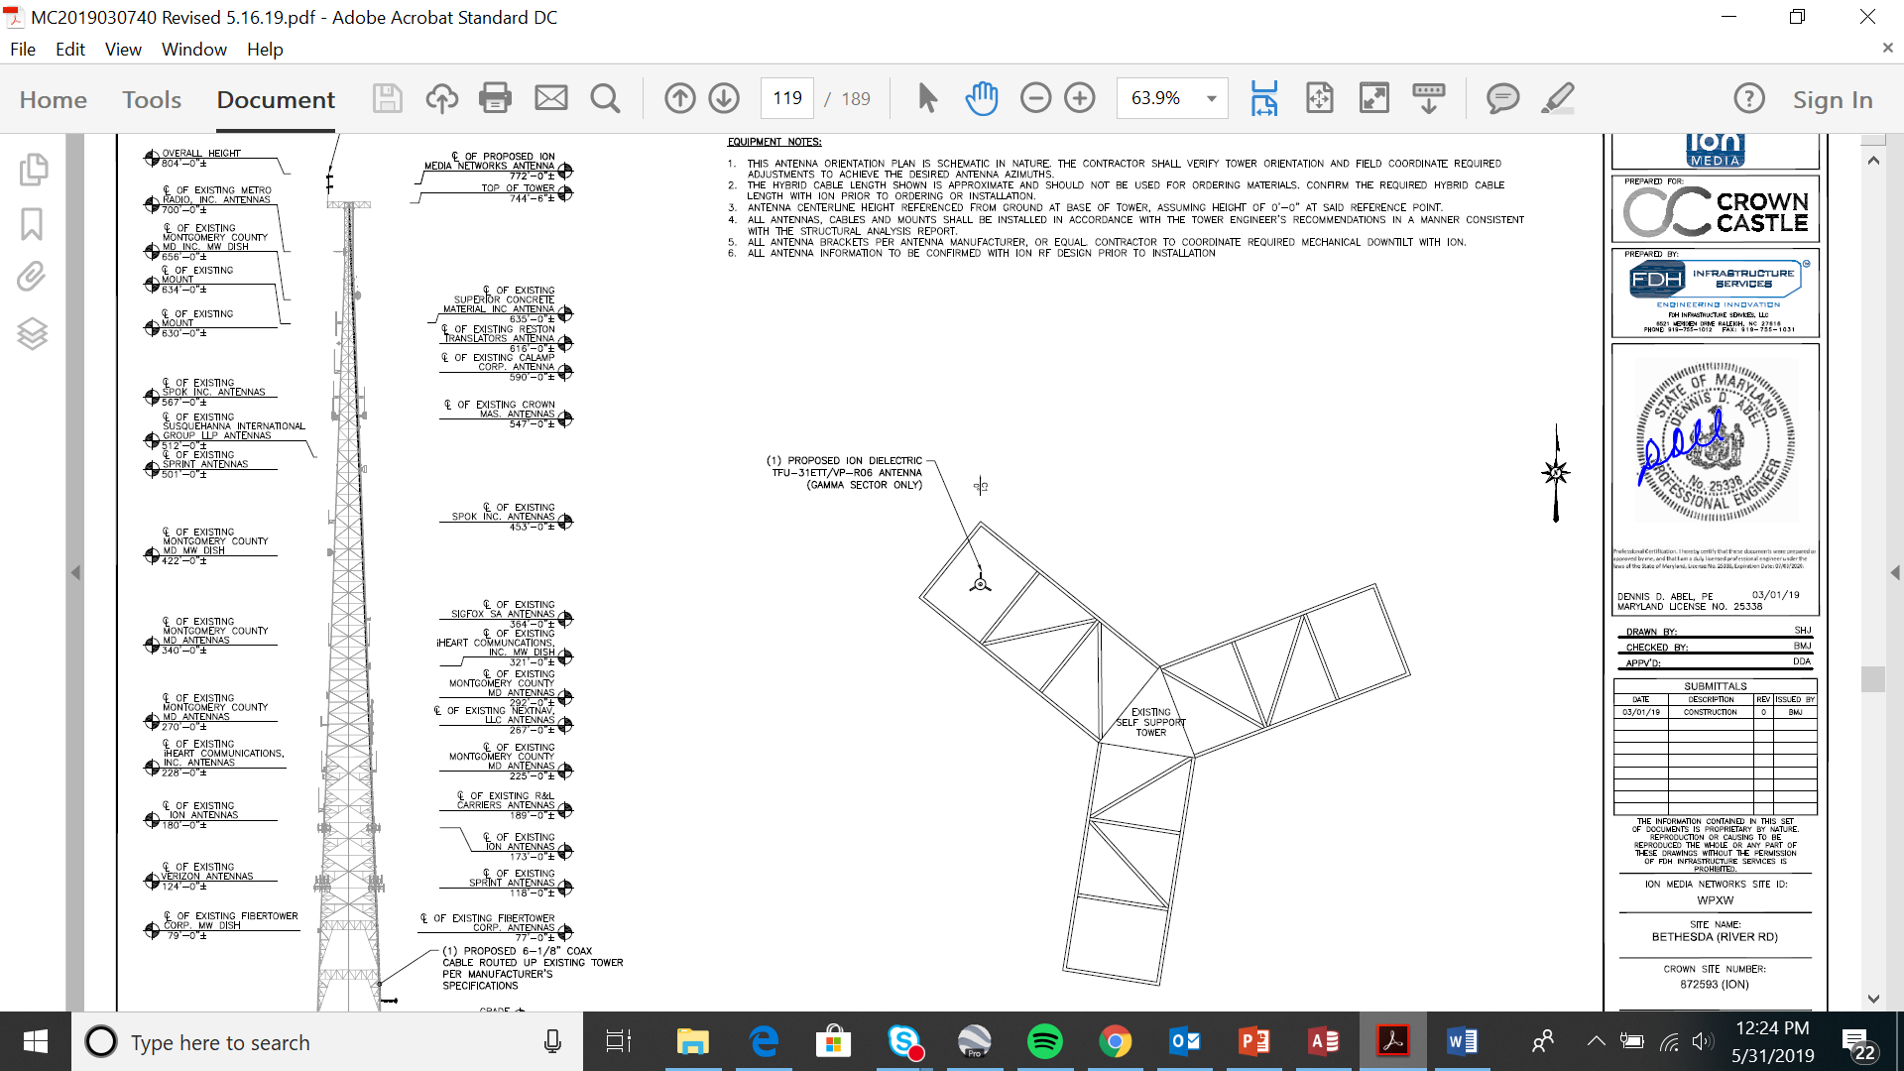
Pinnacle Towers

Slide 10
Pinnacle Towers

Slide 11
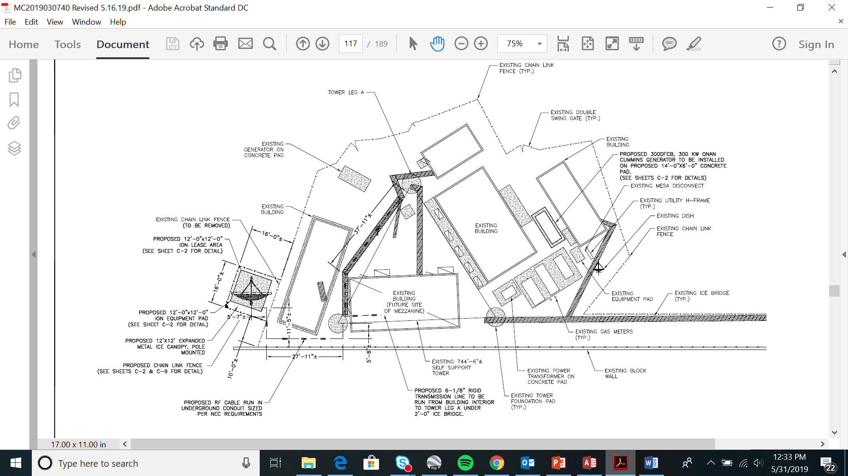
Pinnacle Towers

Slide 12
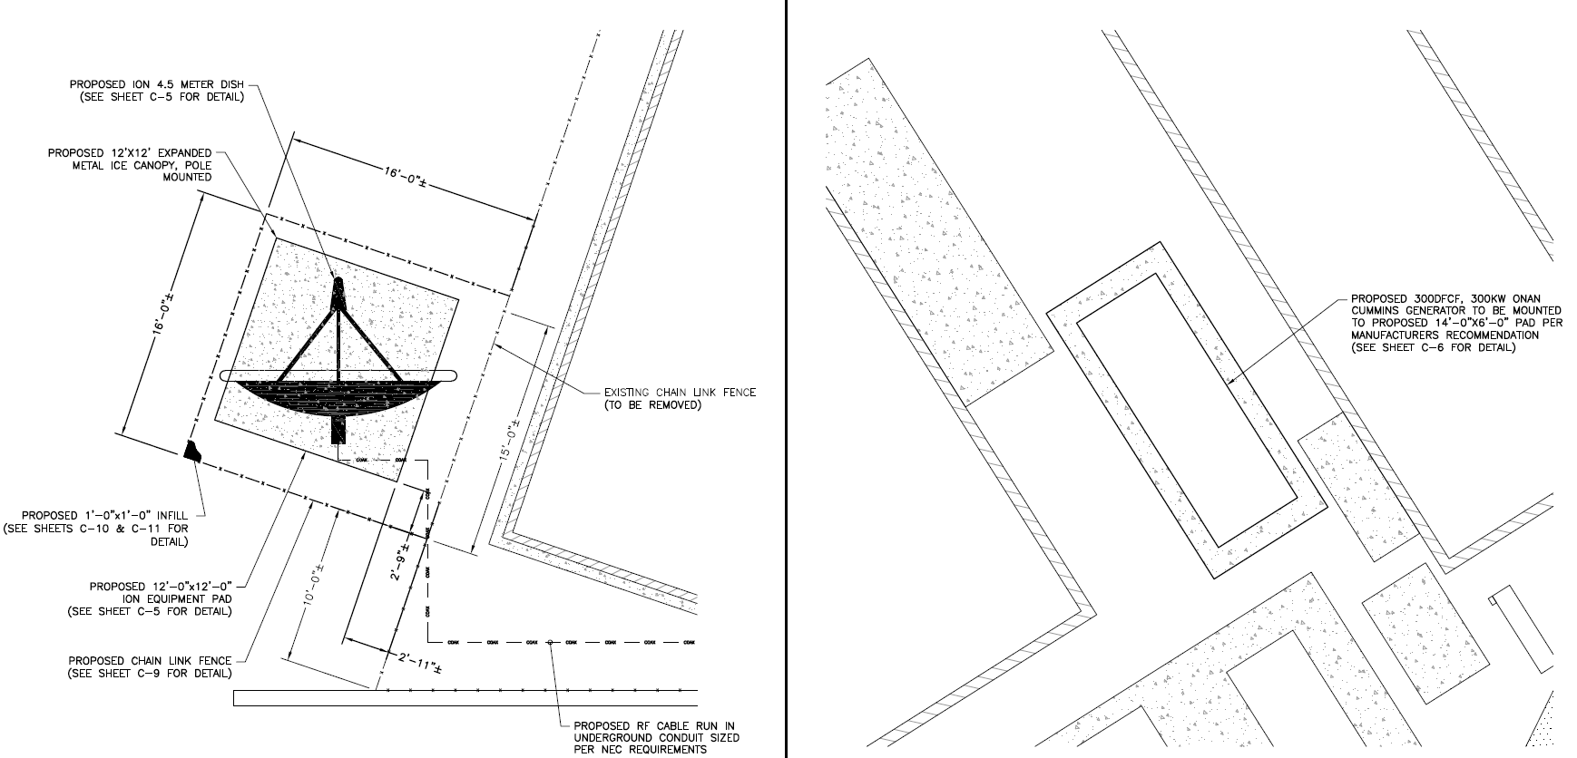
Pinnacle Towers

Slide 13
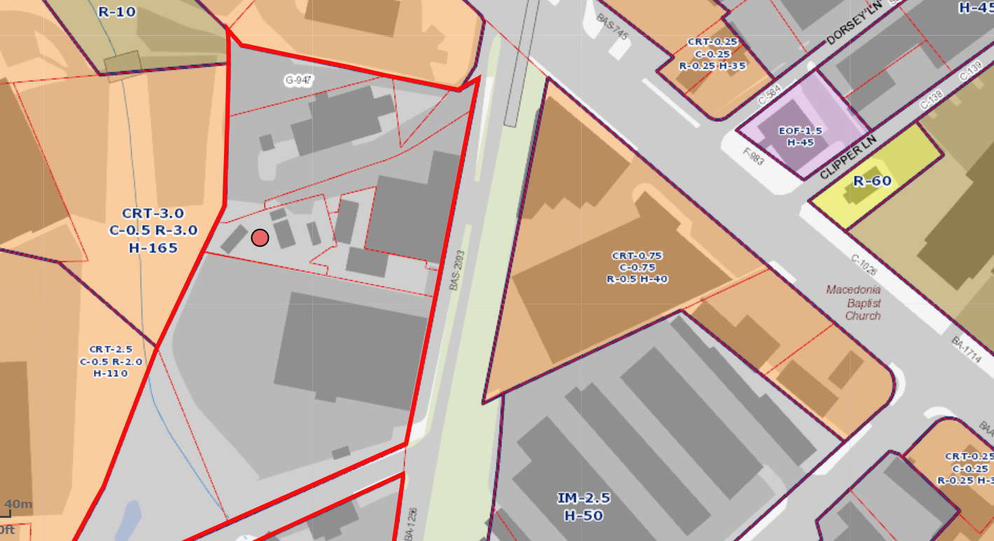
Pinnacle Towers

