Slide 1
Pinnacle Towers

Slide 2
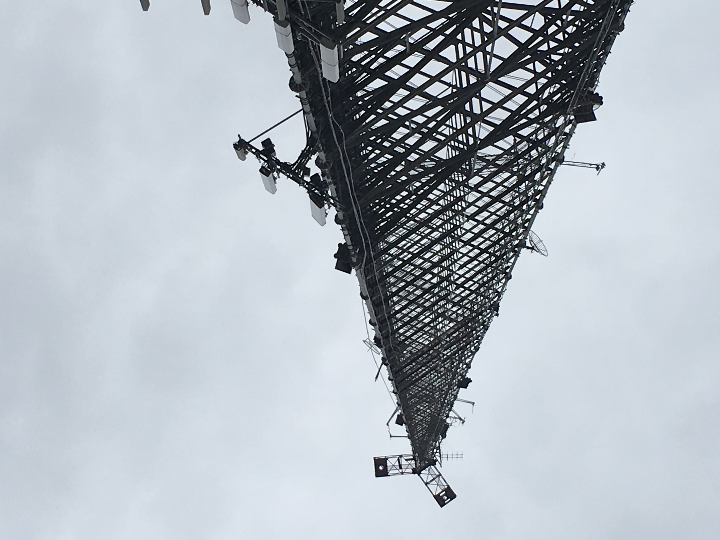
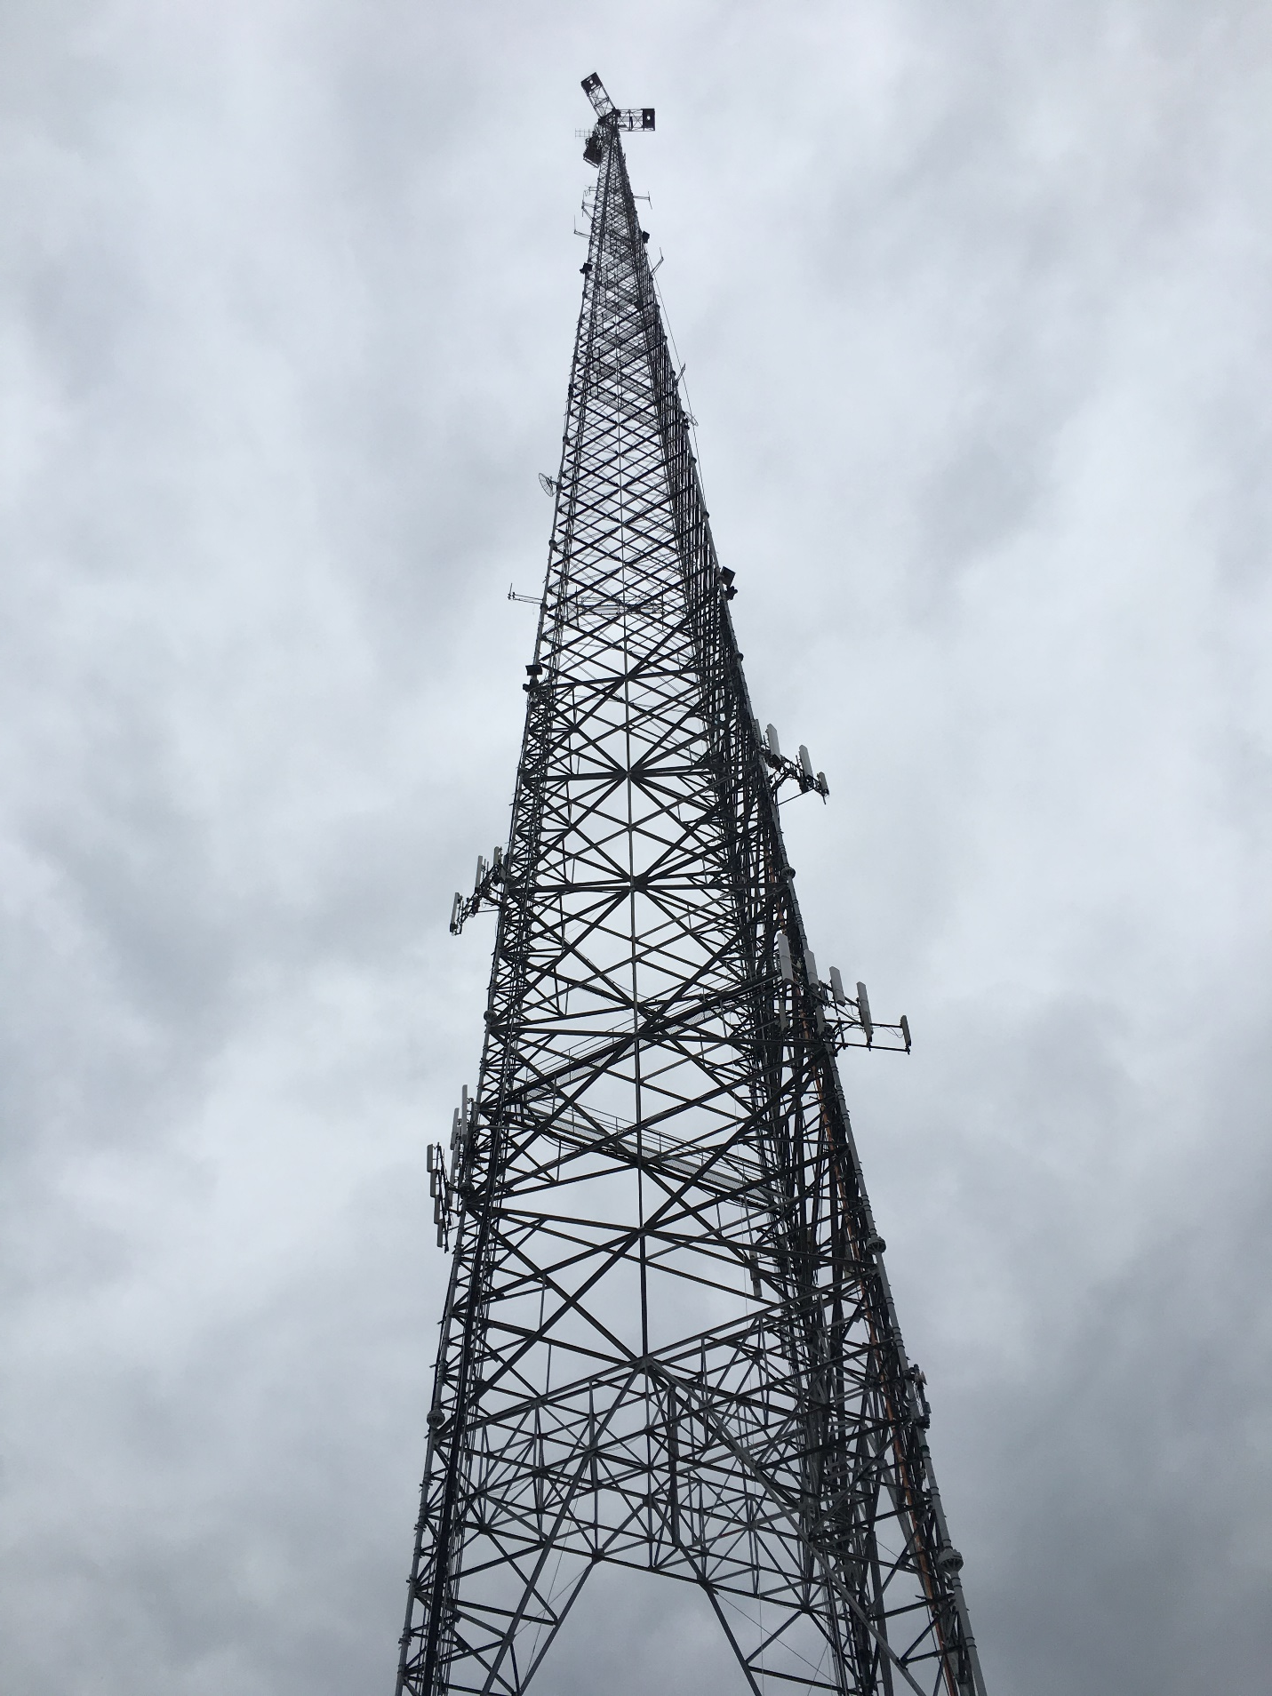
Pinnacle Towers

Slide 3
Pinnacle Towers

Slide 4
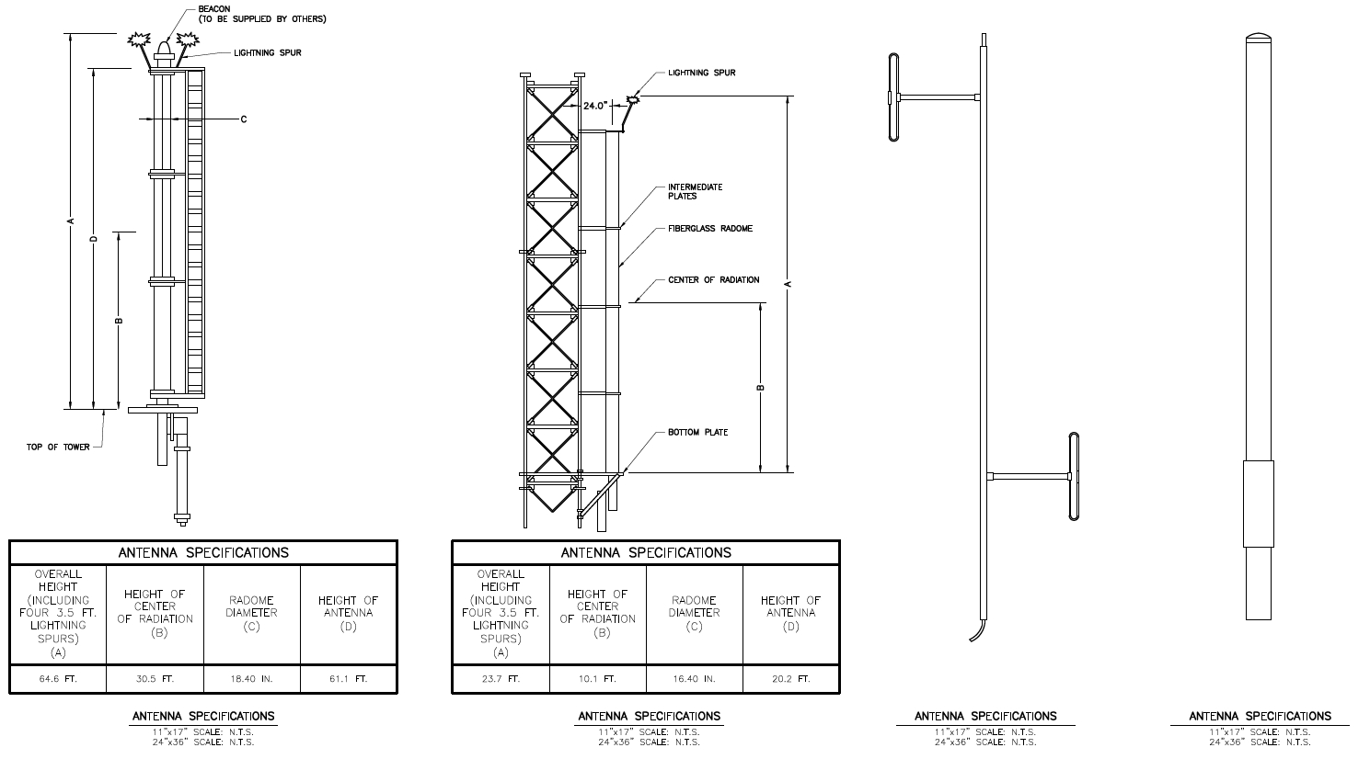
Pinnacle Towers

Slide 5
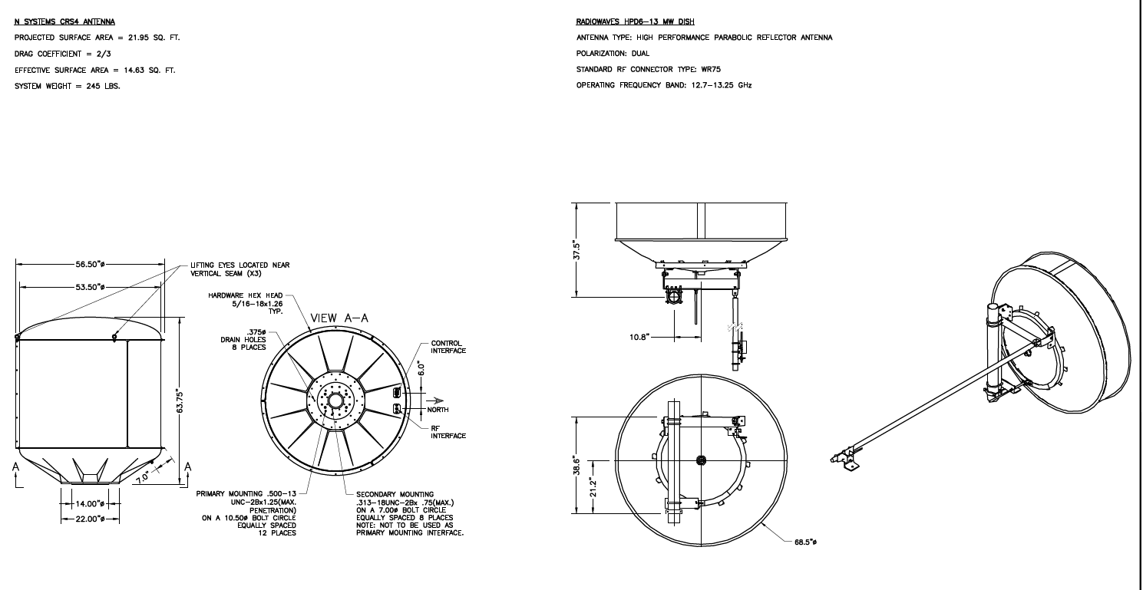
Pinnacle Towers

Slide 6
Pinnacle Towers

Slide 7
Pinnacle Towers

Slide 8
Pinnacle Towers

Slide 9
Pinnacle Towers

Slide 10
Pinnacle Towers

Slide 11
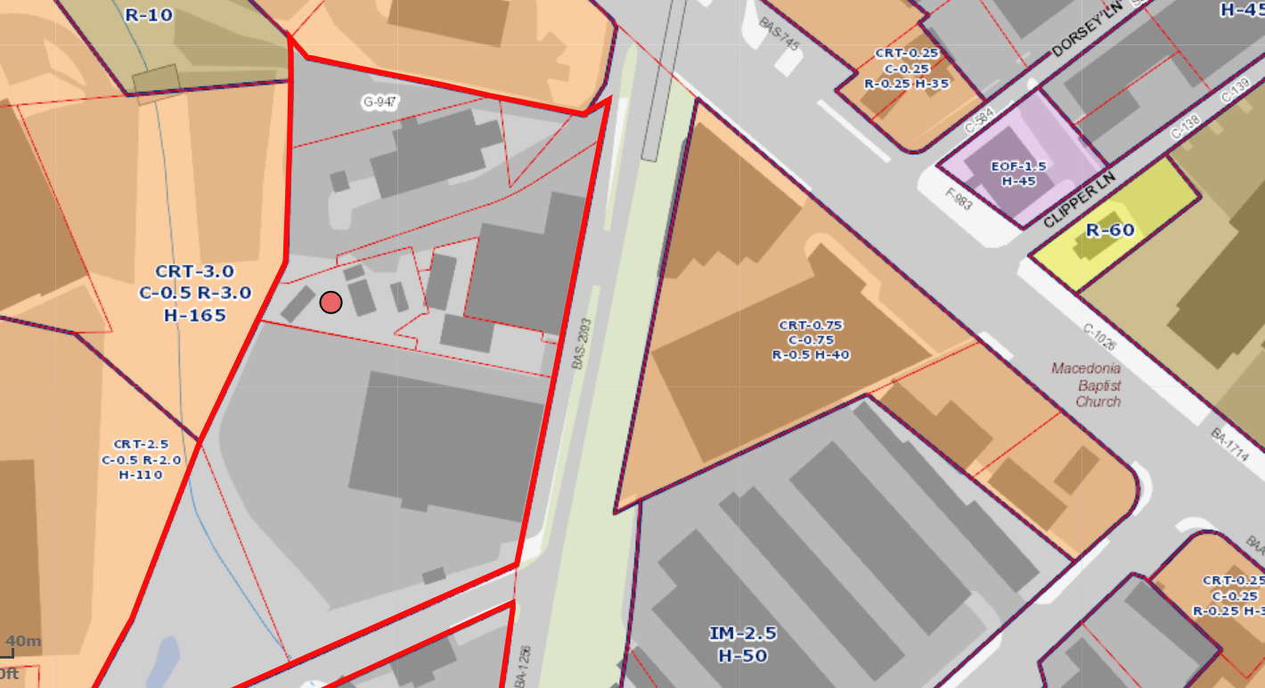
Pinnacle Towers

