Slide 1
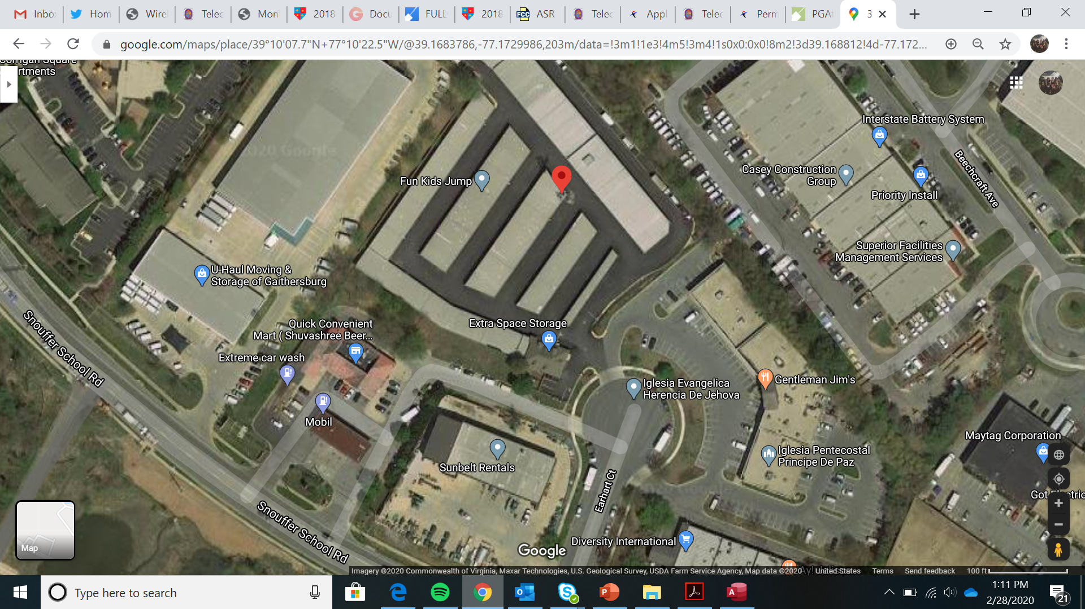
Earhart Monopole

Slide 2
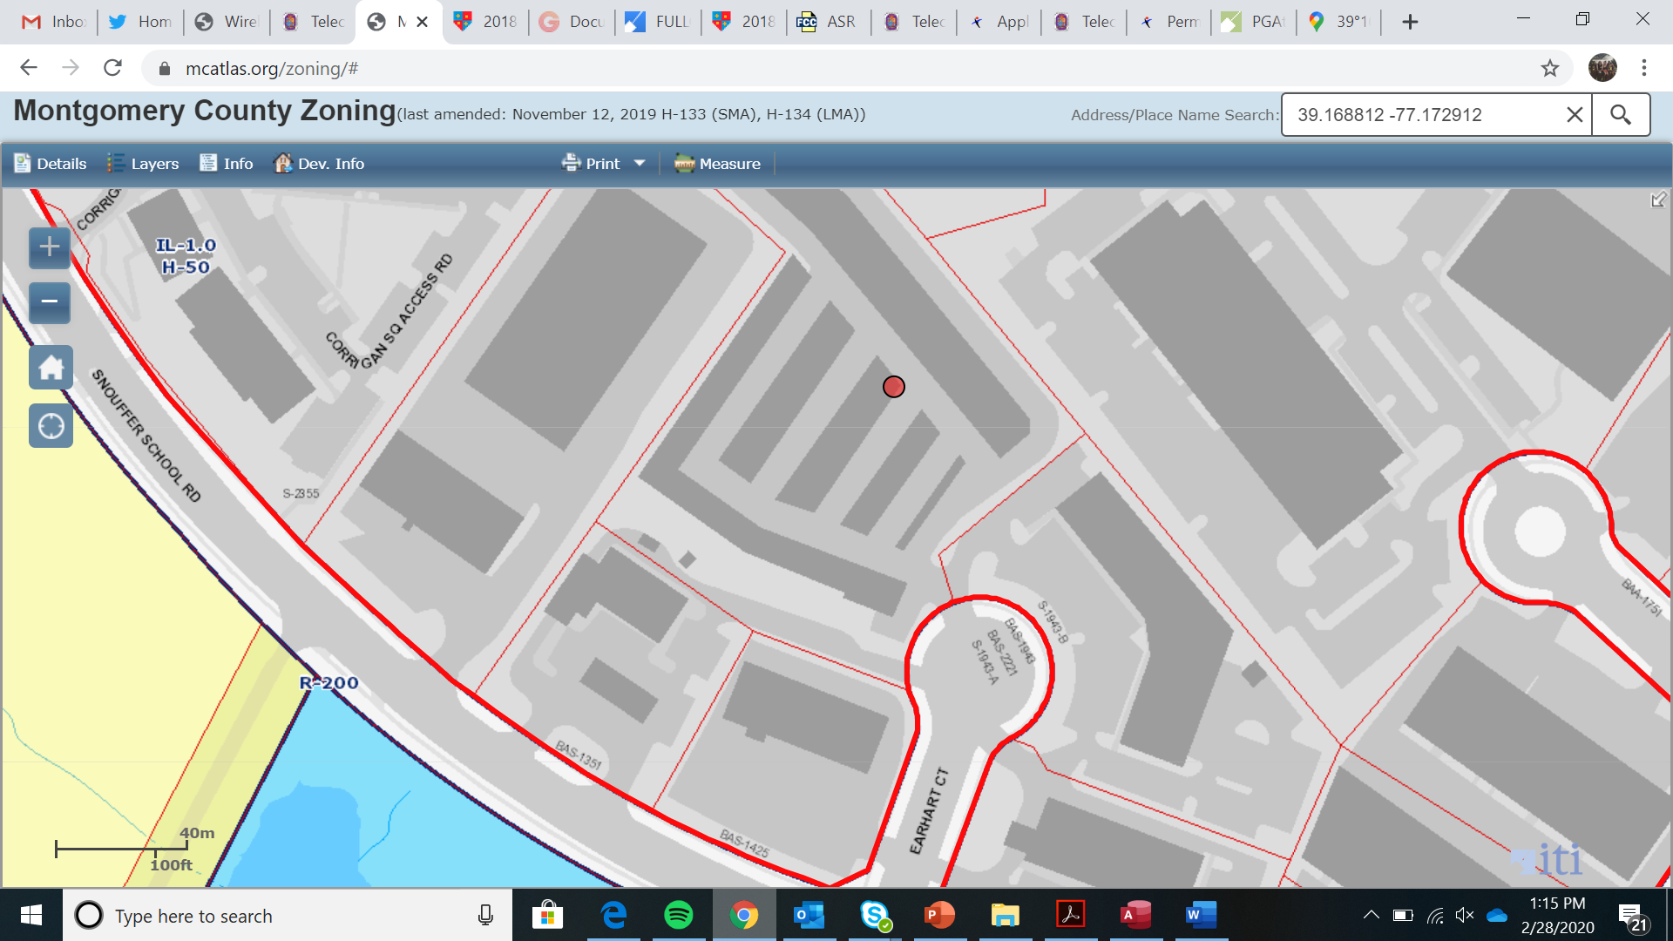
Earhart Monopole

Slide 3
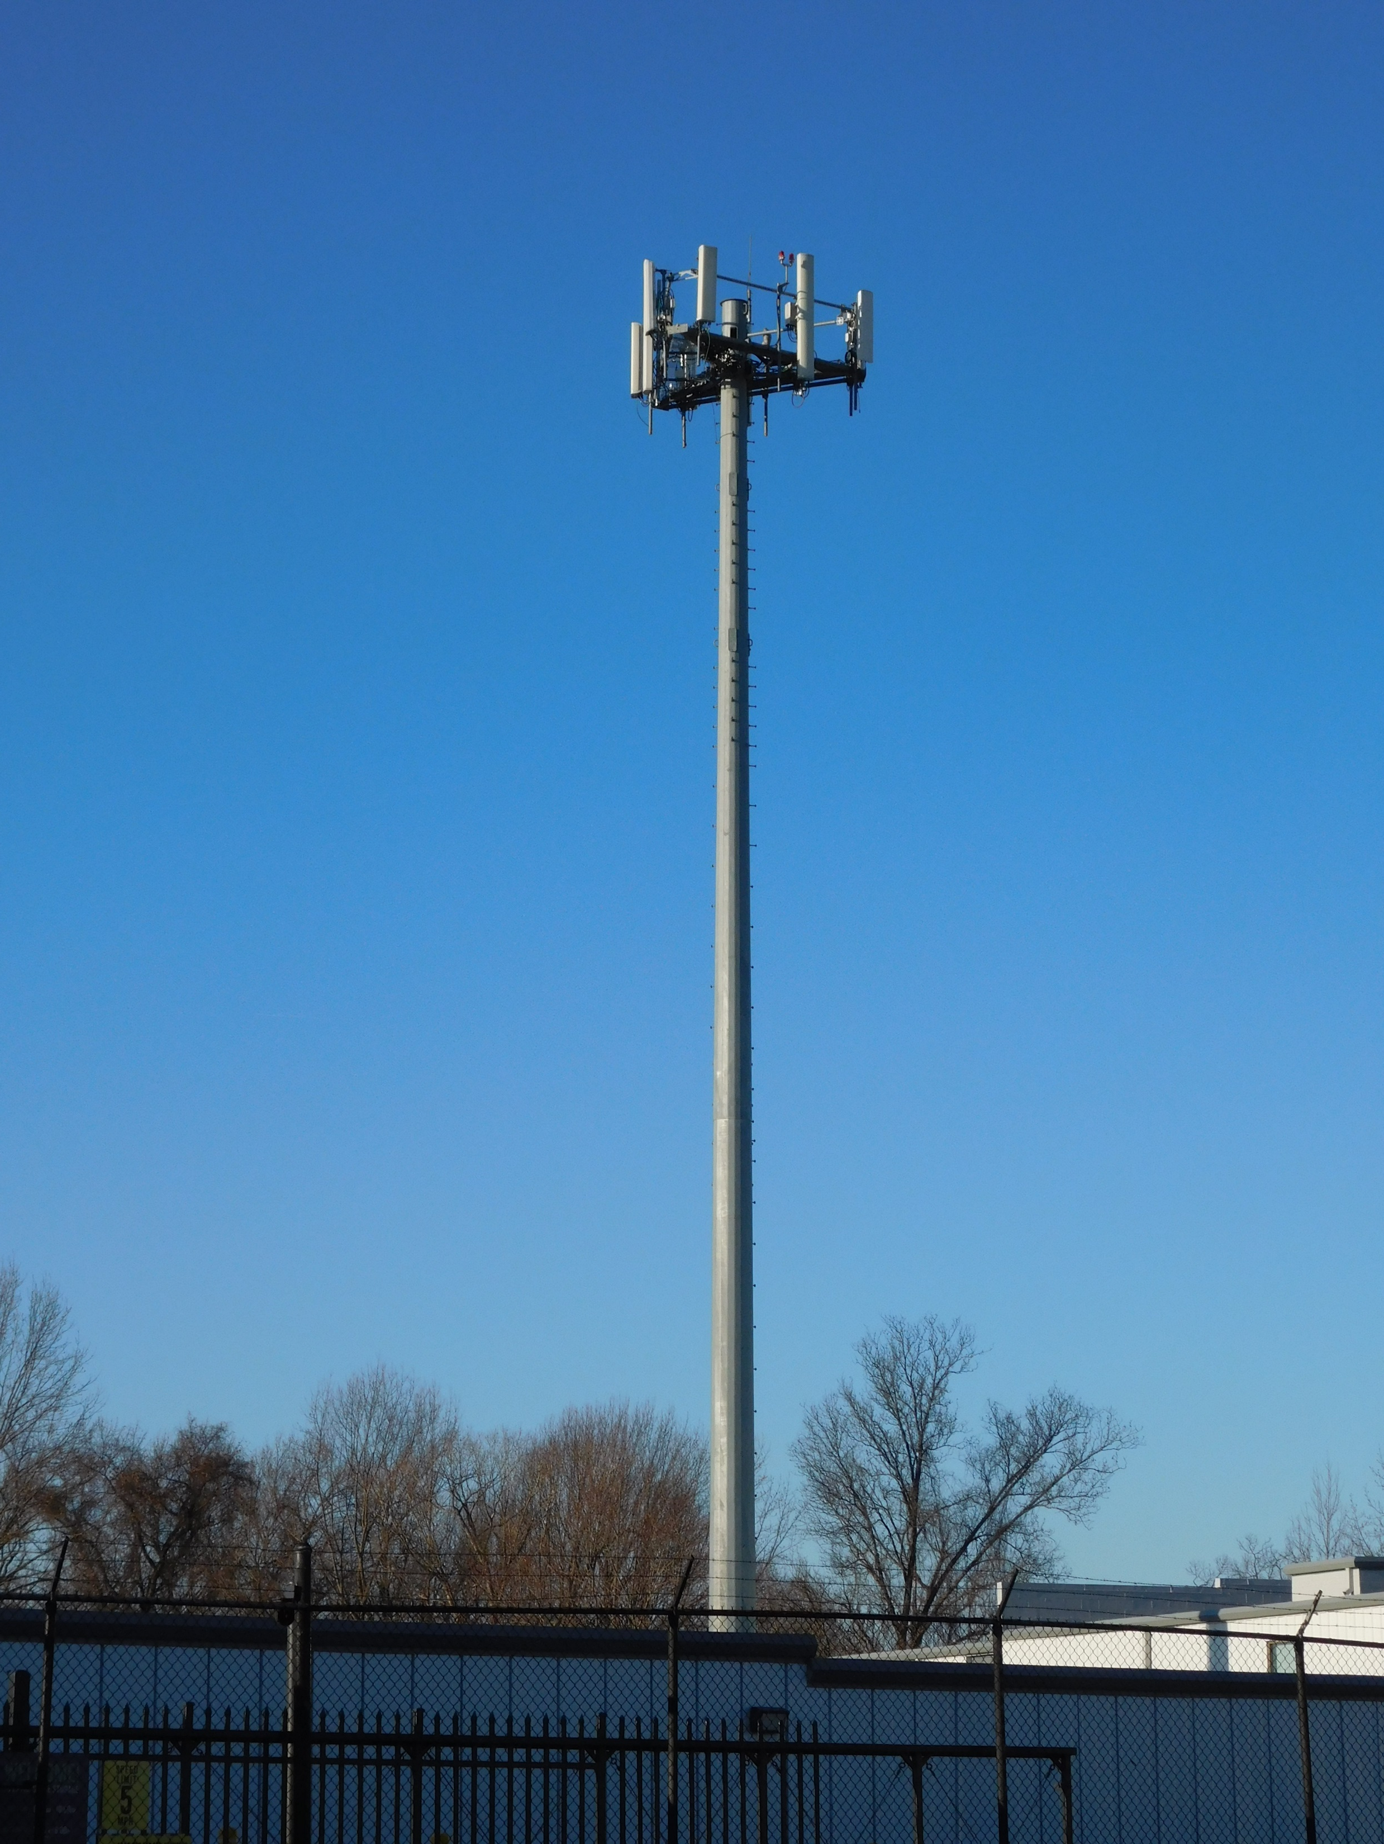
Earhart Monopole

Slide 4
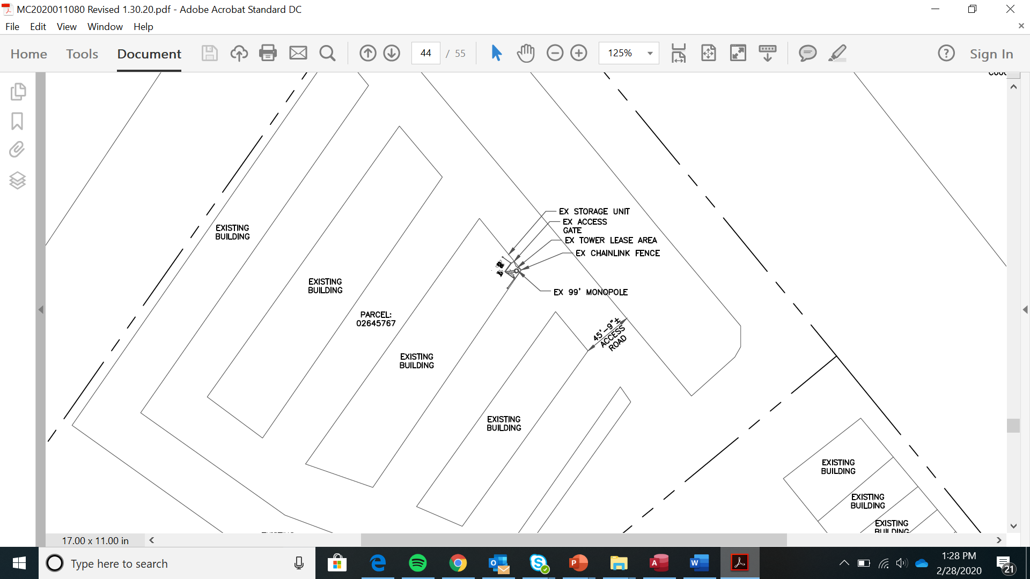
Earhart Monopole

Slide 5
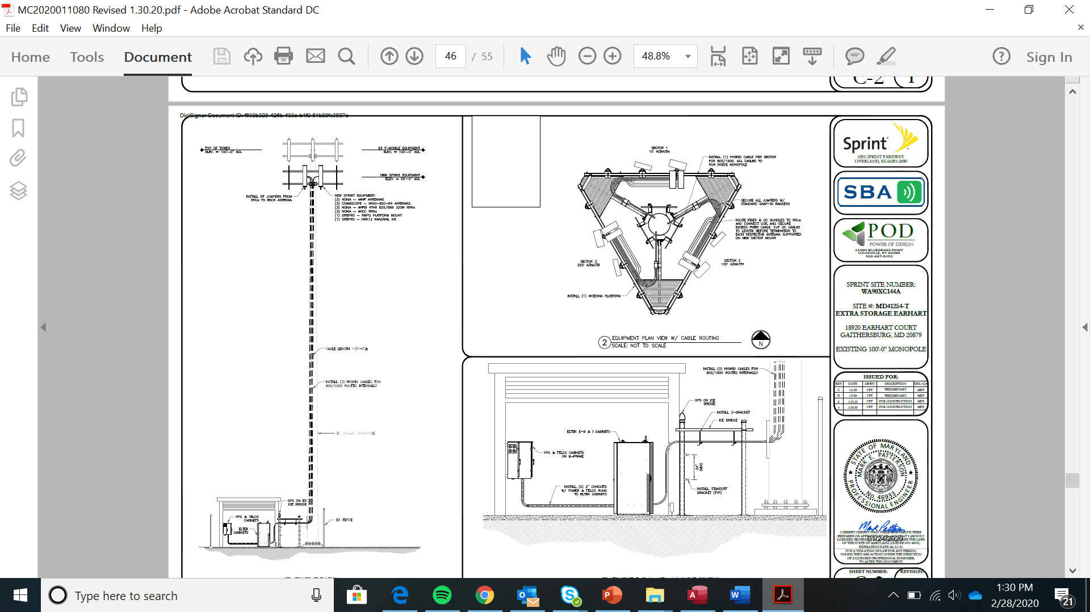
Earhart Monopole

Slide 6
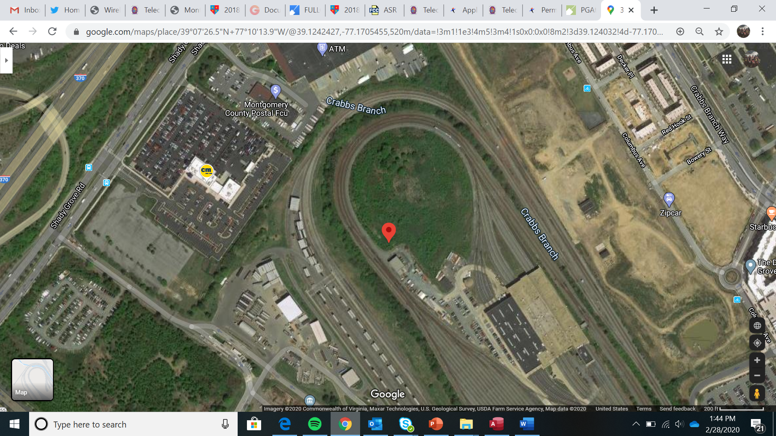
WMATA - Shady Grove

Slide 7
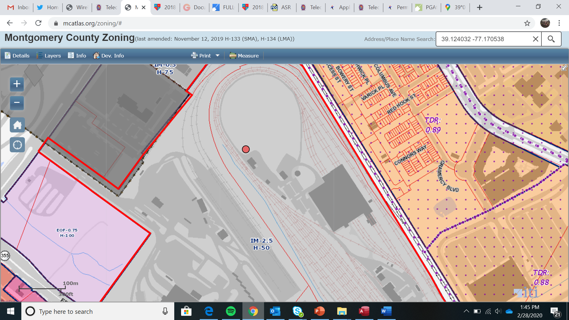
WMATA - Shady Grove

Slide 8
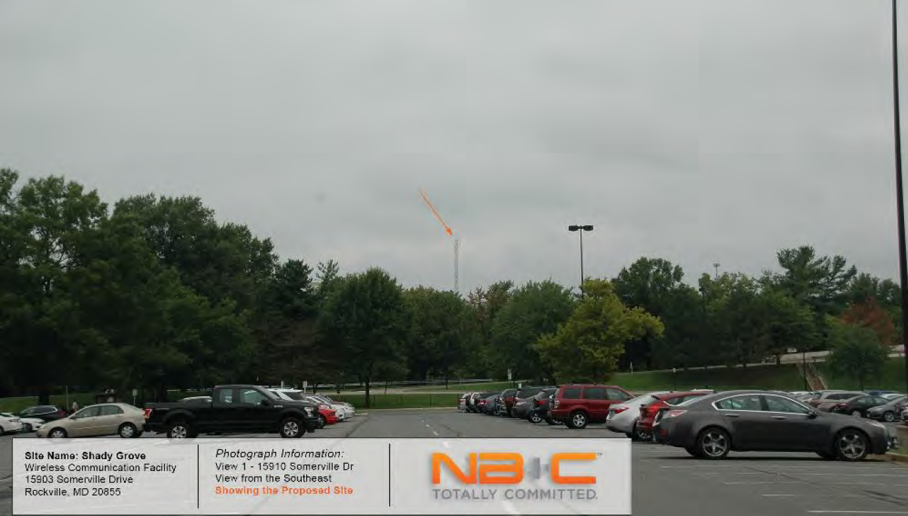
WMATA - Shady Grove

Slide 9
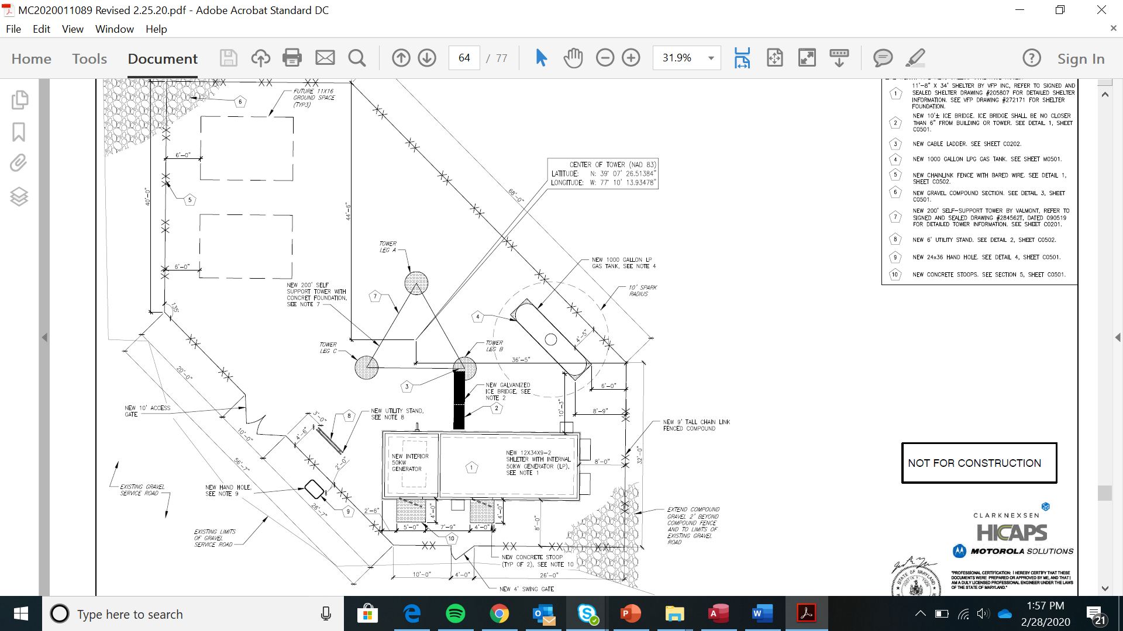
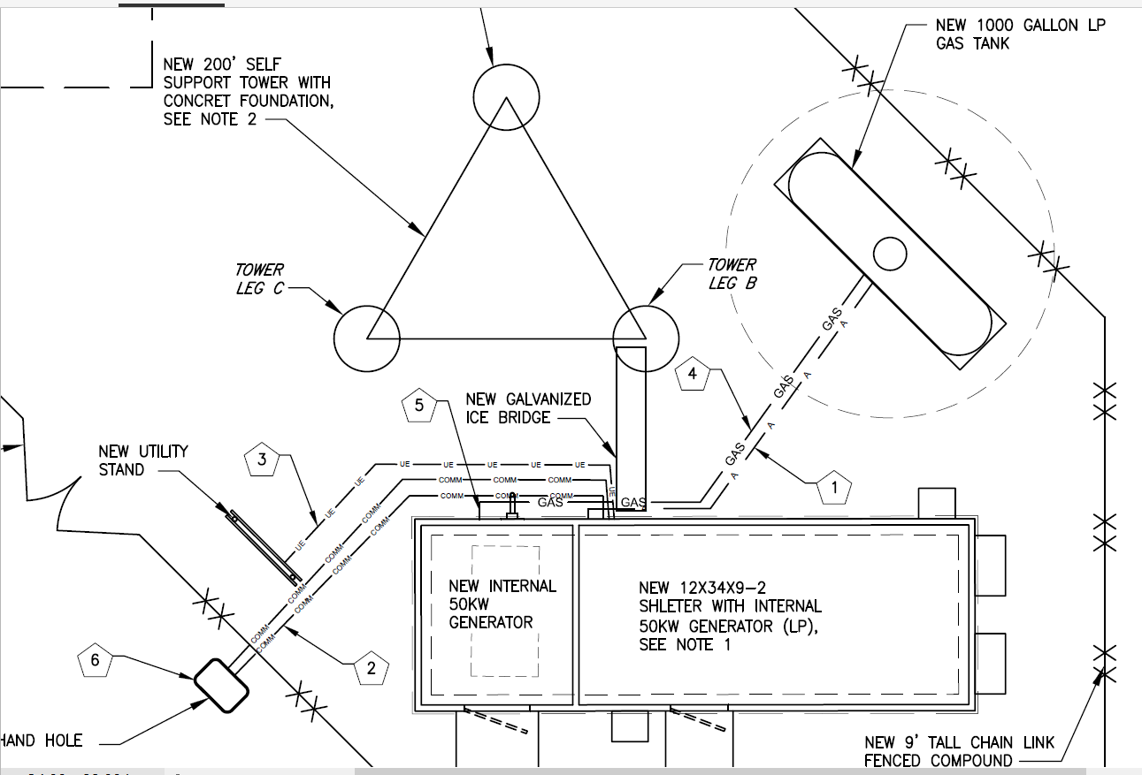
WMATA - Shady Grove

Slide 10
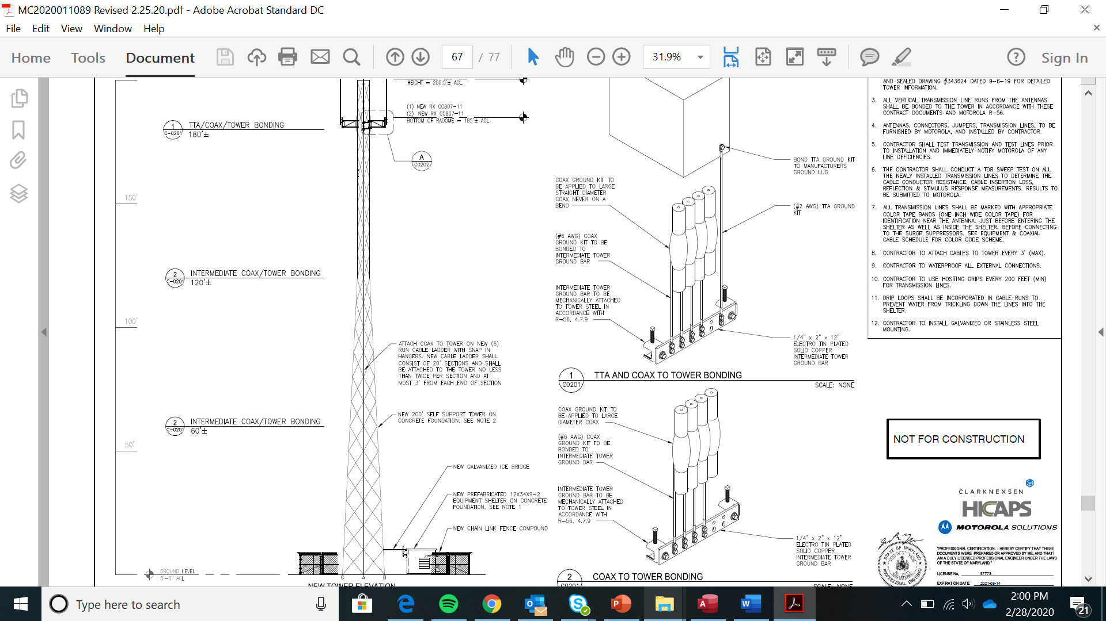
WMATA - Shady Grove

