Slide 1
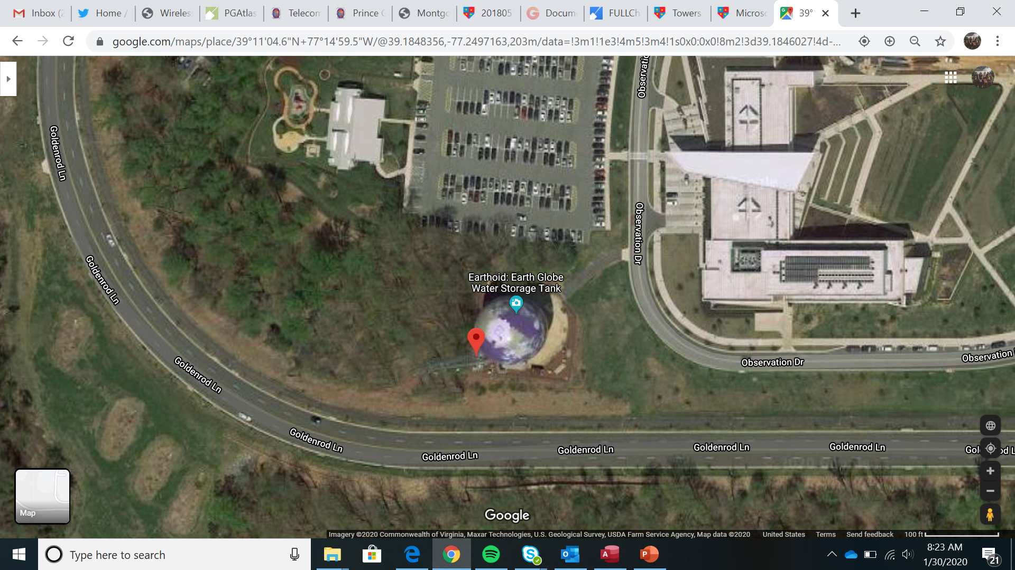
Montgomery College Germantown

Slide 2
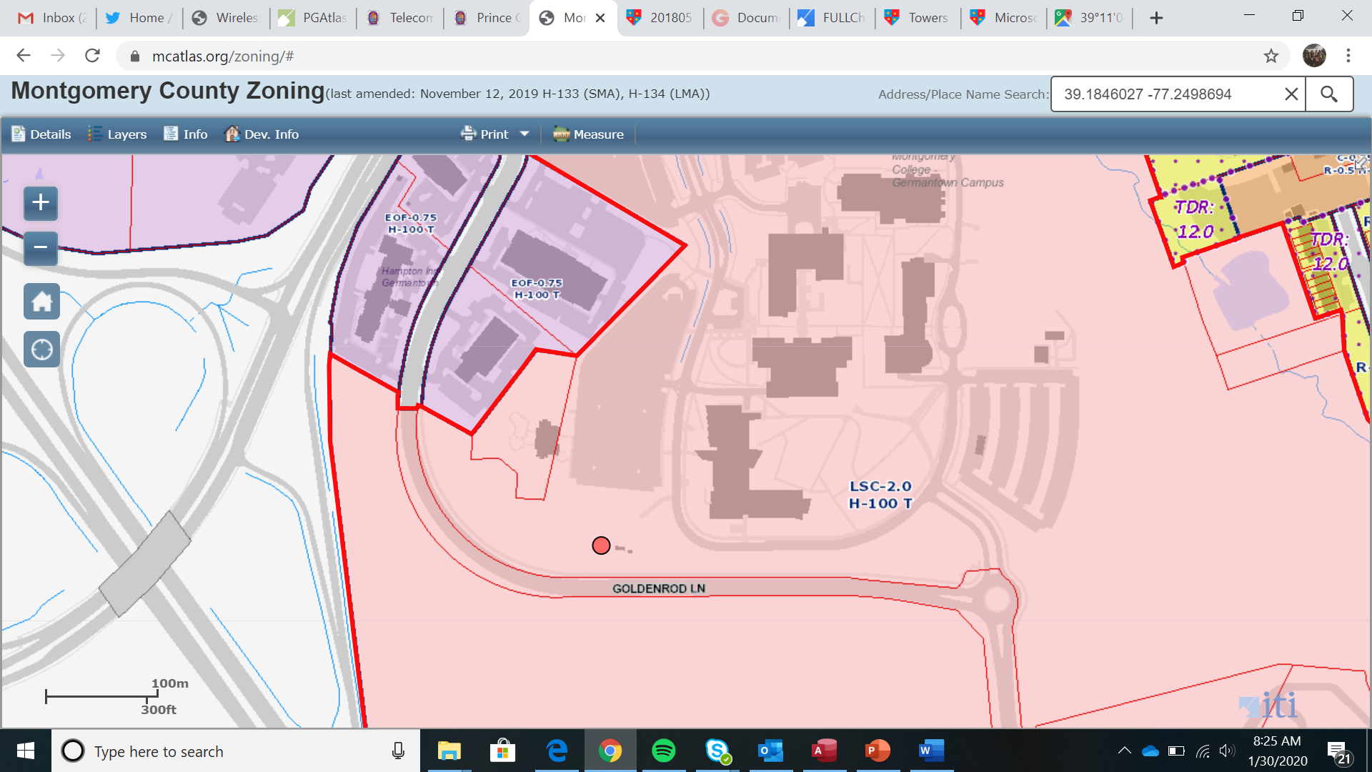
Montgomery College Germantown

Slide 3
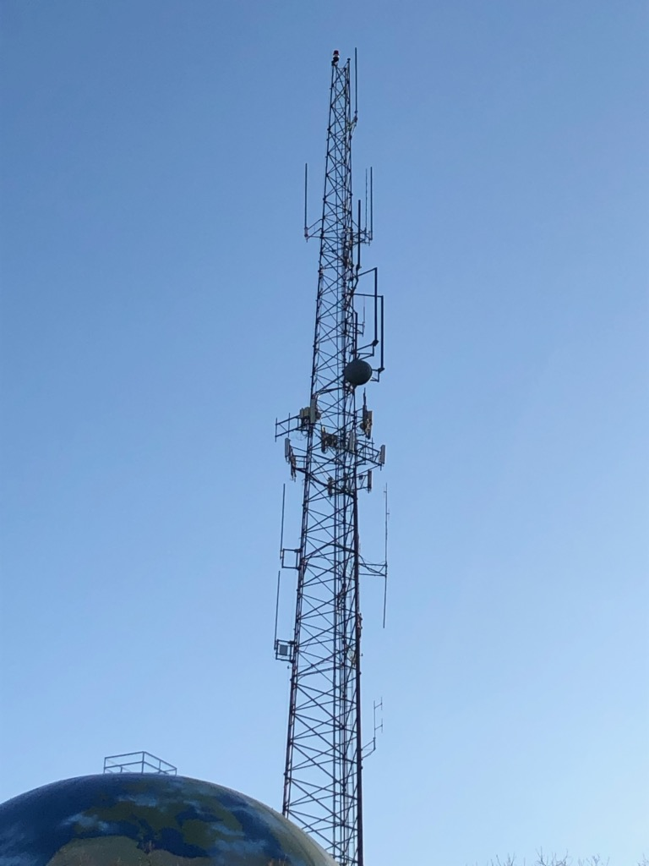
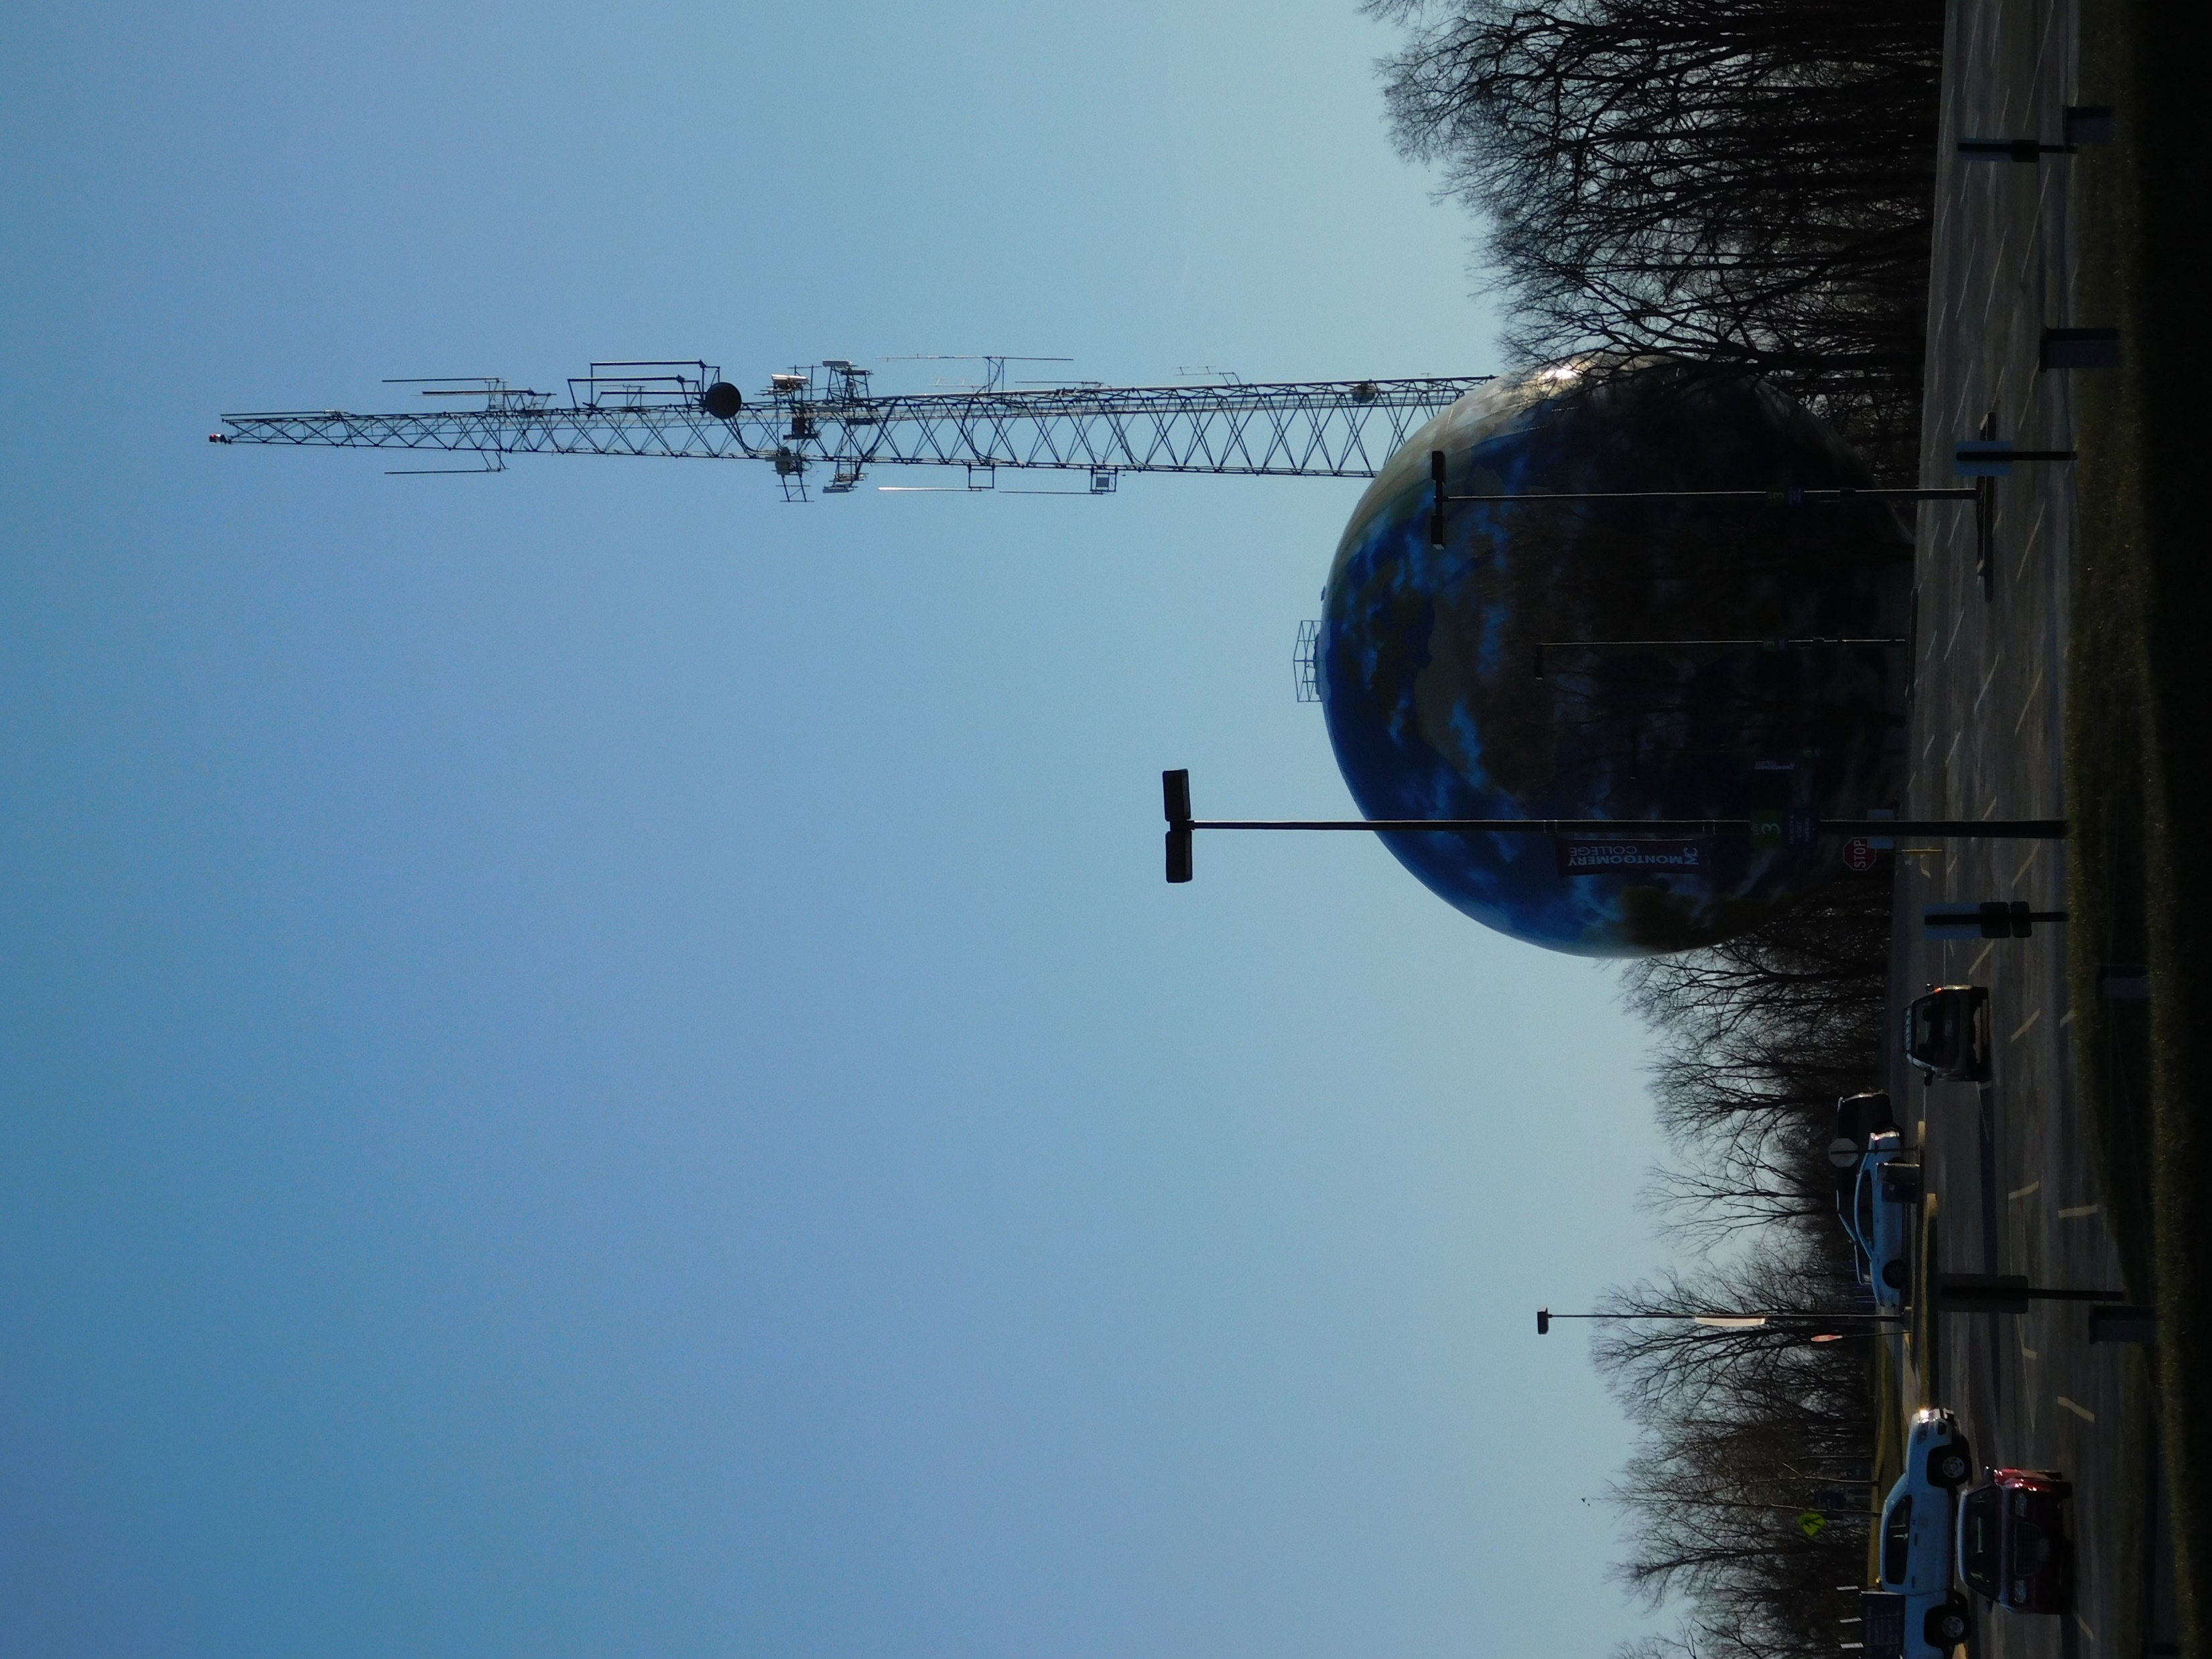
Montgomery College Germantown

Slide 4
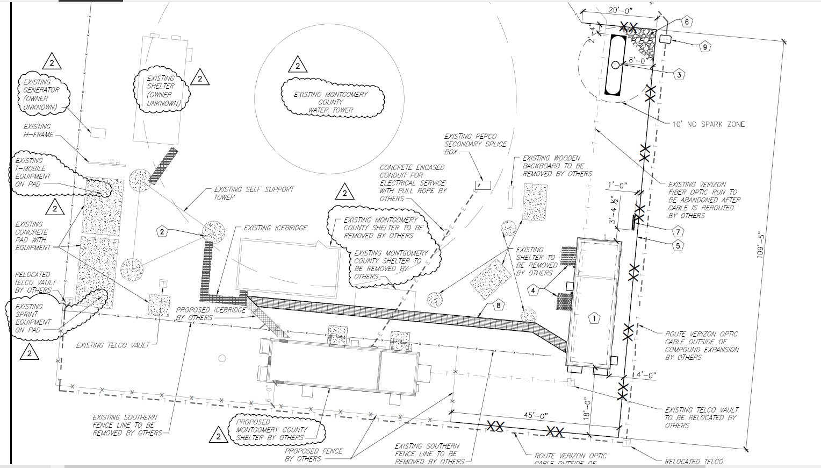
Montgomery College Germantown
Notes:
WMATA to attach (2) whip antennas at 250' and (2) panel antennas at 244' on a 300’ tower owned by WSSC. Install an 11'8"x34' prefabricated shelter and (1) 1,000 gallon liquid
propane tank and backup generator within a compound expansion to the east of the fenced compound. Update LMR network.

Slide 5
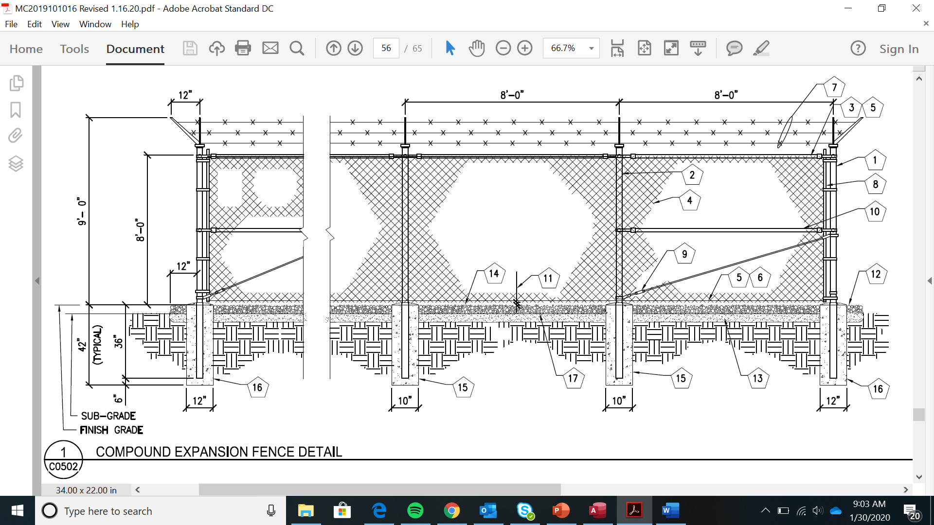
Montgomery College Germantown

Slide 6
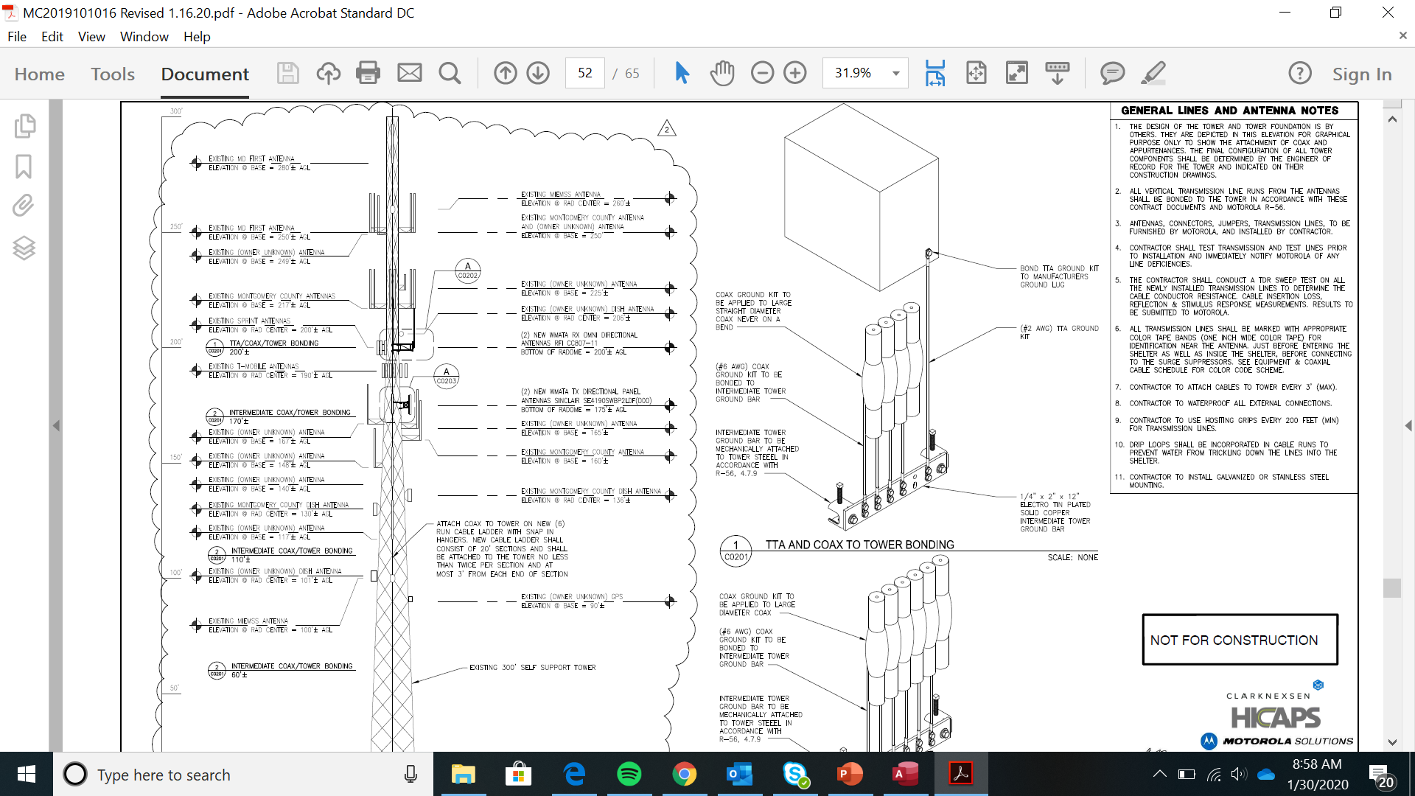
Montgomery College Germantown

Slide 7
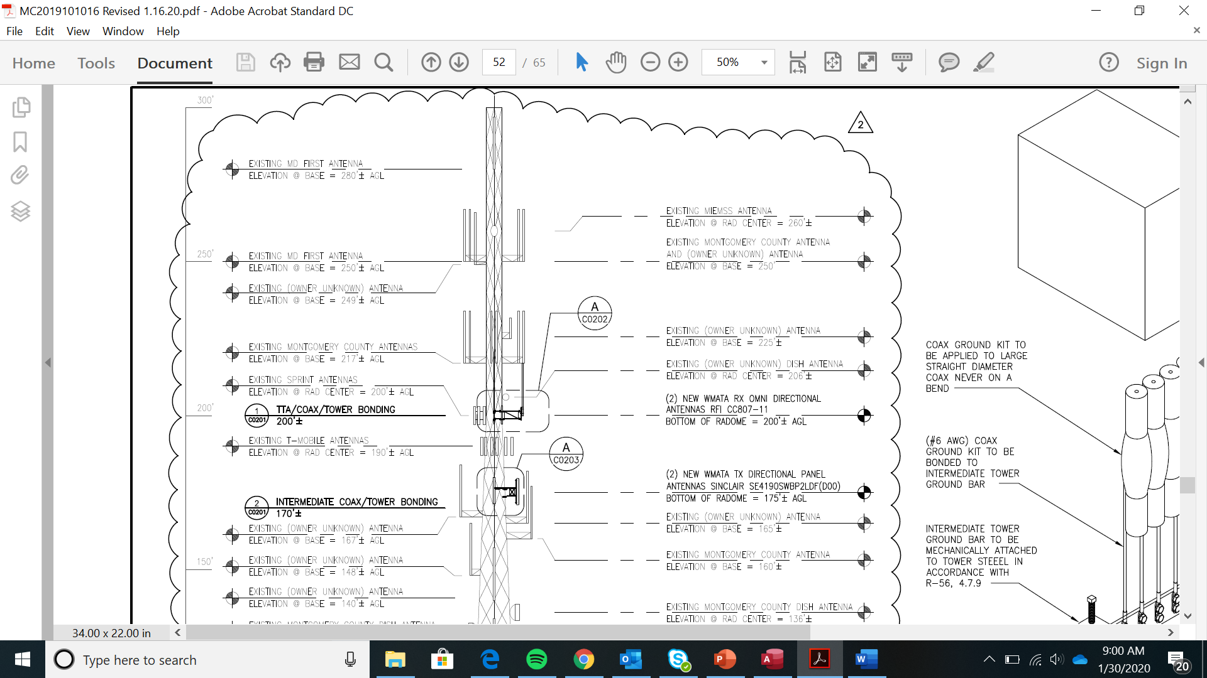
Montgomery College Germantown
Notes:
Applicant submitted calculations showing that ERP value for Sinclair SE419‐SWBP2LDF(D00) was 942 Watts.

