Slide 1
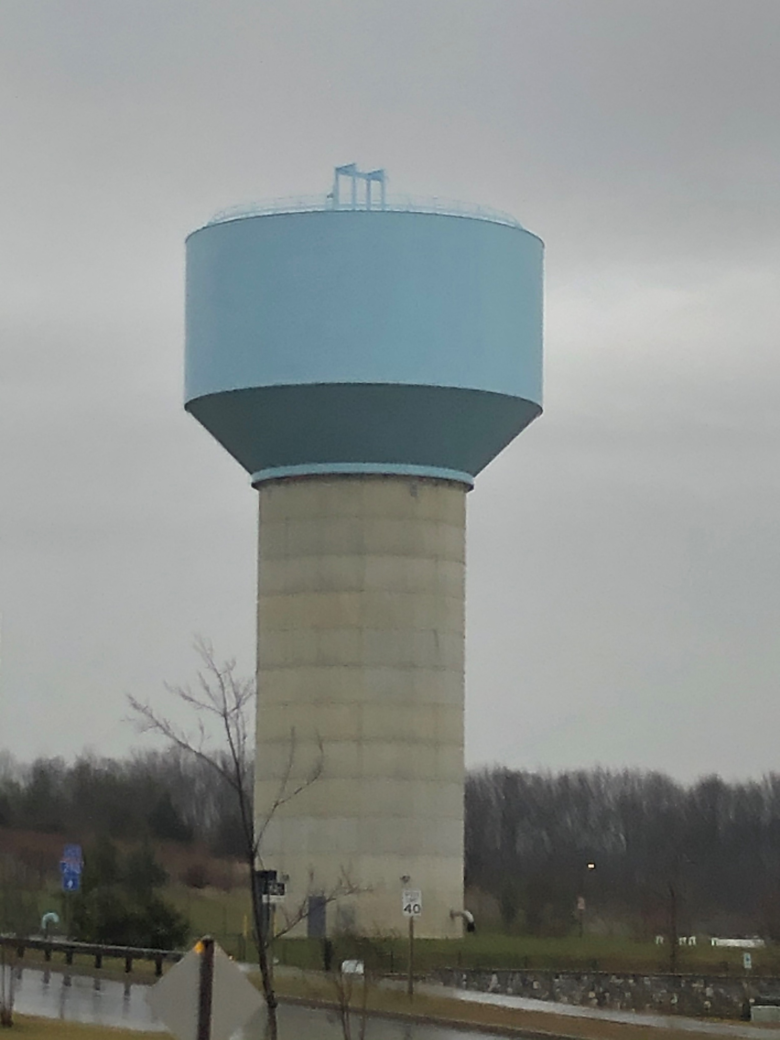
AT&T @ Clarksburg Premium Outlets
Notes:
4301 Brookeville Road, Brookeville

Slide 2
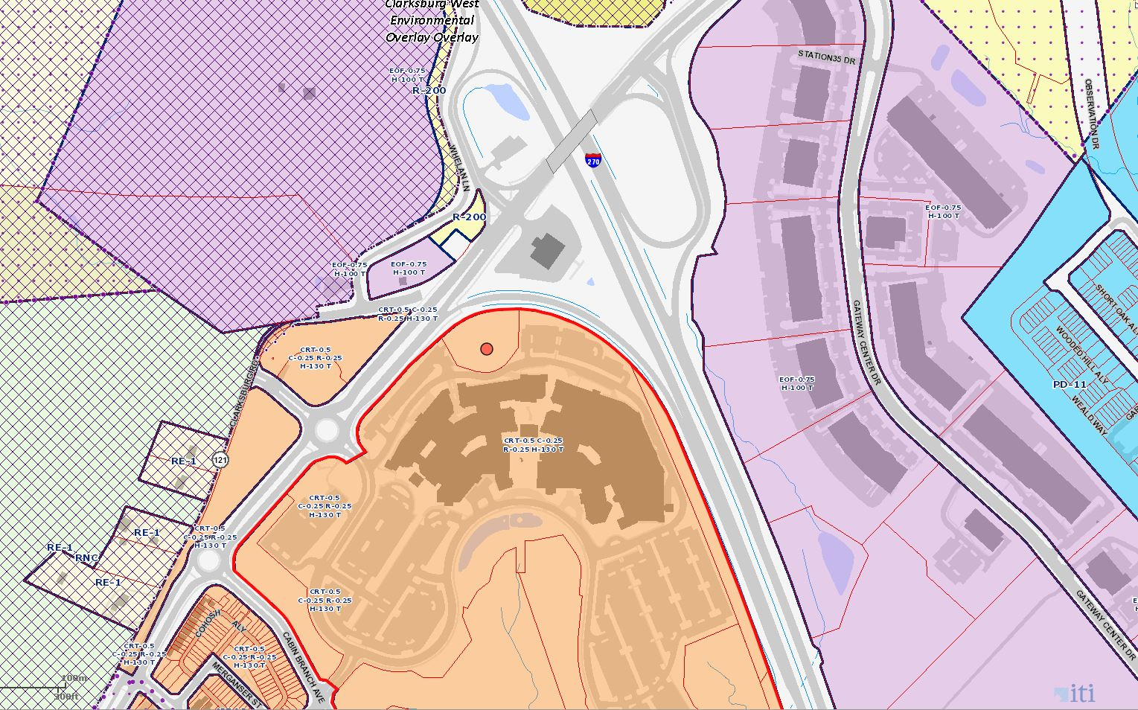
Clarksburg Premium Outlets Water tank
Notes:
The 133.9’ water tank is owned by WSSC. AT&T will be the first carrier on the site. The water tank is located at the recent Clarksburg Premium Outlets center, zoned CRT-0.5.

Slide 3
Clarksburg Premium Outlets
Notes:
This partial drawing of the water tank elevation shows the proposed AT&T attachments of (4) Commscope NNHH-65C-R4 antennas and (2) Commscope 2NN2HH-33C-R4 antennas all at a centerline of 135’ on the railing above the main roof height of the structure called out by red rectangle.

Slide 4
Clarksburg Premium Outlets
Notes:
AT&T proposes to install a 30 kW diesel generator on a new 12’ x 17’ concrete pad within the existing compound. No new fencing will be

