Slide 1
T-Mobile @
PEPCO 790425-010700 (2021101566)

Slide 2
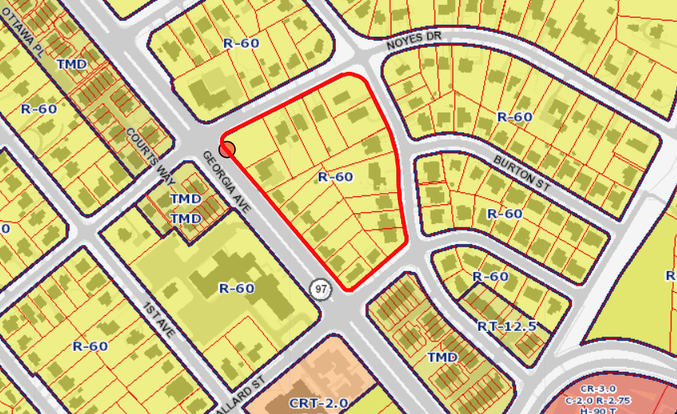
1566 - PEPCO 790425-010700

Slide 3
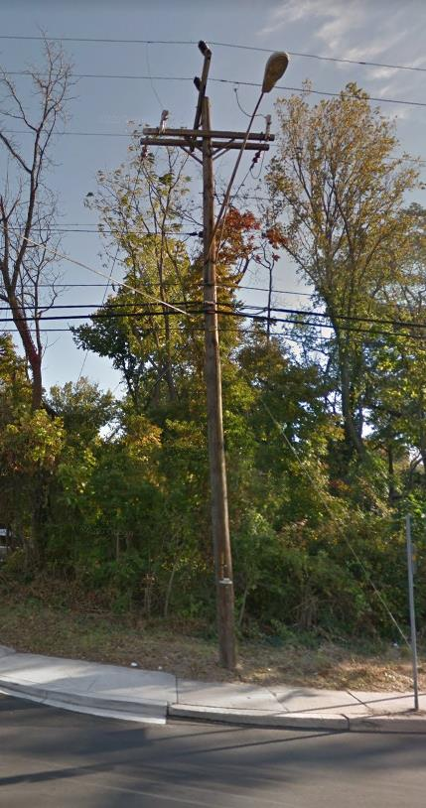
1566 - PEPCO 790425-010700

Slide 4
AT&T @
PEPCO 745460-0763 (2021071518)

Slide 6
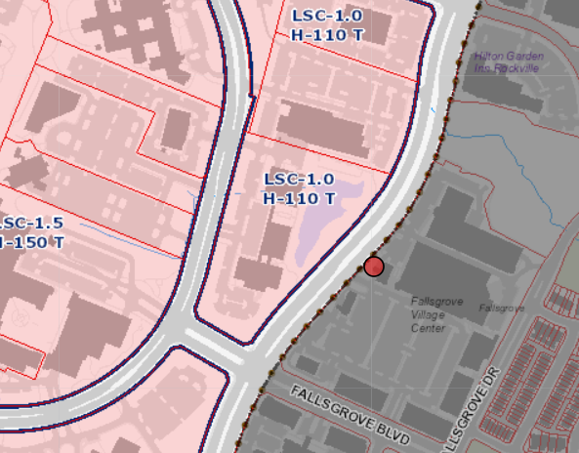
1518 - PEPCO 745460-0763

Slide 7
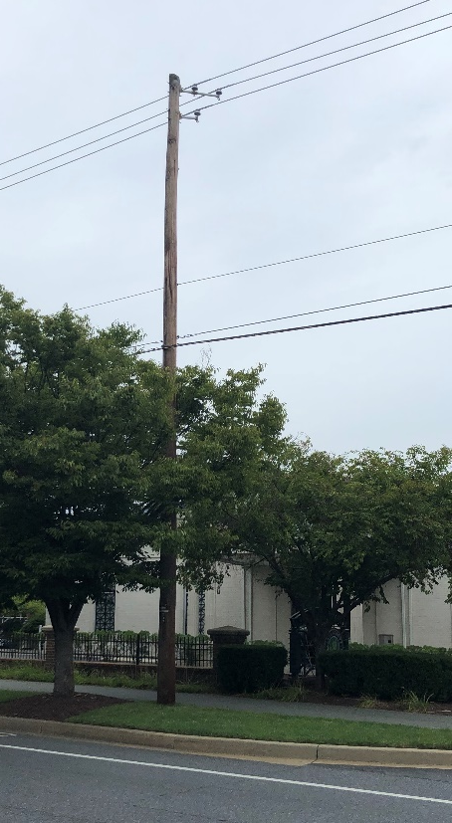
1518 - PEPCO 745460-0763
Photo simulation after replacement
and installation
Pre-replacement

