Slide 1
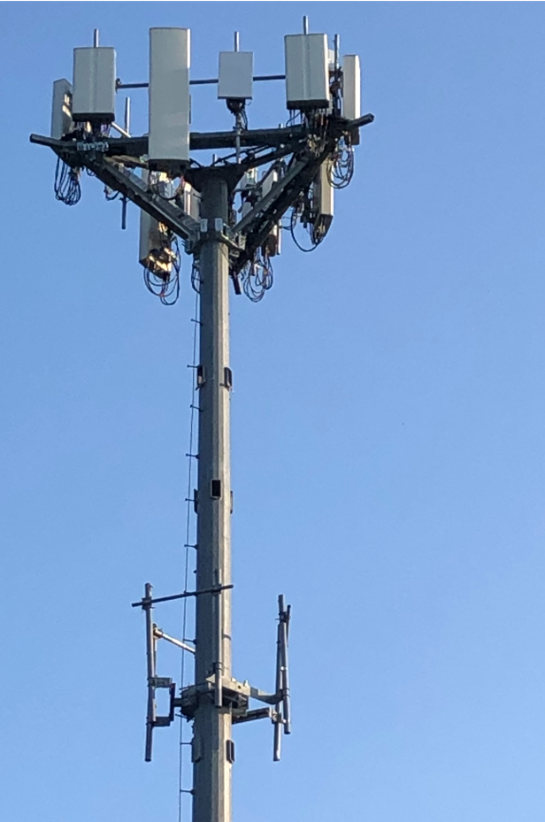
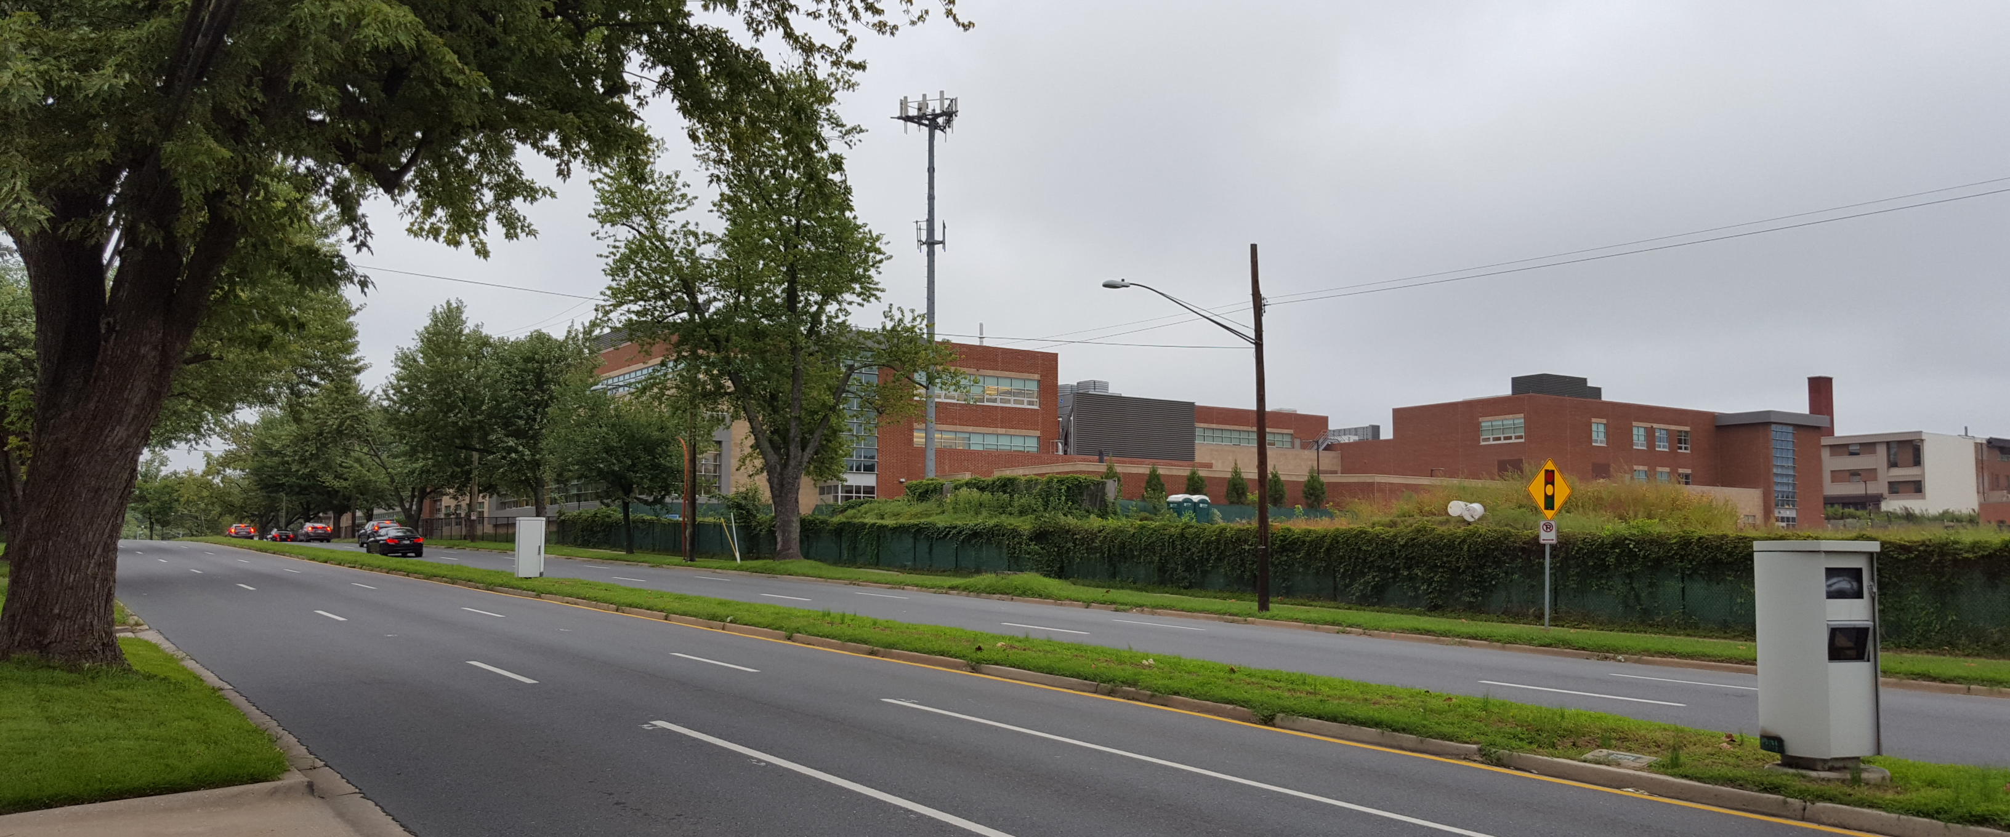
Dish Wireless @ Wheaton High School
2021071515

Slide 2
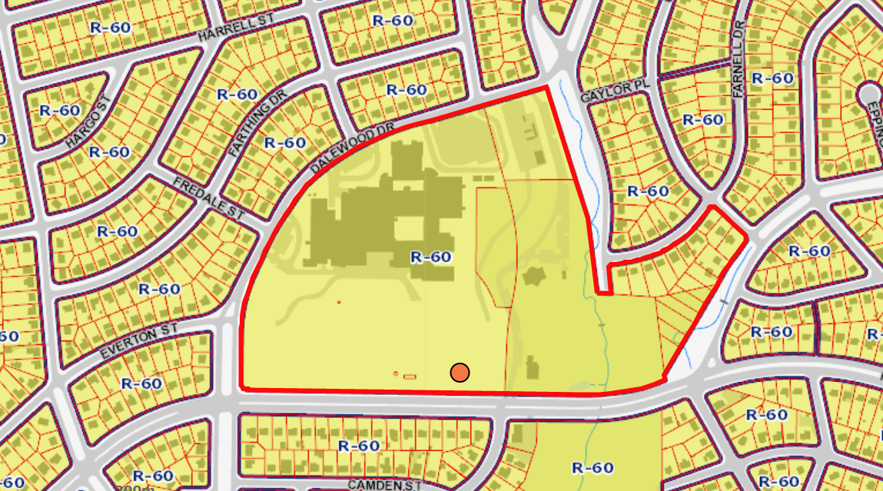
Wheaton High School
https://goo.gl/maps/QdJCJm7GnhS2

Slide 3
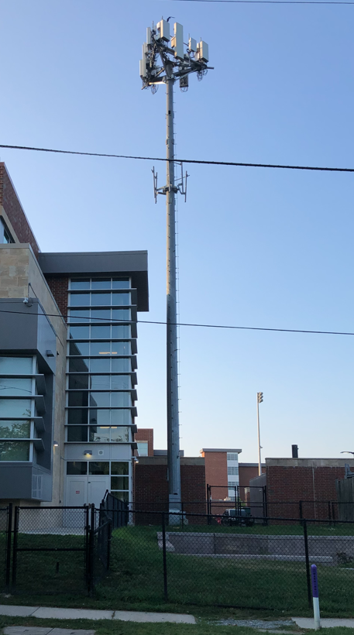
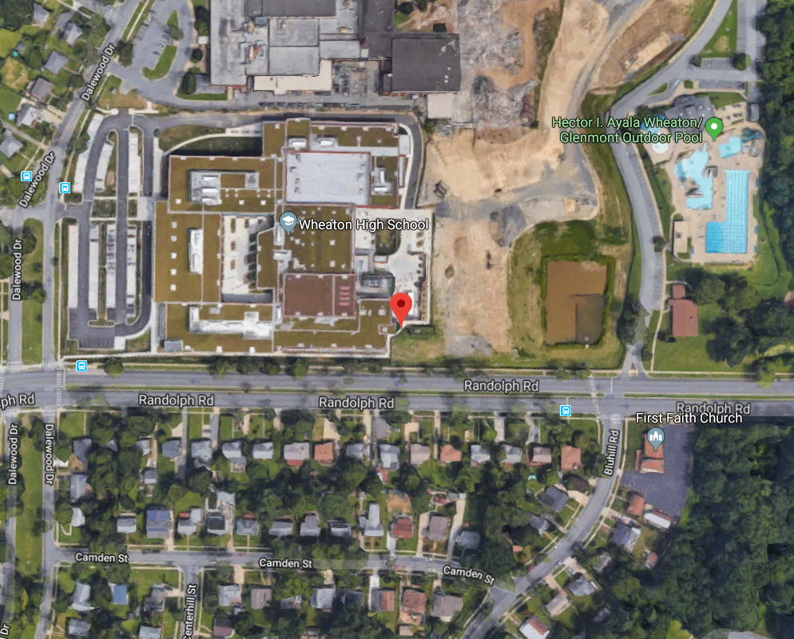
Wheaton High School

Slide 4
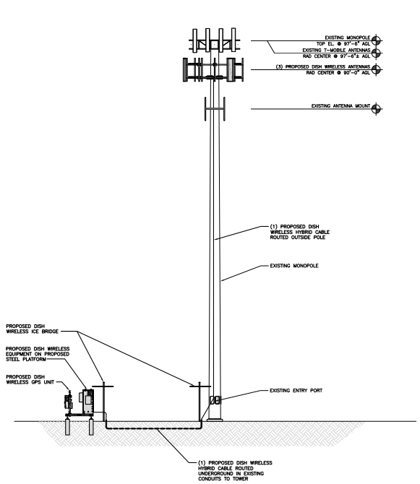
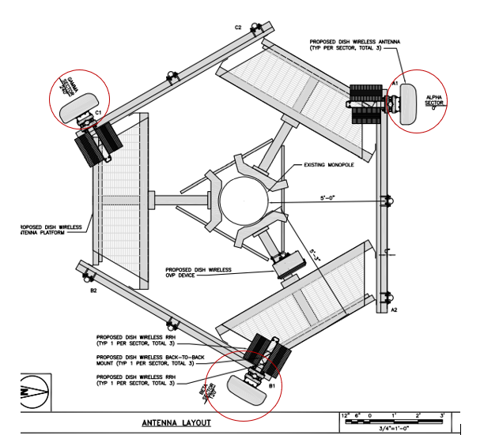
Wheaton High School

Slide 5
Wheaton High School

Slide 6
AT&T @ PEPCO 768445-660780
(2021071519)

Slide 7
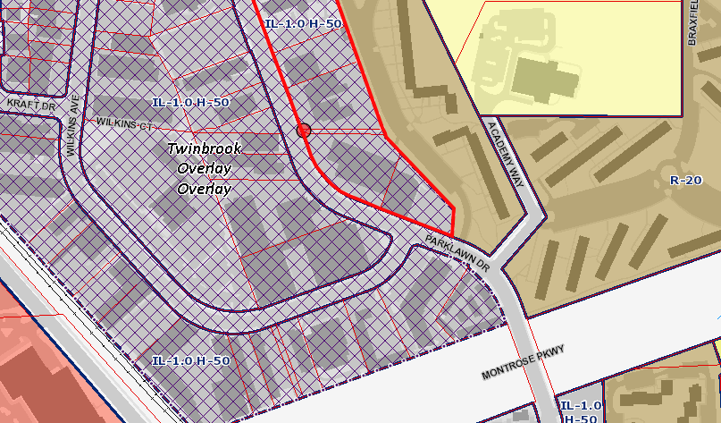
1519 - PEPCO 768445-660780

Slide 8
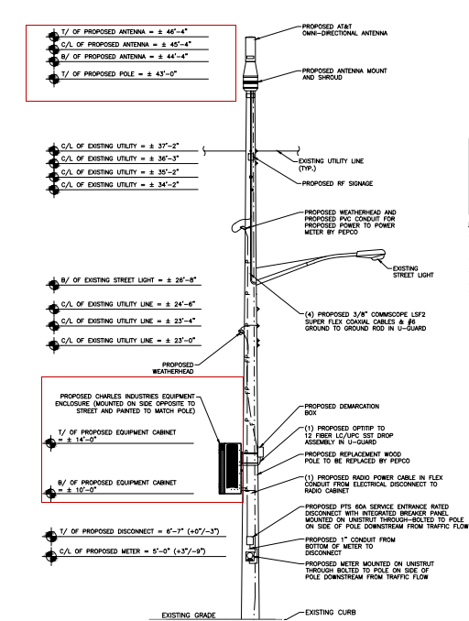
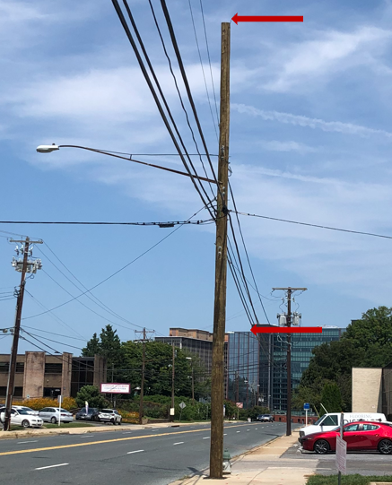
1519 - PEPCO 768445-660780

Slide 9
AT&T @ PEPCO 747472-9946
(2021081538)

Slide 10
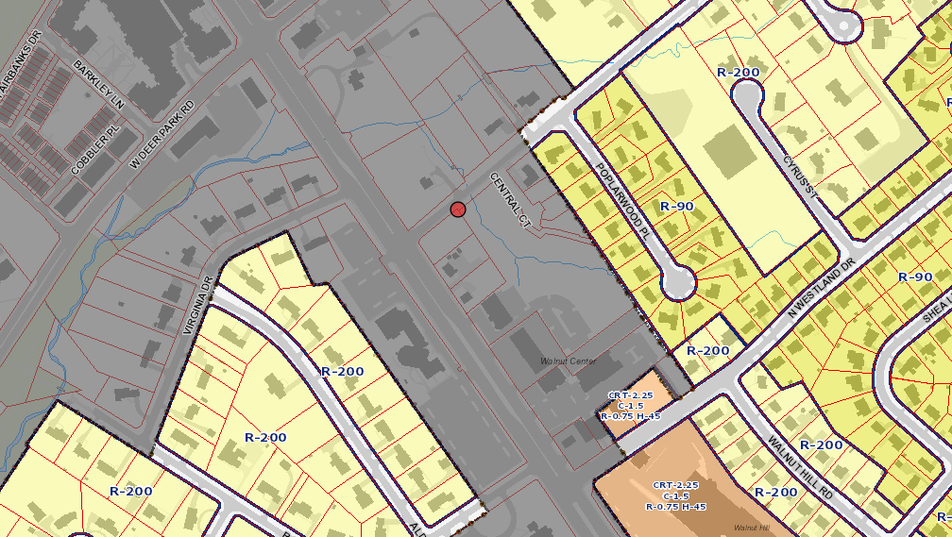
1538 - PEPCO 747472-9946

Slide 11
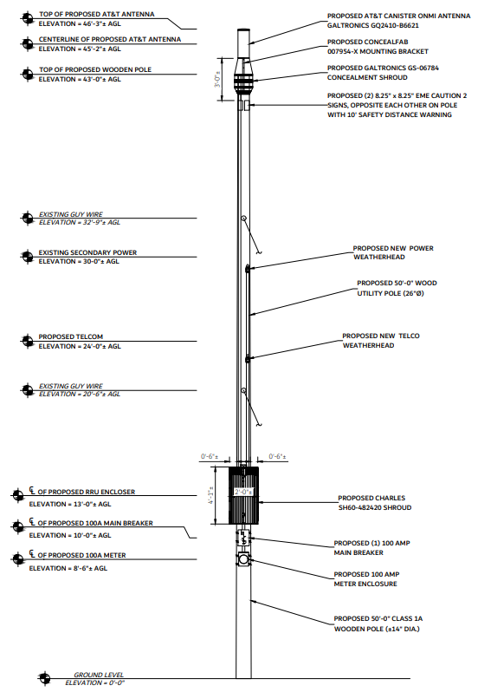
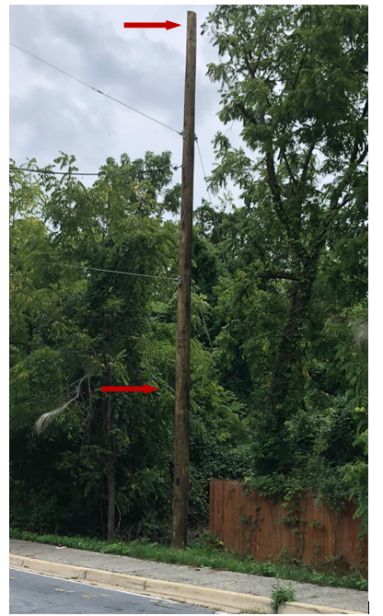
1538 - PEPCO 747472-9946

Slide 12
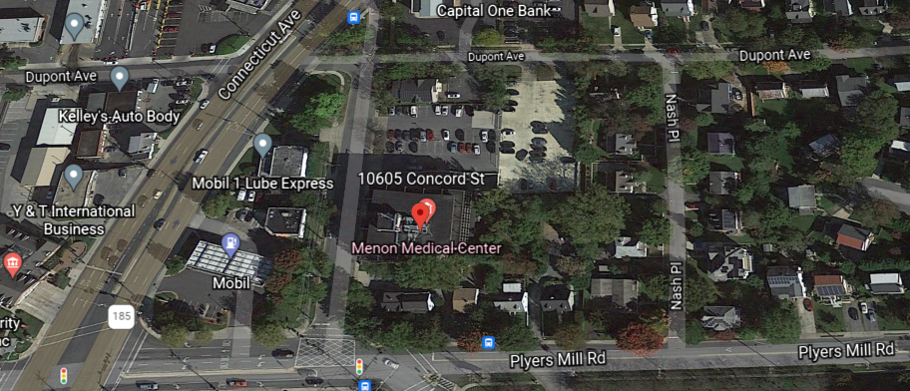
Dish Wireless @ Concord Building
2021091547

Slide 13
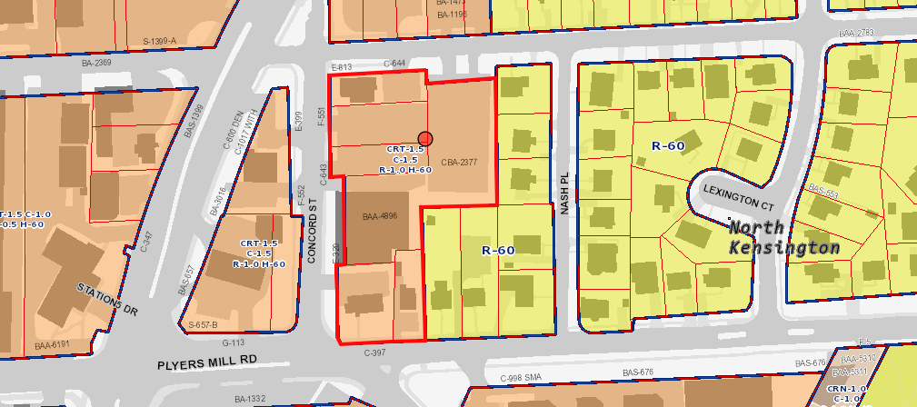
Concord Building

Slide 14
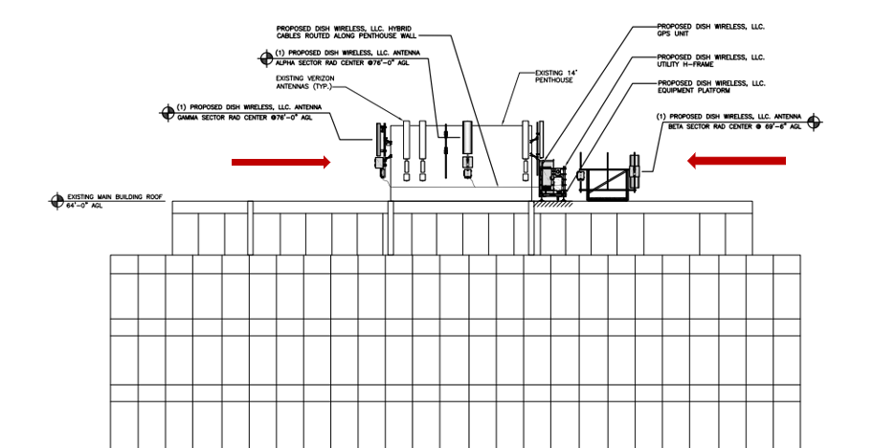
Concord Building

Slide 15
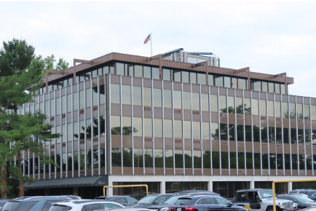
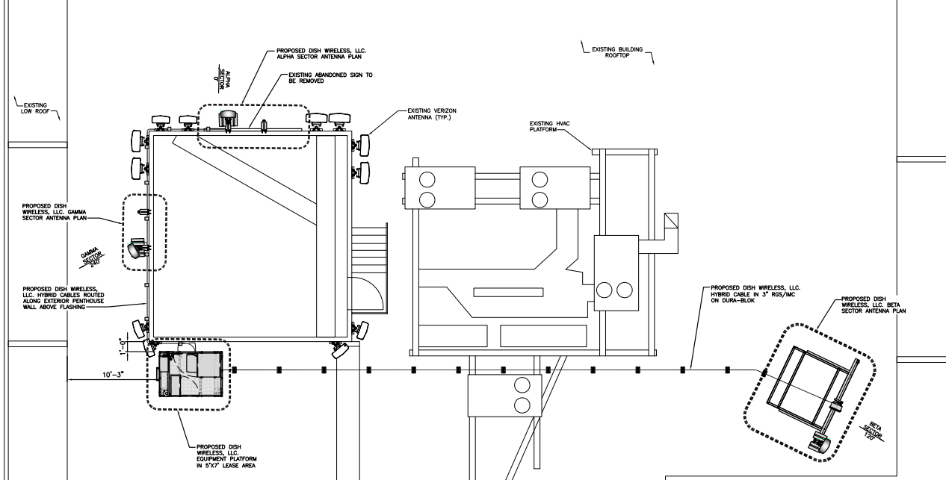
Concord Building

Slide 16
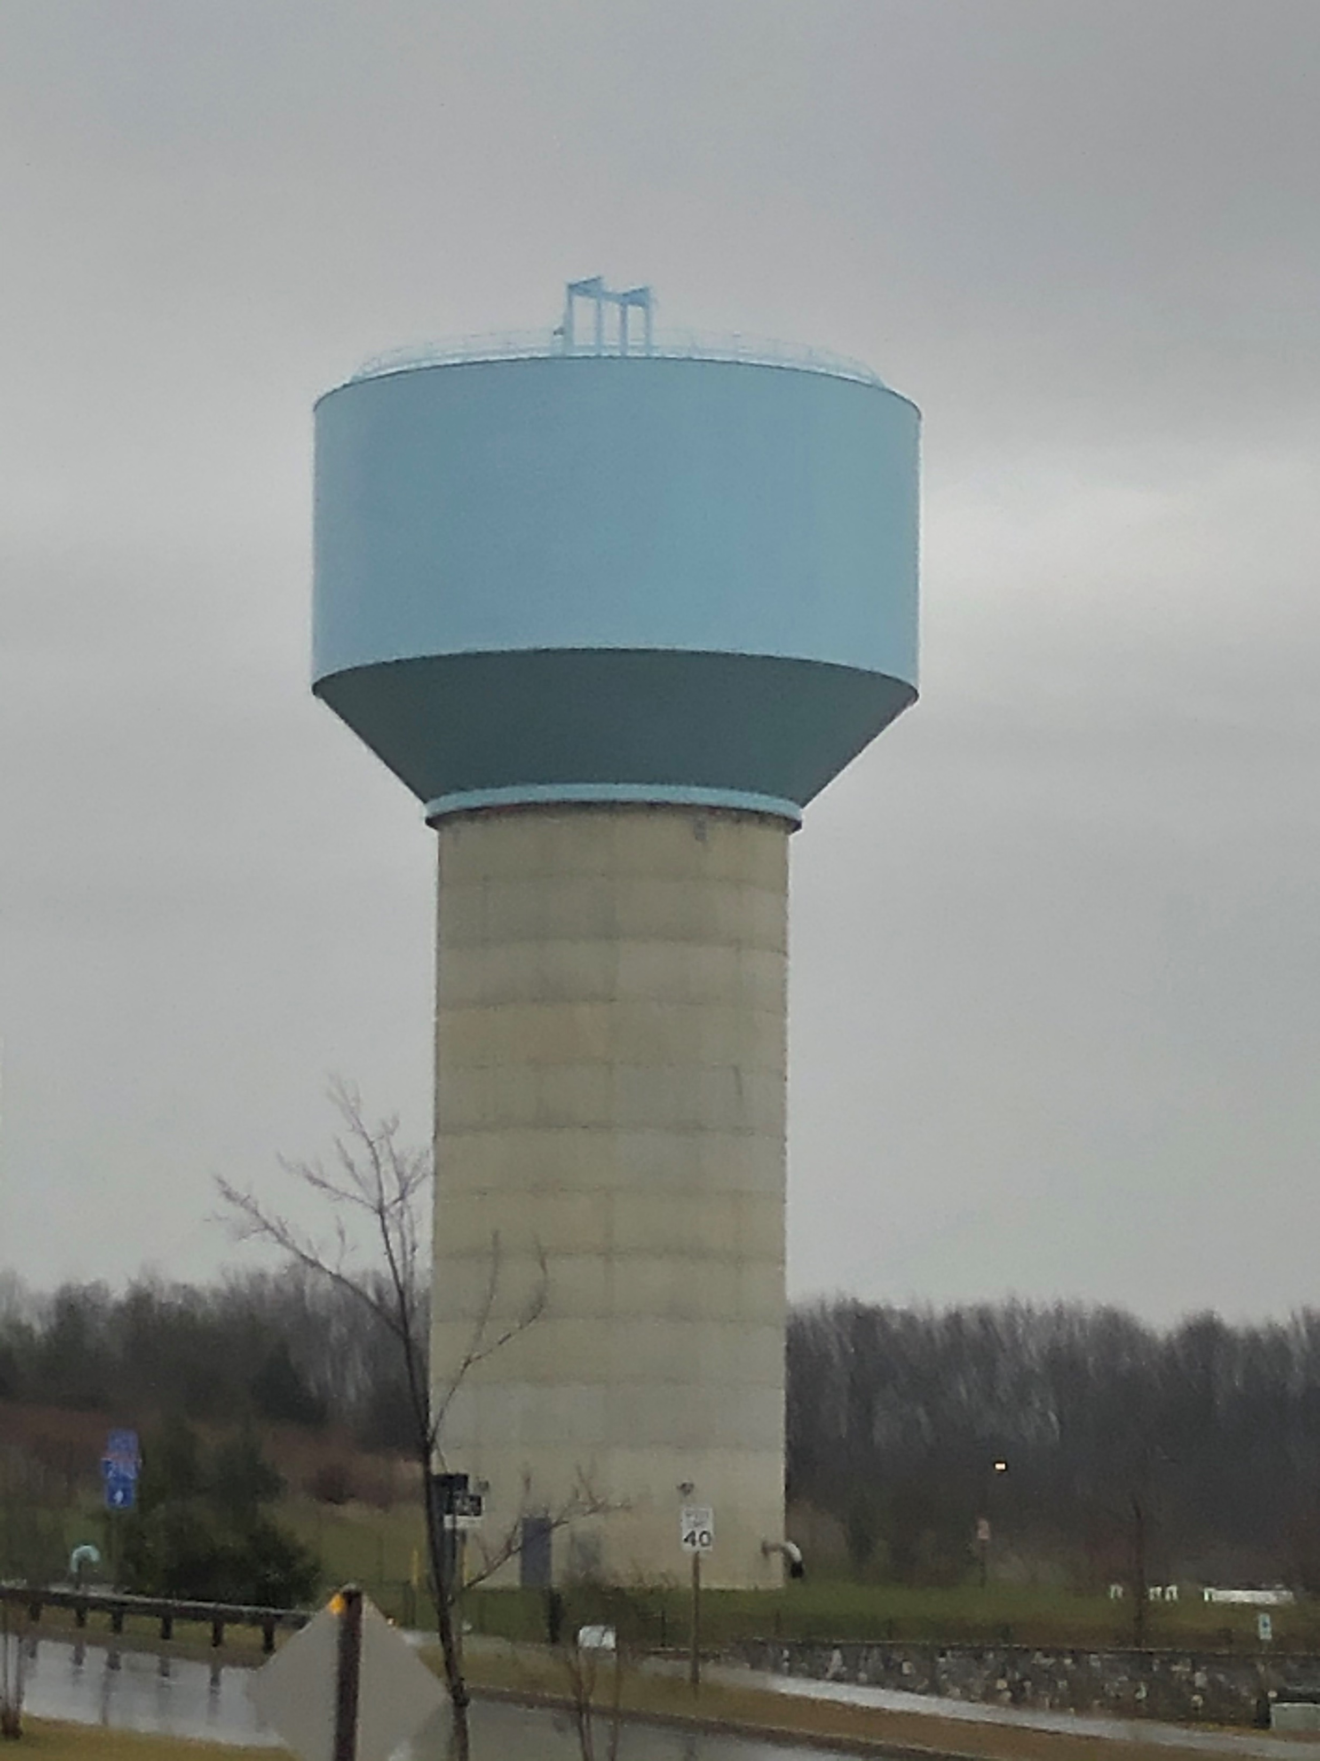
T-Mobile @ Clarksburg Premium Outlets
2021091554

Slide 17
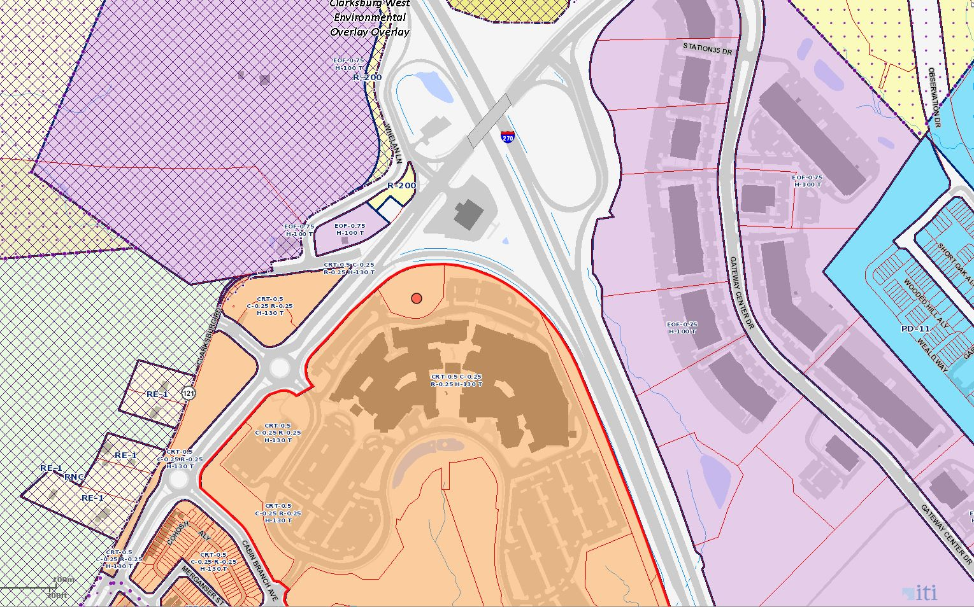
Clarksburg Premium Outlets

Slide 18
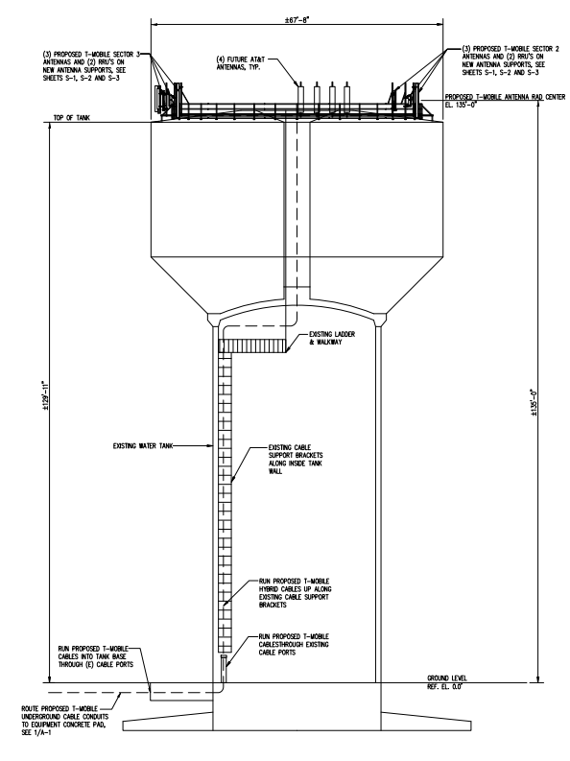
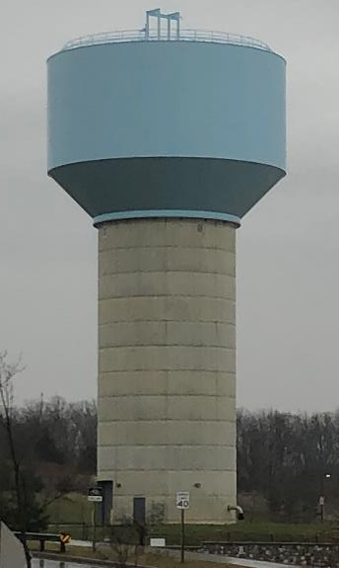
Clarksburg Premium Outlets

Slide 19
