Slide 1
October 2022 TFCG SLIDE DECK

Slide 2
Crown Castle/T-Mobile @
Pepco 799413-820440
(2022061840)

Slide 3
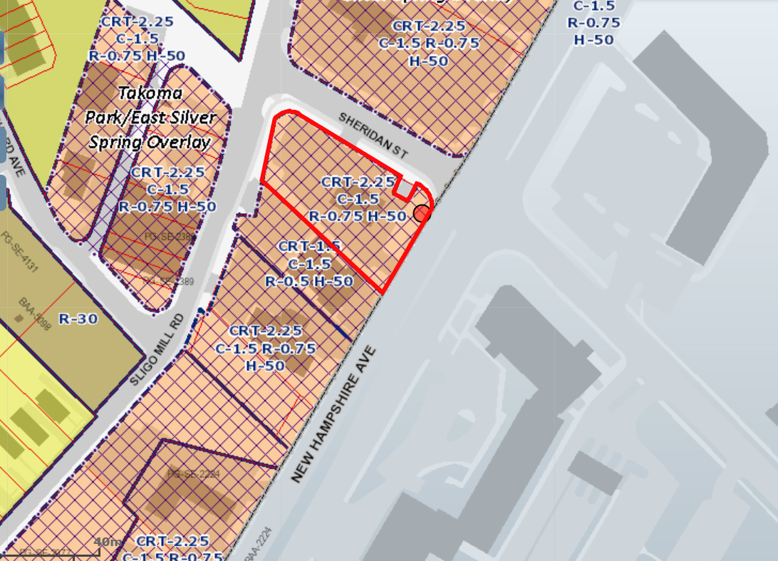
1840 - PEPCO 799413-820440

Slide 4
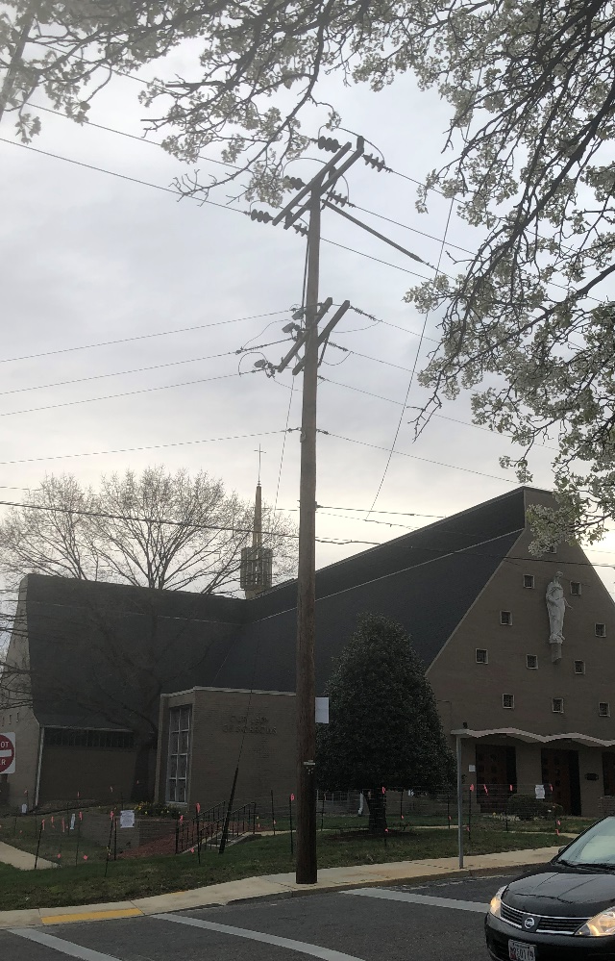
1840 - PEPCO 799413-820440

Slide 5
MasTec Network Solutions/Verizon Wireless@
Pepco 162-S
(2022071881)

Slide 6
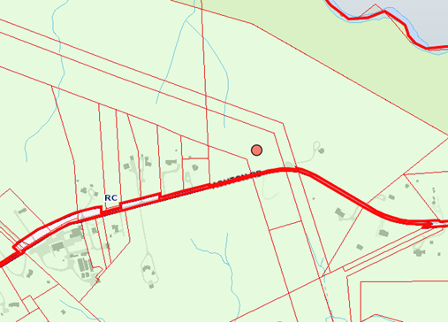
1881 - PEPCO 162-S

Slide 7
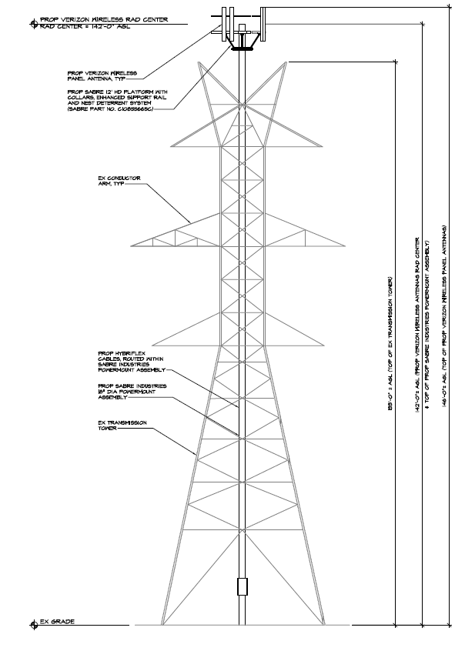
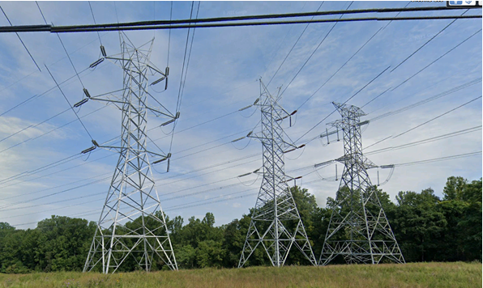
1881 - PEPCO 162-S

Slide 8
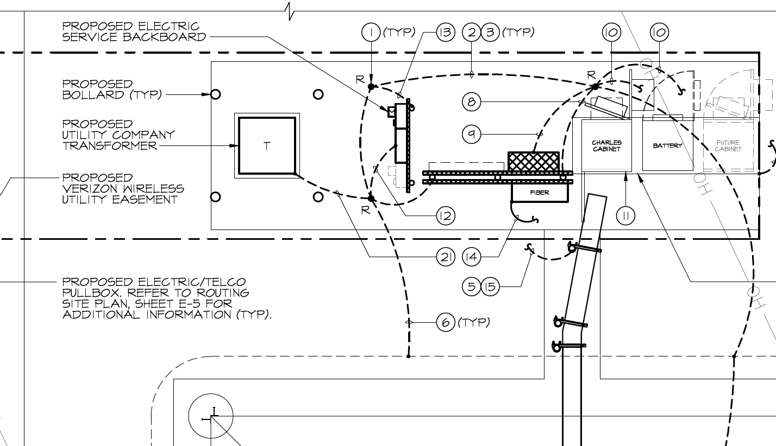
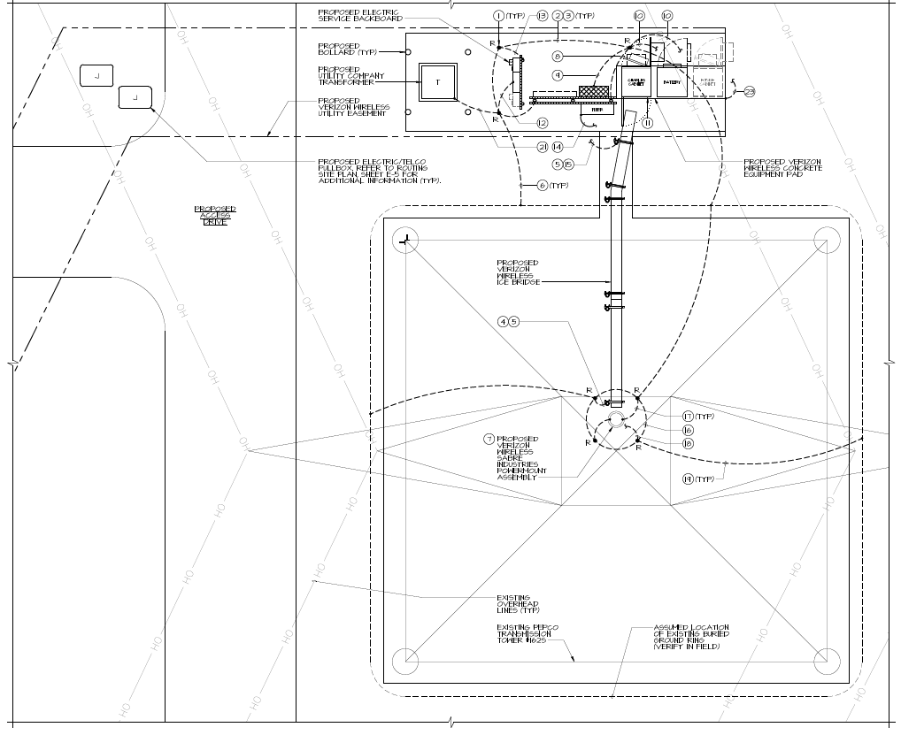
1881 - PEPCO 162-S

Slide 9
Crown Castle/Verizon Wireless @
Diamondback Pole 10021
(2022071864)

Slide 10
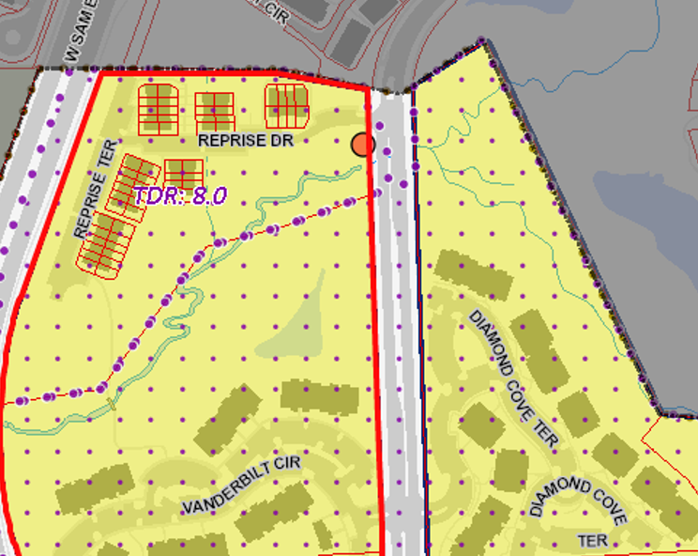
1864 – Diamondback Pole 10021

Slide 11
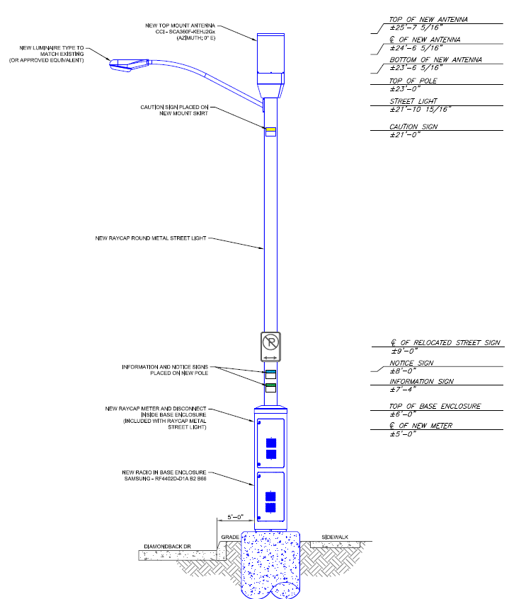
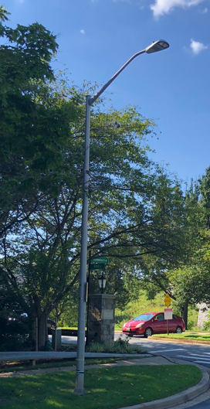
1864 – Diamondback Pole 10021
Existing pole
Proposed new pole
Notes:
Left: picture of existing pole taken at site survey
right: proposed replacement pole drawing

Slide 12
Crown Castle/Verizon Wireless @
Decoverly-Skyhill Pole 11030
(2022071866)

Slide 13
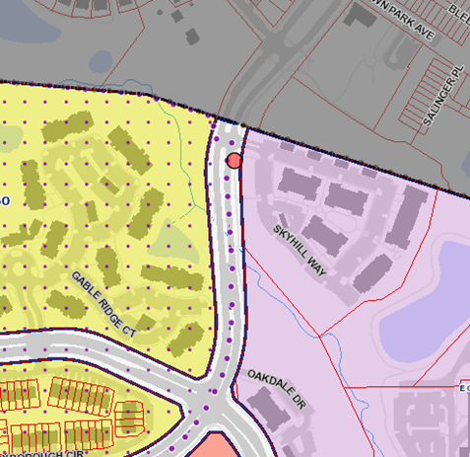
1866 – Decoverly-Skyhill Pole 11030

Slide 14
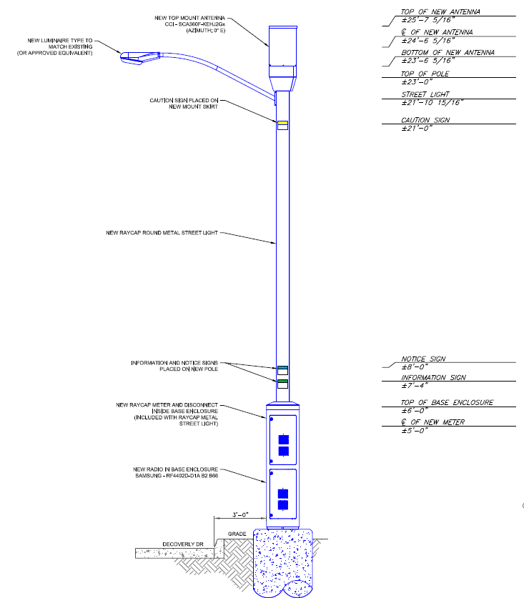
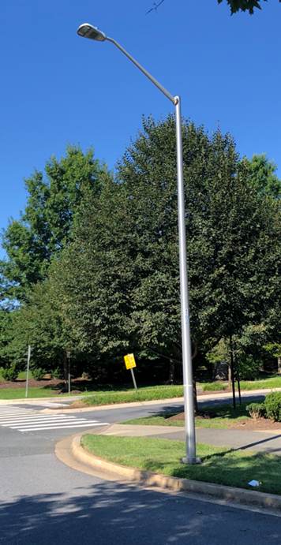
1866 – Decoverly-Skyhill Pole 11030
Existing pole
Proposed new pole
Notes:
Left: picture of existing pole taken at site survey
right: proposed replacement pole drawing

