Slide 1
December 2022
TFCG SLIDE DECK

Slide 2
Dish Wireless @ Pepco 615-S
(2022112013)

Slide 3
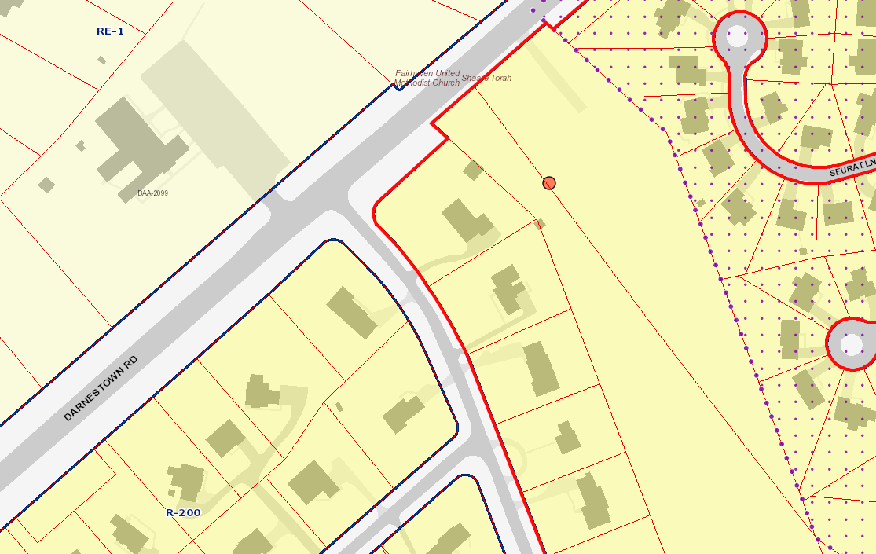
2013 - PEPCO 615-S
Notes:
PEPCO transmission tower in the greater Gaithersburg area, off of Darnestown Rd. The area is zoned R-200.

Slide 4
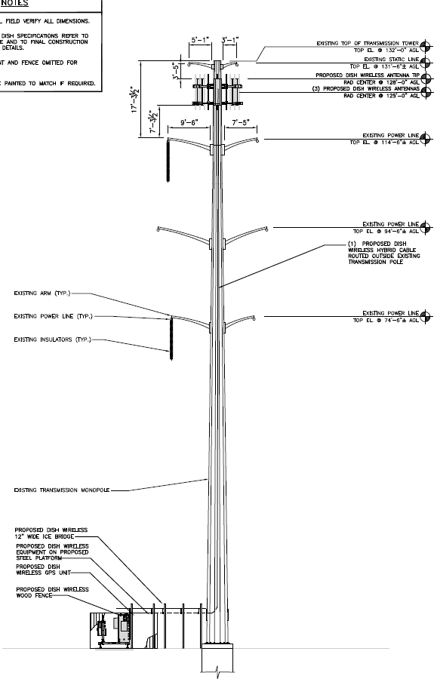
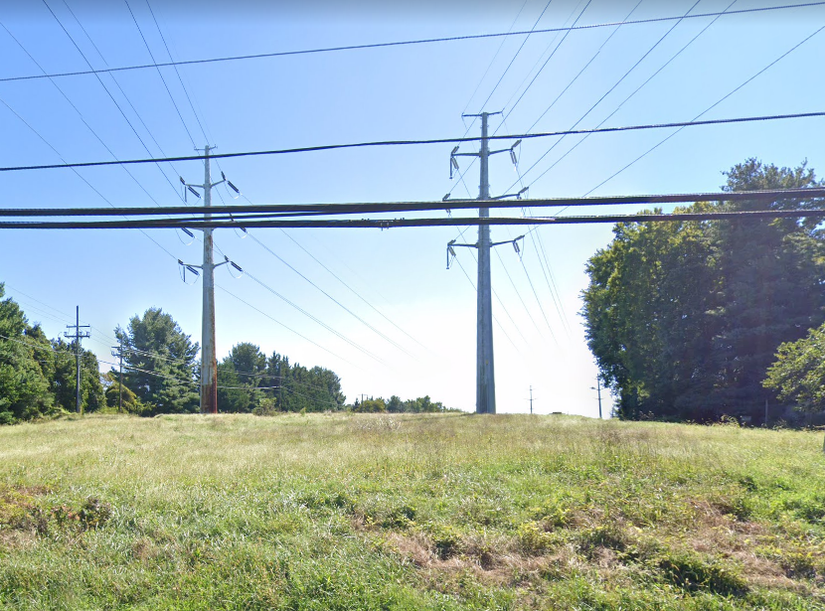
2013 - PEPCO 615-S
Notes:
Antennas will be installed at a RAD center of 125’ on the existing 132’ PEPCO transmission tower. There are no antennas currently colocated on 615-S.

Slide 5
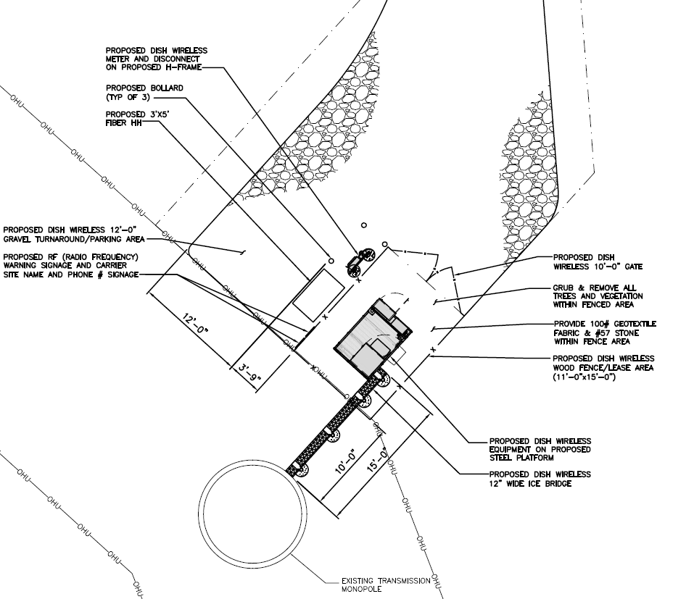
2013 - PEPCO 615-S
Notes:
One new equipment cabinet will be added to a new steel platform at the foot of the existing transmission pole. We recommend this application.

